Slide 1

Welcome to SIT 34
Committee on Earth Observation Satellites
Dr. Stephen Volz, NOAA, CEOS SIT Chair
CEOS SIT-34
Session 1, Agenda Item 1.1
Miami, FL, USA
3 – 4 April 2019

Slide 2
Meeting at a Glance
Wednesday 3rd | Thursday 4th
7:30 – 8:45 Breakfast Loc: Havana Room | 7:30 – 8:45 Breakfast Loc: Havana Room
9:00 – 1:00 CEOS SIT 34 loc: Crystal Ballroom Sessions: Welcome and Introduction, Organizational Matters- part I, and Partnerships | 9:00 – 1:00 CEOS SIT 34 loc: Crystal Ballroom Sessions: Recap, Data, and Oceans and Water Cycle
1:00 – 2:00 Lunch loc: Havana Room | 1:00 – 2:00 Lunch loc: Havana Room
2:00 – 5:45 CEOS SIT 34 loc: Crystal Ballroom Sessions: Partnerships, Observations for End Users, and Wrap up | 2:00 – 4:30 CEOS SIT 34 loc: Crystal Ballroom Sessions: Organizational Matters- part 2, and AOB/closing
Evening Free | Evening Free

Slide 3
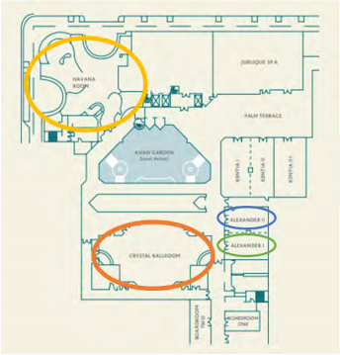
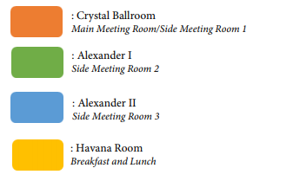
Facility Map

Slide 4
Wifi Information
User ID: Mayfair_Guest
Password: Cranes.1

Slide 5

Presentations
Any updated presentations must be submitted to Albert (AJ) during the break prior to your time slot. There will be no changes to presentations during the discussions.
  Flash Drive or Albert.DeGarmo@NOAA.gov

Slide 6
Questions??
POC: Albert DeGarmo
Albert.DeGarmo@NOAA.gov
281 797 9720

