Slide 1
CEOS Volcano Pilot Project: main results and lesson learned
Mike Poland (USGS)
Simona Zoffoli (ASI)
WG Disasters #8
Buenos Aires, Argentina
4–6 September 2017
PILOT TEAM: Juliet Biggs, David Arnold (University of Bristol), Susi Ebmeier (University of Leeds), Matt Pritchard, Francisco Delgado (Cornell University), Christelle Wauthier (Penn State University), Falk Amelung (University of Miami), Fabrizio Ferrucci (Open University), Mike Pavolonis (NOAA), Rick Wessels (USGS), Eugenio Sansosti (IREA-CNR), Elske de Zeeuw - van Dalfsen (KNMI)

Slide 2
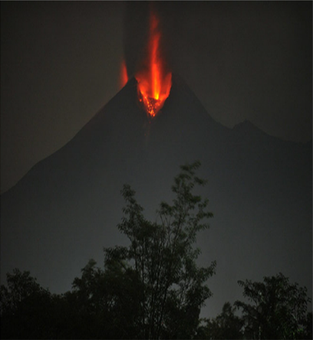
WHAT IS MISSING?
Motivation
up to 45% of the worlds ~ 1400 Holocene age volcanoes are not monitored
What EO data are most critical for detecting changes in unrest and eruptive activity vs. different volcanism and environment?
Strategy for satellite observations depending on volcanoes level of activity
Merapi, Indonesia, erupting in 2010. From Pallister and others, 2013

Slide 3
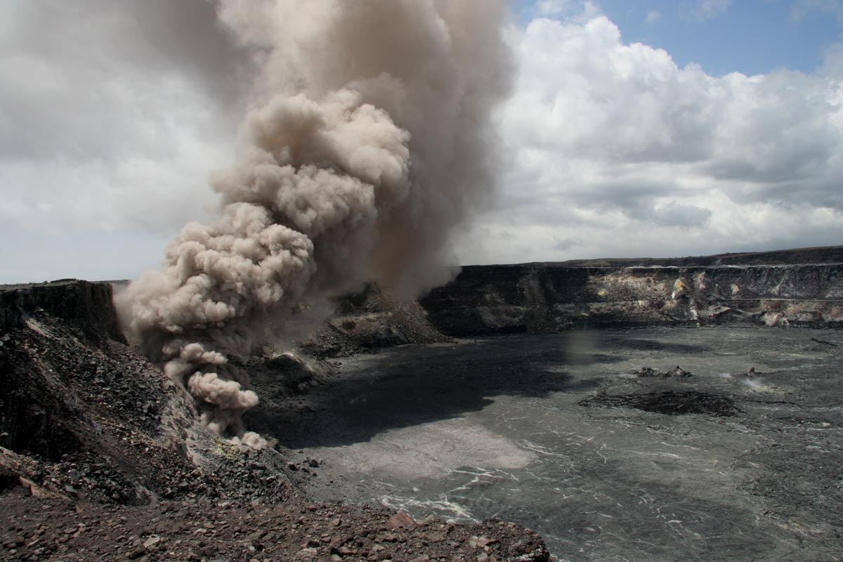
Scope
Demonstrate the impact of EO data in terms of a better understanding of volcano hazards and reducing the risks of eruptions
Encourage coordination between space agencies, value-added providers, and end users to ensure that the agencies who are responsible for volcano monitoring have access to, and understanding of, those data sets that are most critical for making informed DRM decisions

Slide 4
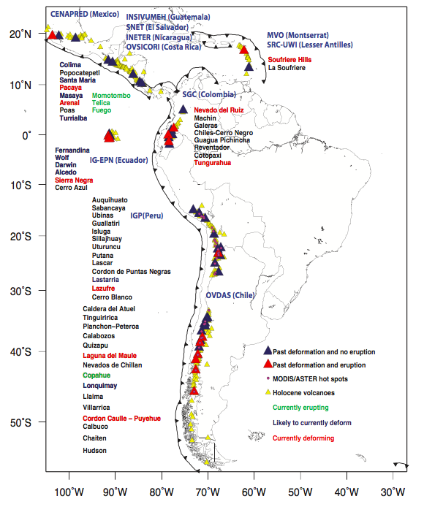
Regional demonstration over Latin America
Demonstrate how EO data can be used to cost-effectively monitor all 315 volcanoes that erupted in the last 10,000 years in the region
Identify volcanoes that may became active in the near future
Track new and ongoing eruptive activity
Why Latin America?
Diversity of environments
Abundant volcanic activity
Benefits to local users
~202 volcanoes in the region have no ground monitoring of any type
Notes:
Triangles are all volcanoes in Latin America. Red triangles are target volcanoes from the CEOS pilot plan. Black boxes and text show regions for planned quarterly monitoring with C-Band (Sentinel-1) and L-Band (ALOS 2) InSAR. Grey text shows the local end users (monitoring agency).

Slide 5
Participants in the Pilot
CEOS Agencies:
USGS, ASI, CNES, CSA, DLR, ESA, NASA, NOAA, JAXA
Value-added providers:
University of Bristol (UK), Cornell University (US), University of Miami (US), Pennsylvania State University (US), IREA/CNR (IT), Open University (UK), NOAA, USGS
End users:
Observatorio Volcanológico de Los Andes del Sur (OVDAS) Chile; Instituto Geofísico del Perú; Instituto Geofísico de la Universidad Nacional de San Agustín, Peru; Instituto Geofísico, Escuela Politécnica Nacional, Ecuador; Servicio Geológico Colombiano, Colombia, Buenos Aires Volcanic Ash Advisory Center, Argentina, Instituto nacional de sismología, vulcanologia, meteorología e hidrologia, (NSIVUMEH), Guatemala, Instituto Nicaraguense de Estudios Territoriales (INETER), Nicaragua

Slide 6
EO data
Optical and IR data for detecting thermal anomalies, gas emissions, and ash plumes
Radar data for ground deformation, new volcanic deposits, and topographic changes
FOCUS on Radar data to understand how the entire international SAR constellation could be used for detecting and characterizing volcano behavior.

Slide 7
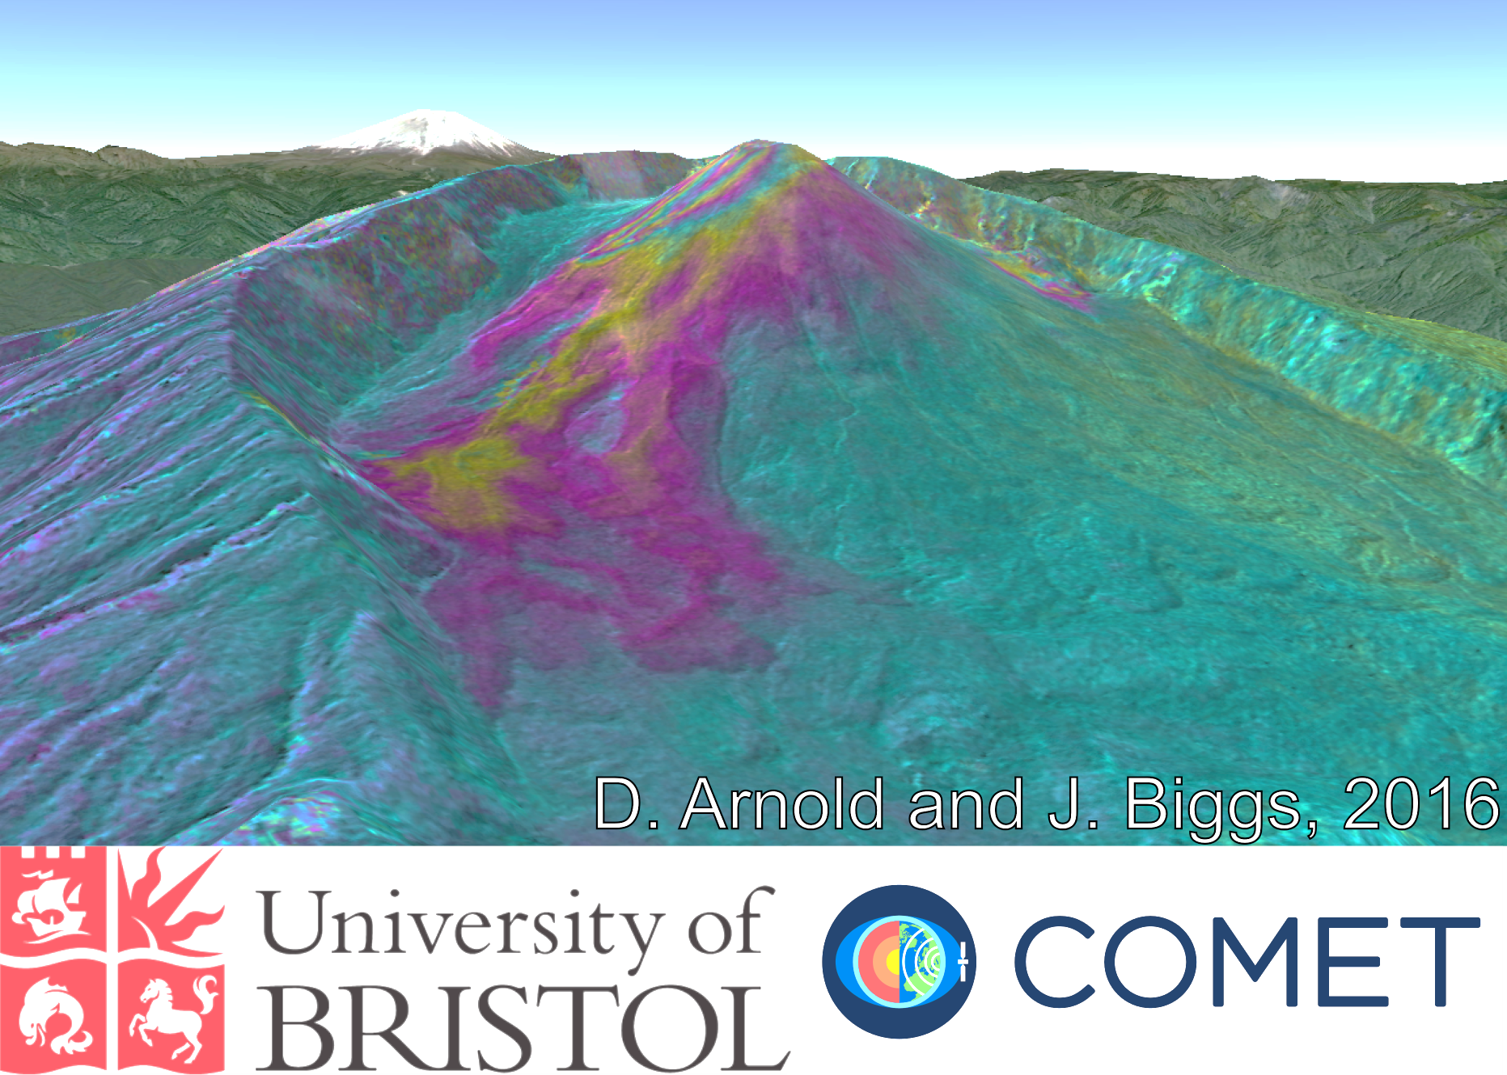
Noteworthy results
Pacaya (Guatemala)
  Santiaguito (Guatemala)
    Masaya (Nicaragua)
      Arenal (Costa Rica)
        Soufrière Hills Volcano (Montserrat)
          Chiles – Cerro Negro (Colombia / Ecuador)
            Reventador (Ecuador)
            Cotopaxi (Ecuador)
          Wolf (Galápagos)
        Fernandina (Galápagos)
      Sabancaya (Perú)
    Cordón Caulle (Chile)
  Calbuco (Chile)
Villarica (Chile)

Slide 8
Utility of data
How have satellite data been useful?
Monitored volcanoes with no ground networks and motivated installation of new sensors (Cordon Caulle)
Provided data for determining alert levels (Chiles-CN)
Complemented ground-based data and contributed to situational awareness during a crisis (Chiles-CN, Calbuco, Villarica, Manutombo)
Filled “gaps” at volcanoes that have some ground-based monitoring (Tungarahua, Pacaya, Santiaguito)
Provide otherwise inaccessible data (Reventador, SHV)
Research (Ubinas)

Slide 9
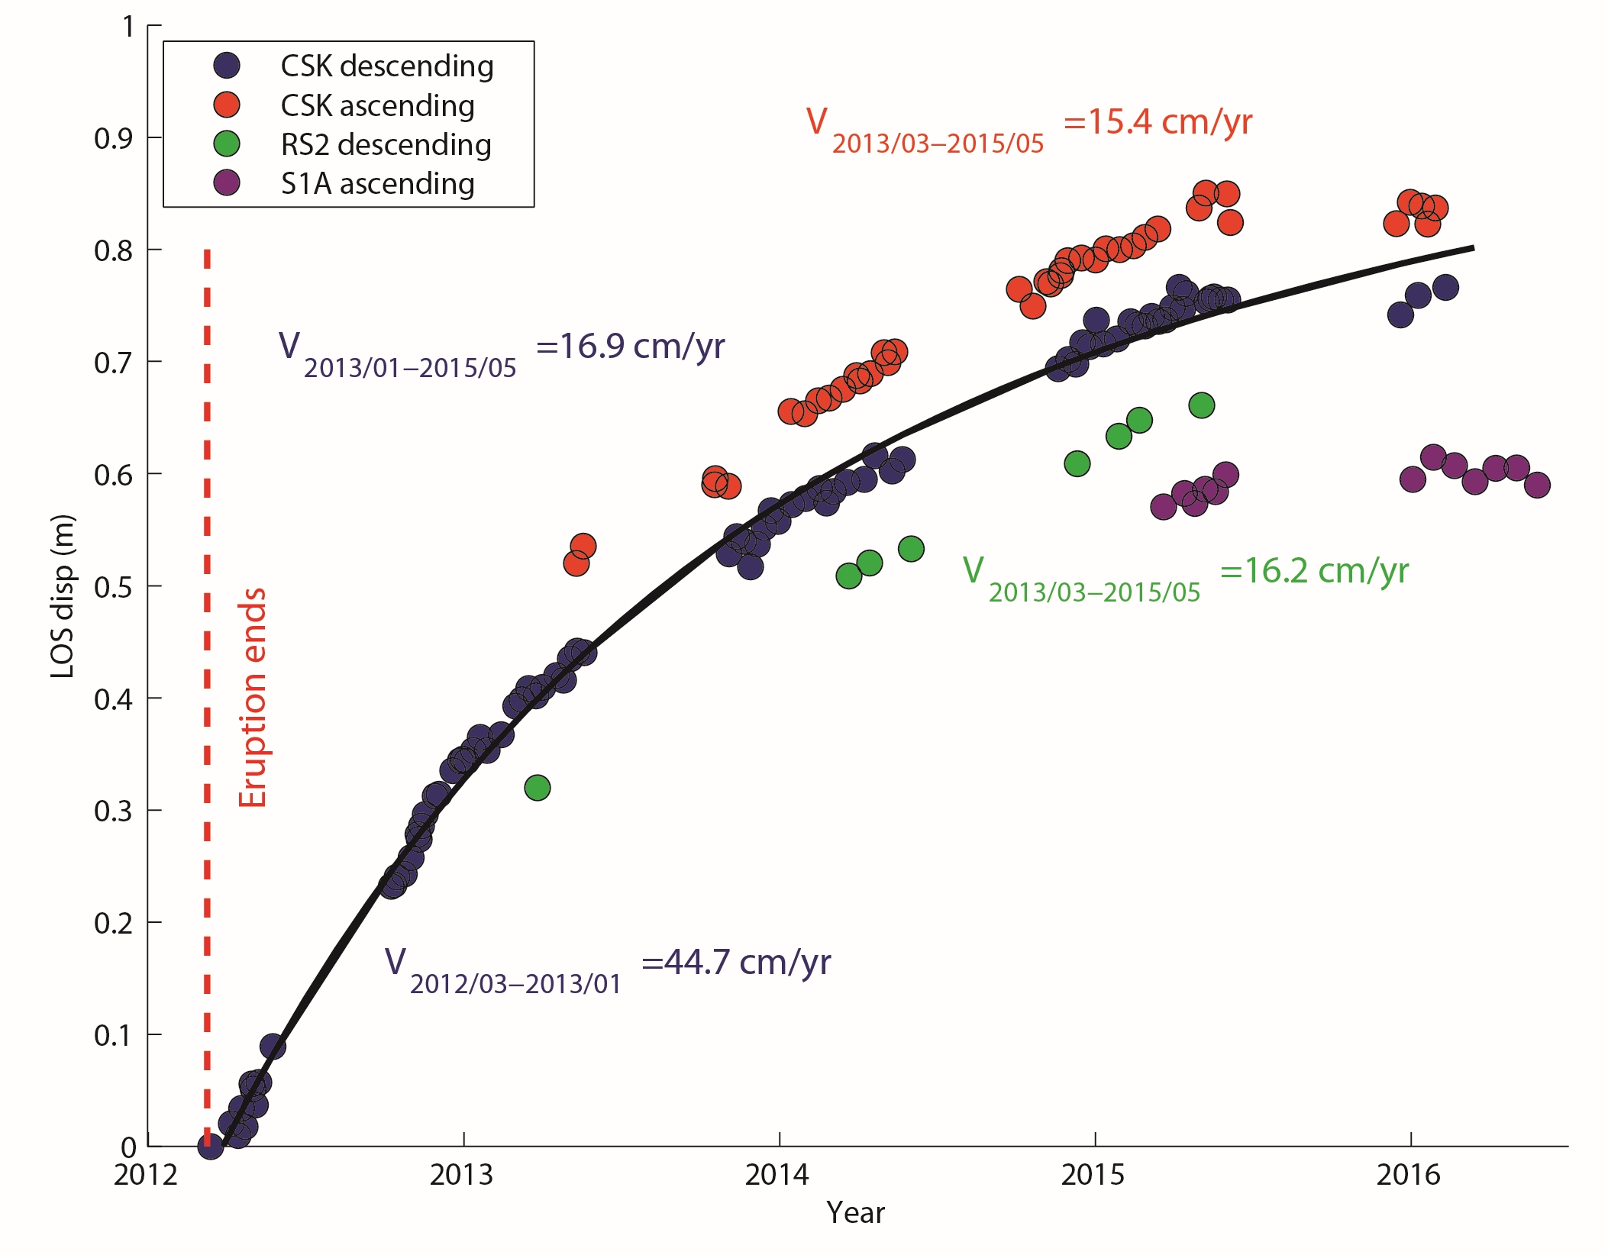
Cordón Caulle, Chile
Inflation of Cordón Caulle, Chile, has been a significant result of the pilot. This deformation would not otherwise be known without pilot data.
The inflation seemed to have stopped in mid-2015.

Slide 10
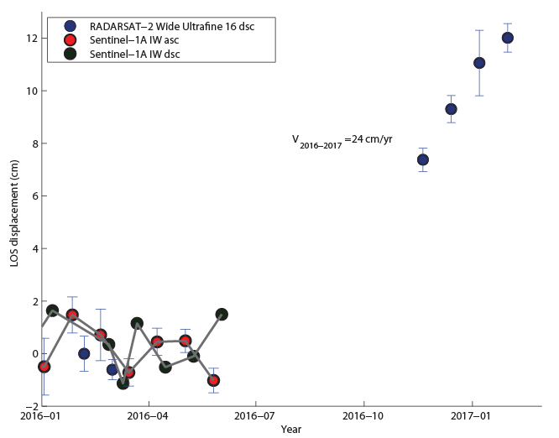
Cordón Caulle, Chile
New results indicate that inflation at Cordón Caulle resumed in mid-2016!
In response to these observations, OVDAS is installing a continuous GNSS station to establish ground-based monitoring of the volcano.

Slide 11
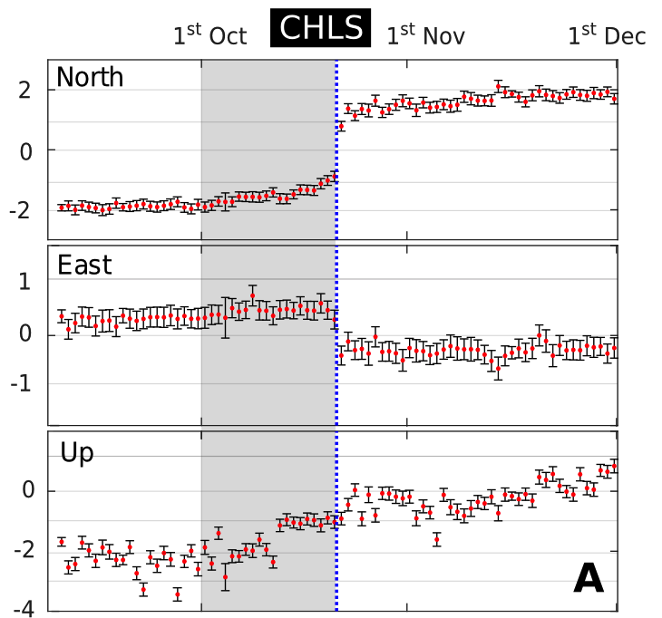
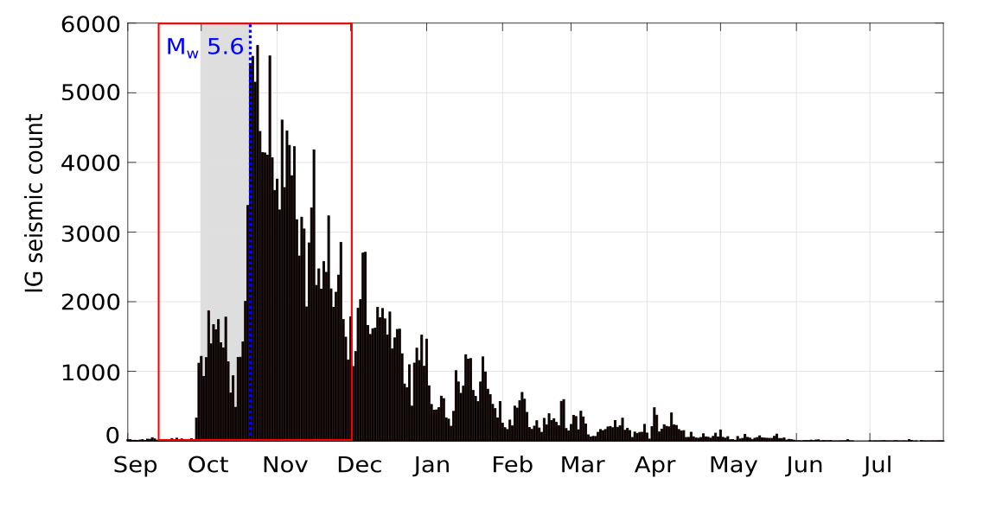
Chiles – Cerro Negro

Slide 12
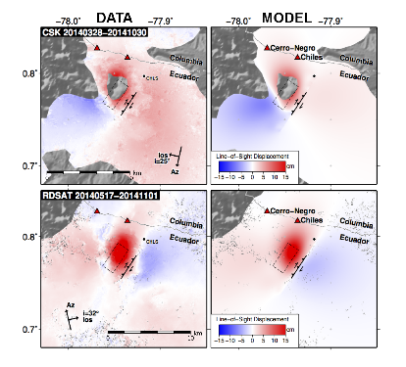
Chiles – Cerro Negro
Cerro Negro
Chiles
Ground deformation – is it magma or “just” the earthquake?
TerraSAR-X
18th Oct- 27th Nov 2014

Slide 13
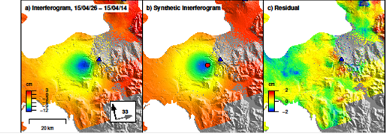
Calbuco, Chile
Observed (left), modeled (center), and residual (right) deformation (from Sentinel-1a, spanning April 14–26, 2015) due to an eruption at Calbuco, Chile, on April 22, 2015. Deformation can be approximated by a source at ~9 km depth beneath the volcano’s west flank.
OVDAS used this source model to validate their tilt meter records

Slide 14
Calbuco, Chile
Feedback from Buenos Aires VAAC manager on May 3, 2015:
“I thank you and congratulate you for the excellent work in making available of all images and products that allow us to significantly improve the tasks of detecting and tracking volcanic eruptions and clouds and ash, since we only have GOES13 and some polar satellites images.”
In the wake of the explosive eruption of Calbuco, the Buenos Aires VAAC used the products to help brief aviation stakeholders

Slide 15
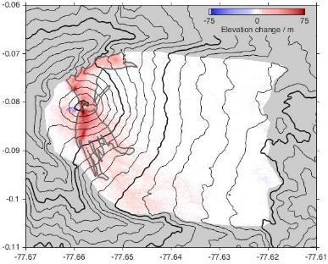
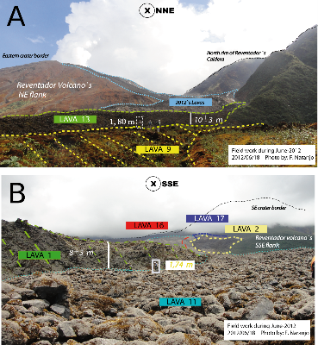
Results: Reventador
IG monitors lava effusion rate using field measurements and photos from overflights (irregular sampling and dependent on clear weather)
Thickness of new lava flows between 2011 and 2014 from TDX CoSSCs
InSAR data provide independent measure of effusion rates. Recent data from CoSSCs have imaged activity that was unknown to IG
Interferograms provide the only source of deformation measurement, important for assessing whether magma is accumulating

Slide 16
Lessons learned
A volcano monitoring system must involve multiple space agencies and satellite platforms to make the most of each satellite system, to get nearly daily coverage when needed and to have updated high resolution topographic maps
Data quotas should be assigned for a) systematic background observations using the needed observing mode (spatial resolution, polarization, etc.), b) case studies requiring dense datasets and c) flexible response to unrest and eruption.
A systematic background mission using ascending and descending passes should take into account both the level of activity at each volcano and the temporal and spatial baselines required to form coherent interferograms and observe deformation transients

Slide 17
Lessons learned
Acquisition plans need to be flexible to accommodate changes in activity, evolving methods and improved understanding of data types
Near real-time data access is vital for decision making, requiring frequent overpasses, rapid tasking and short data latency
Coordination between space agencies, scientists and volcano observatories is crucial in order to provide an operational response and avoid conflicting requests for satellite tasking or interpretations of satellite observations to observatories.

Slide 18
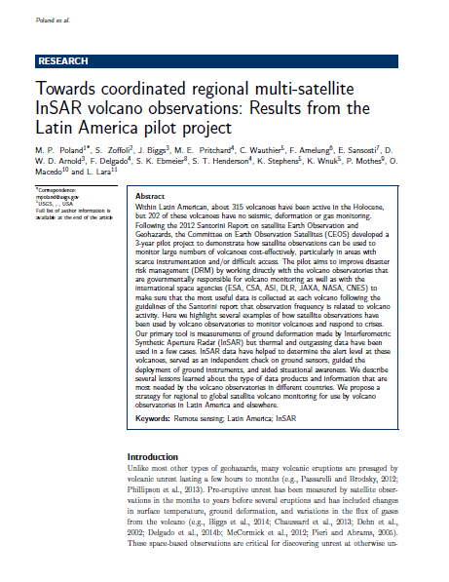
References
A summary publication describes the Latin America aspect of the pilot project, lessons learned, and potential future applications (submitted to Journal of Applied Volcanology ).

Slide 19
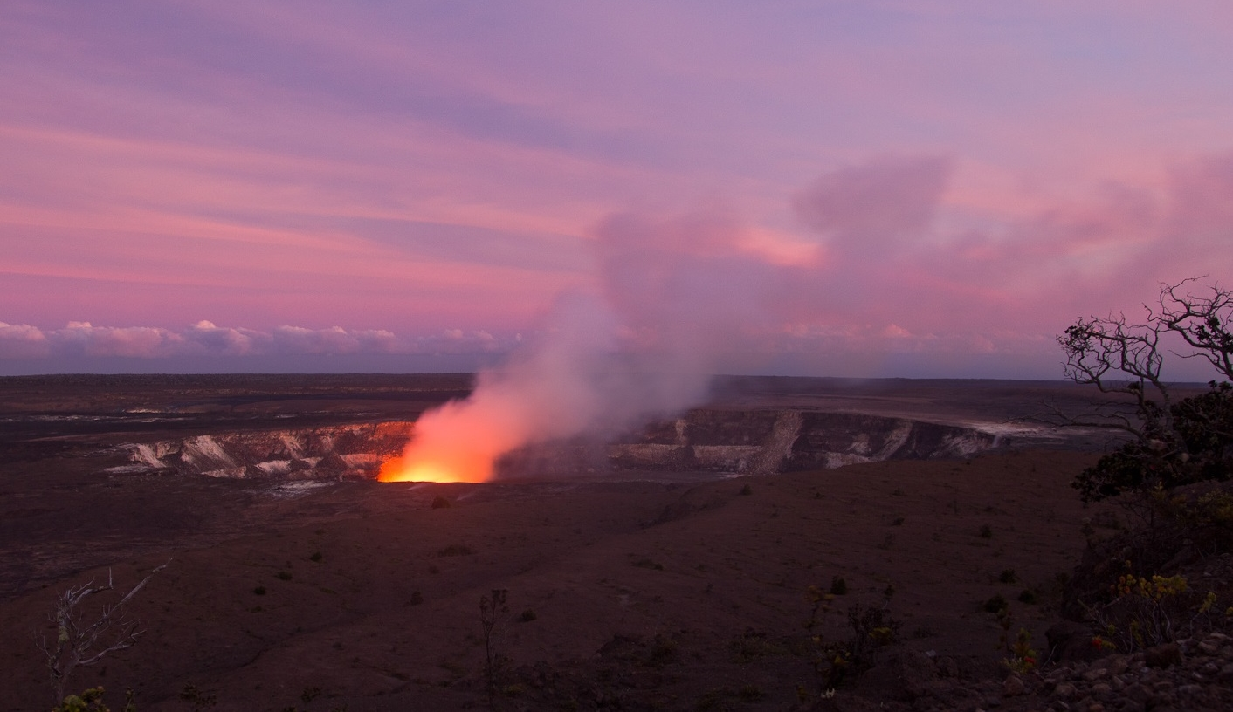
Thank you

