Slide 1

Jupyter Notebooks for Capacity development
Committee on Earth Observation Satellites
Esther Conway (NCEO - UKSA), Ag Stephens (NCEO - UKSA) and Phil Kershaw (NCEO - UKSA)
Jupyter Notebooks for Capacity development Webinar
21st and 22nd July 2021

Slide 2

Jupyter Notebook Collaboration ?
What is a Jupyter Notebook?
A Jupyter Notebooks allow you to combine
rich documentation
live and adaptable code
data visualizations
As a tool to share your data analysis with others, collaborate, teach, and promote reproducible science.
The Jupyter notebook began as an (IPython Notebook), this use of Python makes it ideal starting point for many people using EO data for the first time. In addition it currently supports around 40 programming languages, including Python, R and Julia (Ju-pyt-R).

Slide 3
Where can they be deployed and why is this important for the CEOS Community ?
Standalone computer notebooks can be supplied alongside the relevant data
In classroom/institutional setting using Jupyter Hub adopted by University Data Science Departments
Data Analysis platforms (JASMIN, Earth Analytics Interoperability Lab)
As a centralized web services using a Data Cubes etc (SEO Google Earth Engine, ESA PDGS data cube, Digital Earth Africa)

Slide 4
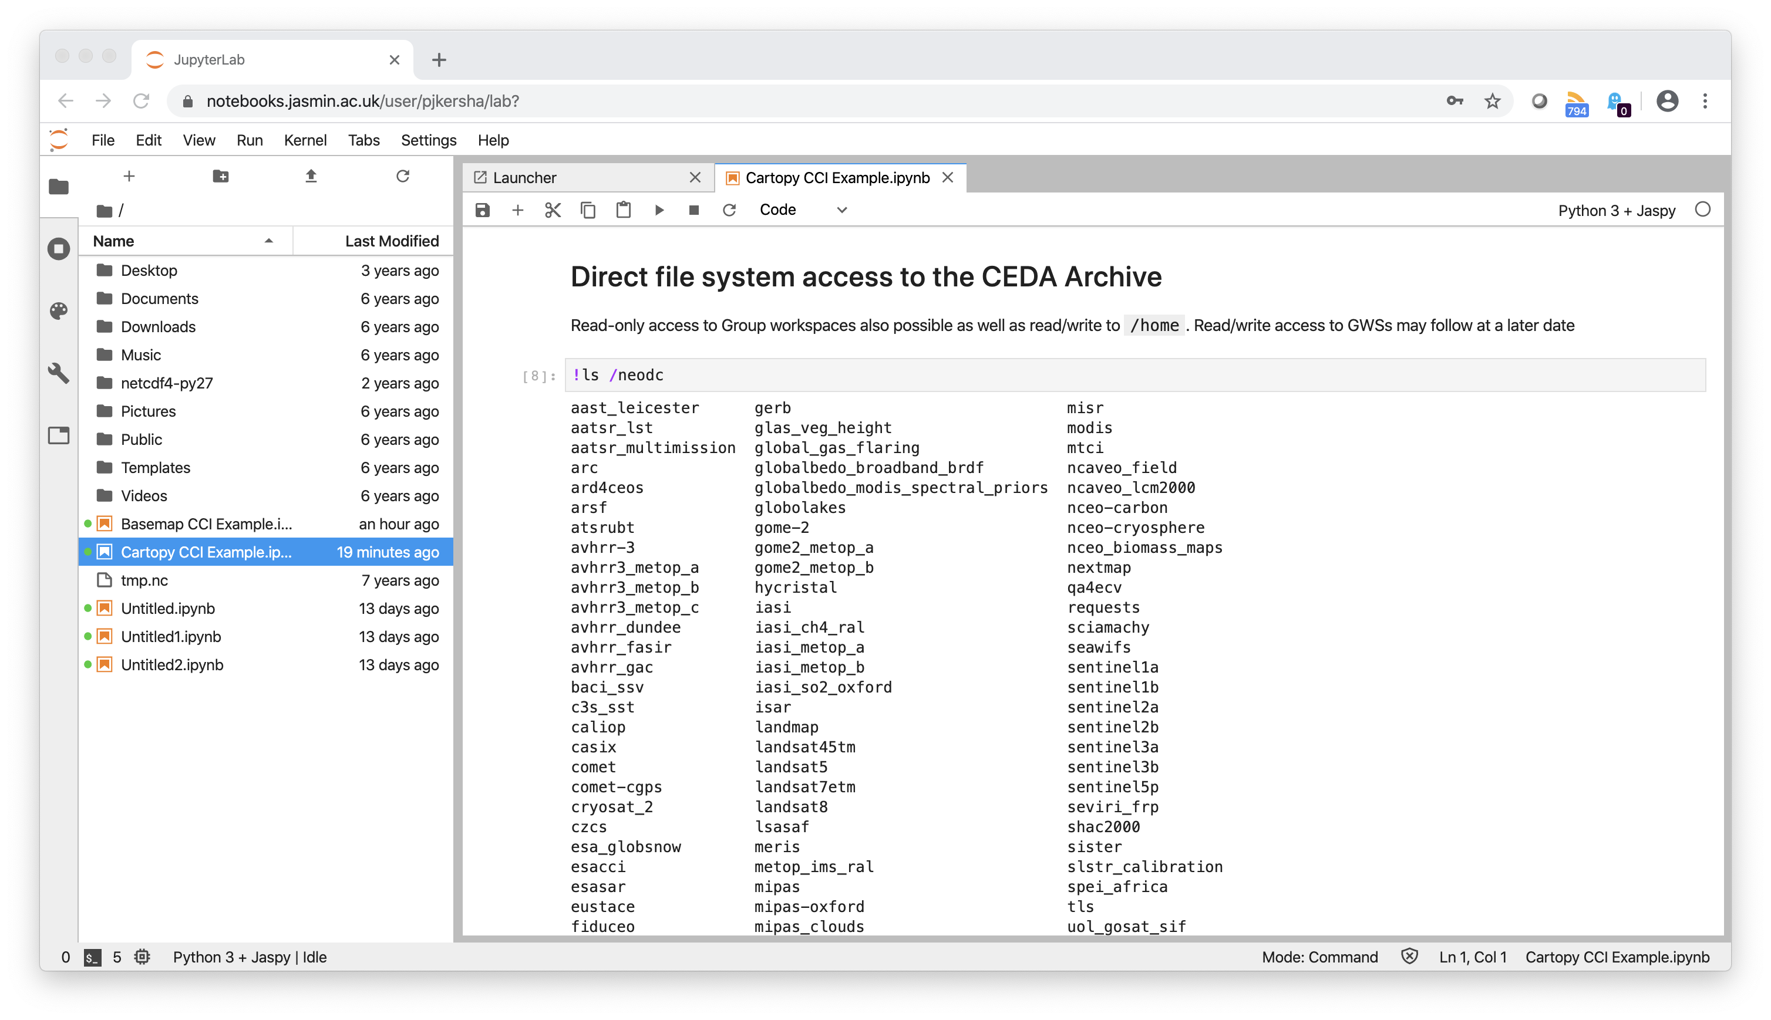
Access to Big Data
Volume, Velocity, Veracity, Variety and Value

Slide 5
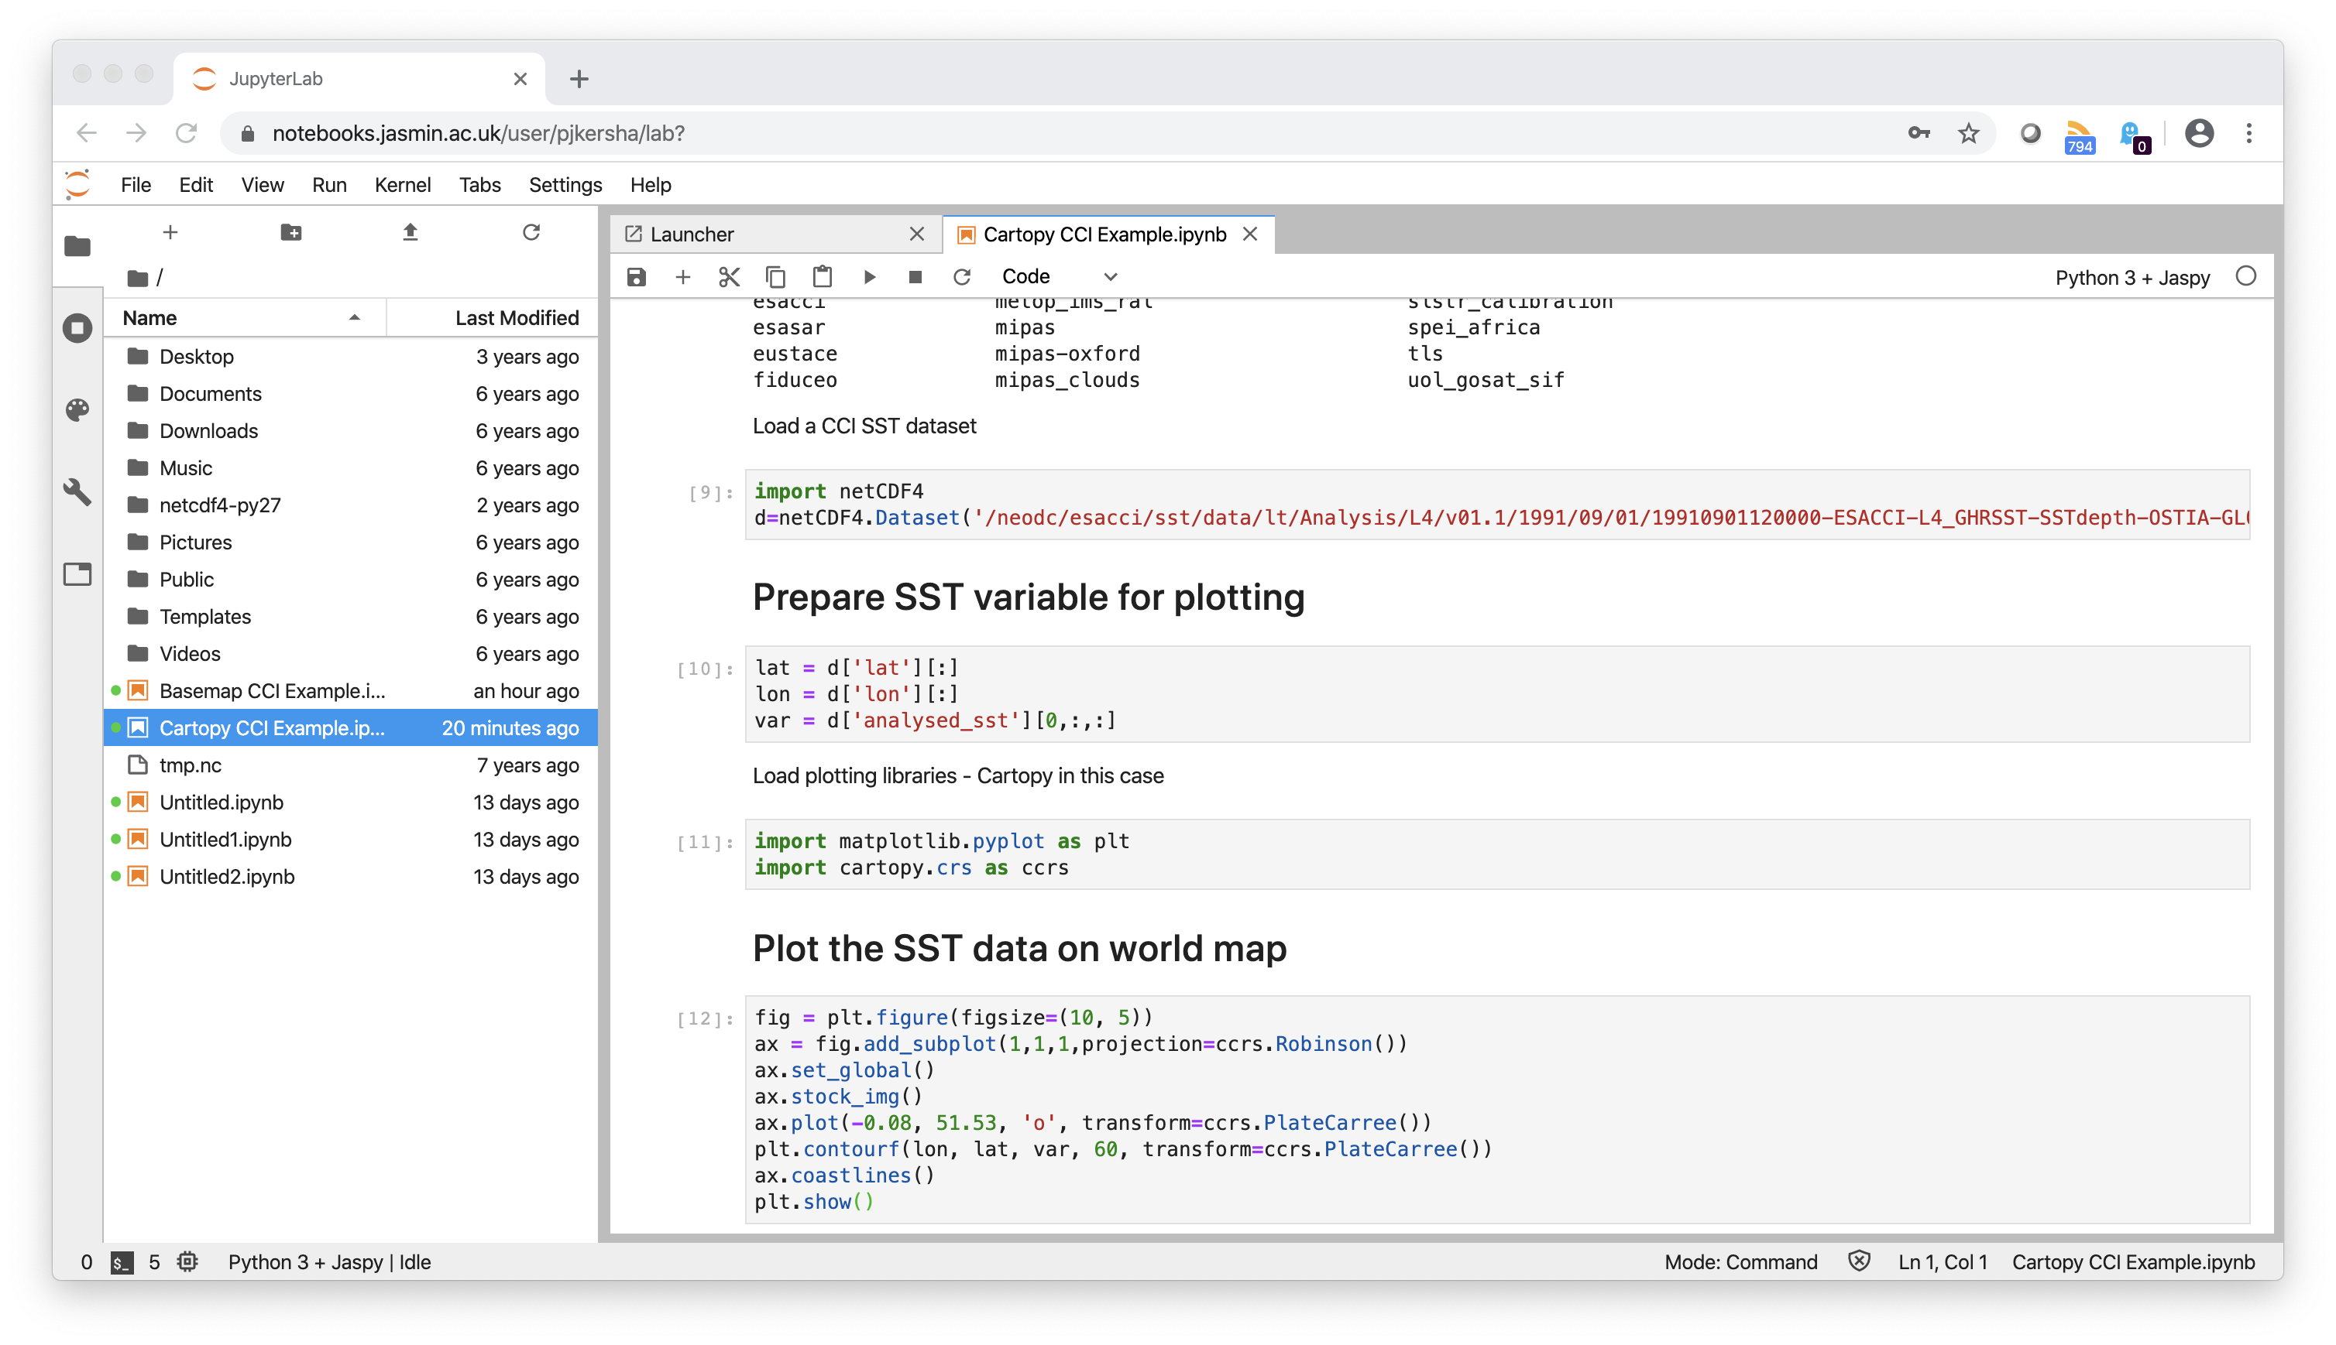
Lowers barriers and support the development
of important data science skills

Slide 6
Integrate with Support Materials
https://software-carpentry.org/
https://catalogue.ceda.ac.uk/uuid/916986a220e6bad55411d9407ade347c
https://matplotlib.org/stable/index.html
https://scitools.org.uk/cartopy/docs/latest/
https://rasterio.readthedocs.io/en/latest/
http://www.johnny-lin.com/pyintro

Slide 7
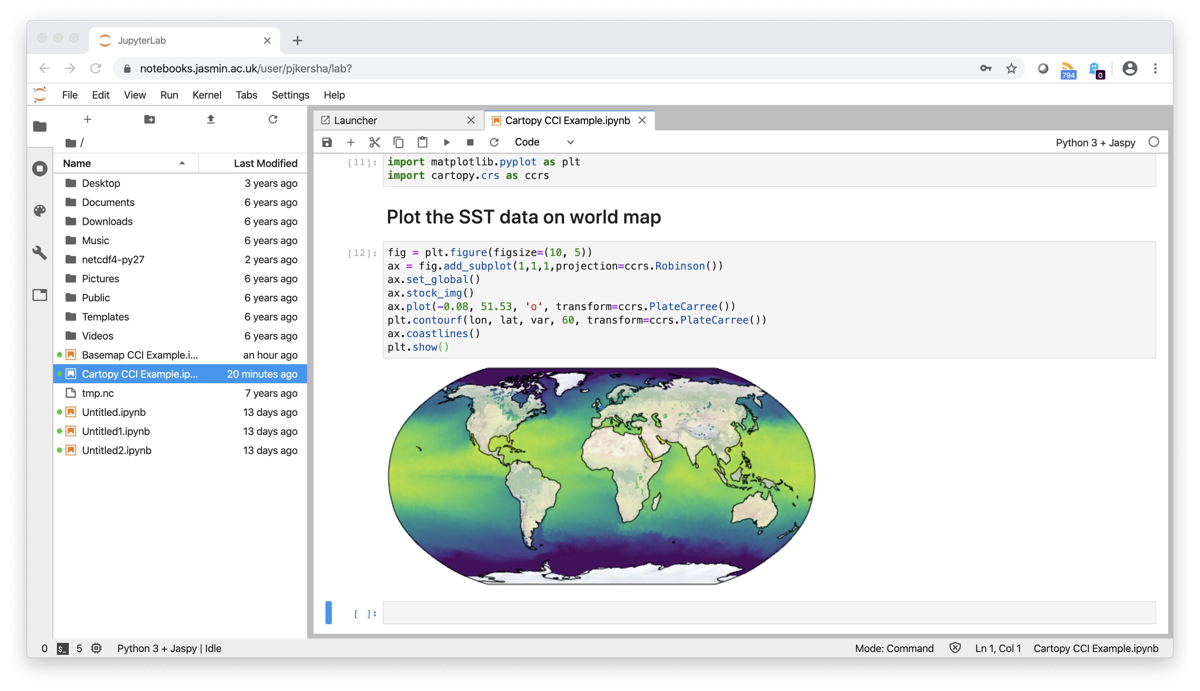
Users are able to obtain meaningful
results quickly

Slide 8
Lets take a look
https://help.jasmin.ac.uk/article/4851-jasmin-notebook-service
https://notebooks.jasmin.ac.uk.
https://github.com/CEOS-Jupyter-Notebooks/CapD-Webinar/blob/main/Cartopy%20OPeNDAP%20CCI%20Example-Copy.ipynb

Slide 9
Who and why would we create a best practice document
Who will benefit form a Best Practice
Data Producers
Authors of Jupyter Notebooks
Providers of EO data training
Users of EO data
EO data archives
Providers of Data Analysis Infrastructure
JUPYTER NOTEBOOK BEST PRACTICE CONTENT
4.1 General Recommendations
4.2 Notebook description and function
4.3 Structure, workflow and documentation
4.4 Technical dependencies and Virtual Environments
4.6 Citation of input data and data access
4.7 Association with archived data
4.8 Incorporation with data cubes
4.9 Version control, preservation and archival
4.10 Open source software licensing
4.12 Publishing software and getting a DOI
4.12 Interoperability and reuse on alternate platforms
4.13 Creating a binder deployment
Developing a Jupyter Notebooks Best Practice

Slide 10
Structure, workflow and documentation
Encourage the development of good workflow and structure within notebooks along with quality documentation. Supporting their reuse and adaptation by new users
Good software engineering principles
Use of Functions
Use of Modules
Size of Notebook
Capturing Output

Slide 11
Technical Dependencies and Virtual Environments
Language and versions
Libraries
Other Code
Virtual Machines on Data Analysis Platforms
Installing libraries from within notebook, recommending conda etc.
Setting up virtual environments
Testing
This ties into software preservation discussion in DSIG and require a technical discussion regarding how new libraries and environments are set up on Data Analysis platforms and other Jupyter hub services.

Slide 12

Incorporation with data cubes
Establishing Connections with Data Cubes
Defining what data gets loaded
Working with xarray
Porting Notebook from hierarchical file system to a data cube
A rich area for Tech Expo discussion would be using Jupyter notebooks with data cubes.

Slide 13




Interoperability and reuse on alternate platforms
As we accumulate notebooks and data for webinars and training. We would propose transferring examples between agency data analysis platforms, to examine issues.

Slide 14

Creating a binder deployment
What is a Binder?
A Binder (also called a Binder-ready repository) is a code repository that contains at least two things:
Code or content that you’d like people to run. This might be a Jupyter Notebook that explains an idea, or an R script that makes a visualization.
Configuration files for your environment. These files are used by Binder to build the environment needed to run your code. Configuration files may be placed in the root of your repository or in a binder/ folder in the repository’s root (i.e. myproject/binder/).
A Binder repository can be built by a BinderHub, which will generate a link that you can share with others, allowing them to interact with the content in your repository.
Another aspect of CapD is supporting the development of systems and services. This may be something that binder could help with.

Slide 15
Contact Us !
esther.conway@stfc.ac.uk

