Slide 1
CEOS Jupyter Notebooks for Capacity Development Webinar
Thursday, July 22, 2021

Slide 2
57
Total Responses
Date Created: Wednesday, July 14, 2021
Complete Responses: 57

Slide 3
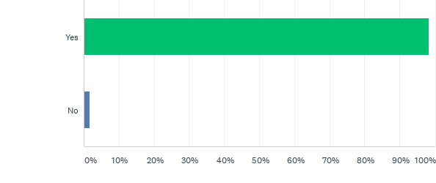
Q1: At CEOS we take your privacy seriously, and will only use your personal information to contact you regarding CEOS events, outputs or to enhance our services based on your feedback. Do you consent to us retaining your information for these purposes?
Answered: 57 Skipped: 0

Slide 4
Q1: At CEOS we take your privacy seriously, and will only use your personal information to contact you regarding CEOS events, outputs or to enhance our services based on your feedback. Do you consent to us retaining your information for these purposes?
Answered: 57 Skipped: 0

Slide 5
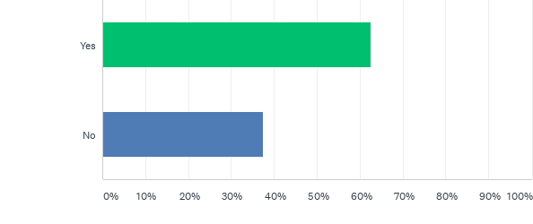
Q6: Do you or your organisation currently use Jupyter NoteBooks?
Answered: 56 Skipped: 1

Slide 6
Q6: Do you or your organisation currently use Jupyter NoteBooks?
Answered: 56 Skipped: 1

Slide 7
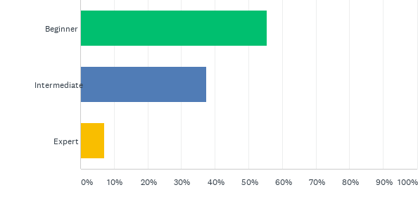
Q7: How would you describe your current skill level with Jupyter Notebooks?
Answered: 56 Skipped: 1

Slide 8
Q7: How would you describe your current skill level with Jupyter Notebooks?
Answered: 56 Skipped: 1

Slide 9
Q8: How useful did you find today's event?
Answered: 56 Skipped: 1

Slide 10
Q8: How useful did you find today's event?
Answered: 56 Skipped: 1

Slide 11
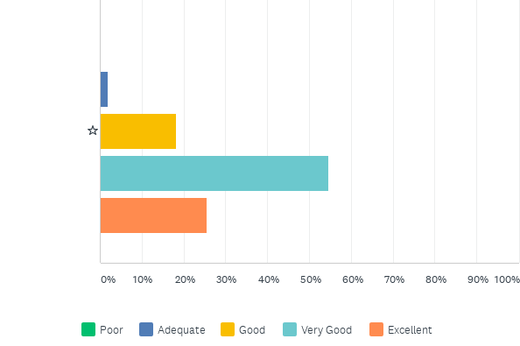
Q9: How would you rate the content of today's event?
Answered: 55 Skipped: 2

Slide 12
Q9: How would you rate the content of today's event?
Answered: 55 Skipped: 2

Slide 13
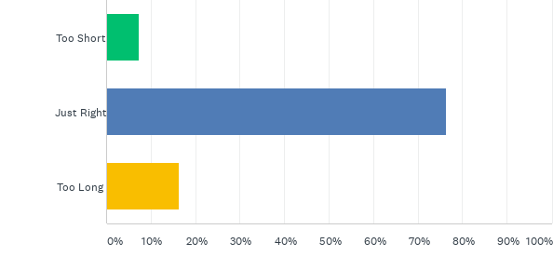
Q10: How would you consider the duration of today's event?
Answered: 55 Skipped: 2

Slide 14
Q10: How would you consider the duration of today's event?
Answered: 55 Skipped: 2

Slide 15
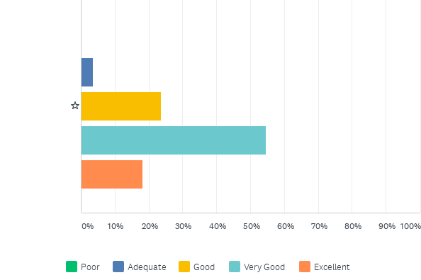
Q11: How would you rate the format of today's event?
Answered: 55 Skipped: 2

Slide 16
Q11: How would you rate the format of today's event?
Answered: 55 Skipped: 2

Slide 17
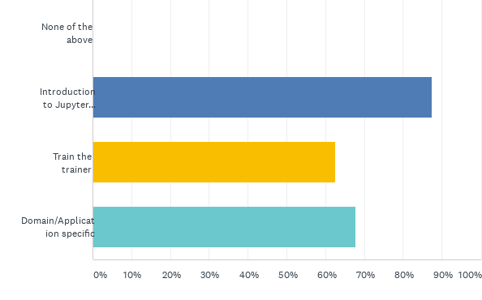
Q13: Would you be interested in the following types of training?
Answered: 56 Skipped: 1

Slide 18
Q13: Would you be interested in the following types of training?
Answered: 56 Skipped: 1

Slide 19
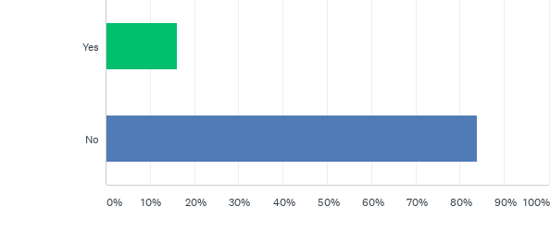
Q14: Do you currently provide EO training via Jupyter Notebooks?
Answered: 56 Skipped: 1

Slide 20
Q14: Do you currently provide EO training via Jupyter Notebooks?
Answered: 56 Skipped: 1

Slide 21
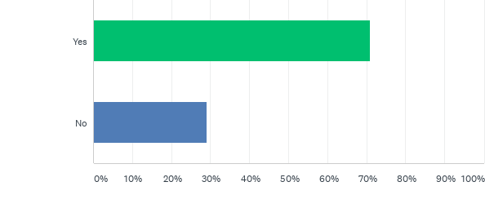
Q15: Would you like to contribute to CEOS Jupyter Notebook based EO training?
Answered: 55 Skipped: 2

Slide 22
Q15: Would you like to contribute to CEOS Jupyter Notebook based EO training?
Answered: 55 Skipped: 2

Slide 23
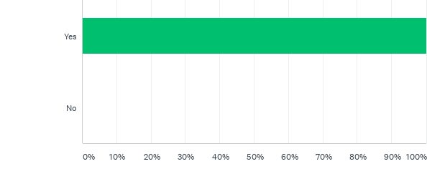
Q16: Would you find a repository of training or application-specific notebooks useful?
Answered: 55 Skipped: 2

Slide 24
Q16: Would you find a repository of training or application-specific notebooks useful?
Answered: 55 Skipped: 2

Slide 25
Q17: Would you like to be informed of CEOS Jupyter Notebook EO services and training materials?
Answered: 55 Skipped: 2

Slide 26
Q17: Would you like to be informed of CEOS Jupyter Notebook EO services and training materials?
Answered: 55 Skipped: 2

Slide 27
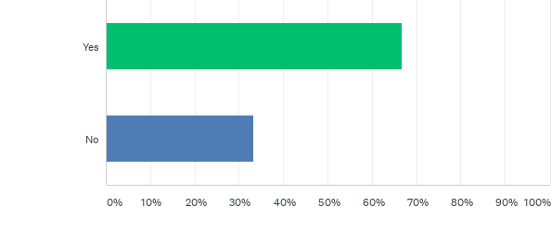
Q18: Would you be interested in running, forming a team for or participating in a Hackathon?
Answered: 54 Skipped: 3

Slide 28
Q18: Would you be interested in running, forming a team for or participating in a Hackathon?
Answered: 54 Skipped: 3

Slide 29
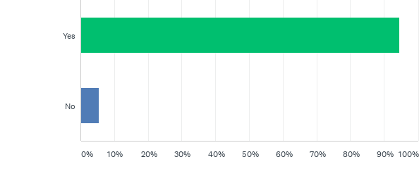
Q19: Would you find a CEOS Jupyter Notebooks best practice document useful?
Answered: 55 Skipped: 2

Slide 30
Q19: Would you find a CEOS Jupyter Notebooks best practice document useful?
Answered: 55 Skipped: 2

Slide 31
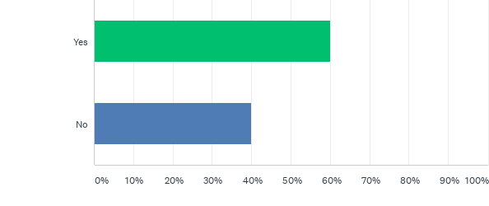
Q20: Would you like to contribute to a CEOS Jupyter Notebooks best practice document?
Answered: 55 Skipped: 2

Slide 32
Q20: Would you like to contribute to a CEOS Jupyter Notebooks best practice document?
Answered: 55 Skipped: 2

