Slide 1
CEOS WGISS TechExpo intro
CEOS/WGISS Yosuke Ikehata

Slide 2
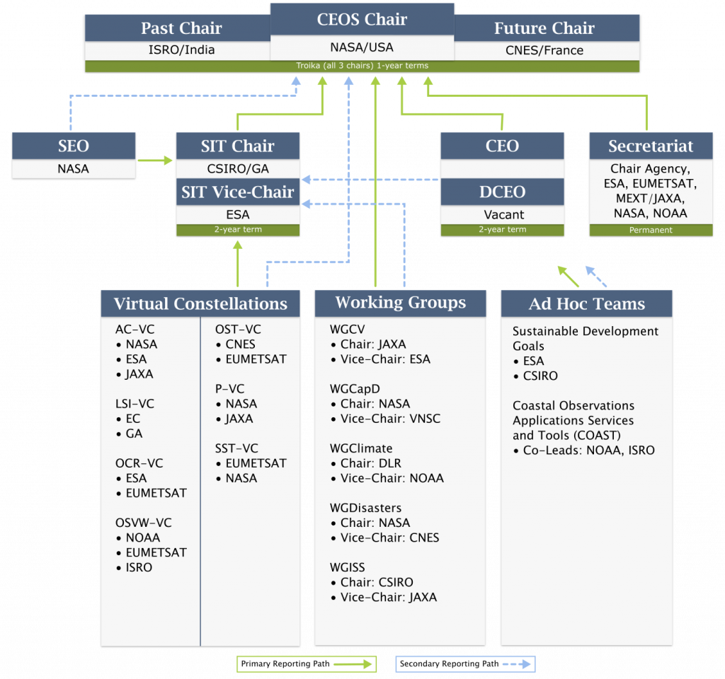
CEOS Organization
Here!
Notes:
WGISS (the Working Group on Information Systems and Services) is a subsidiary body supporting CEOS. WGISS promotes collaboration in the development of systems and services that manage and supply these observation data. WGISS creates and demonstrates prototypes supporting CEOS and Group on Earth Observation (GEO) requirements.

Slide 3
WGISS：Working Group on Information Systems and Services
1. Data Preservation and Stewardship
2. Discovery and Access
3. Interoperability and Use
Technology Exploration Interest Group
(Yousuke Ikehata, JAXA)
- Jupyter Notebooks (Esther Conway, NCEO – UKSA)
4. Technology Exploration
Notes:
WGISS also addresses the internal management of EO data, the creation of information systems and the delivery of interoperable services.The activities and expertise of WGISS span the full range of the information life cycle from the requirements and metadata definition for the initial ingestion of satellite data into archives through to the incorporation of derived information into end-user applications.

Slide 4
1. Data Preservation and Stewardship
Activities in the Data Preservation and Curation
Purpose
Enable the sharing of agency investigations, developments, experiences and lessons learned relating to EO data stewardship.
Draft common cross-agency best practices or guidelines of data stewardship for possible adoption by WGISS.
Sponsor technical exchanges and the conduction of Joint Activities and/or Pilot Projects on specific data stewardship topics.
Establish and maintain a CEOS “Data Purge Alert” service.
Notes:
Earth Observation data are unique snapshots of the condition of the Earth at a specific point in time. As such they constitute a humankind asset, which needs to be preserved, i.e. safeguarded against loss and kept accessible and usable for current and future generations. This task becomes more important in the view of over 40 years’ worth of data available in Earth Observation archives around the world – and the increasing demand for monitoring long-term variations environmental parameters, such as sea surface temperature or global ozone distributions, which require long time series of data. Moreover, with the advent of new, high resolution Earth Observation missions and programs, data volumes are expected to grow significantly over the next years.

Slide 5
2. Discovery and Access
the International Directory Network (IDN)
The CEOS IDN Master Directory assists researchers by providing free, online access to information on scientific datasets (metadata) in the Earth sciences, including geoscience, hydrospheric science, biospheric science, satellite remote sensing, and atmospheric science. This metadata describes data held by university departments, government agencies, multinational organizations, and other organizations all over the world.
the CEOS WGISS Integrated Catalog (CWIC)
The CWIC Project provides the world’s satellite Earth observation data providers with a way to make their data collections and individual granules searchable using common standards.
the Federated Earth Observation Gateway (FedEO)
FedEO (Federated Earth Observation missions access) provides a unique entry point to a growing number of scientific catalogues and services for, but not limited to, EO European and Canadian missions.

Slide 6
3. Interoperability and Use
Future Data Architectures
Data Cube
The CEOS Earth Analytics Interoperability Lab (EAIL)
the Recovery Observatory Project
Carbon Strategy and Portal
Open Source Software and Tools

Slide 7
4. Technology Exploration
To serve as a forum for exchange of technical information and lessons-learned experience about current and trending software technologies, services and other WWW / Internet related software technologies.
Give CEOS/WGISS members opportunities to collaborate and discuss present and future technology solutions;
Research technologies that can help the Earth observation community be flexible and adaptable in their IT infrastructure;
Help facilitate CEOS/WGISS understanding of all generations of technology and support the implementation of both legacy and leading-edge technologies into Earth observation data systems;
Promote technologies in CEOS/WGISS that prove beneficial to the Earth observation community.
In this context, we work with WGCapD and SEO!

Slide 8
About Jupyter Notebook
In WGISS-49, we hold session for Jupyter Notebooks
Ghanaian Crop Modelling Jupyter Notebook and Data Cube /Jose Gomez-Dans (UKSA)
JASMIN Jupyter Notebook Service Challenges and Opportunities/Phil Kershaw, Mat Pryor (UKSA)
Jupyter for CAPD – UK Overseas Development Aid, Agritech, etc./Esther Conway (UKSA), Heiko Balzer (UKSA)
Jupyter Notebooks Survey results, Developing a Best Pract ice[WGISS-50/Esther Conway (UKSA)]

