Slide 1

ESA PDGS Data Cube and Time Series Data
Committee on Earth Observation Satellites
S. Mantovani (MEEO)
G. Troina (ESA)
D. Guerrucci (ESA)
Jupyter Notebooks for Capacity Development Webinar
July 21-22, 2021

Slide 2
ESA’s PDGS
ESA’s Payload Data Ground Segment (PDGS) provides data access to Earth Observation Missions
Operation of data dissemination services per satellite mission
Service evolution
  ESA PDGS Data Cube enables pixel-based access, time series extraction, data subsetting, mosaicking, band combinations, …
  human and machine-to-machine interfaces, including Jupyter to import, write and execute code that runs close to the data

Slide 3
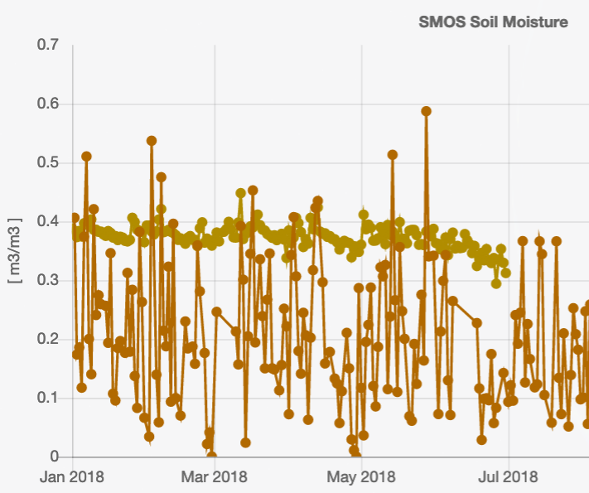
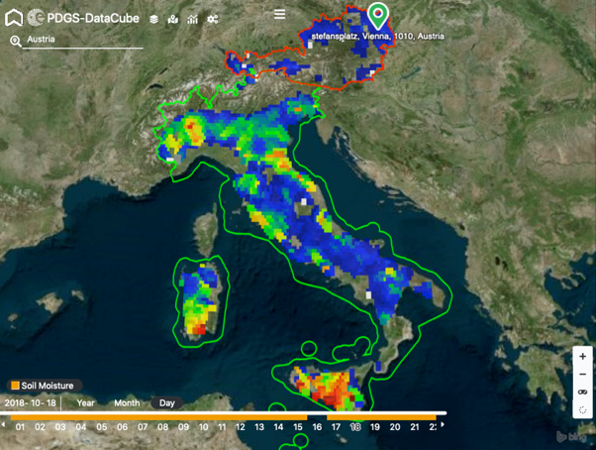
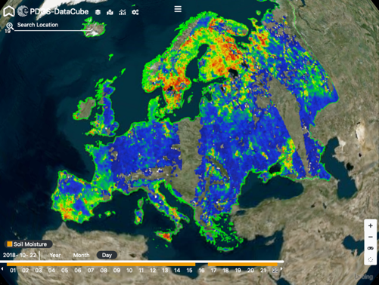
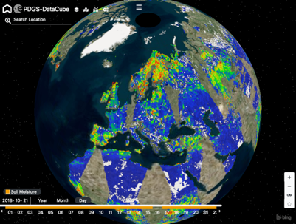
ESA PDGS Data Cube
Global
Regional
Local
Pixel

Slide 4
ESA PDGS Data Cube service: Datasets
Mission | Dataset | Temporal coverage
Landsat-5 | LANDSAT.TM.GTC | 04/1984 – 11/2011
Landsat- 7 | LANDSAT.ETM.GTC | 07/1999 – 12/2003
Tropforest | TropForest | 07/2006 – 04/2011
SPOT-1-5_ESA | SPOT1-5 | 04/1986 – 11/2015
IKONOS-2 | IKONOS.ESA.Archive | 12/2000 – 12/2008
Seasat | SeaSat.ESA.Archive | 07/1978 – 10/1978
Third-Party Missions
Heritage Missions
Earth Explorer
Mission | Dataset | Temporal coverage
ENVISAT | ENVISAT.ATS.LST_2P | 07/2002 - 04/2012
ENVISAT | ENVISAT.ATS.LST_3P | 07/2002 - 04/2012
ENVISAT | ENVISAT.UPA-L2P (SST) | 05/2002 - 04/2012
ENVISAT | ENVISAT.UPA-L3U (SST) | 05/2002 - 04/2012
Ongoing development
Mission | Dataset | Temporal coverage
SMOS | L3_sea_ice_thickness | 01/2010 - 04/2019
SMOS | MIR_SMUDP2 | 01/2019 - 12/2019
SMOS | MIR_OSUDP2 | 01/2019 - 12/2019

Slide 5


ESA PDGS Data Cube service: User Interfaces
explorer
Jupyter
APIs
https://datacube.pdgs.esa.int
https://jupyter.pdgs.esa.int
Jupyter notebooks
rely on adamapi
User centric
Data access
E-collaboration
For scientist
Coding environment
Processing resources
Results publication and / or download
For developers
APIs
OGC interfaces

Slide 6


Jupyter Notebooks for Capacity Development Webinar
How to retrieve time series over your country?
How to compute monthly change map over your country?
Access native data
Pre-process native data
Extract country data
Visualize data
Access country data
Visualize data
10’ vs 2’
Less data → access and processing optimization
Access native data
Pre-process native data
Extract country data
Visualize data
Process country data
Access country data
Visualize data
Process country data
30’ vs 6’

Slide 7
ESA PDGS Data Cube service: Explorer
https://datacube.pdgs.eo.esa.int
  Login

Slide 8
ESA PDGS Data Cube service: Explorer
https://datacube.pdgs.eo.esa.int
  Login
  Add Product to your basket

Slide 9
ESA PDGS Data Cube service: Explorer
https://datacube.pdgs.eo.esa.int
  Login
  Add Product to your basket
  Explore
    in time

Slide 10
ESA PDGS Data Cube service: Explorer
https://datacube.pdgs.eo.esa.int
  Login
  Add Product to your basket
  Explore
    in time
    area of interest

Slide 11
ESA PDGS Data Cube service: Explorer
https://datacube.pdgs.eo.esa.int
  Login
  Add Product to your basket
  Explore
    in time
    area of interest
    point of interest

Slide 12
ESA PDGS Data Cube service: Jupyter
https://datacube.pdgs.eo.esa.int
  Login
  Add Product to your basket
  Explore
    in time
    area of interest
    point of interest
  Go to Jupyter

Slide 13
ESA PDGS Data Cube service: Jupyter
https://datacube.pdgs.eo.esa.int
  Login
  Add Product to your basket
  Explore
    in time
    area of interest
    point of interest
  Go to Jupyter

Slide 14
ESA PDGS Data Cube service: Jupyter
Demo live

Slide 15

ESA PDGS Data Cube service

