Slide 1
Shared Collection Lifecycle Management Principles for Earth Observation Data
I.Maggio, Starion for ESA
Agenda Item 9.3
WGISS-59
24-28 March, 2025
Bangkok, Thailand

Slide 2
WHITE PAPER SCOPE
Data Collection management highlights challenges including data integrity, data authenticity, data replica management (in the cloud and/or archived), data reproducibility and citation. A controlled collections management enables collections to be properly handled and documented, and to become a resource for the user community.
The benefits of Data collections include:
Consistent data accessibility, usability, and long-term preservation;
FAIR (Findable, Accessible, Interoperable, and Reproducible) scientific practices;
Facilitate the reanalysis of satellite measurements.
The purpose of this document is to describe a set of core Earth Observation (EO) Collection lifecycle management principles shared by CEOS organisations.

Slide 3
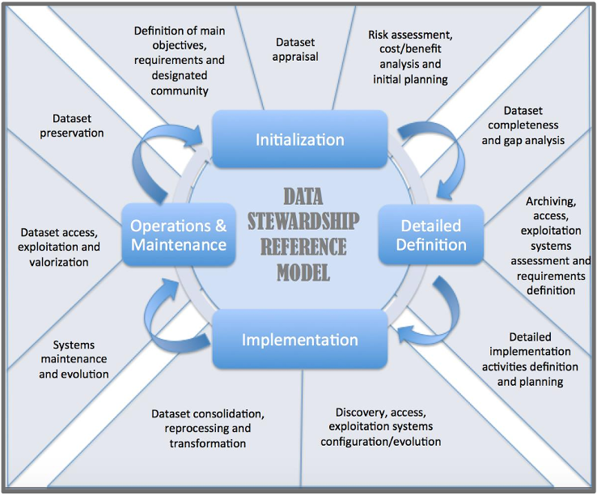
The principles were derived in consideration of current agency practices and framed by a generalised collection lifecycle as represented by the Data collection Stewardship Model.
The Data collection Stewardship process starts during the initialization phase and continues until the Operations and Maintenance phase. For each new data reprocessing the process needs to be restarted.

Slide 4
INITIALIZATION STAGE
PRINCIPLE 1: Products should be consistent within Collections
PRINCIPLE 2: Collection Upgrades should be deliberate, meaningful and well considered
PRINCIPLE 3: At conception of a Collection Upgrade, cost storage, computation requirements, open-sourcing of production code and end-of-life preservation costs should be considered
PRINCIPLE 4: Consider opportunities for interoperability and alignment with products in other organization’s collections

Slide 5
DEFINITION STAGE
PRINCIPLE 5: Provisional products are part of the development process and their management and control are expected to differ from those of standard products within a collection

Slide 6
IMPLEMENTATION STAGE
PRINCIPLE 6a: Ensure Collection infrastructure providers enable disaster recovery
PRINCIPLE 6b: Ensure Collection data integrity
PRINCIPLE 7: Confirm archive or disposal at end-of-life of an old Collection at publication stage of the new one
PRINCIPLE 8: Do not delete or modify Collections without appropriate review, authorisation, and end user communication
PRINCIPLE 9: Assignment of a Persistent Identifier at collection level
PRINCIPLE 10: Maintain accessible records of product files that have been removed or replaced within a collection
PRINCIPLE 11: Consider approaches that authenticate replicas of collections

Slide 7
OPERATIONS & MAINTENANCE STAGE
PRINCIPLE 12: Maintain accessible metadata and documentation for decommissioned Collections.
PRINCIPLE 13: Communicate early and as required with stakeholders on pending decommission to the Collection
PRINCIPLE 14: Source, ancillary, custom auxiliary data, algorithms and production software, and associated documentation should be retained indefinitely
PRINCIPLE 15: Obsolete collections should be disposed of in line with relevant entity and government regulations, policies or procedures
PRINCIPLE 16: Only one version of a baseline data product should be discoverable within a collection

Slide 8
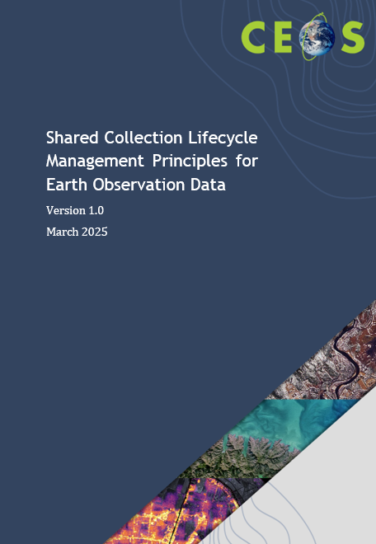
WHITE PAPER STATUS
Final version circulated to WGISS EXEC members
No further feedback received
Document to be formally issued

