Slide 1
EO Data Collections Management and Governance Session Introduction
Mirko Albani, ESA
Agenda Item 9.1
WGISS-59
24-28 March 2025
Centara Grand at Central Ladprao Bangkok, Thailand

Slide 2
Collections management - Background
Challenges to be addressed and managed:
Data collections integrity
Data collections authenticity
Data collections replica management (in the cloud and/or archived)
Data collections reproducibility
Data collections citation
Data collections archiving policy

Slide 3
Collections management – objectives
Present and discuss “Collection Governance practices” from different organizations;
Share experiences and lessons learned;
Produce a CEOS deliverable “White Paper on EO Data Collections Management and Governance”.

Slide 4
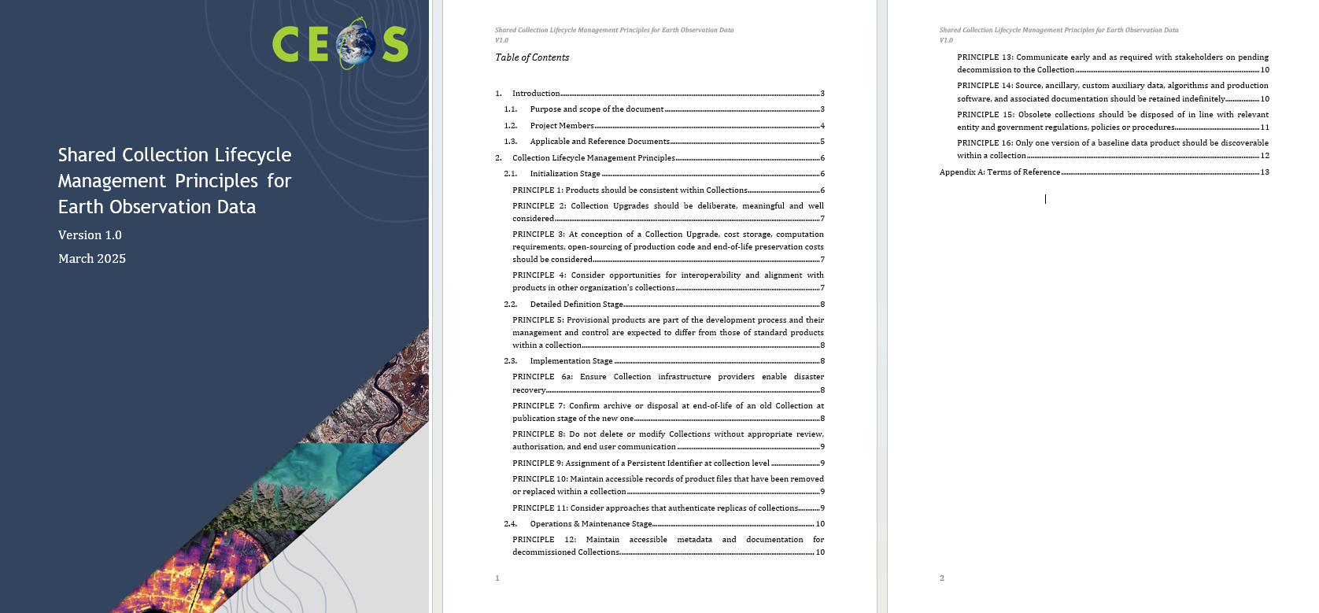
Collection management - Document

