Slide 1
Archive guidelines for the cloud
WGISS-59 3/24-28/2025
Doug Newman
NASA ESDIS Project, Goddard Space Flight Center
Notes:
WGISS - Working Group on Information Systems and Services

Slide 2
Agenda
Our traditional approach
How the cloud might change that
How rapid growth might change that

Slide 3
The traditional approach
3-2-1!

Slide 4
The risks
Accidental deletion/corruption
Malicious deletion/corruption
Hardware viability*
Hardware cost
Disasters
*end of life, obsolescence, failure
*end of life, obsolescence, failure

Slide 5
3-2-1
3 copies of all data
2 different media types
1 copy at a different physical location
Notes:
CWIC - INPE -
UMM-C -

Slide 6
Risk/Mitigation correlation
Risk | Severity | Likelihood | Mitigation
Disasters | High | Low/Medium | Copy in physically different location
Hardware viability | Medium | Medium | Two different media types
Hardware cost | Low | Low | Two different media types
Accidental deletion/corruption | Medium | Medium* | 3 copies
Malicious deletion/corruption | High | Low** | 3 copies
*zero to two events for each DAAC per year
**no instances of malicious deletion recorded

Slide 7
The cloud
How it changes things

Slide 8
3-2-1 revisited
3 copies of all data
2 different media types - media types are not under our control
copy at a different physical location, but we have no control over distance
Notes:
BP - Best Practices
CWIC -
INPE -
UMM-C -

Slide 9
Cloud Service durability
AWS - Eleven 9s*
Azure - Eleven 9s with the option of twelve**
Google cloud - Eleven 9s*
‘If you store 10,000 objects, on average we may lose one of them every 10 million years or so’
*https://aws.amazon.com/blogs/aws/new-amazon-s3-reduced-redundancy-storage-rrs/
** https://learn.microsoft.com/en-us/azure/storage/common/storage-redundancy
***https://cloud.google.com/storage/docs/availability-durability
Notes:
AWS - Amazon Web Services
‘11 9s’ is 99.99999999999% durability

Slide 10
Cloud Service Level Agreements
AWS - refund of costs*
Azure - refund of costs**
Google Cloud - refund of costs***
But the data is gone. This is a risk
* https://aws.amazon.com/s3/sla/
**https://www.microsoft.com/licensing/docs/view/Service-Level-Agreements-SLA-for-Online-Services
***https://cloud.google.com/storage/sla
Notes:
*cloud vendor SLAs offer tremendous durability but if the SLA fails we get a refund, not the data at a later date. The data could be gone.

Slide 11
The risks
Accidental deletion
Malicious deletion
Hardware viability
Hardware cost
Natural disasters
Cloud Vendor viability*
Cloud Vendor cost
*vendor going out of business, reducing required services, etc.

Slide 12
Risk changes
Risk | Severity | Likelihood
Disasters | High | Medium
Cloud viability | High | Low
Cloud cost | Medium | Medium
Accidental deletion/corruption | Medium | Medium*
Malicious deletion/corruption | High | Low**
*zero to two events for each DAAC per year
**no instances of malicious deletion recorded
Notes:
DAAC - distributed data archive center

Slide 13
Rapid growth
The economic view
Notes:
BP - Best Practices

Slide 14
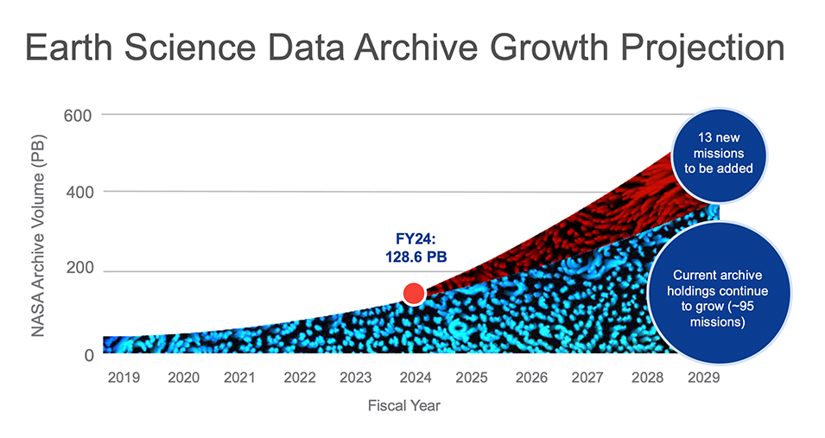
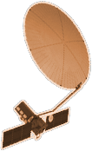


Slide 15
What can we afford?
NISAR alone, over its lifespan, will generate 140 PB of data.
Storage of 140 PB of data in S3 standard access will cost you:
$3 million per month
This figure does not include egress of that data :)
(11% of our volume is generally distributed per month: $3.8 million per month)
Can we afford 3 copies?
Notes:
NISAR - NASA-ISRO Synthetic Aperture Radar
ISRO - Indian Space Research Organisation
S3 - Simple Storage Service

Slide 16
Reducing cost: S3 Intelligent Tiering
We have observed a 50% cost savings on our archive costs since the implementation of S3INT across all earthdata cloud.
This mitigates some of our cost risk
Notes:
S3INT - Simple storage service, intelligent tiering

Slide 17
Reducing cost: S3 versioning
The goal is not to store copies of data.
The goal is not to lose data.
When data deletion is attempted, don’t delete it, mark it as deleted for a period of time, then delete it.
This could mitigate the accidental/malicious deletion risk.

Slide 18
Reducing cost: selective copies
What not to copy:
Data that can be recreated from other sources
Data that is stored with other agencies and entities
This could mitigate cost risks

Slide 19
Our current conclusions
Notes:
BP - Best Practices

Slide 20
Disclaimer
The following is subject to change as we design, implement and test these ideas.

Slide 21
Tier 1 data
This data does not exist somewhere else
This data cannot be derived from other data
High use data (converse of ‘low use data’ defined in tier 2)

Slide 22
Tier 2 data
This data exists at another agency or entity
This data can be reconstructed from data in the Tier 1 category
Low use data. Data that hasn’t been distributed in 5 years.

Slide 23
Tier 1 strategy
Risk | Mitigation
Disasters | multi-AZ cloud storage* ‘S3 … redundantly store objects on multiple devices across a minimum of 3 Availability Zones in an AWS Region’
Cloud Vendor viability | Two cloud copies with different vendors
Cloud Vendor cost | Two cloud copies with different vendors
Accidental deletion/corruption | S3 versioning + MFA deletion
Malicious deletion/corruption | S3 versioning + MFA deletion
SUBJECT TO CHANGE!
*https://docs.aws.amazon.com/AmazonS3/latest/userguide/DataDurability.html
Notes:
AWS - Amazon Web Services
AZ - availability zone
MFA - multi-factor authentication

Slide 24
Tier 2 strategy
Risk | Mitigation
Disasters | multi-AZ cloud storage* ‘S3 … redundantly store objects on multiple devices across a minimum of 3 Availability Zones in an AWS Region’
Cloud Vendor viability | Retrieval/reconstruction of data
Cloud Vendor cost | Retrieval/reconstruction of data
Accidental deletion/corruption | S3 versioning + MFA deletion
Malicious deletion/corruption | S3 versioning + MFA deletion
SUBJECT TO CHANGE!
*https://docs.aws.amazon.com/AmazonS3/latest/userguide/DataDurability.html

Slide 25
Thank you
CONTACT
douglas.j.newman@nasa.gov
WEBSITE
earthdata.nasa.gov
SOCIAL MEDIA
@NASAEarthData
Contact me at…

