Slide 1
Data Compression
Robert Fletcher, UKSA
Agenda Item 8.5
WGISS-59
24-28 March, 2025
Bangkok, Thailand

Slide 2

What is Data Compression?
Data compression is the process of reducing the size of a data file by a reducing in the number of bits needed to represent the data file
Data compression is typically used to reduce the size of digital media files including photos, audio and video
Compressing data can improve data management and save storage capacity, speed up file transfer and decrease costs for storage hardware and network bandwidth
Data compression involves various algorithms and standards that determine how data is compressed. These different algorithms dictate the methods and rules for reducing the size of files or data streams.

Slide 3
Why Data Compression for EO data?
We are facing a deluge in data!
New data volumes will create challenges around storage cost, duplication of data, data management, efficient access to large data volumes and operational efficiency
Agencies and satellite operators will need to evaluate and introduce innovative data management solutions
Can Data Compression be introduced to address some of the foreseen challenges?

Slide 4
Data Compression Vs Deduplication
Data Compression reduces the length or size of information and data by removing unnecessary fillers and spaces while maintaining the same meaning of the information being compressed.
Depending on the compressed data type, either a lossy or a lossless compression algorithm can be used.
Data Deduplication is a data storage technology that takes redundant and repeated parameters and/or files and replaces them with a single identifier or pointer whilst saving only one copy of the data; therefore significantly reducing the size of the data being stored.
No data is lost throughout the deduplication process, and it is a completely “lossless” method for reducing the size of large data quantities.

Slide 5
Data Compression Techniques
Data Compression techniques are usually categorised by two common types:
Lossy Data Compression: Lossy data compression methods sacrifice some data to achieve higher compression ratios. This type of compression is commonly used in multimedia formats like JPEG for images and MP3 for audio. While lossy data compression results in a substantial reduction in file size, there’s also some loss of quality. It’s suitable for situations where the loss is acceptable
Lossless Data Compression: Lossless compression algorithms retain all the original data. They are commonly used in situations where data integrity is crucial, such as text documents and program files. Lossless data compression ensures that the original data can be fully reconstructed from the compressed version without any loss of information
Data Compression involves algorithms and standards that determine how data is compressed and uncompressed. The ‘coder’ element compresses the data, and the ‘decoder’ element reconstructs it, known collectively as the ‘codec’. There are many algorithms and standards – covering both lossy and lossless methodologies.

Slide 6
Data Compression Examples
File Compression: Most common type of data compression. Used to reduce file size, for ease of management and transfer speed. Common formats include ZIP, RAR, and 7zip
Video Compression: Video media files are often very large due to the data required to store each frame. Video compression is commonly used for streaming, video conferencing, and storing video content
Audio Compression: Commonly used in digital music formats such as MP3, which is a lossy compression which makes audio files more compact. Being lossy, some of the sound quality is removed
Image Compression: Often used for digital photography to ensure faster loading of images and efficient storage. JPEG is a common format used for image compression. This is the most relevant type of compression for EO imagery but needs to be adopted for EO related file formats.

Slide 7
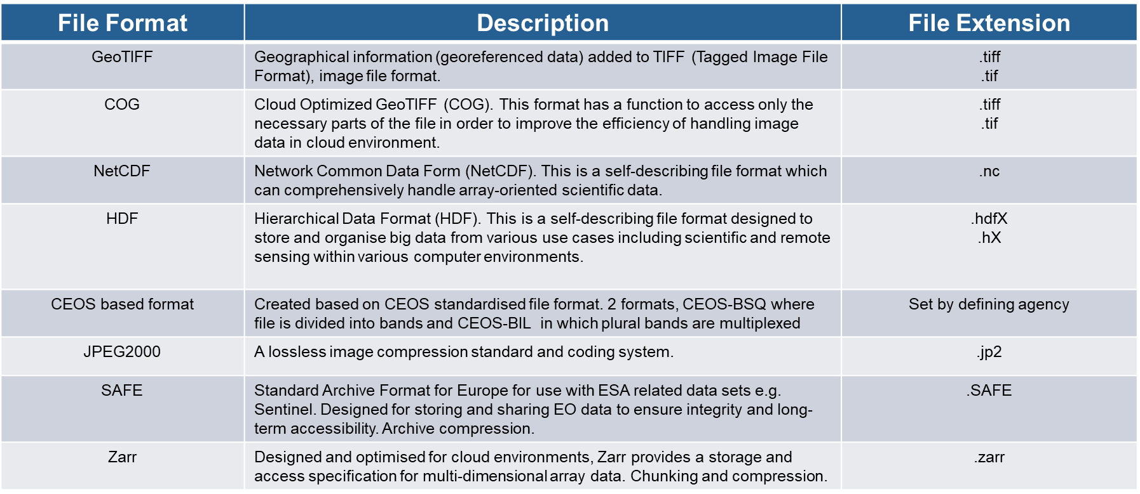
Common EO file types

Slide 8
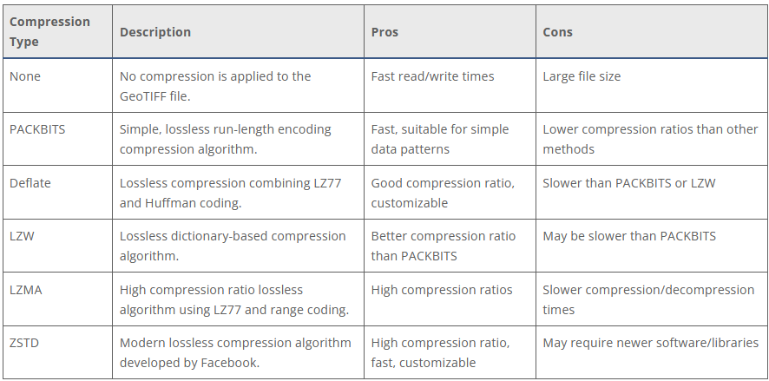
Examples of Compression Algorithms for GeoTIFF
Credit: Daniel O'Donohue @ Mapscaping

Slide 9
Challenges in EO data compression
Preserving critical details: Balancing compression efficiency with maintaining the necessary level of detail for the intended application. Users don’t like losing data quality
Adapting to diverse sensors: Different satellite sensors produce data with unique characteristics, requiring tailored compression algorithms. With more missions launching this will become more challenging going forward
Real-time processing needs: For applications requiring near-instantaneous data analysis, compression algorithms must be computationally efficient
Computational complexity: Balancing compression efficiency with processing power needed for compression and decompression.

Slide 10
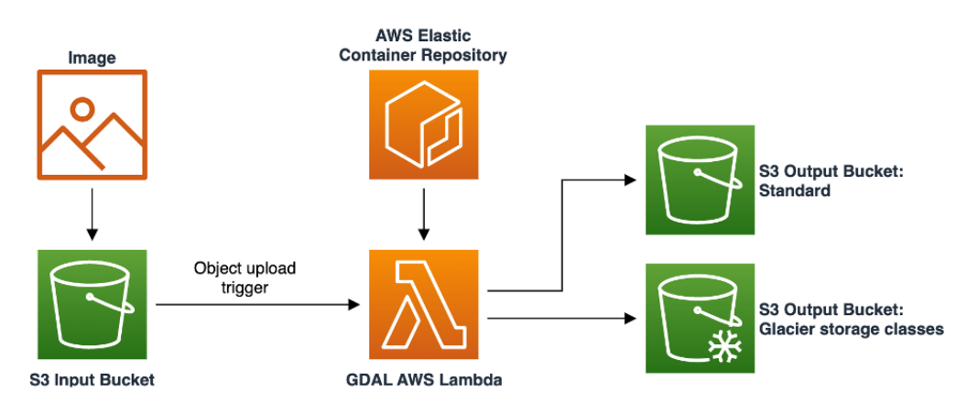
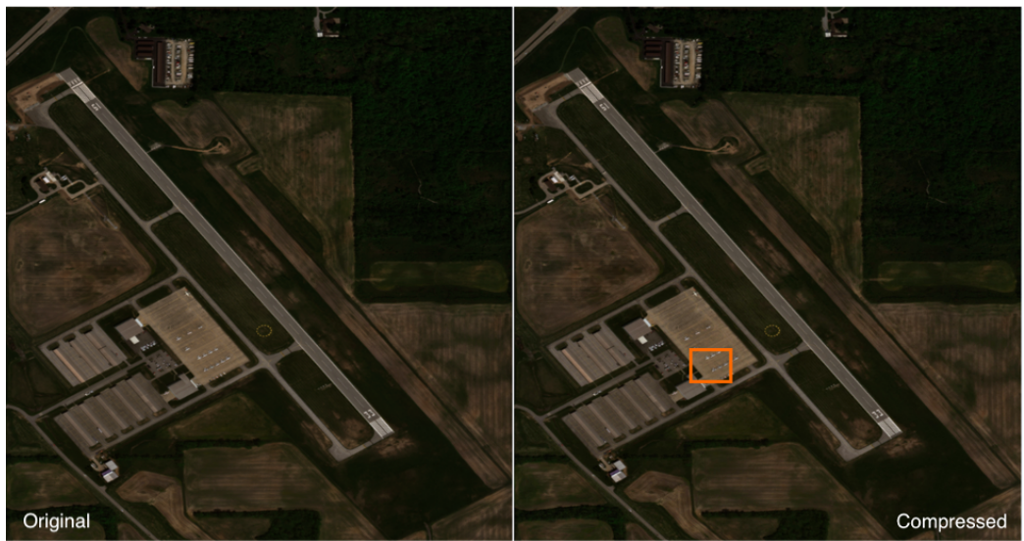
EO Data Compression on AWS - Example
The Goal: To deploy a low cost solution to compress satellite imagery with Geospatial Data Abstraction Library (GDAL), using AWS Lambda, Docker, S3 and S3 Glacier storage. Data set is Worldview 3. Solution archives original image, and keeps compressed image online.
Results:
GDAL JPEG quality set @ 75%
Original file size = 40.6MB
Compressed file size = 1.4MB
Reduction = 96%
Quality = 95% similar
Credit: Amazon Web Services

Slide 11
AI Driven Data Compression
AI based data compression leverages artificial intelligence techniques to achieve efficient compression of data. Traditionaly compression algorithms are based on fixed rules and patterns. AI brings adaptability and learning capabilities to the compression process:
Machine Learning Models: ML based AI algorithms analyse patterns in data and build predictive models. These models are used to predict the next values in a sequence, which in turn allows for more efficient representation and compression rates
Context Based Compression: The Context Modelling based AI technique takes into account the context of data to improve compression. The compression algorithm adapts its behaviour based on the context of the data it is currently processing
Neural Network Based Compression: Neural networks, can be trained to learn data representations that are more compressible. Neural network architectures can be used for learning efficient data representations.

Slide 12
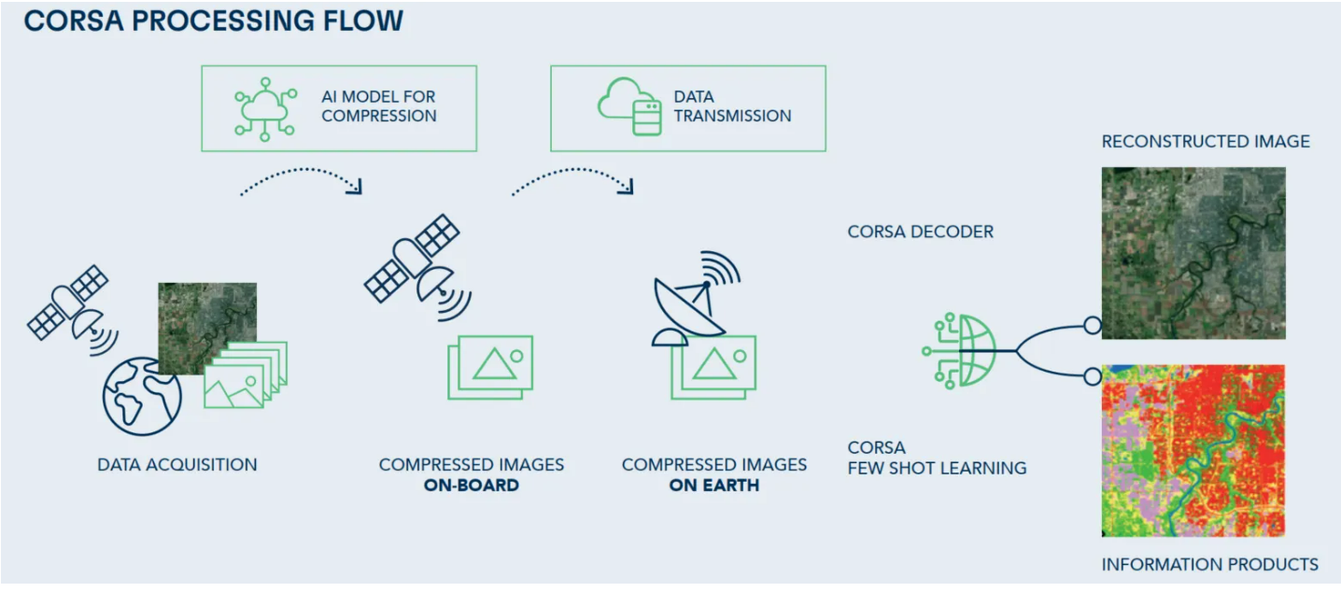
AI Driven Data Compression Example
The Goal: The use of deep learning models to achieve high compression ratios while maintaining image quality, to allow for complex data analysis.
In Europe, VITO Remote Sensing have developed CORSA, which is a revolutionary AI Driven Data Compression Algorithm for EO data. VTIO Remote Sensing CORSA
CORSA has proven compression rates of 100x on Sentinel-1, Senitnel-2 and PRISMA data, without compromising data quality. CORSA is described as ‘nearly lossless’.
The technology is aimed to enable space providers and agencies to improve efficiency and reduce costs
Credit: VITO Remote Sensing

Slide 13

Data Streaming via Video Technologies
DestinEStreamer on Destination Earth https://platform.destine.eu/services/service/destine-streamer/
DestinEStreamer revolutionises EO and climate data management, leveraging tech for seamless access, streamlined processing, and new services
DestinEStreamer compresses imagery, sensor, and raster-simulation data into bitstream objects using modern, open-source video codecs. Along with standard data access routines (APIs, Web Application, and Python examples)
Utilising advanced compression and access techniques to offer:
Reduced Storage Needs: Significantly lower storage requirements, increasing the capabilities to offer more datasets
Simplified Data Handling: Effortlessly scan, access, and transform data into analysis-ready formats on-the-fly
Improved Data Consumption: Enhance the efficiency of data usage.
Credit: GeoVille

Slide 14
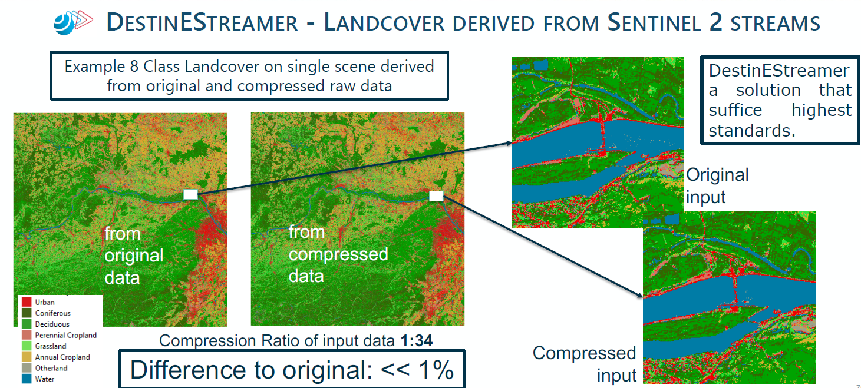
Data Streaming via Video Technologies
DestinEStreamer on Destination Earth https://platform.destine.eu/services/service/destine-streamer/
Credit: GeoVille

Slide 15
Conclusion
Data Compression can play an important role in future EO data storage, to reduce storage hardware requirements, data transmission time, and communications bandwidth
However, Data quality is a key concern to the users of the data. Lossy data compression not great for use cases
Methodologies utilising AI are being developed specifically for EO, with very positive results
Is Data Compression the right approach to help tackle the ‘deluge of data’?
Or should we be looking at other methods and solutions such as distributed storage arrays to provide redundancy and reduce duplication, or AI/ML driven satellite acquisition methods to be more selective with data capture?...

