Slide 1
Digital Twin White Paper
Yousuke Ikehata(JAXA), Maral Bayaraa(UKSA)
Agenda Item 8.5
WGISS-59
27th March 2025
Bangkok, Thai

Slide 2



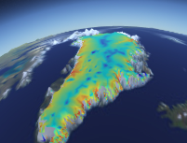
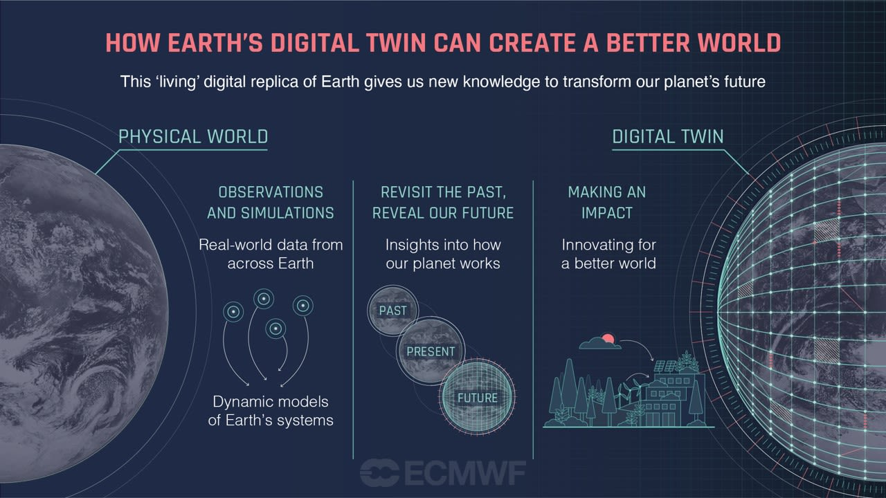
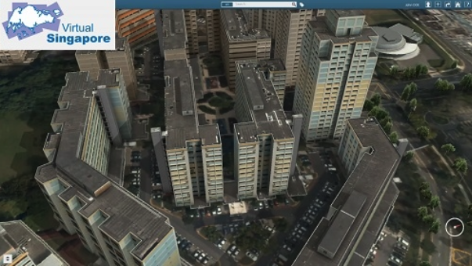
Digital twins – AI4EO supporting modelling
https://vesl.jpl.nasa.gov/
Modelling the glaciers, ice sheets, sea level and solid earth
EO data
Virtual Singapore
www.nrf.gov.sg
3D digital replica of Singapore + NRT data. Urban planning problems
EO data can also be used to support small-scale digital twins, i.e. in the construction sector

Slide 3

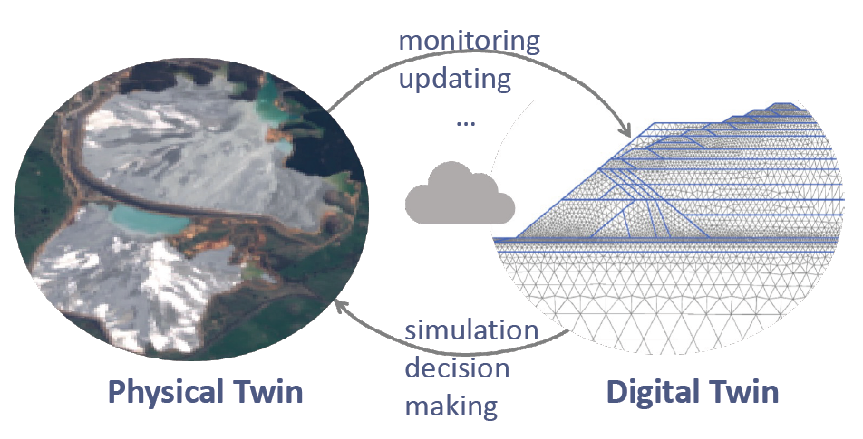
Digital twins construction monitoring example
The key differences between a true digital twin and any other digital model are in its ability to update itself automatically to the conditions of the physical twin, as the physical twin changes and vice versa.
To that end, monitoring data from EO and other sources are integrated together to generate the necessary insights for updating the state of the digital twin.
The real value of digital twins is in its ability to forecast and simulate alternative future scenarios, so that the best actions are recommended for decision making. This is a significant task and may be feasible only with the promise of data-driven approaches, such as Deep Learning, at its core

Slide 4
WGISS presenstations
We’ve already discussed some “Digital Twin” presentations, and I think it is very attractive topic for technology aspect.
  [WGISS-55] Professional Open-Source Framework for Earth System Digital Twins and Applications
  [WGISS-56] Integrated Digital Earth Analysis System (IDEAS)
  [WGISS-57] CropSmart: An EO-based digital twin for making wiser cropping decisions

