Slide 1
CEOS WGISS
Jupyter Notebooks Best Practice
Esther Conway (STFC)*,Yousuke Ikehata (JAXA),
Agenda ID: 2025.03.26_16:30
WGISS_59
Bangkok Thailand
March 2025

Slide 2
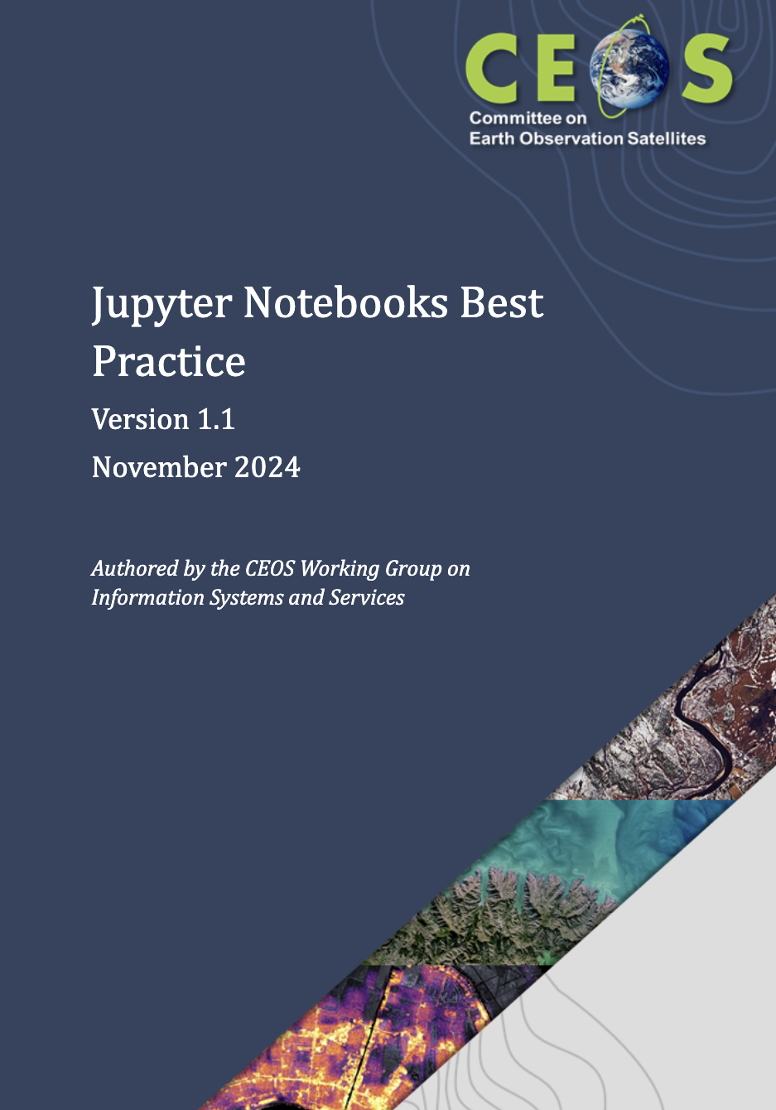
Best Practice Document - Published
Table of Contents
1. Introduction
2. Background
3. Objectives and Needs
4. Jupyter Notebook Best Practice Content
4.1. Notebook description, purpose and discoverability
4.2. Structure, workflow, code and documentation
4.3. Technical dependencies and Virtual Environments
4.3.1. Notebook Specific Dependencies
4.3.2. Platform and Environment Specific Dependencies
4.3.3. Data Access and Service Dependencies
4.3.4. Complex Systems and Dependencies on Active Teams
4.4. Citation, access to and navigation of input data
4.5. Association with archived data
4.6. Archival, Preservation and Retirement
4.7. Open-source software licensing 17
4.7.1. For Notebooks as Documentation
4.7.2. Software Considerations
4.8. Publishing, Versioning and DOI 19
Annex A: More information on Jupyter Notebooks Platforms and Services 20
Annex B: Jupyter Notebook Exemplars 21
First Webinar Exemplars 21
Final Workshop Exemplars and training scenarios 23
Annex C: Notebook metadata 24
https://ceos.org/document_management/Working_Groups/WGISS/Documents/WGISS%20Best%20Practices/CEOS_JupterNotebooks_Best%20Practice_v1.1.pdf

Slide 3



Question from Rob Woodcock CSIRO and 1st Tech Expo topic
Have you though about Jupyter notebooks
I never thought leading Tech Expo would involve listening to a broad West Tyrone accent at 2:00am
Have you thought about how WGISS could collaborate with CapD

Slide 4

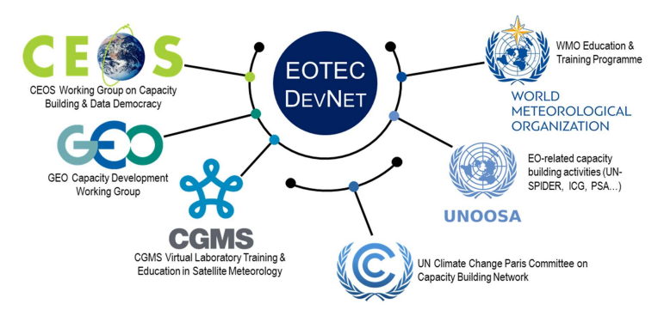




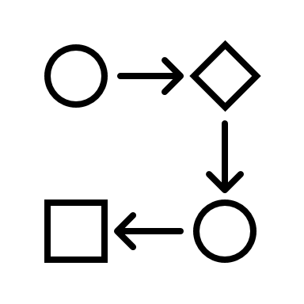





Tech Expo Overview Yousuke Ikehata
Data Preservation and Stewardship
Collaboration
Techniques
AI/ML
Federations
UI/UX
WGCapD
Data Discovery and Access
JupyterNotebook
Data Presentation?
(Potential Topic)
WGDisaster
Data Interoperability
and Use

Slide 5
Jupyter Strategy
CaoD , GEO ?, CODATA ?, WGISS
Actions !
‹#›
Data Discovery and Access
Collaboration and developing a Community of Interest
Training Capabilities (online access to Jupyter Notebooks and Data)
Data Interoperability and Use
Best Practice Document
Tech Expo
Introduction to Jupyter Notebooks
Data Preservation and Stewardship
CaoD/WGISS
Preservation and CEOS repository
Domain Specific /CapD Webinars
Tech Expo Webinars
Tech Expo

Slide 6
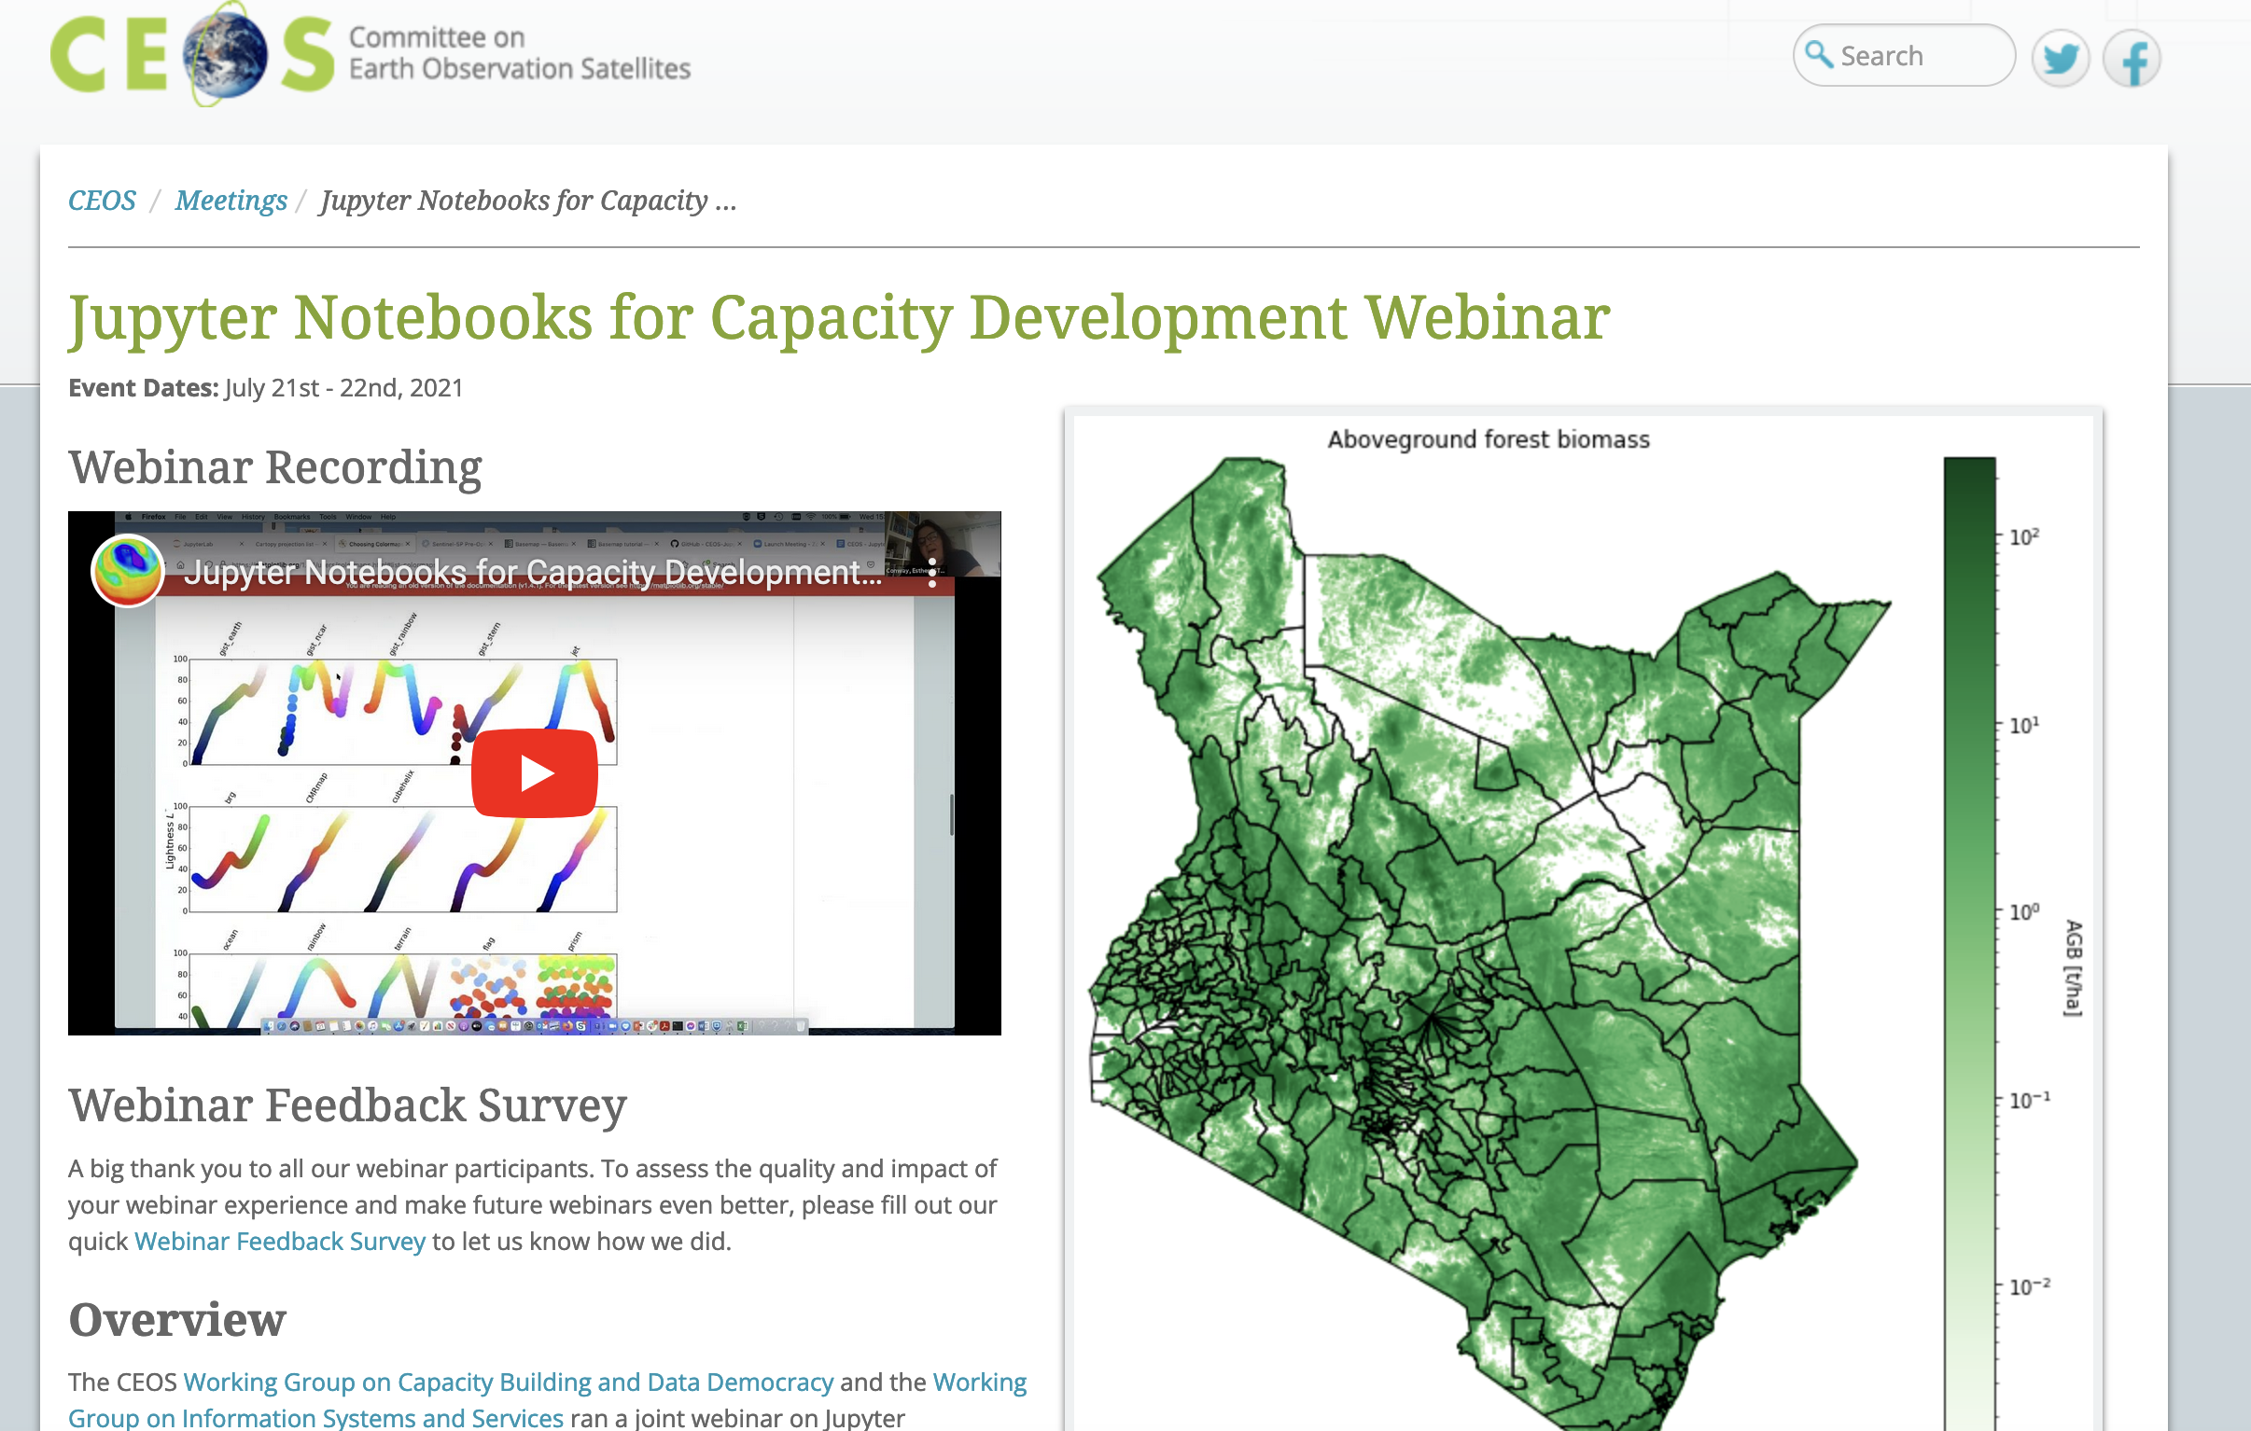

Jupyter Notebooks for Capacity Development Webinar

Slide 7
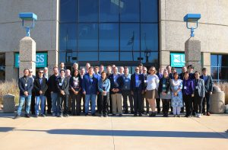

Webinars Surveys and Meetings
3 workshops
2 Surveys
Many Meetings

Slide 8
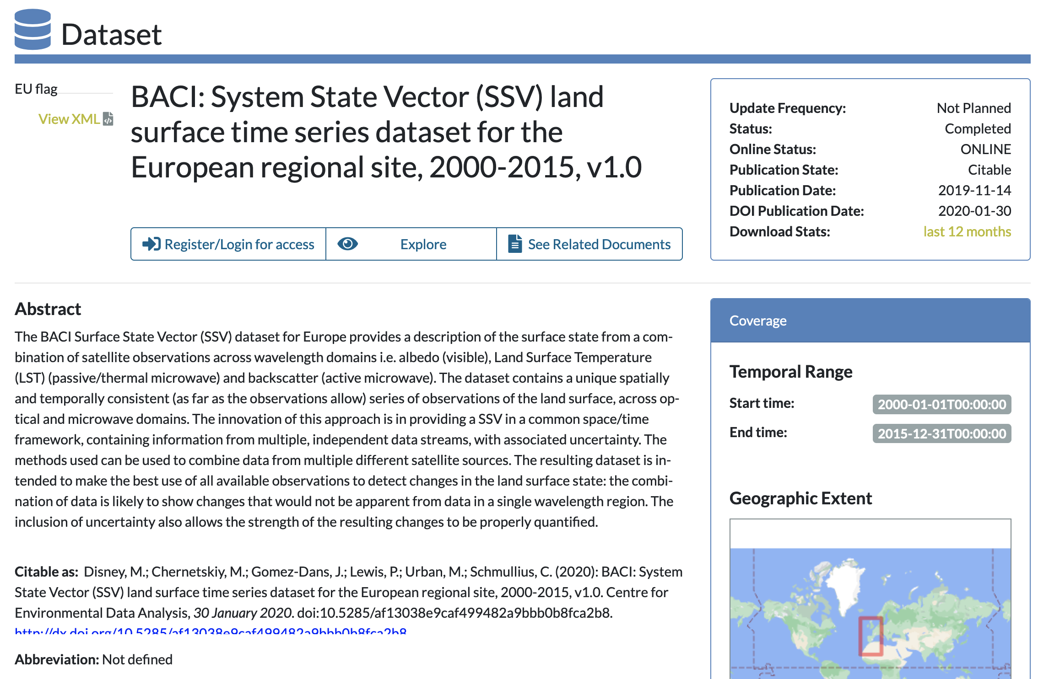
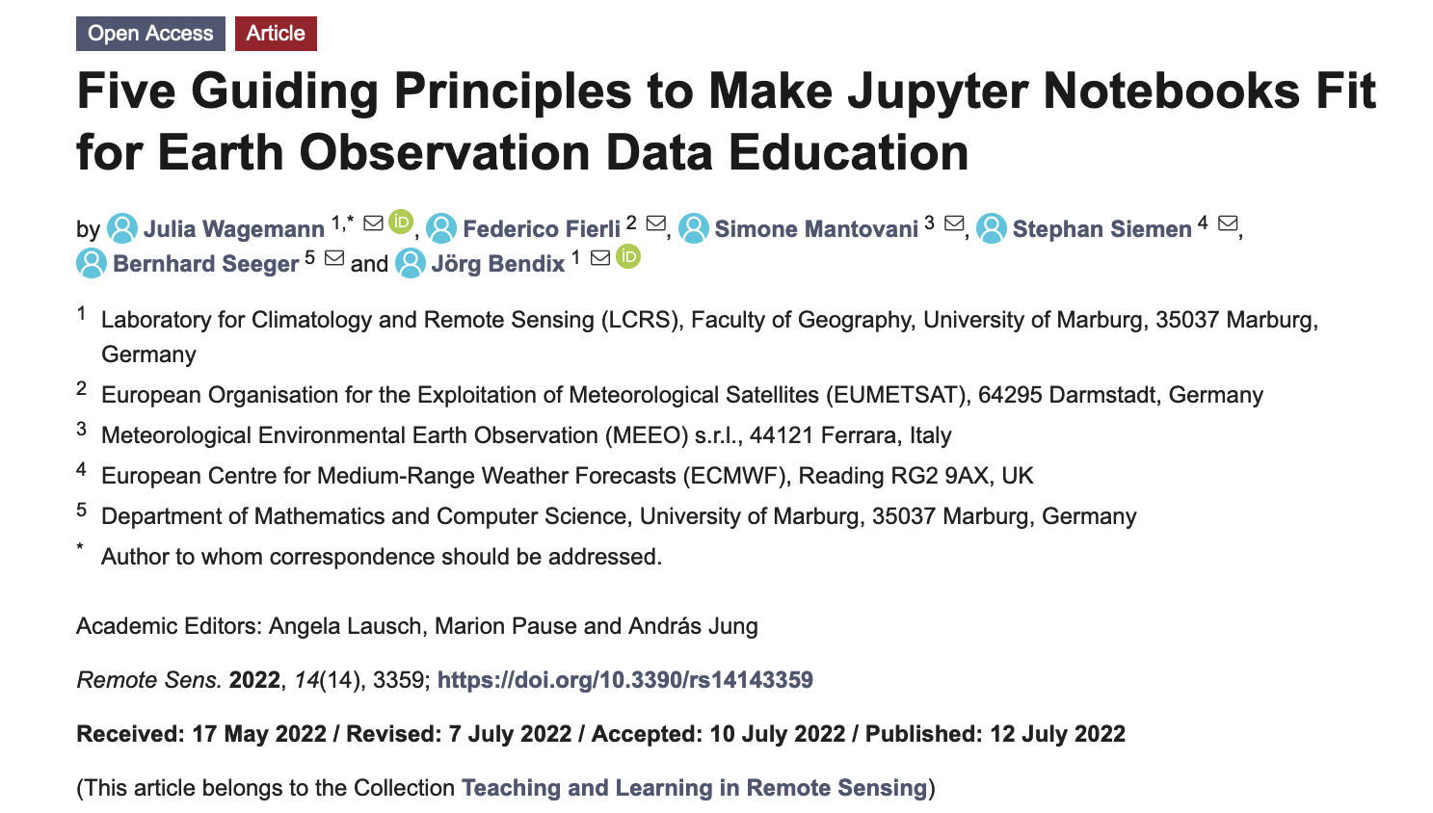
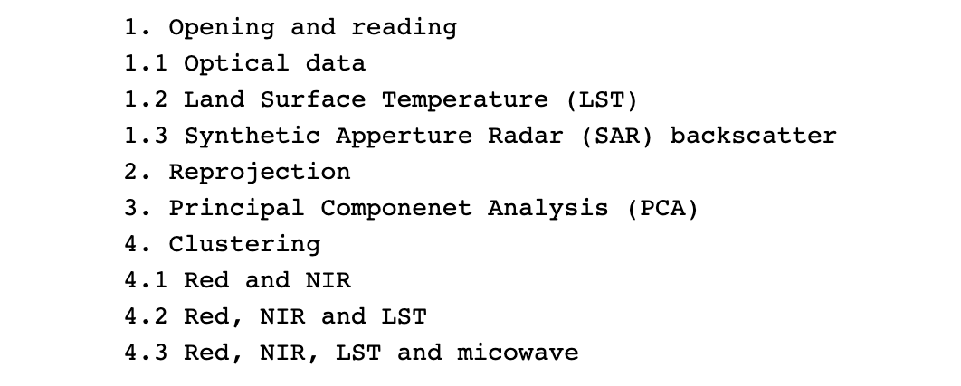
Thinking of content as well as the technical aspects
Use of EUMETSAT Guiding Principles as input document – Good quality notebooks for a purpose
https://www.mdpi.com/2072-4292/14/14/3359

Slide 9
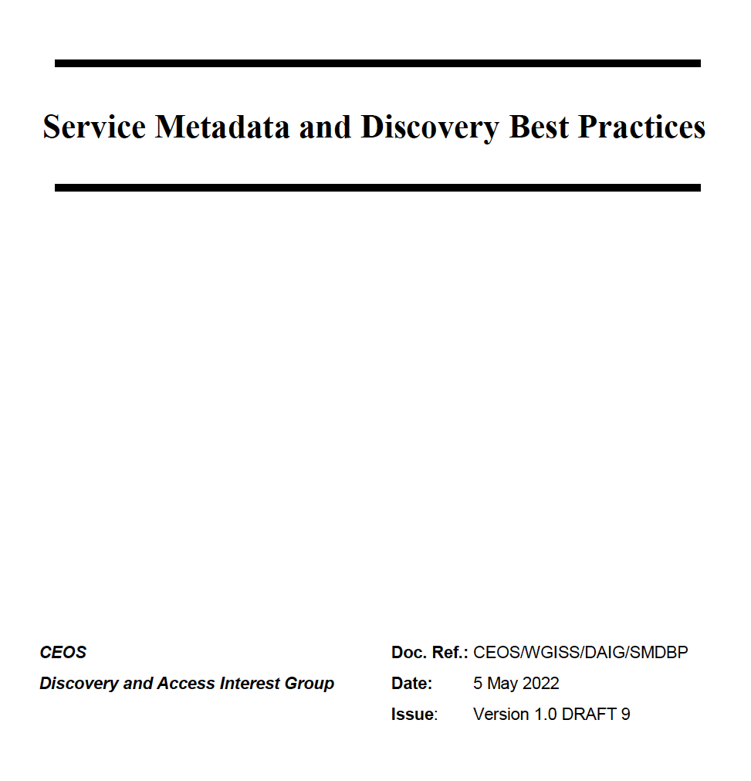
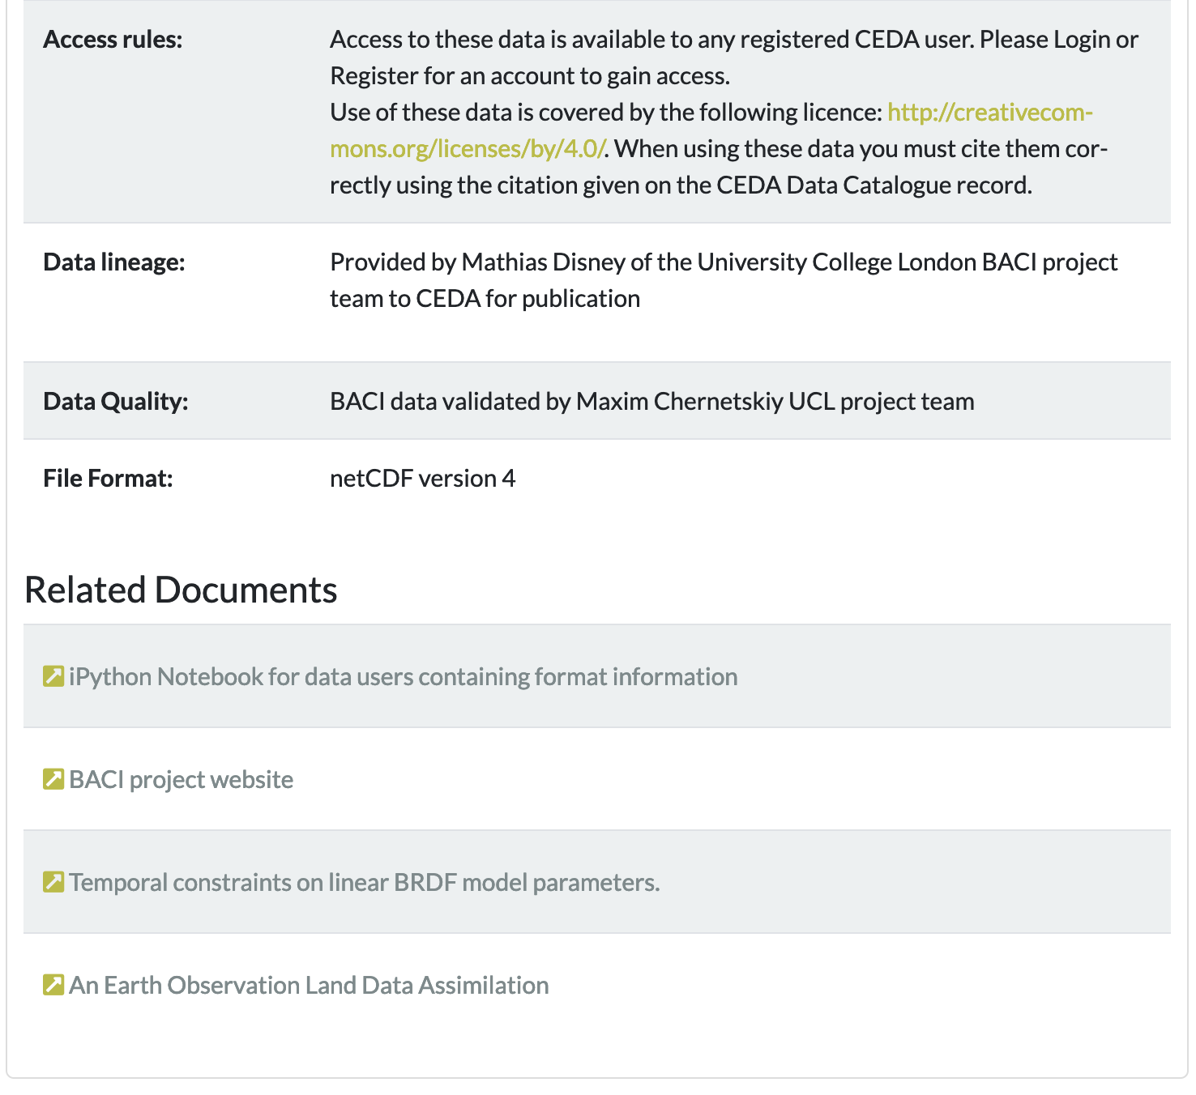
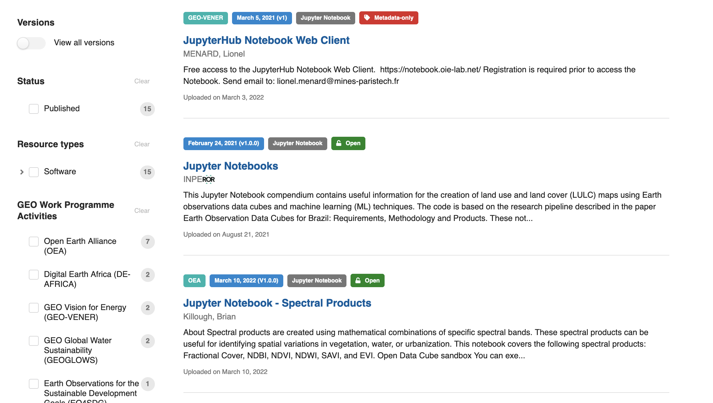
Linking services, tools and data

Slide 10

Metadata in Notebook
This document explains basics of opening and manipulation of the BACI Surface State Vector (SSV) files in netCDF format. SSV consists of surface reflectance, albedo, land surface temperature (LST) and synthetic apperture radar (SAR) backscatter. All datasets have the same spatial resolution, geographical projection and temporal step. Presented examples are based on the following python 2.7 libraries:
netCDF4 - working with python netCDF;
GDAL - Geospatial Data Abstraction Library;
seaborn - enhanced data visualization and
scikit-learn - machine learning library.
Datasets can be found in /group_workspaces/jasmin2/baci/sigil/baci_wp2_files/
All regional sites which are in the geographical Europe are in the same folder /group_workspaces/jasmin2/baci/sigil/baci_wp2_files/13_europe/
Datasets are in sinusoidal projection and divided by MODIS tiles https://modis-land.gsfc.nasa.gov/MODLAND_grid.html This means that processed regions are larger than BACI regional sites.
Table of Contents:
1. Opening and reading 1.1 Optical data 1.2 Land Surface Temperature (LST) 1.3 Synthetic Apperture Radar (SAR) backscatter 2. Reprojection 3. Principal Componenet Analysis (PCA) 4. Clustering 4.1 Red and NIR 4.2 Red, NIR and LST 4.3 Red, NIR, LST and micowave
"metadata": {
"title": "Discover Sentinel-3 OLCI Level 1 data",
"description": "This notebook introduces you to ...",
"author": "Julia Wagemann",
"image": "./img/img_04.png",
"link": "link_to_jupyterhub/notebook.ipynb",
"github": "link_to_github/notebook.ipynb",
"tags": {
"domain": "atmosphere",
"variable": "toa_reflectance",
"satellite": "Sentinel-3",
"sensor": "OLCI",
"level": "L1"}
Credit to Julia Wagemann EUMETSAT
Slide ‹#›

Slide 11
Our understanding of dependencies changed
Richard Moreno (CNES)
Sometimes its more like a technical onion
Simone Mantovani (MEEO)
At some point ti becomes to complex – the team become the dependeny
Jupyter Hub
Binder
Google Colabs
ESA PGDS
EUMETSAT Data books
Google Earth Engine/Open Datacube sandbox
Amazon Webservices EAIL
4.3. Technical dependencies and Virtual Environments
4.3.1. Notebook Specific Dependencies
4.3.2. Platform and Environment Specific Dependencies
4.3.3. Data Access and Service Dependencies
4.3.4. Complex Systems and Dependencies on Active Teams

Slide 12
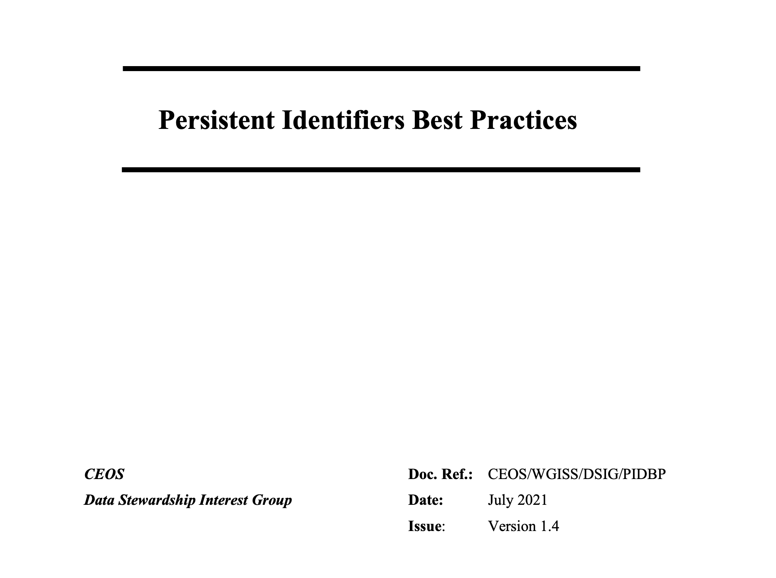
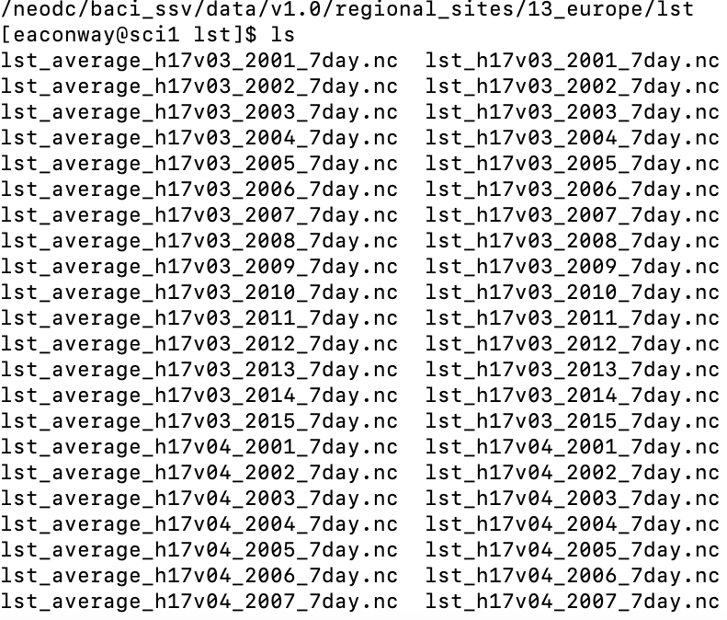
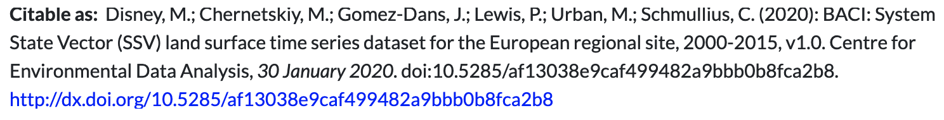
Citation and Access
Not just DOI’s but location and structure for 3rd Party Distributions
Direct Access (Open)
Direct Access Application instructions (licensed)
Direct Access OpenDap/THREDDS Server instruction (remote access e.g. Binder)
Download instructions

Slide 13

Open Source Software licensing
It’s the analysis that’s important – requirements will differ
2 Level Analysis
  License using creative commons as base
  Software Aspect
https://creativecommons.org/licenses/

Slide 14
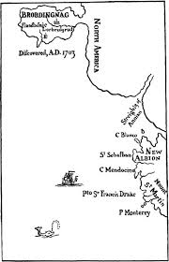

The Preservation Question
Reproducible environments
Too Valuable to loose camp
Standardized Environments
Two Tier Archive
Active and Legacy Notebooks
Postive Pressure /Auto Retirement
We will end up with a library of broken things camp

Slide 15

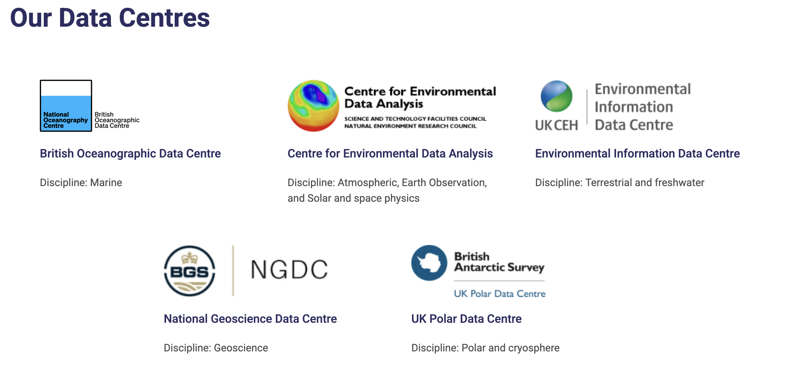




Jupyter Notebooks moving forward !
BOOST Project
https://eds.ukri.org/environmental-data-service
Questions: esther.conway@stfc.ac.uk

