Slide 1
Self-Sovereign Identity(SSI)
Activity in Japan.
Yousuke Ikehata, JAXA
Agenda Item 7.5
WGISS-59
26th March 2025
Bangkok, Thai

Slide 2
What is SSI
Self-Sovereign Identity (SSI) is an approach to digital identity that gives individuals control over the information they use to prove who they are to websites, services, and applications across the web.
Ref https://en.wikipedia.org/wiki/Self-sovereign_identity

Slide 3
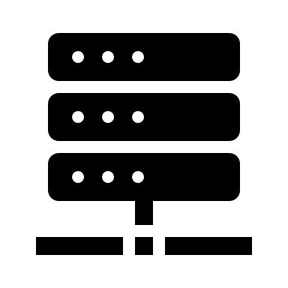




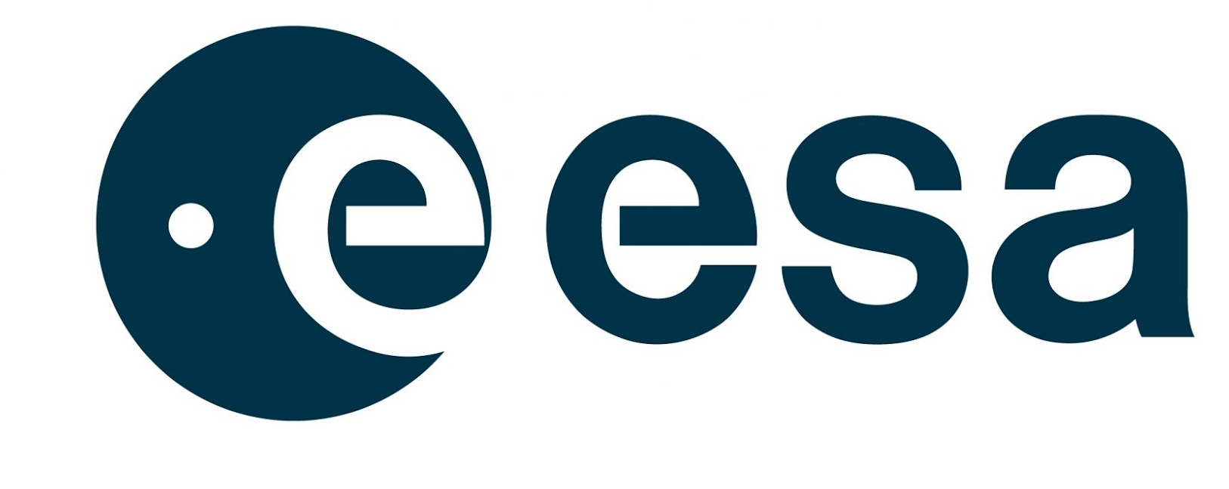
LDAP authentication
Most basic authentication
Users and passwords stored in local database.
2. auth.
User
pass
1. login
3. Success auth.
LDAP
1. login
Difficult to collaboration
3. Success auth.

Slide 4




OpenID connect
Modern authentication in clouds and web services.
Platformer(Google/X/facebook, and so on) provides(controls) authentication.
1. login
2. auth.
3. Success auth.
User
Pass
Mutual
Auth.
1. login
3. Success auth.
2. auth.

Slide 5

SSI authentication
User has/controls user information.
1. login
2. auth.(verify)
3. Success auth.
Mutual
Auth.
Verifiable data registry
1. login
3. Success auth.
2. auth.(verify)

Slide 6
SSI = VCs using DIDs
Verifiable Credential example
  SSI
    User(Holder) sends VCs to use Verifier(ex: web service, cloud service, etc)
  VC is json document with electronic signature.
  VCs providers are verified by DIDs.
    But DID isn’t necessary for verification VCs.
{"verifiableCredential": {
"@context": [
"https://www.w3.org/2018/credentials/v1",
"https://www.w3.org/2018/credentials/examples/v1"
],
"id": "0892f680-6aeb-11eb-9bcf-f10d8993fde7",
"type": [
"VerifiableCredential",
"UniversityDegreeCredential"],
"issuer": {
"id": "did:example:76e12ec712ebc6f1c221ebfeb1f",
"name": "Acme University"},
"issuanceDate": "2021-05-11T23:09:06.803Z",
"credentialSubject": {
"id": "did:example:ebfeb1f712ebc6f1c276e12ec21",
"degree": {
"type": "BachelorDegree",
"name": "Bachelor of Science"}},
"proof": {
"type": "Ed25519Signature2018",
"created": "2021-05-17T15:25:26Z",
"jws": "eyJhbGciOiJFZERTQYjY0Il19..nlcAA",
"proofPurpose": "assertionMethod",
"verificationMethod": "https://pathToIssuerPublicKey"}}}

Slide 7
What is DID?
A Decentralized IDentifier (DID) is a type of globally unique identifier that enables an entity to be identified in a manner that is verifiable, persistent (as long as the DID controller desires), and does not require the use of a centralized registry. DIDs enable a new model of decentralized digital identity that is often referred to as a self-sovereign identity. They are an important component of decentralized web applications.
Ref https://en.wikipedia.org/wiki/Decentralized_identifier

Slide 8
What is VCs?
Verifiable Credentials (VCs) are digital credentials which follow the relevant World Wide Web Consortium open standards.
They can represent information found in physical credentials, such as a passport or license, as well as new things that have no physical equivalent, such as ownership of a bank account. They have numerous advantages over physical credentials, most notably that they're digitally signed, which makes them tamper-resistant and instantaneously verifiable.
Ref https://en.wikipedia.org/wiki/Verifiable_credentials

Slide 9
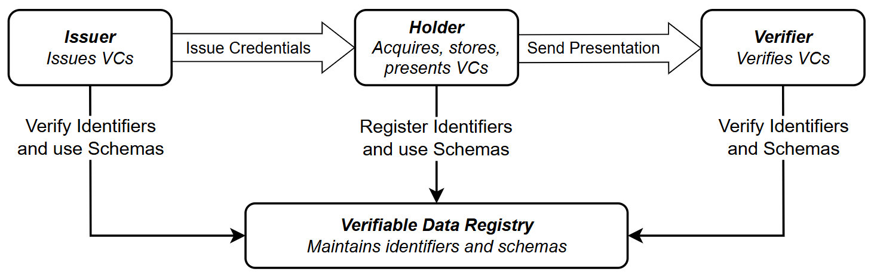
Roles and information flow in VCs
Data distributor
User
Federated Platform
https://www.w3.org/TR/vc-data-model-2.0/

Slide 10
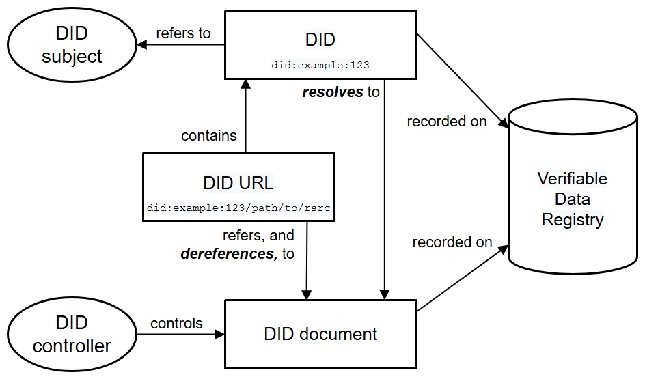

DIDs Architecture
https://www.w3.org/TR/did-1.0/
User
…
Payload
Server

Slide 11
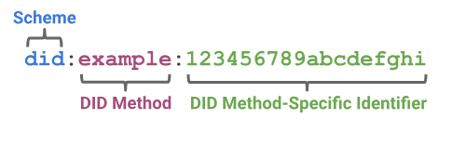
DID structure
Decentralized identifiers (DIDs) are a new type of identifier that enables verifiable, decentralized digital identity.
  https://www.w3.org/TR/did-1.0/

Slide 12
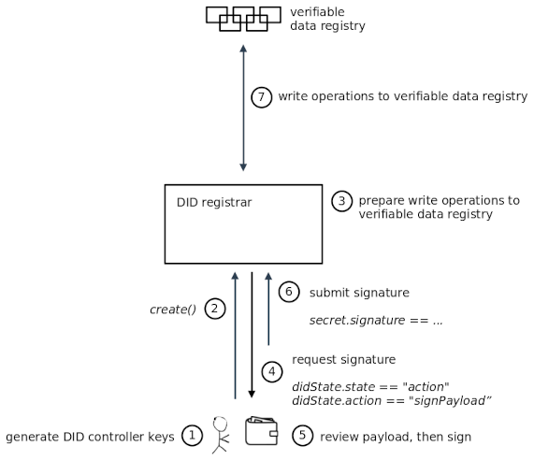
Key Management
Client-managed Secret Mode
https://identity.foundation/did-registration/#client-managed-secret-mode

Slide 13
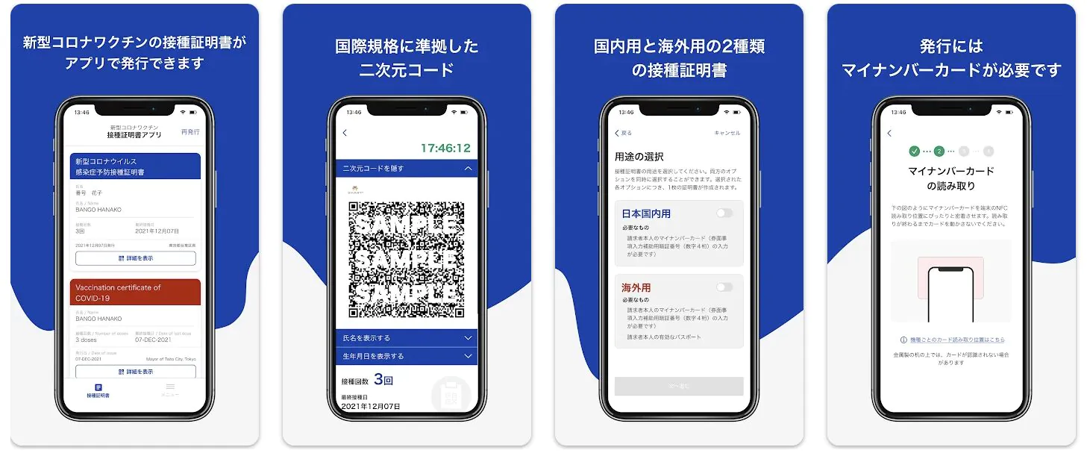
Use case: Covid-19 Vaccination
Digital Agency in Japan released an application for “Certificate of COVID-19 Vaccination” in 2021.
It is an implementation by using VCs, and it took standards “SMART Health Card(SHC)”.
SHC is developed by “Vaccination Credential Initiative(VCI), and it is discussed by Microsoft, Amazon Web Service, Oracle and so on.

Slide 14
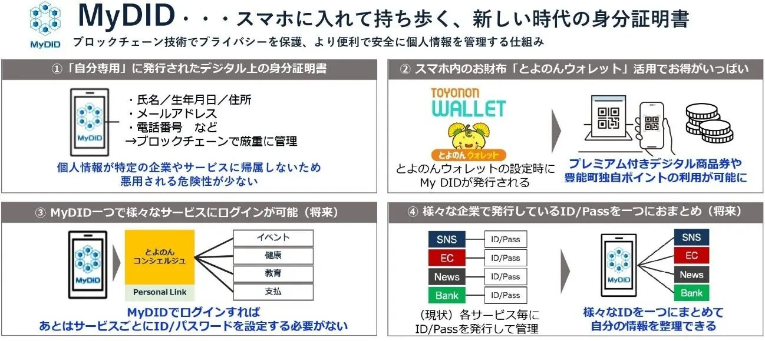
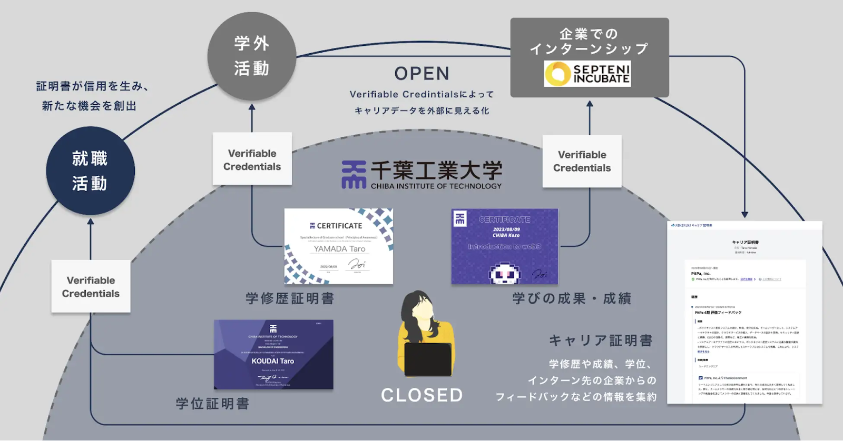
Other use case
https://digitalplatformer.co.jp/220607002/
https://www.it-chiba.ac.jp/media/pr230822.pdf
Implementation in some municipalities to provides local currency and services.
Implementation in some universities for school/course credits and service in Univ.

Slide 15
System architecture for SSI
Holder=User
App
Issure
2. Register VCs
Verifiable data registry
wallet
1. Issue VCs
3.Send VCs
4. Verify VCs
(Authentication)
Federated
Resource
6.Provide service.
5.Authorization
Verifier=Service
App
App

Slide 16
Pros. / Cons.
Pros.
  SSI can enhance privacy by blockchain and encryption.
  SSI will decrease fraudulent identity.
Cons.
  There aren’t common tool.
    Client is only accepted smart phone now.
    Client must use dedicated application.
  Need standardization for VCs.
    Or we need to translate VCs.
  Too much complexity for procedure.

Slide 17
Appendix

Slide 18
The 10 principles of the SSI (1/2)
Existence
  Users must have an independent existence, enabling them to maintain their identity in the digital world without reliance on third-party credentials.
Control
  Users must control their identities, managing their data as they see fit, even if it is provided by a third party like the DMV.
Access
  Users must be able to access their own data and any associated claims without interference, ensuring they can view any changes to their identity.
Transparency
  Systems must be transparent, allowing users to monitor how their data is managed and ensuring fairness and balance in identity systems.
Persistence
  Identities should be long-lived and under the user's discretion, even with changing data storage or multiple identifiers.

Slide 19
The 10 principles of the SSI (2/2)
Portability
  Identity-related information and services should be easily transferable and not controlled by a centralized entity, ensuring user control over where data is stored.
Interoperability
  Identities should be usable across various systems and internationally, supporting portability and global access.
Consent
  Users must agree to the use of their identity, with their data shared only with their consent.
Minimisation
  The disclosure of personal data should be minimized, only sharing the necessary information to protect privacy.
Protection
  Users’ rights must be respected, ensuring a balance between transparency, fairness, and protection, with decentralized systems to maintain security and compliance with regulations like GDPR.

