Slide 1
ESA/DLR - Across repository data discovery, access and management
Agenda Item 7.3
WGISS-59
24-28 March, 2025
Bangkok, Thailand

Slide 2


Objectives
Move forward the federation of (institutional) EO data repositories.
Develop a small demonstrator to discover, download, process, manage EO data across repositories.

Slide 3
Use Cases Definition
UC1: A user can access a client and discover (free and open) data from online repositories hosted by different organizations and can download a granule from a free and open data set.
UC2: A user can access a client and discover (restrained) data from online repositories hosted by different organizations and can ask for authorisation to download restrained data and can download a granule from a restrained data set.
UC3: A user can access a client and discover (free and open or restrained) data located in near-line/offline repositories (archived data) hosted by different organizations and can download a granule (deferred access).

Slide 4
Use Cases Definition
UC4: A data manager can access a client and obtain information about data hosted in online, near-line, and offline repositories of different organizations and decide whether to remove data in own repository or whether to copy data across from external repository.
UC5: A user can access a collaborative platform and discover, visualize, and process data hosted by different repositories (online, near-line, offline).
UC6: Any federated organisation interested in collecting metrics about requests originated from external organization.

Slide 5
Use Cases Definition
Use Cases | Description | Status
UC1.1 | A user can access a client and discover (free and open) data from online repositories hosted by different organizations and can download a granule from a free and open data set. ------ Consider Federation and Discovery | Ongoing
UC1.2 | A user can access a client and discover (free and open) data from online repositories hosted by different organizations and can download a granule from a free and open data set. ------ Consider Authorization | Ongoing
UC2 | A user can access a client and discover (restrained) data from online repositories hosted by different organizations and can ask for authorisation to download restrained data and can download a granule from a restrained data set. | Ongoing
UC3 | A user can access a client and discover (free and open or restrained) data located in near-line/offline repositories (archived data) hosted by different organizations and can download a granule (--> deferred access). | Not started
UC4.1 | A data manager can access a client and obtain information about data hosted in online, near-line, and offline repositories of different organizations and decide whether to remove data in own repository or whether to copy data across from external repository. ----- Consider the Near line and online repository | Not started
UC4.2 | A data manager can access a client and obtain information about data hosted in online, near-line, and offline repositories of different organizations and decide whether to remove data in own repository or whether to copy data across from external repository. ----- Consider the offline repository | Ongoing
UC5 | A user can access a collaborative platform and discover, visualize, and process data hosted by different repositories (online, near-line, offline). | Not started
UC6 | A mechanism to exchange statistics about usage of data by users of another organisation shall be defined, together with a harmonised identification of metrics from the different sources. | Not started

Slide 6
ESA/DLR Federation Project
UC 1
Roberto Alacevich - ESA
Mario Winkler – DLR
Federated Catalog

Slide 7

ESA-DLR Use-Case 1.1 – Logical Architecture
Note: on ESA side only one of the two catalogues will be a physical instance
ESA MM STAC GUI
Landsat 8-9
ESA Multi Mission STAC Catalogue
(FedEO)
ESA MO STAC GUI
SMOS
…
ESA Multi Organisation
STAC Catalogue
DLR MO STAC GUI
DLR MM STAC GUI
Landsat 8-9
DLR Multi Organisation
STAC Catalogue
Sentinel 2
DLR Multi Mission STAC Catalogue
(stac-fastapi-pgstac)
…
MM STAC Catalogs need to be accessible from external Network
Collections – Subset of data selected by ESA and DLR

Slide 8
ESA-DLR Use-Case 1.1 – Data
STAC items with download links pointing to data (or data assets) location
Temporal Coverage: acquisition between 01/01/2025 and 15/01/2025
Spatial Coverage: acquisition over Italy (roughly)
Some data and corresponding metadata already available in both ESA and DLR catalogues and data storage
  Landsat 8-9 OLI/TIRS Collection 2 Level-2 (note: the other catalogue’s collection will be considered as a new one, but the overlapping products should be recognised and not duplicated)
    Some products in both catalogues
    Some products just in ESA catalogue
    Some products just in DLR catalogue
Some data and corresponding metadata available only in DLR catalogue and data storage
  Sentinel-2 Collection 1 Level-2A
Some data and corresponding metadata available only in ESA catalogue and data storage
  SMOS L1 and L2 Science Data Collection Level-2

Slide 9
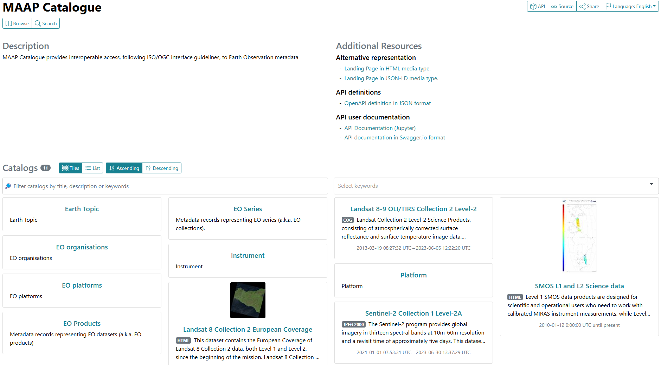
ESA-DLR Use-Case 1.1 – ESA Catalogue Instance
ESA Multi Mission/Organisation STAC Catalogue (dynamic catalogue), instantiated in Spacebel infrastructure
  To be populated with agreed metadata + data in S3 (data to be provided by ESA)
  No intention to whitelist DLR catalogue (restricted data will have authentication and authorisation check)
  Preliminary result available
  (some technical differences between
  catalogues still to be tackled)
https://radiantearth.github.io/stac-browser/#/external/maap.spacebel.be/catalogue/?.language=en

Slide 10
ESA-DLR Use-Case 1.1 – DLR Catalogue Instances
DLR Multi Mission STAC Catalogue
  Instantiated in DLR infrastructure
  Dynamic, searchable catalogue based on stac-fastapi-pgstac
  Populated with Sentinel-2 and Landsat 8-9 sample data
  Next: Restrict access (download) to authorized users to prepare UC1.2
DLR Multi Organisation STAC Catalogue
  Next: Instantiate catalogue and connect to ESA Multi Mission Catalogue

Slide 11
ESA/DLR Federation Project
UC 2 (UC 1.2)
Sofia Marzo - ESA
Mattia Stipa – ESA
Ulrich Raape - DLR
Federated Authentication & Authorization

Slide 12



Benefits of a Federation(1/2)
Simplified Authentication and Authorization: Federated Identity Management allows users to access and share resources across all trusted domains while simplifying the process of authentication and authorization. Users' credentials are stored only with their home organization, which acts as the Identity Provider. When a user logs into a service, the Service Provider trusts the Identity Provider to validate the credentials.
Single Sign-On (SSO): With SSO functionality, users can access multiple services within the same security domain using a single set of credentials. This reduces the need for multiple logins and enhances user convenience.
Improved Collaboration: Enabling federated access facilitates collaboration by allowing users from different organizations to access services without needing to create separate accounts. This user-centric approach simplifies inter-organizational access to resources.

Slide 13



Benefits of a Federation (2/2)
Enhanced User Experience: Users register only once with their home organization, and authentication is carried out by the user's home organization. All resources are available to the user with a single set of credentials, improving the overall user experience.
Efficient Resource Management: Federated access ensures that resources are managed efficiently, with clear responsibilities and acceptable usage policies. This includes complying with security protocols, reporting suspected security breaches, and acknowledging the source of the data.
Overall, a federation between ESA and DLR would streamline data access, enhance collaboration, and improve the user experience by providing a seamless and secure way to access shared resources.

Slide 14

Federated User Profile
Attributes:
  Username
  Email address
  First Name
  Last Name
  Organization/Institution
  Country of residence
attributes communicated between IdPs; local IdP user profiles might contain more attributes --> profile enrichment solutions can be applied

Slide 15
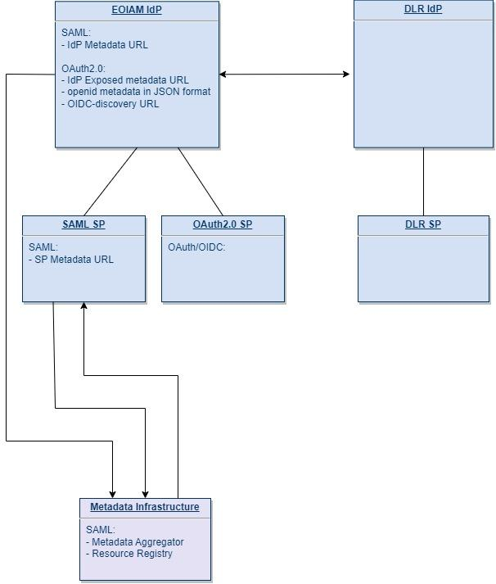
Federation High-level Architecture
For the demonstrator we are going to use
Virtual users
Open & free data sets
  Dummy license contract to simulate license-protected resources using open & free data sets
AuthZ will be attribute-based
AuthN will be based on the following access conditions
User / Service​ | EOC Service​ | ESA Service​
EOC user​ | EOC user accesses protected EOC resource and authenticates at EOC IdP​ | EOC user accesses protected ESA resource and authenticates at EOC IdP​
ESA user​ | ESA user accesses protected EOC resource and authenticates at ESA IdP​ | ESA user accesses protected ESA resource and authenticates at ESA IdP​
Access conditions (ABAC)
Registration
Acceptance of T&C
Country of Residence

Slide 16
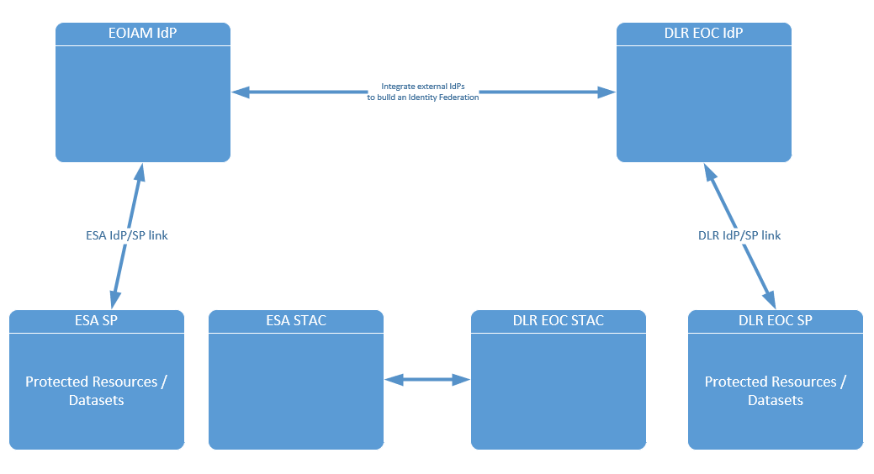
Status Overview
Login with DLR account:
configured
Login with ESA account:
configured
online
online
Interim dummy service
Interim dummy service
online
online
online
online

Slide 17
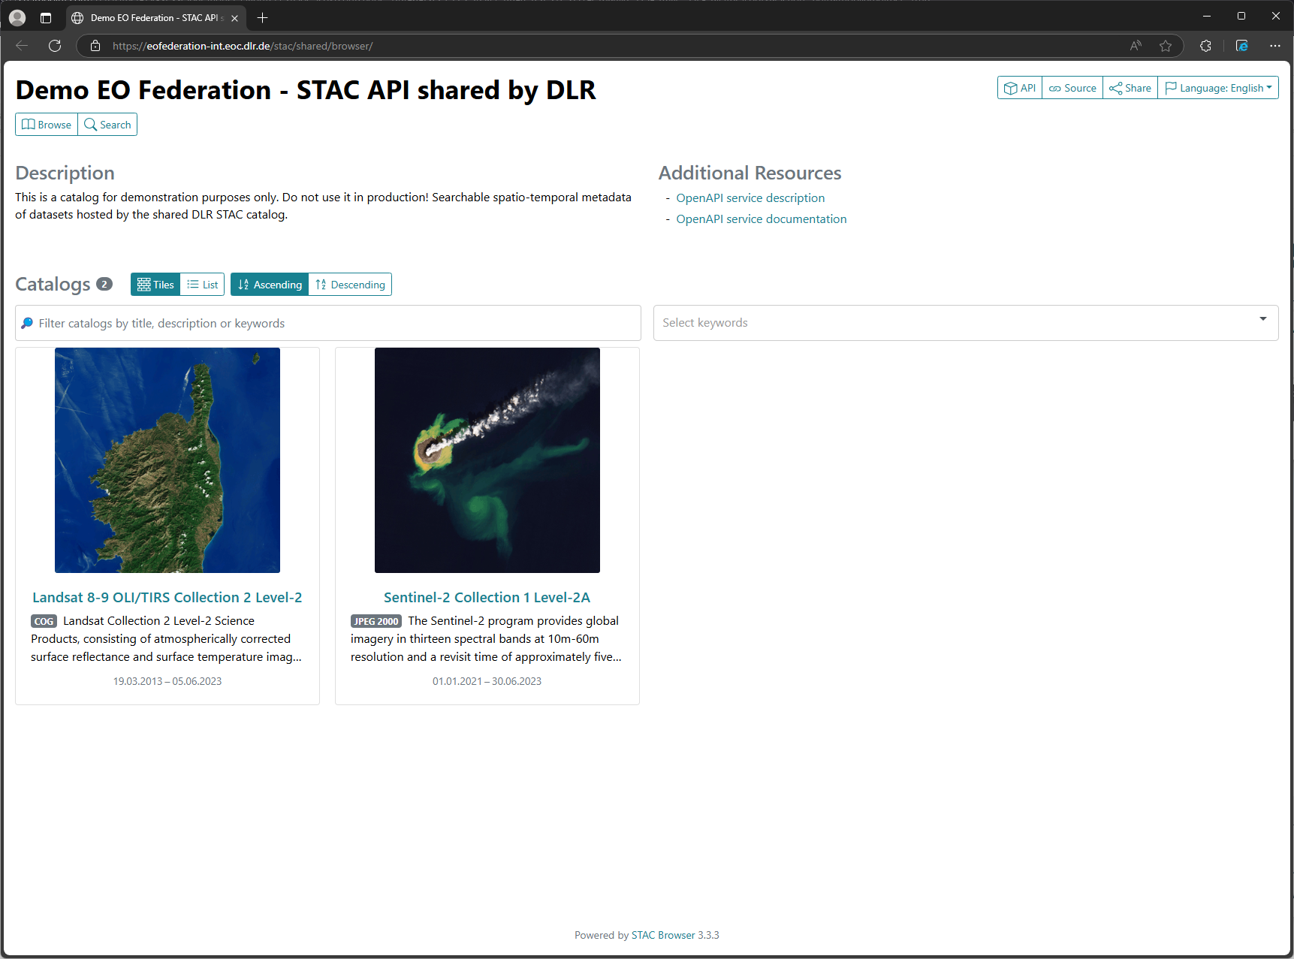
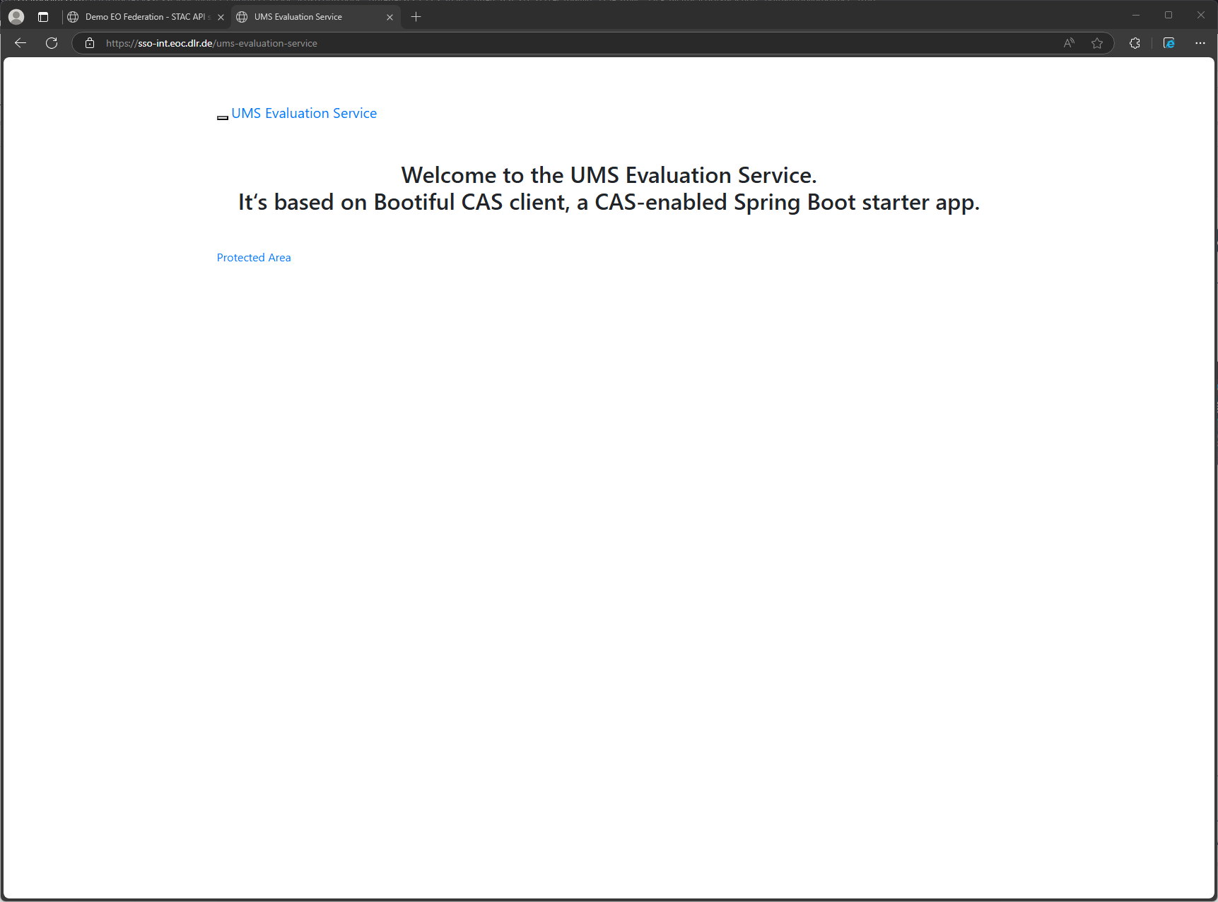
Status Starting from EOC service
Start with EOC Demonstrator Service
(to be connected to EOC UMS)
Dummy service until protected EOC service is online

Slide 18
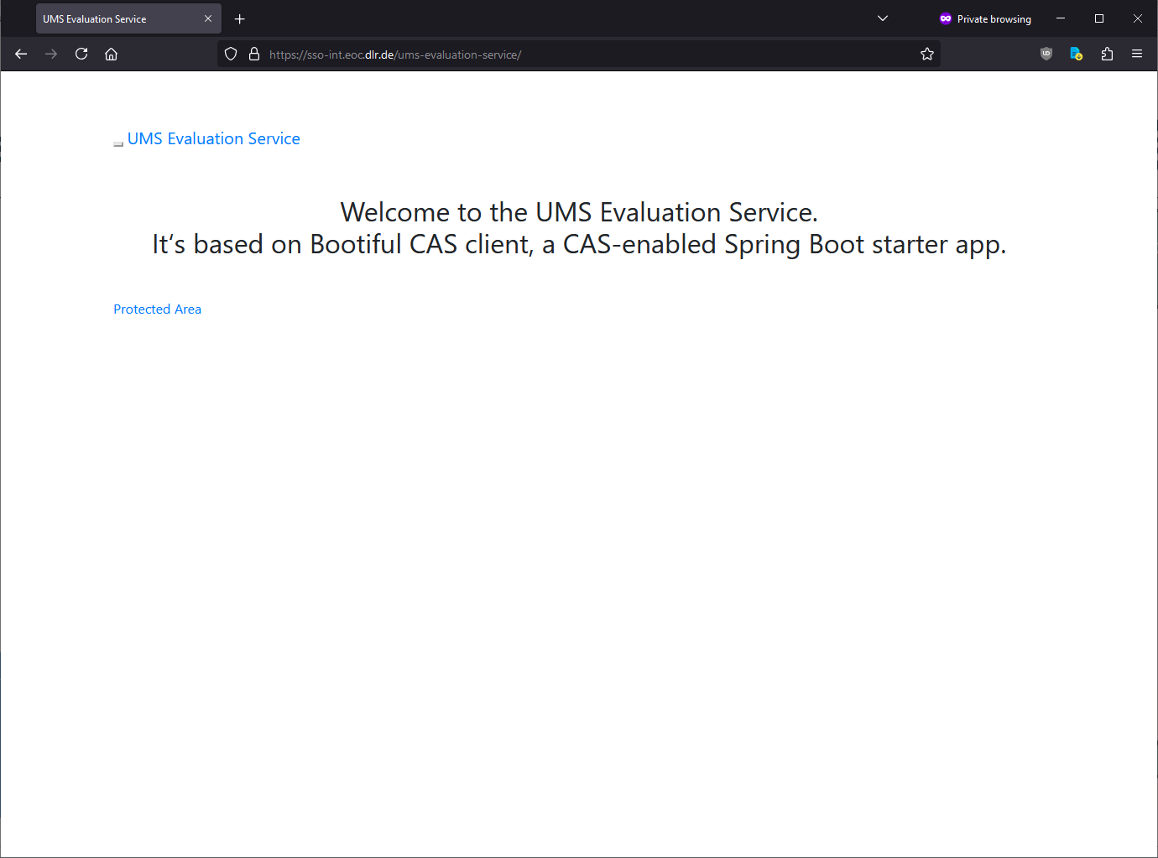
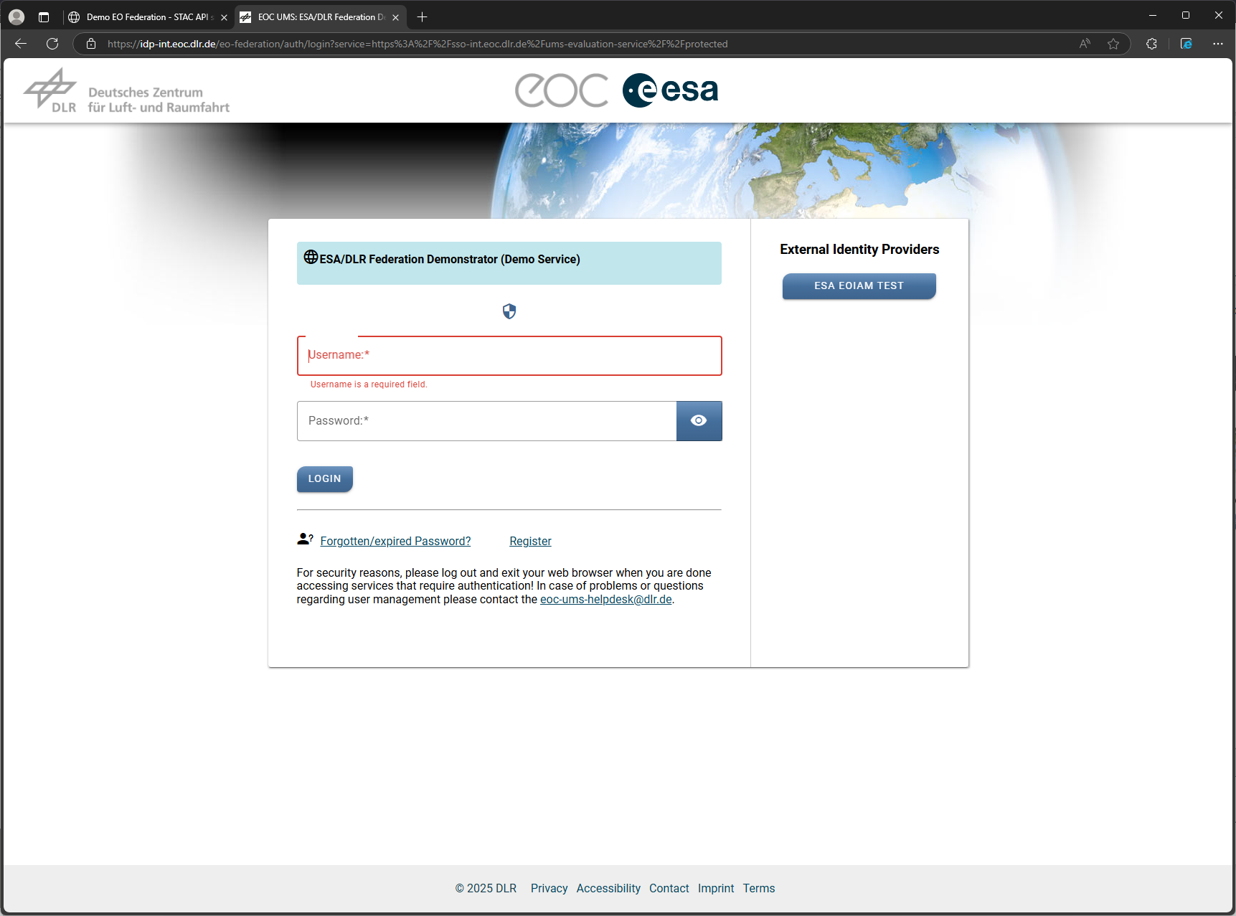
Status Starting from EOC service
Click on "External Identity Provider" jumps to ESA IdP
Click on "Protected Area" jumps to EOC IdP

Slide 19
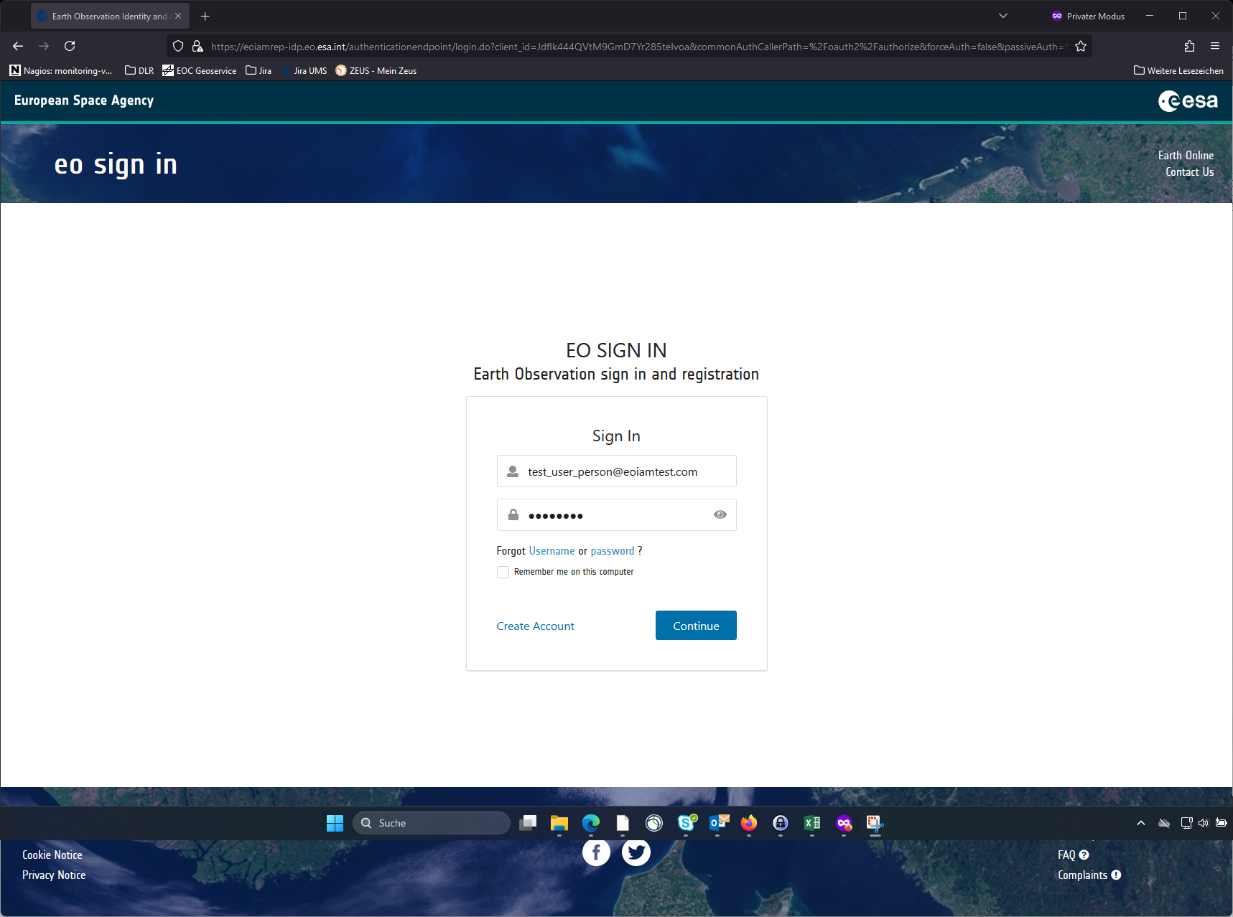
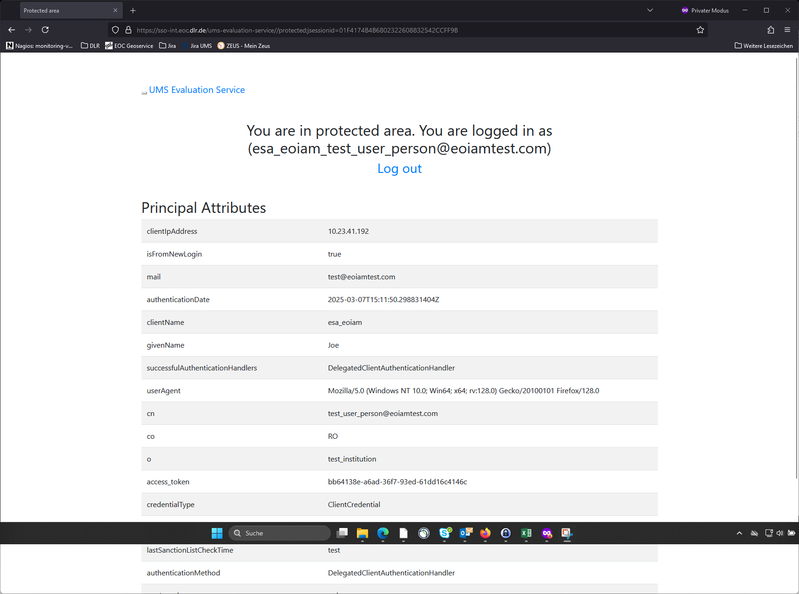
Status Starting from EOIAM
"Login with ESA account" on EOC IdP jumps to EO IAM Login
Login with
test_user_person@eoiamtest.com
EO IAM redirects back to EOC IdP
local session is generated
Dummy service shows session attributes

Slide 20
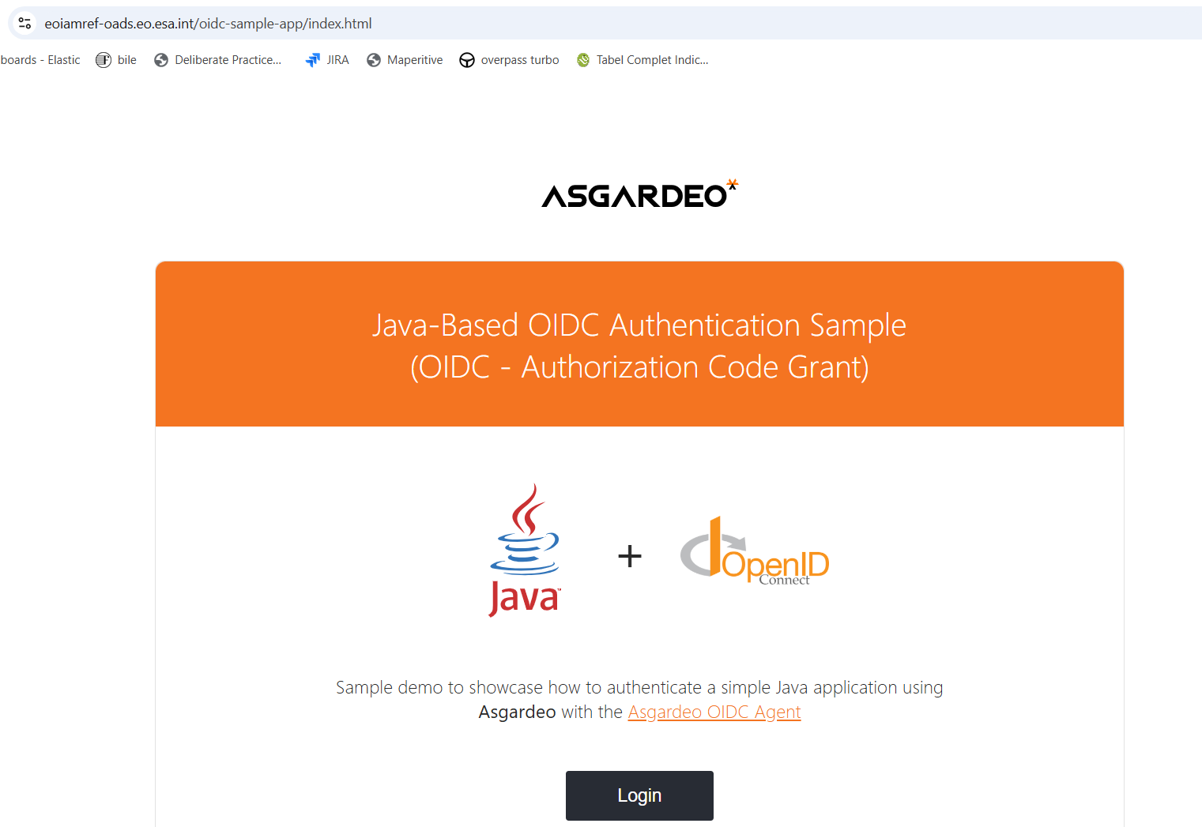
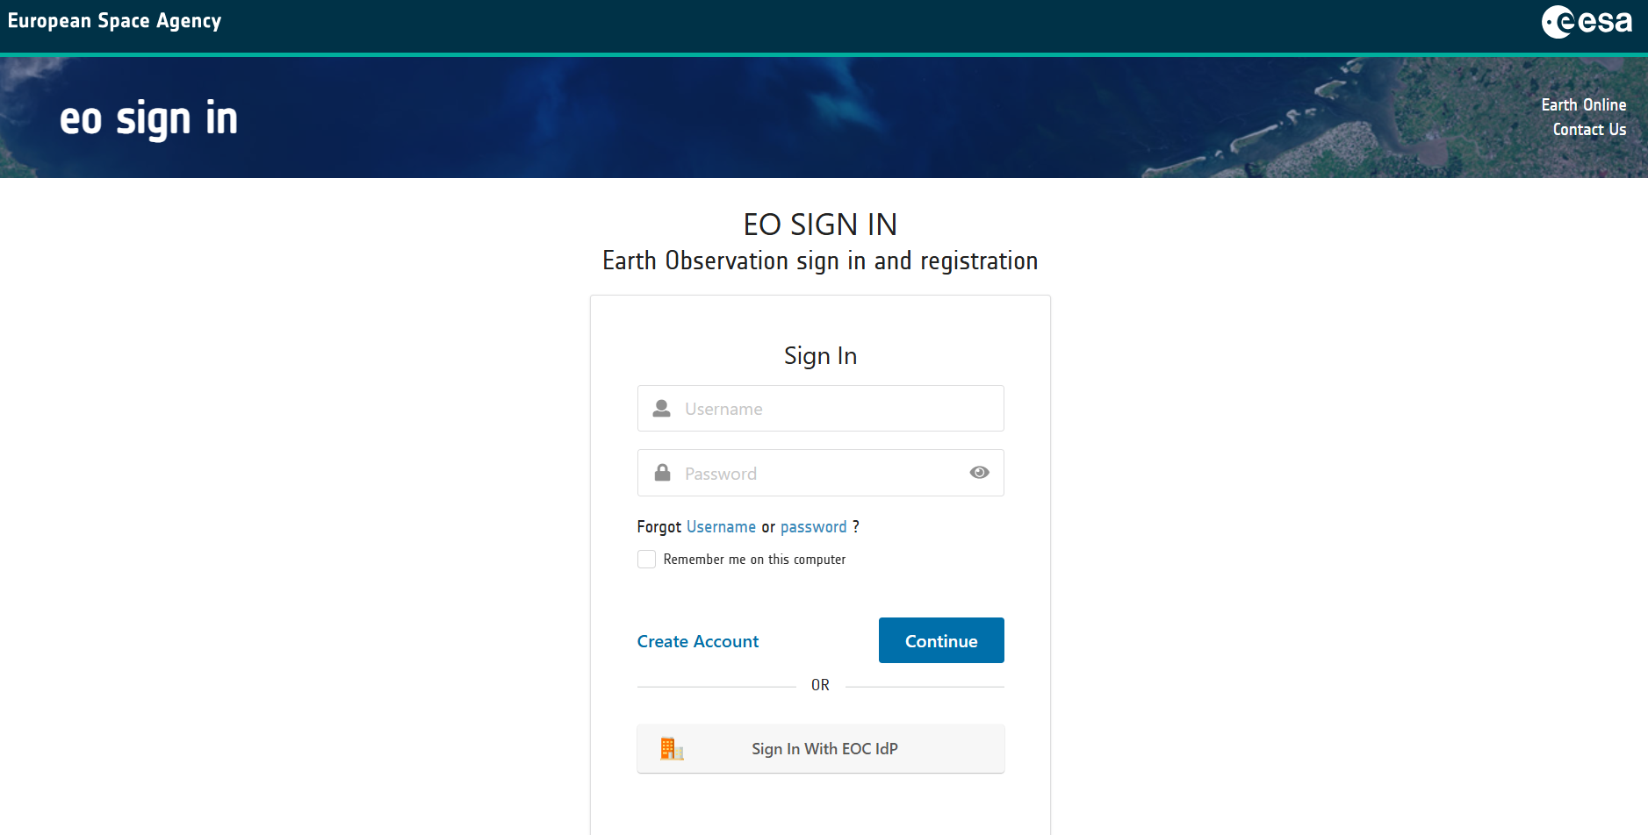
Status Starting from EOIAM service
Test service used for the beginning to access important data like tokens and federated user attributes
Click on "Login" redirects to EOIAM IdP
Click on "Sign in With EOC IdP" redirects to EOC IdP. The flow stops here.
(ongoing configuration)

Slide 21
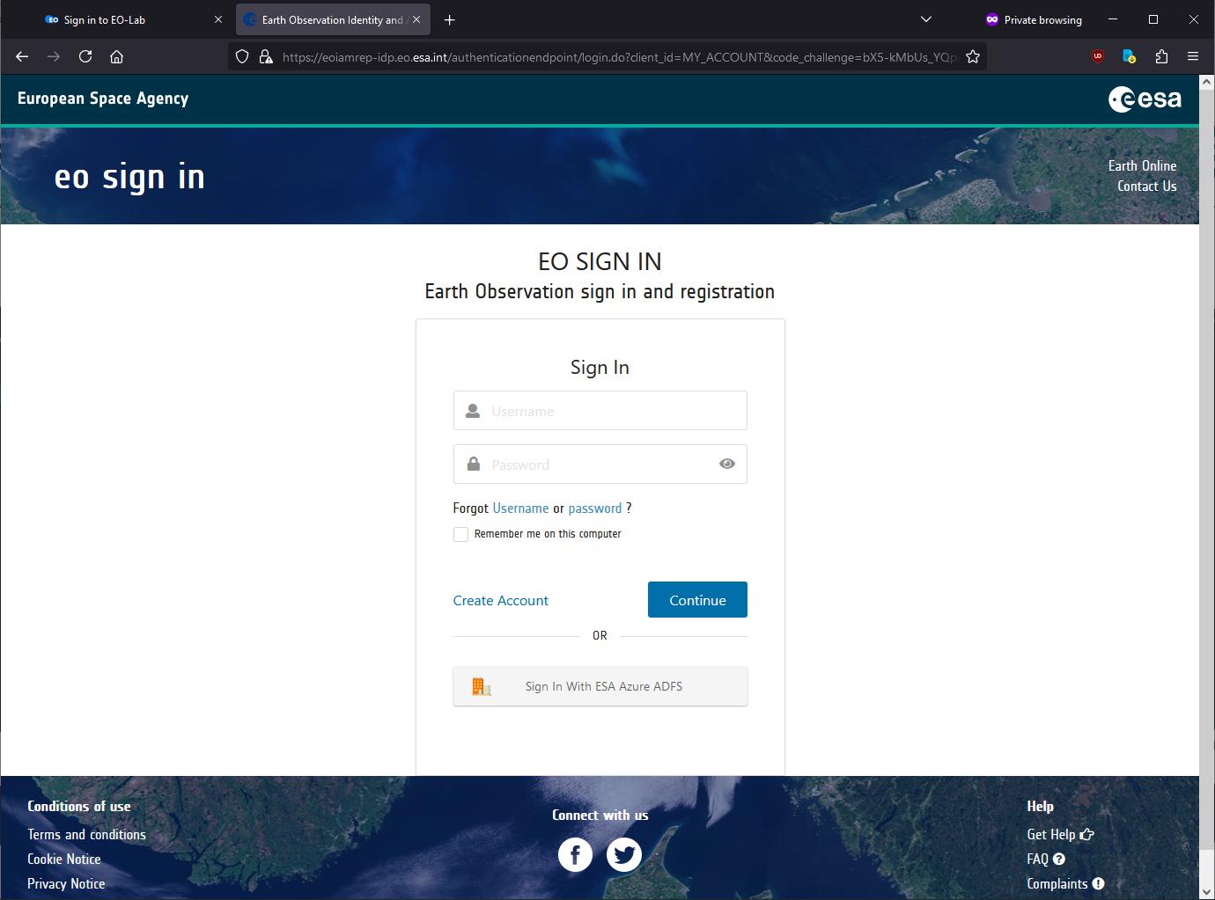
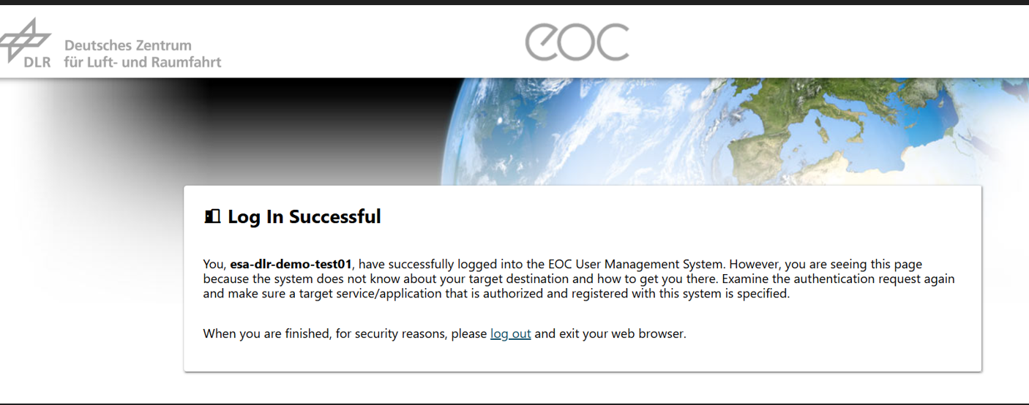
Status Starting from EOIAM service
From Terma network, browser perspective: "Login with EOC test account" on EOIAM IdP – only login from designated SPs will present the EOC Home organization button, see previous slide
From Terma network, browser perspective: the user can perform the direct login. This is just a basick check for underlying connectivity.

Slide 22
ESA/DLR Federation Project
UC 4.2
Iolanda Maggio – Starion for ESA
Mario Winkler – DLR
Offline repository

Slide 23
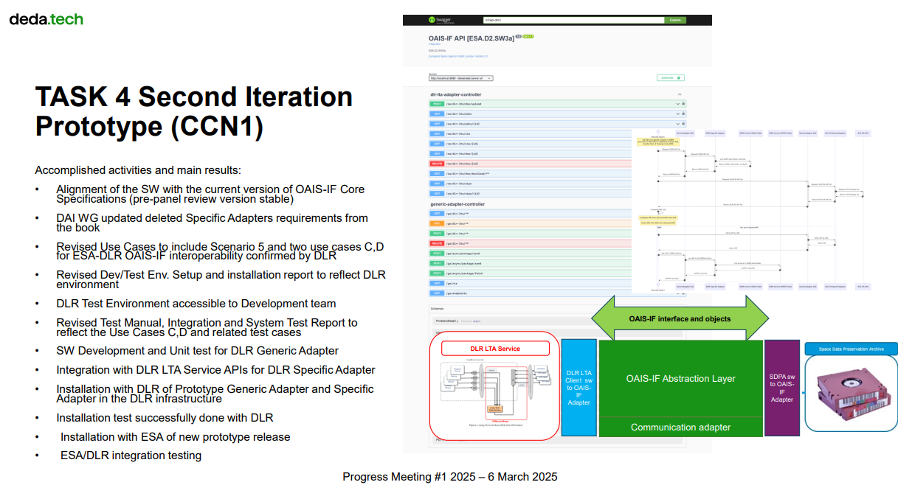
OAIS – Interoperability Framework
Dedicated Presentation on OAIS-IF

Slide 24
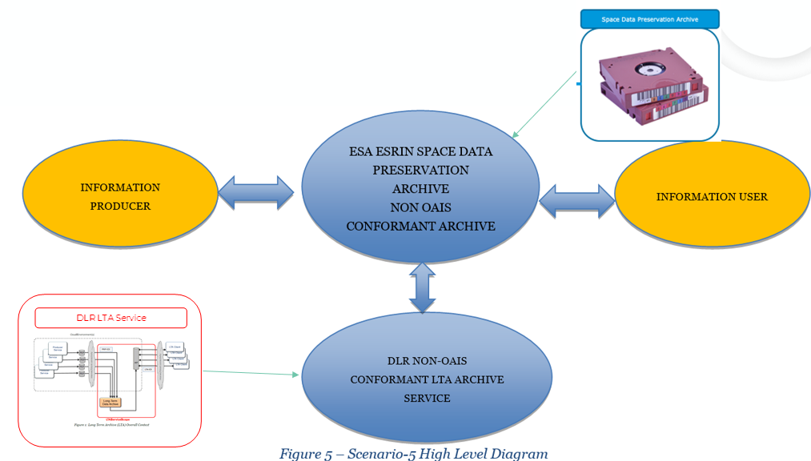
DLR-ESA Archives Interoperability Scenario
The Scenario is based on the interoperable exchange between the components of the ESA ESRIN EO Space Data Preservation System to automatise the interoperability between the EO Space Data Preservation Archive and DLR LTA Service. The actor involved is this scenario are part of the ESA LTDP and DLR technical team.

Slide 25
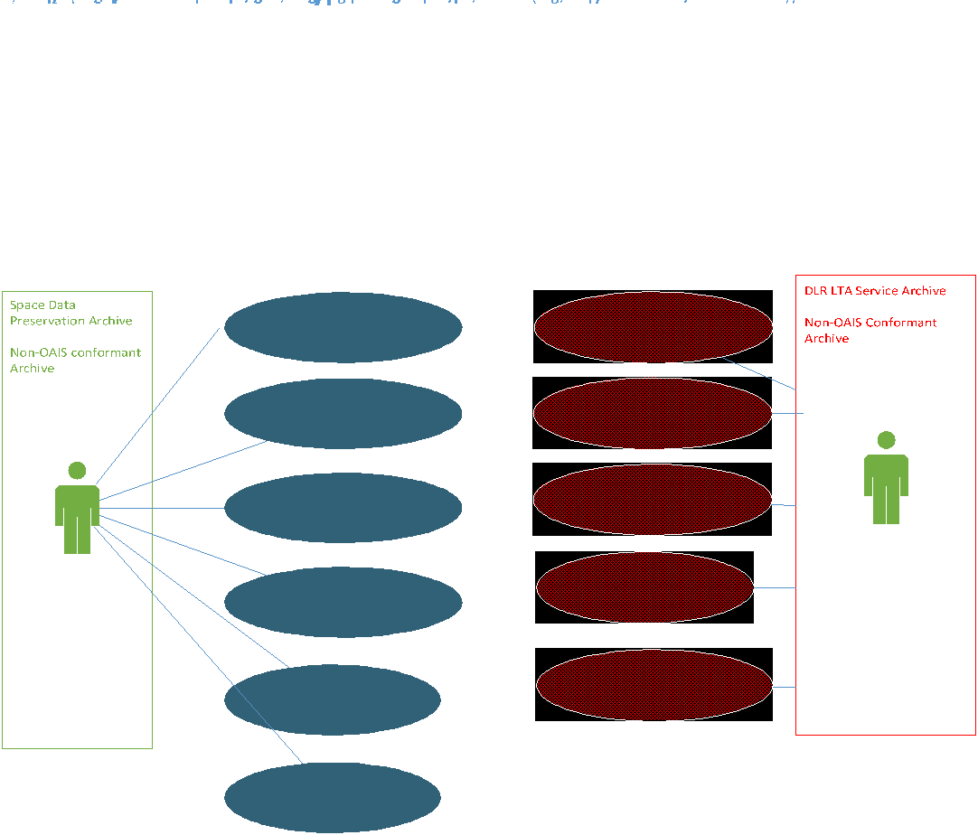
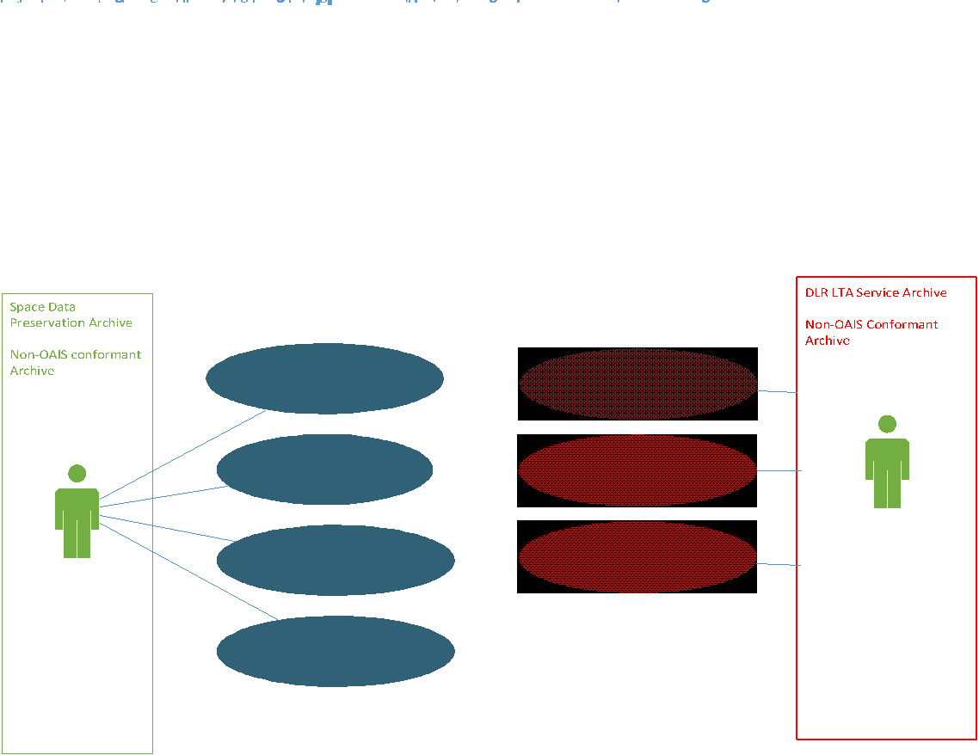
DLR-ESA Use Case C, D
Use Case for gap filling and data exchange
Use Case for content inventory verification
Two test successfully completed, and consequently no other sessions were planned by the ESA and DLR testers. ​

Slide 26
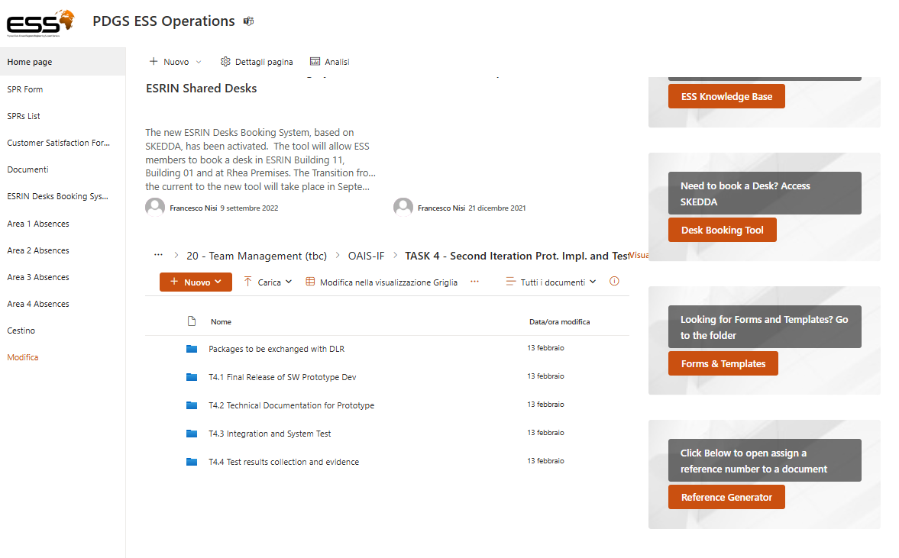
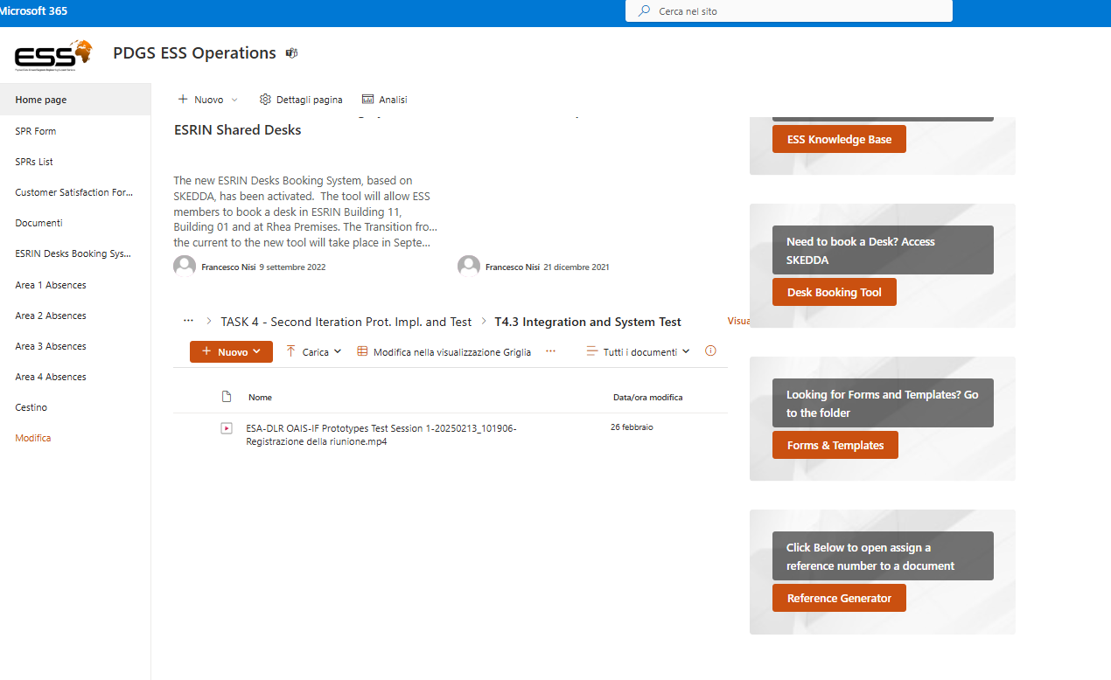
Repository available for consultation
TASK 4 - Second Iteration Prot. Impl. and Test

Slide 27
Outcomes
The source code for OAIS-IF Prototypes Adapter future availability as open in Github instead of availability in local ESA environment 🡪 Verification started on ESA Github availability for this scope
DLR underlined the importance of Use Case D for archives federations and proposed few enhancement in metadata filtering to better identify and decide the digital object or collections to be deleted in case of overlapping.
  In Use Case D, if deletion request is submitted, the archive could decide to really delete data or only metadata or to keep only metadata and use the identifier available in the OAIS-IF prototypes Adapter information model.
The received feedback are crucial for the OAIS-IF specifications review in progress in 2025 🡪 ESA shall share the query filters requirement from DLR to the CCSDS DAI WG in order to add query filters in the specifications.
DLR identified additional features to improve the Adapter prototype for usage in operations.

