Slide 1
WGISS-59
Federated AuthN and AuthZ Use Cases
S. Marzo(ESA)
S. Brose (ESA)
Agenda Item 7.2
WGISS-59
24-28 March, 2025
Bangkok, Thailand

Slide 2
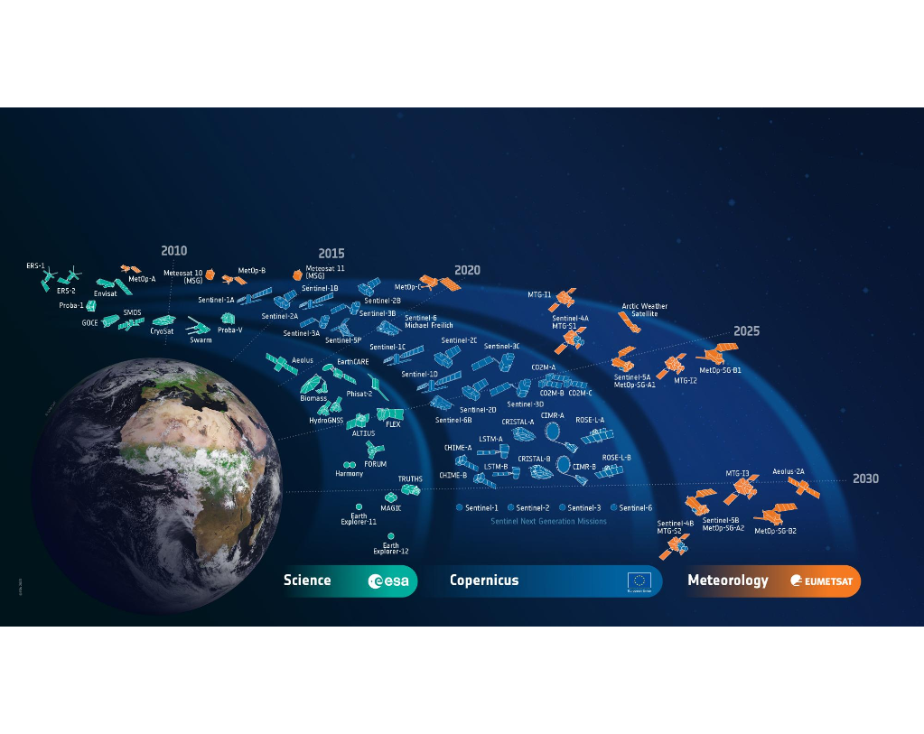
Problem Statement
Diverse Missions, Varied Access Needs
🡪 Complex authorization landscape
Decentralized & Fragmented Authorization
🡪 Centralized IAM
Expanding to a federated ecosystem
🡪 Interoperability with other Agencies and improved user experience
Notes:
Diverse Missions, Varied Access Needs – Multiple missions involve different user groups requesting access to various data collections, creating a complex authorization landscape.
Decentralized & Fragmented Authorization – The current process operates outside EO-IAM, relying on local, attribute-based decisions at the application level. A centralized approach within EO-IAM is needed to streamline and manage permissions effectively.
Expanding to a Federated Ecosystem – Beyond centralization, the growing need for interoperability with agencies like NASA, DLR, and Copernicus demands an authentication and authorization model that supports federation and cross-organization access.
(1) There are numerous missions identifying several types of users that ask to access different data collections. The authorization process is currently managed outside EO-IAM and it relies upon local actions performed by the applications on an attribute base (e.g. country of residence for open & free data access). Our goal is to centralize this process embedding it in EO-IAM functionalities and ideally managing it through permissions.
Lots of different users, different collections, etc.
(2) Solution of (1) was to implement EOIAM (2) In particular, we aim to give our users:
Authorization to access services (e.g., Jupyter notebook)
Authorization to use specific resources (e.g., a certain amount of VM, RAM and CPU)
Federation with other communities (we would like to evaluate the option of leveraging eduGAIN solution for example)
It is worth mentioning indeed that there exist data policies that grant users different rights, also depending on the accessed data.

Slide 3


Authentication
Authentication is the act of confirming the truth of an attribute of a single piece of data or entity (e.g. user of an application)
In the digital world we tend to simplify the confirmation by using a username and password.
Authentication works through passwords, one-time pins, biometric information, and other information provided or entered by the user
Who are you?

Slide 4
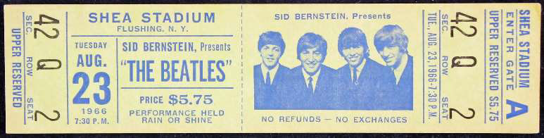
Authorization
Authorization is the function of specifying access rights to resources related to information security and computer security in general and to access control in particular.
More formally, to authorize is to define an access policy (could be also your concert ticket)
Authorization is often implemented with RBAC (Role Based Access Control), ABAC (Attribute Based Access Control) in which users are pooled in groups based on their role/attribute.
Authorization works through settings that are implemented and maintained by the organization.​
​
What are you allowed to do?
Notes:
RBAC = Role Based Access Control
ABAC = Attribute Based Access Control
Authentication works through passwords, one-time pins, biometric information, and other information provided or entered by the user. Authorization works through settings that are implemented and maintained by the organization.

Slide 5
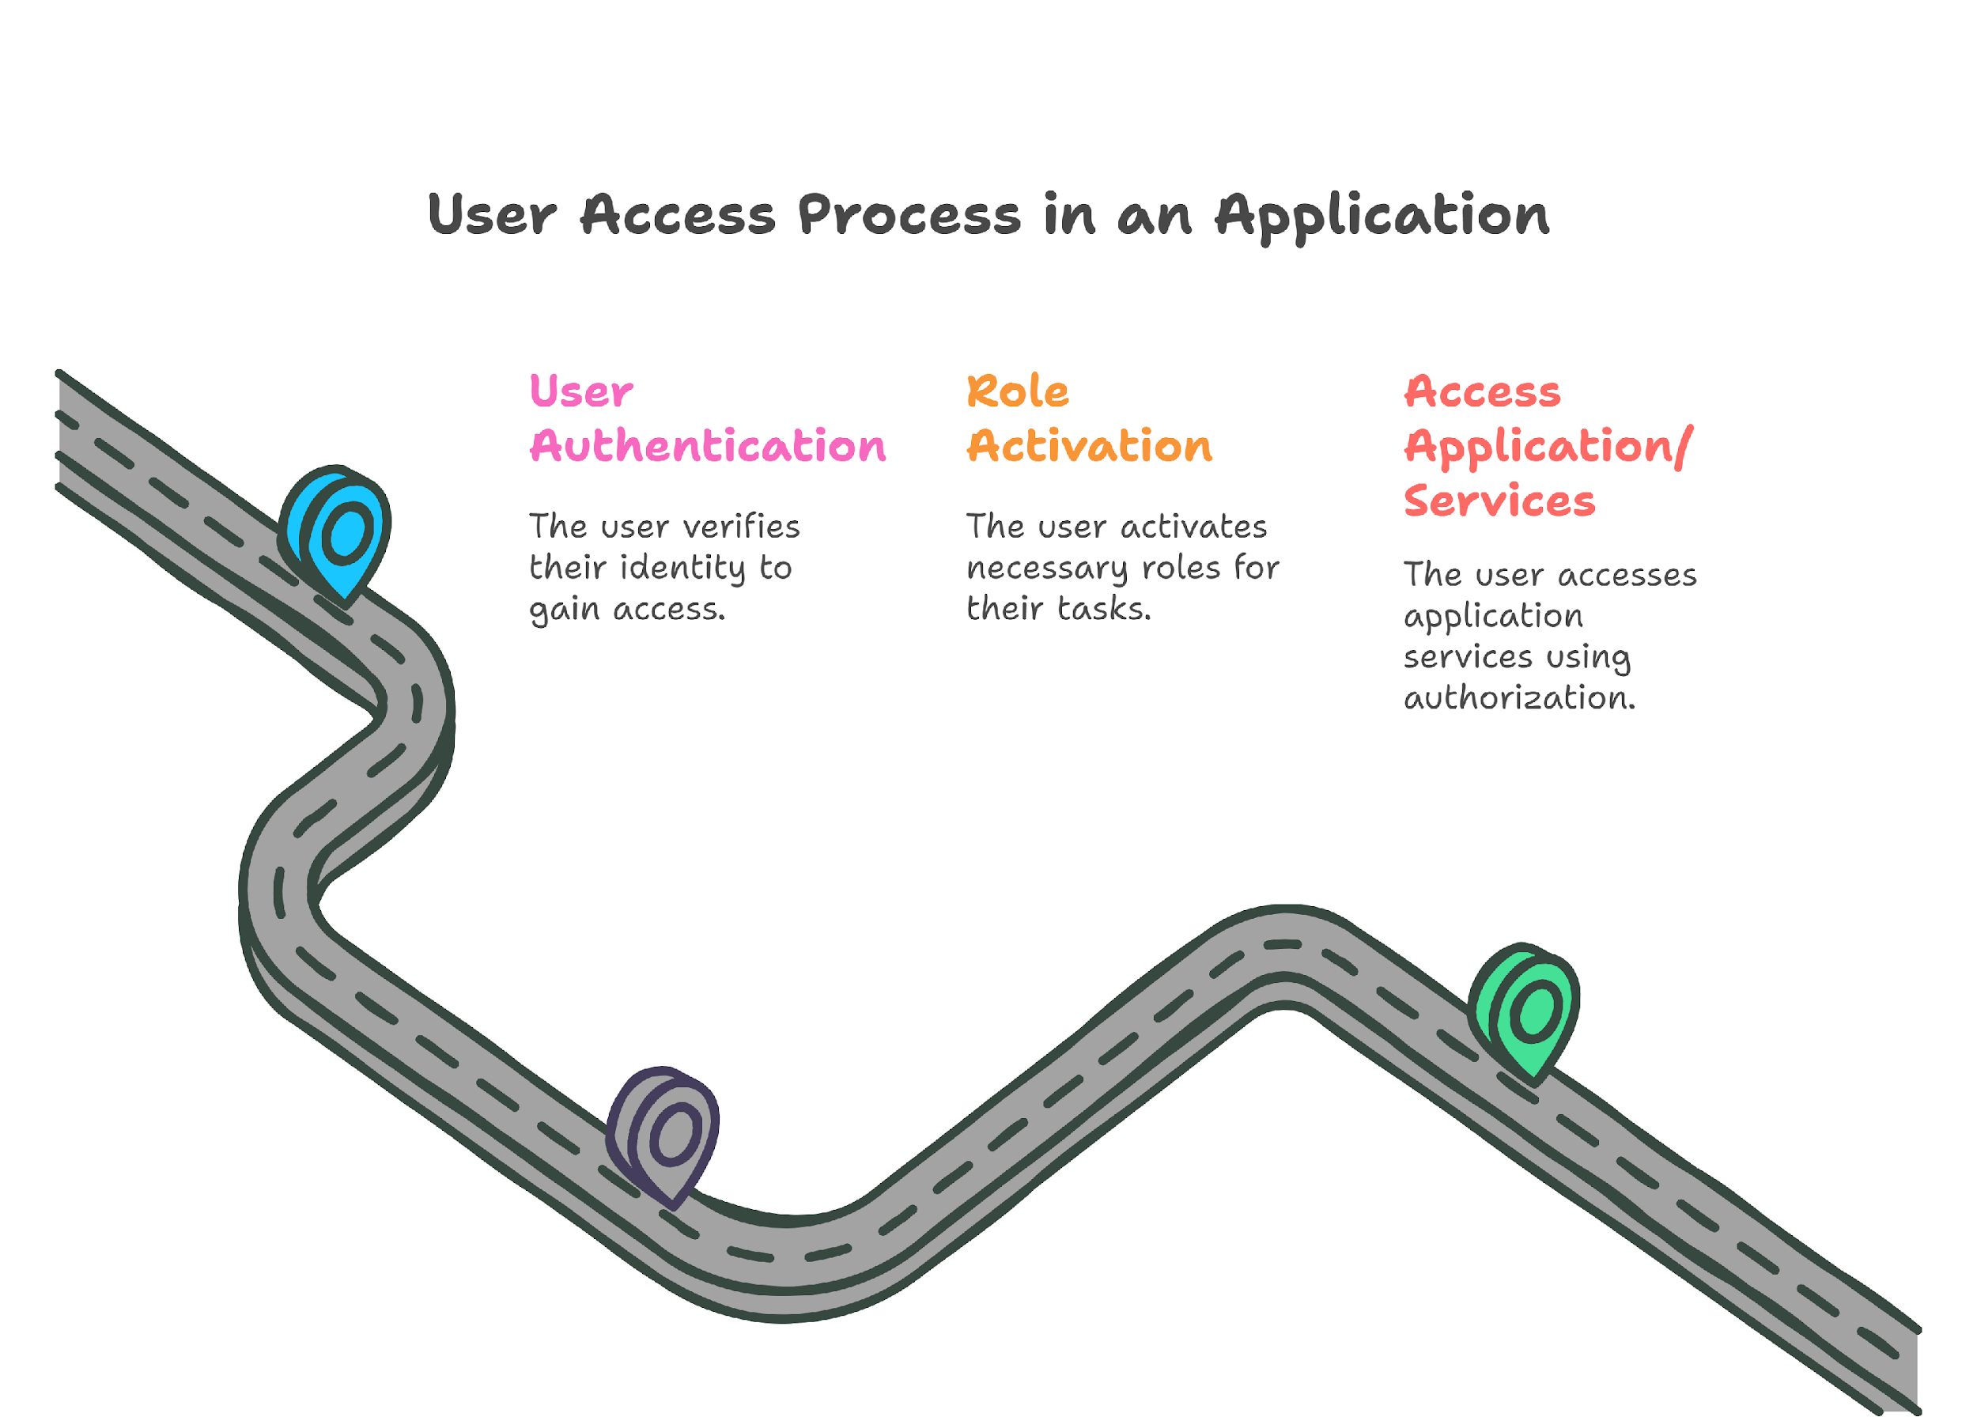
User Access Process

Slide 6

What is IAM?
User Management
IAM (Identity and Access Management) refers to the framework of policies, processes, and technologies used to manage digital identities and control access to resources within an organization.
IAM ensures that the right individuals and entities have the appropriate access to technology resources at the right times, for the right reasons.
IAM is crucial for:
  Enhancing security by preventing unauthorized access.
  Supporting compliance with regulations like GDPR.
  Improving user experience by enabling Single Sign-On (SSO) and streamlined access to resources.
AuthZ
AuthN
Access Control
Notes:
Authentication: Verifying an individual's or system's identity using credentials like passwords, biometrics, or multi-factor authentication (MFA).
Authorization: Granting permissions to access specific resources based on roles, policies, or attributes.
User Management: Managing digital identities, including creation, updates, and removal of user accounts.
Access Control: Applying policies to restrict or allow access based on predefined rules.

Slide 7


Identity and Service Providers (IdP & SP)
An identity provider (IdP) is a system entity that creates, maintains, and manages identity information while providing authentication services to applications. Web applications and other relying party applications delegate user authentication to a trusted IdP.
A service provider (SP) is a system entity that receives and accepts authentication assertions from the IdP.
Notes:
The IdP can also provide additional attributes and convey them to the service providers. Examples include user data (name, email...) or affiliation with the IdP's organization.
The SP acts as a gateway for front-end applications, handling authentication information and verifying it based on access rules.

Slide 8
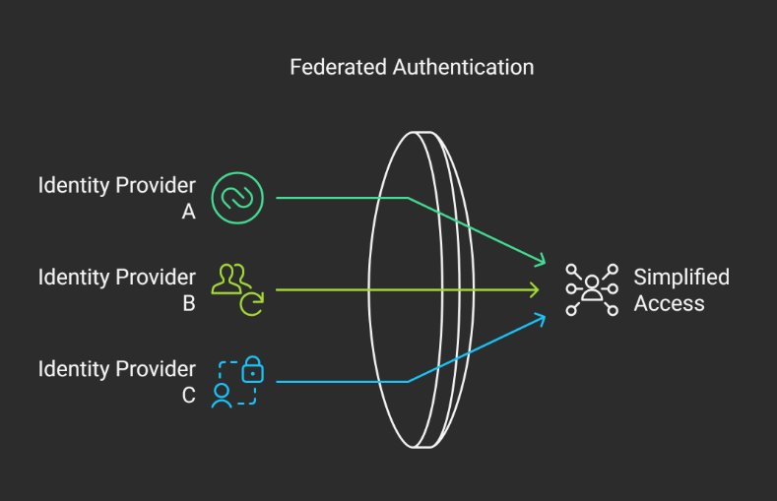
Identity Federation
An Identity federation is a group of Identity and Service Providers that sign up to an agreed set of policies for exchanging information about users and resources to enable access to and use of the resources. There are many research and education identity federations around the globe and they commonly have a national coverage. According to a federation agreement between the organizations belonging to the federation, each identity provider is expected to provide to the federated services a certain number of information about its users accessing such services
The objective of federated authentication is to simplify inter-organizational access to resources. With a SINGLE LOGIN, a researcher can access applications across multiple organizations.
Notes:
The rationale of this use case is about the possibility for a federated service to decide under which conditions its resources can be accessed by the users requesting such resources. Information for authorisation can be obtained by the service either from the user’s profile (the set of attributes that are released to identify his digital identity) or directly from the user (i.e. by requesting the user to provide such information when trying to access to the resource). The latter generally implies an overhead for the service in terms of effort required for managing user data. This overhead also includes the additional responsibility on the data provided by the user that is linked to the privacy regulations on personal data protection that usually apply to any federation (i.e. the European General Data Protection Regulation - GDPR).

Slide 9
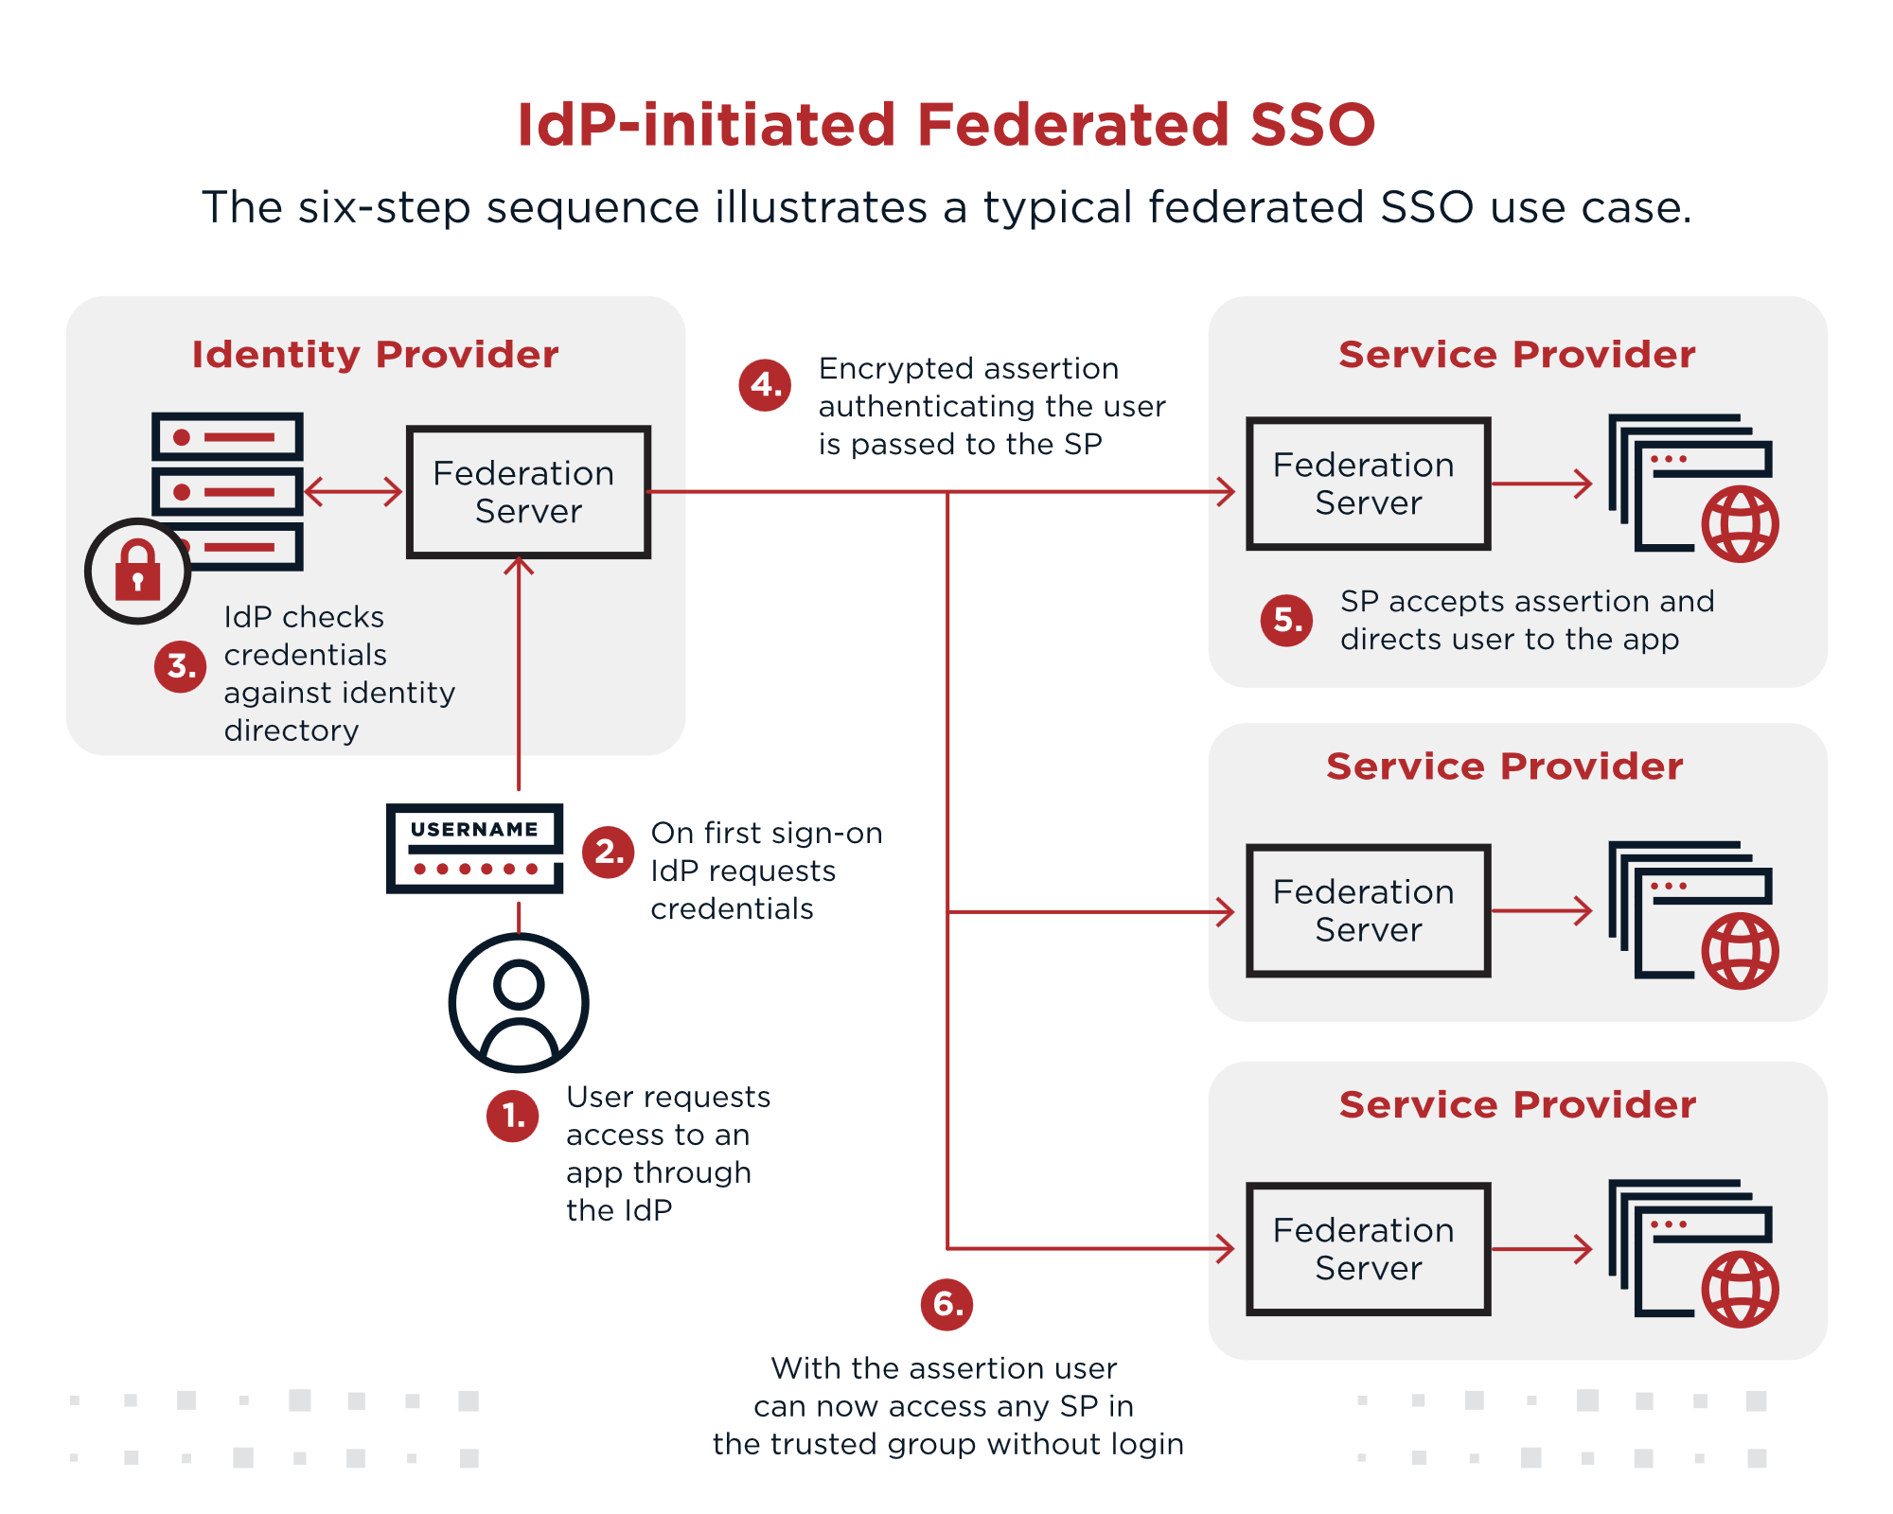
How does federation work?
Identity federation is used by enterprises to provide access to:
Users from supplier and partner networks
New users outside the traditional organizations, e.g., after mergers and acquisitions
Users who own a public organization ID (such as ORCID ID)
Social logins such as Facebook, Google, LinkedIn, or Apple
Notes:
What is federated Identity? How it works and its importance to enterprise security | CSO Online
What is a Federation?
A federation is essentially a trust network composed of organizations that agree to use common rules and standards for identity management and secure access. In the context of eduGAIN, these organizations can be universities, research centers, or online service providers (like scientific journals, research tools, or e-learning platforms).
There are several federated identity workflows, but a common setup is for one organization to serve as the IdP using an identity and access management (IAM) platform, where a user’s identity information is stored. The IdP establishes a trusted relationship with service providers (SPs), which are outside the security domain of the original organization.
For example, an employee’s organization might be the IdP, and the third-party apps they use to do business are SPs. The diagram below illustrates the six-step sequence for this use case.
1. The employee requests access to an app through their organization (the IdP).
The IdP requests the employee’s credentials.
The IdP authenticates the employee’s identity using stored data created when the user set up their account or joined the organization.
When the authenticated employee tries to access one of the third-party apps, the SP sends a request to the IdP.
The IdP indicates that the user has been authenticated and has permission to access that service, usually through a SAML 2 assertion or other protocol.
The employee proceeds without needing to sign in again.

Slide 10
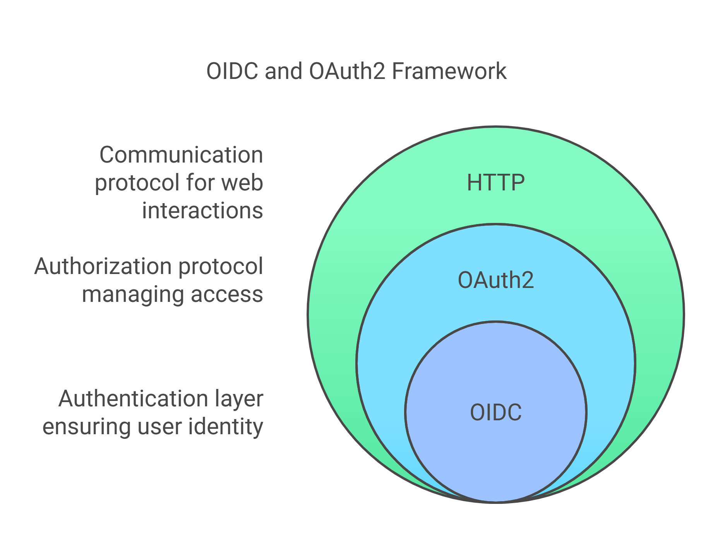
AuthN & AuthZ Main Protocols
OpenID Connect (OIDC) is for authentication
OAuth 2.0 is for authorization
Notes:
OAuth 2.0
This protocol makes use of a token-based authorization. OAuth 2.0 can give users restricted access to resources and apps without revealing the authorization credentials. This protocol can eliminate the process of creating an account to access OAuth-enabled apps and tools.
OAuth differs from the other protocols in such a way that it is much more of an authorization protocol than an authentication protocol. The difference is authentication simply verifies a user but authorization verifies what all tools, apps, and resources a user can access.
OpenID Connect
OpenID Connect is more of an extension to OAuth 2.0 and it allows organizations to verify users using an authorization server. Although the OpenID connect uses an authorization server it mainly deals with the authentication of the user rather than the authorization.
Even though OpenID can perform most of the functions of OAuth 2.0, it is a bit different from it. OpenID connect is more API-friendly, so it can be used for web-based tools as well as apps. Also, OpenID provides more secure encryption to the authentication token.

Slide 11
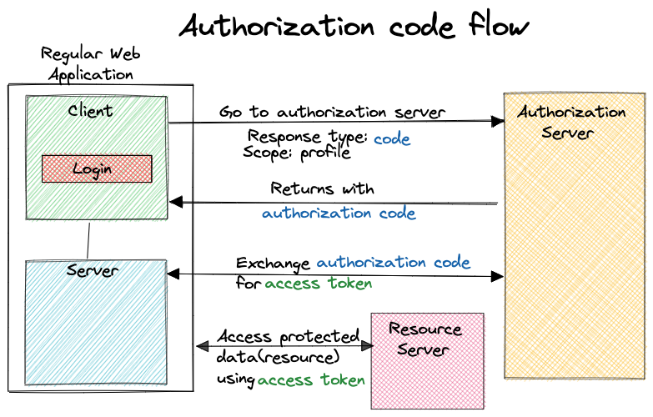
OAuth2 Authorization Code Flow
OAuth2 drawbacks:
No standard way to get the user's information
Every implementation is a little different
No common set of scopes
Notes:
Scopes in OpenID Connect define what information an application can request about a user from the Identity Provider (IdP). They determine the level of access to the user's profile data.
OAuth 2.0 and OpenID Connect Explained: Building Secure Authentication Systems - DEV Community

Slide 12
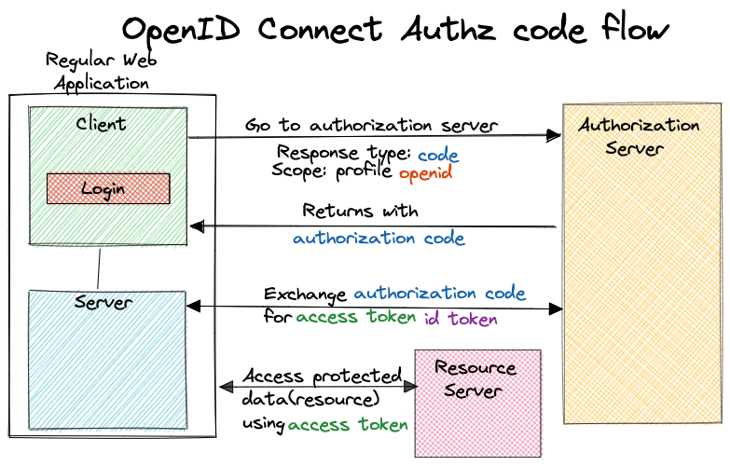
OIDC Authorization Code Flow
Why use OIDC?
ID token
UserInfo endpoint for getting more user information
Standard set of scopes
Standardized implementation
Notes:
Scopes in OpenID Connect define what information an application can request about a user from the Identity Provider (IdP). They determine the level of access to the user's profile data.

Slide 13
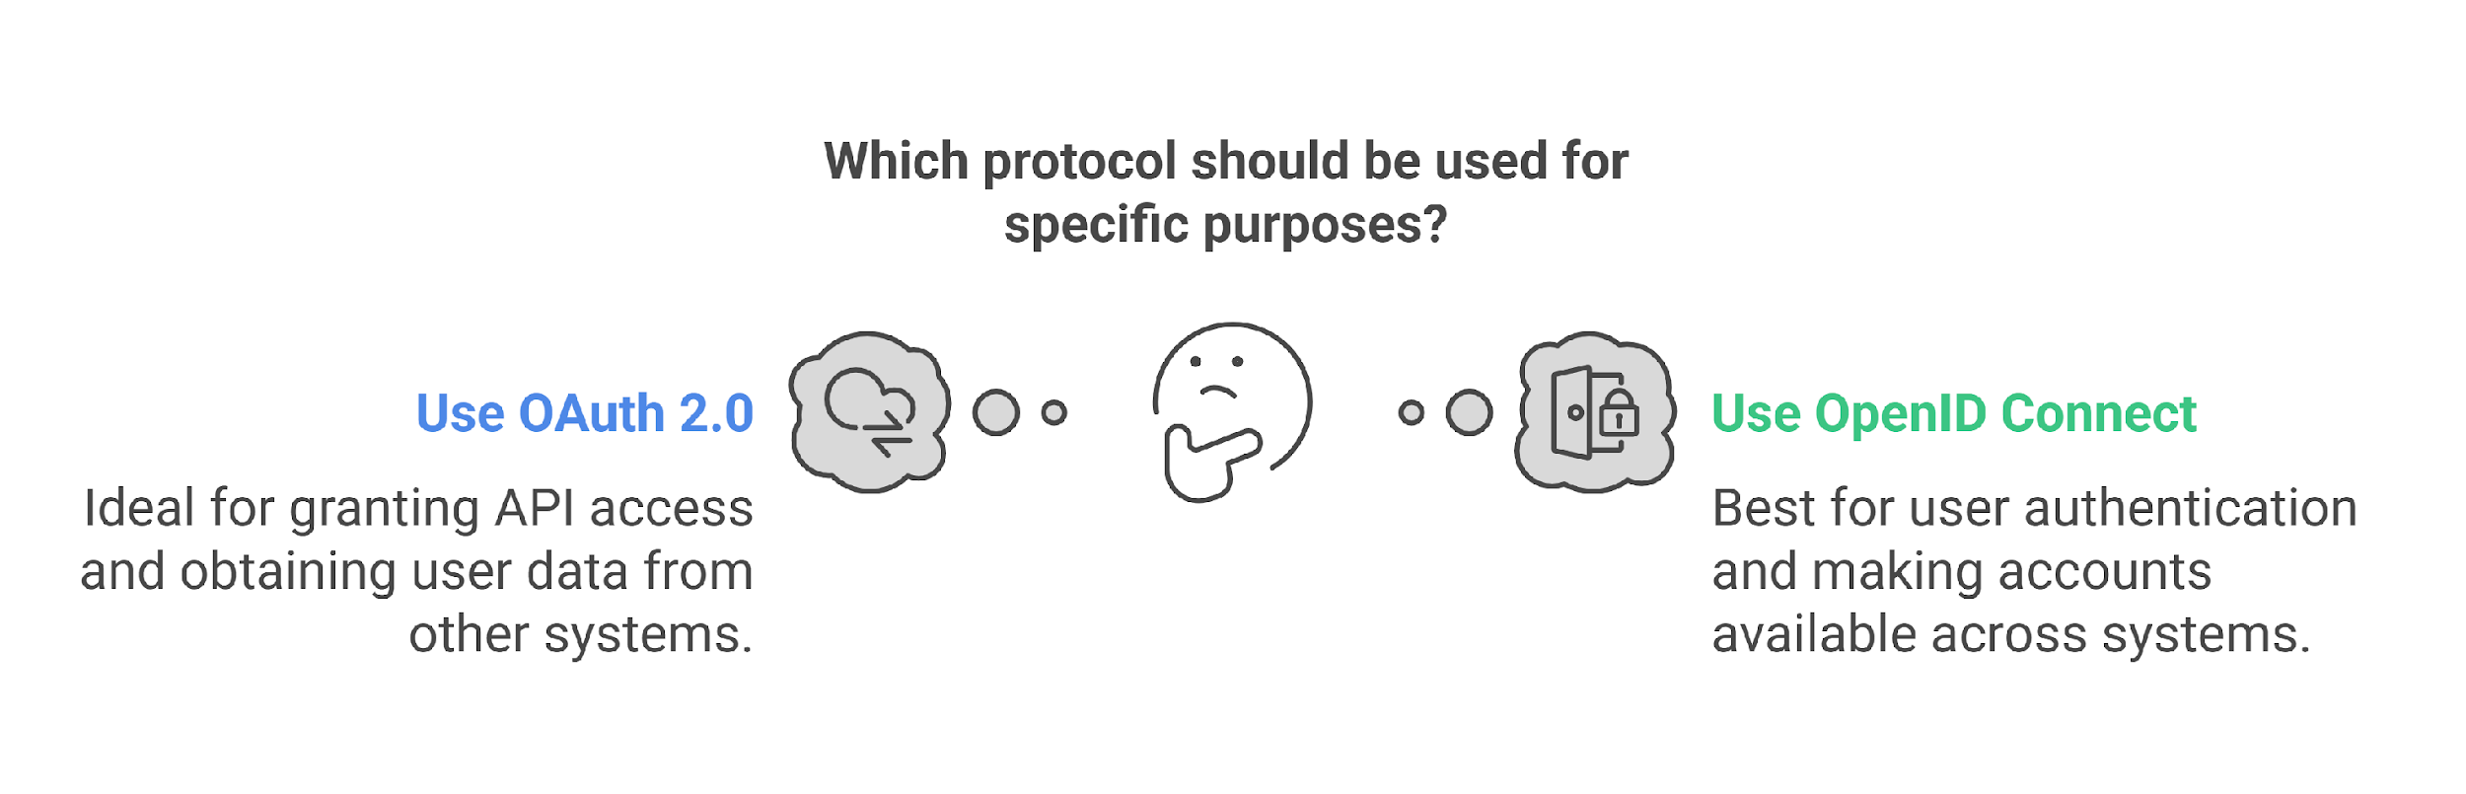
OAuth + OIDC in a Nutshell
Why Not Just OAuth?
OAuth alone does NOT authenticate users—it only grants access to APIs.
OIDC ensures the app knows who the user is, preventing security risks like impersonation.
✅ By combining OAuth 2.0 and OIDC, apps get both authentication and authorization in a single, secure flow.

Slide 14
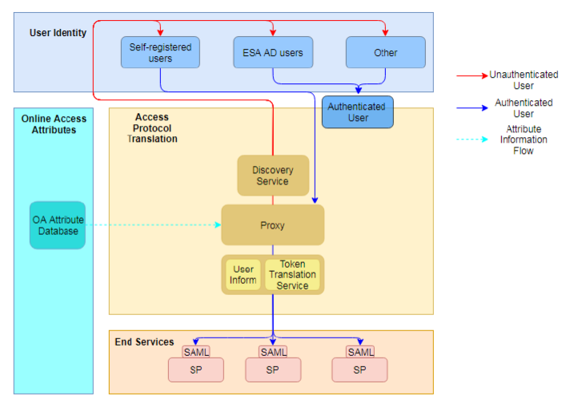
<ESA Use case> EO-IAM System Design Overview (1/2)
The EOIAM system is an IAM system intended to provide authentication functionalities to ESA’s SPs along with user management capabilities. The system is based on the open-source product WSO2 IS v5.9.0 and the architecture is inspired by the AARC BP arch [1].
AuthZ
The EOIAM system is designed to fulfil the desired functions:
Authentication and authorization functions
User management functions such as provisioning and deprovisioning of users, user management.

Slide 15
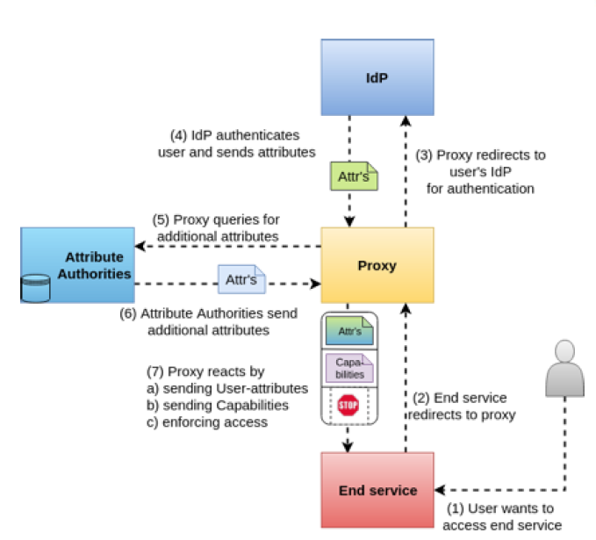
Authorization Models (1/2)
a) Centralised Policy Information Point
In this model, the proxy aggregates the information and makes it available to the end services so they can make the authorisation decision.
Notes:
Source: Deliverable DJRA1.4: Evolution of the AARC Blueprint Architecture
The AARC BPA champions a proxy architecture in which services in a research collaboration can connect to a single point, the SP-IdP-Proxy (hereafter termed “proxy”), which itself takes the responsibility for providing the connection to the identity federations in eduGAIN, thus reducing the need for each service having to separately connect to an identity federation/eduGAIN.
Identity Federations (eduGAIN):
eduGAIN is a global federation connecting various national and regional academic identity federations. It allows institutions, organizations, and researchers to authenticate and access services across different federations with a single set of credentials.
SP (Service Provider) & IdP (Identity Provider):
SP is the service or application (e.g., research tools, databases) that a user wants to access.
IdP is the organization or institution (e.g., university) responsible for authenticating the user.
Proxy (SP-IdP-Proxy):
The proxy acts as an intermediary between services (SPs) and identity providers (IdPs). Instead of each service needing to connect individually to multiple identity providers or federations, the proxy handles that connection centrally.

Slide 16
Authorization Models (2/2)
This is the selected authorization model that will be implemented in EOIAM:
b) Centralised Policy Management & Decision Making
The proxy makes the authorisation decision and conveys it to end services for enforcement.
Notes:
Source: Deliverable DJRA1.4: Evolution of the AARC Blueprint Architecture & AARC Best practices for managing authorisation
SP-IdP-Proxy (proxy), which serves as a single integration point between the Identity Providers from the User Identity Layer and the Service Providers in the End Services Layer. Thus, the proxy acts as an SP towards the Identity Federations for which this proxy looks like any other SP, while towards the internal SPs it acts as an IdP.

Slide 17
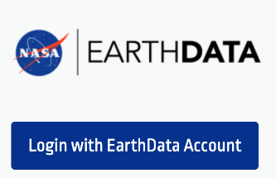



[ASCEND] ESA-NASA MAAP: Project
Data and computing in ESA MAAP
Data and computing in NASA MAAP
=> Joint access to data and algorithms using your home organisation’s IdP. ESA and NASA users can access each other’s MAAP without explicitly creating an EO-IAM (ESA) or EarthDATA login (NASA) both from within their MAAPS and prior to entering the MAAP.
Notes:
ESA and NASA users can access each other’s MAAP without explicitly creating an EO-IAM (ESA) or EarthDATA login (NASA) both from within their MAAPS and prior to entering the MAAP.

Slide 18
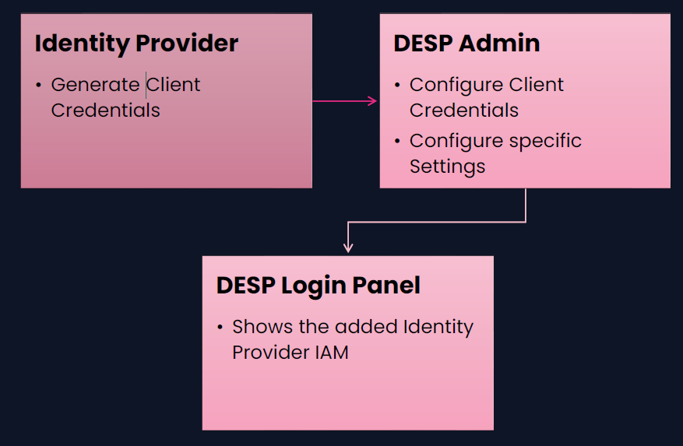
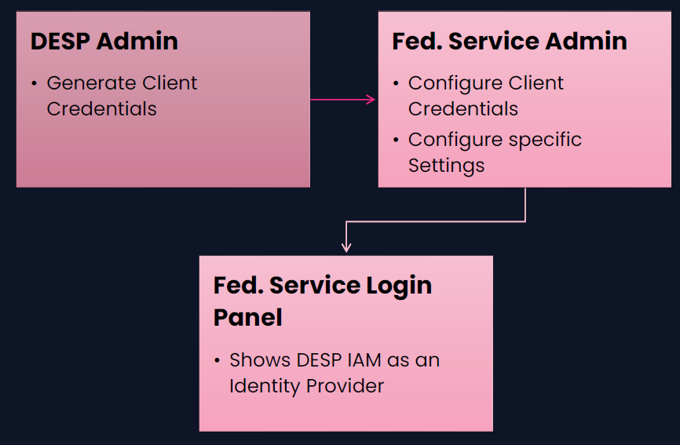
DestinE Federation Solutions
Destination Earth is a flagship initiative of the European Commission to develop a highly accurate digital model of the Earth to monitor and simulate natural phenomena, hazards and the related human activities.
Federated Identity Provider Overview
Federated Service Overview

Slide 19

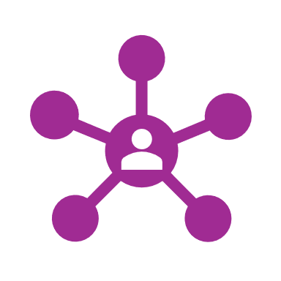
eduGAIN
eduGAIN is a service that interconnects identity federations around the world, simplifying access to content, services, and resources for the global research and education community. It coordinates elements of the federations' technical infrastructure and a policy framework controlling the exchange of information.
eduGAIN comprises over 70 participant federations connecting more than 7,000 Identity and Service Providers. It provides the necessary trust and security to exchange home organizations’ identity information to access services within the federation
Notes:
eduGAIN was pioneered by the GÉANT research and education networking community in Europe. Development of the eduGAIN service was initiated in GÉANT 2 Project work, and followed up in the successor GÉANT 3 project.

Slide 20
EduGAIN: Who is it for?
Identity federations
Identity Providers
  Join the eduGAIN service as it enables you to interconnect with other federations
  Lean on eduGAIN trustworthy service – enables secure exchange of federation information
  Enable you to provide more services for your users available through other federations
  Gain in time saving and lower administration costs as no need for bilateral federation agreements
  Join an identity federation participating in eduGAIN​
  Offer more to your users – enable access to a wider range of services than are available locally or nationally
  No extra administrative burden if you are already participating in an identity federation
Service Providers
  Join an identity federation participating in eduGAIN
  Grow your audience by making your service available to a greater number of users
  Lower costs per user – your audience grows without increasing costs for maintenance of users credentials
Where do we stand?

Slide 21
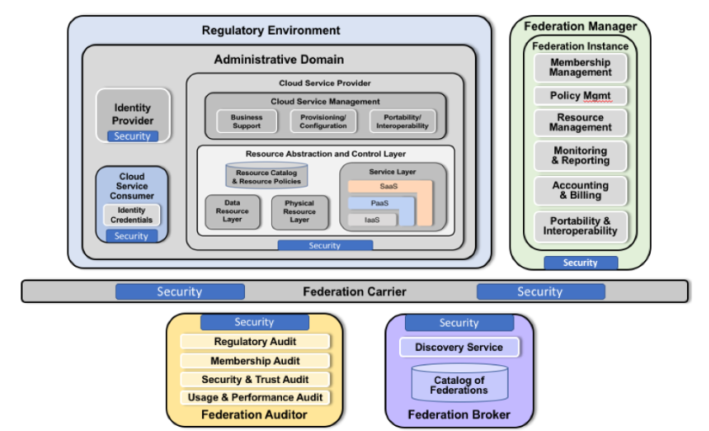
Deployment Models and Governance
Federation goes beyond just transparency and resource sharing at the user level. It requires high-level entities to agree on resource ownership, sharing methods, and the basic rules for participation.
A governance[1] model encapsulates these agreements and policies. Successful collaboration hinges on aligning the interests of federations and service providers. Resource Owners can share sensitive resources while ensuring accountability and billing for their use.
Federated environments often start with agreements among stakeholders, leading to the development of resources like:
Documentation for outreach and understanding the federation's goals.
Interoperability components to enhance onboarding with advanced standards.
Automation to reduce interactions between Resource Owners.
Moreover, User Education and Awareness[2] is vital for a well-functioning federation, supported by these resources.
Notes:
[1] The NIST Cloud Federation Reference Architecture
[2] OGC Testbed-15: Federated Clouds Security Engineering Report
For successful collaboration, federations and service providers must align their interests.
Resource Owners may share confidential resources with the Federation while maintaining accountability and billing over their usage. Federated environments typically begin with an out-of-band agreement among stakeholders, leading to the creation of various internal resources, such as:
Documentation for outreach and shared understanding of the federation's purpose.
Interoperability components to streamline the onboarding process using advanced standards and solutions.
Automation of tasks and procedures to minimize interactions between Resource Owners.
Additionally, User Education and Awareness is crucial for a mature federation, supported by these resources.

