Slide 1
Federated Authentication & Authorization
WGISS-59 3/24-28/2025
Doug Newman
NASA ESDIS Project, Goddard Space Flight Center
Notes:
WGISS - Working Group on Information Systems and Services

Slide 2
Agenda
Holistic Identity Management
Architecture & Implementation
Roadmap

Slide 3
Holistic Identity Management
Federating Identity Management

Slide 4
For data consumers - less friction
The ability to use existing credentials (social login, for example) to access NASA earthdata data and services
The ability to use more secure authentication (NASA Launchpad, for example) for all NASA earthdata data and services

Slide 5
For data producers - better management
Non-US Agency data providers (members of CEOS, for example) will be able to manage their metadata in NASA CMR
Notes:
CEOS - Committee for Earth Observing Satellites
CMR - Common Metadata Repository

Slide 6
For NASA - less risk, more opportunities
Eliminate the need to manage credentials
Increase data use by easing authentication and authorization across multiple systems
Improve security posture
Multi-factor authentication where needed
Scalability
Notes:
Improve security posture - by allowing the selection of authentication mechanisms on an application by application basis

Slide 7
Federated authentication
A user can use their social login credentials to access NASA data
A user could use their social login credentials to access NASA data
Does that decrease friction for users acquiring data from multiple agencies?

Slide 8
Architecture & Implementation

Slide 9
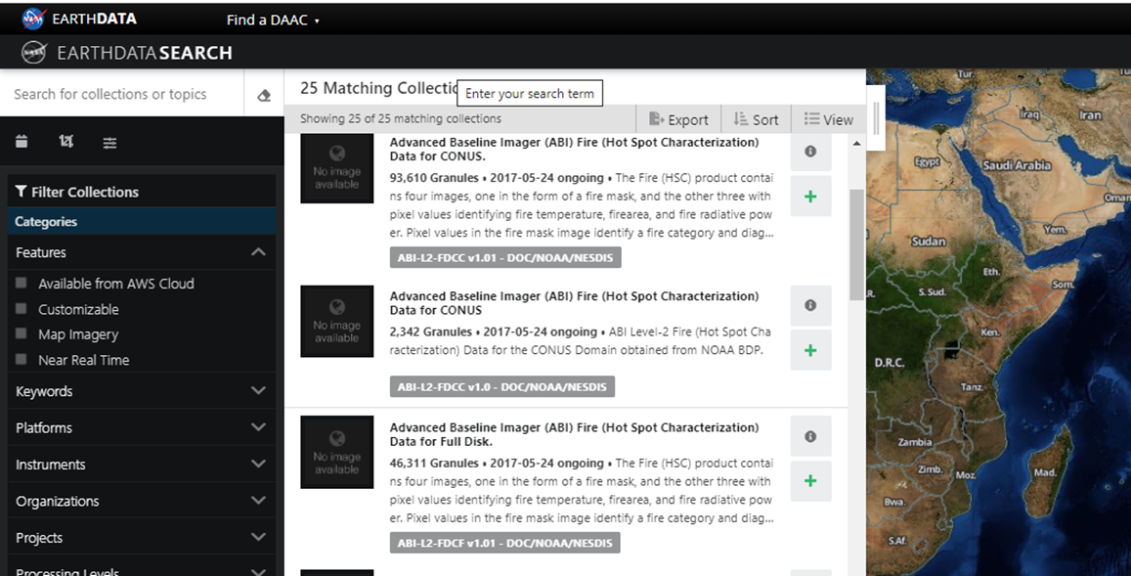
Minimum Viable Product Architecture
Identity Provider
Google
Client
Earthdata Login
Identity Federation Service
MFA
Identity Provider
Keycloak
Microsoft Business
Identity Provider
Notes:
MFA - Multi-factor authentication
urs.earthdata.nasa.gov
search.earthdata.nasa.gov
Keycloak - https://www.keycloak.org/

Slide 10
Keycloak
The backbone of our architecture is Keycloak technology that provides,
Single sign-on
Identity Brokering
Social Login
User Federation
Notes:
https://www.keycloak.org/

Slide 11
Roadmap
Notes:
BP - Best Practices

Slide 12
Minimum Viable Product
Functionality:
Allow Google and NASA Launchpad for authentication.
Applications can specify what identity providers are allowed for their application. For example, apps allowing access to sensitive information would allow NASA Launchpad MFA only
Delivery date: Quarter 2 of 2025
Notes:
MFA - Multi-factor Authentication

Slide 13
Roadmap
Q3 2025 - Additional social logins (AWS Cognito, id.gov)
Q4 2025 - UI/UX improvements
Q1 2026 - Additional social logins (Facebook, Microsoft)
Notes:
UI - User Interface
UX - User Experience
AWS - Amazon Web Services

Slide 14
Thank you
CONTACT
douglas.j.newman@nasa.gov
WEBSITE
earthdata.nasa.gov
SOCIAL MEDIA
@NASAEarthData
Contact me at…

