Slide 1
Interoperability: Vocabulary and Quality Factors (cont.) Review of Calibration and Validation Recommendations
Cody Anderson, USGS/WGCV
Agenda Item 5.2
WGISS-59
24-28 March 2025
Centara Grand at Central Ladprao Bangkok, Thailand

Slide 2
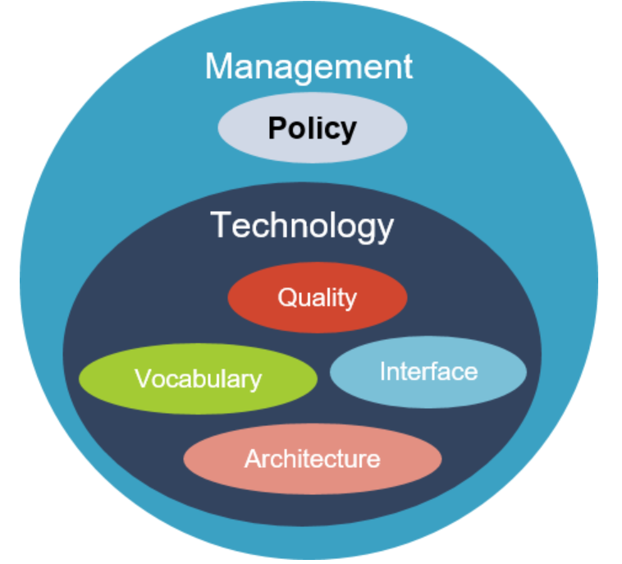
Quality Factor - Definition
Quality
Indicators (parameters, metrics, etc.) for informing users of the trustworthiness (accuracy, uncertainty, consistency, etc.) of the data provided (measurands, measurements, observations, etc.)
Notes:
CEOS Plenary 2025 – 14, 15, 16 YO pre university age

Slide 3
Quality Factor Chapter
Quality
Previous | Table of contents | Next
Quality informs users of the trustworthiness of Earth Observation data and products. Multiple Calibration and Validation (Cal/Val) groups/venues exist as forums for the exchange of information about understanding, expressing, and improving data quality, along with influencing the interoperability between multiple datasets and products. .
Calibration and Validation
Calibration is the process of quantitatively defining a system’s response to known and controlled signal inputs. Validation, on the other hand, is the process of assessing, by independent means, the quality of the data products derived from those system outputs.

Slide 4
Quality Factor Chapter (cont.)
Cal/Val Groups/Venues
CEOS Working Group on Calibration and Validation (WGCV):
https://ceos.org/ourwork/workinggroups/wgcv/
and Subgroups
Atmospheric Composition Subgroup (ACSG)
https://ceos.org/ourwork/workinggroups/wgcv/subgroups/acsg/
Infrared Visible Optical Sensors (IVOS)
https://ceos.org/ourwork/workinggroups/wgcv/subgroups/ivos/
Land Product Validation (LPV)
https://ceos.org/ourwork/workinggroups/wgcv/subgroups/lpv/ Microwave Sensors Subgroup (MSSG)
https://ceos.org/ourwork/workinggroups/wgcv/subgroups/mssg/
Synthetic Aperture Radar (SAR)
https://ceos.org/ourwork/workinggroups/wgcv/subgroups/sar/
Terrain Mapping Subgroup (TMSG)
https://ceos.org/ourwork/workinggroups/wgcv/subgroups/tmsg/
WMO Global Space-based Inter-Calibration System (GSICS)
https://gsics.wmo.int/site/global-space-based-inter-calibration-system-gsics
Joint Agency Commercial Imagery Evaluation (JACIE):
https://www.usgs.gov/calval/jacie
Very High-resolution Radar & Optical Data Assessment (VH-RODA):
https://earth.esa.int/eogateway/events/vh-roda

Slide 5
Quality Factor Chapter (cont.)
Cal/Val Recommendations
ID | Recommendations
CALVAL#1 | The Measurand and Uncertainty of stated values within products are key to communicating and understanding data quality
CALVAL#2 | All products should have associated quality indicators, traceable to reference standards to allows users to access usability of the data for their applications
CALVAL#3 | CEOS ARD Framework should be used as a starting point for development of Interoperable and Analysis Ready Data: https://ceos.org/ard/
CALVAL#4 | Post-launch, Level-1 products should be calibrated using CEOS Fiducial Reference Measurements (CEOS-FRM).
CALVAL#5 | CEOS endorsed Cal/Val sites and reference networks (RadCalNet: https://www.radcalnet.org/#!/; SARCalNet: https://www.sarcalnet.org/, etc.) should be used for calibration and validation of Earth Observation data

Slide 6
Quality Factor Chapter (cont.)
Cal/Val Recommendations
CALVAL#6 | The Quality Assurance Framework for Earth Observation (QA4EO) developed by Group on Earth Observations (GEO) and endorsed by the Committee on Earth Observation Satellites (CEOS) should be followed to enable interoperability and quality assessment of earth observation data
CALVAL#7 | The Joint Agency Commercial Imagery Evaluation (JACIE) Best Practices document can be used as a guideline for standard calibration and validation activities to be performed: https://www.usgs.gov/publications/joint-agency-commercial-imagery-evaluation-jacie-best-practices-remote-sensing-system
CALVAL#8 | The ESA Earth Data Assessment Project (EDAP) process provides multiple reporting metrics related to quality: https://earth.esa.int/eogateway/activities/edap
CALVAL#9 | CEOS CAL/VAL portal can be used as a reference site for accessing agreed good practices and CAL/VAL protocols for interoperability for Earth observation calibration and validation activities

