Slide 1
Review of Vocabulary Recommendations
Peter Strobl, EC-JRC
Agenda Item 5.1
WGISS-59
24-28 March, 2025
Bangkok, Thailand

Slide 2
How it started
Background
Joint initiative of CEOS WGCV, CEOS WGISS, and CEOS LSI-VC
Mandate: CEOS WGCV Action Item 49-06 (June 2021) “[…] to advance the idea of a CEOS common online dictionary, with a view to eventually reaching out to launch a broader community effort”
Status of activities
CEOS Common Terminology group established August 2021
Workplan drafted
Integrated WGISS Data Stewardship Glossary (pdf) and NOAA NESDIS Data Management Lexicon (pdf) into existing WGCV ‘Terms and Definitions’ Wiki
Discussing categorization of terms- prototyping approach using base terms and high impact terms – ongoing
Discussing governance
Reaching out to promote initiative internally with focus on WGISS, WGCV, LSI-VC externally with ISO/OGC
Summarize finding - publish
http://calvalportal.ceos.org/ca/t-d_wiki

Slide 3
Process
Collating existing vocabularies
Recording inconsistencies, issues and good practice
Discussions and Review of ISO standards
First draft of paper
Peer review comments on ontology
Learn from literature on ontology
CEOS common terminology group LSI-VC/WGCV/WGISS
Meetings with communities to discuss issues
Initial ideas for an improved framework
Feedback from 12 experts
Second draft of paper
Published version of paper
Interoperability Handbook Chapter 1: Semantics/ Vocabulary
2020
2021
2022
2023
2024
Decision by plenary to task WGISS
Joint development of factors for IF
CEOS Interoperability Framework WGISS/LSI-VC/WGCV
Distribution of Chapters
Proposal for Interoperability Framework in LSI-VC
First Draft of IF by LSI-VC
Adoption of IF by plenary and tasking of Handbook 2.0
First outline of IH2.0

Slide 4
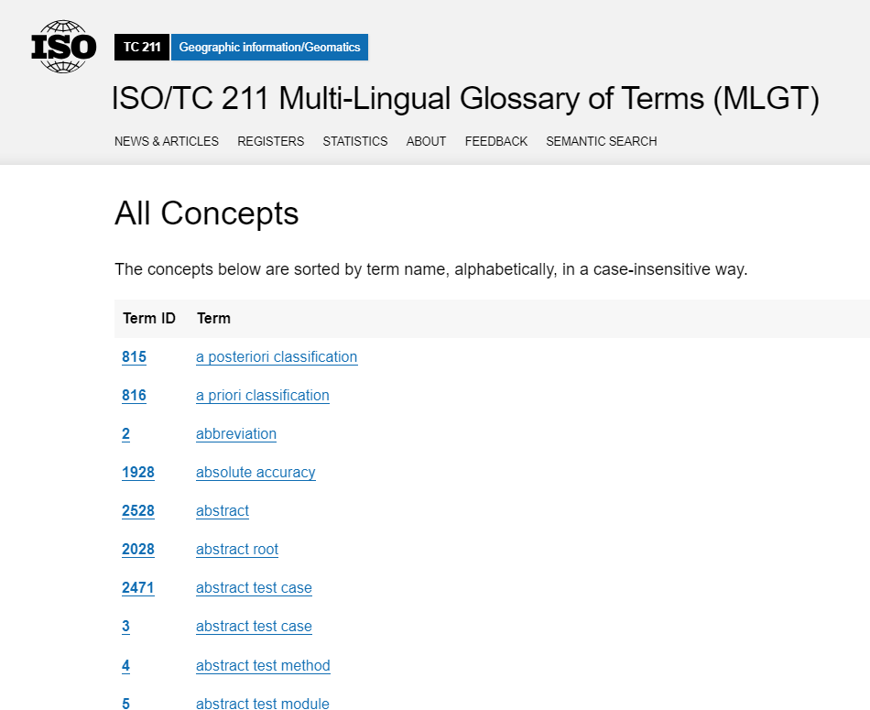
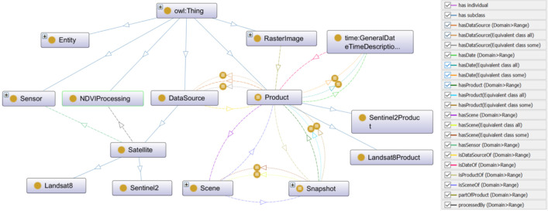
Format of terminologies
Mostly alphabetical lists
Often in PDFs
Hard to ‘explore’
Or formal ontology
Meant for computers, not people

Slide 5
Problems found
Simple lists of words are not used often – structure is important
Lack of versioning (or keep older definitions) – and definitions change
Ambiguity of definitions for some terms – e.g. ISO online browsing platform has 77 versions of ‘observation’
Inconsistent definitions (e.g. in-situ, observation, sample, …)
Superficial definitions (e.g. interoperability) lacking full framework
Circular definitions – and poor use of the foundational ‘base terms’
Development process – isolated efforts – creates these problems

Slide 6
Suggested approach
Formal ‘thesaurus’ (controlled and structured vocabulary, with explicit relationship between terms)
Collaboration between standard-setting and good-practice setting organisations to develop a collective-effort wiki-style vocabulary
Long-term commitment to collaborative working
Oversight editorial teams
Terminology in documents linked to central reference (with version control at the individual definition level)
Conflicts handled through separate ‘branches’
More complete frameworks (e.g. CEOS interoperability / CEOS FRM etc) connected to the terminology alongside higher level definitions

Slide 7
A good thesaurus is:
Consistent
On a foundation of base terms. No ambiguity. No circular or overlapping definitions. Clear preferred terms. Alternative definitions explained clearly.
Interrelated
Clearly shows relationships between terms – in a definitional, contextual and ontological way. Mutually exclusive parent / sibling / child relationships
Understandable
Clear definitions, with differentiation/disambiguation of controversial terms. Checked for understandability by multidisciplinary teams
Educational
Not just for computers! Promotes a conceptual framework, shows linkages, satisfies curiosity, helps communication of concepts. Links to detailed frameworks for high-impact terms.
Updateable
Unified thesaurus with version control at the level of individual terms, methods for providing disambiguation links, and adding new terms.

Slide 8
Categories of terms
 | Category of term | Examples
 | Base terms | Data, entity, phenomenon, property | Underpinning terms – small committee to create list
 | Core terms | Uncertainty, leaf area index, data centre, spectral resolution, accuracy, precision, measurement | Basic vocabulary for Earth sciences – small committee to create list and collate existing definitions
 | Controversial terms | Sampling, observation, in-situ, processing level, model, confidence | Terms different communities use differently. Facilitated discussions or disambiguation pages
 | High impact terms | Interoperability, analysis ready data, data assimilation, real-time, operational | Terms that need a framework document – developed in the right committee. Link to simple, high-level definition

Slide 9
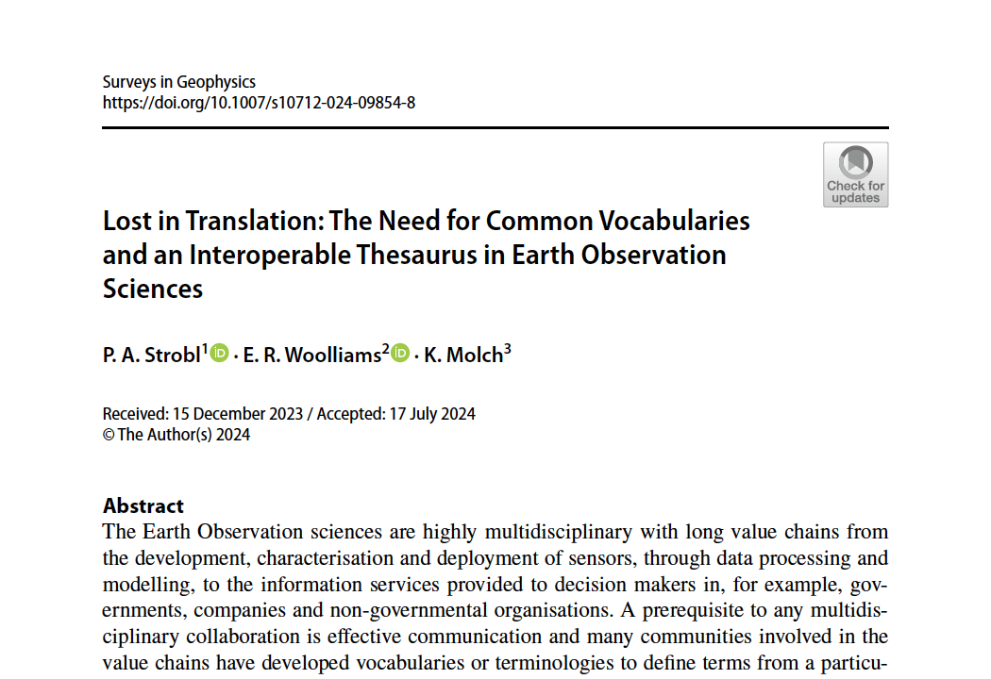
Recent paper published
Lost in translation: The need for common vocabularies and an interoperable thesaurus in Earth observation sciences
P.A. Strobl¹, E.R. Woolliams² and K. Molch³
¹EC-JRC, ²NPL, ³DLR
Journal: Surveys in Geophysics
Online: 1 October 2024
https://doi.org/10.1007/s10712-024-09854-8
First draft (July 2023) reviewed by 12 observation experts
Journal peer review included significant challenge from ontology expert
Challenging review procedure (8 months)
Final paper has benefited from the insights of all these perspectives.

Slide 10
In-situ disambiguation
Location of sample
In-situ / Ex-situ
Observed in its original location vs brought back to laboratory for testing
In-situ / satellite
Observed e.g. ground-based, sea- or airborne vs from an orbiting platform
In-situ / remote
Observed close to the location of the sample vs from a (significant) distance
Various communities use the term 'in-situ' in different ways – in contrast to different alternatives.
It is very important to be clear about which notion of ‘in-situ’ is referred to. Sometimes it relates more to location and sometimes to fidelity.
vs
Location of sensor
vs
Distance sensor to sample
vs

Slide 11
Observation
Process of observing / observation value
Continuum from measurement to simulation
Bokulich 2020 (philosopher) defined increasing ‘model ladenness’ of data – as below
(but other splits possible!)
Distinction hard – but we disagree with ISO approach of considering simulation as a form of observation based only on an algorithm as observer!
Measurement?
Observation?
Model?
Raw measure-ment
Data conversion / calibration
Data correction
Data scaling
Interpolation
Data scaling / regridding
Data fusion
Data assimilation
Simulation
Level 1
Level 2
Level 3/4

Slide 12
Interoperability
interoperability is a ‘characteristic of a product or system to work with other products or systems’
Easy to agree, unhelpful to use
Need a framework for each community to define more specific aspects of this.
Building on same core and base terms. Linked through single top-level definition.
Illustration courtesy P. Strobl

Slide 13
A better approach to Semantics
Several steps are proposed to achieve this goal:
Initiate:
SEM#1 Migrate the merged WGCV/WGISS Terms and Definitions wiki to a GitHub
Embark:
SEM#2 Invite and encourage all CEOS actors to participate
SEM#3 Enable version control SEM#4 Abandon and ban the practice of singular vocabularies
Reach out:
SEM#5 Seek formal collaboration with ISO/TC 211 and any other stakeholders in ESS
SEM#6 Assemble online repositories for abbreviations, acronyms, and metadata e.g. with STAC

Slide 14
Suggested practical approach
Build on all the existing, excellent work and invite all stakeholders
But someone must start this!
Treat it as a proper project, led by a ‘thesaurus curator’ and using professional tools to link definitions (glossarist?, github?)
Produce and maintain guidelines and principles for definitions from the start
Get a small group to build the ‘base’ and ‘core’ terms first, so other definitions build on those
Invite the right technical experts to build other definitions on those base and core terms, using existing terminologies
Checked against new principles
Make disagreements open and public
Link to more complete framework documents for high-impact terms

Slide 15
A better Thesaurus
THES#1 | Terminology shall be consistent and categorical
THES#2 | Terms should have clear and mappable relations
THES#3 | Definitions shall not be circular
THES#4 | Definitions should be kept short and unambigous
THES#5 | Examples and explanations shall be provided as notes
THES#6 | Definitions must refer to sources where these exist
THES#7 | Thesaurus shall be version controlled
THES#8 | Thesaurus should provide room for controversial definitions
Clear rules shall guide the set-up of a common Thesaurus

Slide 16
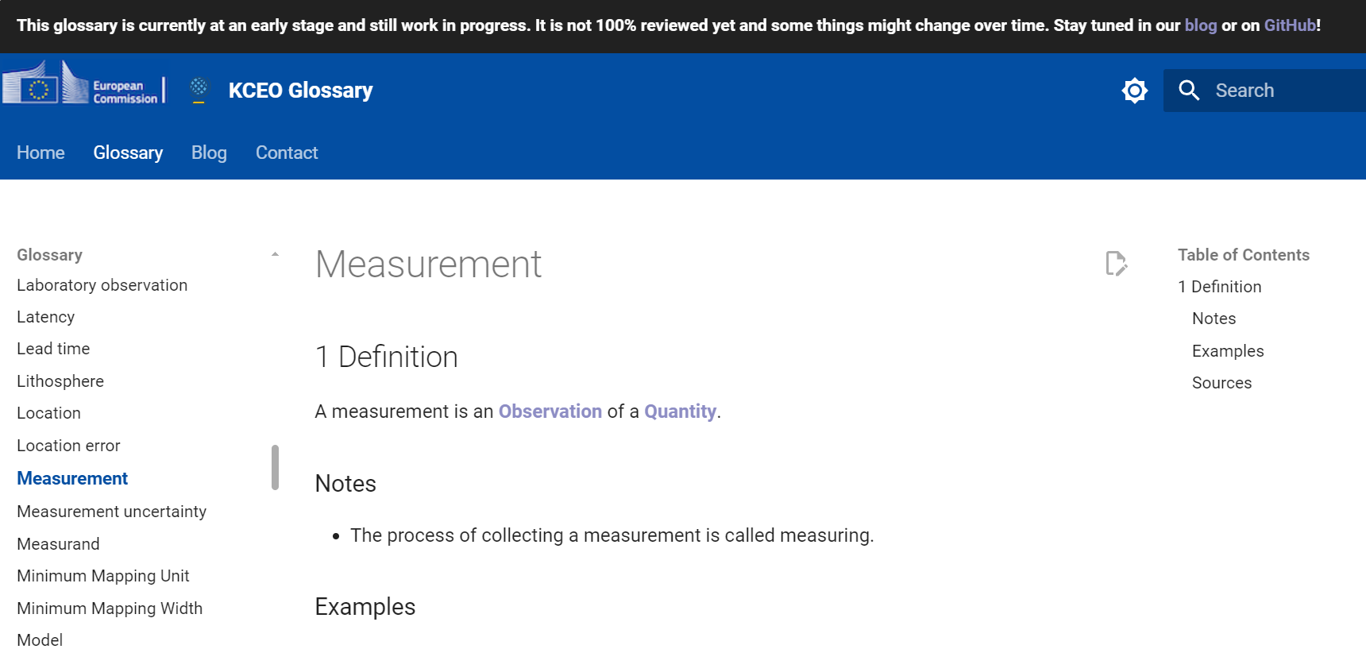
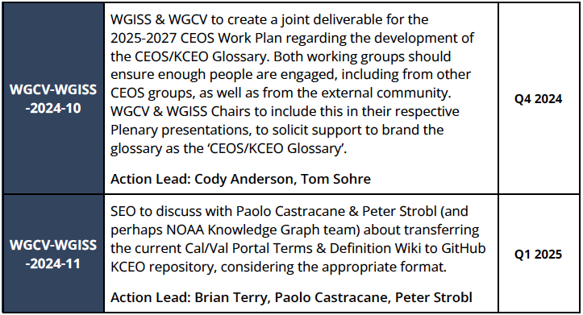
Someone just started!
The 'Knowledge Centre on Earth Observation' of the European Commission has started implementing these concepts in the KCEO Glossary
Opportunity to participate once initial set up completed
How about a formal CEOS-KCEO glossary connection?

Slide 17
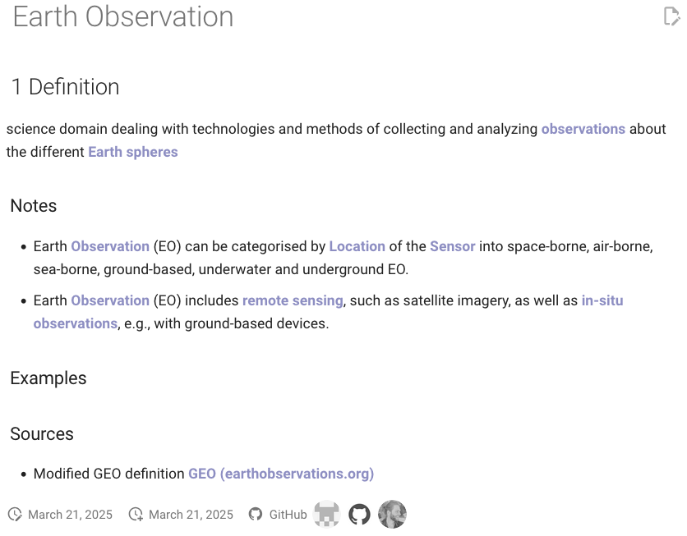
Example from the KCEO Glossary
GitHub based
Structured and linked
Short and concise
Traceable sources
Allows additional definitions
But work in progress, majority of terms still require clean-up!
https://ec-jrc.github.io/KCEOGlossary/earth_observation/
Courtesy: D. Weckmueller, M. Lahsaini

Slide 18
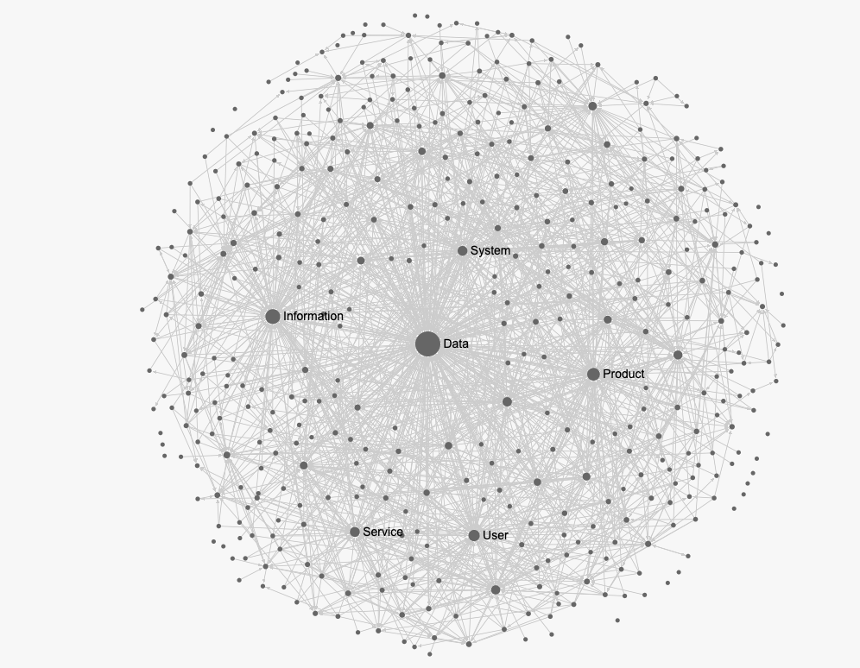
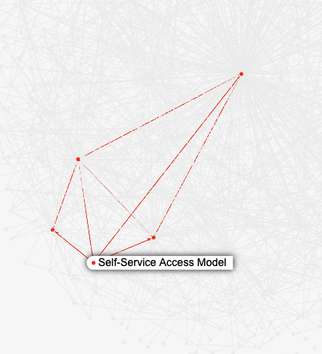
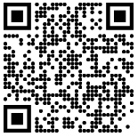
The Gordian knot!
Sigmajs Graph of the CEOS Cal/Val Glossary
Let’s get started!
https://ec-jrc.github.io/KCEO-Glossary/ceos_glossary/
Courtesy: D. Weckmueller

Slide 19
Thank you!
let’s discuss!

Slide 20
Presentation Guidance
All presentations should be uploaded to the shared google drive: https://drive.google.com/drive/folders/1u0XPcfM8-HDfTK06CPluxKRFvcDZxS1i
Ask Libby for edit access as required (libby@symbioscomms.com)
Files should be named Item_Presentation Title_Name_version
E.g. 1.3_WGISS Chair Report_Tom Sohre_v1
Presenters should join the webex line and present from their own screen using screen share features

