Slide 1
STAC progress report
WGISS-59 3/24-28/2025
Doug Newman
NASA ESDIS Project, Goddard Space Flight Center
Notes:
STAC - Spatio-Temporal Asset Catalog
WGISS - Working Group on Information Systems and Services

Slide 2
Agenda
NASA ESDIS (CMR) STAC
CWIC infrastructure
What is next
Notes:
ESDIS - Earth Science Data Information System
CMR - Common Metadata Repository
CWIC - CEOS WGISS Integrated Catalog
CEOS – Committee on Earth Observing Satellites

Slide 3
NASA ESDIS STAC
Progress report

Slide 4
Where we are right now
4th Quarter 2024 - implementation of Collection Search extension for CWIC and BP compliance
Collection Search implemented.
Functionality to link CWIC catalogs, via UMM-C records, to CMR implemented.
To do: Update INPE collection metadata with STAC endpoints
2025 - begin adding other high-value extensions
Electro-Optical
Projection
View Geometry
Hyperspectral Imagery
Satellite
Query
Sort
Notes:
BP - Best Practices
UMM-C - Unified Metadata Model for collections
INPE - National Institute for Space Research (Brazil)
https://github.com/stac-extensions/eo
https://github.com/stac-extensions/projection
https://github.com/stac-extensions/view
https://github.com/stac-extensions/hsi
https://github.com/stac-extensions/sat
https://github.com/stac-api-extensions/query
https://github.com/stac-api-extensions/sort

Slide 5
What we did
Implemented Collection Search extension in CMR STAC
Bonus: Added a virtual ‘ALL’ provider to CMR STAC

Slide 6
CWIC infrastructure
Progress Report

Slide 7
What we did
Updated INPE collection records in CMR/IDN to point to agency STAC APIs
Bonus: Updated USGS EROS collection records in CMR/IDN to point to agency STAC APIs
Notes:
USGS - United States Geological Survey
EROS - Earth Resources Observation and Science
API - application programming interface
IDN - International Directory Network

Slide 8
What that means
Using CMR STAC a user can discovery collections at CMR/IDN and navigate to granules at
INPE - 31 collections
USGS_EROS - 14 collections
Using STAC Browser, users can employ collection search across all CMR/IDN collections holdings

Slide 9
What is next
The big picture

Slide 10
What is next
Fix STAC browser to support collection search for collections that do not support granule search
Add more STAC API enabled collections from other agencies
ISRO have an API but no collections have been updated
Build capacity for STAC Browser contributions
Replace OpenSearch implementation with STAC
Notes:
ISRO - Indian Space Research Organisation

Slide 11
STAC migration
Notes:
https://access.earthdata.nasa.gov/holdings
FEDEO - Federated Earth Observation Gateway
NRSCC - National Remote Sensing Center of China
USGS LSI - United Status Geological Survey Langelier Saturation Indices

Slide 12
CEOS STAC Collection & Granule discovery BP
Our Best Practices for using STAC for discovery
Notes:
CEOS - Committee on Earth Observation Satellites
BP - Best Practices

Slide 13
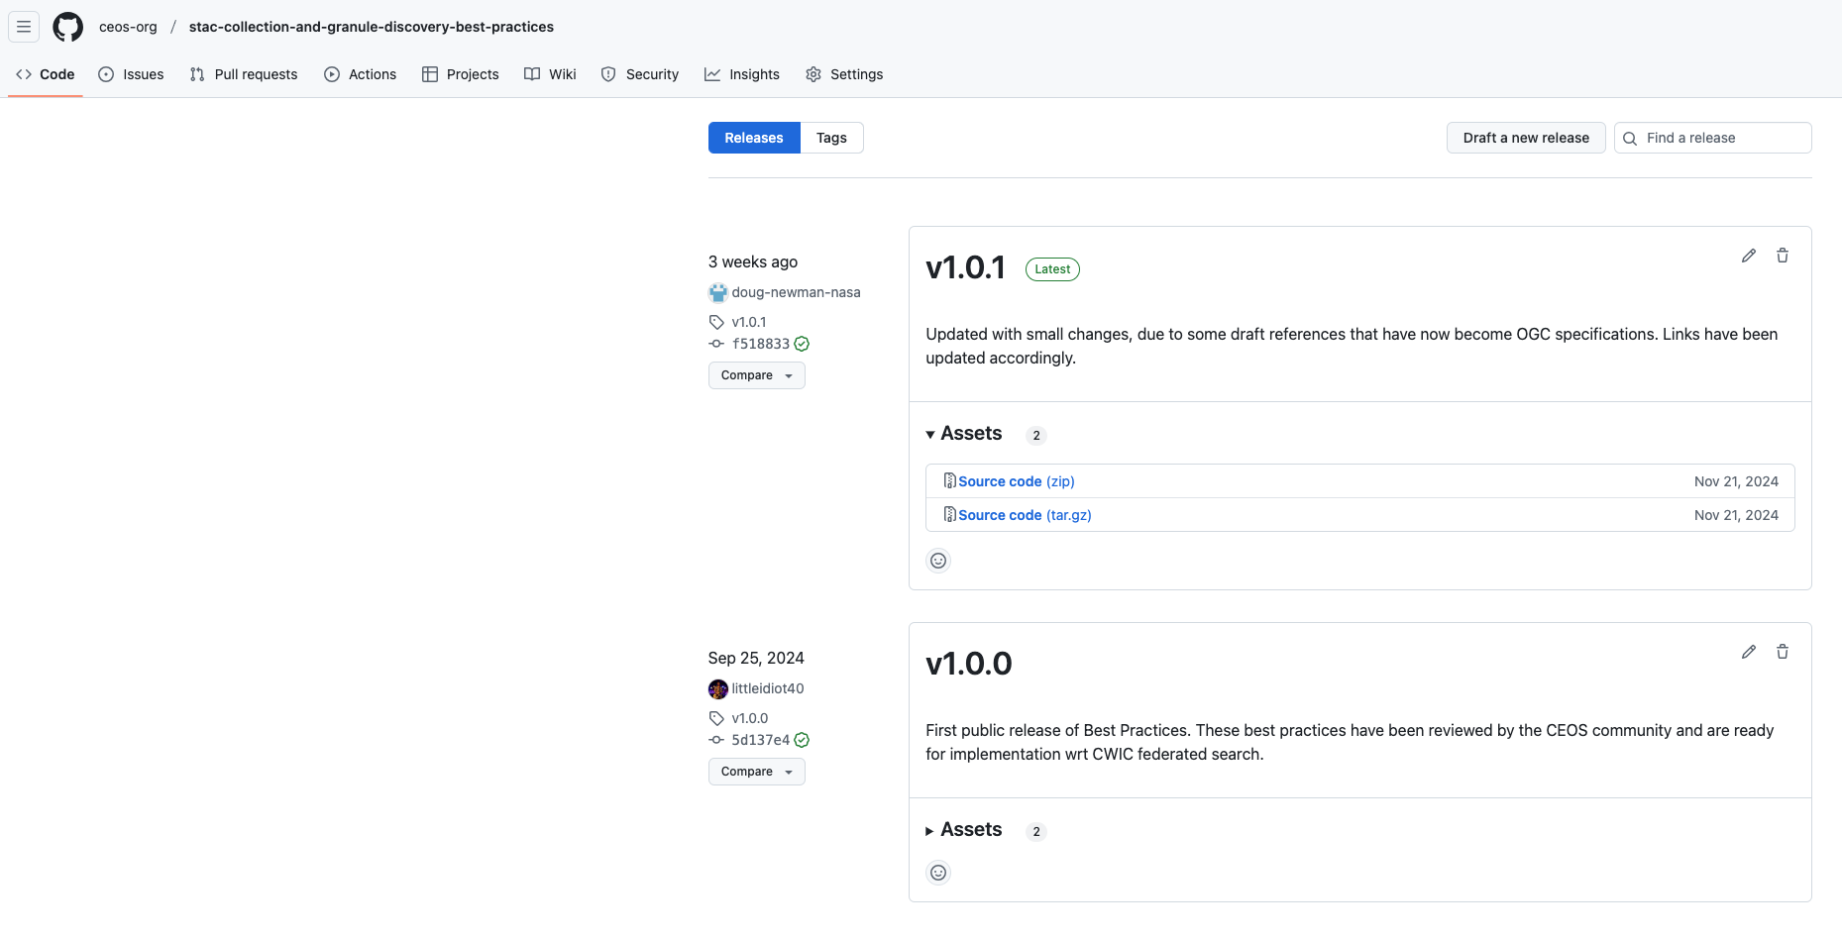
Current status
We have created our first minor release (1.0.1)!
Notes:
https://github.com/ceos-org/stac-collection-and-granule-discovery-best-practices/releases

Slide 14
Demo!
Live!
Notes:
CEOS - Committee on Earth Observation Satellites
BP - Best Practices

Slide 15
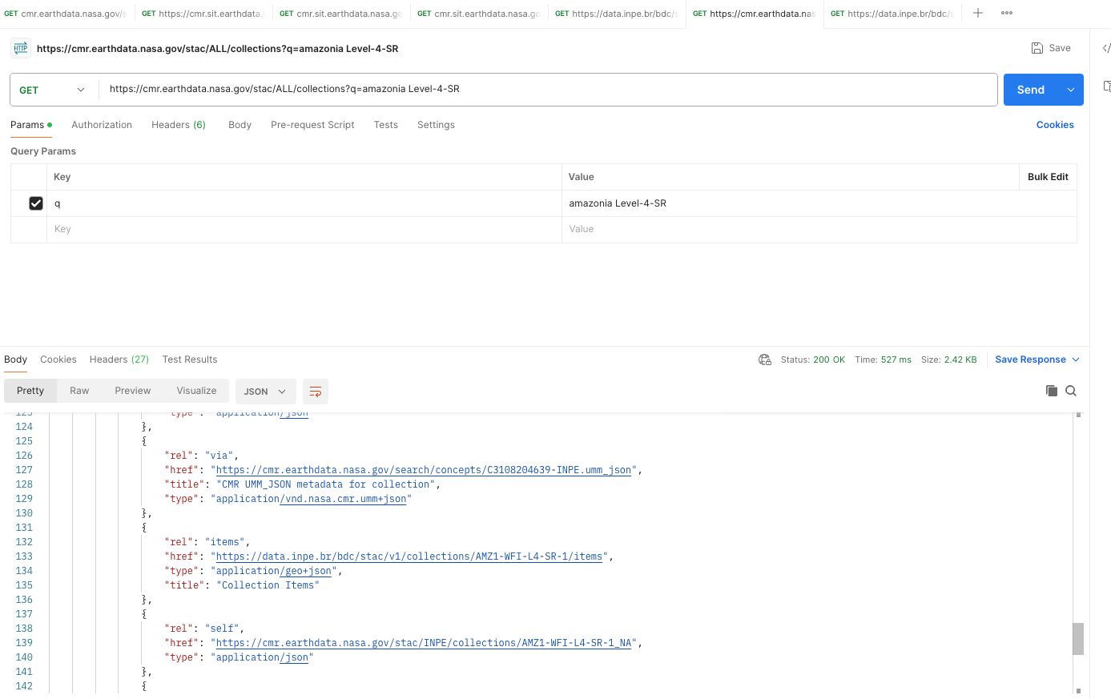
REST queries
Notes:
https://cmr.earthdata.nasa.gov/stac/ALL/collections?q=amazonia Level-4-SR
Search for INPE record
https://data.inpe.br/bdc/stac/v1/collections/AMZ1-WFI-L4-SR-1/items

Slide 16
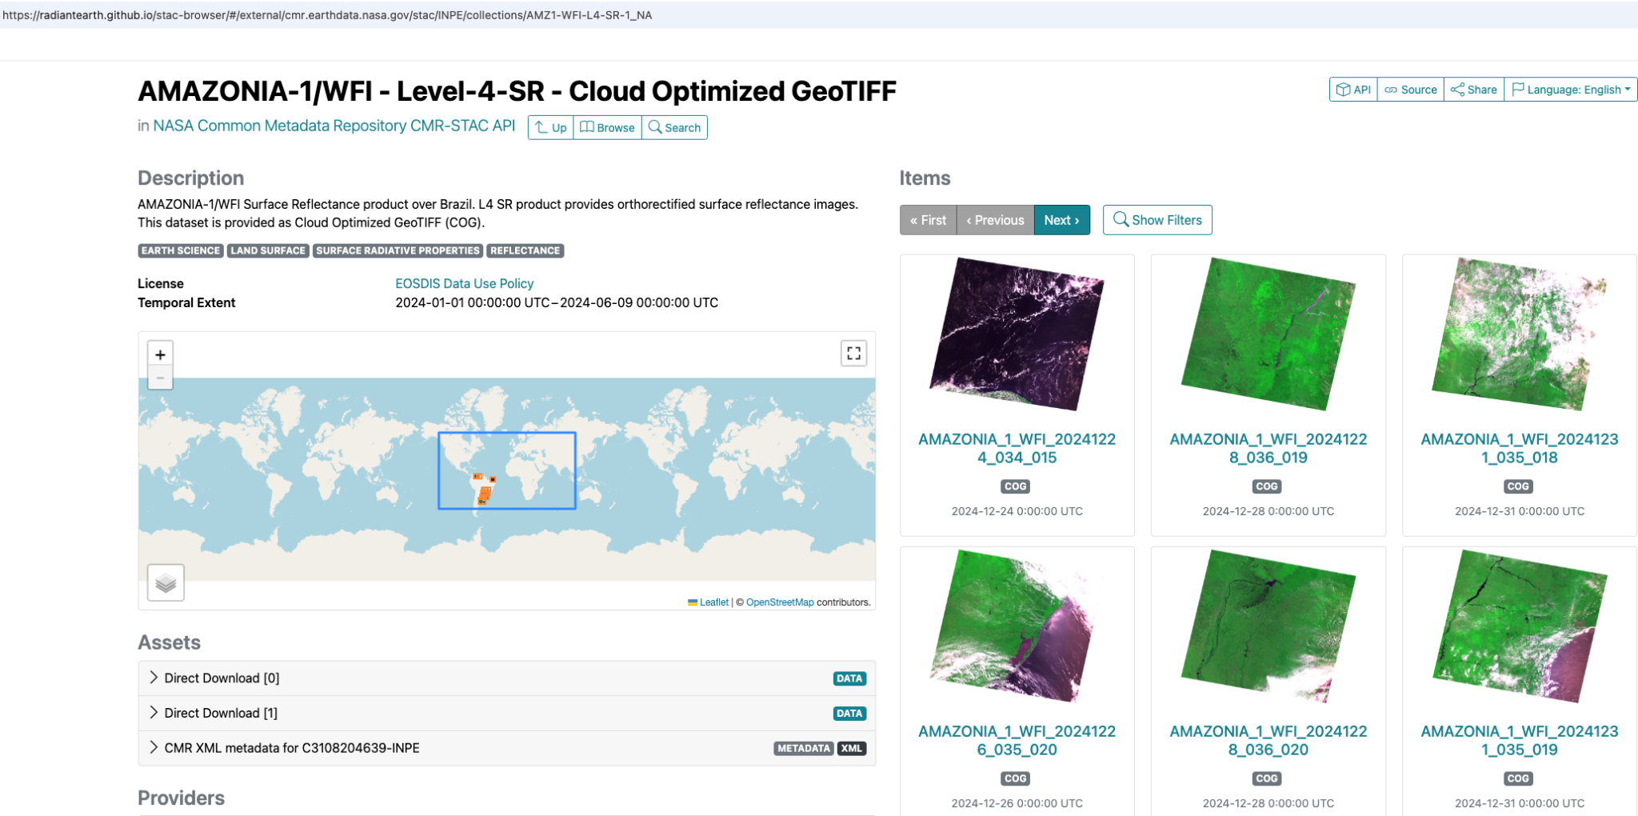
STAC browser
Notes:
https://radiantearth.github.io/stac-browser/#/external/cmr.earthdata.nasa.gov/stac?.language=en
Select INPE catalog
Search for ‘Amazonia’

Slide 17
Let’s replace Open Search with STAC
CONTACT
douglas.j.newman@nasa.gov
WEBSITE
earthdata.nasa.gov
SOCIAL MEDIA
@NASAEarthData
Contact me at…

