Slide 1
NASA Agency Report
WGISS-59 3/24-28/2025
Doug Newman
NASA ESDIS Project, Goddard Space Flight Center
Notes:
WGISS - Working Group on Information Systems and Services
ESDIS - NASA Earth Science Data Information System

Slide 2
Agenda
Current & future state
Cloud migration
Focusing on user needs
Consolidation of tools and services
Notes:
ESDIS -
CMR - Common Metadata Repository
CWIC -

Slide 3
Current & future state
Where we are today and where we are going

Slide 4
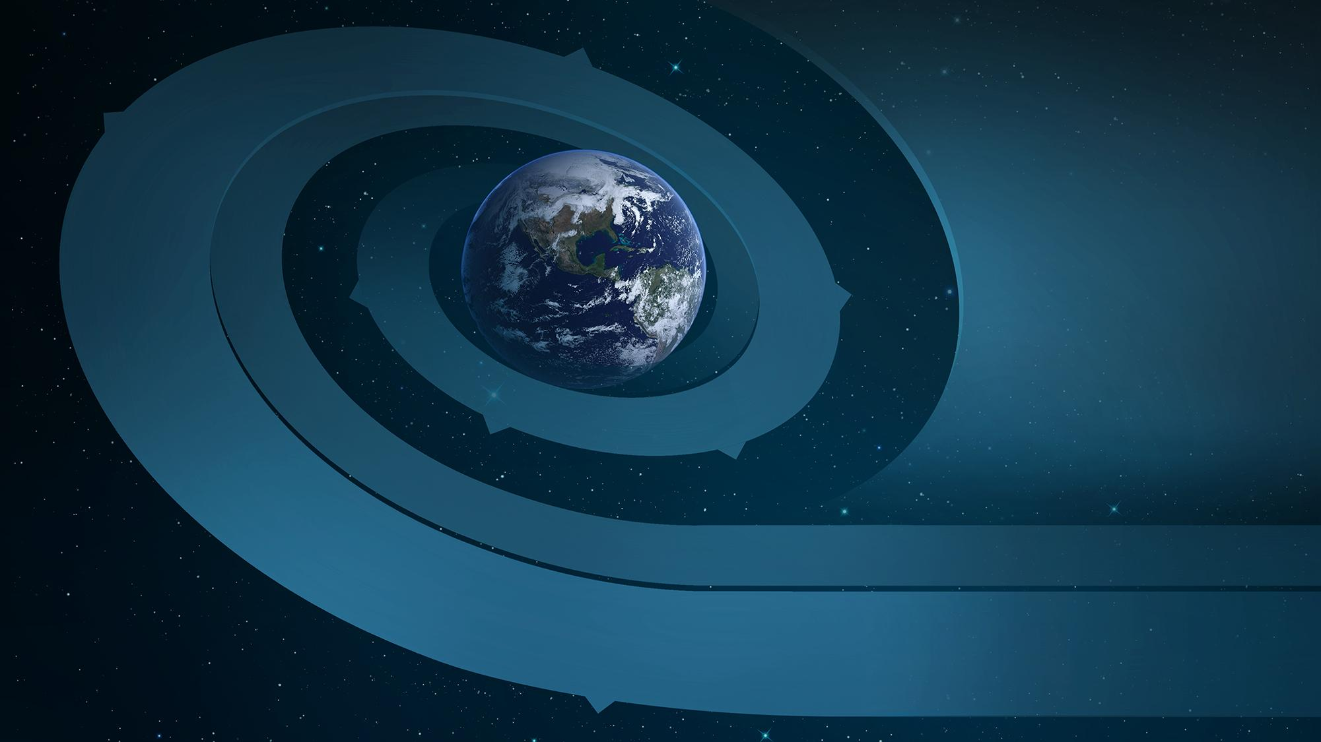
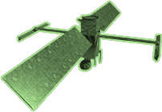
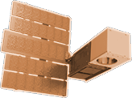
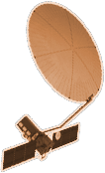
CYGNSS (8)
NISTAR, EPIC
2015
GRACE-FO (2)
SMAP
ICESAT-2
OCO-2
2020
LIS
SAGE III
GPM
SENTINEL-6
MICHAEL FREILICH
TSIS-1
EARTH FLEET
LANDSAT 8
ECOSTRESS
LANDSAT-9
SUOMI NPP
INVEST/CUBESATS
GEDI
CIRIS 2023
NACHOS 2022
CTIM 2022
NACHOS-2 2022
MURI-FD 2022
SNOOPI* 2023
HYTI* 2023
OCO-3
1995
2010
SWOT
LANDSAT 7
CALIPSO
EMIT
TERRA
TEMPO
CLOUDSAT
AQUA
AURA
JPSS INSTRUMENTS
CLARREO-PF
TROPICS (4)
2000
OMPS-LIMB 2022
LIBERA 2027
OMPS-LIMB 2027
OMPS-LIMB 2032
2005
PACE
PREFIRE (2)
ISS INSTRUMENTS
KEY
NISAR
INTERNATIONAL PARTNERS
U.S. PARTNER
ISS INSTRUMENT
JPSS INSTRUMENT
CUBESAT
LAUNCH DATE TBD
TSIS-2*
(PRE) FORMULATION
IMPLEMENTATION
OPERATING
EXTENDED
MAIA*
SENTINEL-6B
INCUS*
GLIMR*
LANDSAT NEXT*
ESO-1, 2, 3, 4*
MISSIONS
2025

Slide 5
DATA
End User Average Distribution Volume FY24 (unofficial) ~450 TB/Day
ARCHIVE
Total Archive
Volume In Cloud Only FY24 (unofficial) 66.7 PB
SUMMARY
FY 24
End User Distribution
Files including from Cloud
FY24 ~4.5 Billion
Total Number of Files
Over 3.8 Billion
Average Archive Growth
147.3 TB/Day
Total Archive
Volume Including
in Cloud
128.6 PB
Distinct Users of EOSDIS Data & Services
(Google Analytics)
8.4 Million
Unique Datasets
17,496
Collections in Cloud 5,595+
Website Sessions
(Google Analytics)
3.5 Million
EOSDIS Customer Satisfaction Index Score (2024)
78
Notes:
TB - Terabyte
PB - Petabyte
FY - Financial Year

Slide 6
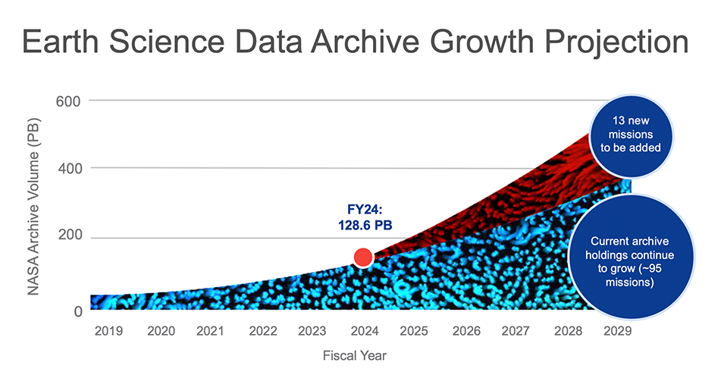

Slide 7
Cloud migration

Slide 8
The primary goal of cloud migration is…
User access to data, adjacent to high performance compute

Slide 9
The details
66.7Pb of data in Amazon Web Services, S3
Region: US-WEST-2
Access: S3 API and HTTPS
Discovery: STAC and CMR APIs, Earthdata Search UI
Notes:
S3 - Simple Storage Services
API - Application Programming Interface
HTTPS - Hypertext Transfer Protocol Secure
STAC - Spatio-Temporal Asset Catalog
CMR - Common Metadata Repository
UI - User Interface

Slide 10
Progress
Average Archive Growth
~147 TB per day
Total Archive
Volume In Cloud ~67 PB and counting
Remaining Archive
Volume on premises
~61 PB
Notes:
https://www.earthdata.nasa.gov/about/data-metrics

Slide 11
A focus on user needs

Slide 12
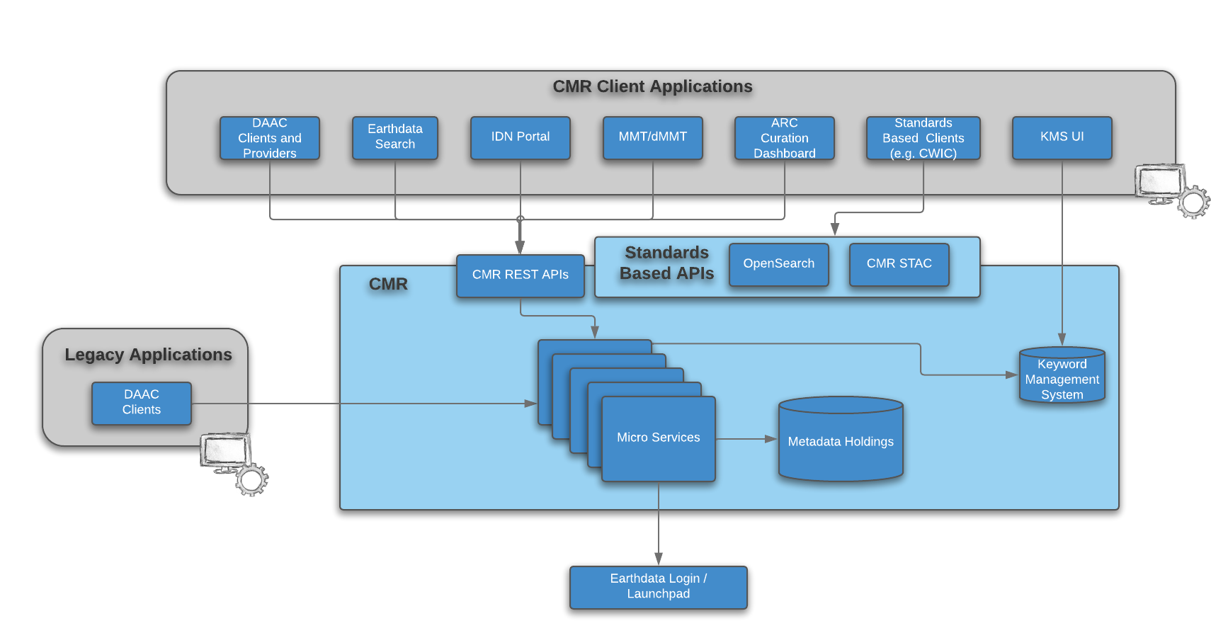
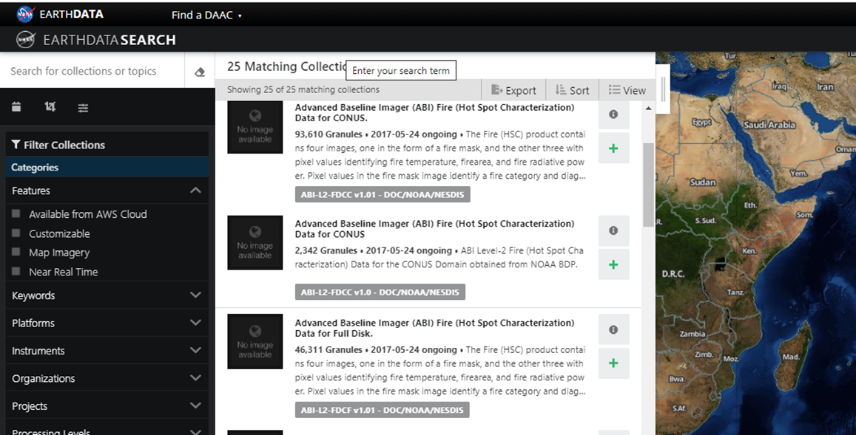
Data discovery - CMR & Earthdata Search
CMR is a high-performance, high-quality, continuously evolving metadata system that catalogs Earth Science data and associated service metadata records. These metadata records are registered, modified, discovered, and accessed through programmatic interfaces leveraging standard protocols and APIs.
Earthdata Search is a search client, backed by the Common Metadata Repository (CMR), whose primary goal is to be a means for end-users (usually scientists and students) to discover, visualize, refine, and access earth science data.
Notes:
https://cmr.earthdata.nasa.gov
https://search.earthdata.nasa.gov
API - Application Programming Interface

Slide 13
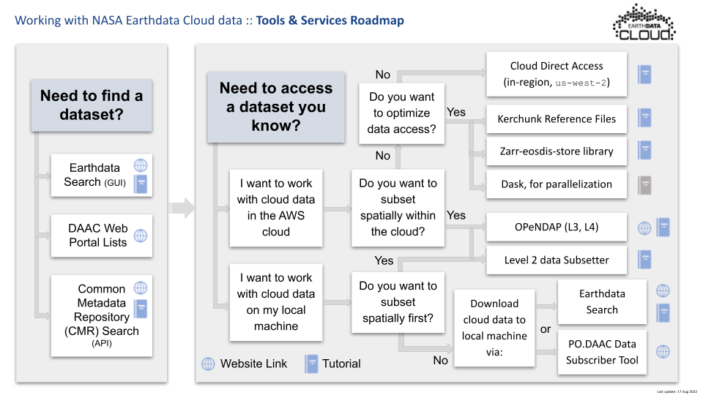
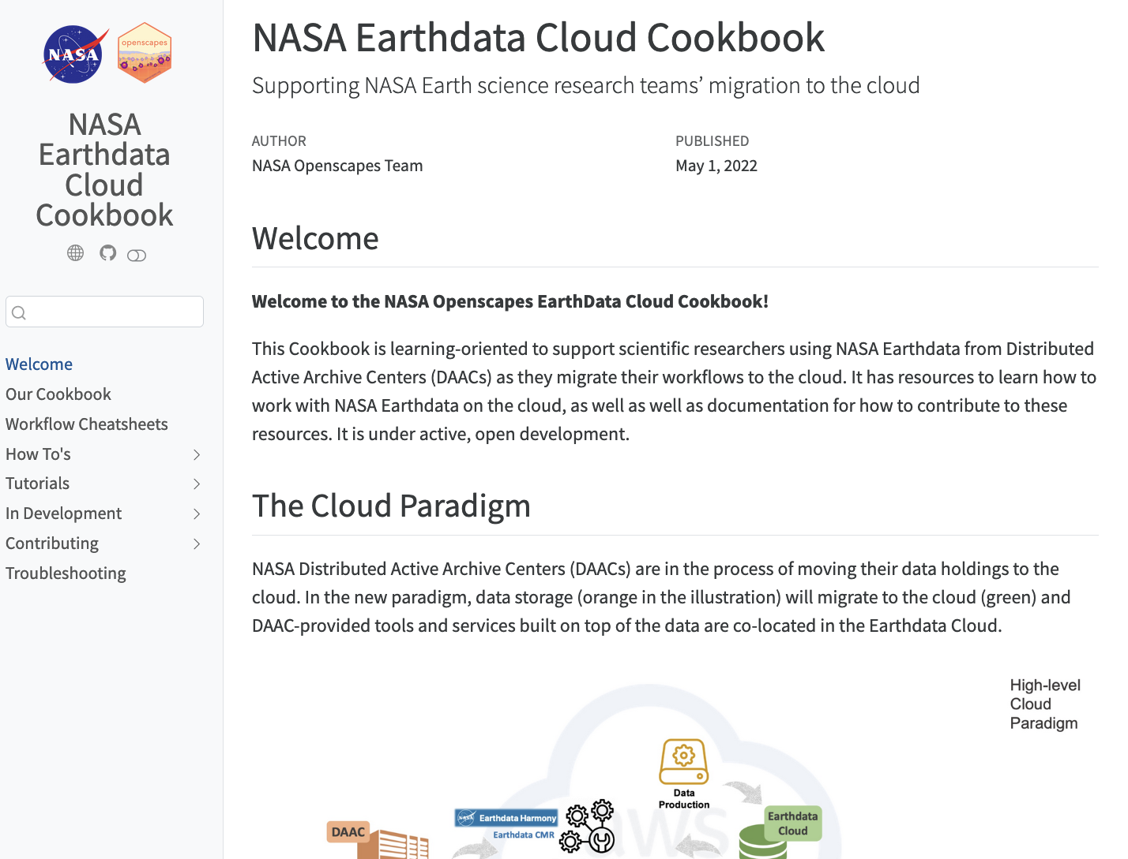
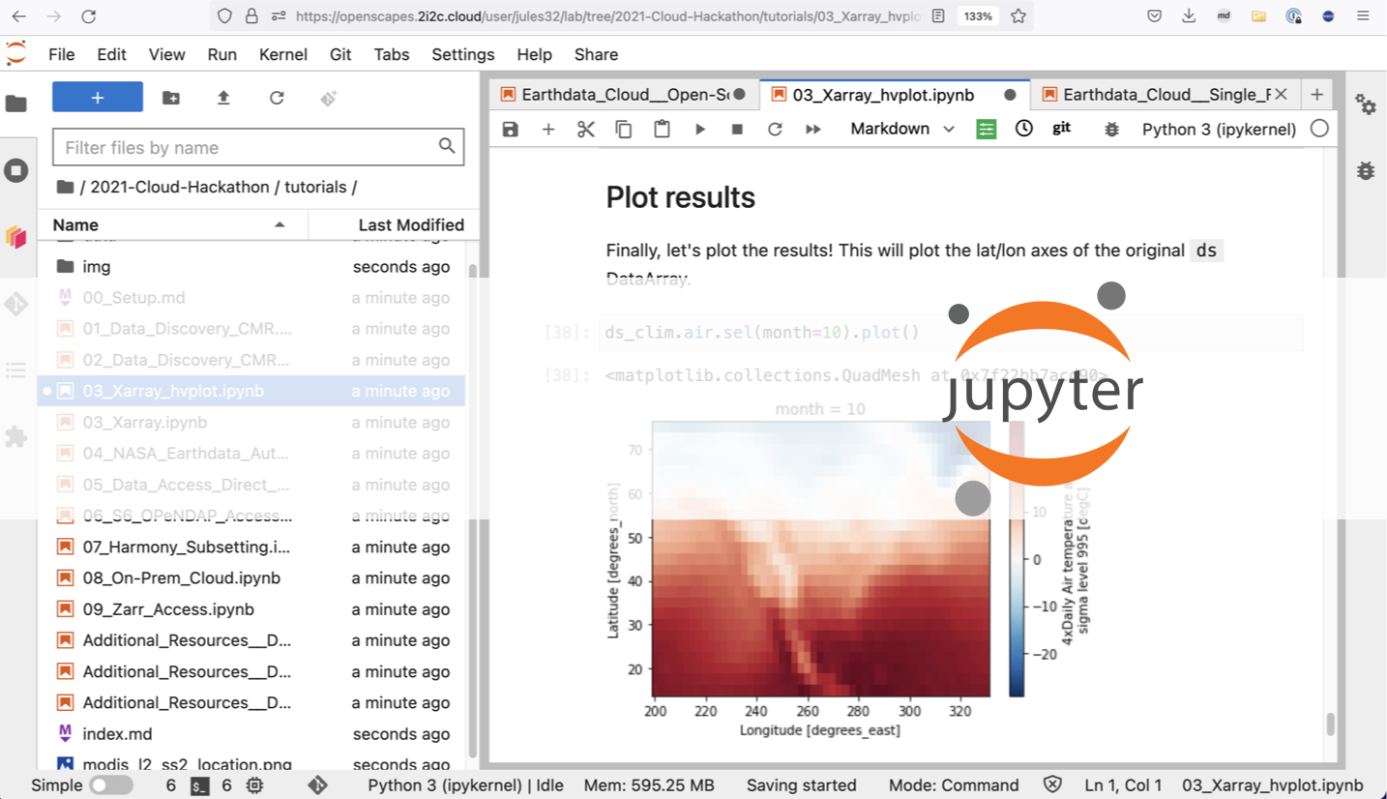
Data discovery & use - Openscapes
Openscapes supports scientists using data from NASA Earthdata served from the DAACs as they migrate workflows to the cloud, easing the discovery, access and usage of NASA Earth Science data.
Software - EarthAccess
Workshops, tutorials and mentoring
from science community members
Cloud-based development environments - 2i2c Jupyter Hubs
Notes:
https://openscapes.org/
https://earthaccess.readthedocs.io/en/latest/
https://openscapes.org/blog/2024-03-04-earthaccess-tech-spotlight/
https://nasa-openscapes.github.io/earthdata-cloud-cookbook/how-tos/find-data/earthdata_search.html
https://nasa-openscapes.github.io/cookbook-navbar-page.html
https://workshop.openscapes.2i2c.cloud/hub/login
https://nasa-openscapes.github.io/about.html#white-paper-value-of-hosted-jupyterhubs
SMD - NASA Science Mission Directorate
DAAC - Distributed Active Archive Center

Slide 14
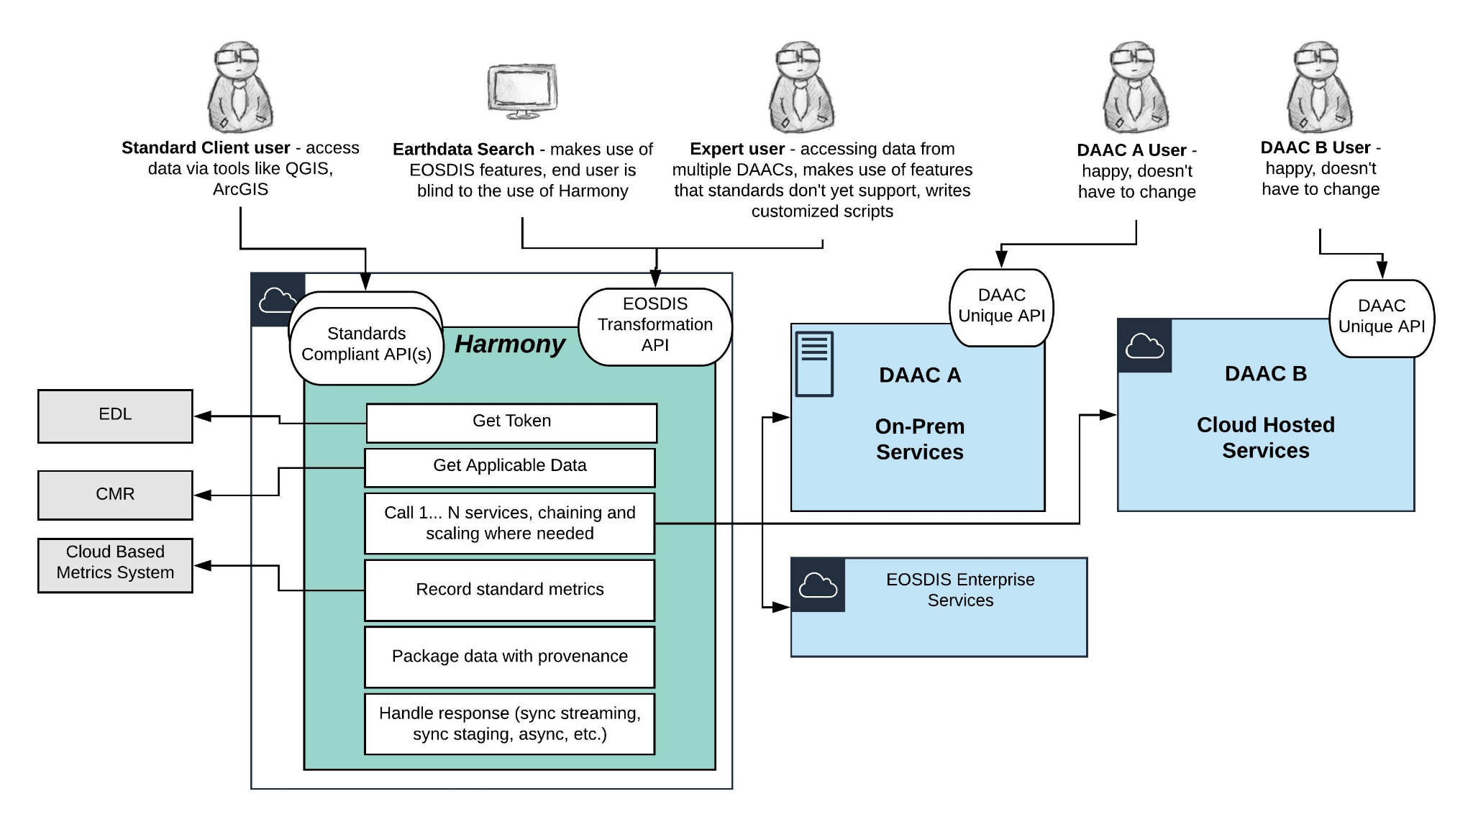
Data transformation - Harmony
Harmony is NASA ESDIS’ cloud based, open-source, data transformation platform. It provides unified access to data products and services across various earth science disciplines.
Open and Shared: Code for Harmony and its services are open source, enabling transparency, code shareability, and cross-team contributions.
Evolving Standards: architected to adhere to widely used standards like OGC and STAC.
Leveraging the Cloud: takes full advantage of the cloud and native technologies, leading to better scalability and reliability in the face of growing data volumes.
Unified Access: leverages several earth science data systems but provides those capabilities in a uniform manner
Notes:
https://harmony.earthdata.nasa.gov
EDL - Earthdata Login
EOSDIS - Earth Observing System Data Information System

Slide 15
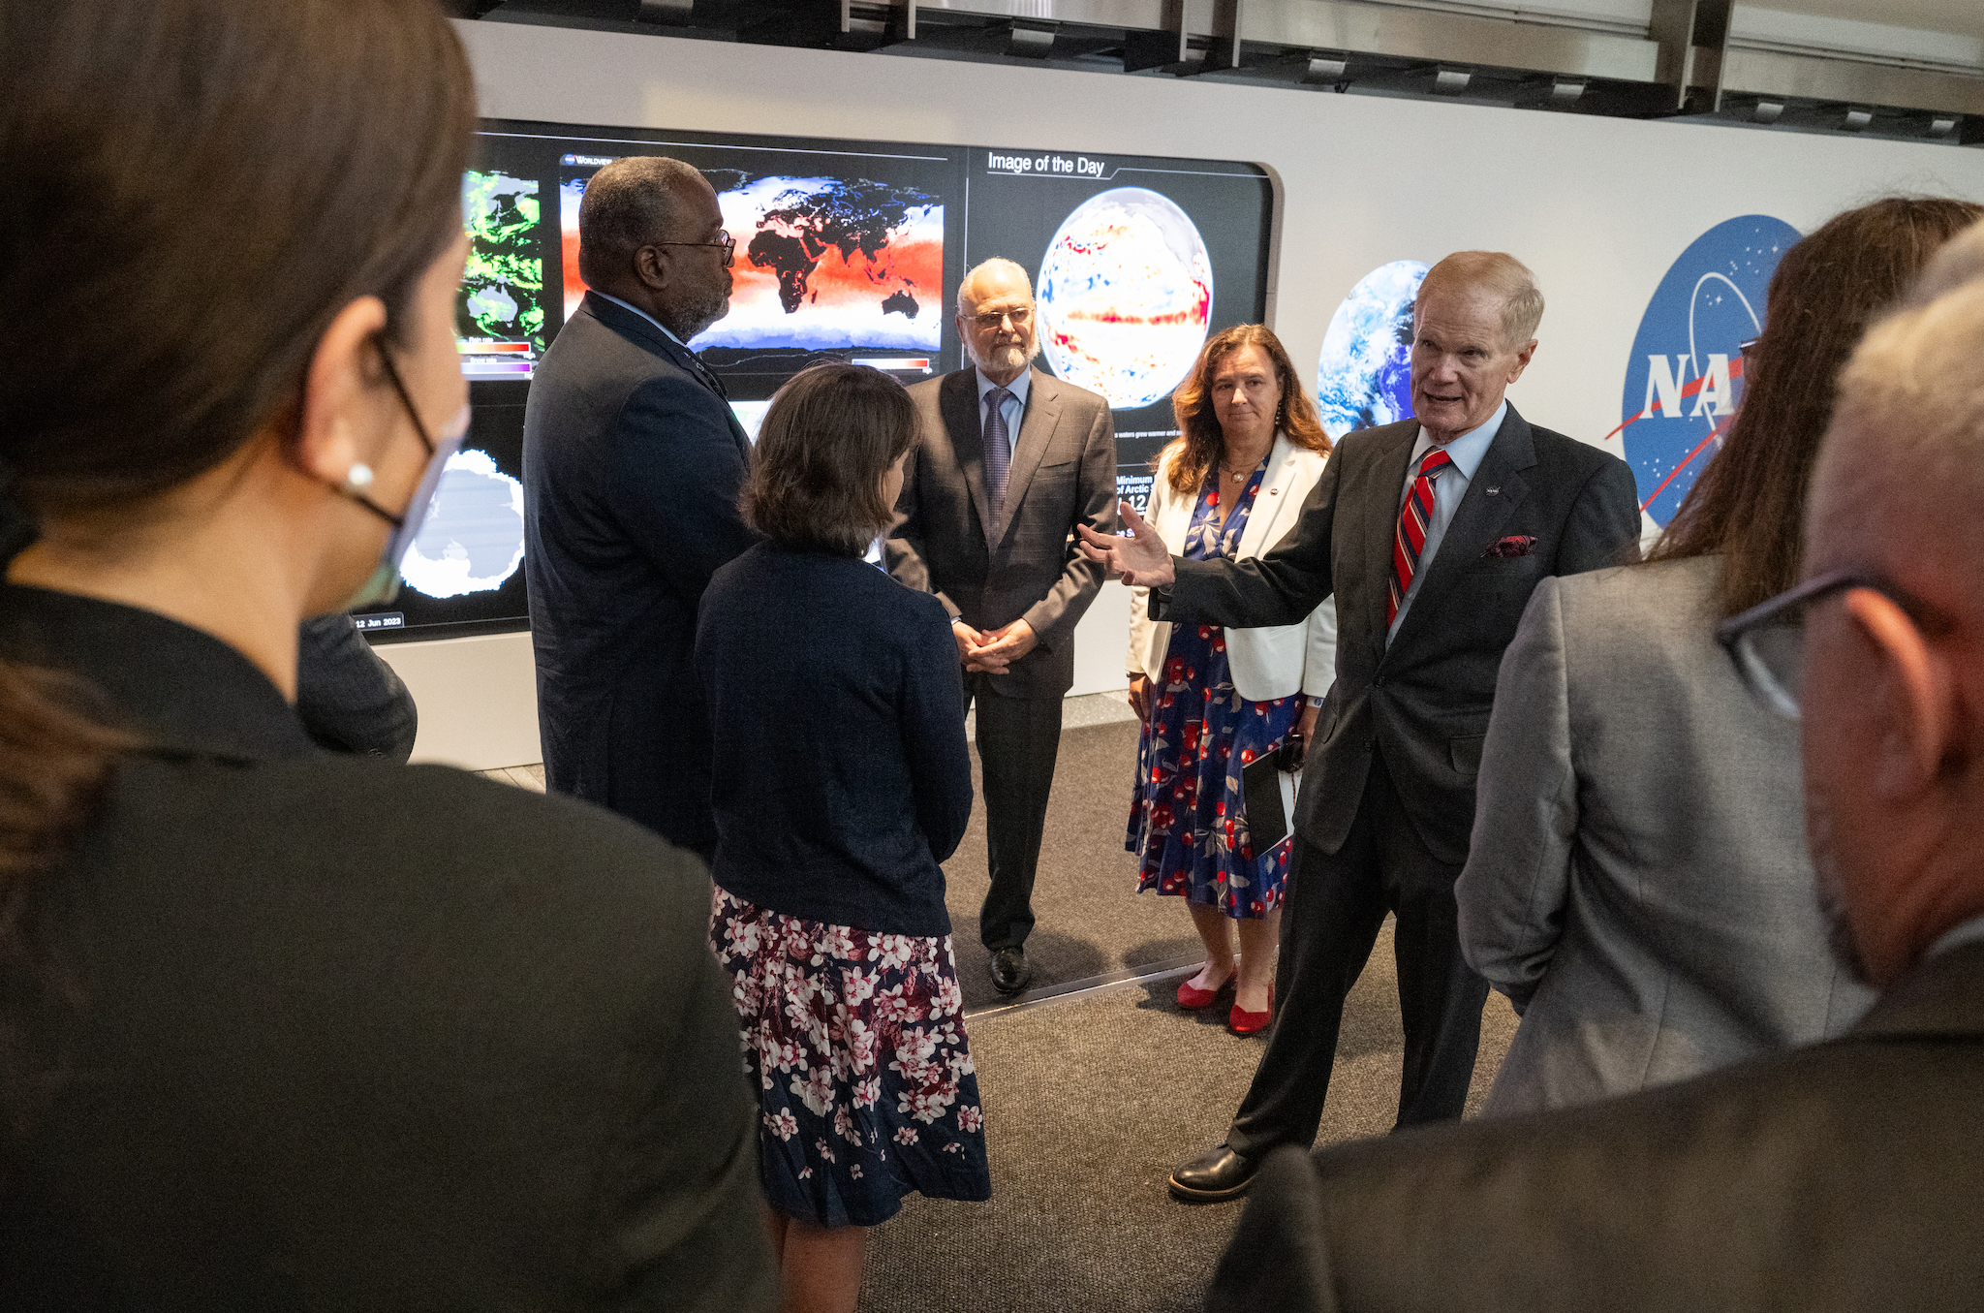
Data Visualization - Worldview
Worldview is a visualization user interface for over 1000 global, full-resolution satellite imagery layers, allowing users to visualize and then download the underlying data.
Worldview is integrated into NASA’s Earth Information Center Hyperwall exhibits at NASA Head Quarters, The Smithsonian Natural History Museum and earth.gov
In 2023, Worldview served more than 5000 unique users with 10,000 daily page views. It was cited in over 300 journal and news articles.
NASA Administrator Bill Nelson at the NASA Earth Information Center Hyperwall. This installation contains live Worldview instances of recently-acquired satellite imagery.
Notes:
EGIS - Earthdata Geospatial Information Service
ESRI - Environmental Systems Research Institute
https://naturalhistory.si.edu/NASA-EIC
https://earth.gov/stories/hyperwall

Slide 16
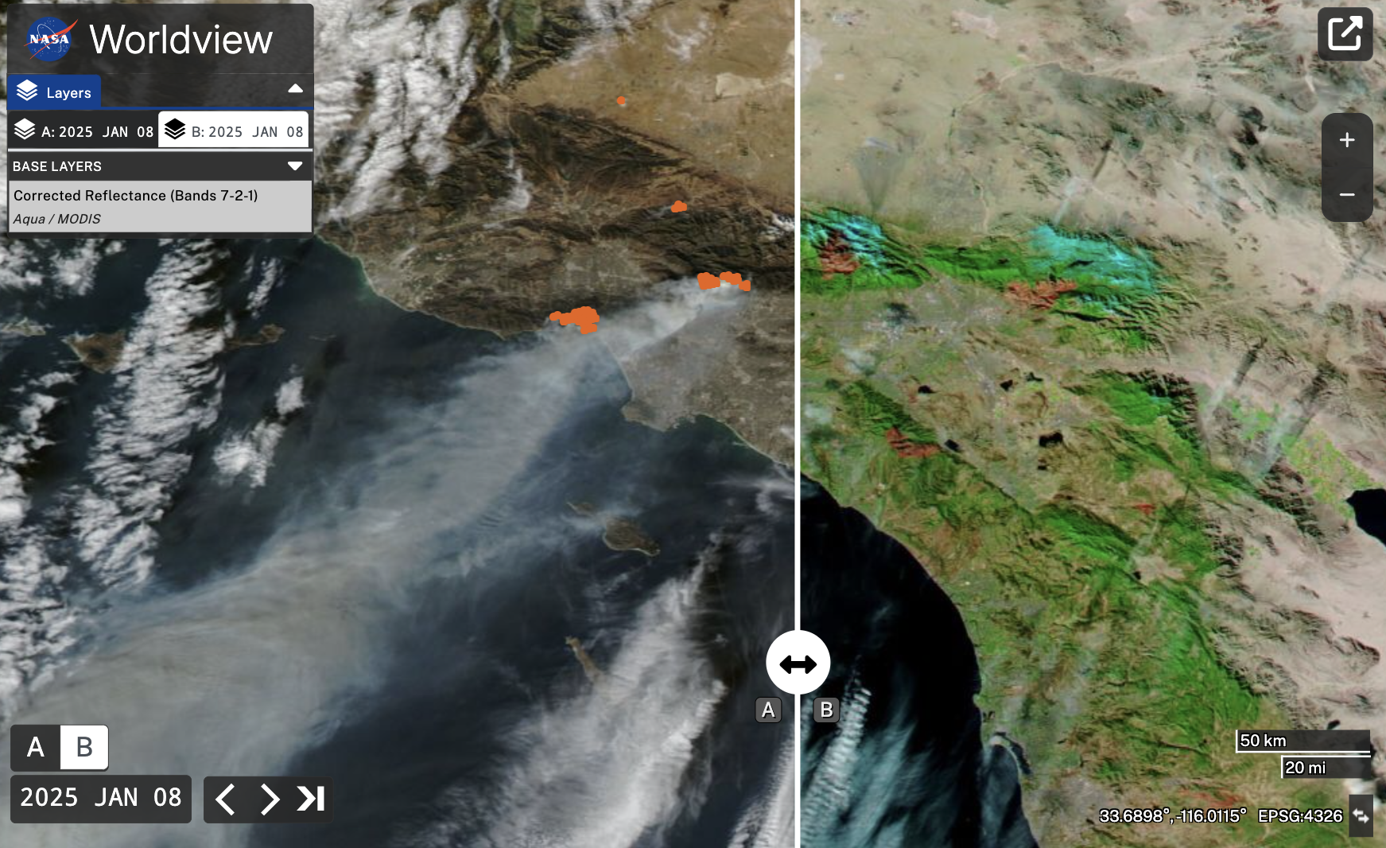
Data Visualization - FIRMS
The Fire Information for Resource Management System (FIRMS) distributes Near Real-Time (NRT) active fire data as part of the NASA’s Land, Atmosphere Near real-time Capability for Earth observation (LANCE). Globally these data are available within 3 hours of satellite observation, but for the US and Canada active fire detections are available in real-time.
In 2023, FIRMS served more than 3.8 million users from over 180 countries, over 13 million pageviews. On average FIRMS sends out 70,000 fire alerts per day. During the California Wildfires of 2025 FIRMS was received more page views than any other NASA site.
Notes:
FIRMS - Fire Information for Resource Management System
LANCE - Land, Atmosphere Near-real-time Capability for EOS
https://firms.modaps.eosdis.nasa.gov/usfs/map/#m:advanced;d:2025-01-07..2025-01-08;l:fires_landsat_landsat,fires_modis_aqua,fires_modis_terra,fires_viirs_noaa20,fires_viirs_noaa21,fires_viirs_snpp,fire-perimeter,countries,earth;@-118.25,34.22,9.96z
https://www.earthdata.nasa.gov/news/worldview-image-archive/wildfires-los-angeles-california

Slide 17
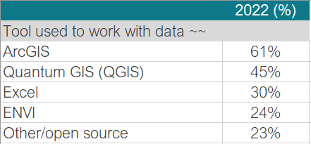
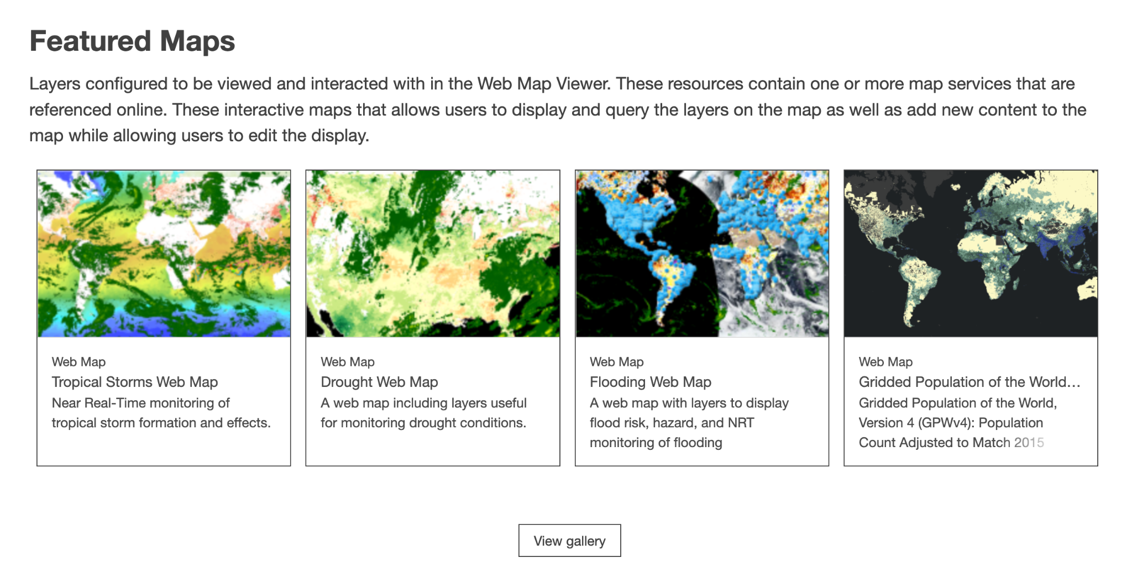
Data visualization - EGIS
In 2022, after examining NASA’s annual American
Customer Satisfaction Index results, it became clear
that NASA needed to provide support for our users in
the ESRI/ArcGIS ecosystem.
EGIS, the Earthdata Geospatial Information system,
provides
ArcGIS & OGC-compliant raster & feature services
Map layers, Story maps, Web maps, Map applications
Notes:
EGIS - Earthdata Geospatial Information Service
ESRI - Environmental Systems Research Institute
OGC - Open Geospatial Consortium
https://gis.earthdata.nasa.gov/

Slide 18
Consolidation of tools and services

Slide 19
Web unification & Service de-duplication
Web Unification
Service Deduplication
Simpler, more coherent set of information and tooling for engaging with NASA Earth data
Reduced infrastructure and maintenance for NASA
Unifies all ESDS-funded public facing web properties into earthdata
Ensures common look and feel across content
Compliance with the IDEA Act
Identify areas of overlap between existing tools and services and converge where possible
Maintain as much value as possible for unique user communities
Notes:
21st Century Integrated Digital Experience Act (IDEA) that was signed into law in 2018. The Act requires all agencies in the executive branch to make sure their websites are compliant with Section 508, have a consistent look and feel, are searchable, secure, mobile-friendly, and without duplicative information.

Slide 20
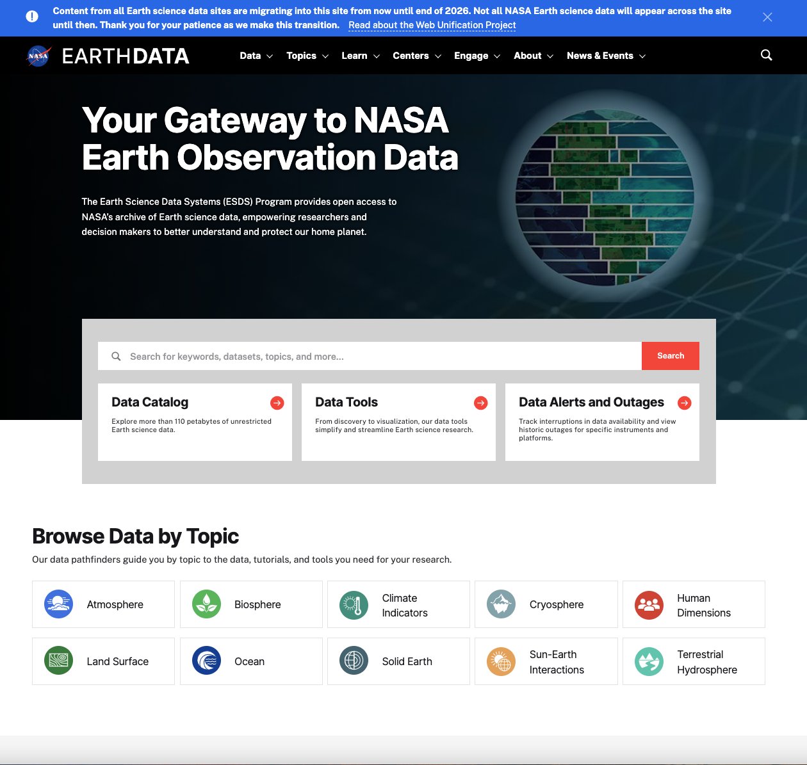
Web Unification
https://earthdata.nasa.gov

Slide 21
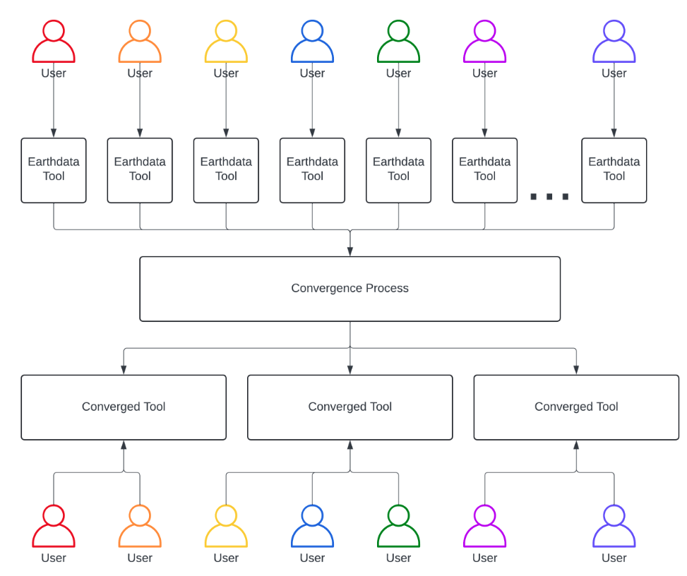
Service de-duplication
No. of converged tools/services < No. of original tools/services

Slide 22
Ingest & Archive - SIA
The past: data is archived, on-premises, at twelve archive centers (DAACs)
The present: Cumulus: data is archived in the cloud but infrastructure and data is distributed across multiple tenants and managed by our DAACs
The future: Service for Ingest & Archive (SIA) centralized, enterprise archive
SIA will be ‘a world-class, forward-looking, cost-efficient data archive system for Earth Science’
Status: planning and requirements development
Notes:
DAAC - Distributed Active Archive Center
Cumulus issues;
distributed software is costly to maintain and operate
cloud-native data access is cumbersome for users requiring data from multiple disciplines

Slide 23
Processing - Harmony
The past: A consolidation of various enterprise-level data processing services, using standards-based, OGC-inspired APIs.
The present: Integration of GES DISC processing functionality represented in Giovanni.
The future: Integration of processing capabilities from other DAACs. For example,
HyP3 SAR processing - Alaska SAR Facility
AppEEARS - Land Processes DAAC
Notes:
OGC - Open Geospatial Consortium
HyP3 - Hybrid Pluggable Processing Pipeline
SAR - Synthetic Aperture Radar
AppEEARS - Application for Extracting and Exploring Analysis Ready Samples

Slide 24
Thank you
CONTACT
douglas.j.newman@nasa.gov
WEBSITE
earthdata.nasa.gov
SOCIAL MEDIA
@NASAEarthData
Contact me at…

