Slide 1
JAXA Agency Report
Dr. Makoto NATSUISAKA JAXA
Agenda Item 2.4
WGISS-59
24-28 March, 2025
Bangkok, Thailand

Slide 2
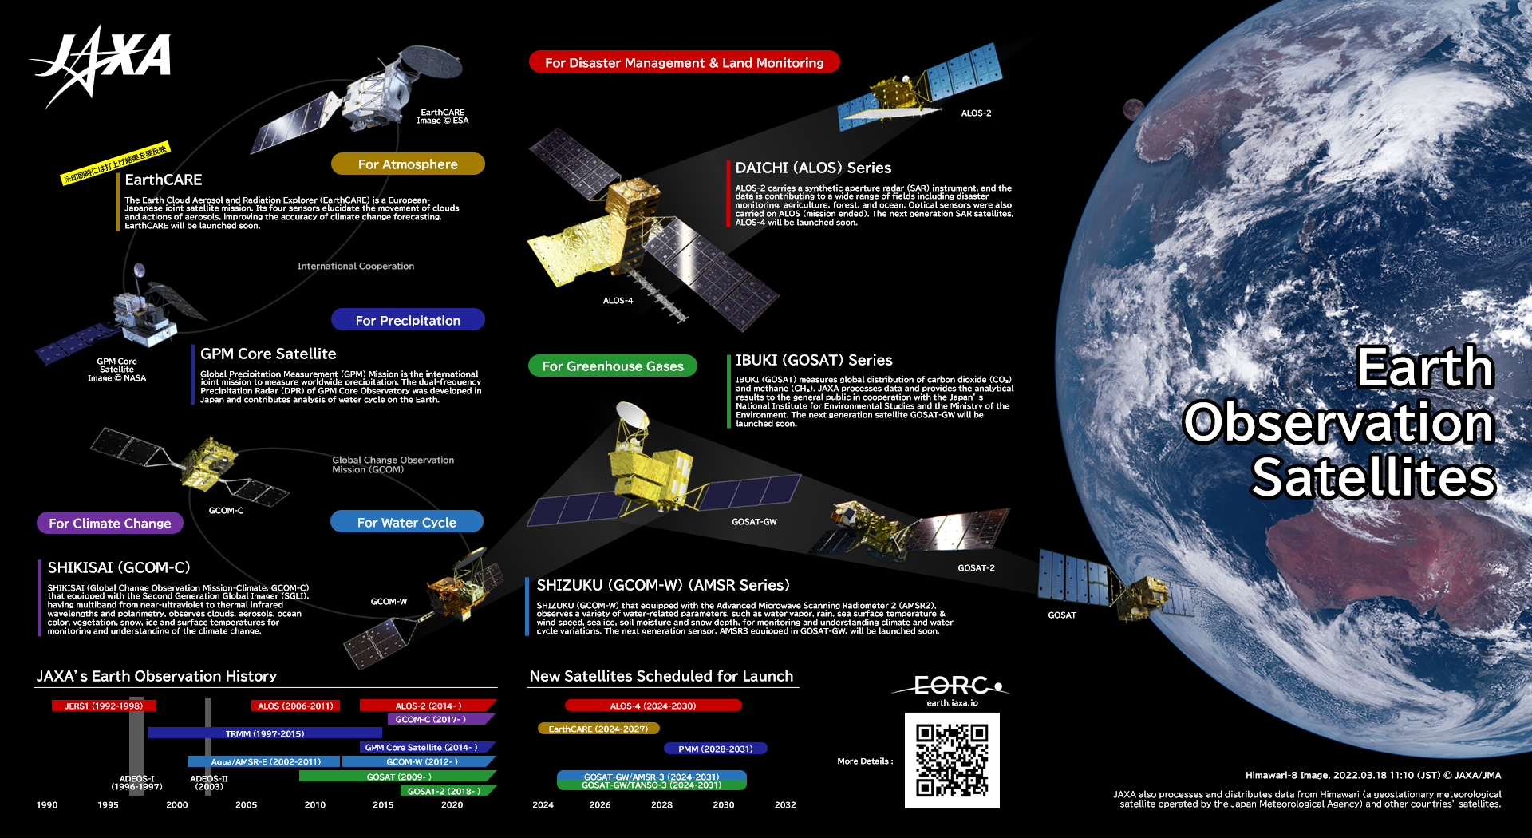
Presentation Guidance
(2025-)

Slide 3
History and Launch Schedule
May 29, 2024: EarthCARE (Hakuryu) launched by Space X Falcon 9, JAXA provides Cloud Profiling Radar (CPR). (Successful)
July 1, 2024: ALOS-4 (Daichi 4) (SAR) by H3 F3 (successful)
JFY*2025: GOSAT-GW (GHG spectrometers and microwave radiometer) to be launched with H-IIA *JFY starts from April

Slide 4
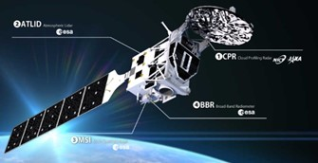
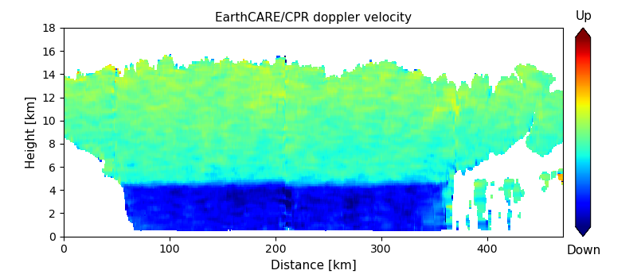
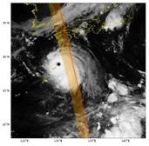
New Satellite - EarthCARE
EarthCARE is a joint mission with ESA.
JAXA and NICT provide CPR, which is the world’s first W-band Doppler radar (94GHz) enabling observations of vertical structure of clouds, as well as the ascending and descending movement of clouds, to the mission.
Vertical distribution of the CPR Doppler velocity for a tropical cyclone in the northeast Pacific
(22 UTC, 22 August 2024)

Slide 5
EarthCARE Update
L1 b products were released in Jan. 2025.
Level 2 products were released in Mar. 2025.
<JAXA products>
https://www.eorc.jaxa.jp/EARTHCARE/data/L2prd_list_std_e.html
<ESA products>
https://www.eorc.jaxa.jp/EARTHCARE/data/ESA_L2prd_list_e.html
The CPR is sensitive to thick cloud, while the ATLID is sensitive to thin cloud. Combining the CPR and the ATLID allows observation of a wider range of cloud types

Slide 6
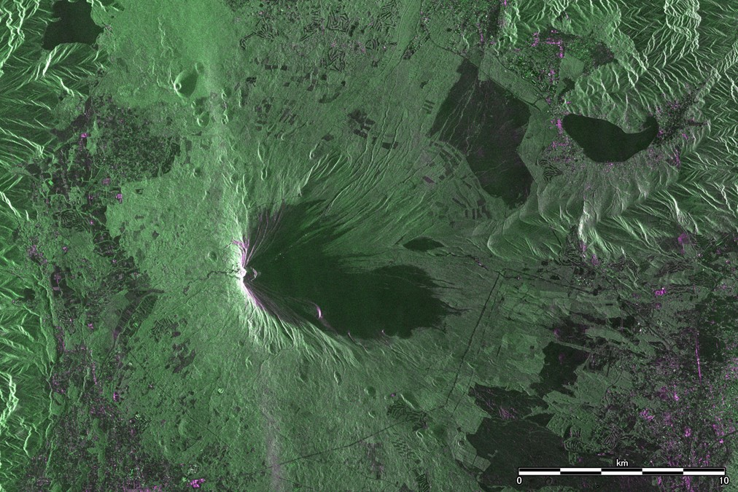
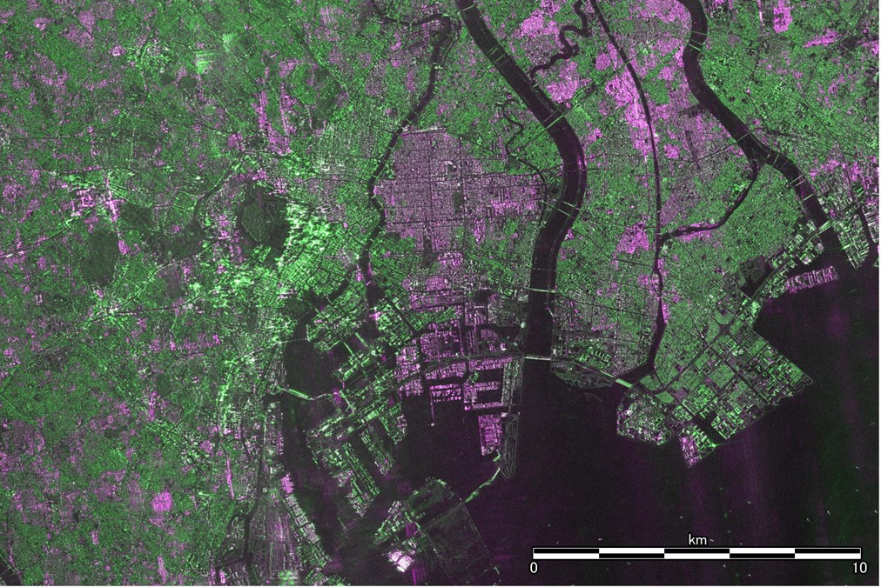
New Satellite - ALOS-4
Advanced Land Observing Satellite-4 “DAICHI-4” (ALOS-4) is a Phased Array type L-band Synthetic Aperture Radar-3 (PALSAR-3) satellite dedicated to disaster monitoring, observations for GIS information, etc.
Extended swath width to 200 km with world's highest resolution (3 m)
Mt. Fuji Downtown Tokyo

Slide 7
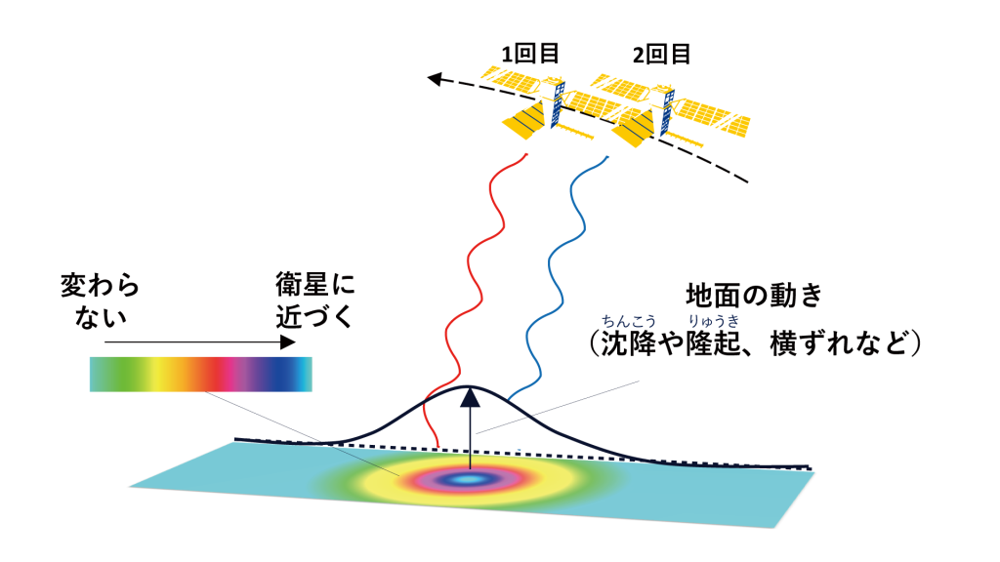
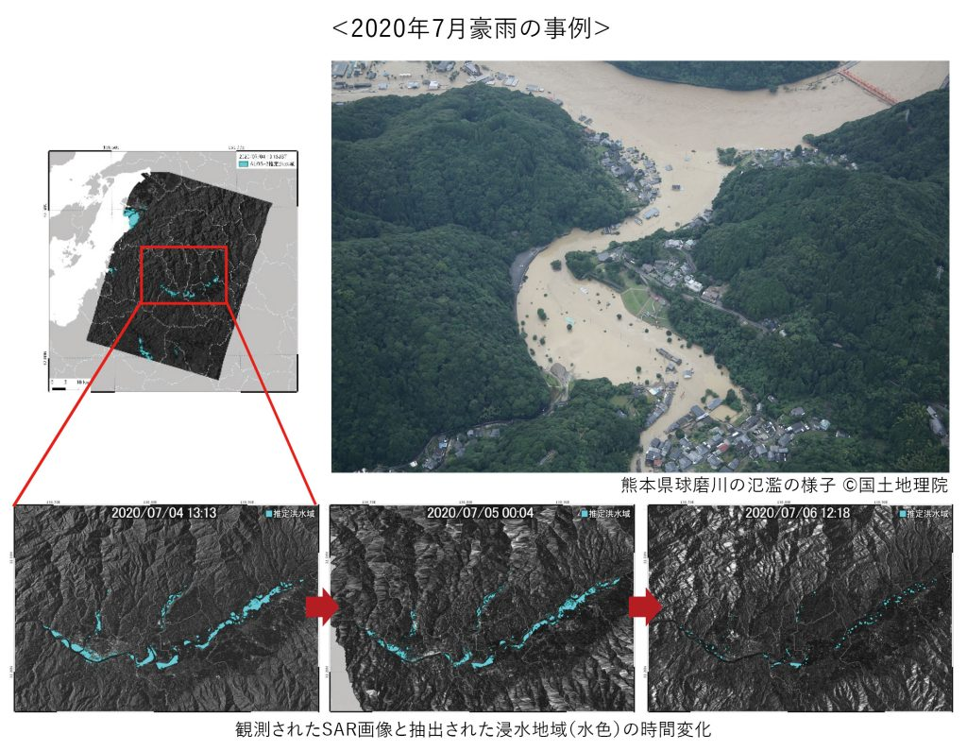
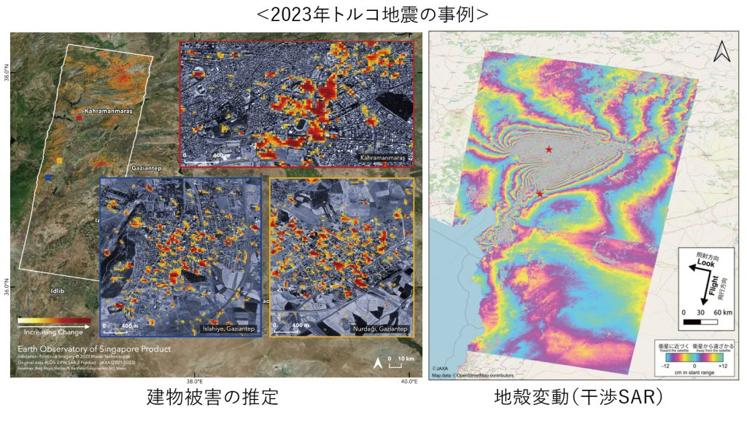
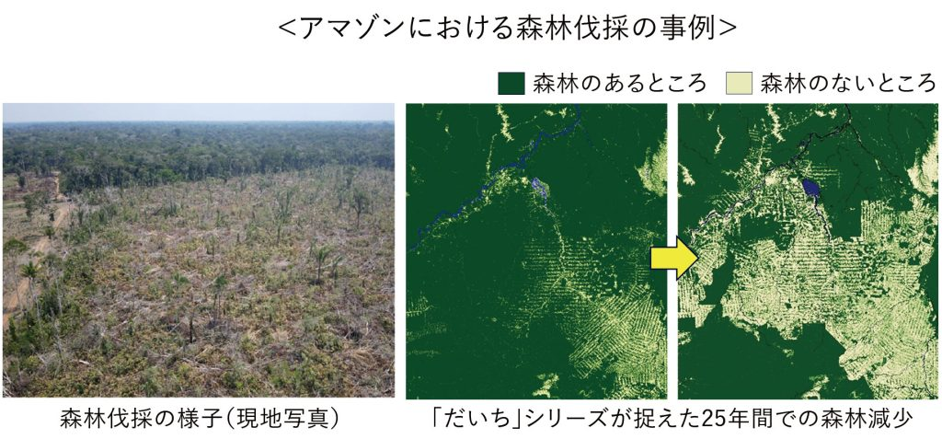
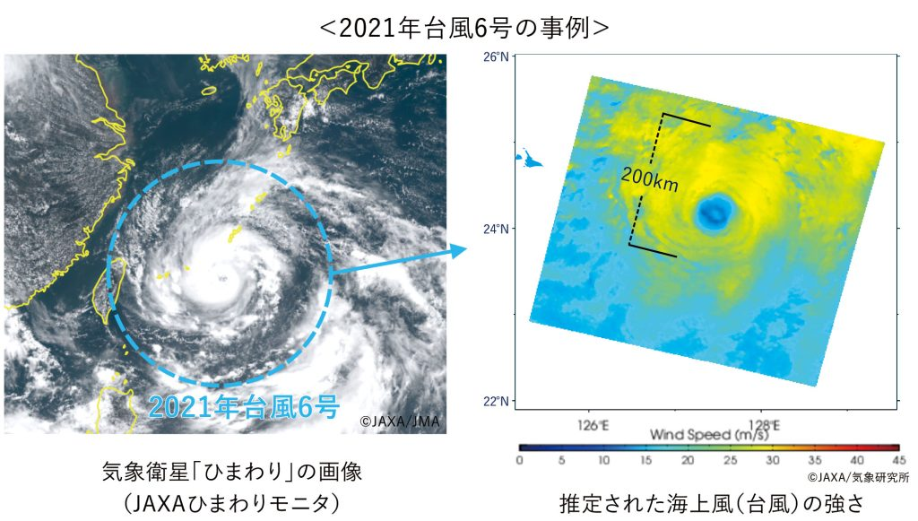
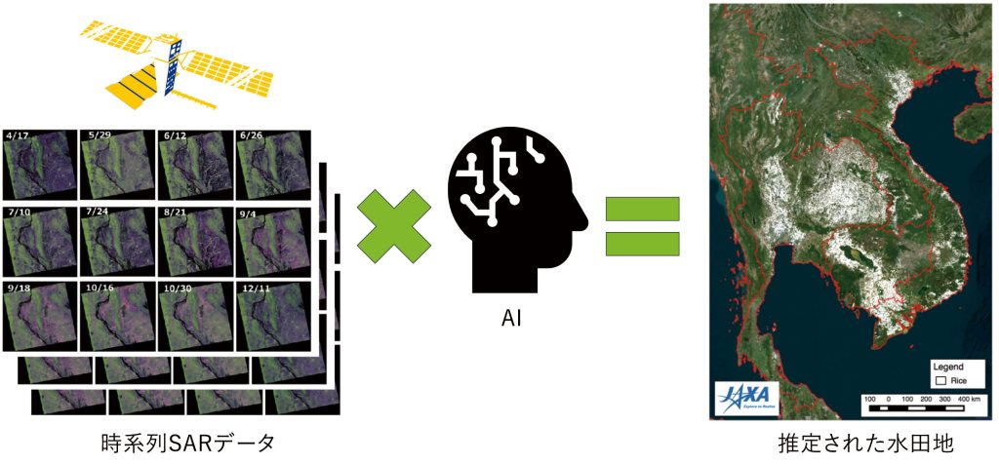
ALOS-4
Crustal Movement
Disaster Monitoring
Forest/ Agriculture
Ocean

Slide 8
ALOS-4 Update
ALOS-4 was successfully launched on July 1, 2024, and CAL/VAL has been carried out.
Products will be released soon vis commercial data providers. The data providers were selected in Jan. 2025.
Tenchijin : https://tenchijin.co.jp/
PASCO : https://alos-pasco.com/

Slide 9
New Satellite - GOSAT-GW
GOSAT-GW is a joint mission with JAXA and Japanese Ministry of the Environment (MOE) will carry two instruments, AMSR3 & TANSO-3.
AMSR3, developed by JAXA, will succeed AMSR series observations adding new high-frequency channels for solid precipitation retrievals and water vapor analysis in NWP.
TANSO-3, led by Japanese Ministry of the Environment (MOE), will improve observation capability of greenhouse gases from GOSAT-2/TANSO-2. (Choose grating spectrometer to enable spatially detailed observation)

Slide 10
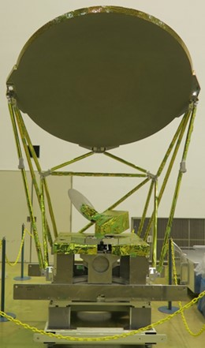
GOSAT-GW Update
AMSR3 specifications:
https://www.eorc.jaxa.jp/AMSR/satellite/gosat-gw_en.html
・ Additional 166 & 183 GHz channels to enable monitoring of global precipitation (rain & snow) and contribute to water vapor analysis in NWP
・ Additional 10.25 GHz channels with improved NEDT to enable robust SST retrievals in higher spatial resolution
AMSR series (AMSR-E, AMSR2, AMSR3: Microwave channels of 6.9-89GHz) achieve continuous observation +22 years
The launch is expected in JFY2025.

Slide 11
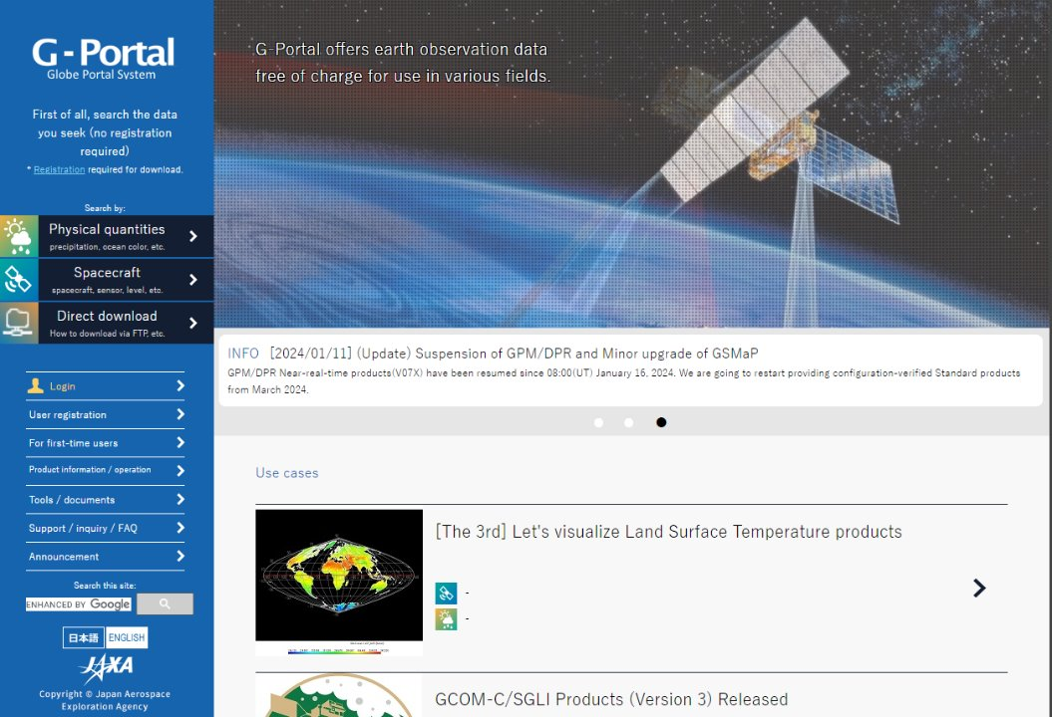
G-Portal
GｰPortal (https://gportal.jaxa.jp/) is a data dissemination system for JAXA EO products.​
enabling search & download of products via HTTPS and SFTP
providing products, documents, tools etc.​
connected with FedEO and IDN based on the CEOS Opensearch
Web API (WMS, WCS) are available
12,000 users, 2.4PB products (Mar. 2025) (increasing 0.4PB/year)

Slide 12
G-Portal Updates
New products (EarthCARE L1b, L2a) have been added since Jan. 2025.
CEOS Opensearch server and WebAPI server have been updated.
Investigation on STAC has been carried out.
Cloud migration has just started. ​
associated information was obtained through participation in the 3rd CGMS WGIV cloud technology workshop.
Preliminary investigations on AI/ML and foundation models have been started.

Slide 13
DOI Updates
Numbers of DOI registration are
standard products … 1,023 <- https://gportal.jaxa.jp/
research products … 15 <- https://earth.jaxa.jp/en/data/index.html
ref. https://earth.jaxa.jp/doi/ja/

