Slide 1
WGISS-59
CSIRO agency report
Matt Paget, CSIRO
Agenda Item 2.2
WGISS-59
24-28 March, 2025
Bangkok, Thailand

Slide 2
Overview
EASI 2.0 🡪 CSIRO cloud-hosted data analytics platform
SAR backscatter 🡪 ARD product workflow
Land and coastal mapping 🡪 Regional EO applications
AVHRR 🡪 CEOS historical data collection
Himawari 🡪 New product workflow
Hyperspectral and ODC 1.9 🡪 New product & analytics capability
EASI data catalogue services 🡪 CEOS interoperability

Slide 3
EASI 2.0
AWS EKS Auto for much reduced maintenance overhead
CEOS Analytics Lab can be updated in the next week or two
Karpenter for improved node/pod spin-up and scaling efficiency (> 2x)
More GPU options
ARM64 image builds for ODC environment and custom processing
Anticipate reduction in AWS costs
Towards: multi-AWS-region processing

Slide 4
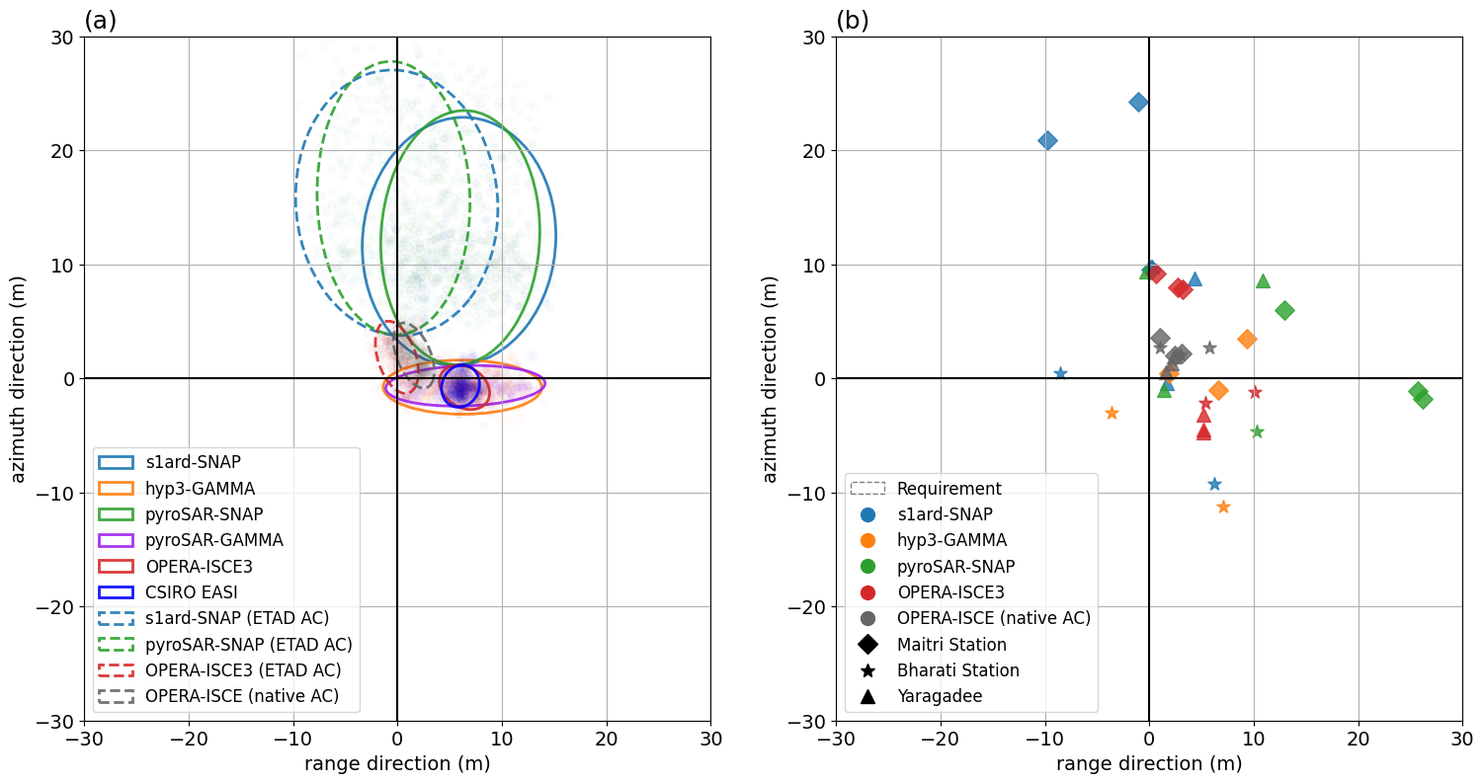
SAR backscatter
Processing workflow built in EASI
ASF source, SNAP-10, scalable
Intercomparison exercise with GA
Conversations with JPL NISAR & Opera teams
Used by the CEOS biodiversity / ecosystem extent study team
Applications in Aust and Asia
Flooding, land mapping
Intercomparison of S1 backscatter for study sites in Australia. S1 backscatter produced with multiple methods: SNAP, pyroSAR, Gamma, Opera and EASI. Analysis and results to be published soon. Compliments of Geoscience Australia.

Slide 5
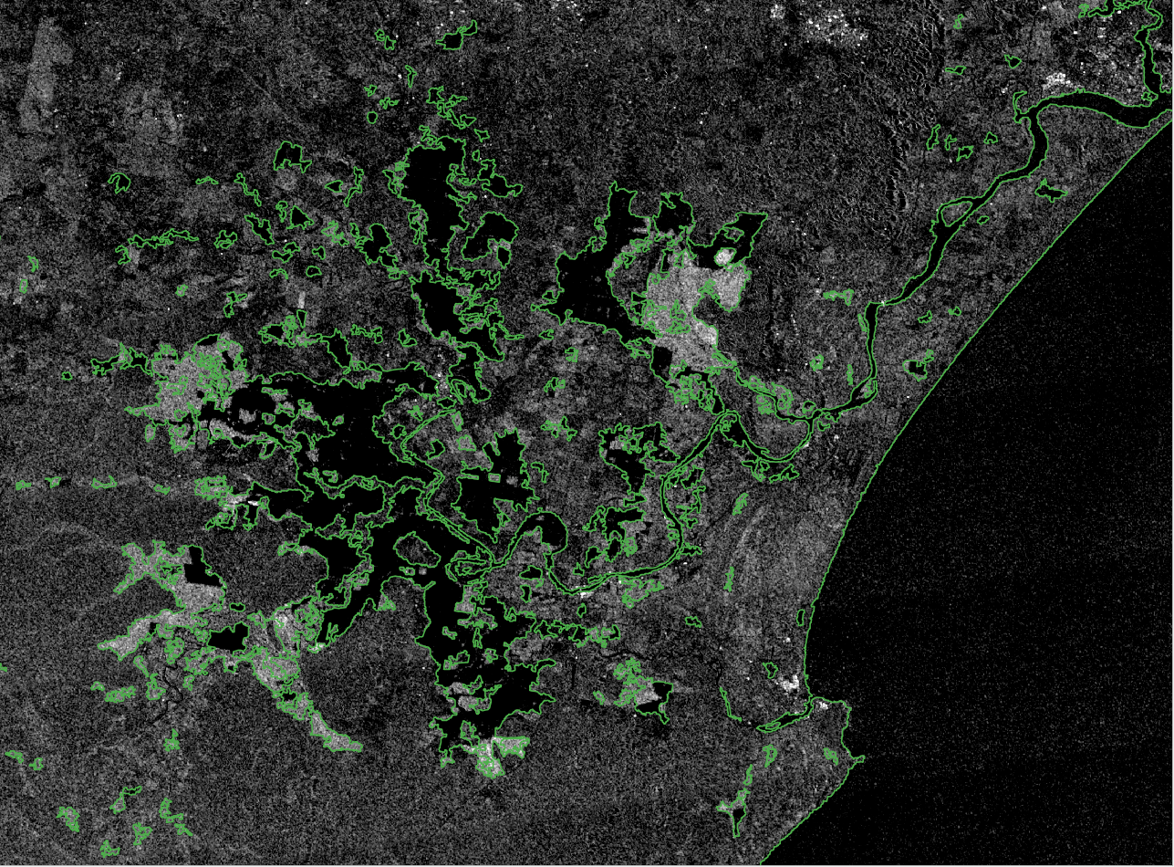
NovaSAR for cyclone Alfred
NovaSAR-1 flood analysis for northern NSW, March 2024. HH NovaSAR image captured on 10 March 2025. "Dark" backscatter represents open water and specular (mirror-like) reflections. ”Bright" areas occur where water is present beneath vegetation - the signal has a strong double bounce off the water surface and the vertical trunks. This scattering mechanism would not occur in the Sentinel-1 data because it is VV/VH (no HH polarisation).

Slide 6
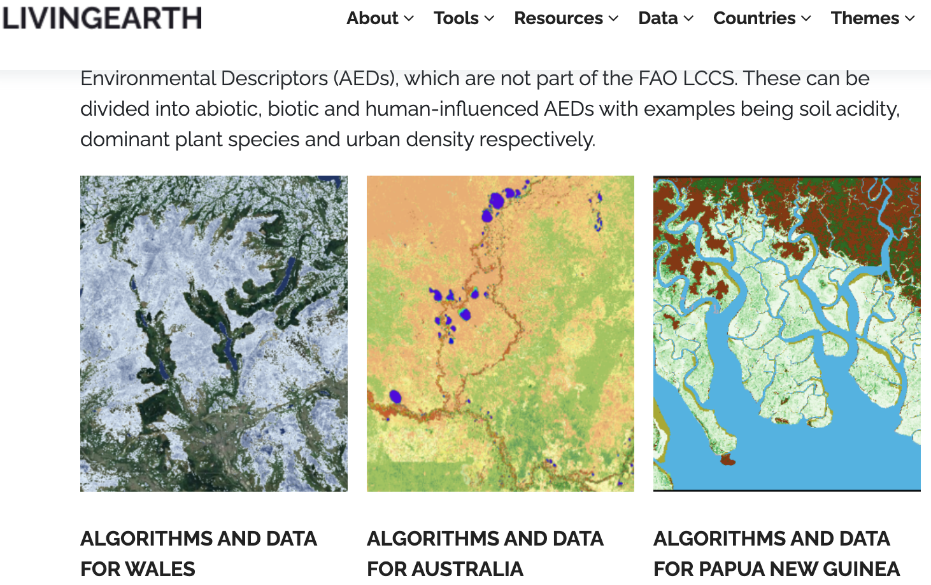
Land and coastal mapping
Land Cover Classification System (LCCS) built in EASI
Decision tree framework for separating classes
Compatible with “Living Wales” and DEA Land Cover
Training tools and notebooks
Global datasets provide a baseline, then specialize per application / area
Land and coastal mapping projects in SE Asia (with in-country partners)
PNG, Vietnam, Bangladesh, (more expected soon)
Aquawatch – inland and offshore water quality
https://livingearthhub.org/
Aquawatch international pilot sites (Asia), Aust)

Slide 7
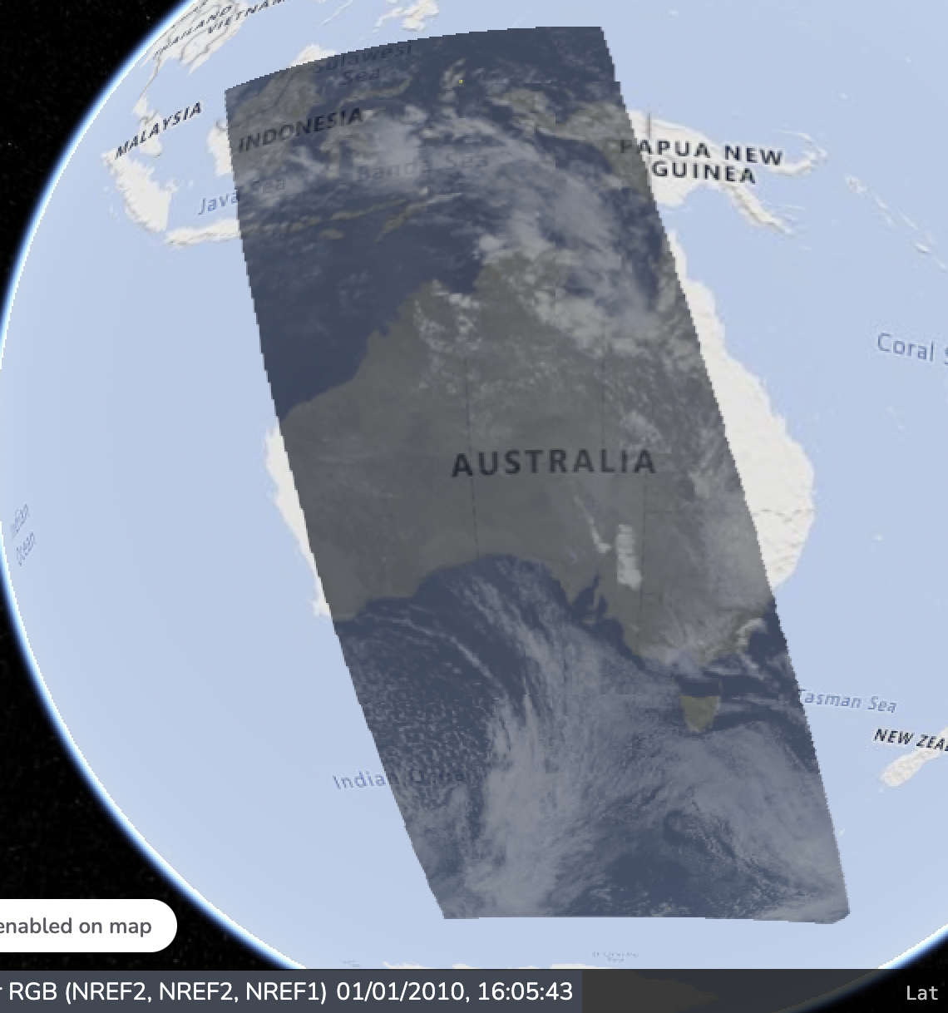
Australian AVHRR
Current online archive (Australian cut-outs), https://explorer.csiro.easi-eo.solutions/products/avhrr_toa
Archive uplift L0 🡪 L1C (WGISS-56)
Collating and publishing information
Scene footprints
Atmospheric correction (WGISS-57, 58)
Re-implemented our original at.corr. method
Trialing RTTOV
Updated and consistent ancillary datasets
Comparison of methods exercise?
Living Planet Symposium 2025 🡪 ”Atmospheric Correction of the 30+ Year Australian AVHRR Archive using the RTTOV radiative transfer model”, Andrew Prata et al
Example AVHRR BRDF-corrected mosaic

Slide 8
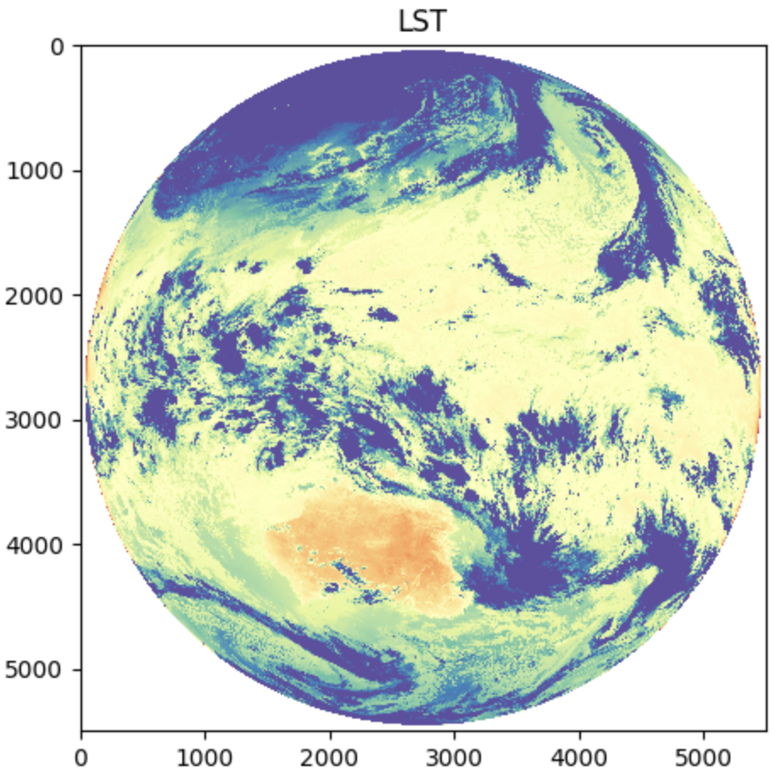
Himawari
Geostationary over Pacific and east Asia (JMA, JAXA)
Source: AWS opendata (NOAA)
Developing a TOA workflow
Unpack (bz2) and combine (strips) using satpy
Retain digital numbers to apply custom/future calibrations
Write to COG / Zarr for efficient dense time-series data loading
Applications
At.corr. workflows: volcanic ash transport
Land surface: cloud masking with other sensors
Example Himawari image full-disk (1 Dec 2022), processed to LST

Slide 9
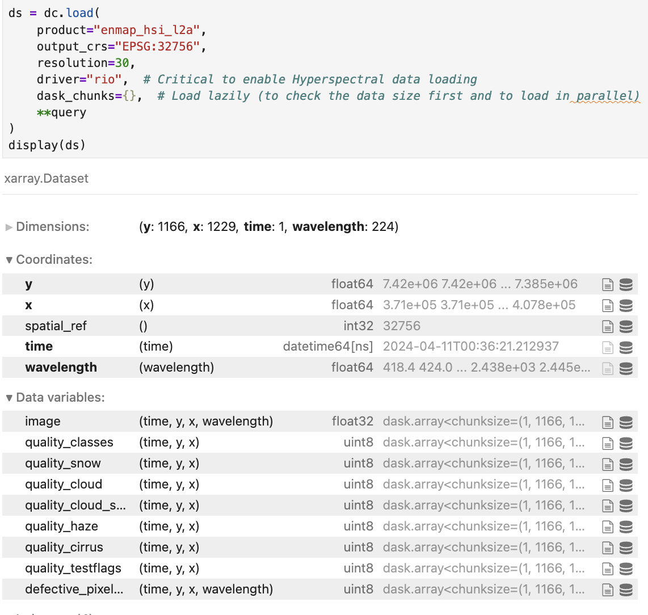
Hyperspectral and ODC 1.9
ODC 1.9 supports custom data loading and multiple dimensions
Improved flexibility and efficiently for search and load
Hyperspectral sensors
EnMAP, EMIT, Prisma, etc
Wavelength as a dimension
Select and slice bands (like time/space)
Convolve bands

Slide 10
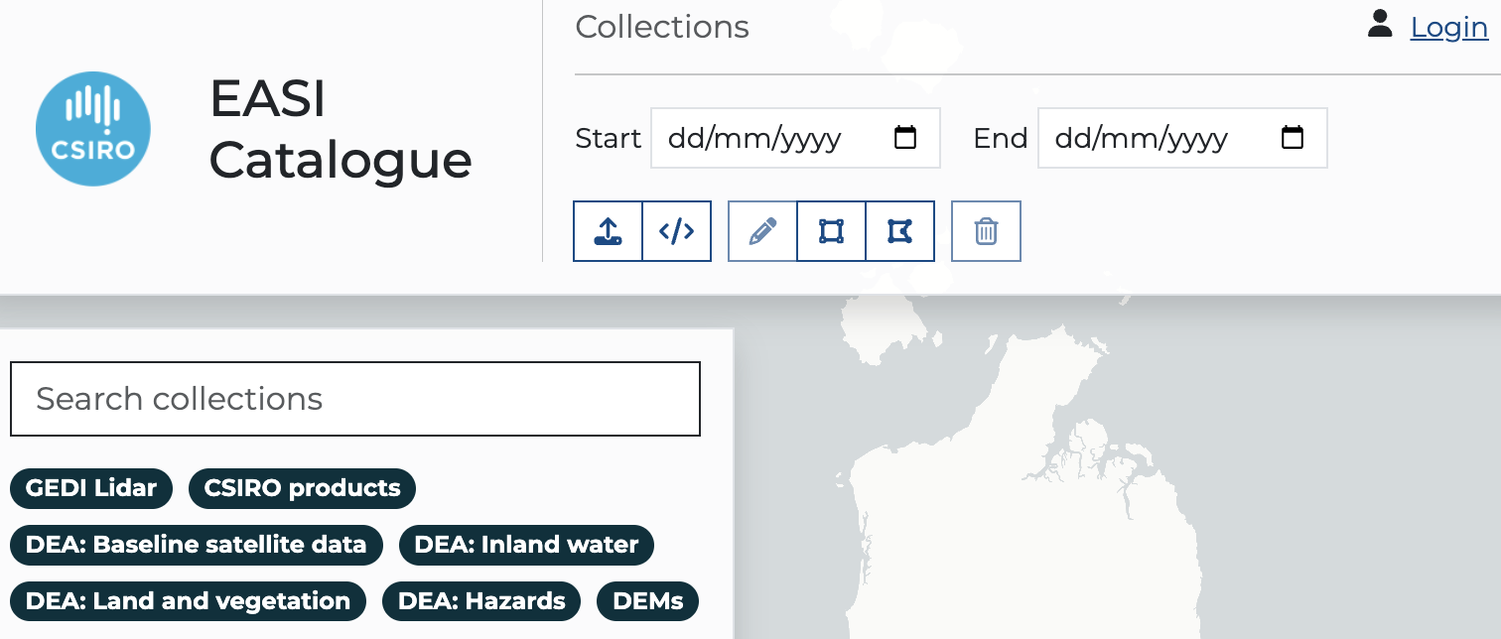
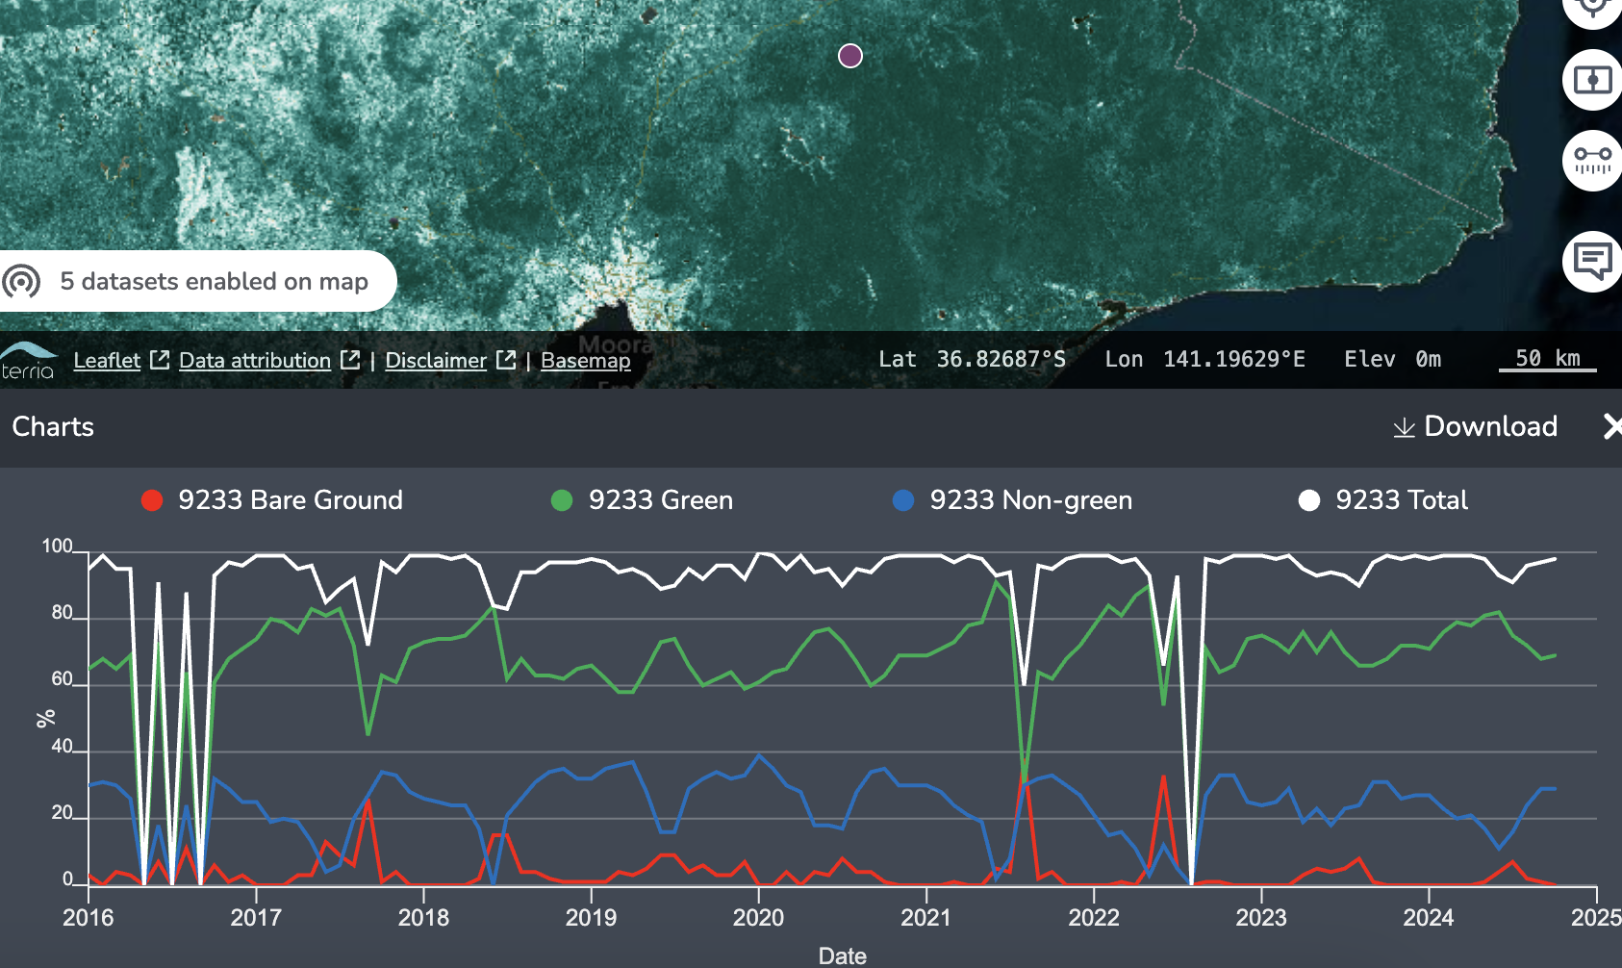
EASI data catalogue services
Rationale
Improved integration, discovery and use of data for our researchers
Align with CEOS interoperability
Expected features
Data product workflows: user ordering, status transparency, BYO data
Data product information
STAC endpoint
Web processing services
Work in progress: https://catalogue.dev.easi-eo.solutions/
Work in progress: https://wps.dev.easi-eo.solutions/

Slide 11
Thank you
Matt Paget – matt.paget@csiro.au
Robert Woodcock - robert.woodcock@csiro.au Former CEOS WGISS Chair
… plus a cast of many ☺

