Slide 1
Agency Report - UKSA
Robert Fletcher, UKSA
Agenda Item 2.1
WGISS-59
24-28 March, 2025
Bangkok, Thailand

Slide 2
Future Missions with UK involvement
Biomass - Biomass was conceived by Prof Shaun Quegan, of the National Centre for Earth Observation (NCEO) and based at the University of Sheffield, to address the huge uncertainties in the amount of carbon stored in forests and how this changes with time
MicroCarb - MicroCarb is a ground-breaking UK-French bilateral space mission. Led by UK Space Agency and CNES, the French space agency, it will be the first European satellite dedicated to measuring Carbon Dioxide (CO2) – the main greenhouse gas caused by human activity and a key contributor to climate change
TRUTHS - TRUTHS is a climate focused satellite mission, led by the UK Space Agency (UKSA) in partnership with several European states. Delivered by the European Space Agency (ESA), it will facilitate improved understanding of changes in the Earth’s climate and the response to the worlds net zero agenda.

Slide 3
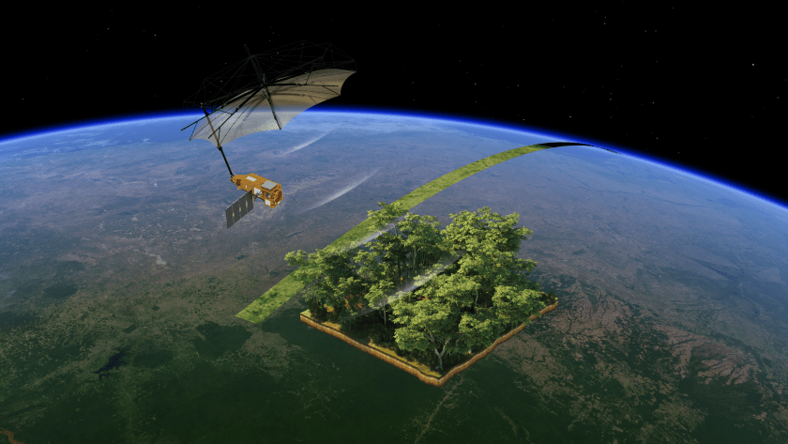
Biomass UK contributors
UK Space Agency is a partner with ESA in the mission; the prime contractor is Airbus Defence and Space based at Stevenage, Herts. Other UK entities directly involved are Harwell-based ESA Climate Office, the University of Edinburgh, University College London (UCL), Enersys ABSL, European Astrotech UK and Nammo Cheltenham
Launch date: April 2025
The Biomass mission satellite will measure the world’s Tropical Forests in 3D, providing unprecedented information. Image: European Space Agency (ESA)

Slide 4
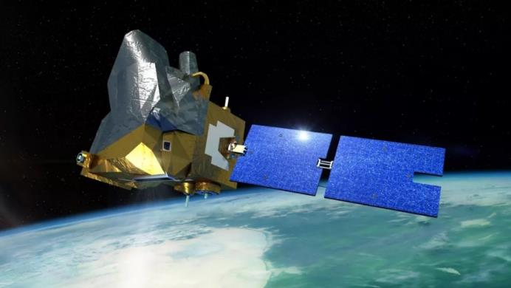
MicroCarb UK contributors
MicroCarb’s infrared spectrometer was built by Airbus France. The UK National Physical Laboratory (NPL) provided the SI-traceable ground calibration facility, and are developing algorithms and quality metrics. STFC RAL Space, based at Harwell developed the mission’s pointing and calibration system. Thales Alenia Space completed the satellite’s assembly integration and test campaign at RAL Space’s facilities and are responsible for the launch campaign preparations, whilst GMV UK designed, implemented and quality assured the algorithms and operational processors.
Launch date: Summer 2025
The MicroCarb satellite will map sources and sinks of carbon dioxide (CO2)- the most important greenhouse gas – on a global scale. Image: CNES

Slide 5


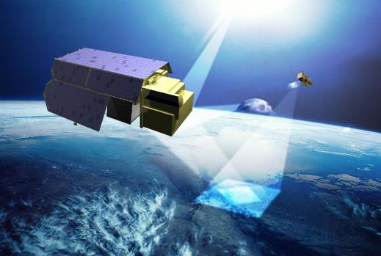
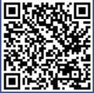
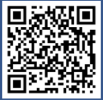
TRUTHS (UKSA contacts: Kainat Hussain/William Smith)
A UK-conceived and UK-led ESA mission. TRUTHS will be a calibration lab in space, increasing accuracy of EO data ten-fold.
It will provide a benchmark reference of the optical radiation state of the planet.
Our ambition is to host the TRUTHS ground segment in the UK, to build and develop the UK's capabilities for end-to- end delivery of a complex space mission
A UK Ground Segment will provide opportunities for scaling up skills development in the Flight Operations and Downstream sector
Planned launch date: 2030
Watch the S4C TRUTHS video:
Download the S4C TRUTHS mission explainer:

Slide 6
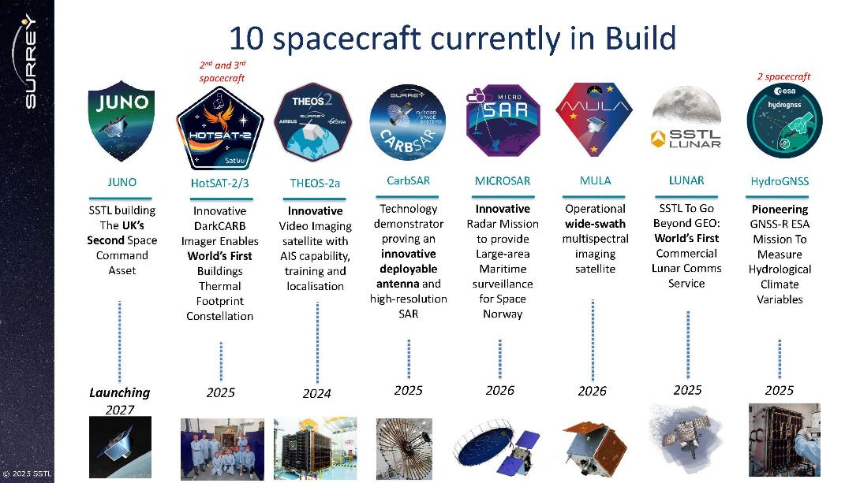
SSTL spacecraft in build

Slide 7
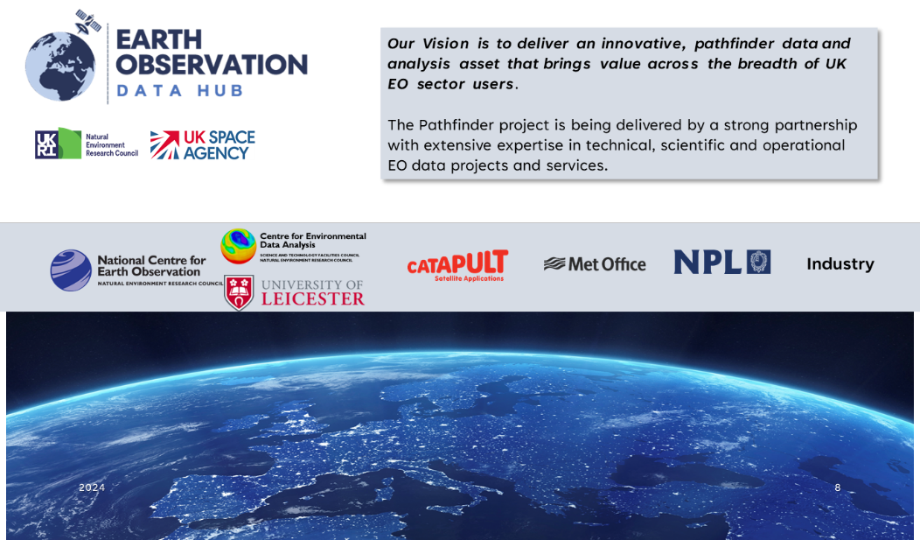
UK EO Data Hub

Slide 8
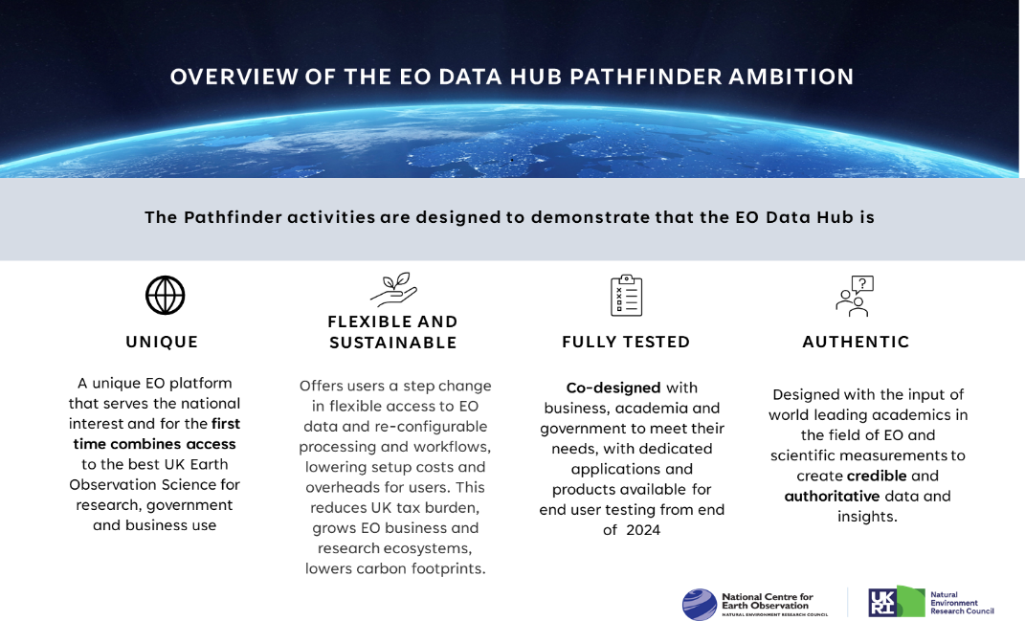
UK EO Data Hub

Slide 9
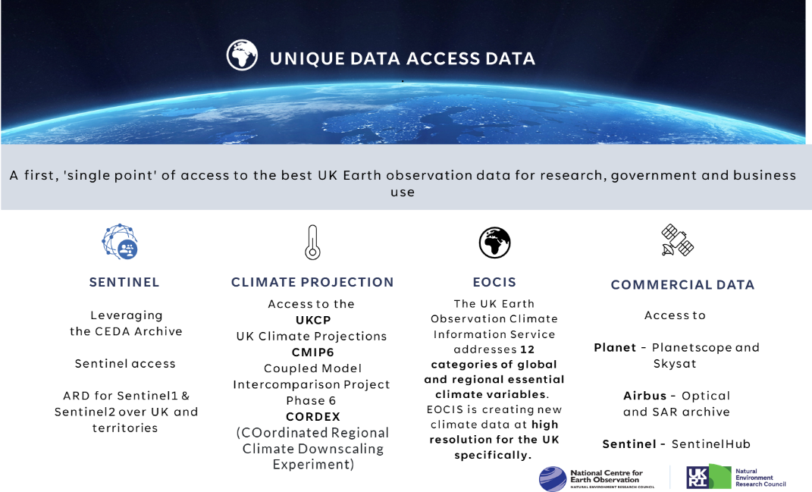
UK EO Data Hub

Slide 10
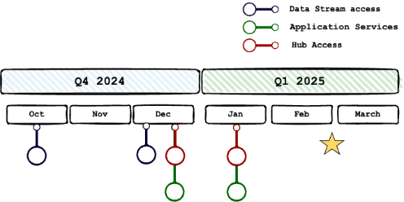


UK EO Data Hub
Hub Prototype / Pre-Production (DRAFT)
Q1 2025: EODH selected testers go live
December - Testers and evaluators; first "2" demonstrators
January - Selected and solicited demonstrators – early adopters
Application Services (Pre-production) (DRAFT)
  Q1 2025: EODH selected testers go live
  December - Testers and evaluators
  January - Go Live – early adopters
Datastreams access
  Q4 2024: Project early testers
  December – Selected access
Hub and Applications: Full Release: Q1 2025

Slide 11


UKSA’s CEOS Chair Theme: Unlocking EO Data for Society
Vast and rapidly growing collections of global satellite Earth observation data offer immense societal value. However, bridging the gap to use such data to transform public services and grow data-fuelled businesses is ongoing challenge faced by many countries.
UKSA will use our year as CEOS Chair to:
  Share knowledge and best practice for bridging the gap between EO data and public services
  Unlock EO data for the UN Framework Convention on Climate Change global stocktakes
  Champion the joint UK-NASA led work to develop best practices for the space-based measurement of methane emissions – and push for their adoption in an update to the Global Methane Pledge at COP30 in Brazil.
  Inspire the next generation with ‘CEOS in Schools’
21

Slide 12
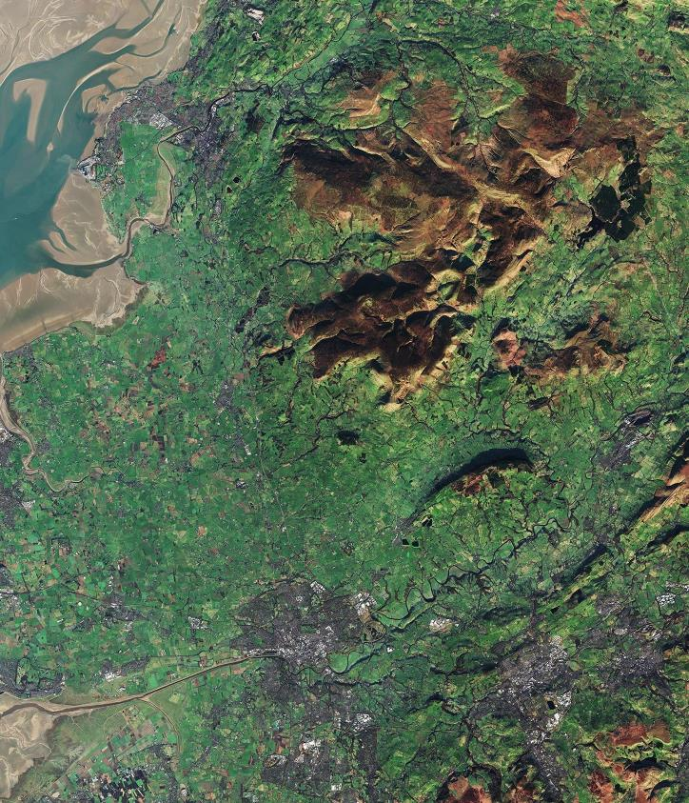

CEOS ‘In Schools’ objectives
Educate: Create a low-cost repeatable programme that can Educate and inspire young people on EO
Collaborate: Provide an opportunity for students to work collaboratively across International borders using the platform of CEOS.
Engage: Facilitate a discussion between CEOS principals and youth representatives on key CEOS topic areas.

