Slide 1
WGISS Communications
Libby Rose
Agenda Item 12.2
WGISS-59
24-28 March, 2025
Bangkok, Thailand

Slide 2
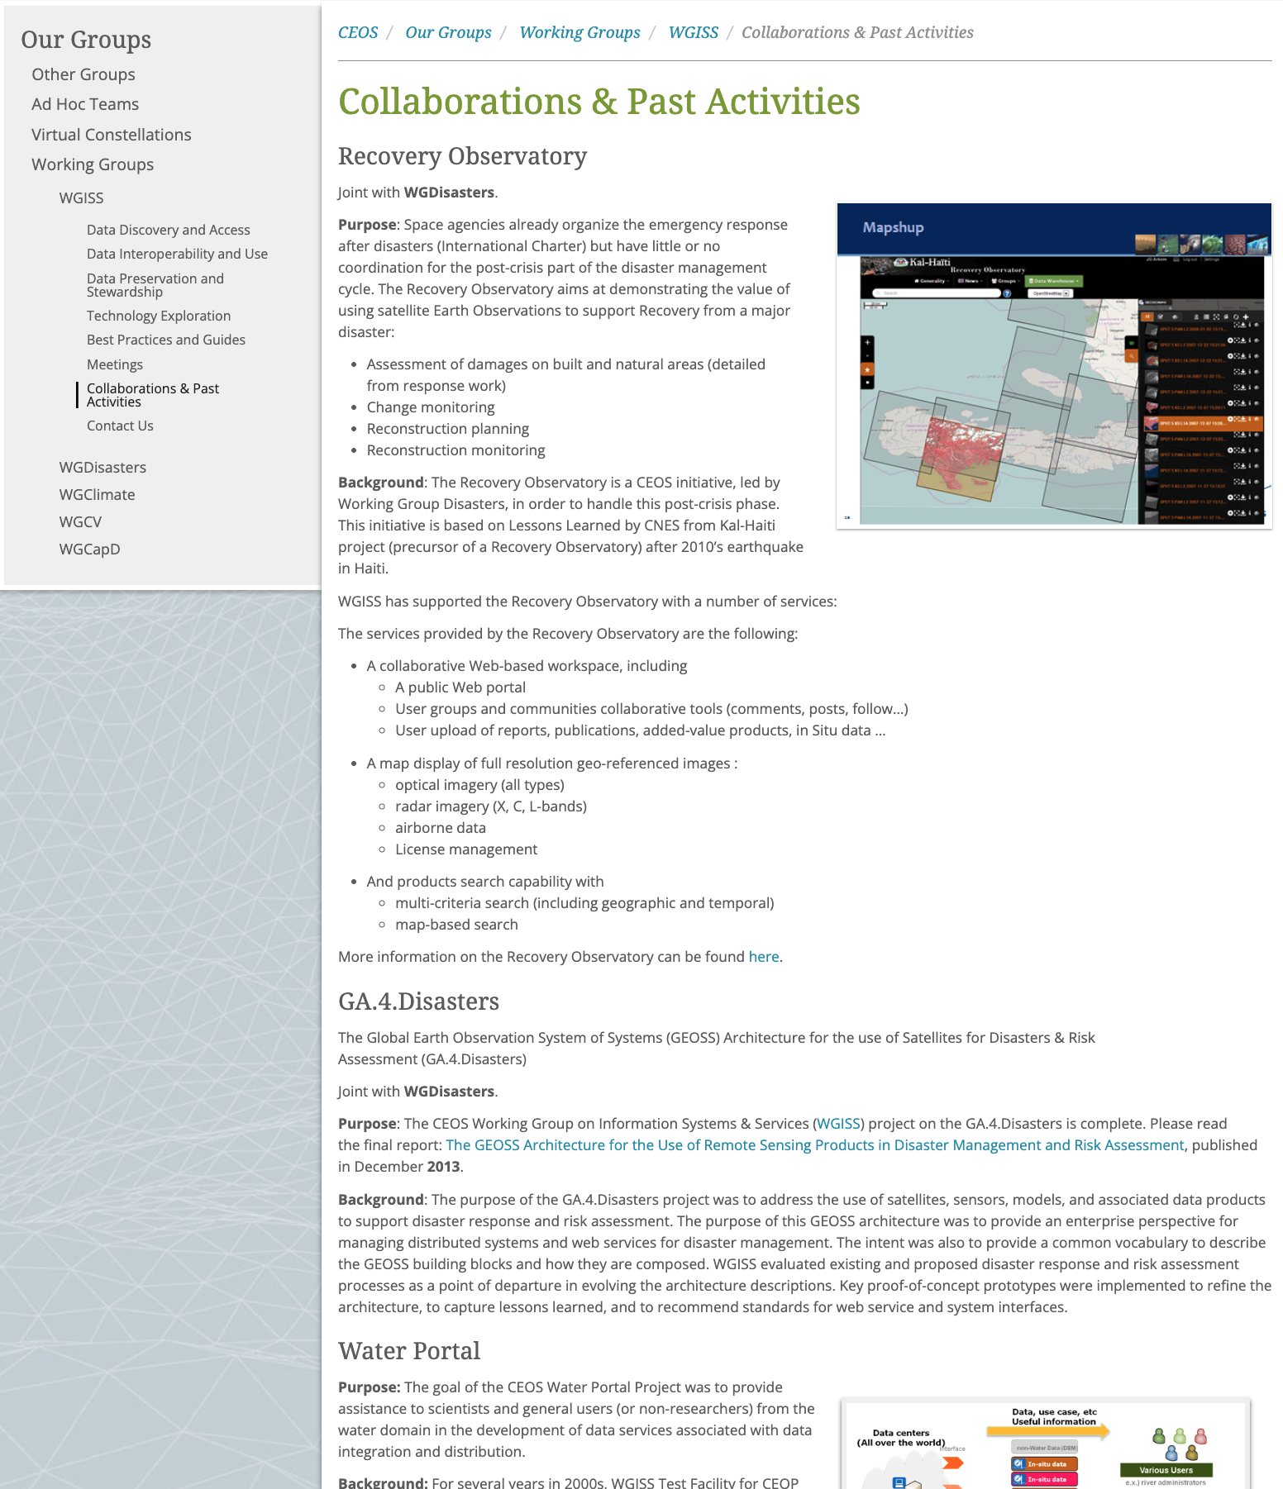
Collaborations Page
https://ceos.org/ourwork/workinggroups/wgiss/collaborations/
Removed previous ‘Past Activities’ page
Consolidated information from three subpages (Recovery Observatory, Water Portal, GA.4.Disasters) onto one page
Anything else to add to this page?

Slide 3
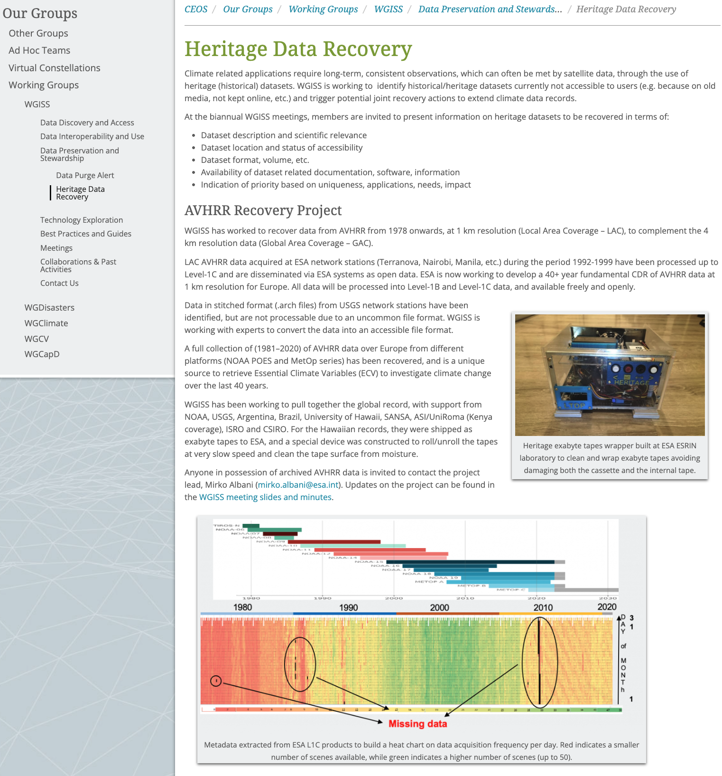
Heritage Datasets Page
https://ceos.org/ourwork/workinggroups/wgiss/preservation/heritage-data-recovery/
New subpage under DSIG
Bring awareness to the activity, and call for contributions for:
Other datasets for recovery
Other AVHRR collections

Slide 4
External Documents of Relevance
Within the Best Practices & Guides page
https://ceos.org/ourwork/workinggroups/wgiss/documents/#external
Listed CGMS Cloud Best Practices
Anything else for now?

Slide 5
WGISS Slide Deck
Started last July here: WGISS Overview_July24
Should this be linked on the WGISS website?
Who is this being developed for? What should it contain?
With what frequency should it be updated?

Slide 6
In progress comms actions
WGISS CDA article
Content has been provided by DAIG, but needs work to refine into more of a story. Comms team will work on it
Jupyter Notebooks Best Practices:
Okay to post on social media now that it is finalised?

Slide 7
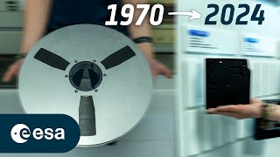
Suggestions
Interoperability Handbook:
Between SIT-40 and SIT TW, some sort of campaign to solicit community review?
Post final document on social media once finalised
Heritage Datasets:
ESA produced this nice video with Mirko: This is how ESA stores Earth observation data
Can we build on this to solicit community feedback on other datasets for recovery / other AVHRR archives?

Slide 8
CEOS Comms Opportunities
CEOS will have an exhibition booth at Living Planet Symposium 2025
WGISS can contribute physical or digital materials
Blog: ceos.org/news
Social media:
CEOS Communications Quarterly Revisit
Quarterly Newsletter Mailing list
Sign up!
http://eepurl.com/ij_2z1
Twitter: @CEOSdotORG
Facebook: @socialceos
LinkedIn: @CEOSdotORG

