Slide 1
WGISS-59 Software Heritage
Morane Gruenpeter,
Software Heritage
Agenda Item 10.4
WGISS-59
24-28 March, 2025
Bangkok, Thailand

Slide 2



A universal source code archive
serving the scholarly ecosystem
Morane Gruenpeter
Head of Open Science operations
Software Heritage Archive | WGISS-59 | 27/03/2025
Notes:
What is the main goal of this presentation:
You should be part of the ALIG to influence the conversation on how source code can be preserved in libraries collections. And getting access to archival features and a community dedicated to software preservation.
My name is Morane Gruenpeter
I'm the head of Open Science Operations in the Software Heritage team at INRIA research center in Paris
My background is in computer science
After a major career shift from being a classical musician (a harpist).
We have only a few minutes today, if you are interested I can come and present Software Heritage to your team in greater detail and show the available functionalities.

Slide 3
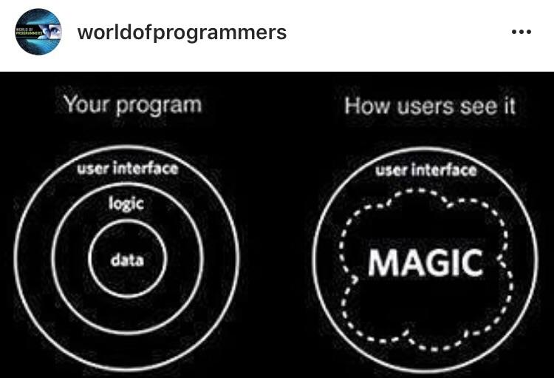
What to archive? what is software?
Software as a concept
project or entity
the community around the project
the software idea / algorithms / solutions
Not a digital artifact
Software artifacts
Executables
  For multiple environments
Source code
A very large collection of digital artifacts
Software Heritage archive | WGISS-59 | Gruenpeter M. | 27/03/2025 | CC-BY 4.0 | #‹#›/21

Slide 4
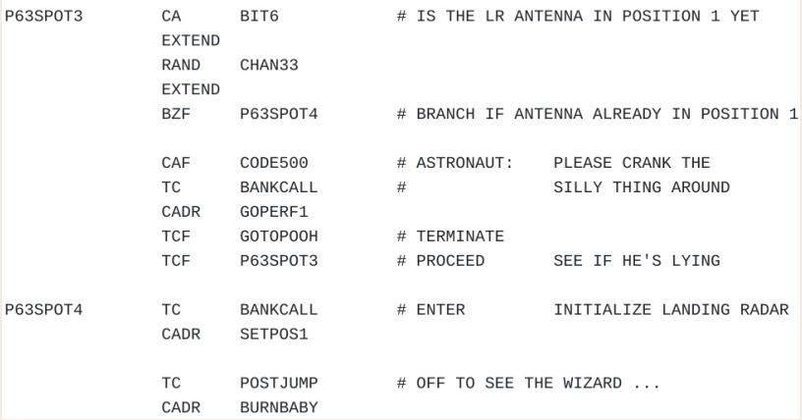
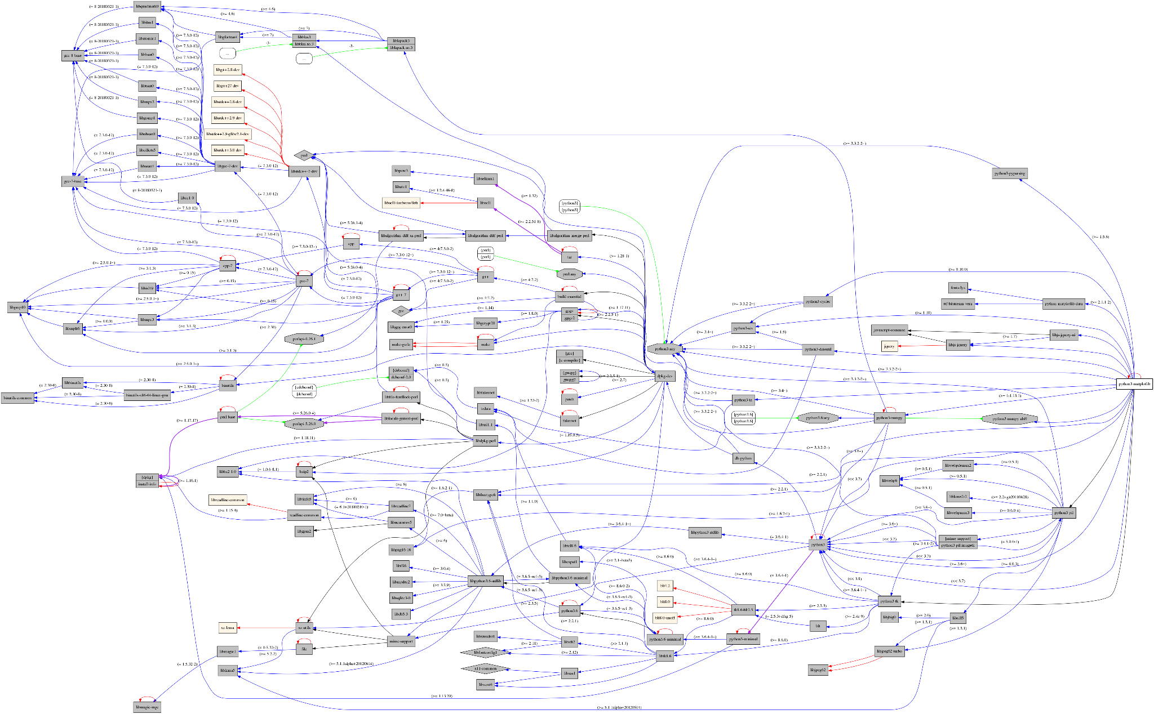
Software source code is not “just” data
Apollo 11 source code (excerpt)
Software evolves over time
projects may last decades
the development history is key to its understanding
Complexity
millions of lines of code
large web of dependencies
easy to break, difficult to maintain
sophisticated developer communities
research software is a thin layer
on top of the global software stack
Debian Matplotlib dependencies obtained with debtree
Software Heritage archive | WGISS-59 | Gruenpeter M. | 27/03/2025 | CC-BY 4.0 | #‹#›/21
Notes:
Software source code is special
The curation and preservation of software requires different functionalities and services than the processing of publications or research data

Slide 5
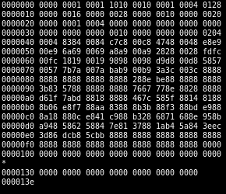

The Knowledge is in the Source Code
“Source code provides a view into the mind of the designer.”
Len Shustek, 2006
Computer History Museum
This is not source code
https://en.wikipedia.org/wiki/Binary_file
“Programs must be written for people to read, and only incidentally for machines to execute.” Harold Abelson, 1985
Structure and Interpretation of Computer Programs (1st ed.),
https://en.wikipedia.org/wiki/The_Human_Condition_%28Magritte%29 René Magritte, 1933, The Human Condition
Software Heritage archive | WGISS-59 | Gruenpeter M. | 27/03/2025 | CC-BY 4.0 | #‹#›/21

Slide 6
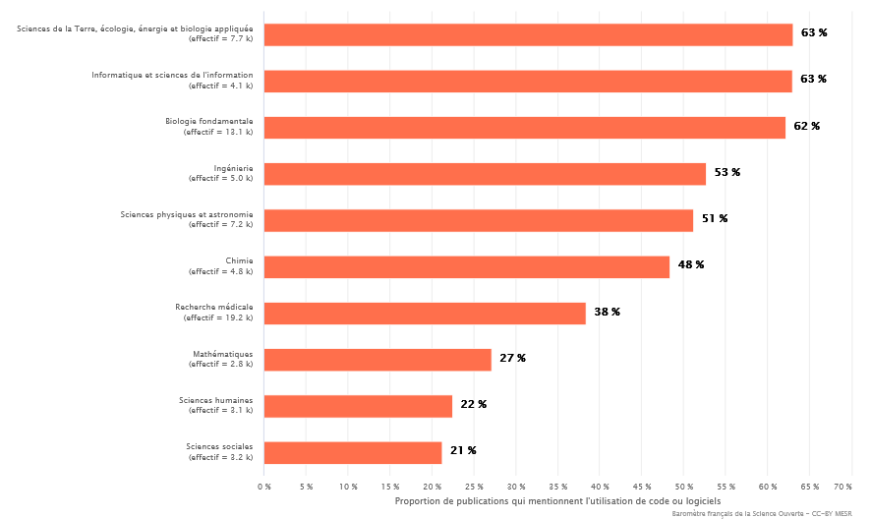
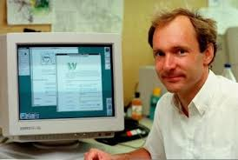
A new challenge in Academia
Software powers all research disciplines!
Proportion of French publications mentioning use of code or software, by discipline (2023 data from
https://barometredelascienceouverte.esr.gouv.fr)
Research software can have an impact on society as a whole
Tim Berners-Lee invented the World Wide Web, while working at CERN on a NeXT machine (1989)
Software Heritage archive | WGISS-59 | Gruenpeter M. | 27/03/2025 | CC-BY 4.0 | #‹#›/21

Slide 7
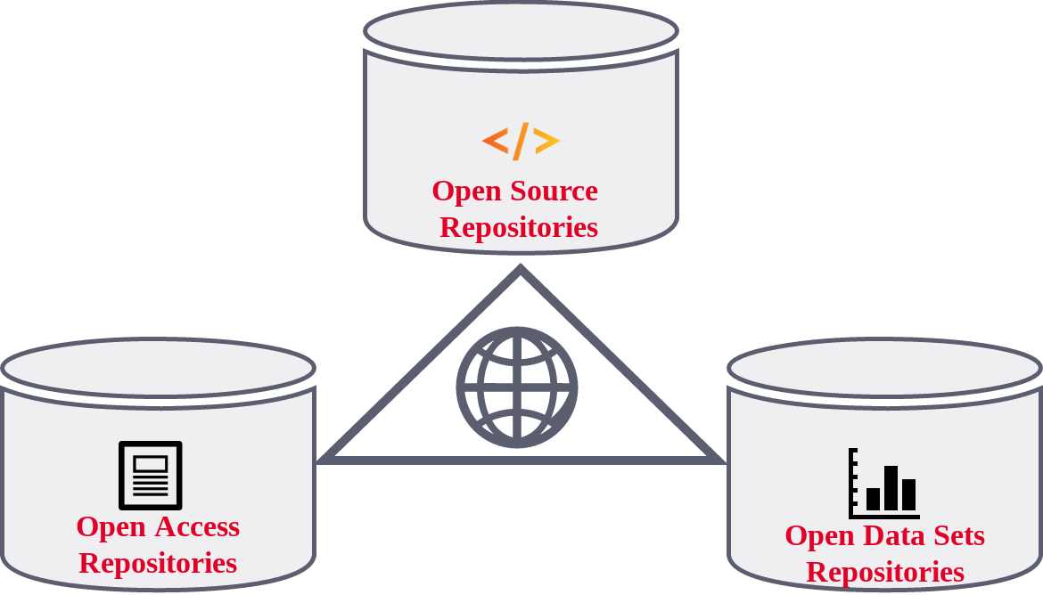


Software on par with research articles and data
A key pillar: software (source code)
← The links in the picture are important!
Three pillars of Open Science
Software Heritage CC-By 4.0 2019
UNESCO recommendations for Open Science, 2021
French National plan for Open Science, 2021-202
Software Heritage archive | WGISS-59 | Gruenpeter M. | 27/03/2025 | CC-BY 4.0 | #‹#›/21
Notes:
“Software is an essential research output, and its source code implements and describes data generation and collection, data visualisation, data analysis, data transformation, and data processing with a level of precision that is not met by scholarly articles alone. Publicly accessible software source code allows a better understanding of the process that leads to research results, and open source software allows researchers to build upon the results obtained by others, provided proper mechanisms are put in place to make sure that software source code is preserved and that it is referenced in a persistent way. There is a growing general awareness of its importance for supporting the research process “
It is actually what we’ve been doing, with mutualized infrastructure to avoid fragmentation and provide connections to the publications and the Datasets.
We have seen in recent years, a major culture shift in Academia
Software is finally recognized as a first class research output.

Slide 8
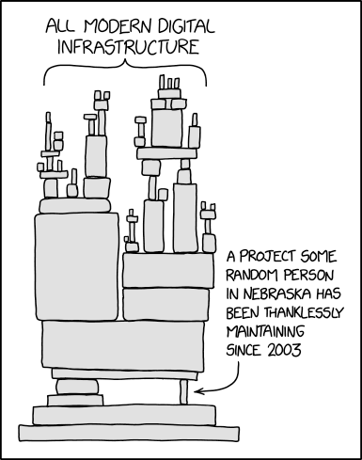
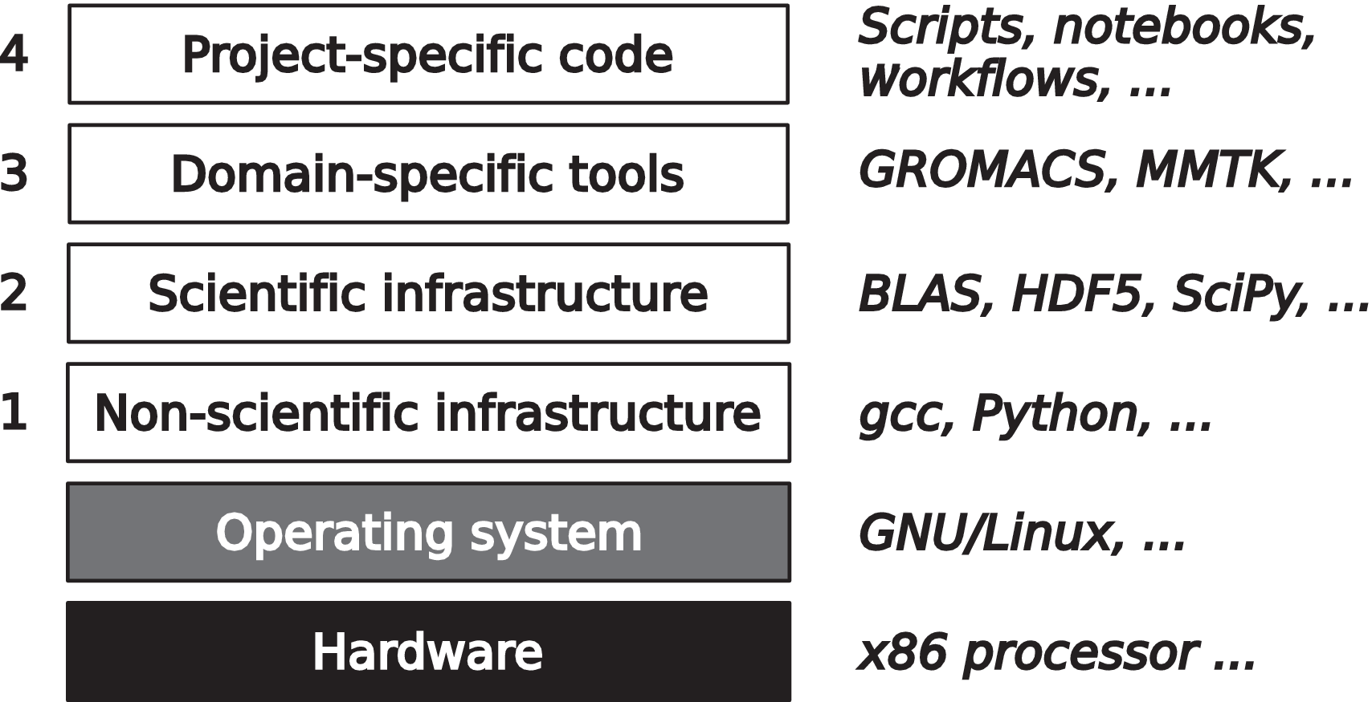
The software stack: More than Research Software
Research Software is a thin layer on top of the global software stack
What’s the the Software Collapse?
Konrad Hinsen. Dealing With Software Collapse. Computing in Science and Engineering, 2019, 21 (3), pp.104-108. ⟨10.1109/MCSE.2019.2900945⟩. ⟨hal-02117588⟩
Can be preserved in a:
Scholarly Infrastructure
Universal Source Code Archive
https://xkcd.com/2347/
Software Heritage archive | WGISS-59 | Gruenpeter M. | 27/03/2025 | CC-BY 4.0 | #‹#›/21
Notes:
A lot of research software is developed in forges that host much more than just scientific code.
“scholarly infrastructures that support software source code written in academia must go the extra mile to ensure they adopt standards and provide mechanisms that are compatible with the ones used by tens of millions of non-academic software developers worldwide. They also need to ensure that the large amount of software components that are developed outside academia, but are relevant for research activities, are properly taken into account.”

Slide 9

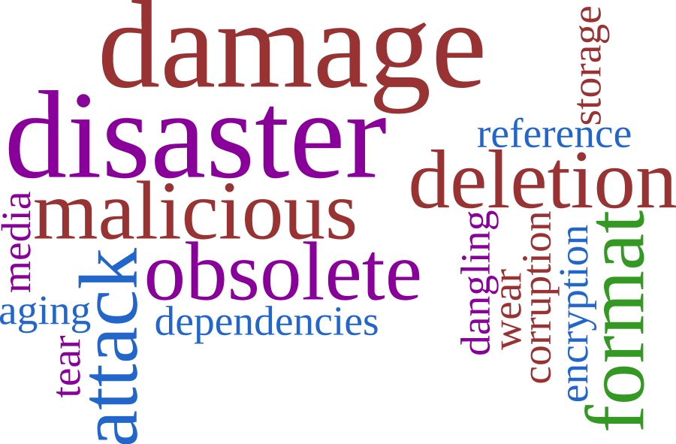
Is source code fragile?
Software Heritage archive | WGISS-59 | Gruenpeter M. | 27/03/2025 | CC-BY 4.0 | #‹#›/21

Slide 10

Have you met Software Heritage, the universal source code archive?

Slide 11
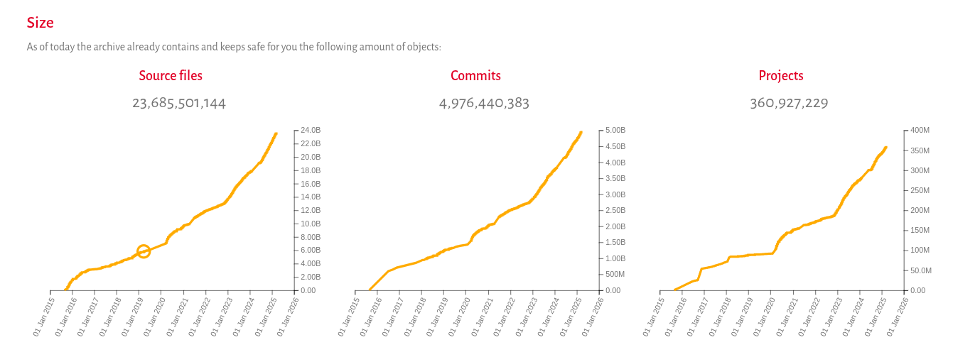
A nonprofit, multi-stakeholder and open infrastructure
to collect, preserve and share all source code
Snapshot: March 24th 2024
Software Heritage archive | WGISS-59 | Gruenpeter M. | 27/03/2025 | CC-BY 4.0 | #‹#›/21
Notes:
It is the largest collection today of source code artifacts, with more than 300 million projects and 19 billion unique source code files.
You may have heard about SWH.
Let me know in th chat if you have already heard about it, seen an identifier to it or used it..

Slide 12



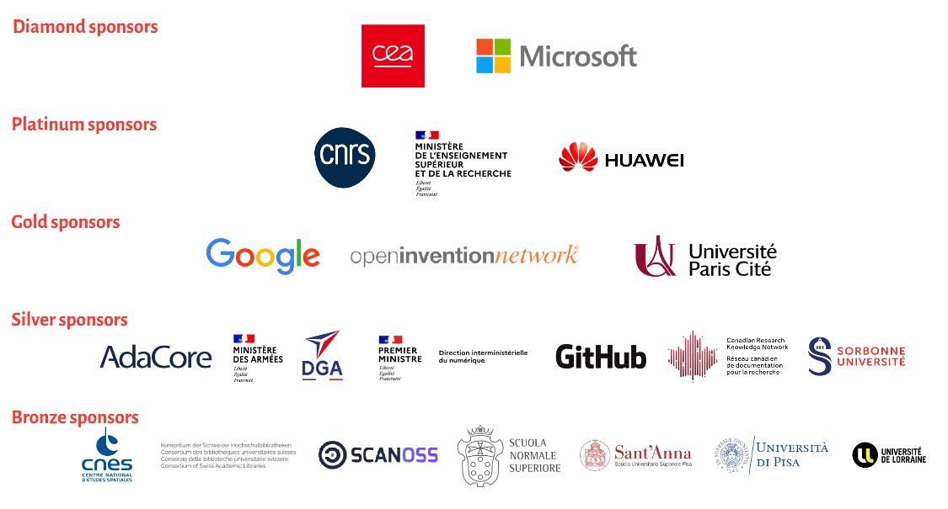
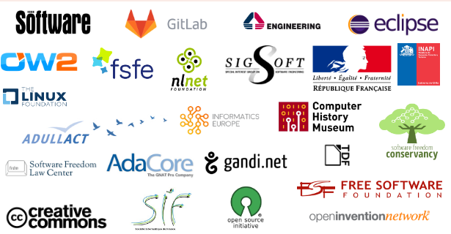
An international and non-profit initiative launched in 2016
built for the long term
Sharing the vision
Donors, members, sponsors
http://www.softwareheritage.org/support/testimonials
Software Heritage archive | WGISS-59 | Gruenpeter M. | 27/03/2025 | CC-BY 4.0 | #‹#›/21
Notes:
Roberto and Stefano (the founders of the archive) decided in 2015 that we need to take care of our software commons before it is lost forever. Some projects are already lost.

Slide 13

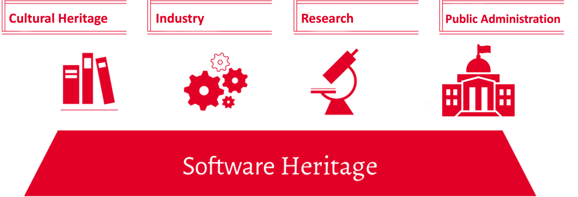
Software Heritage in a nutshell
Reference catalog
find and reference all
software source code
Universal archive
preserve all software
source code
Research infrastructure
enable analysis of all
software source code
Software Heritage archive | WGISS-59 | Gruenpeter M. | 27/03/2025 | CC-BY 4.0 | #‹#›/21

Slide 14




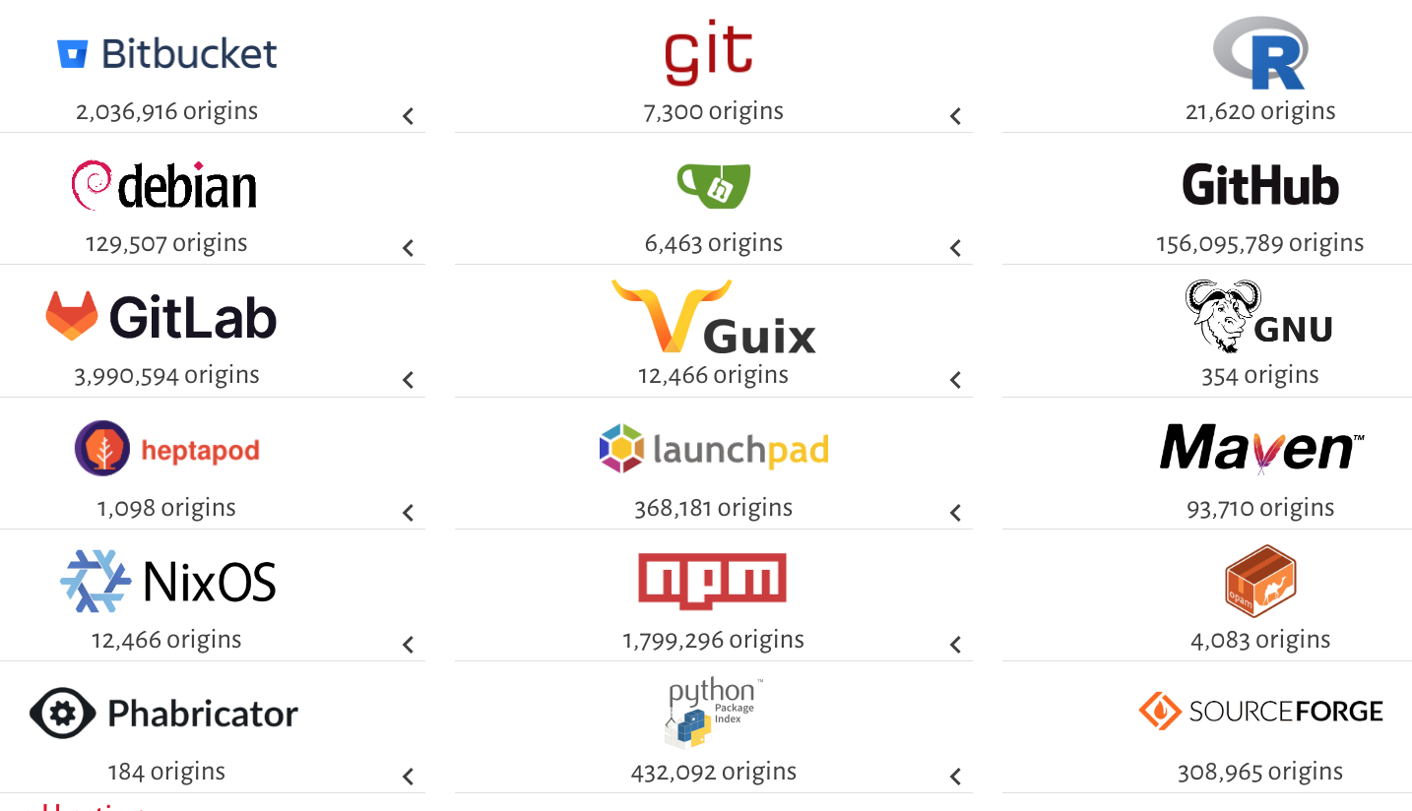




An Open infrastructure
to collect, preserve and share all source code
Sharing the source code commons with a set of trustworthy and open services, providing access to the largest source code library in the world.
And also …
DEPOSIT
to submit software source archives and its associated metadata
CRAWLING
SAVE CODE NOW SERVICE
At any time, for free:
For a project
For a forge
🚒 Rescue operations 🔥
Software Heritage archive | WGISS-59 | Gruenpeter M. | 27/03/2025 | CC-BY 4.0 | #‹#›/21
Notes:
How SWH collections are created and curated: have a look behind the scenes

Slide 15
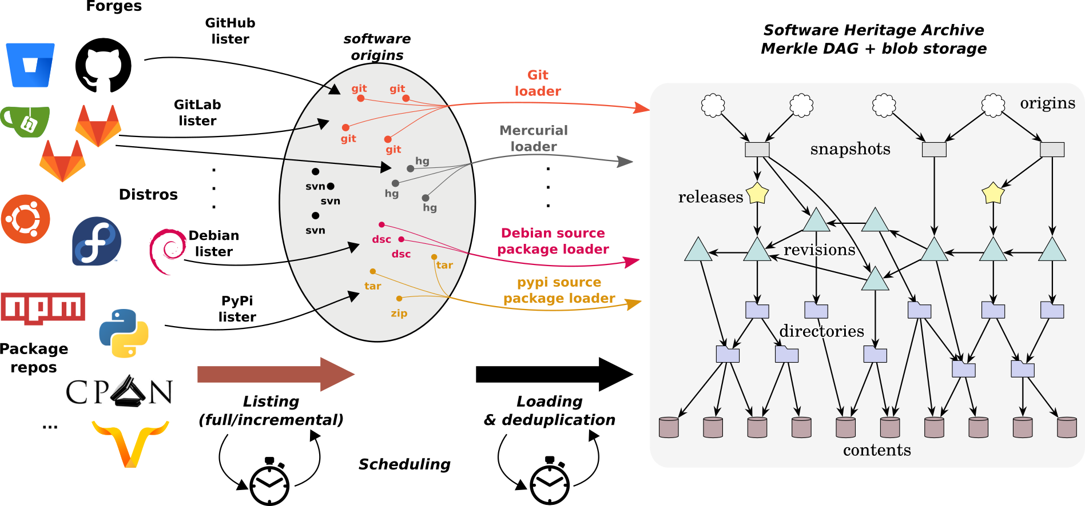
The complete workflow
Full development history permanently archived in a uniform data model
Software Heritage archive | WGISS-59 | Gruenpeter M. | 27/03/2025 | CC-BY 4.0 | #‹#›/21

Slide 16
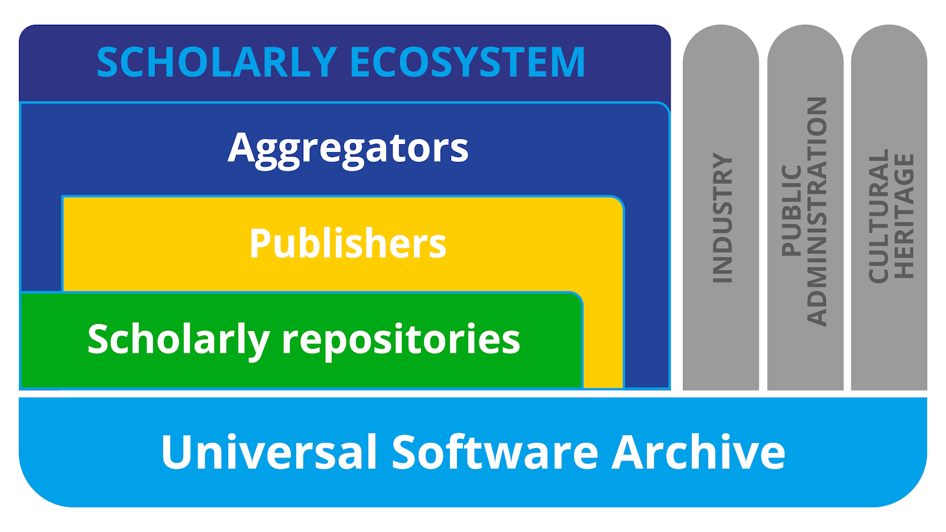

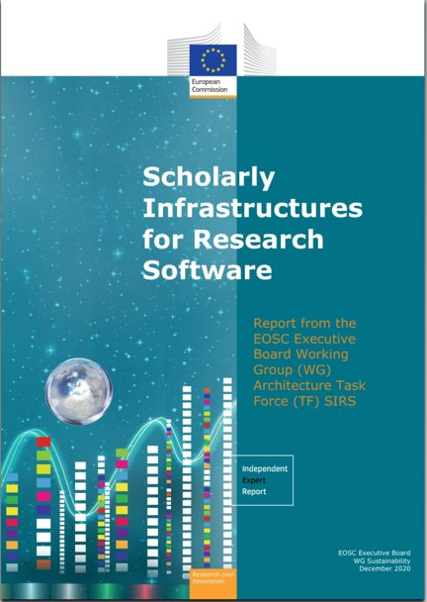











Serving the scholarly ecosystem
Creating connections and mutualizing efforts
EOSC SIRS report: European Commission, Directorate-General for Research and Innovation, Scholarly infrastructures for research software : report from the EOSC Executive Board Working Group (WG) Architecture Task Force (TF) SIRS, Publications Office, 2020, https://data.europa.eu/doi/10.2777/28598
Software Heritage archive | WGISS-59 | Gruenpeter M. | 27/03/2025 | CC-BY 4.0 | #‹#›/21
Notes:
We are serving the scholarly ecosystem, and we can’t do it by ourselves.
We need to connect the existing scholarly platforms to the base layer of the architecture, which is library of Alexandria or as we also call the universal source code archive, accepting all public code without restrictions.
Most software isn’t developed in Academia and yet Software usually depends on source code that isn’t part of the scholarly ecosystem.

Slide 17


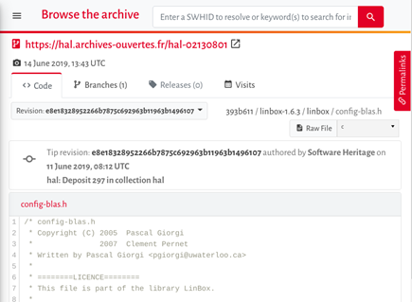
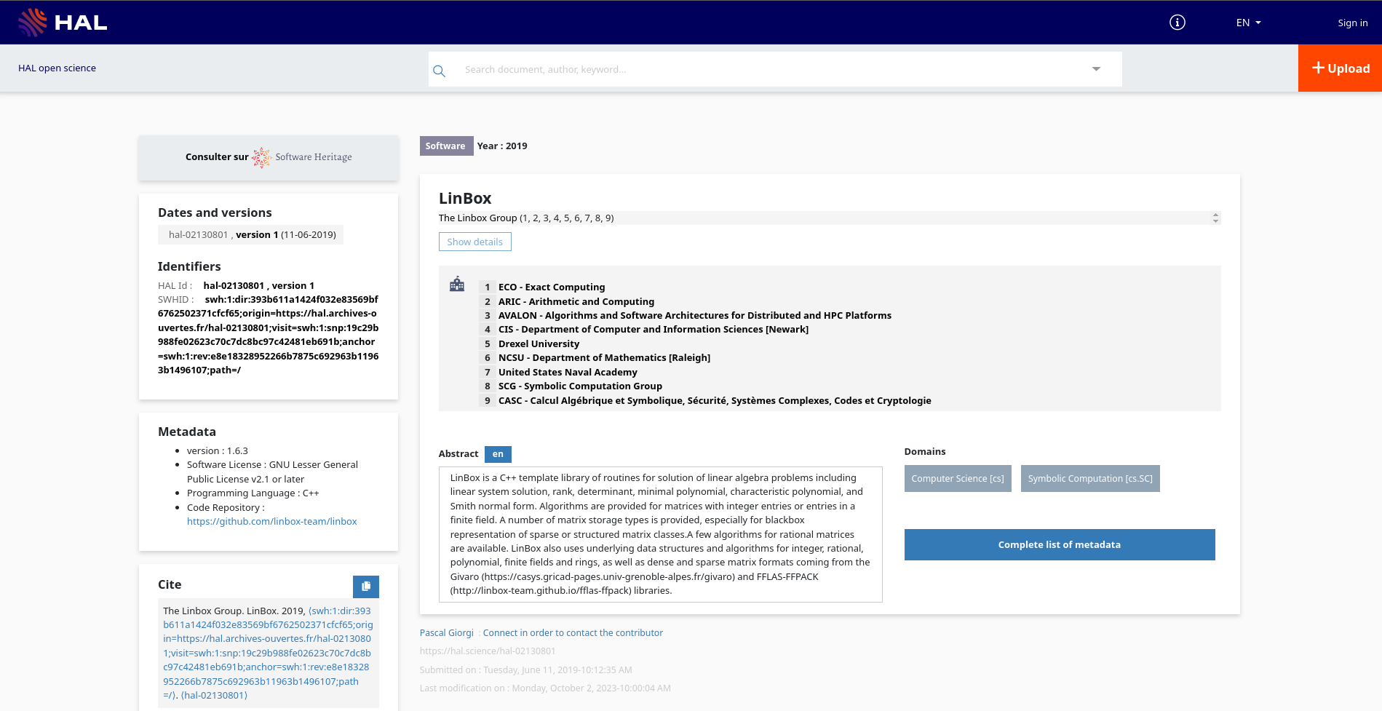
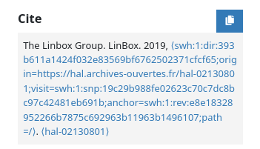
HAL (CCSD) x SWH = Connecting the scholarly ecosystem
The Research Software deposit in the French National Archive - HAL
Two options for researchers:
🚀 Copy-pasting a PID
📦 Adding files
Moderation of the metadata
swh:1:dir:393b611a1424f032e83569bf6762502371cfcf65
https://hal.science/hal-02130801
Open Science series: the software source code deposit
Software Heritage archive | WGISS-59 | Gruenpeter M. | 27/03/2025 | CC-BY 4.0 | #‹#›/21
Notes:
All the work done with the different connectors is based on service we have created in France with the remarkable collaboration with the CCSD and an internal INRIA team of documentalists, and we are now exporting the service to platforms in the EU ecosystem.
Since 2023, the SWHID deposit on all HAL instances is available.
What is this SWHID deposit?
It is an easier pipeline for researchers to get acknowledgement for their software production.
First developing using a version control system on a collaborative development platform. Then archiving the code in SWH with the Save Code Now.
After the code is archived with the full dev history, the researchers can use a SWHID and create a software record in HAL.
They can easily add the entry in their annual report, laboratories reports and even at the institutional level.
The code is saved with the development history alongside the metadata record which increases visibility on HAL and is indexed in SWH.

Slide 18
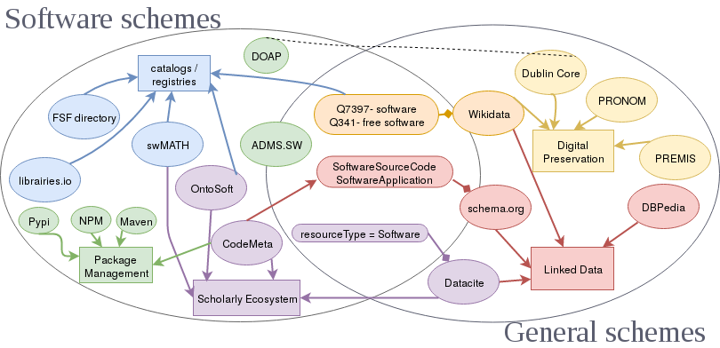
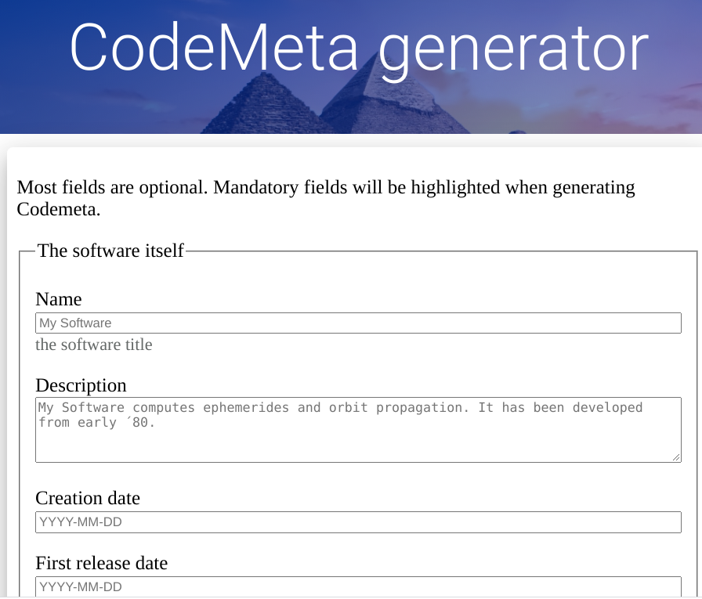
Curating software with CodeMeta
A subset of schema.org
An academic community
A tool to describe software with intrinsic MD
Gruenpeter M. and Thornton K. (2018) Pathways for Discovery of Free Software (slide deck from LibrePlanet 2018). https://en.wikipedia.org/wiki/File:Pathways-discovery-free.pdf accessed on 6.11.2020.
Software Heritage archive | WGISS-59 | Gruenpeter M. | 27/03/2025 | CC-BY 4.0 | #‹#›/21
Notes:
I would like to suggest the following call to action
Because policy can make a difference
We need to build on common
We need to ensure long term support for these open infrastructures
We need to invest in curation and training activities for researchers and support staff
We need to formally recognize code creation as a valuable activity in a researchers career
We need to engage in community driven efforts to implement community standards and guidelines
And last but not least, publicly funded software should be open source by default
Brinkman et al. highlights the need for a collaborative approach where policies set the framework, infrastructures provide the necessary tools, and the community drives the actual practices. To achieve this, there must be ongoing dialogue and collaboration between policy makers, infrastructure providers, and the research community to ensure that research software is properly curated, recognized, and valued as a vital component of the scientific process.

Slide 19
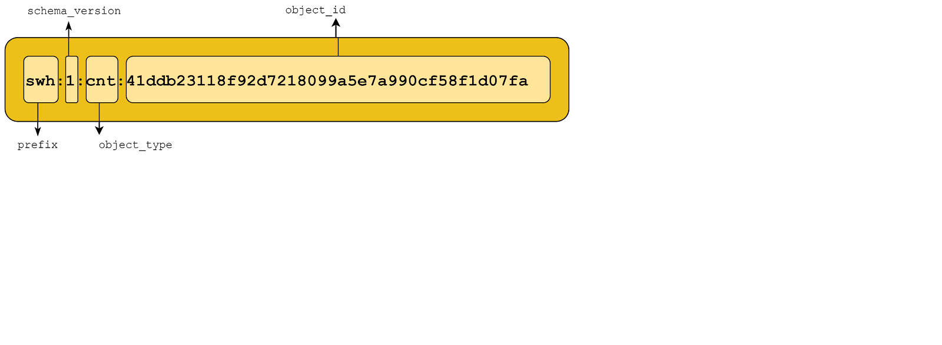
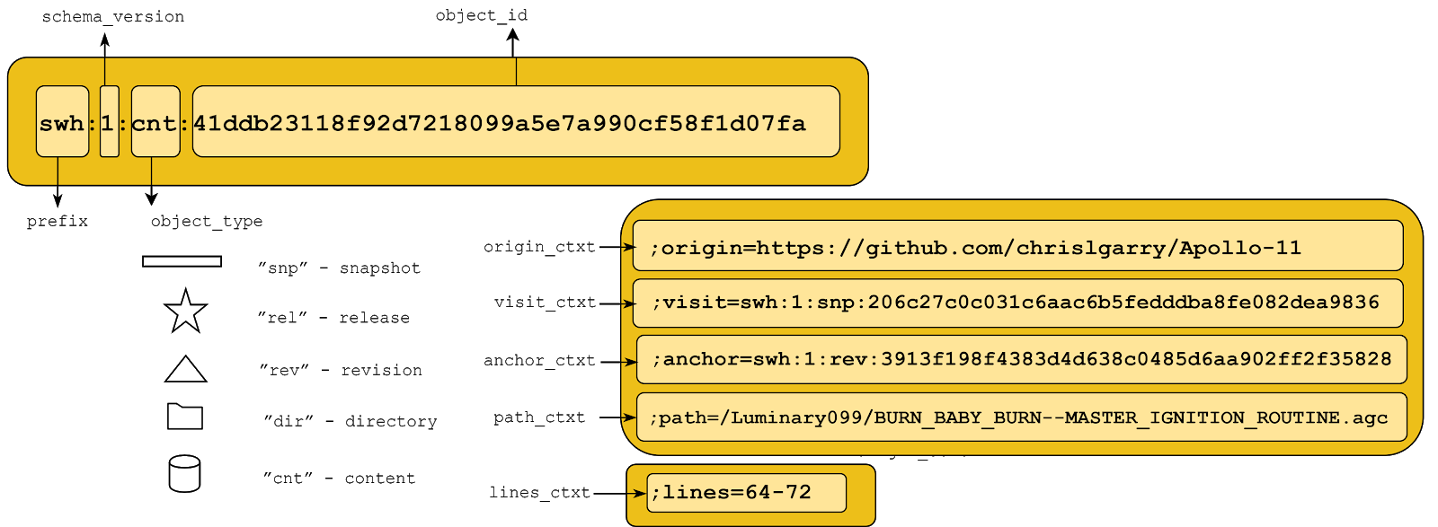
Meet the SWHID: The SoftWare Hash identifier
SWHIDs are intrinsic identifiers which are intimately bound to the designated object, they do not need a register, only agreement on a standard.
Intrinsic: compute a unique digital fingerprint
decentralised: do not need a registry, only agreement on a standard
cryptographically strong identifiers
Intrinsic vs. extrinsic blog post
Go to API endpoint
Software Heritage archive | WGISS-59 | Gruenpeter M. | 27/03/2025 | CC-BY 4.0 | #‹#›/21

Slide 20

Call to action
Software preservation requires a global and coordinated effort.
“Policy describes what is required, desired, and incentivised;
infrastructure determines what is possible;
but the community determines how things are done in practice.”
(Brinkman et al., 2020)
Mutualisation
Curation
Sustainability
Recognition
Open by default
Software Heritage archive | WGISS-59 | Gruenpeter M. | 27/03/2025 | CC-BY 4.0 | #‹#›/21
Notes:
I would like to suggest the following call to action
Because policy can make a difference
We need to build on common
We need to ensure long term support for these open infrastructures
We need to invest in curation and training activities for researchers and support staff
We need to formally recognize code creation as a valuable activity in a researchers career
We need to engage in community driven efforts to implement community standards and guidelines
And last but not least, publicly funded software should be open source by default
Brinkman et al. highlights the need for a collaborative approach where policies set the framework, infrastructures provide the necessary tools, and the community drives the actual practices. To achieve this, there must be ongoing dialogue and collaboration between policy makers, infrastructure providers, and the research community to ensure that research software is properly curated, recognized, and valued as a vital component of the scientific process.

Slide 21
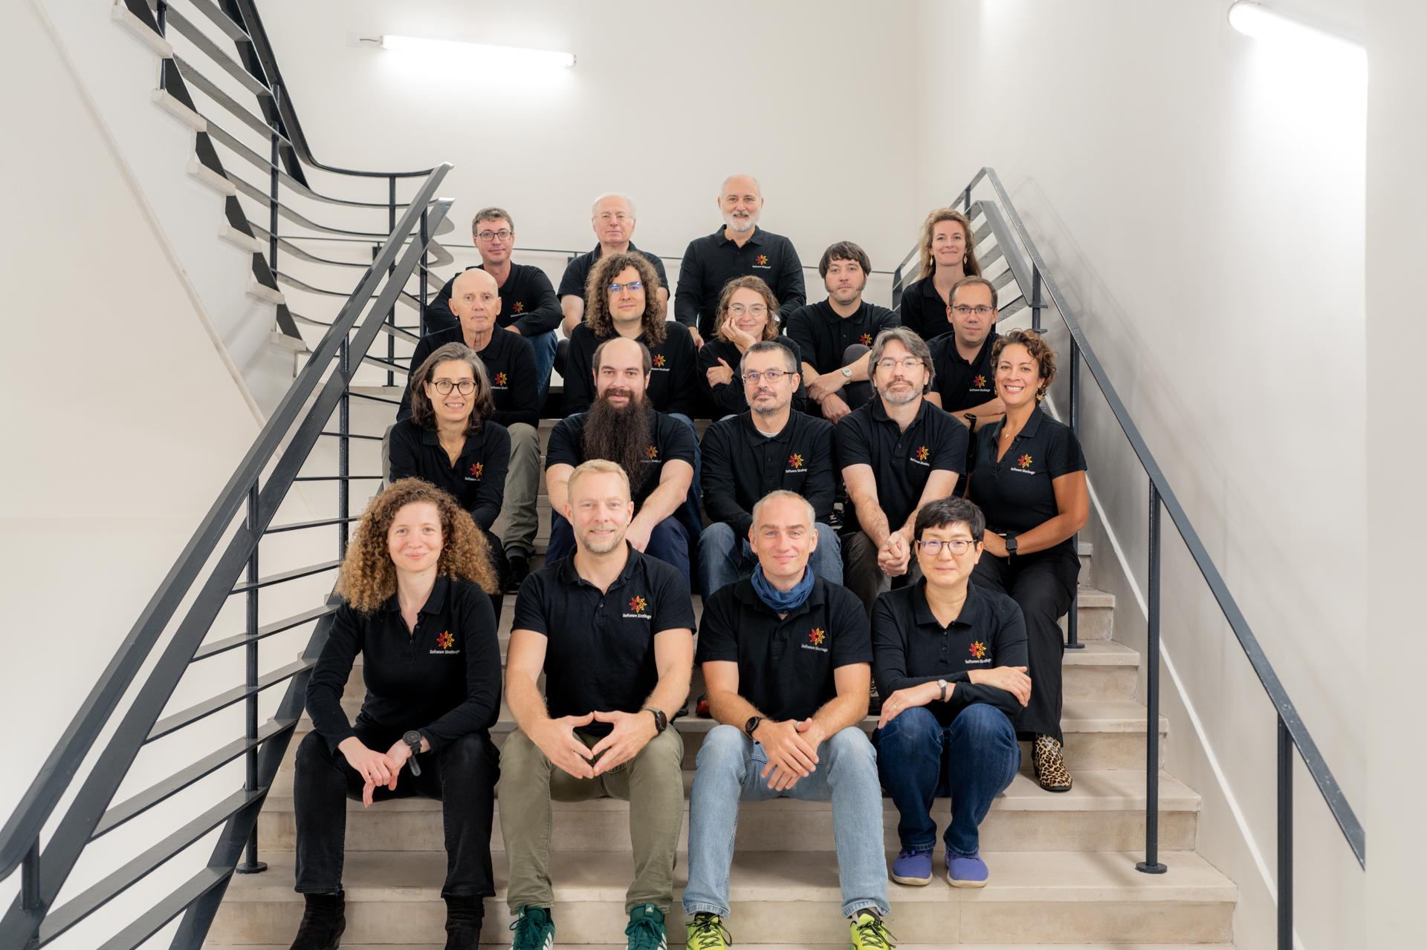
Let’s work together
morane@softwraeheritage.org
https://www.softwareheritage.org/
👋
Behind the scenes: the SWH team!
Software Heritage archive | WGISS-59 | Gruenpeter M. | 27/03/2025 | CC-BY 4.0 | #‹#›/21

Slide 22
Links to be shared with your users:
🔑 Guidelines for researchers: https://www.softwareheritage.org/howto-archive-and-reference-your-code/
🏷️ Describe a software (intrinsic metadata made easy) : https://codemeta.github.io/codemeta-generator/
❓ The FAQ: https://www.softwareheritage.org/faq/
🗺️ The SWH guided tour: https://archive.softwareheritage.org/?guided_tour=0&guided_tour_next=https://archive.softwareheritage.org/
🎯 "Open Science tutorial: source code deposit" (how to build services upon SWH): https://youtube.com/playlist?list=PLD2VqrZz2-u3bOWtoCoBIh5Flt6iYXsq3
👋 “Book” a SWH ambassador: https://www.softwareheritage.org/ambassadors/
🗺️ The Metadata curation roadmap: https://doi.org/10.5281/zenodo.14509418

Slide 23
🧰 Implementing new services at the library:
the SWH documentation treasure island
The Web API: https://archive.softwareheritage.org/api/
API terms of use: https://www.softwareheritage.org/legal/api-terms-of-use/
API endpoints: https://archive.softwareheritage.org/api/1/
The technical roadmap: https://docs.softwareheritage.org/devel/roadmap/roadmap-2023.html#roadmap-current
SWH legacy software services: https://www.softwareheritage.org/swhap/

