Slide 1
Heritage Software Hub (HESH)
B. Keary (Solenix for ESA)
WGISS#59
27/03/2025

Slide 2
Why to Preserve Software
Since data is being preserved, any associated software should be preserved alongside it to maintain the data’s maximum value.
Having access to the original software is crucial for any potential reanalysis/reproduction of earlier work, ensuring that researchers can understand how data was processed in the past, and make meaningful comparisons with modern data analysis.
Data processing software provides valuable historical context for scientific data as it reflects the analysis methods and technologies used over time.

Slide 3
HESH: Heritage Software Hub
“Preserve and maintain the execution capability of software”
Platform for collection and preservation of earth observation (EO) software in a functional environment to enable on-demand use of preserved software.
Preserve technical knowledge and know-how
Avoid potential future porting/re-writing of software
Keep software accessible for ad-hoc data reprocessing and testing
Software packaged in containers to eliminate/reduce the need to preserve specific hardware and legacy OS components.

Slide 4
HESH Architecture
Software Catalogue
Synchronise
Search/Discover
CMDBuild REST API
Database of preserved software
User interface populated with contents of database (software metadata)
Containerised processing software deployed on ESACloud (IaaS)
User interaction, via VMware REST API, with VMs on ESACloud
Software Archive
Browse
User Interface and Web Server
Retrieve
Select
VMWare REST API
VMWare on ESACloud
User/Software Curator
Execute
Execute
Software Hosting and Execution Infrastructure
Interact
Salvage, Package, Virtualise
Spawn
Salvaging, Packaging and Virtualisation Toolset
Store

Slide 5
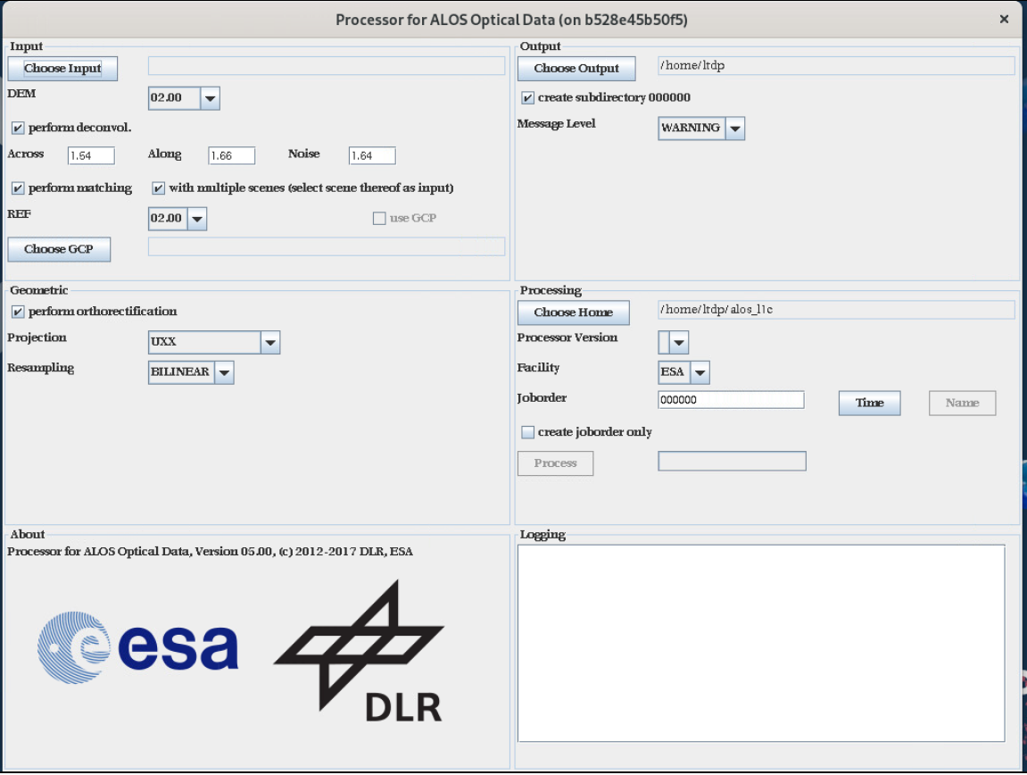
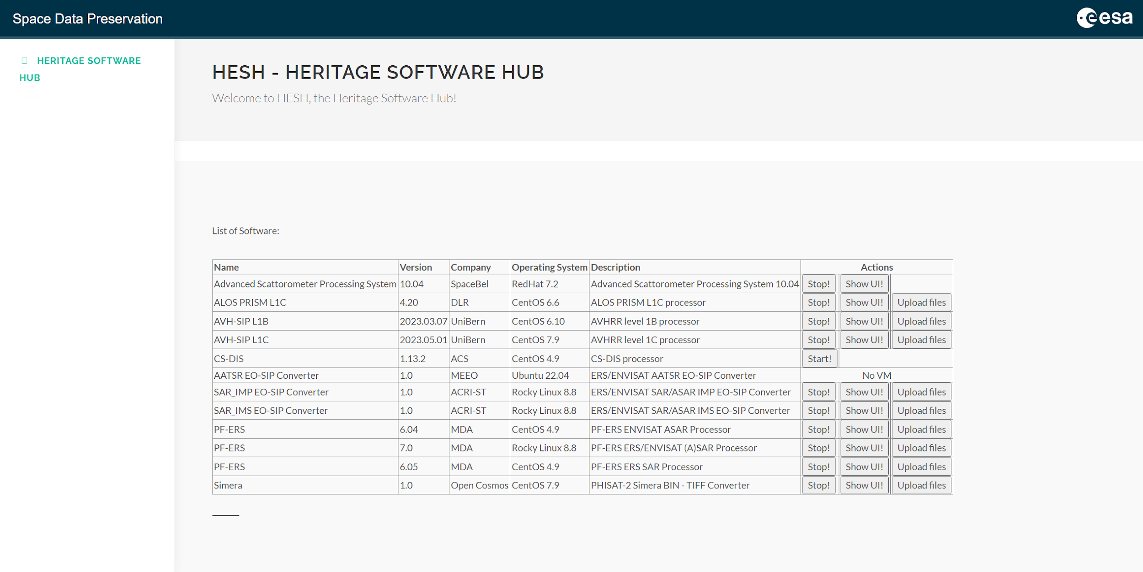
HESH User Interface
Details of preserved software
Mission-specific EO software originating from ESA Ground Segment, industry, etc.
Manage/access VMs hosting containerised software

Slide 6
Principles of Software Preservation
These three principles, which correspond to the different phases of the software preservation process, help to guarantee the robust preservation of software while maximising benefit to, and usage by, potential future users of the software.

Slide 7
Lack of documentation and expert knowledge
Mitigated by early adoption of a preservation strategy that ensures comprehensive documentation and expert knowledge collection
Difficulty assessing/preserving the full functionality of software due to lack of familiarity by data managers/preservationists
Risk of partial/full obsolescence prior to beginning the preservation process poses a critical treat. Risk particularly high for software that depends on any specialised hardware
Mitigated by good preservation planning
The need to avert these risks further reinforces the importance of planning the preservation activities as soon as possible so that software and hardware may be preserved while they are still available

Slide 8
EO Software Preservation Module: A collection of everything required to adequately preserve the software for future use.
⇒ Not everything is mandatory, but if it exists it must be preserved.
Software:
Base software – All installation files and scripts
Additional software – Patches, custom packages, etc.
Auxiliary/Other Components:
Task Tables
Orchestrator
Others – e.g. DEM libraries
Test Material:
Test dataset (TDS)
Documentation:
Installation/User manual
Software release note
Software modification report
Interface document
Test report – Accompanying the TDS
Other documentation – Anything else

Slide 9
Use Case: ERS/ENVISAT SAR/ASAR Reprocessing
Reprocessing ERS & ENVISAT (A)SAR data
Preserved data processors and converters
Bulk processing ongoing:
Mission | L0 Product | L0 Volume | L1 Product | L1 Volume (approx.)
ERS | SAR_IM__0P | 700 TB | SAR_IMS_1P | 1670 TB
 |  |  | SAR_IMP_1P | 400 TB
ENVISAT | ASA_IM__0P | 122 TB | ASA_IMS_1P | 430 TB
 |  |  | ASA_IMP_1P | 110 TB
IMP/IMS EO-SIP Converters
Level 0 SAR/ASAR Products
PF-ERS (A)SAR v7.0
Level 1 IMP/IMS Products
IMP/IMS EO-SIP Packages

Slide 10
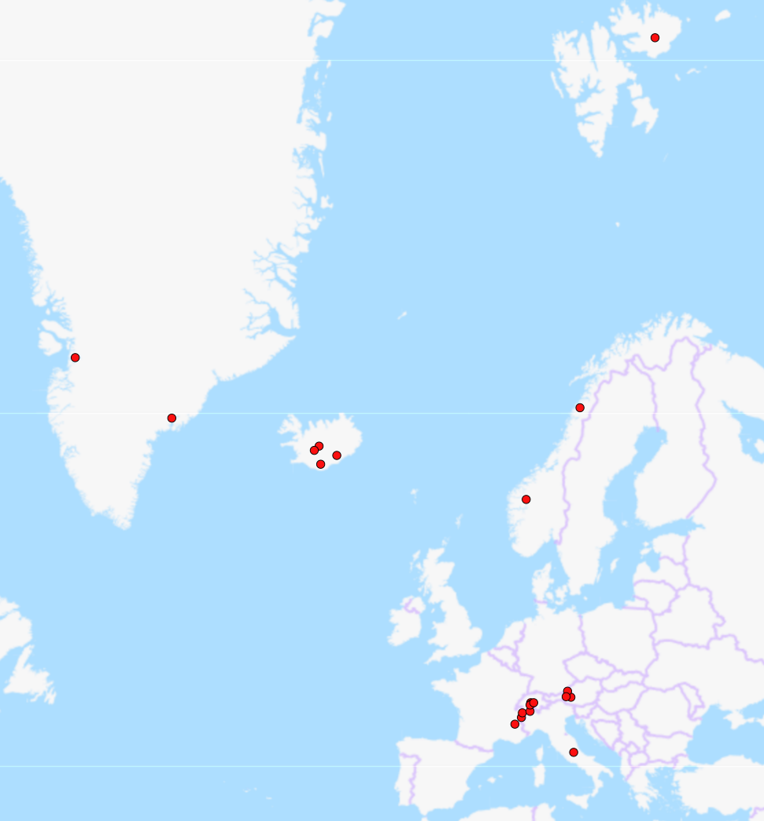
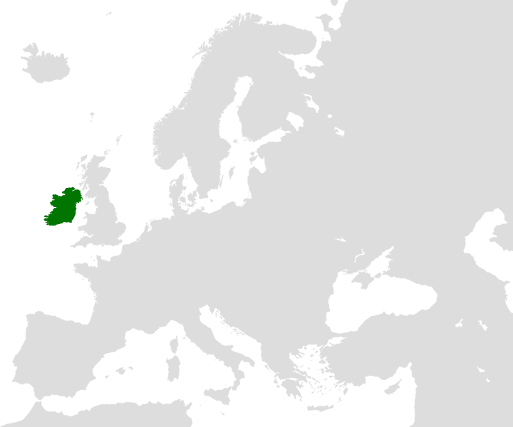
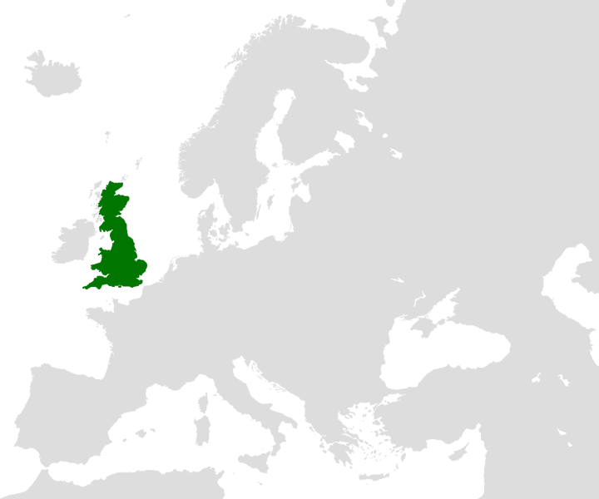
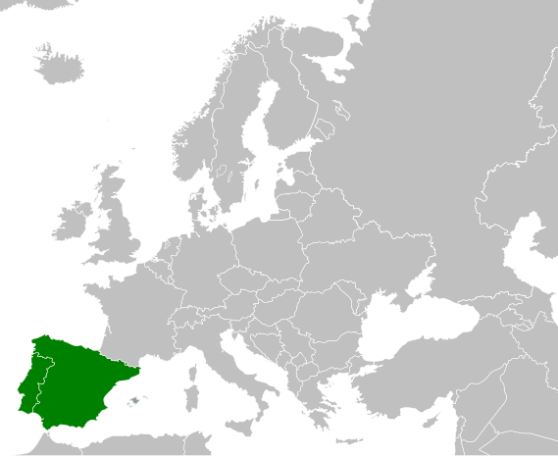
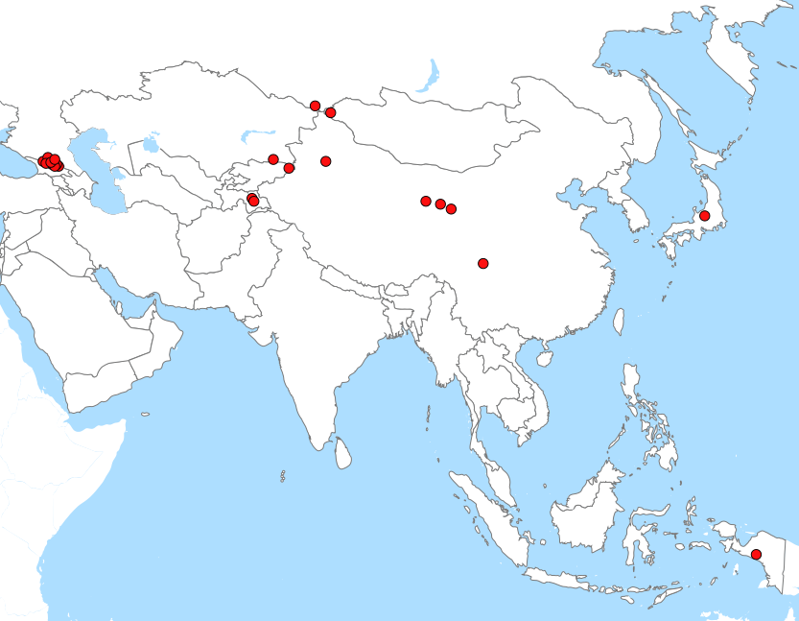
Use Case: ERS/ENVISAT SAR/ASAR Reprocessing
Geographical Coverages
Ireland
Great Britain
Iberian Peninsula
Thematic Collections
European Volcanoes
European Glaciers
Major European Lakes
Asian Glaciers

