Slide 1
Software preservation
Session Introduction
I.Maggio, Starion for ESA
Agenda Item 10.1
WGISS-59
24-28 March 2025
Centara Grand at Central Ladprao Bangkok, Thailand

Slide 2
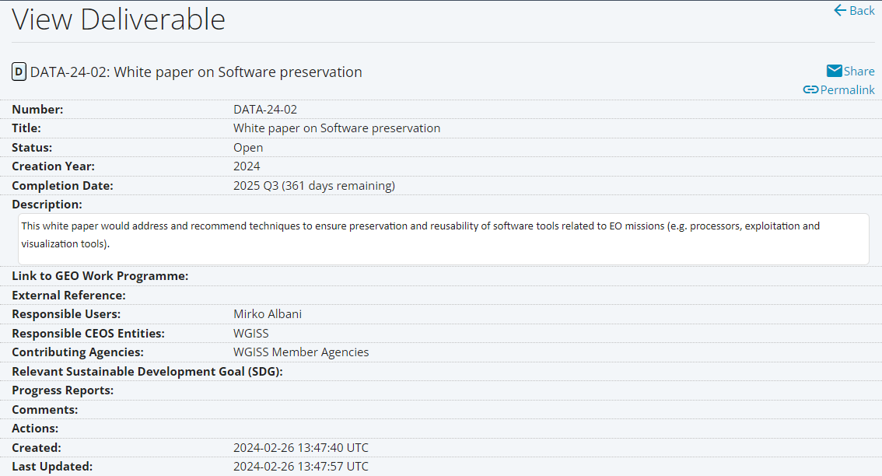
CEOS DELIVERABLE FROM DSIG

Slide 3
SOFTWARE PRESERVATION - SCOPE
The white paper should be intended to assist data/software managers in the Earth observation (EO) domain with the task of ensuring the long-term preservation of EO missions and data related software, thus improving data accessibility and usability for current and potential future users.
The intended audience should comprise data and software providers, decision makers and scientists, and data managers/stewards for data centres and repositories.
It will introduce the concept of software preservation, outlining its importance and justifying the effort to ensure effective preservation of EO data related software.
Details of the main principles of software preservation will be provided, as well as brief descriptions of the primary strategies that may be implemented by data managers, together with challenges.

Slide 4
WHY TO PRESERVE SOFTWARE
There are several reasons that justify expending the effort required to preserve software, foremost of which is the simple fact that since data is being preserved, any associated software should be preserved alongside it to maintain the data’s maximum value.
Having access to the original software is crucial for any potential reanalysis/reproduction of earlier work, ensuring that researchers can understand how data was processed in the past, thus enabling meaningful comparisons with modern data analysis.

Slide 5
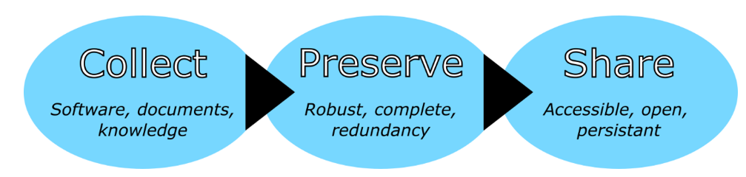
PRINCIPLES OF SOFTWARE PRESERVATION
These three principles, which correspond to the different phases of the software preservation process, help to guarantee the robust preservation of software while maximising benefit to, and usage by, potential future users of the software.

Slide 6
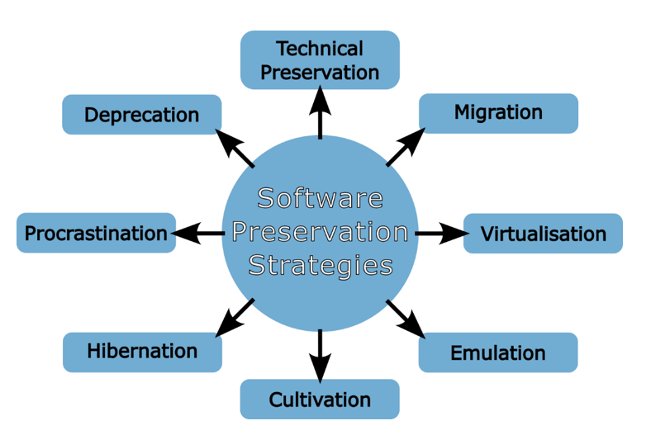
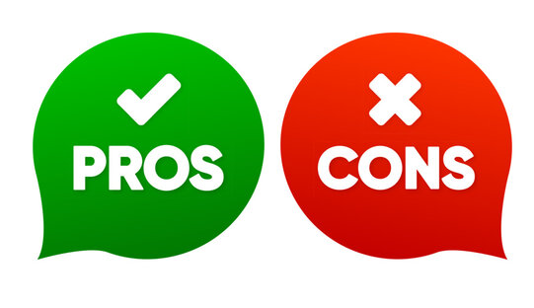
SOFTWARE PRESERVATION STRATEGIES
When it comes time to initiate the software preservation process there exist a number of strategies available to the responsible data curator. The choice of a strategy depends on the exact nature of the software to be preserved, and in some cases more than one strategy, or a hybrid approach, might be adopted.

Slide 7
CHALLENGES AND COMPLICATIONS (1/2)
A well planned and proactive approach to software preservation may help to avoid some of the following most encountered challenges, particularly for larger, well-resourced organisations.
Lack of documentation and expert knowledge represent a challenge for the preservation process (mitigated by early adoption of a preservation strategy that ensures an adequate documentation and expert knowledge collection).
Preserving the full functionality of the software may be difficult as data managers/curators may not be familiar enough with the entire software to accurately assess whether all aspects are functioning as designed.
Risk of partial or full obsolescence prior to beginning the preservation process poses a critical risk that is particularly pronounced for software that depends on any specialised hardware (mitigated by a good preservation planning).
The need to avert these risks further reinforces the importance of planning the preservation activities as soon as possible so that software (and hardware) may be preserved while they are still available.

Slide 8
CHALLENGES AND COMPLICATIONS (2/2)
Intellectual property (IP) rights which may prevent the distribution of the software without first receiving explicit permission from the rights holder.
Software preservation often requires the manipulation of the software in a manner which may not be permitted by the licence agreements.
Resource availability, both in terms of personnel and finances.
Software preservation activities can involve expenses, particular if employing a strategy of technical preservation for software that relies on specialist hardware that must be purchased and preserved.
Even if all the required expertise are available, preservation is still a time-consuming process that requires significant effort and commitment from the personnel involved.

Slide 9

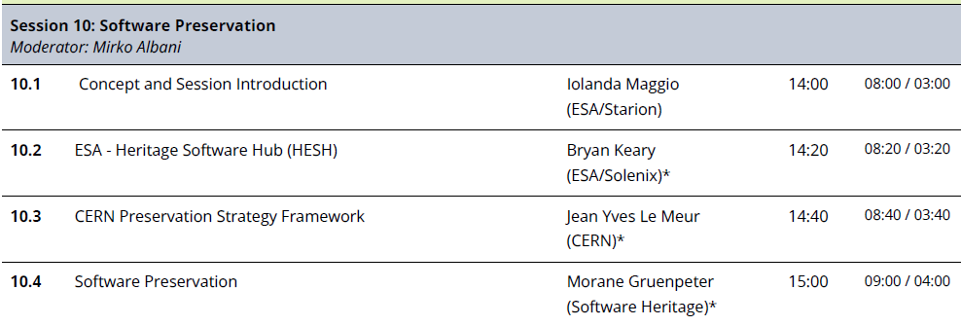
WAY FORWARD
A dedicated session has been organized to share experiences and technical information to be used to draft the relevant CEOS White Paper

