Slide 1
WGISS-59
SEO Updates
David Borges
CEOS SEO
Agenda Item 1.9
WGISS-59
24 March 2025
Bangkok, Thailand

Slide 2
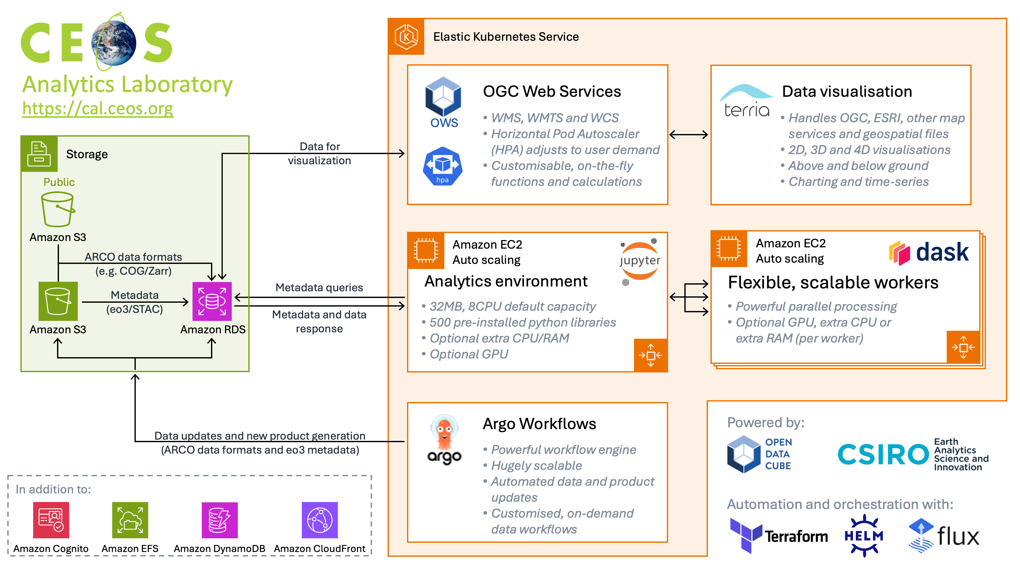
CEOS Analytics Lab
-Cloud native analytics platform available to CEOS activities that might otherwise not have access to similar resources.
-Interface and back-end updates last month. Access to greater range of Jupyter images to help ensure past code still works using previous image versions while still offering access to latest python libraries.
https://ceos.org/cal/
WGCV-WGISS-24-12: SEO to discuss with WGISS DAIG regarding connecting IDN & FedEO to CEOS Analytics Lab.

Slide 3
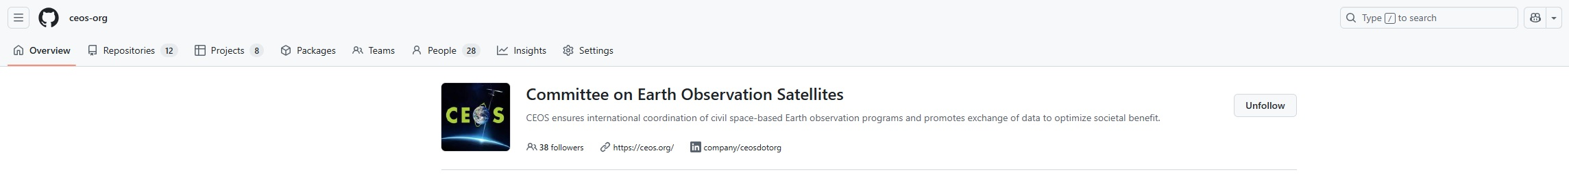
CEOS Organisational GitHub
-Licensing: Trial licensing at repository level have been implemented to provide necessary open-source licensing where necessary but maintain copyright ownership by individual contributors (agencies). [GEO]
Software: Apache 2.0 | Data & Content: CC-BY 4.0
WGISS-58-29: WGISS members should create GitHub account and/or request membership in CEOS org account.
WGCV-WGISS-24-05: SEO to develop ‘Contributor Guidelines’ for GitHub Org account to standardize internal and external contributions across repos. [Under development by SEO, will share with WGISS for edits/feedback]
WGCV-WGISS-24-11: SEO to discuss with Paolo Castracane & Peter Strobl (and NOAA) about transferring current Cal/Val Portal Terms & Definition Wiki to GitHub KCEO repo, considering appropriate format.

Slide 4
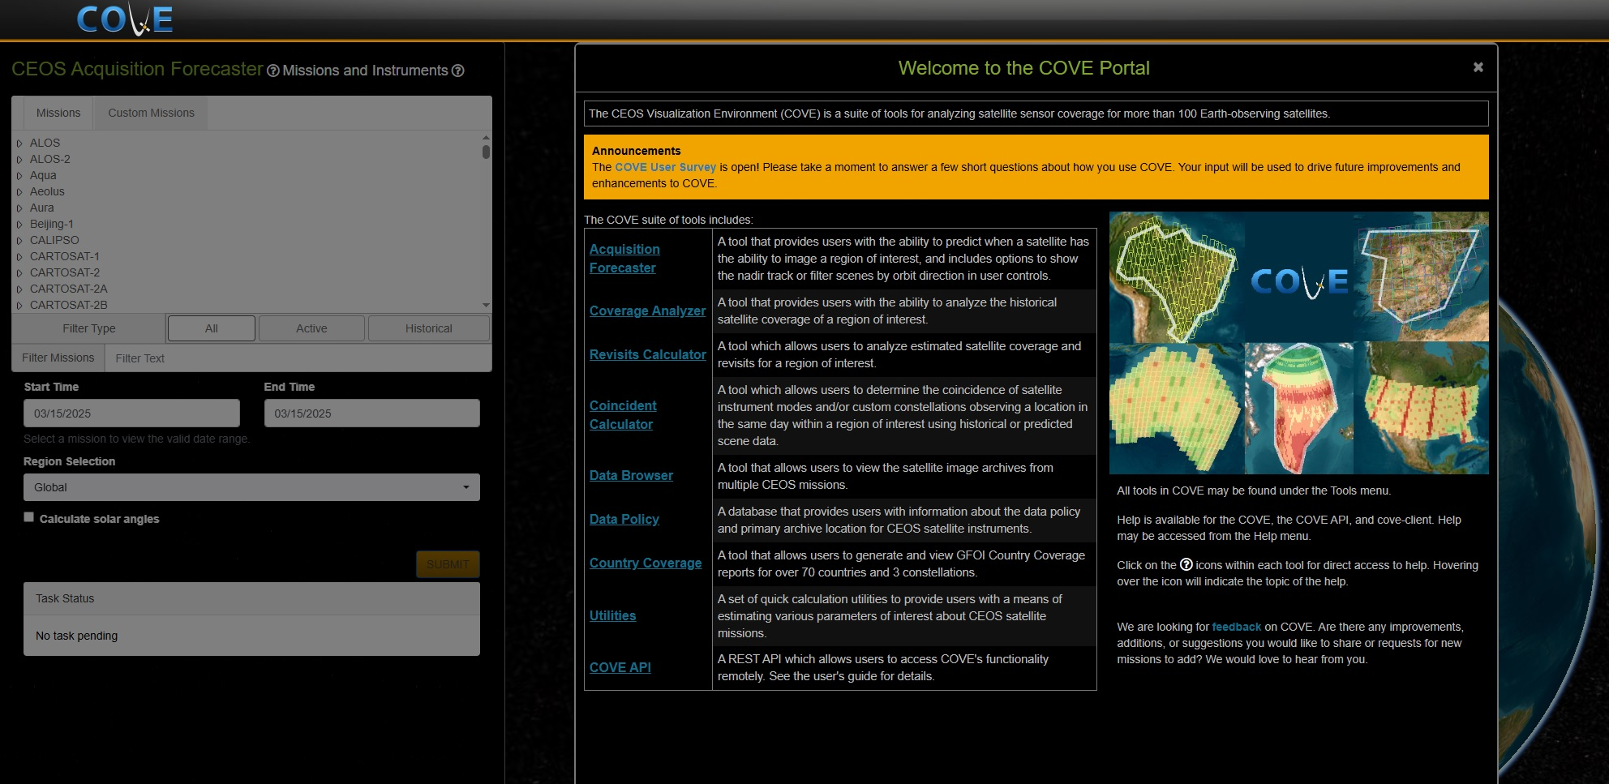
CEOS COVE Portal
SEO is considering closing down CEOS COVE as use metrics are quite low.
Intent would be to open source most of the individual COVE tools and share on GitHub before shut down.
If anyone has strong feelings on this topic, please share your perspective.

Slide 5
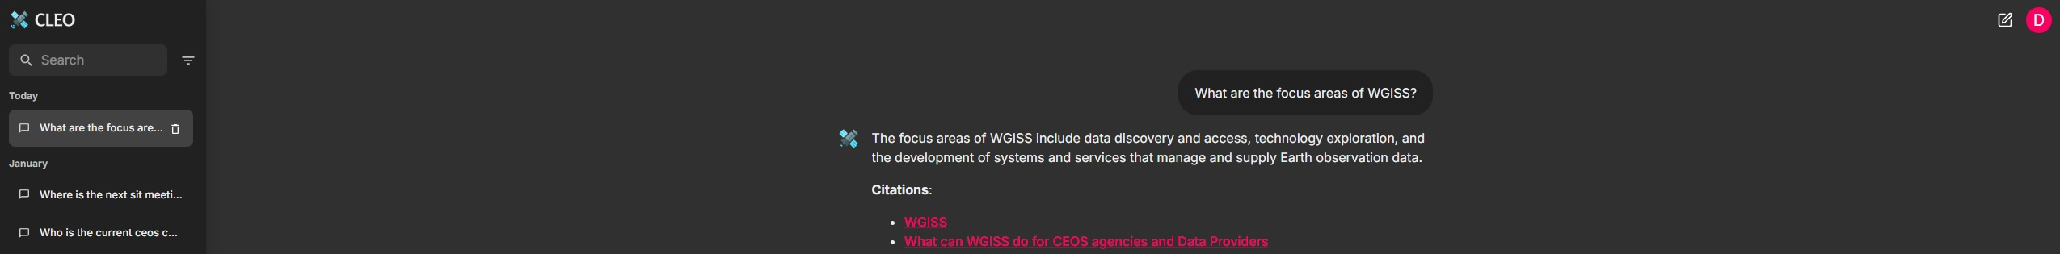
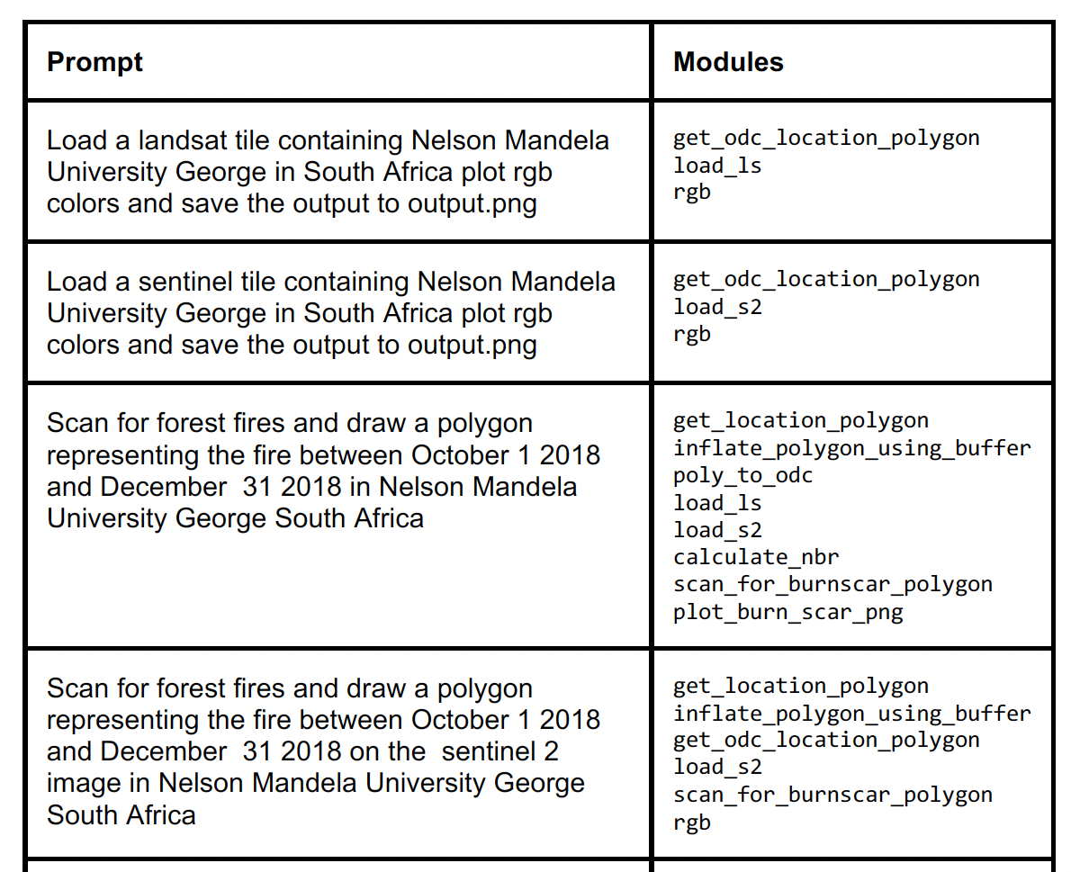
New CEOS Tooling (R&D)
CEOS Liaison for Earth Observations [CLEO]
“CEOS-GPT” functionality allowing natural language chat query, tuned to all content on CEOS website, File Management system, and CEOS MIM Database.
EO-GPT
Decomposable Earth Observation analysis capability. Ability to have natural language conversations to conduct complex, earth observation analysis and research. Increasing accessibility of technical EO applications.

Slide 6

Further WGISS / SEO Collaboration
Interoperability Handbook 2.0
Alex Leith supporting Architecture Factor
CEOS-ARD
Matthias Mohr supporting evolution of PFS, towards “Composable Building Blocks”.
Process inspired by guerilla standards approach that birthed STAC (Hanson).
Systemic Commercial Engagement (how best to capture across CEOS).
TEIG Analysis: Aligning ESIP AI/ML Ready Data & CEOS-ARD. Addressed at LSI-VC-17 (Yousuke).
WGISS-58-21: TEIG to investigate with DAIG and SEO the available technologies for federated authentication, and which would fit the objectives of CEOS.

