Slide 1
WGISS Action Review
Libby Rose
Agenda Item 1.8
WGISS-59
24-28 March, 2025
Bangkok, Thailand

Slide 2
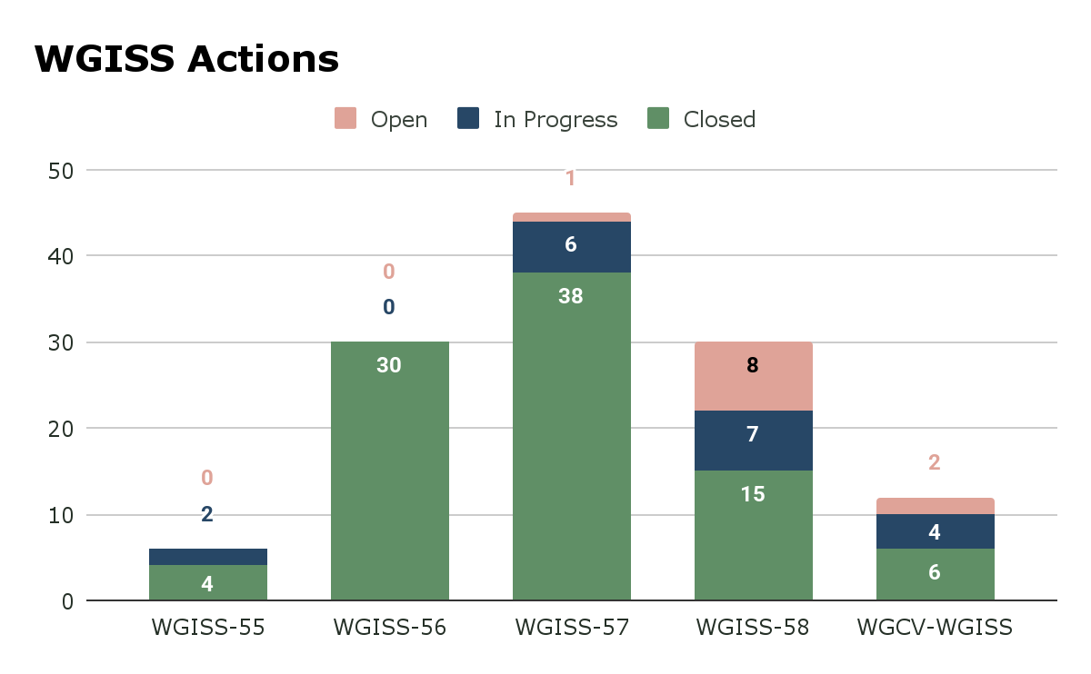
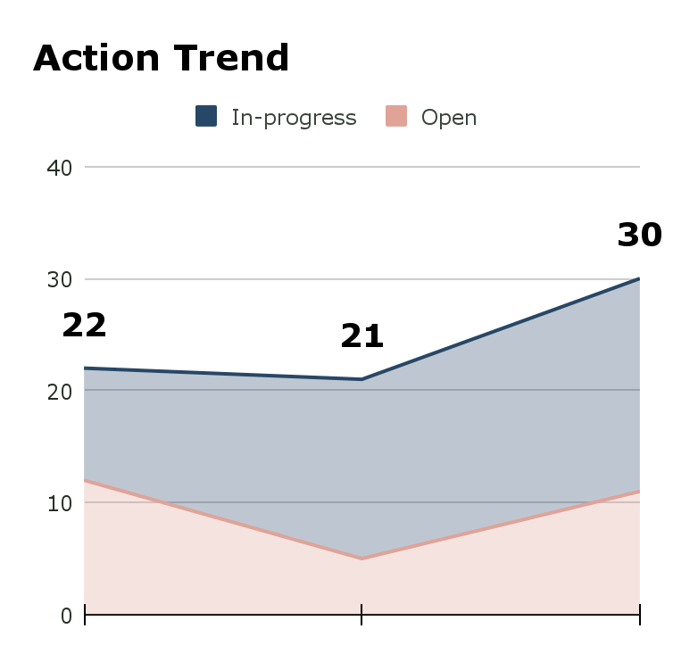
Status of actions
Open: 11
In progress: 19
WGISS-57 WGISS-58 WGISS-59

Slide 3
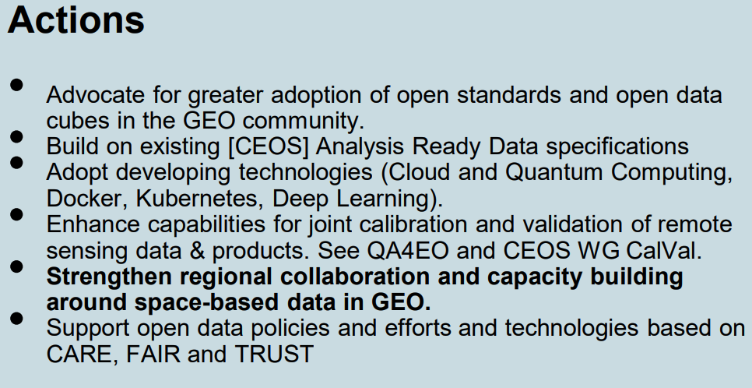
WGISS-58-01
Interest Group leads to review the GEO Open Data Open Knowledge (ODOK) actions to identify opportunities for collaboration.
Is there anything from these actions we should follow up?

Slide 4
WGISS-58-29
WGISS members should ensure they have a GitHub account, and are a member of the CEOS Organisational account. Contact Brian Terry (SEO) for assistance if needed.
  Action will be closed

Slide 5
WGISS-55-05
WGISS (Yves Coene, Damiano Guerrucci) to invite WGDisasters to provide tools and software developed by WGDisasters so they can be made discoverable to global users through the service discovery.
  September 2023: WGDisasters have been contacted but no answer received so far
  Can this be closed?

Slide 6
WGISS-58-30
WGISS Secretariat to put together guidance for Interest Groups about surveying CEOS Agencies on various topics.
Target audience & goals:
  Who would you like to respond? What is the best way to contact them?
  Are they an audience that regularly interacts with CEOS?
  Make use of WGISS POCs to target each agencies individually
  How many responses are expected?
Is a survey necessary? Would targeted telecons / virtual workshop be more effective?
Effort required to respond:
  Will they need to contact others within their agency to provide a response?
  Does the agency actually have the answers you are looking for?
References and sufficient descriptions should be provided
Questions should be reviewed by Exec before the survey is distributed, to ensure they are appropriate

