Slide 1
Overview of CEOS Interoperability Handbook 2.0
Nitant Dube
& Tom Sohre,
Agenda Item 1.7
WGISS-59
24-28 March, 2025
Bangkok, Thailand

Slide 2
CEOS Interoperability Handbook V 2.0
Objective
CEOS Interoperability Handbook Version 2.0 should provide guidance to the organizations for development of Interoperable Data and Services and help them in measuring their maturity level
Interoperability Handbook
Maturity Matrix

Slide 3
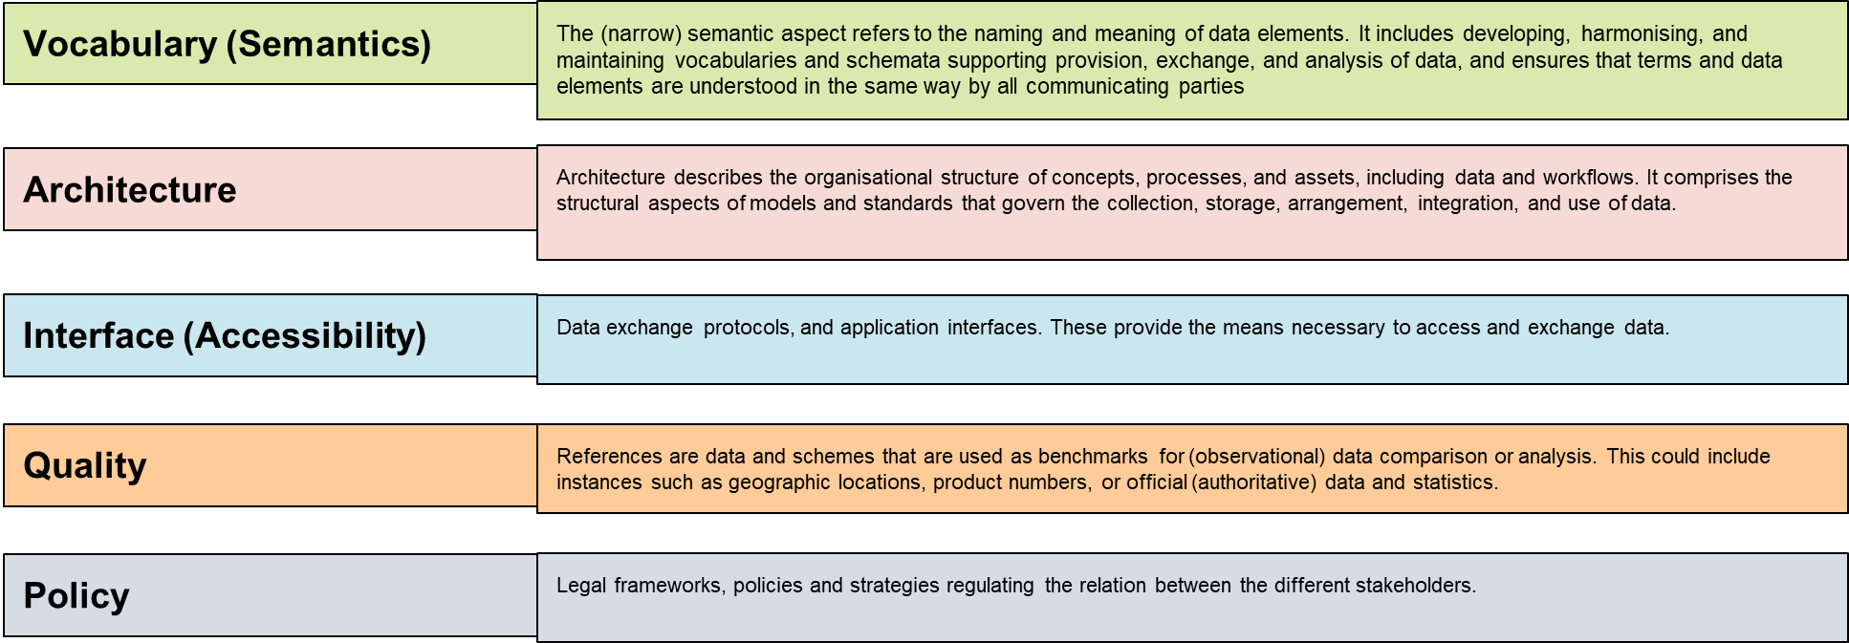
Interoperability Framework : Factors
Management
Policy
Technology
Quality
Vocabulary
Interface
Architecture

Slide 4
Handbook on github
The First Draft of Interoperability Handbook 2.0 is now available on github
https://github.com/ceos-org/interoperability-handbook

Slide 5
Handbook Chapter Layout
Chapters
Chapter-1 : Introduction
Chapter-2: Interoperability Framework
Chapter-3: Vocabulary (Semantics)
Chapter-4: Architecture
Chapter-5: Interface (Accessibility)
Chapter 6: Quality
Chapter 7: Policy

Slide 6
Recommendations

Slide 7
Vocabulary
Semantic (6)
Vocabulary (14)
Thesaurus (8)

Slide 8
Architecture
Data (20)
Metadata (6)
Architecture (40)
Cloud (6)
Publishing (4)
Technology (4)

Slide 9
Interface
Data Discovery (11)
Interface (18)
Data Access (5)
Authentication and Authorization (2)

Slide 10
Quality
Quality
Calibration & Validation ( 5)

Slide 11
Policy
Policy
Policy (8)

Slide 12
Thanks nitant@sac.isro.gov.in tsohre@usgs.gov

