Slide 1
Data Preservation & Stewardship Interest Group (DSIG) Work Plan
Mirko Albani, ESA
Agenda Item 1.4
WGISS-59
24-28 March 2025
Centara Grand at Central Ladprao Bangkok, Thailand

Slide 2
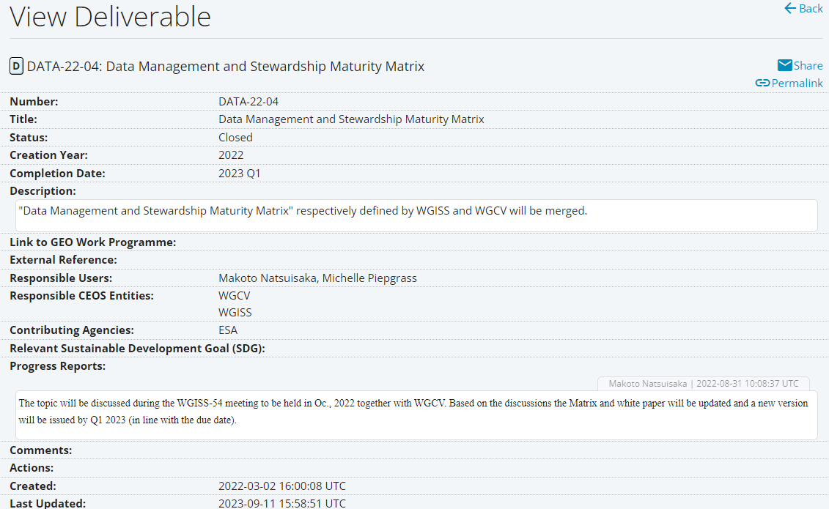
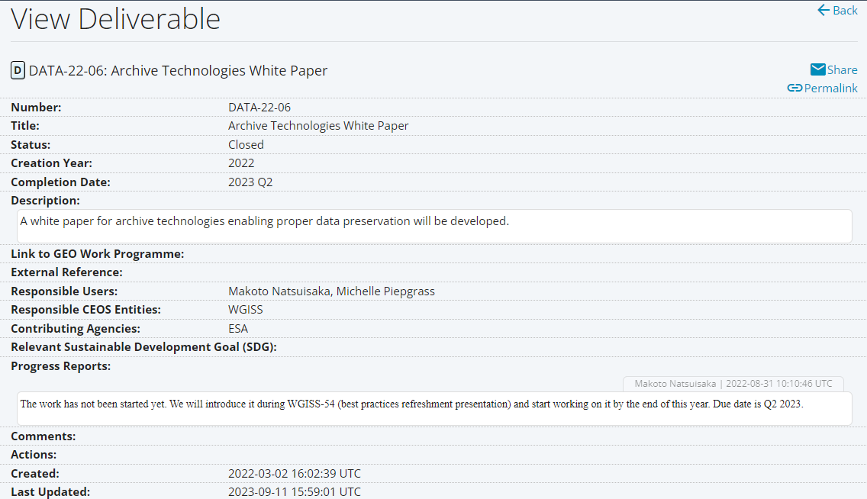
CEOS Deliverables 2021 - 2023

Slide 3
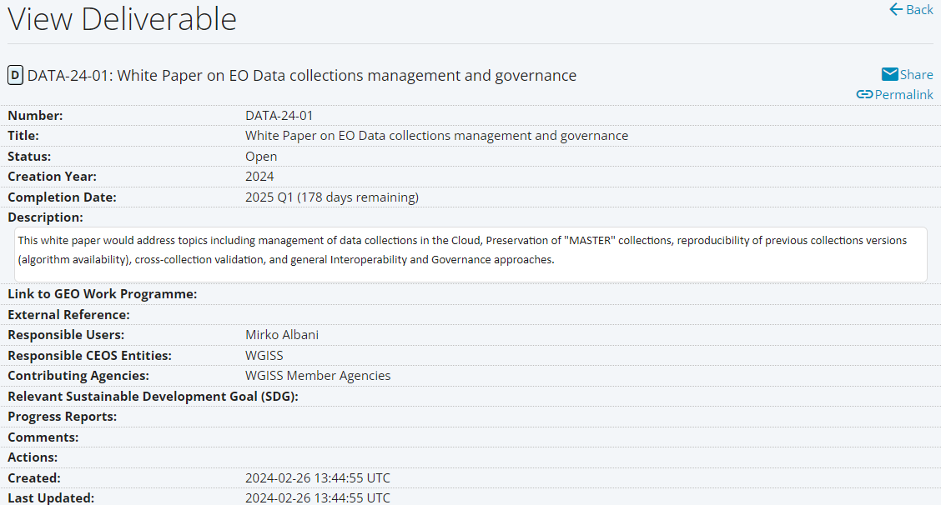
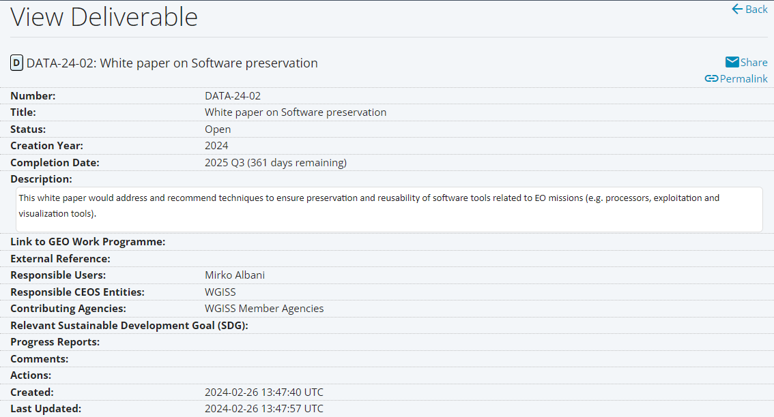
CEOS Deliverables 2023 - 2025
Completion Date: CONFIRMED

Slide 4
CEOS Deliverable DSIG Vision
Long-term accessibility and exploitability of Earth Science data requires that not only sensed data but also technical content and associated information needs to be properly preserved and made accessible. In addition, data provenance and data citation are key aspects to be further discussed in the CEOS framework which might benefit from shared and coordinated approaches.
Ongoing/future deliverables will address:
Data Associated Content and Information Preservation
Long Term Data Preservation processes
Data Provenance and Citation
Proposed deliverable for 2026-28:

Slide 5
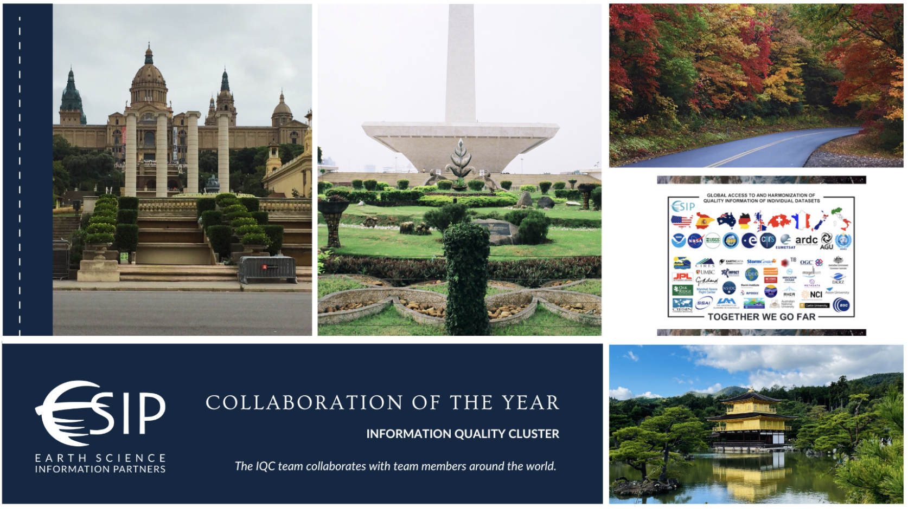
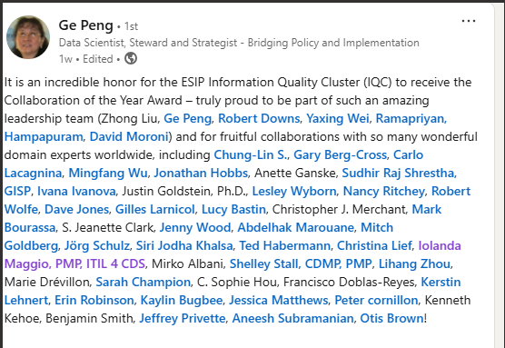
Earth Science Information Partners - Collaboration of the Year Award
The Information Quality Cluster (IQC) team received the Collaboration of the Year Award. IQC is a powerful example of collaboration that spans disciplines and time zones to set and define Earth science data standards.
WGISS DSIG (through Mirko/Iolanda) contributed to the paper “Harmonizing Quality Measures of FAIRness Assessment Towards Machine-Actionable Quality Information”
https://ntrs.nasa.gov/api/citations/20180004864/downloads/20180004864.pdf
Paper will be linked in the WGISS “external documents of relevance” section.

