Slide 1
FedEO Report
Yves Coene (Spacebel for ESA), Mattia Stipa (ESA)
CEOS WGISS #59, Bangkok (Thailand)
Session 1: Opening Session, 25/03/2025

Slide 2
Outline
FedEO Collections and Collaborations
FedEO Updates & Federations
  JAXA G-Portal
  ESA/DLR
  FedEO/CDSE
  FedEO STAC evolution
Updates to Online documentation
  OpenSearch (CDA)
  STAC (FedEO)
STAC Validation

Slide 3
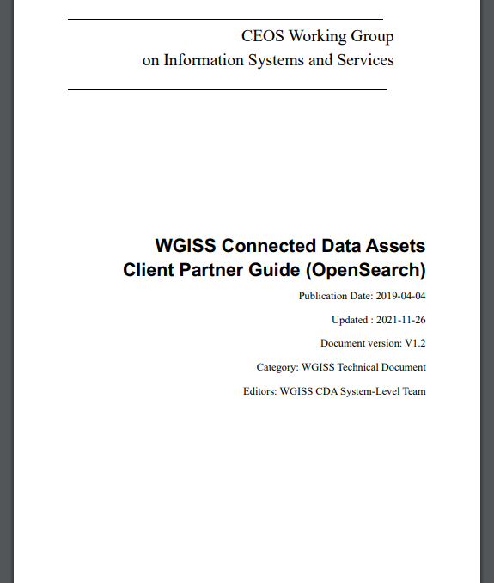
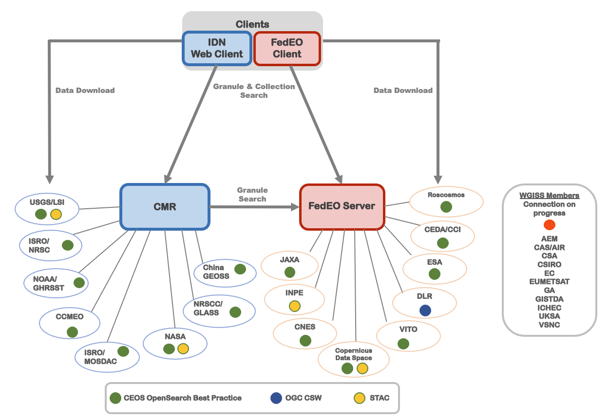
WGISS Connected Data Assets
FedEO: Federated Earth Observation missions access

Slide 4
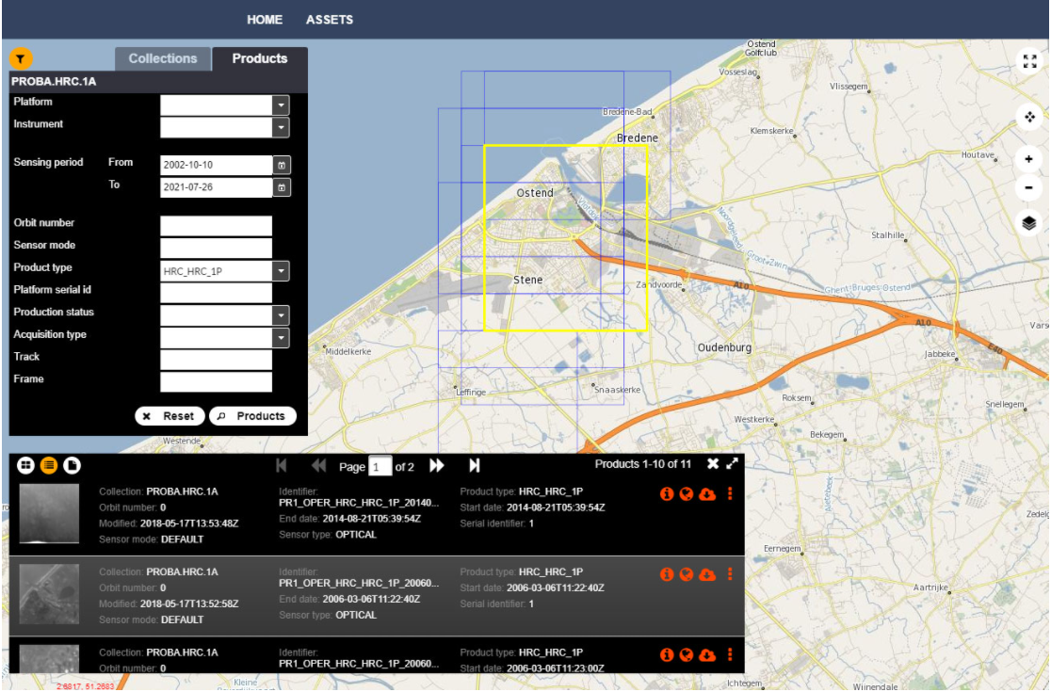
FedEO in CEOS Domain
FedEO Client available at
https://fedeo-client.ceos.org
FedEO Server (API) available
at https://fedeo.ceos.org/readme.html
Validation server (API) available at https://geo.spacebel.be/readme.html
Notes:
https://earth.esa.int/eogateway/news/new-version-of-the-fedeo-client

Slide 5
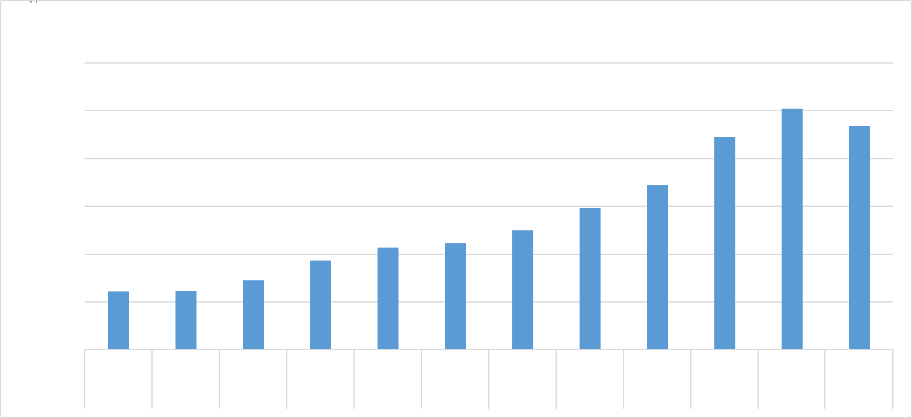
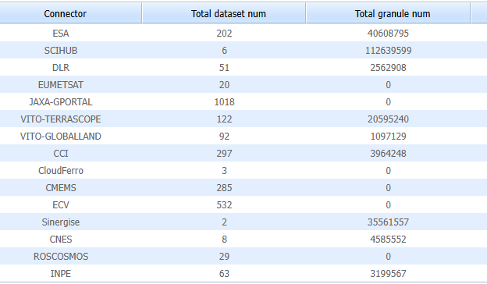
FedEO Collections and Collaborations
Updates since WGISS-58:
234 million granules (-7% - mainly JAXA)
2698 collections (was 2388)
JAXA:
  granules temporarily unavailable
INPE:
  From 35 to 63 collections.
  From 1.9 to 3.2 million granules
ESA:
  From 38 to 40 million granules
Status:
CNES (REFLECS) to be reconnected.

Slide 6
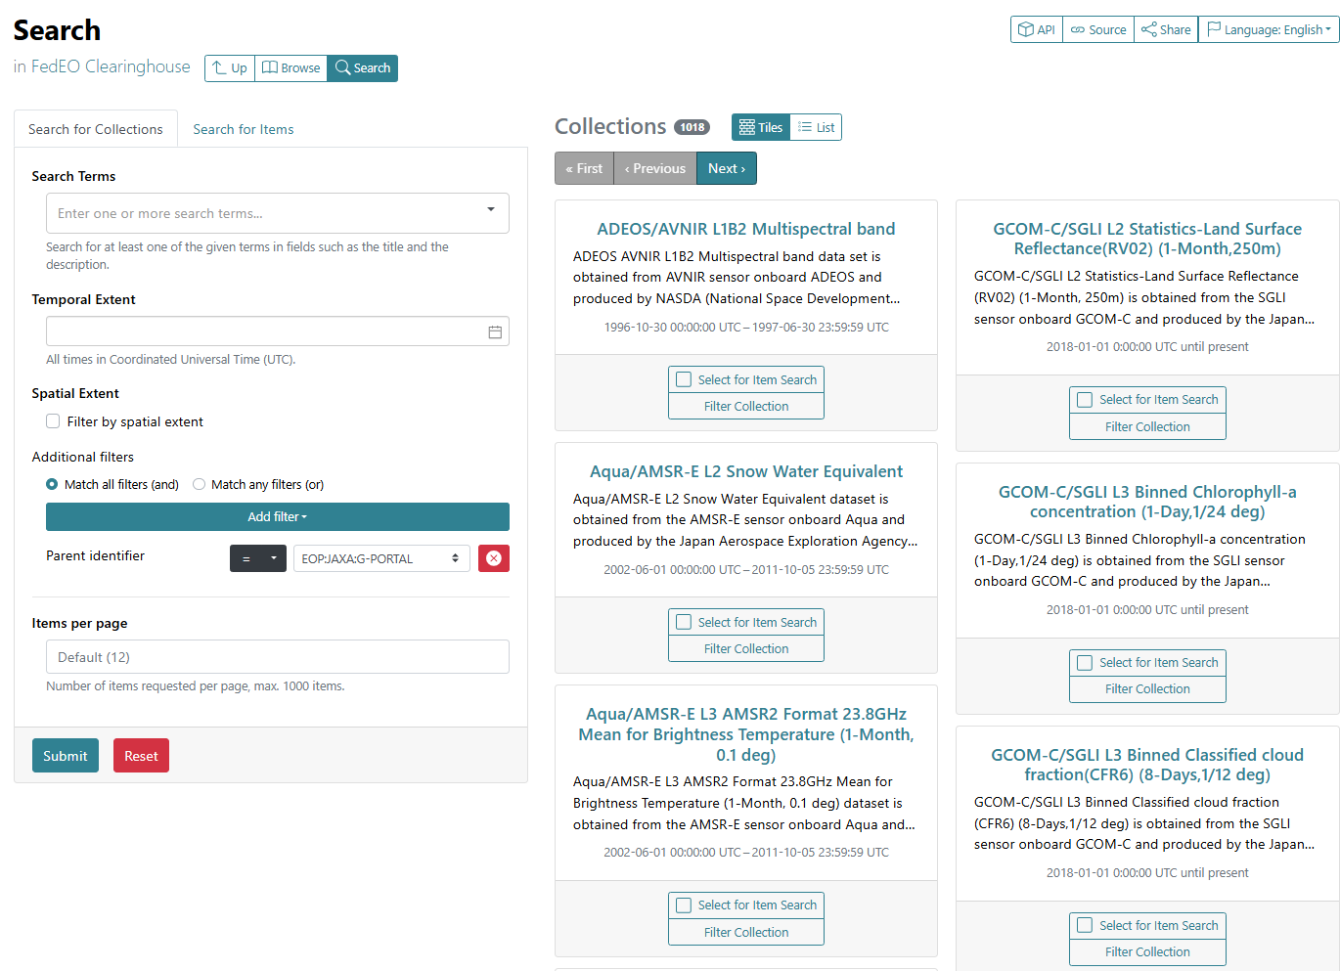
Integration – JAXA G-Portal
Context:
  JAXA replacing G-Portal catalogue interfaces
    Collection search (1018 collections)
    Granules search
Activity:
  March 2025: Integration in FedEO of new JAXA collection search endpoint implementation.
Next steps:
  April 2025: Check new version of granule search interface.

Slide 7

STAC API Federation
FedEO originally
  Federated backends via their OpenSearch or OGC CSW interface.
  Exposes for all OpenSearch and STAC
Since 2024, also federation with pure STAC API catalogues is supported.
  INPE: first catalogue integrated via its STAC API (/collections, /items)
Additional federations via STAC API underway:
  ESA / DLR Federation (prototype)
  FedEO / Copernicus CDSE

Slide 8
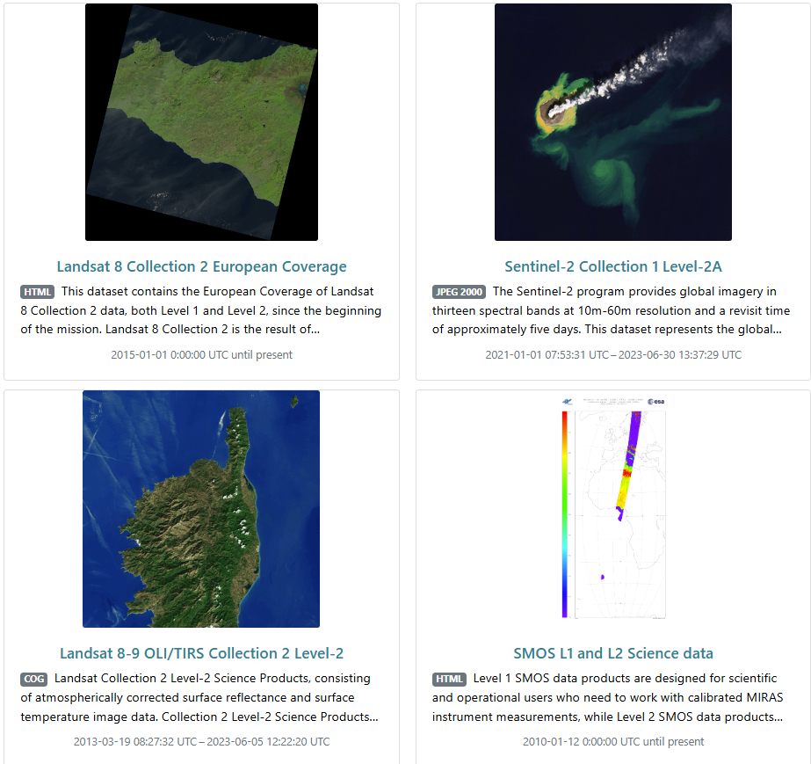
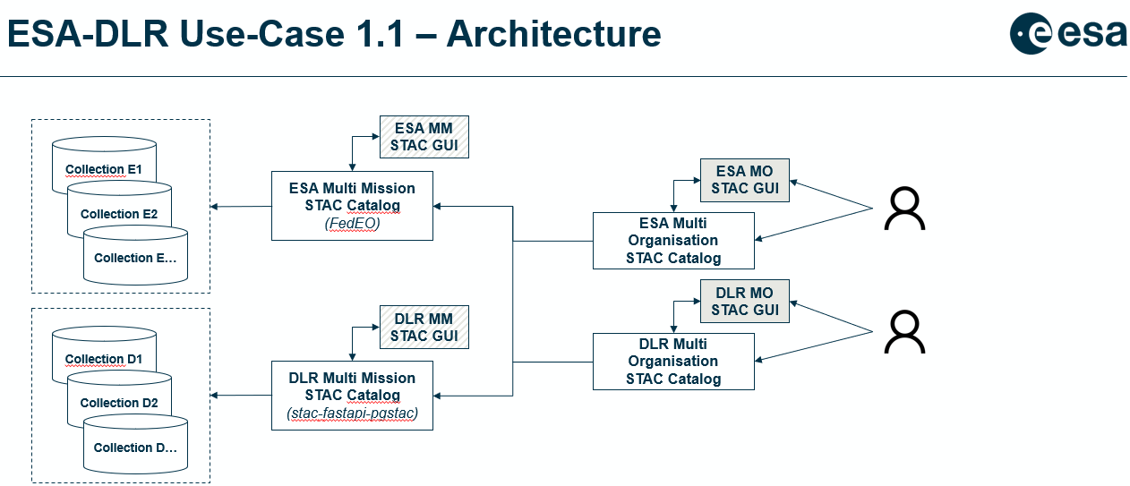
STAC API Federation – DLR / ESA
Objective:
  Federating 2 multi-mission STAC API catalogues (to share collections), data on S3.
  Retaining separate Portals (clients)
  Hands-on experiments to:
    Identify issues/limitations, e.g. inheriting queryables, CQL query capabilities etc.
    Identify/group duplicate products (1 product, multiple download?), …

Slide 9
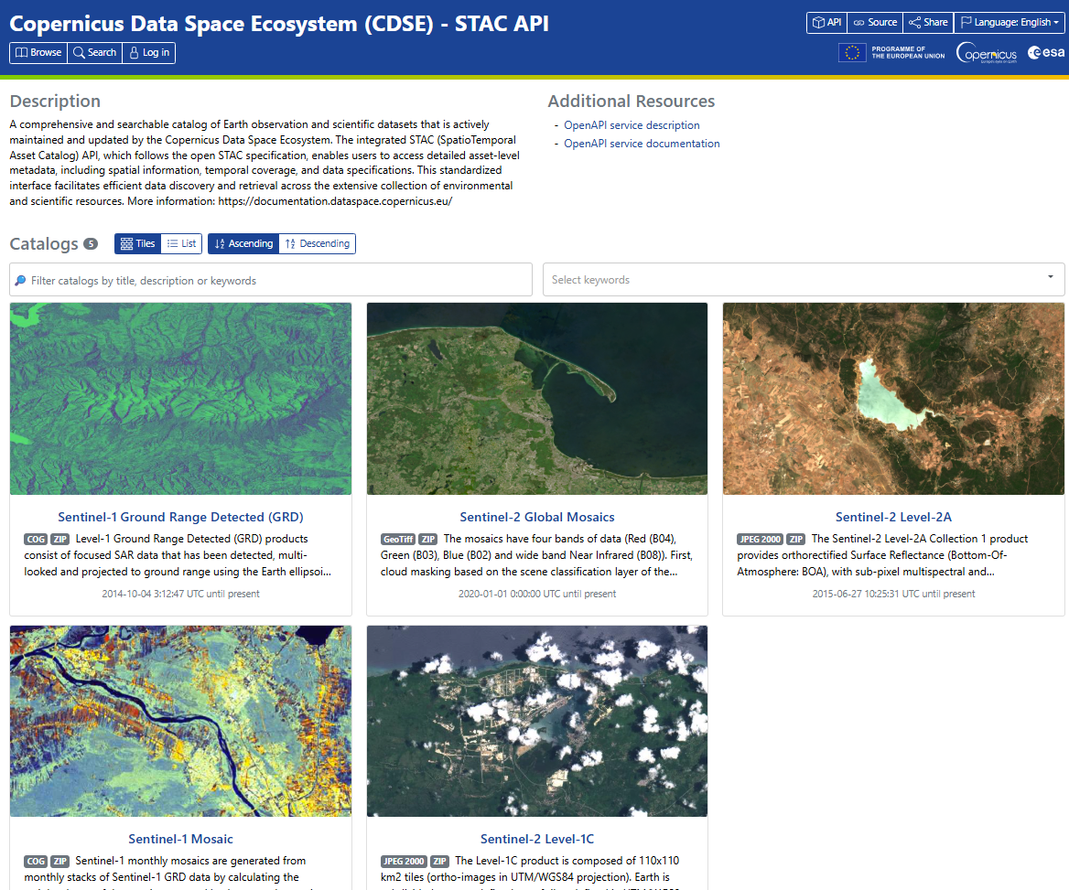
STAC API Federation – FedEO / Copernicus CDSE
Objective:
  Federate FedEO STAC API with Copernicus Data Space Ecosystem (CDSE)
  STAC API
  Replace previous integration in FedEO based on (legacy) OpenSearch API.
Status:
  17 collections available on FedEO.
    Data access: HTTPS or S3
  Improvements needed to “inherit” global and collection specific queryables as OpenSearch parameters.
  Not included in metrics/assets as not returning total results as previous OpenSearch API.
Notes:
https://browser.stac.dataspace.copernicus.eu/?.language=en

Slide 10
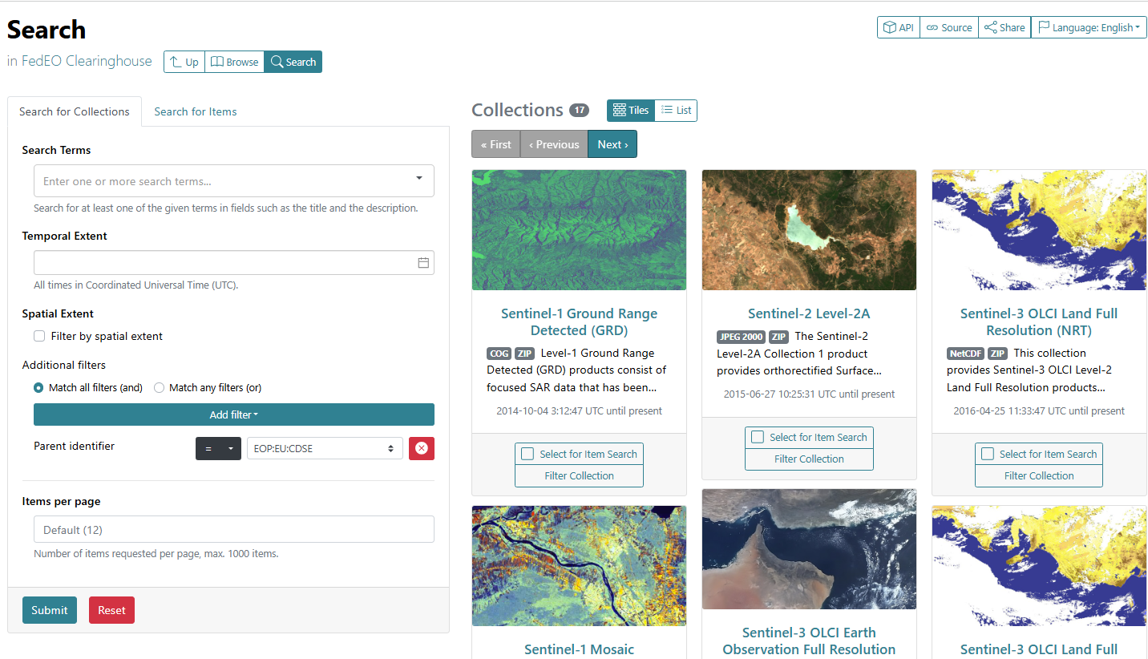
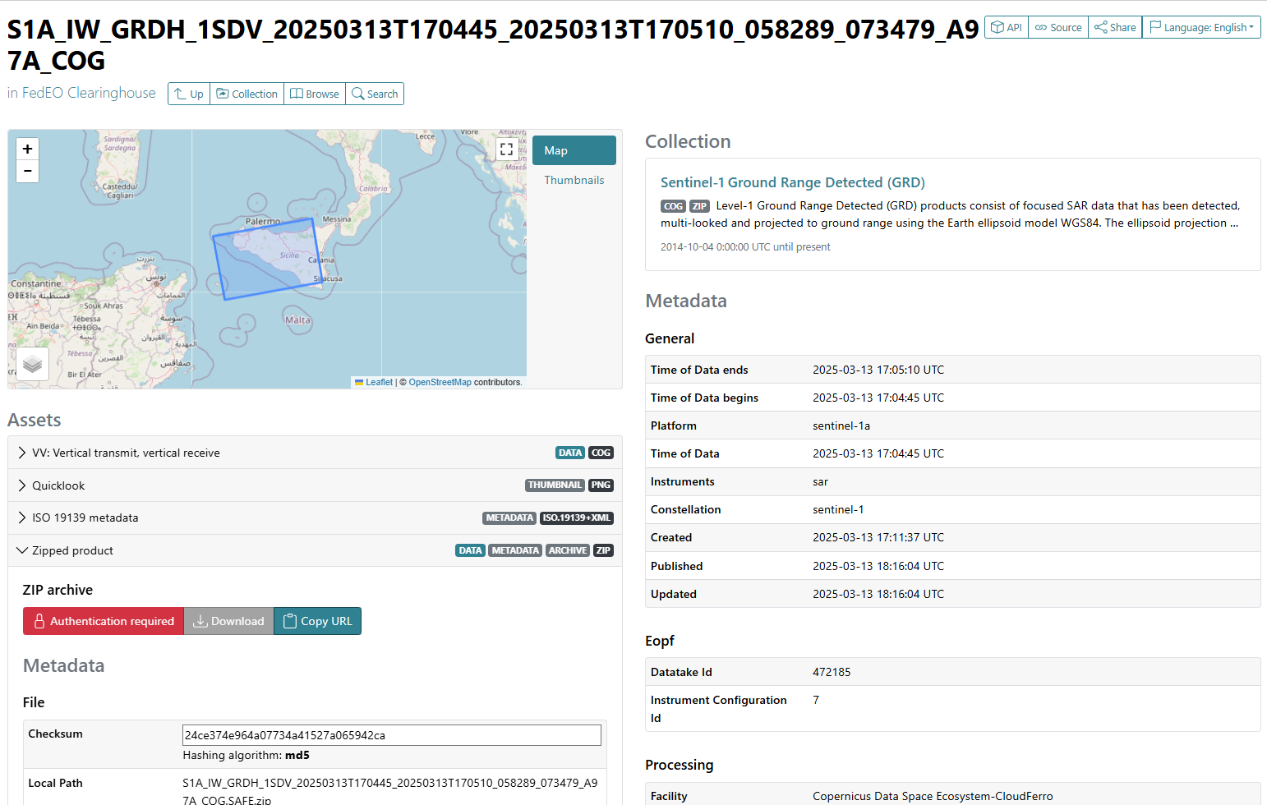
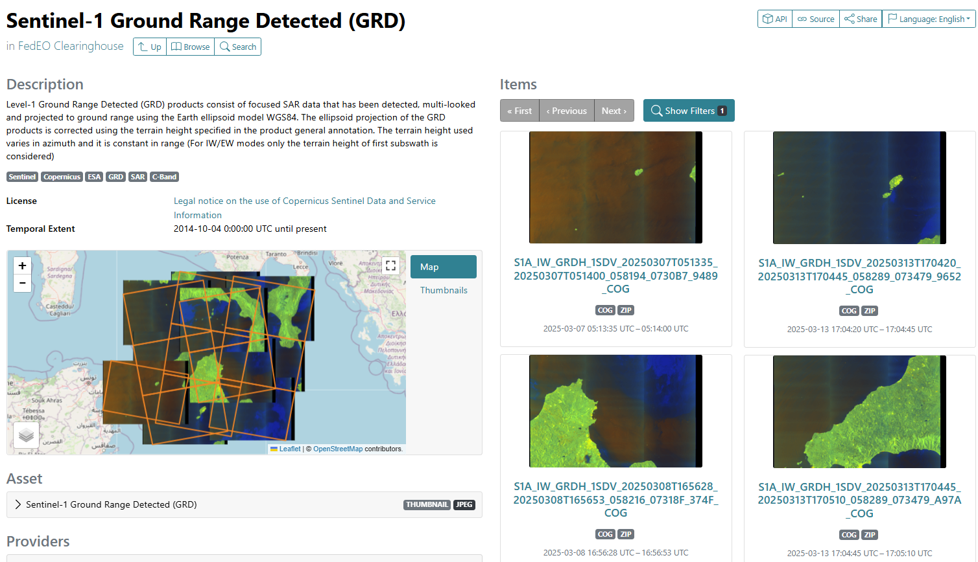
STAC API Federation – Copernicus CDSE

Slide 11
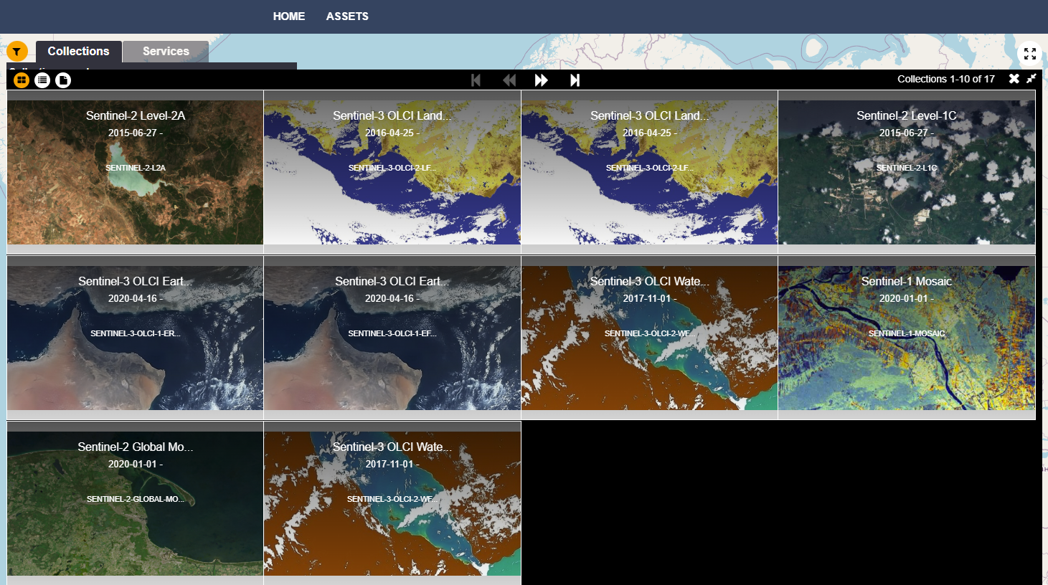
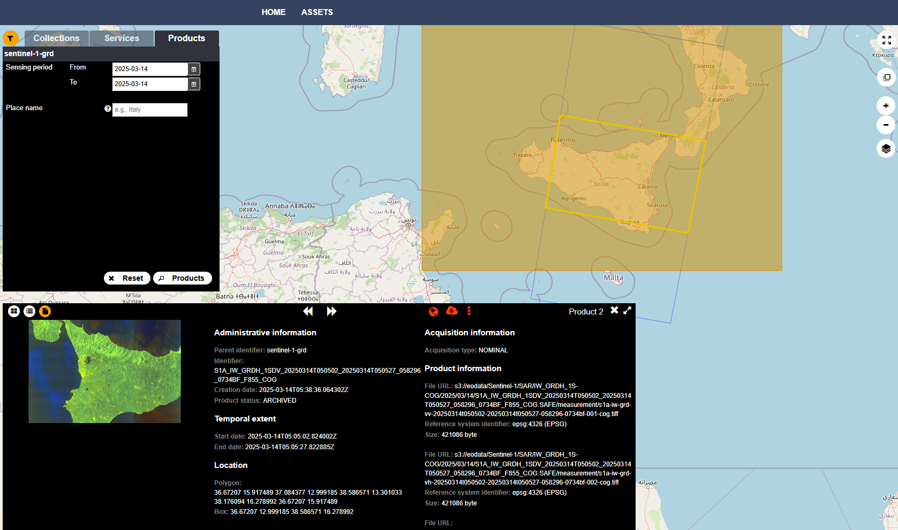
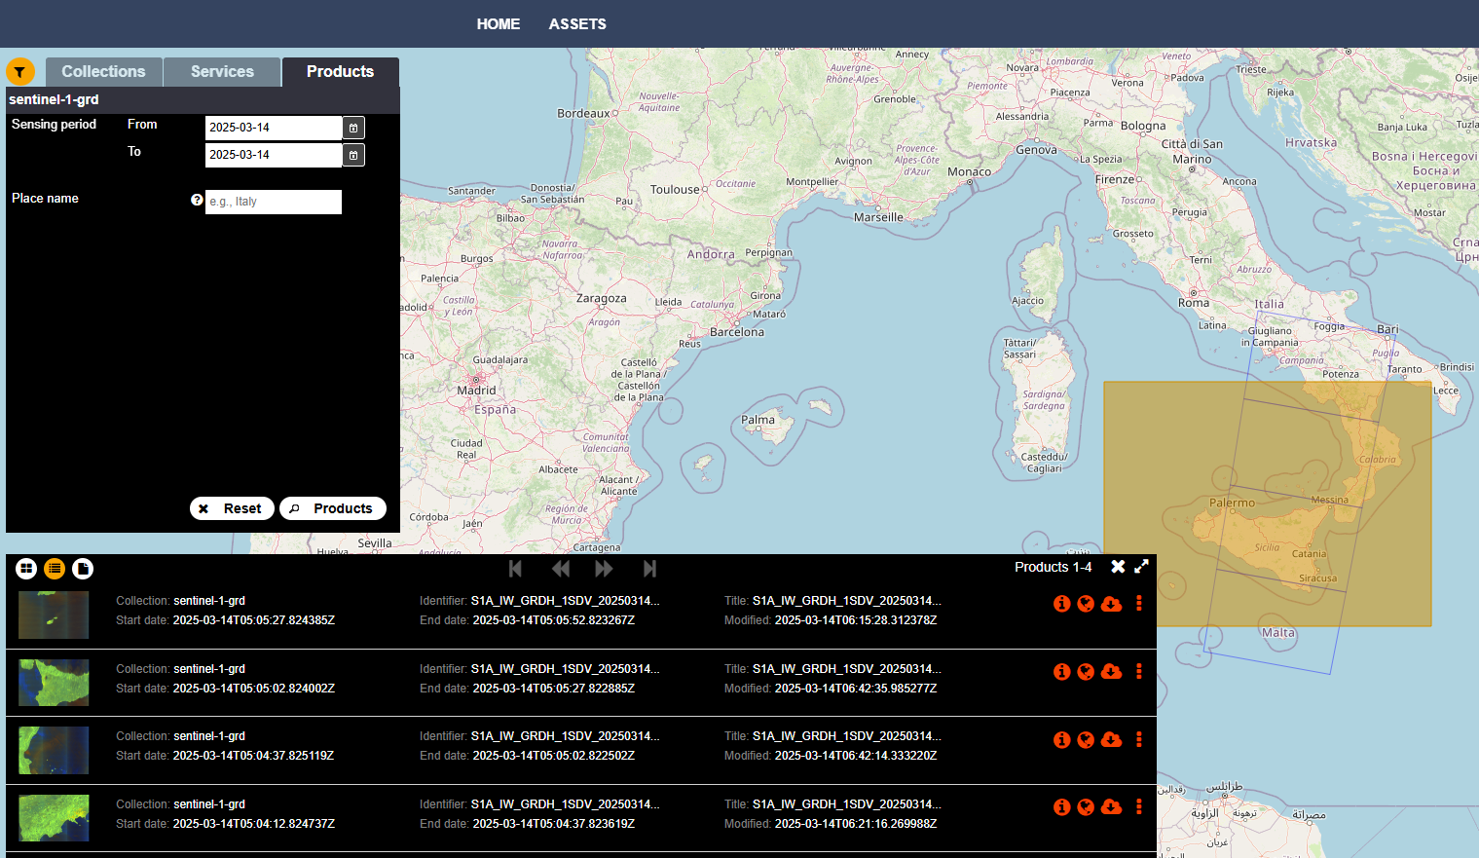
STAC API Federation – Copernicus CDSE
Sentinel backend interface migrated to stac.dataspace.copernicus.eu/v1/
17 CDSE collections available in FedEO API via two-step search (including OpenSearch, STAC API)

Slide 12

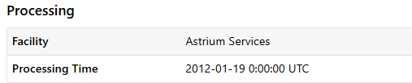
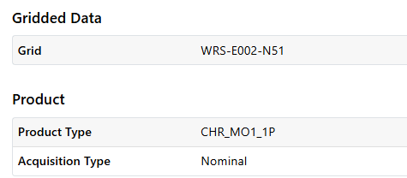

Evolution – STAC encoding improvements
FedEO STAC encoding (visible in STACBrowser)
  Collection
    License information (text content).
    Creation date
    Updated date
    Processing Level
  Granule
    Processing Facility
    Processing Time
    Constellation (correction)
    Product type (Product extension)
    Acquisition type (Product extension)
    Time published
    Gridded Data (Grid extension)
  …
WMTS StacBrowser

Slide 13
Evolution – STAC improvements – OGC WMTS
STAC WebMapLink Extension
  https://github.com/stac-extensions/web-map-links
  Allows defining bindings with various visualization services: WMS, …
  Use with OGC WMTS service ?
Prototype STAC implementation:
  ESA Catalogue / ESA WMTS Service serving quicklooks
  Use WebMapLink/WMTS extension and access with STACBrowser ?
Expected results:
  Possible update of “STAC WebMapLink Extension” for WMTS.
  Update of STACBrowser to support above extension for WMTS.

Slide 14
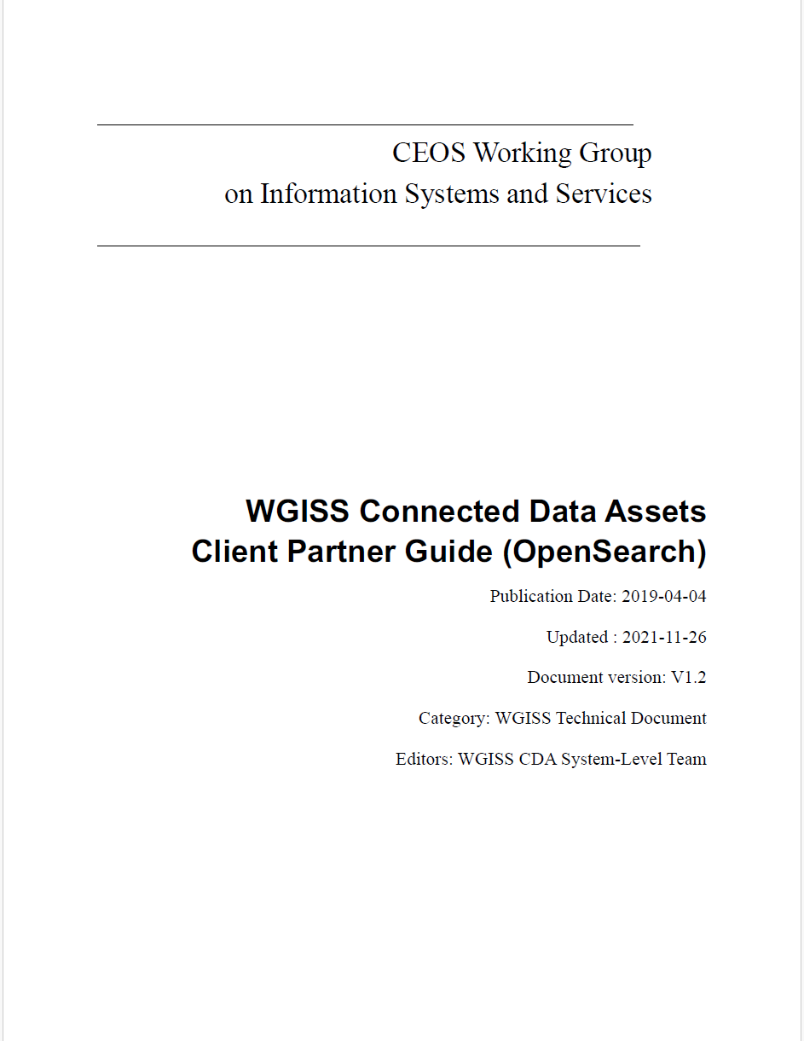
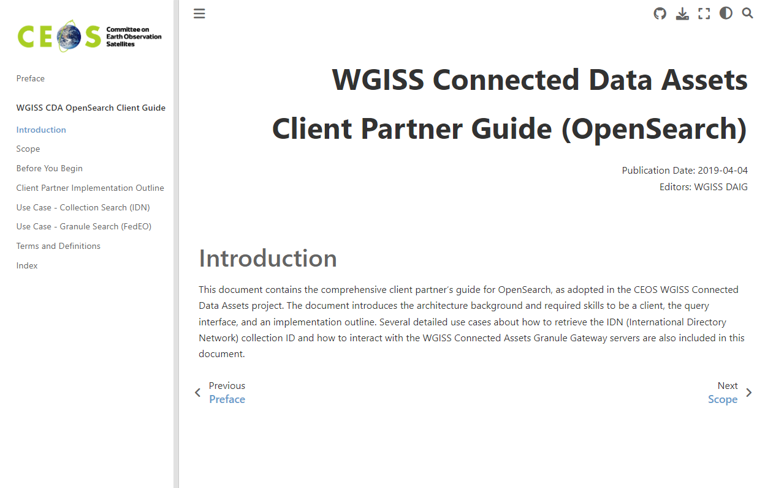
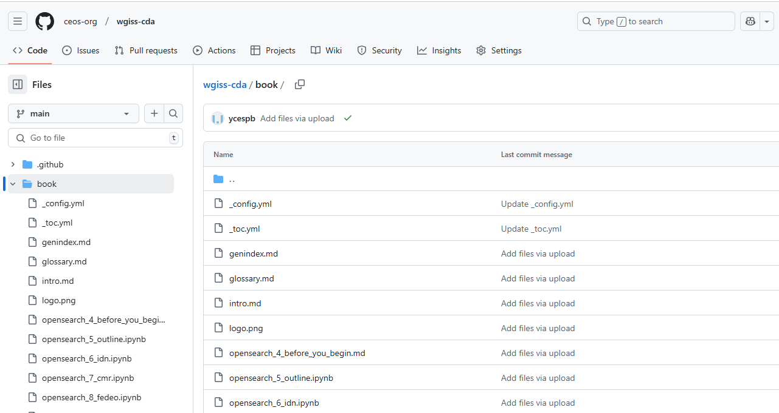


Updates to Online
Documentation
CDA Client Partner Guide (PDF) mostly migrated:
  GitHub / GitHub Pages
  https://github.com/ceos-org/wgiss-cda
  Rebuilt after each “commit”
  https://ceos-org.github.io/wgiss-cda
WGISS Connected Data Assets Client Partner Guide (OpenSearch):
https://ceos-org.github.io/wgiss-cda
Notes:
https://jupyterbook.org/en/stable/publish/gh-pages.html

Slide 15
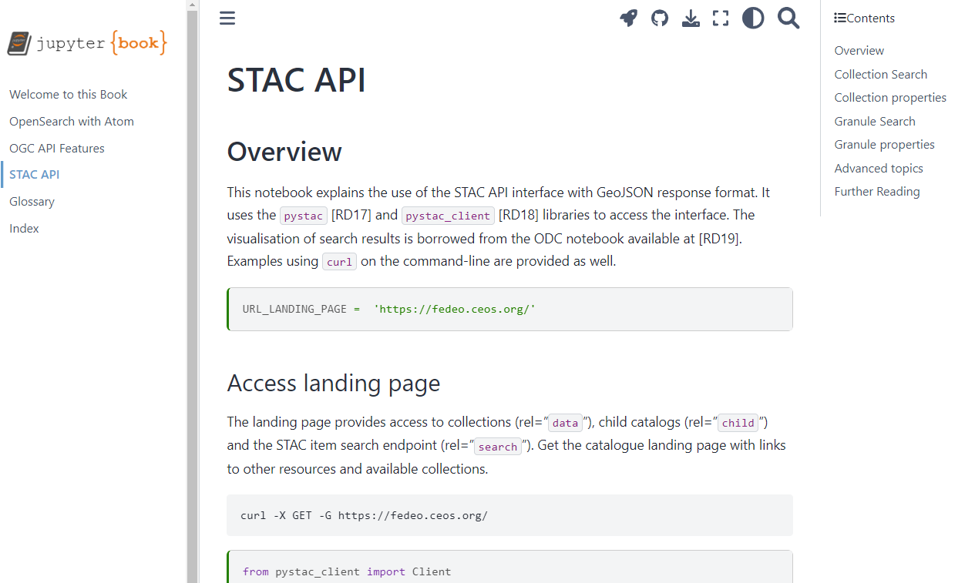

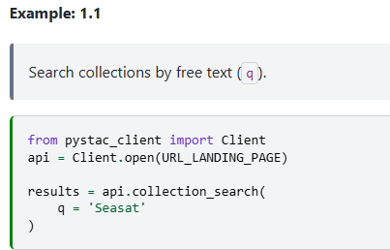
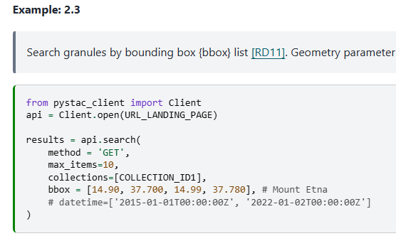
Updates to Online STAC
Documentation
Updated documentation for FedEO STAC API
  Pystac_client collection-search examples added.
FedEO API Online Documentation:
https://fedeo.ceos.org/stac.html

Slide 16
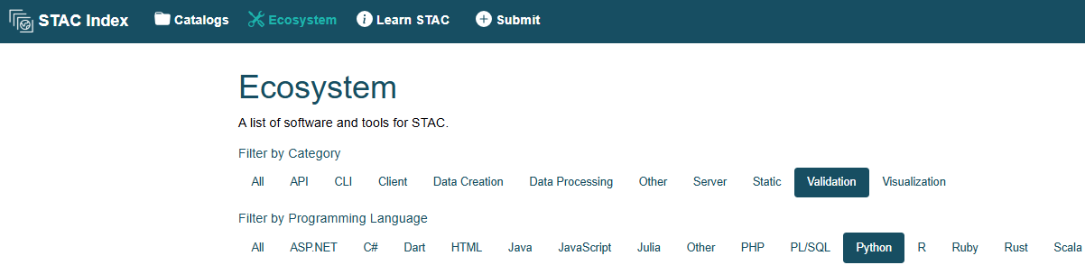
STAC Validation Tool(s)
Action from WGISS-58:
Existing “Validation Tools”:
  Stacindex.org > Ecosystem > Validation
  Copernicus CDSE / EOF Conformance Test Suite
    https://gitlab.com/eof-conformance-test-suite
  Comparison https://github.com/stac-utils/stac-node-validator/blob/master/COMPARISON.md

Slide 17
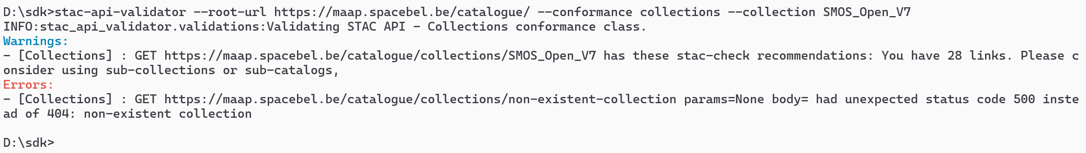
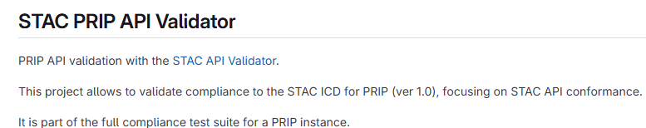
STAC Validation Tool(s)
(1) “STAC API Validator”
  https://github.com/stac-utils/stac-api-validator (Apache 2.0)
  Python-based
  Batch tool, no Web GUI, Very slow.. (10 minutes… loads full catalogue, loads all assets, …)
  Scope: verification of API, checks per conformance classes
  Is also part of Copernicus CDSE / EOF Conformance Test Suite
Notes:
https://gitlab.com/eof-conformance-test-suite/prip-cts/-/tree/main/stac-api-validator?ref_type=heads

Slide 18
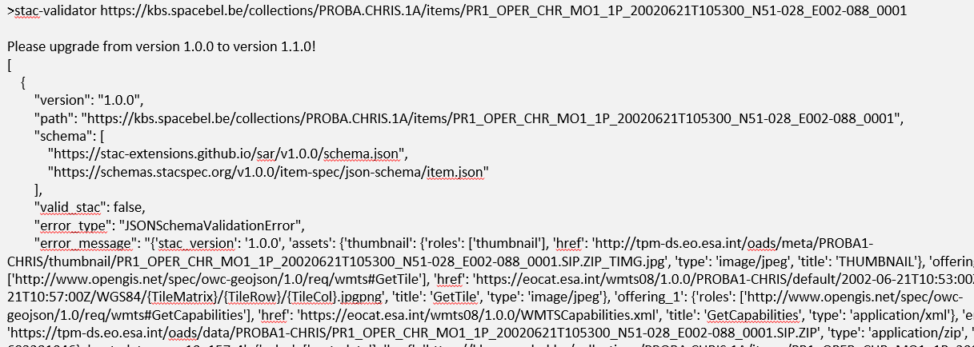
STAC Validation Tool(s)
(2) “STAC Validator”
  https://github.com/stac-utils/stac-validator (Apache 2.0)
  Python
  Batch tool no Web GUI. Online GUI at staclint.com
  Scope: verification of STAC objects. Uses https://github.com/python-jsonschema/jsonschema to check STAC object against (STAC) JSON schema(s).
  Limitation: Reports only first error.

Slide 19
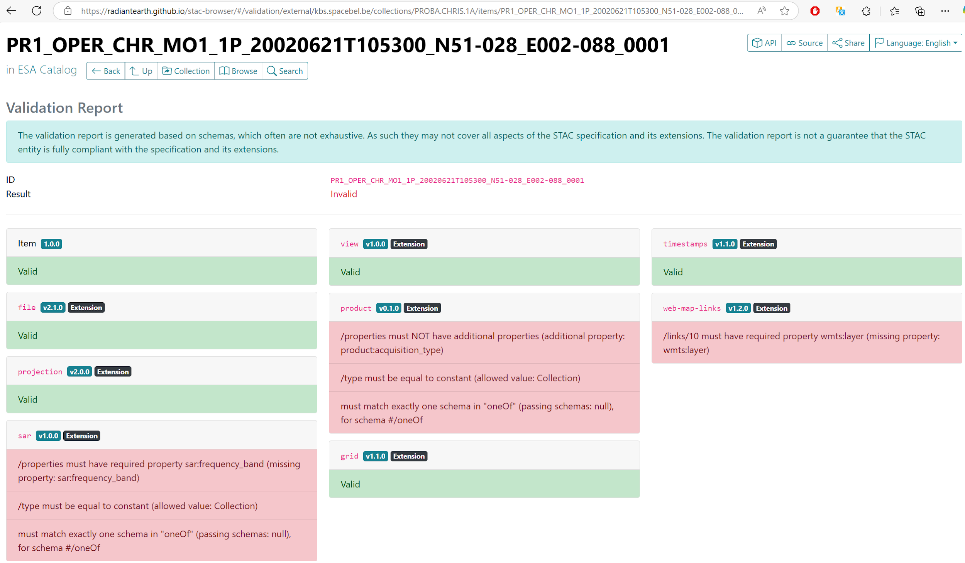
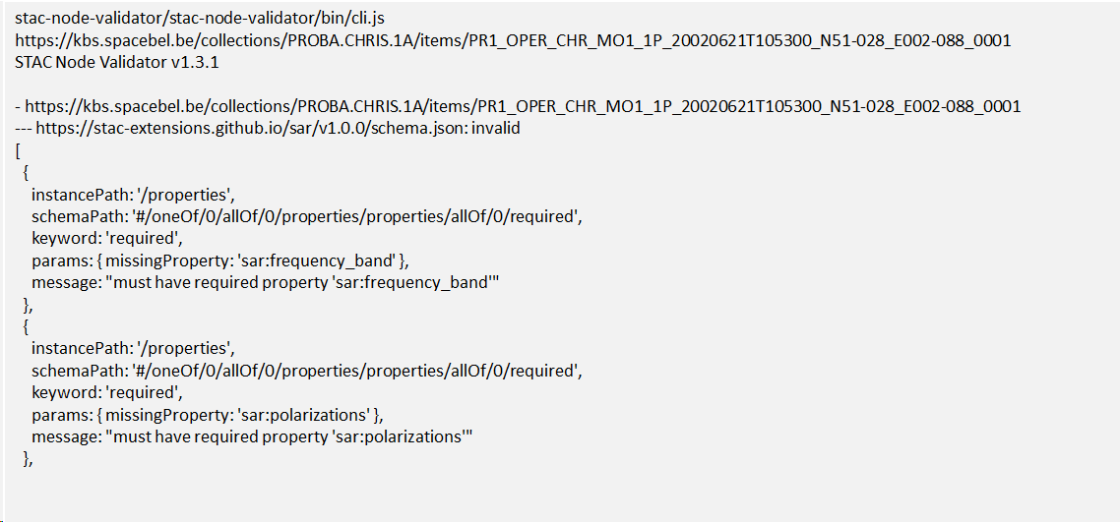
STAC Validation Tool(s)
(3) “STAC Node Validator”
  https://github.com/stac-utils/stac-node-validator (Apache 2.0)
  Javascript-based
  Batch tool, no Web GUI
  Scope: verification of STAC objects, also used inside
  STACBrowser. Does not stop after first error.
  Command-line output:

Slide 20
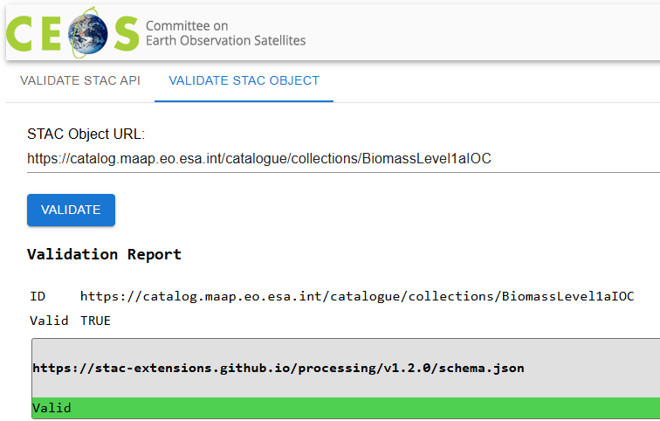
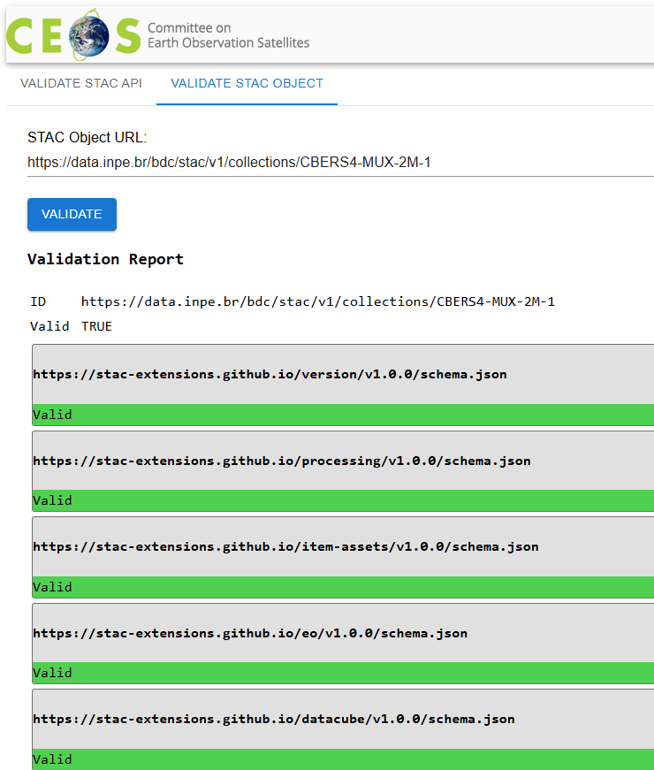
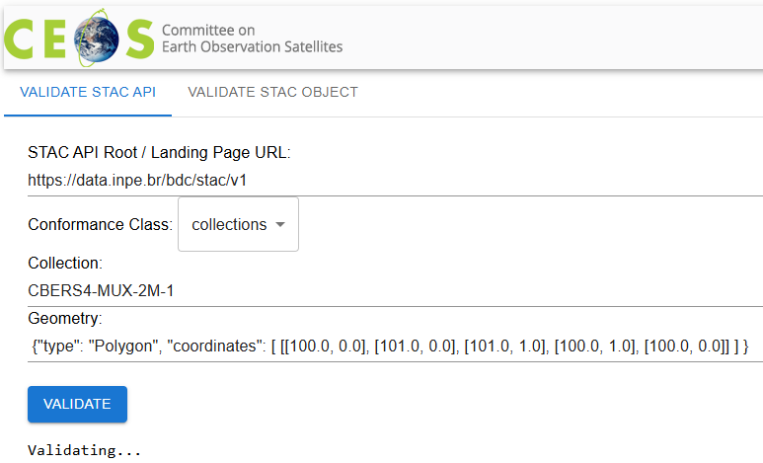
CEOS STAC Validator
Objective:
  Easy to use Web interface: No need to install of Python / Node.js etc to use it.
  Available from CEOS Web site and in CEOS GitHub (open-source)
  Combine checks from multiple libraries to cover STAC API and STAC objects.
  E.g. Web GUI in front of: “STAC API Validator” and ““STAC Node Validator”.

Slide 21
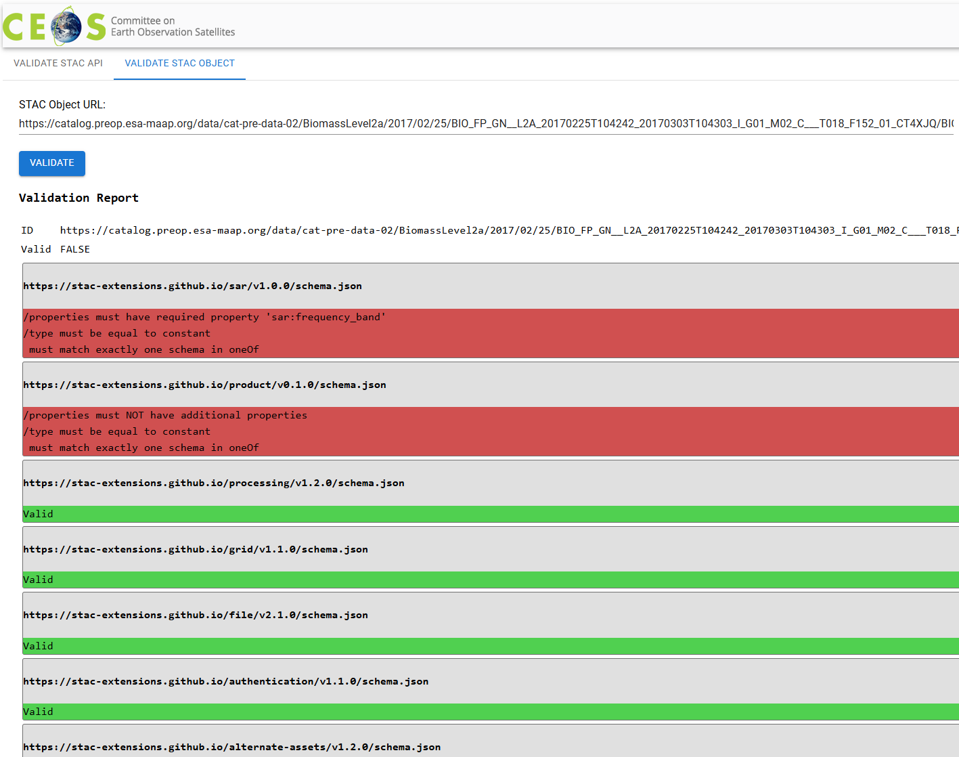
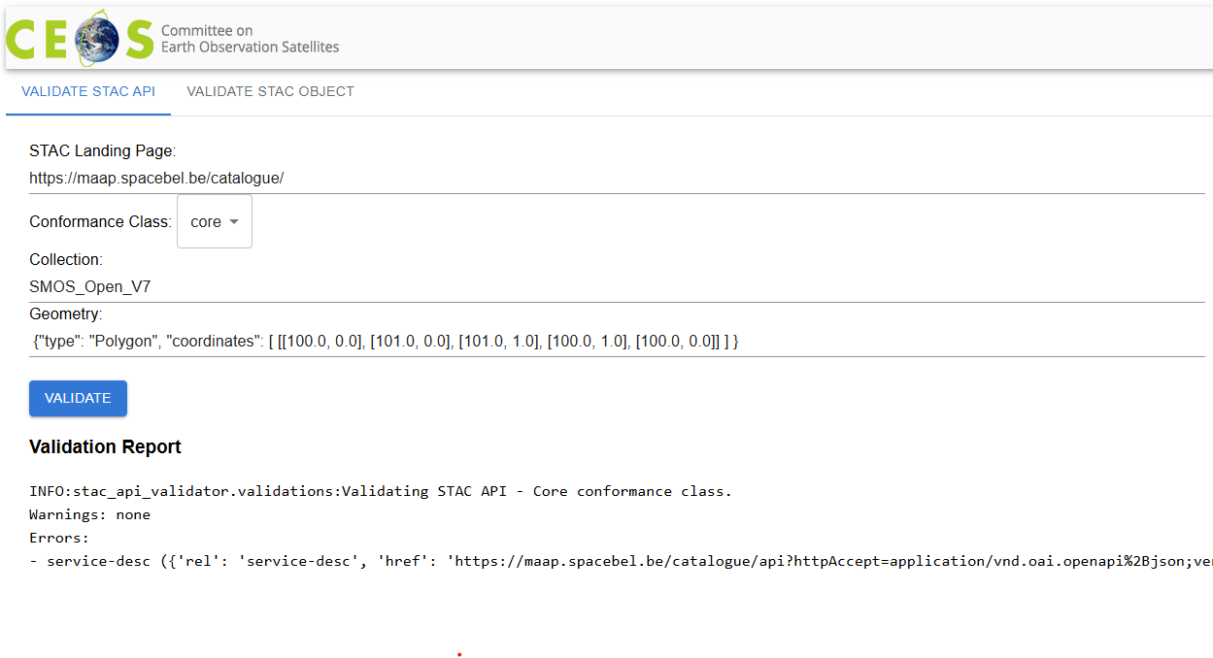
CEOS STAC Validator
Approach:
  Initial version to combine existing (batch) tools.
  Reuse existing open-source
  validators and contribute changes.
    e.g. limit recursion, do not load assets, …
  Extend later with additional tests for
  selected CEOS Best Practices.

Slide 22
Conclusion
Adoption by data providers of STAC allows federation with FedEO
  New CDSE STAC interfaces available through FedEO.
  FedEO provides the dual interfaces: STAC (native) and OpenSearch
Progress on STAC Validator action
  Looked into candidate tools
  Investigated internal logic (suitable for large catalogues, with possibly assets behind authentication).
  First version expected before next WGISS.

Slide 23


