Slide 1
Connected Data Assets Overview
D.Guerrucci (ESA)
F. Marchesi (Solenix for ESA)
Y. Coene (Spacebel for ESA)
M. Morahan (NASA)
Agenda Item G.4
WGISS-58
16-17 October 2024
Sioux Falls, South Dakota, USA

Slide 2
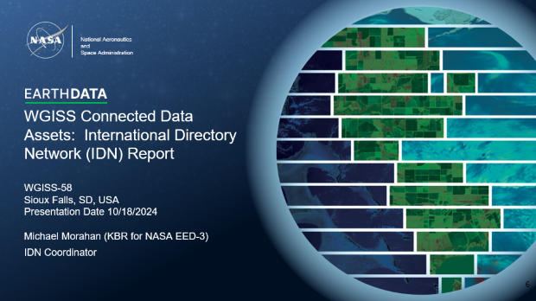
Overview

Slide 3
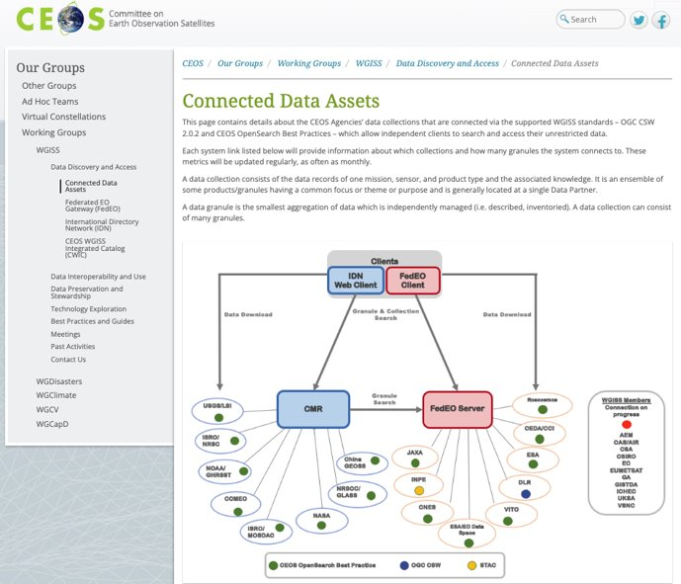
Connected Data Assets
Connected Data Assets are intended as the CEOS Agencies’ data collections that are connected via CEOS tools (FedEO and IDN) that are implementing WGISS BP allowing independent clients to search and access their unrestricted data

Slide 4
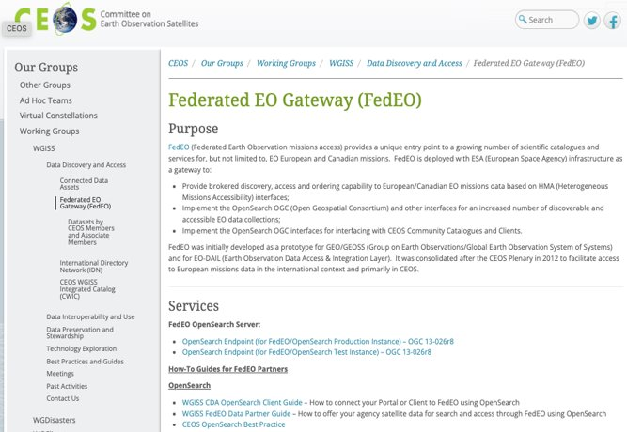
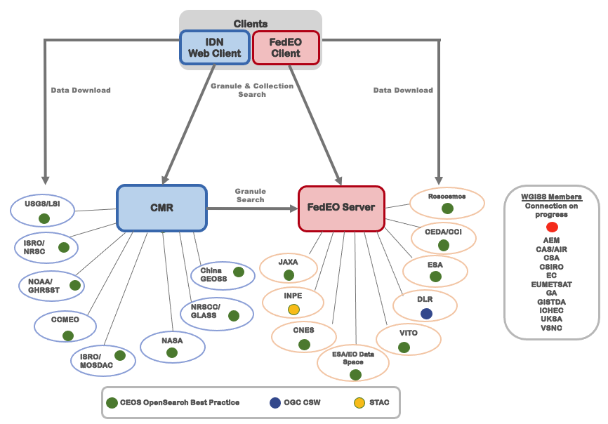
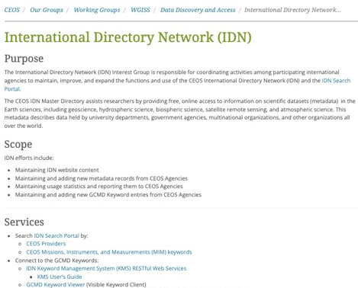
Connected Data Assets
The Interest Group is concerned with:
Ensuring data users have easy and efficient ways of discovering and accessing data and associated services through the exploitation of standard protocols and the harmonising of search and data retrieval processes
Keeping CEOS DAIG Website and tools (FedEO – IDN) updated and aligned in terms of Purpose and Services
Maintaining contact with all CEOS Member, updating Data Discovery registration process and including active members in the CDA figure with related available Data Discovery interfaces

Slide 5
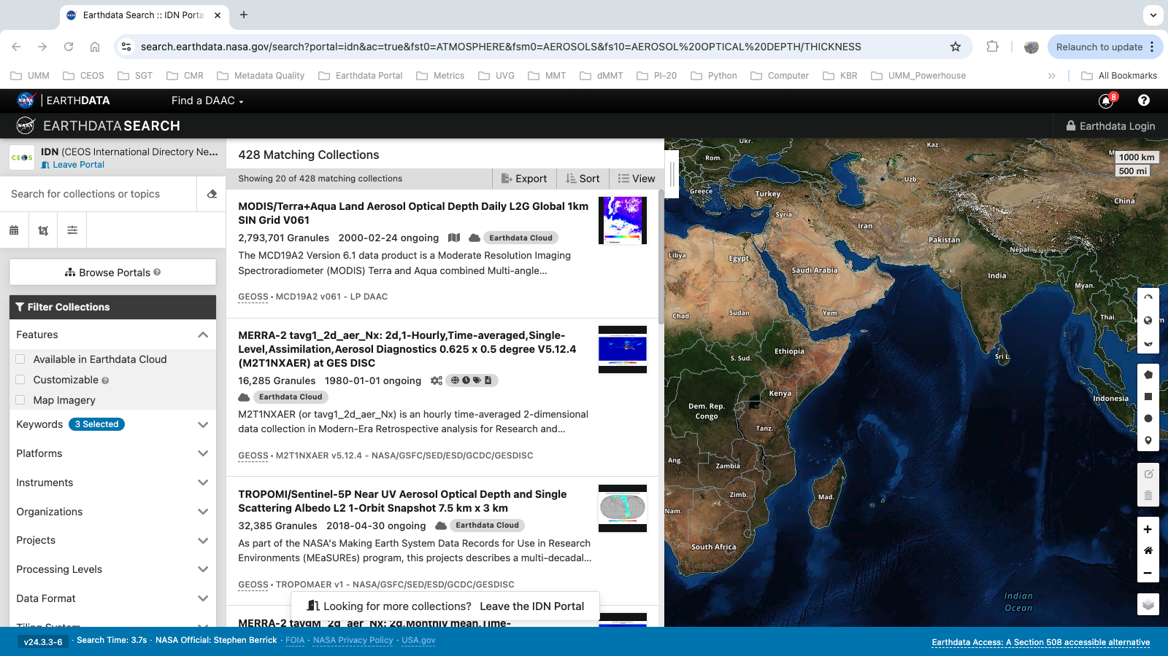
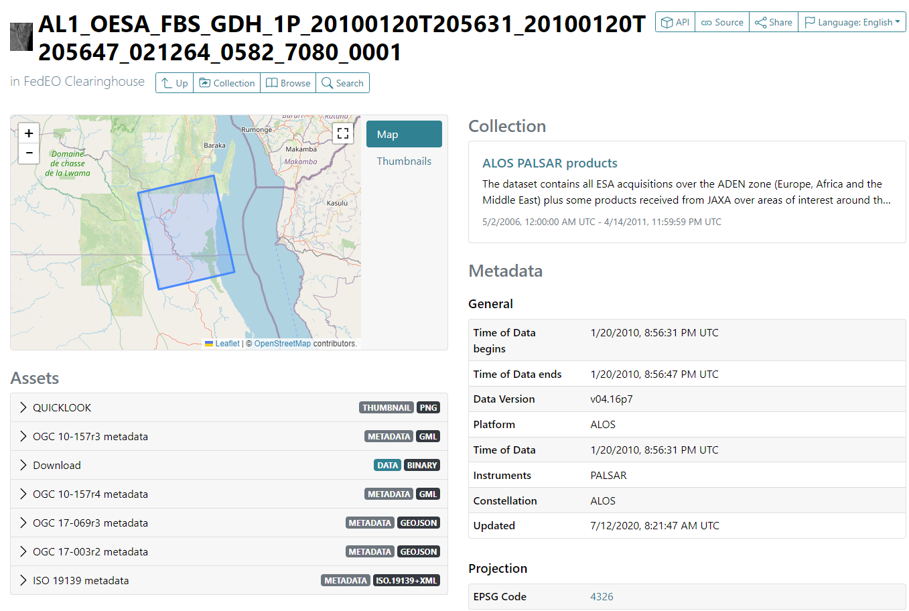
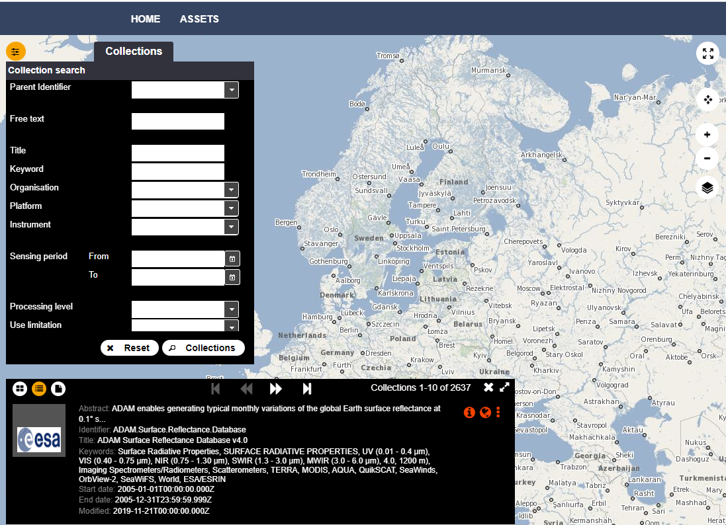
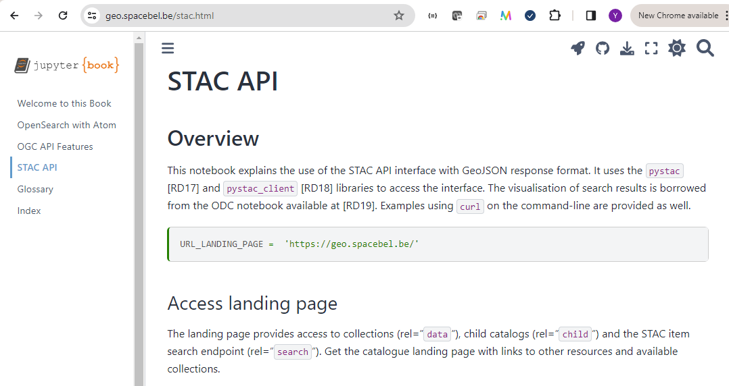
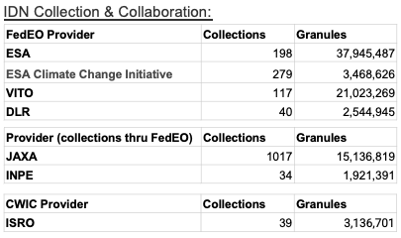
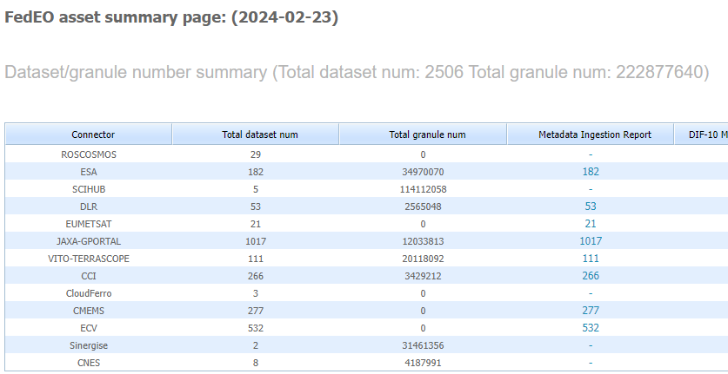
CEOS Data Access Resources

Slide 6
WGISS Connected Data Assets: International Directory Network (IDN) Report
WGISS-58
Sioux Falls, SD, USA
Presentation Date 10/18/2024
Michael Morahan (KBR for NASA EED-3)
IDN Coordinator
Notes:
CEOS: Committee on Earth Observation Satellites
WGISS: Working Group on Information Systems and Services
CNES: National Centre for Space Studies
KBR: Kellogg Brown & Root ltd

Slide 7
Agenda/Table of Contents
1. CEOS/IDN/CWIC Collaborations
2. WGISS IDN/CWIC CEOS.org updates
3. POC list with respect to the list of WGISS Principals
POC information
Links to Provider’s metadata
Links to Provider's collections
Notes:
CEOS: Committee on Earth Observation Satellites
IDN: International Directory Network
CWIC: CEOS WGISS Integrated Catalog
WGISS: Working Group on Information Systems and Services
POC: Point of Contact

Slide 8
CEOS/IDN/CWIC Collaborations
Updates, status and counts of FedEO, JAXA, INPE, ISRO and USGS providers.

Slide 9
Recap of Collaborations
Updates:
FedEO Provider | Collections | Granules
ESA | 198 | 37,945,487
ESA Climate Change Initiative | 279 | 3,468,626
VITO | 117 | 21,023,269
DLR | 40 | 2,544,945
Provider (collections thru FedEO) | Collections | Granules
JAXA | 1017 | 15,136,819
INPE | 34 | 1,921,391
CWIC Provider | Collections | Granules
ISRO | 39 | 3,136,701
USGS | 154 | 13,062,715
Status:
USGS
Working on a solution to ingest USGS STAC collections
Notes:
FedEO: Federated Earth Observation
ESA: European Space Agency
VITO: Vlaamse Instelling voor Technologisch Onderzoek (Belgium)
DLR: Deutsches Zentrum für Luft-und Raumfahrt (Germany)
JAXA: Japan Aerospace Exploration Agency
ISRO: Indian Space Research Organisation
INPE: National Institute for Space Research (Brazil)

Slide 10
WGISS IDN/CWIC CEOS.org Updates
ceos.org updates to CWIC and IDN pages.

Slide 11
Updates to CEOS CWIC Page
Updated contact information to Data Discovery and Access group email.
Removed link to old video.
Updated transition note.
Removed links to:
CSW software and documents
Retired CWIC middleware applications.
OpenSearch Validation tool
Removed old CSW deprecation notices.
CEOS CWIC Page:
https://ceos.org/ourwork/workinggroups/wgiss/access/cwic/
Notes:
CEOS: Committee on Earth Observation Satellites
IDN: International Directory Network
CWIC: CEOS WGISS Integrated Catalog
WGISS: Working Group on Information Systems and Services
CSW: Catalog Service for the Web (CSW)

Slide 12
Updates to CEOS IDN Page
Removed link to Earthdata-IDN site
Updated contact information to Data Discovery and Access group email
Added links to new sub-pages to query the IDN Search Portal by:
CEOS Providers
CEOS Missions, Instruments, and Measurements (MIM) keywords
CEOS IDN Page:
https://ceos.org/ourwork/workinggroups/wgiss/access/international-directory-network/
Notes:
CEOS: Committee on Earth Observation Satellites
IDN: International Directory Network

Slide 13
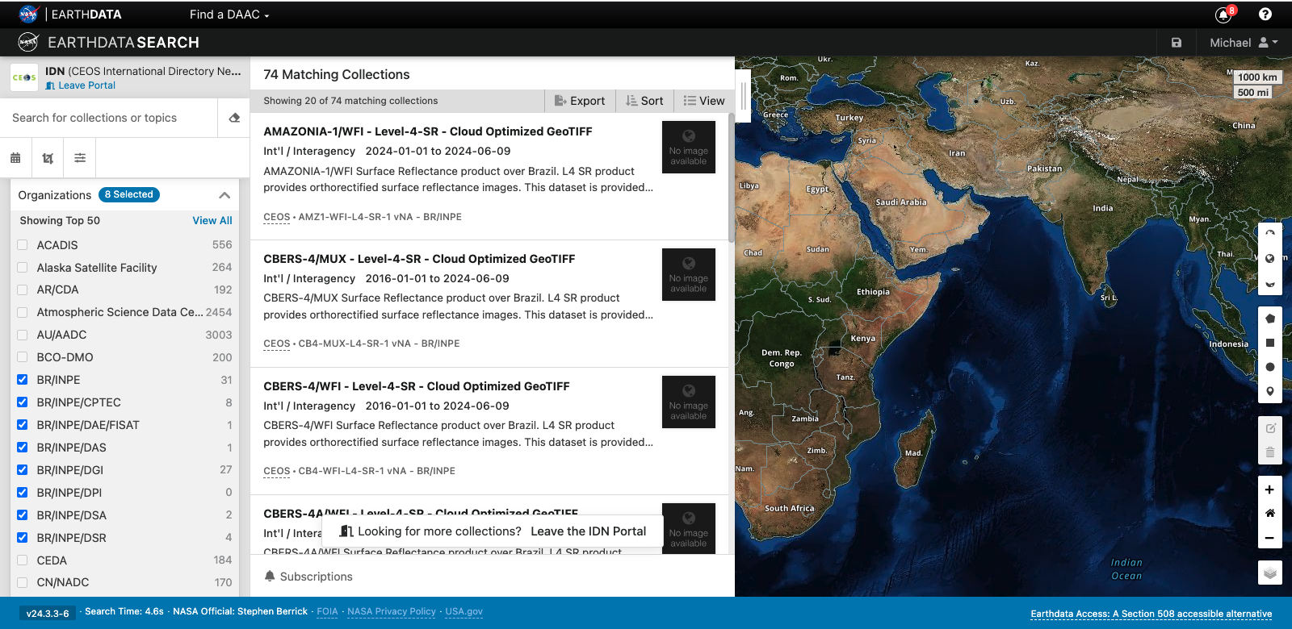
Datasets by CEOS Members Page
Logo linked to agency homepage
Agency name linked to IDN Search Portal query of agency’s collections.
The portal:
Displays agency’s collections
If granules are associated with the collection users will be able to download them.
Agency’s (metadata provider’s) country of origin.
CEOS IDN Datasets by CEOS Members Page:
https://ceos.org/ourwork/workinggroups/wgiss/access/international-directory-network/datasets-by-ceos-members/
Notes:
CEOS: Committee on Earth Observation Satellites
IDN: International Directory Network

Slide 14
Missions, Instruments and Measurements (MIM) Keyword Search Page
List of MIM keywords with links to related IDN Search Portal queries.
The portal:
Displays the related MIM collections
If granules are associated with the collection users will be able to download them.
CEOS IDN Datasets by CEOS Members Page:
https://ceos.org/ourwork/workinggroups/wgiss/access/international-directory-network/ceos-missions-instruments-and-measurements-mim-keywords-idn-search/
Notes:
CEOS: Committee on Earth Observation Satellites
IDN: International Directory Network
MIM: Missions, Instruments and Measurements

Slide 15
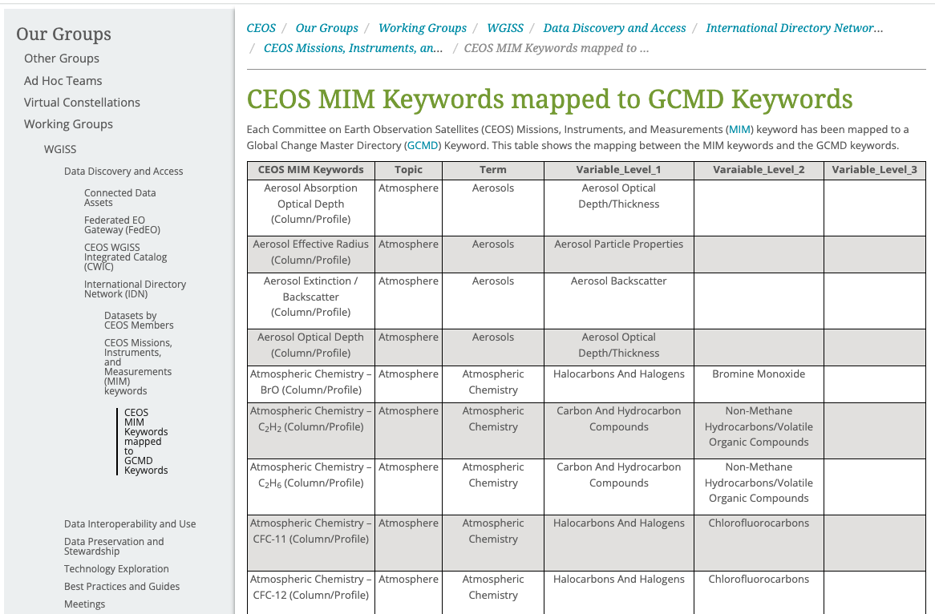
Missions, Instruments and Measurements (MIM) Keyword Search Page to Global Change Master Directory (GCMD) Keyword Mapping Page
On the MIM Keyword search page there is a link to the MIM to GCMD Keyword mappings.
These mappings were used for the MIM Keyword collection search on the IDN Search Portal.
CEOS IDN Datasets by CEOS Members Page:
https://ceos.org/ourwork/workinggroups/wgiss/access/international-directory-network/ceos-missions-instruments-and-measurements-mim-keywords-idn-search/ceos-mim-keywords-mapped-to-gcmd-keywords/
Notes:
MIM: Missions, Instruments and Measurements
GCMD (Global Change Master Directory)

Slide 16
POC list with respect to the list of WGISS Principals
Collections POC, Links to Provider's collection metadata and IDN Search Portal queries

Slide 17
CEOS Collection Providers’ POCs
Agencies | POCs
BELSPO | Yves Coene (SPACEBEL for FedEO/ESA)
CNES | Damiano Guerrucci (FedEO/ESA)
CONAE | Homero Lozza (WGISS POC)
CSIRO | Matt Paget (WGISS POC)
DLR | Damiano Guerrucci (FedEO/ESA), Yves Coene (SPACEBEL for FedEO/ESA)
ESA | Damiano Guerrucci (FedEO/ESA), Yves Coene (SPACEBEL for FedEO/ESA)
EUMETSAT | Damiano Guerrucci (FedEO/ESA), Yves Coene (SPACEBEL for FedEO/ESA)
GISTDA | P - Pakorn Apaphant (WGISS POC)
INPE | Lubia Vinhas (WGISS POC)
ISRO | Nitant Dube (WGISS POC), Sai Kalpana (ISRO)
JAXA | Yousuke Ikehata (WGISS POC), Kaori Kuroiwa (Restec for JAXA)
KARI | Damiano Guerrucci (FedEO/ESA), Yves Coene (SPACEBEL for FedEO/ESA)
NASA | Katie Baynes (NASA)
NOAA | Ken Casey (WGISS POC) , Rich Baldwin (NOAA)
NRSCC | Yuqi Bai (NRSCC)
NSMC/CMA | No Contact
ROSCOSMOS | Damiano Guerrucci (FedEO/ESA), Yves Coene (SPACEBEL for FedEO/ESA)
ROSHYDROMET | No Contact
USGS | Tom Sohre (WGISS POC),Torbert, Christopher (USGS EROS)
Notes:
Agencies’ full Names:
CONAE (Comisión Nacional de Actividades Espaciales)
CSIRO (Commonwealth Scientific and Industrial Research Organisation)
DLR (Deutsches Zentrum für Luft-und Raumfahrt)
ESA (European Space Agency)
EUMETAT (European Organisation for the Exploitation of Meteorological Satellites)
GISTDA (Geo-Informatics and Space Technology Development Agency)
INPE (Instituto Nacional de Pesquisas Espaciais)
ISRO (Indian Space Research Organisation)
JAXA/MEXT (Japan Aerospace Exploration Agency/Ministry of Education, Culture, Sports, Science, and Technology)
KARI (Korea Aerospace Research Institute)
NASA (National Aeronautics and Space Administration)
NOAA (National Oceanic and Atmospheric Administration)
NRSCC (National Remote Sensing Center of China)
NSMC/CMA (National Satellite Meteorological Center/China Meteorological Administration)
Roscosmos (Roscosmos State Corporation for Space Activities)
ROSHYDROMET (Russian Federal Service for Hydrometeorology and Environmental Monitoring)
USGS (United States Geological Survey)

Slide 18
CEOS Collection Providers’ Metadata Links
Agencies | Metadata
BELSPO | https://cmr.earthdata.nasa.gov/search/collections.dif10?data_center=VITO&page_size=110&pretty=true
CNES | https://cmr.earthdata.nasa.gov/search/collections.native?data_center=fr/CNES&page_size=50&pretty=true
CONAE | https://cmr.earthdata.nasa.gov/search/collections.umm_json?data_center=AR/CREDAS&page_size=10&pretty=true
CSIRO | https://cmr.earthdata.nasa.gov/search/collections.native?data_center=AU/CSIRO/CLW&data_center=AU/CSIRO/CMAR&data_center=AU/CSIRO/ENTO&page_size=15&pretty=true
DLR | https://cmr.earthdata.nasa.gov/search/collections.native?data_center=DE/DLR/DFD/ISIS&data_center=DE/DLR/DFD&data_center=DE/DLR/DFD/EOWEB&data_center=DE/DLR/DFD&data_center=DE/DLR
ESA | https://cmr.earthdata.nasa.gov/search/collections.native?data_center=VITO&data_center=ESA/ESRIN&data_center=DE/DLR&data_center=CEDA&project=FedEO&page_size=550&pretty=true
EUMETSAT | https://cmr.earthdata.nasa.gov/search/collections.native?data_center=EUMETSAT/OSISAF&data_center=EUMETSAT&page_size=75&pretty=true
GISTDA | https://cmr.earthdata.nasa.gov/search/collections.native?data_center=TH/MSTE/GISTDA&page_size=20&pretty=true
INPE | https://cmr.earthdata.nasa.gov/search/collections.native?data_center=BR/INPE&data_center=BR/INPE/DSR&data_center=BR/INPE/DSA&data_center=BR/INPE/DPI&data_center=BR/INPE/DGI&data_center=BR/INPE/DAS&data_center=BR/INPE/DAE/FISAT&data_center=BR/INPE/CPTEC&page_size=100&pretty=true
ISRO | https://cmr.earthdata.nasa.gov/search/collections.native?data_center=IN/ISRO/NRSC-BHUVAN&data_center=IN/ISRO/NDC&data_center=IN/ISRO/MOSDAC&page_size=100&pretty=true
JAXA | https://cmr.earthdata.nasa.gov/search/collections.native?data_center=JP/JAXA/EOC&data_center=JP/JAXA/SAOC&data_center=JP/JAXA/EORC&page_size=1020&pretty=true
KARI | https://cmr.earthdata.nasa.gov/search/collections.native?data_center=KR/KARI&page_size=1020&pretty=true
NASA | https://cmr.earthdata.nasa.gov/search/collections.native?provider_ID=ASF&page_size=2000&pretty=true (Replace provider_id values with other NASA provider values.)
NOAA | https://cmr.earthdata.nasa.gov/search/collections.native?provider=GHRSSTCWIC&page_size=200&pretty=true, https://cmr.earthdata.nasa.gov/search/collections.native?provider=NOAA_NCEI&page_size=2000&page_num={1-11}&pretty=true
NRSCC | https://cmr.earthdata.nasa.gov/search/collections.native?data_center=CN/Global%20change%20data%20center&data_center=CN/ChinaGEOSS&page_size=50&pretty=true
NSMC/CMA | https://cmr.earthdata.nasa.gov/search/collections.native?data_center=CN/FENGYUN&page_size=50&pretty=true
ROSCOSMOS | https://cmr.earthdata.nasa.gov/search/collections.native?data_center=RU/NTs%20OMZ&page_size=50&pretty=true
ROSHYDROMET | https://cmr.earthdata.nasa.gov/search/collections.native?data_center=RU/ROSHYDROMET/FERHRI&page_size=10&pretty=true
USGS | https://cmr.earthdata.nasa.gov/search/collections.native?provider_id=USGS_LTA&provider_id=USGS_EROS&page_size=150&pretty=true

Slide 19
CEOS Providers’ IDN Search Portal Direct Datasets links
Agencies | IDN Search Portal
BELSPO | https://search.earthdata.nasa.gov/search?portal=idn&fdc=VITO&ac=true
CNES | https://search.earthdata.nasa.gov/search?portal=idn&fdc=FR%2FCNES
CONAE | https://search.earthdata.nasa.gov/portal/idn/search?fdc=AR/CREDAS
CSIRO | https://search.earthdata.nasa.gov/search?portal=idn&fdc=AU/CSIRO/ENTO!AU/CSIRO/CMAR!AU/CSIRO/CLW
DLR | https://search.earthdata.nasa.gov/search?portal=idn&fdc=DE%2FDLR%2FDFD%2FISIS!DE%2FDLR%2FDFD!DE%2FDLR%2FDFD%2FEOWEB!DE%2FDLR%2FDFD!DE%2FDLR
ESA | https://search.earthdata.nasa.gov/search?portal=idn&fdc=VITO!ESA%252FESRIN!DE%252FDLR!CEDA&fpj=FedEO&as[project][0]=FedEO
EUMETSAT | https://search.earthdata.nasa.gov/search?portal=idn&fdc=European%2BOrganisation%2Bfor%2Bthe%2BExploitation%2Bof%2BMeteorological%2BSatellites%2B%2528EUMETSAT%2529!EUMETSAT%2BOcean%2Band%2BSea%2BIce%2BSatellite%2BApplication%2BFacility%2B%2528OSI%2BSAF%2529!EUMETSAT%2Bfor%2BCopernicus
GISTDA | https://search.earthdata.nasa.gov/search?fdc=TH%2FMSTE%2FGISTDA&portal=idn
INPE | https://search.earthdata.nasa.gov/search?portal=idn&fdc=BR%2FINPE!BR%2FINPE%2FDSR!BR%2FINPE%2FDSA!BR%2FINPE%2FDPI!BR%2FINPE%2FDGI!BR%2FINPE%2FDAS!BR%2FINPE%2FDAE%2FFISAT!BR%2FINPE%2FCPTEC
ISRO | https://search.earthdata.nasa.gov/search?portal=idn&fdc=IN%2FISRO%2FNRSC-BHUVAN!IN%2FISRO%2FNDC!IN%2FISRO%2FMOSDAC
JAXA | https://search.earthdata.nasa.gov/search?portal=idn&fdc=JP%2FJAXA%2FEOC!JP%2FJAXA%2FSAOC!JP%2FJAXA%2FEORC
KARI | https://search.earthdata.nasa.gov/search?portal=idn&fdc=KR%2FKARI
NASA | https://search.earthdata.nasa.gov/search?portal=idn&q=NASA/&oe=t
NOAA | https://search.earthdata.nasa.gov/search?portal=idn&q=NOAA_NCEI
NRSCC | https://search.earthdata.nasa.gov/search?portal=idn&fdc=CN%2FGlobal%20change%20data%20center!CN%2FChinaGEOSS
NSMC/CMA | https://search.earthdata.nasa.gov/search?portal=idn&fdc=CN%2FFENGYUN
ROSCOSMOS | https://search.earthdata.nasa.gov/search?portal=idn&fdc=RU%2FNTs%20OMZ
ROSHYDROMET | https://search.earthdata.nasa.gov/search?portal=idn&fdc=RU%2FROSHYDROMET%2FFERHRI
USGS | https://search.earthdata.nasa.gov/search?projectId=6573552843

Slide 20
WGISS CDA Overview - FedEO
Yves Coene (Spacebel for ESA), Mattia Stipa (ESA)
CEOS WGISS #58, Sioux Falls (SD, US)
Session G: Joint WGISS/WGCV Topics, 18/10/2024

Slide 21
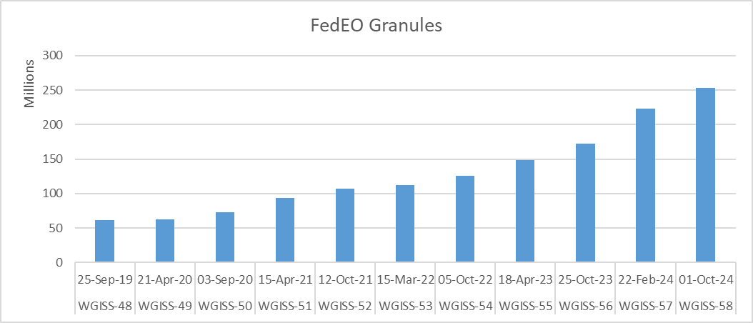
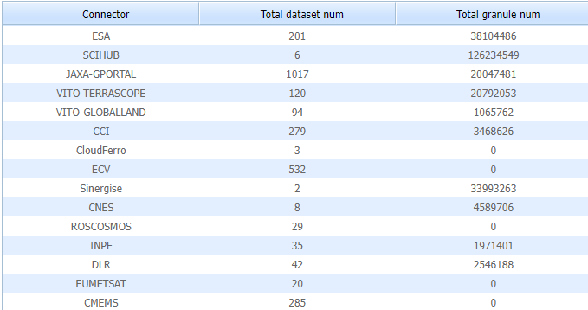
FedEO Report
Updates since WGISS-57
223 to 252 million granules (+13%)
INPE (new)
35 collections, 1.9 million granules
VITO Global Land (new)
94 colletions, 1 million granules
CEOS ARD
ESA
From 34.9 to 38 million granules
Copernicus
Additional collection
Status
CNES (REFLECS) to be reconnected

Slide 22
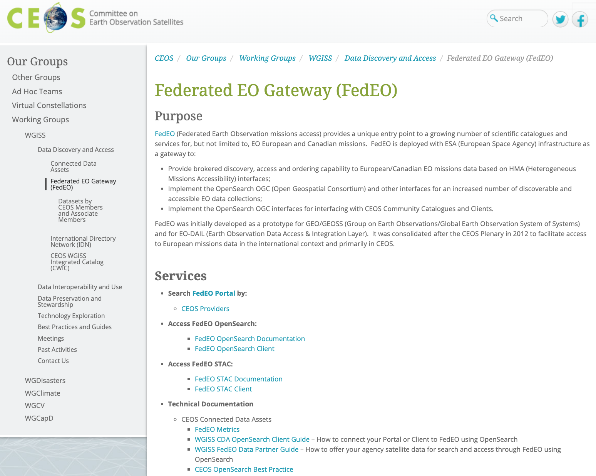
Updates to CEOS FedEO Page
Reorganised “Services” section
OpenSearch
STAC
Added link to new sub-page to query the FedEO Catalogue by
CEOS Provider
CEOS FedEO Page:
https://ceos.org/ourwork/workinggroups/wgiss/access/fedeo/

Slide 23
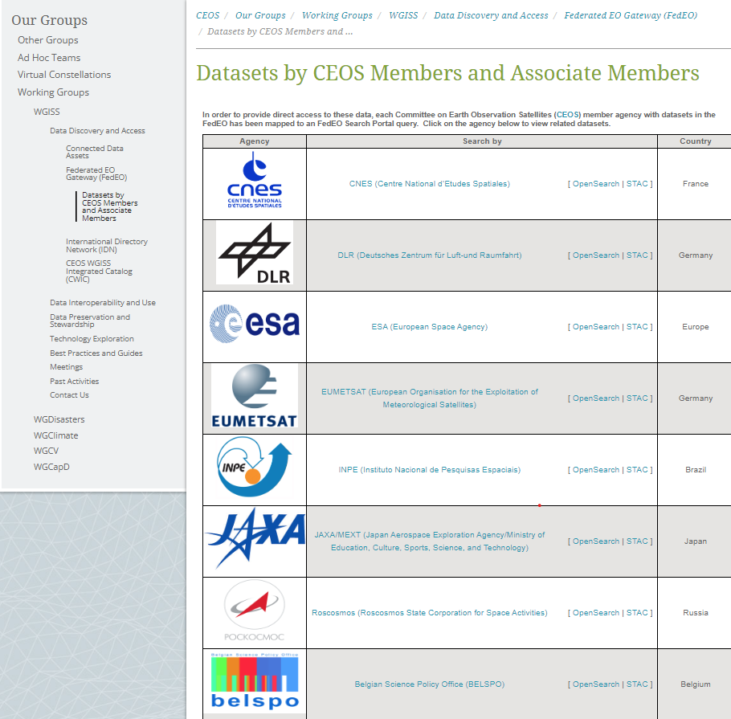
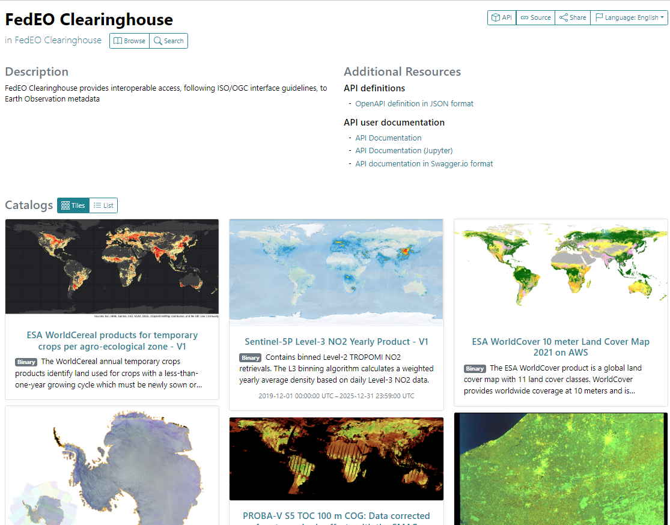
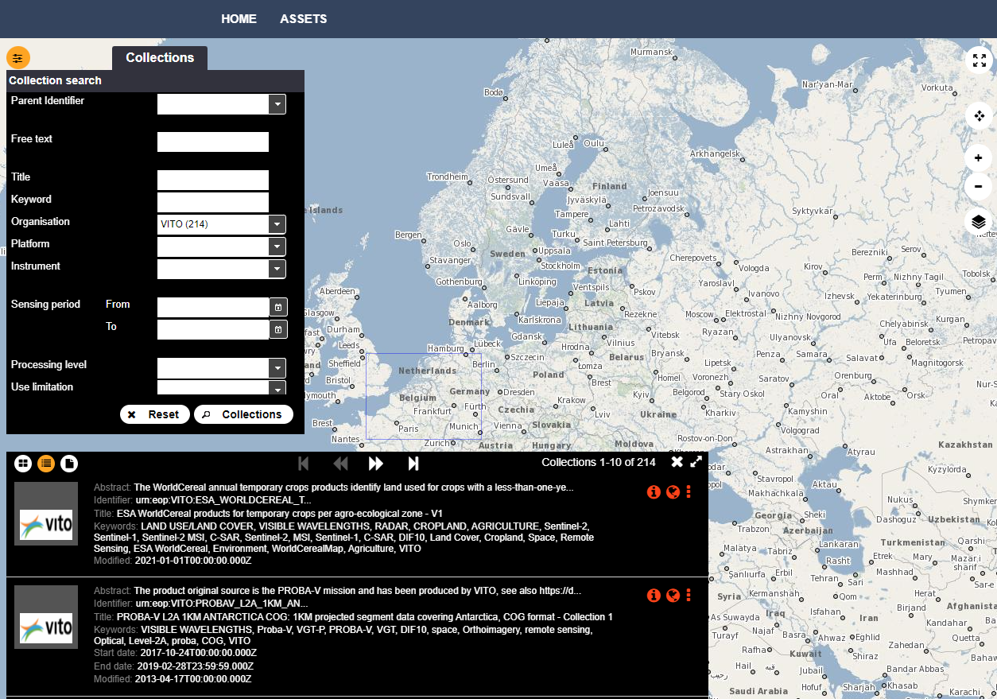
Datasets by CEOS Members Page
Links to FedEO Queries (collections)
FedEO OpenSearch Client
STAC Client
Links to tools/services to be added
CEOS FedEO Datasets by CEOS Members Page:
https://ceos.org/ourwork/workinggroups/wgiss/access/fedeo/datasets

Slide 24
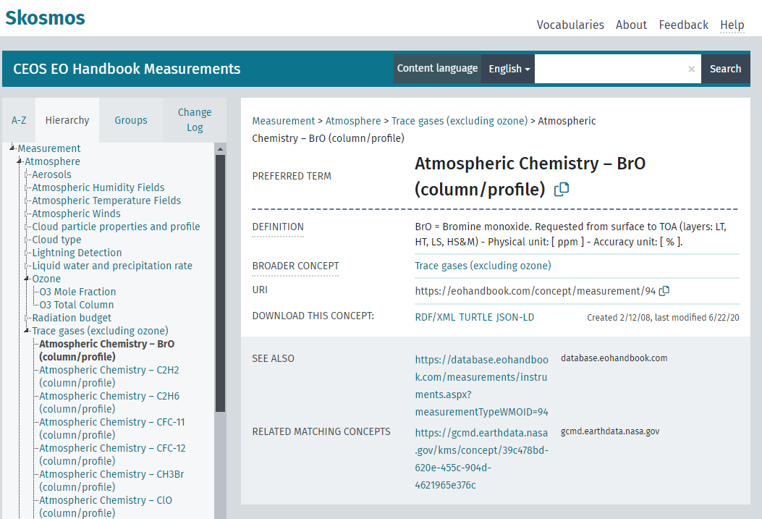
FedEO MIM Keyword Search Page (in Progress)
Work Performed:
MIM key words from CEOS database export (by G. Dyke)
MIM to GCMD mapping (by M. Morahan)
FedEO collections indexed with CEOS MIM keywords (Measurements) based on GCMD/MIM mapping
In Progress:
MIM Keyword Search Page
Preliminary SKOS Representation MIM-GCMD:
https://emc.spacebel.be/skosmos/ceos/en/
Notes:
https://ceos.org/ourwork/workinggroups/wgiss/access/international-directory-network/ceos-missions-instruments-and-measurements-mim-keywords-idn-search/

Slide 25
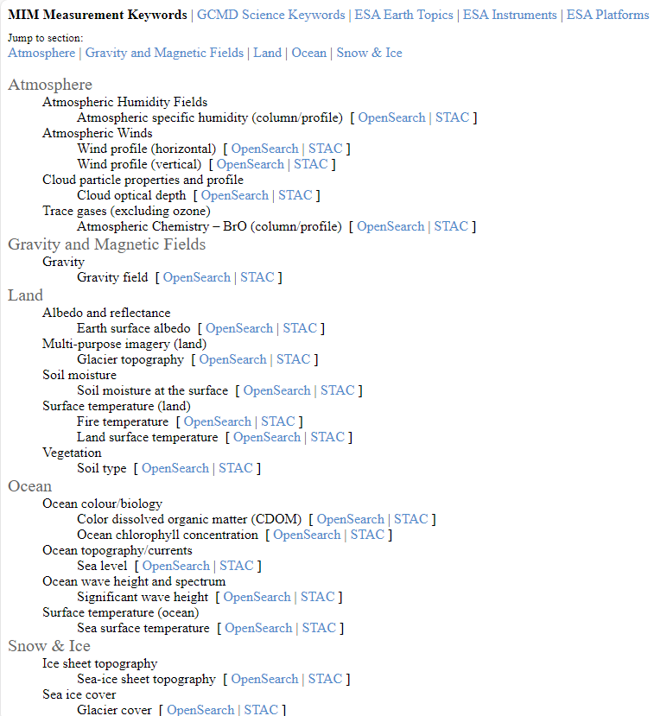
Datasets by MIM Keyword Page
Will include links to FedEO Queries (collections):
FedEO OpenSearch Client
STAC Client
Same page allows browsing by ESA/GCMD SKOS keywords: platforms, instruments, science keywords, ...
CEOS FedEO Datasets by MIM Keyword Page:

Slide 26
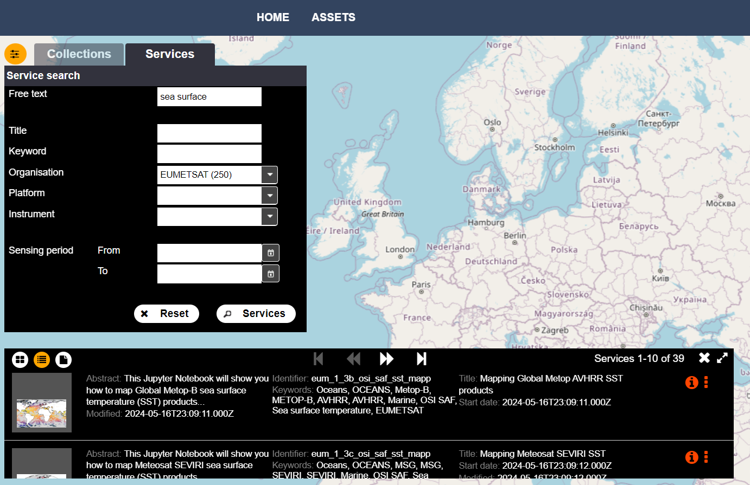
FedEO OpenSearch Client
Support for “service & tools” discovery (by 11/2024).
Searchable by organisation, platform, instrument, free text etc.
Incl. CEOS SW Tools Survey v1.0, Jupyter Notebook metadata (GitHub/GitLab), …
Also via STACBrowser
CEOS FedEO Datasets by MIM Keyword Page:
https://geo.spacebel.be/client/# (Work in progress)

Slide 27
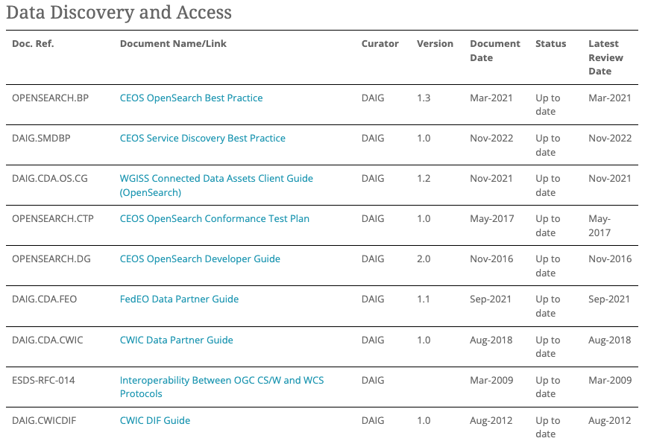
Documentation
Last deliverable
CEOS Service Discovery BP v.1.1
Next deliverable
CEOS STAC Collection & Granule Discovery BP v.1.0

Slide 28
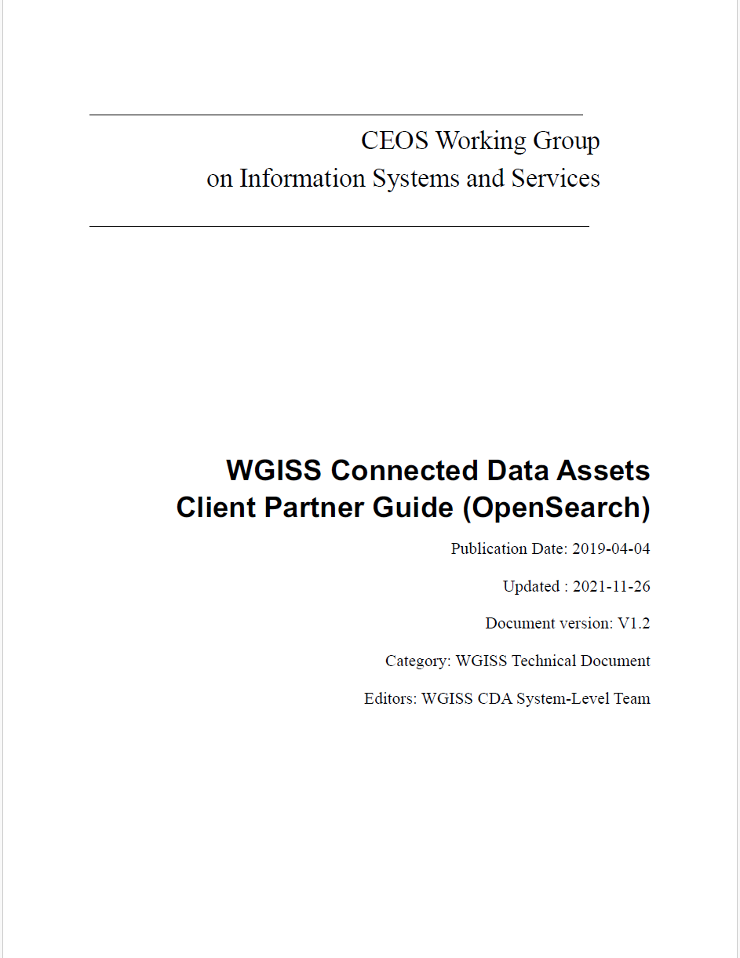
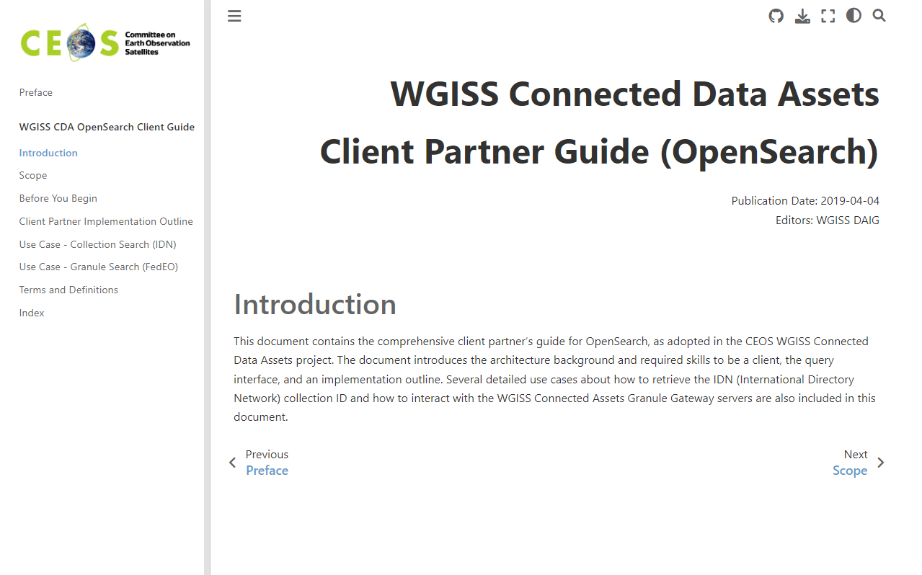
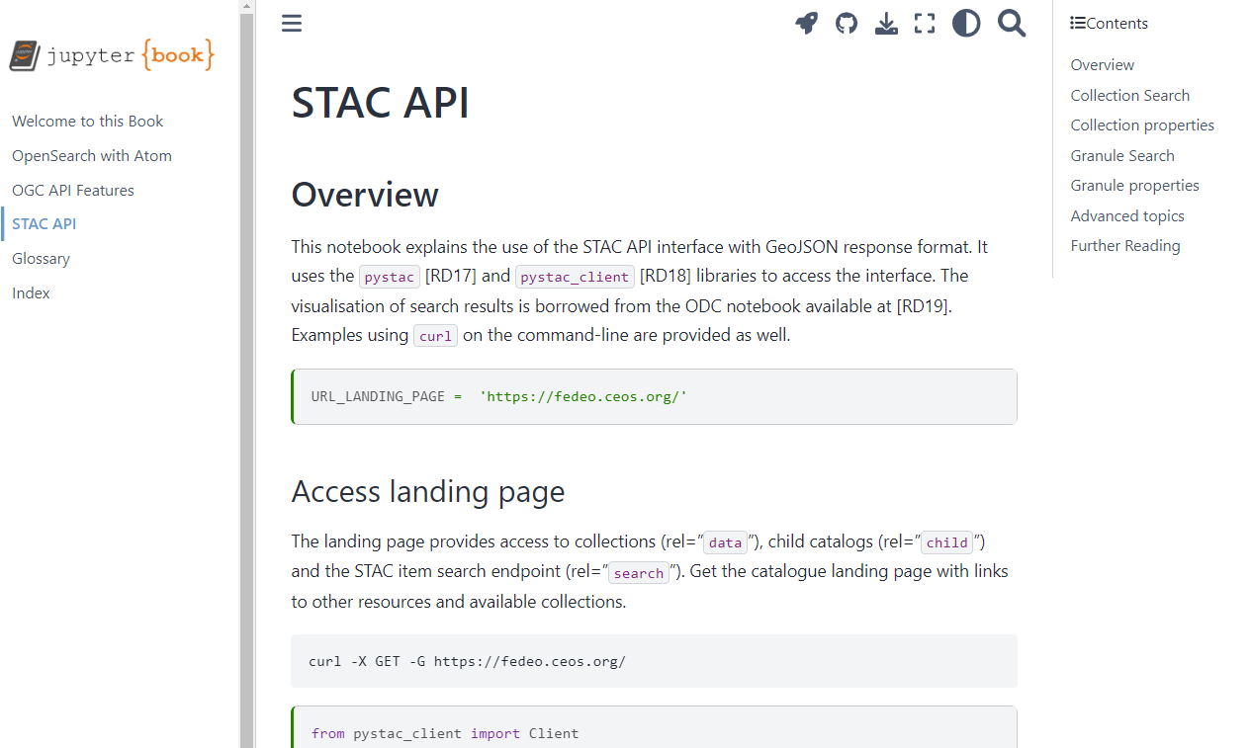
Updates to Online Documentation
Client Partner Guide (PDF) being migrated:
GitHub / GitHub Pages
Jupyter Notebook / JupyterBook
Online Documentation for FedEO API
OpenSearch API
STAC API
FedEO API Online Documentation:
https://fedeo.ceos.org/stac.html
Notes:
https://jupyterbook.org/en/stable/publish/gh-pages.html

Slide 29
Conclusion
Data Discovery registration process
If you wish to make your data discoverable as part of the CEOS Connected Data Assets, please send a request to Access-SysTeam-Help@wgiss.ceos.org and you will be contacted for the provision of additional details.
List of members
Coordinator - D. Guerrucci (ESA)​
FedEO - D. Guerrucci (ESA), Y. Coene (Spacebel for ESA)​
IDN - M. Morahan (NASA) ​
CWIC - M. Wong (NASA)​
Current members: NASA, JAXA, CSIRO, DLR, ICHEC, INPE, USGS, CNES, EUMETSAT, UKSA

