Slide 1
Discussion: Expressing Uncertainty Information
Cody Anderson, USGS
CEOS WGCV Vice-Chair
Agenda Item G.4
WGISS / WGCV Joint Meeting
15 & 18 October 2024
Sioux Falls, South Dakota, USA

Slide 2
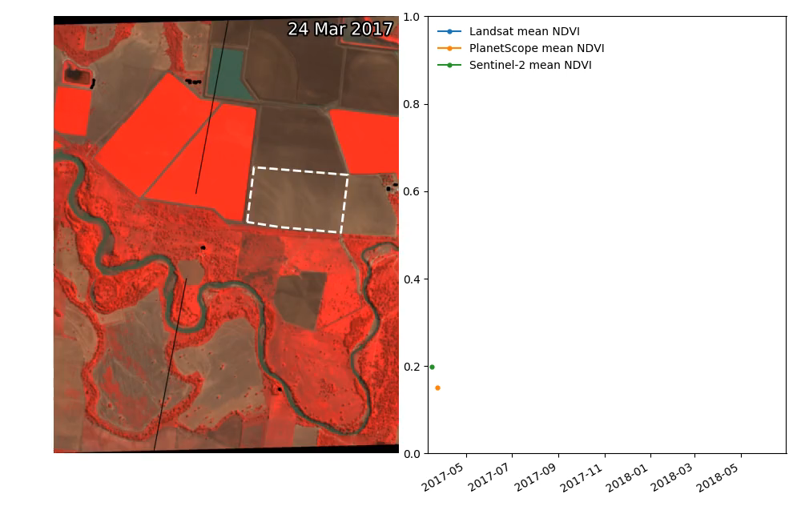
Importance of Uncertainty
Example from Australia: Time series of Normalised Difference Vegetation Index (NDVI) derived separately from Landsat, Sentinel-2 and PlanetScope data over an agricultural site (marked by dotted white line) in the Namoi region of New South Wales, Australia. The animation shows differences in the individual NDVI profiles from the three sensors. Combined use of the NDVI from the three sensors is limited due to inherent differences in the source data, cross calibration of data from the sensors could address this issue.
Credit: Robbi-Bishop Taylor, GA

Slide 3
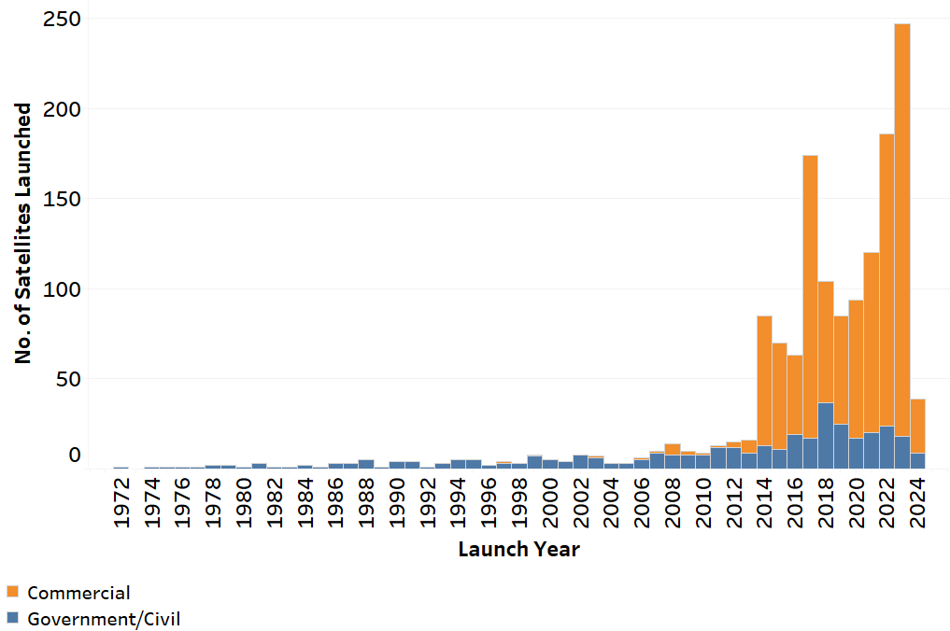
Satellite Launches per Year
Importance of Uncertainty

Slide 4
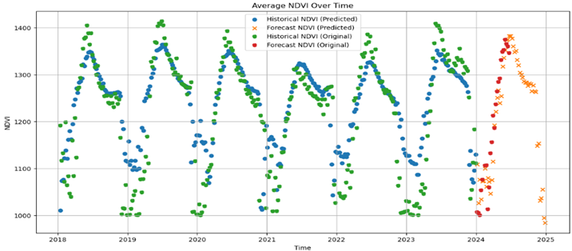
Importance of Uncertainty
A Generalist Foundation Model for EO Data Imputation and Forecasting (multimodal inputs: HLS indices, LST, Elevation)
[Dr. Neal Pastick, EROS]
Do not distribute; preliminary results

Slide 5
Uncertainty Workshop – March 2024
Prelaunch Characterization (Lab Measurements)
  Julia Barsi – NASA Goddard Space Flight Center
Vicarious Calibration (RadCalNet)
  Brian Wenny – SSAI/NASA Goddard Space Flight Center
Processing Chain (Raw-to-TOA Product)
  Mary Pagnutti – I2R/USGS EROS
Cross Calibration (Product-to-Product)
  Esad Micijevic – USGS EROS

Slide 6
Goals of this Workshop
Focus: Radiometric Uncertainty of Top of Atmosphere (TOA)/Level 1, passive, reflective, optical imagery
Improve understanding/methodologies of Prelaunch Characterization leading to better independent Absolute Uncertainty Estimates
Communicate consistent methodologies for On-Orbit Absolute Calibration to a Reference and tracing of Uncertainties
Improve understanding of Uncertainties added through a production chain
Start addressing how to achieve a consistent dataset between different missions while preserving the Uncertainty chain

Slide 7
Elementary Statistics
What’s This?
Accuracy

Slide 8
Elementary Statistics
What’s This?
Precision

Slide 9
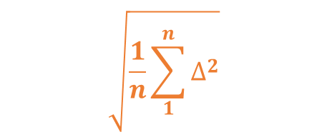

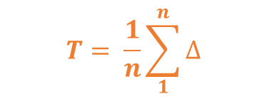

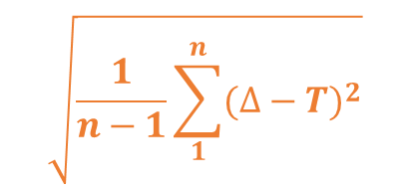

Elementary Statistics
What’s This?
Uncertainty?
Uncertainty?
Clear?
Precision?
Precision?
Accuracy?
Accuracy?

Slide 10
Definitions - International Bureau of Weights and Measures (International vocabulary of metrology – Basic and general concepts and associated terms (VIM) - 3rd edition)
Measurement Accuracy - Accuracy
  closeness of agreement between a measured quantity value and a true quantity value of a measurand

Slide 11
Definitions - International Bureau of Weights and Measures (International vocabulary of metrology – Basic and general concepts and associated terms (VIM) - 3rd edition)
Measurement Accuracy - Accuracy
  closeness of agreement between a measured quantity value and a true quantity value of a measurand
    NOTE 1 The concept ‘measurement accuracy’ is not a quantity and is not given a numerical quantity value. A measurement is said to be more accurate when it offers a smaller measurement error.
    NOTE 2 The term “measurement accuracy” should not be used for measurement trueness and the term “measurement precision” should not be used for ‘measurement accuracy’, which, however, is related to both these concepts.
    NOTE 3 ‘Measurement accuracy’ is sometimes understood as closeness of agreement between measured quantity values that are being attributed to the measurand.

Slide 12
Definitions - International Bureau of Weights and Measures (International vocabulary of metrology – Basic and general concepts and associated terms (VIM) - 3rd edition)
Measurement Precision – Precision
  closeness of agreement between indications or measured quantity values obtained by replicate measurements on the same or similar objects under specified conditions

Slide 13
Definitions - International Bureau of Weights and Measures (International vocabulary of metrology – Basic and general concepts and associated terms (VIM) - 3rd edition)
Measurement Precision – Precision
  closeness of agreement between indications or measured quantity values obtained by replicate measurements on the same or similar objects under specified conditions
    NOTE 1 Measurement precision is usually expressed numerically by measures of imprecision, such as standard deviation, variance, or coefficient of variation under the specified conditions of measurement.
    NOTE 2 The ‘specified conditions’ can be, for example, repeatability conditions of measurement, intermediate precision conditions of measurement, or reproducibility conditions of measurement (see ISO 5725-1:1994).
    NOTE 3 Measurement precision is used to define measurement repeatability, intermediate measurement precision, and measurement reproducibility.
    NOTE 4 Sometimes “measurement precision” is erroneously used to mean measurement accuracy.

Slide 14
Definitions - International Bureau of Weights and Measures (International vocabulary of metrology – Basic and general concepts and associated terms (VIM) - 3rd edition)
Measurement Uncertainty – Uncertainty
  non-negative parameter characterizing the dispersion of the quantity values being attributed to a measurand, based on the information used
    NOTE 1 Measurement uncertainty includes components arising from systematic effects, such as components associated with corrections and the assigned quantity values of measurement standards, as well as the definitional uncertainty. Sometimes estimated systematic effects are not corrected for but, instead, associated measurement uncertainty components are incorporated.
    …

Slide 15
Definitions - International Bureau of Weights and Measures (International vocabulary of metrology – Basic and general concepts and associated terms (VIM) - 3rd edition)
Measurement Uncertainty
Definitional Uncertainty
Standard Measurement Uncertainty
Combined Standard Measurement Uncertainty
Relative Standard Measurement Uncertainty
Uncertainty Budget
Target Measurement Uncertainty
Expanded Measurement Uncertainty

Slide 16
Definitions - International Bureau of Weights and Measures (International vocabulary of metrology – Basic and general concepts and associated terms (VIM) - 3rd edition)
Measurement Uncertainty
Definitional Uncertainty
Standard Measurement Uncertainty
Combined Standard Measurement Uncertainty
Relative Standard Measurement Uncertainty
Uncertainty Budget
Target Measurement Uncertainty
Expanded Measurement Uncertainty
Clear?

Slide 17
Extra-Elementary Statistics
What’s This?
Where is This?

Slide 18
Extra-Elementary Statistics
What’s This?
Is This Uncertainty?

Slide 19
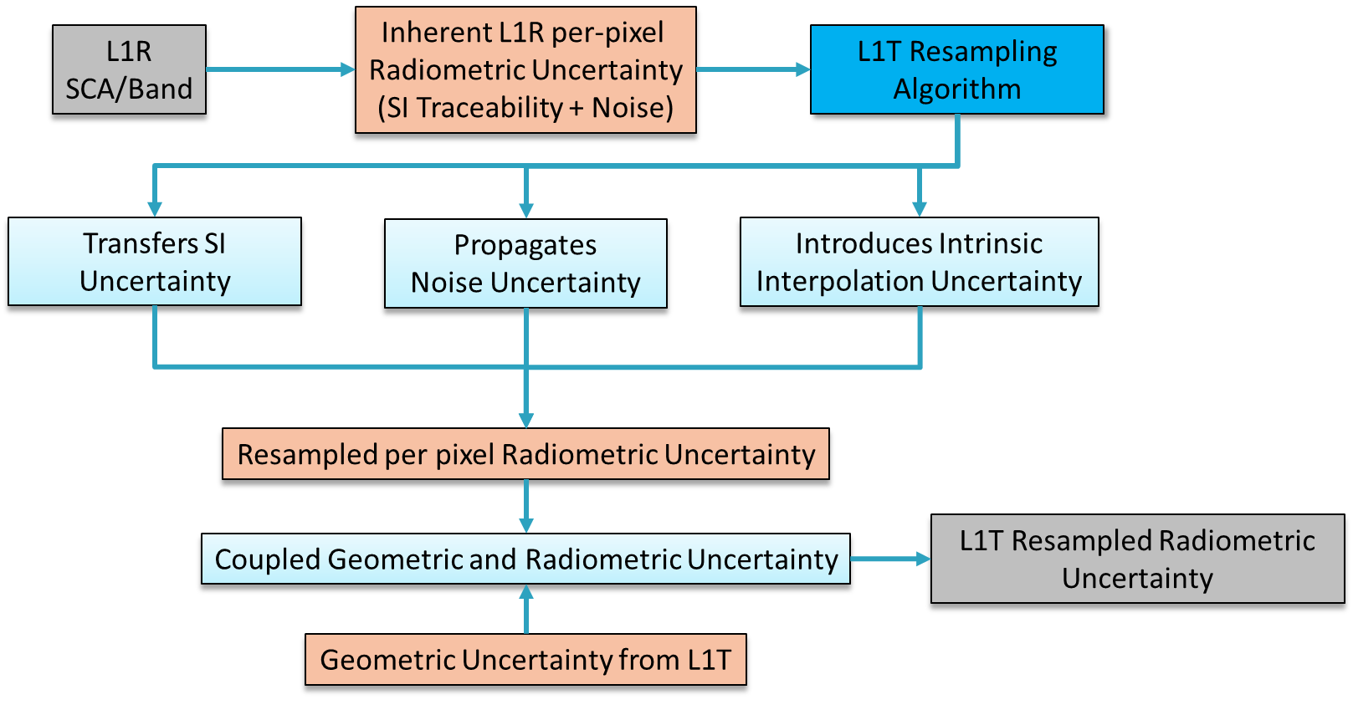
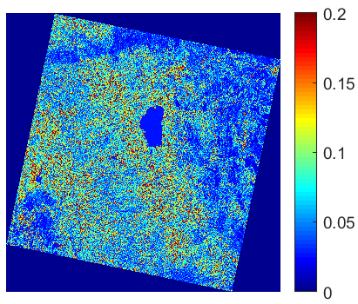
Per-Pixel Uncertainty

Slide 20
Per-Pixel Uncertainty
Inputs:
  Radiometric Uncertainty: Si-Traceability, Signal-to-Noise Resampling Kernal/Heterogeneity of Image
  Geometric Uncertainty: Root Mean Square Error (RMSE), 90% Circular Error (CE90)

Slide 21
What is Needed?
Is Per-Pixel Uncertainty Needed?
  How do/will users use it?

Slide 22
What is Needed?
Is Per-Pixel Uncertainty Needed?
  How do/will users use it?
What Level of Accuracy of Uncertainty is Needed?

Slide 23
What is Needed?
Is Per-Pixel Uncertainty Needed?
  How do/will users use it?
What Level of Accuracy of Uncertainty is Needed?
  1/10th of a percent steps from 0% to 5%?
  ½ of a percent steps from 5% to 10%?
  1% steps from 10% to 20%?
  5% steps from 20% to 50%?
  10% steps from 50% to 100+%?

Slide 24
What is Needed?
Is Per-Pixel Uncertainty Needed?
  How do/will users use it?
What Level of Accuracy of Uncertainty is Needed?
  1/10th of a percent steps from 0% to 5%?
  ½ of a percent steps from 5% to 10%?
  1% steps from 10% to 20%?
  5% steps from 20% to 50%?
  10% steps from 50% to 100+%?
  125 steps ~2^7, 7 bits per pixel
    - Too Much?
    - User Tool to calculate?

