Slide 1
CEOS Cal/Val Portal
Paolo Castracane
STARION for ESA
Agenda Item G.2
WGISS / WGCV Joint Meeting
15 & 18 October 2024
Sioux Falls, South Dakota, USA

Slide 2
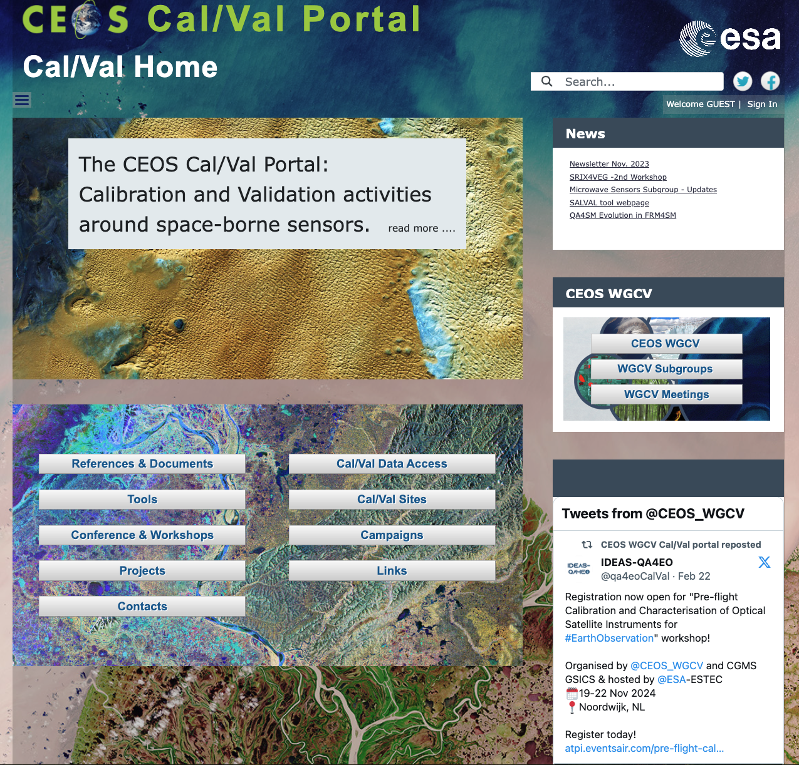
Table of Contents
CEOS Cal/Val Portal Overview
ACTIONs from WGCV-53
Content Updates
Outreach
Collaboration area with WGISS (discussion)
https://calvalportal.ceos.org

Slide 3
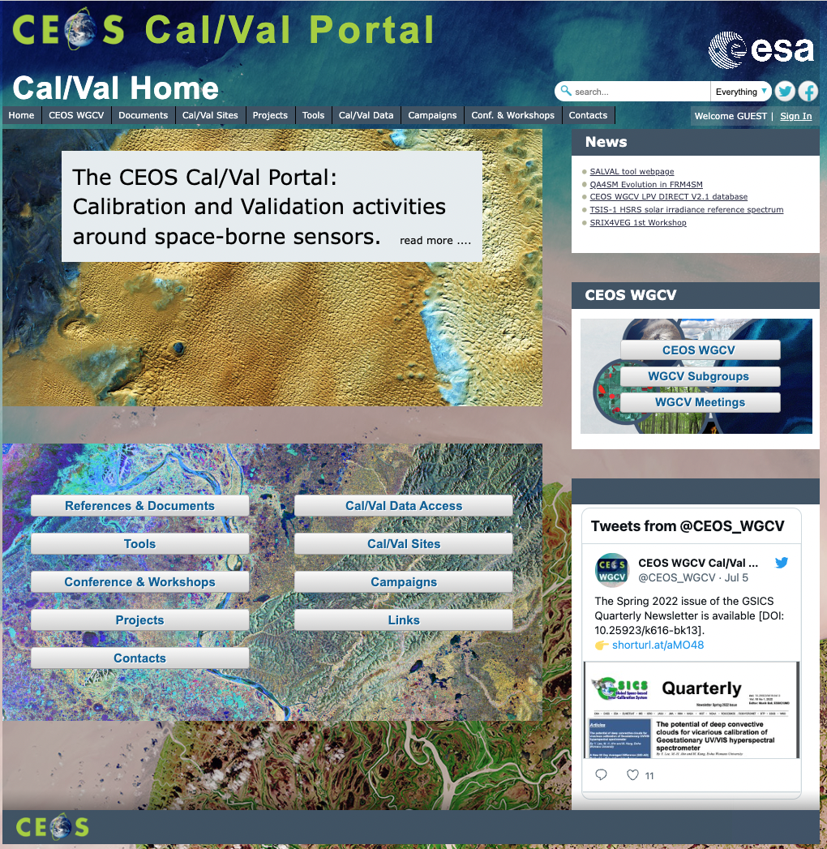
CEOS Cal/Val Portal
Overview
The CEOS CalVal portal (https://calvalportal.ceos.org/) serves as the main forum for exchange and information sharing for the CEOS Working Group on Calibration and Validation.
It provides access to agreed good practices and Cal/Val protocols to the wider Earth Observation community within CEOS and beyond.
It connects users to reference data and networks and provides reliable, up-to-date and user-friendly information useful for Cal/Val tasks, facilitating data interoperability and performance assessment through an operational CEOS coordinated and internationally harmonised Cal/Val infrastructure consistent with QA4EO principles.

Slide 4
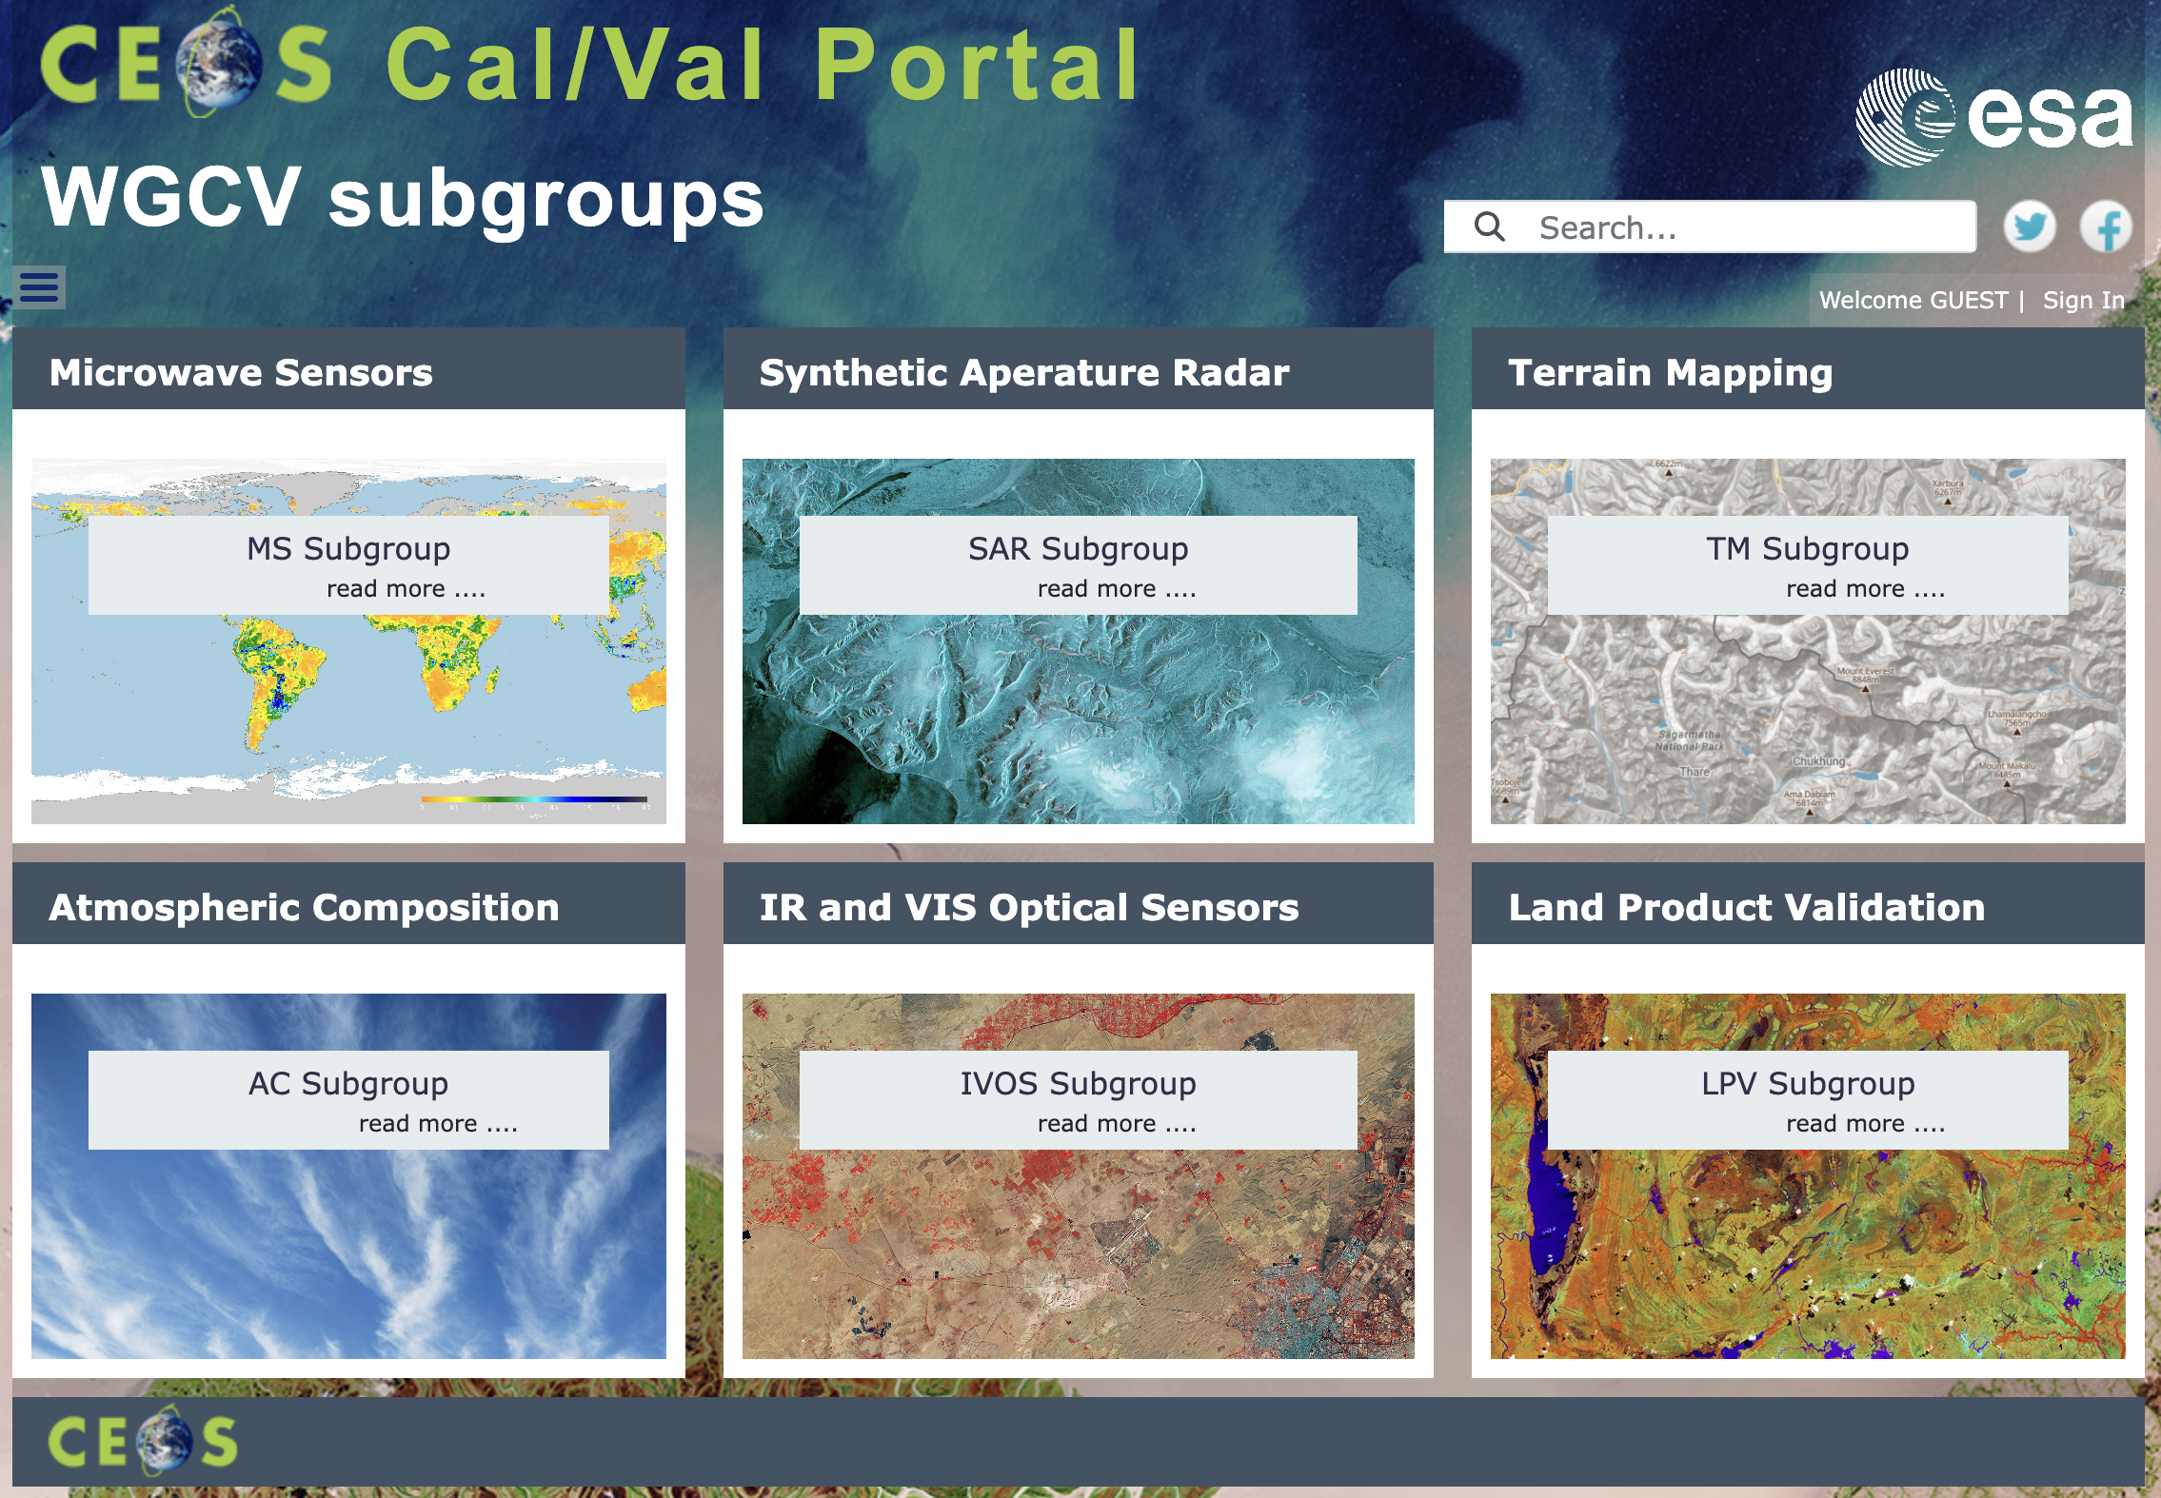
CEOS WGCV subgroups
Entry point for all the subgroups:
IVOS subgroup, SAR subgroup and Microwave Sensor MSSG webpages are hosted by the portal
For LPV subgroup we link the website:
https://lpvs.gsfc.nasa.gov/
For Atmospheric Composition ACSG and Terrain Mapping TMSG we links to ceos.org Terms of Reference pages
Slide ‹#›

Slide 5
Overview - numbers
https://calvalportal.ceos.org
Some numbers: 11th October 2024:
Users
1293 Registered Users
155 CEOS WGCV SAR Subgroup and 3 super-users
54 MTF Members
23 SITSat Members
6 Cal/Val Doc Repository (rights for editing)
21 Terms and Definitions (rights for editing)
- System availability
BC uses Nagios (http://www.nagios.org/) for monitoring the IT services.
The availability of the Cal/Val Portal is close to 100%.
https://calvalportal.ceos.org

Slide 6
Actions from WGCV#53
ID | Description | Due Date | Status
WGCV-53-ACT-11 | Paolo Castracane to add the MDPI Open Access publication on “Choice of Solar Spectral Irradiance Model for Current and Future Remote Sensing Satellite Missions” to the Cal / Val portal, as an example to support IVOS communications regarding the change to the reference solar spectrum. Link: https://www.mdpi.com/2072-4292/15/13/3391 | April 2024 | Completed see webpage: https://calvalportal.ceos.org/solar-irrad-spectrum
WGCV-53-ACT-18 | Paolo Castracane to draft a page for the Cal/Val Portal where WGCV’s contributions to climate / GCOS IP can be collated. | May 2024 | Completed see webpage: https://calvalportal.ceos.org/2022-gcos-ip

Slide 7
Actions from WGCV#53
ID | Description | Due Date | Status
WGCV-53-ACT-13 | Paolo and Nigel to make updates to the FRM Assessment Framework documentation to: Make clear that the assessment is relative to the intended purpose of the site. Remove subjectivity in parameters by incorporating clarifications present in the accompanying documentation, but which have to date been left out of the Matrix description. Clarify that verification should be undertaken by independent people from CEOS, not the person filling in the template (i.e., self-assessment followed by independent review). Make the Validation column a different colour. Consider inclusion of additional links to reference materials, mechanisms to allow assessors to provide feedback, etc. Aim to have an updated Version 2.0 by the May timeframe. This will align well with the next NDACC Steering Committee meeting. | May 2024 | In progress: Development has been triggered including all the collected feedback: Intro panel for each assessment Additional info for Configuration of Parameter (Question) and Answer Supporting Documents/References Verification (last column) for independent assessor Automatic CEOS FRM classification Assessment report Configuration for WGISS Maturity Matrix has started with Iolanda Maggio
WGCV-53-ACT-14 | Paolo, Nigel and Kuze-san, to work with Jean-Christopher Lambert on the issues with the FRM Assessment Framework specifically for the atmospheric domain. Notes: May need some clarifications in the accompanying documentation regarding the situation / approach for Level 2 atmospheric data. | End April 2024 | In progress: A working group: Jean-Cristophere, Kuze-san, Nigel and Paolo is working on an update of the FRM Assessment Framework Guideline including a new Category named “Network”

Slide 8
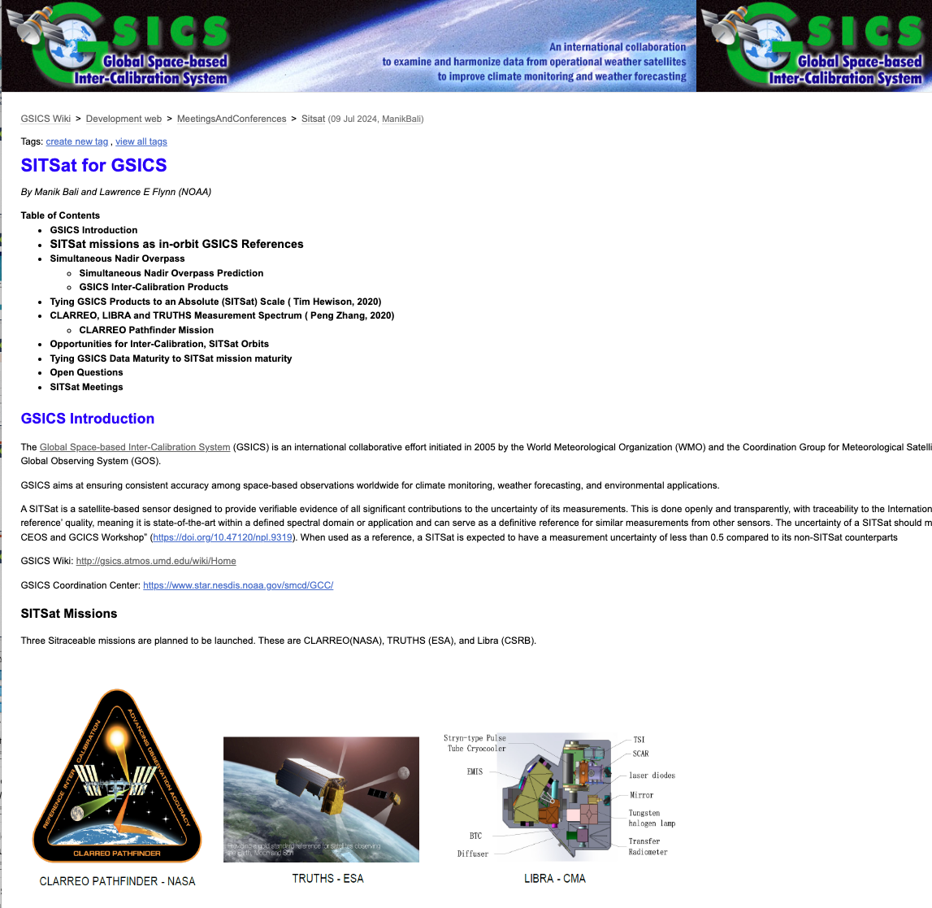
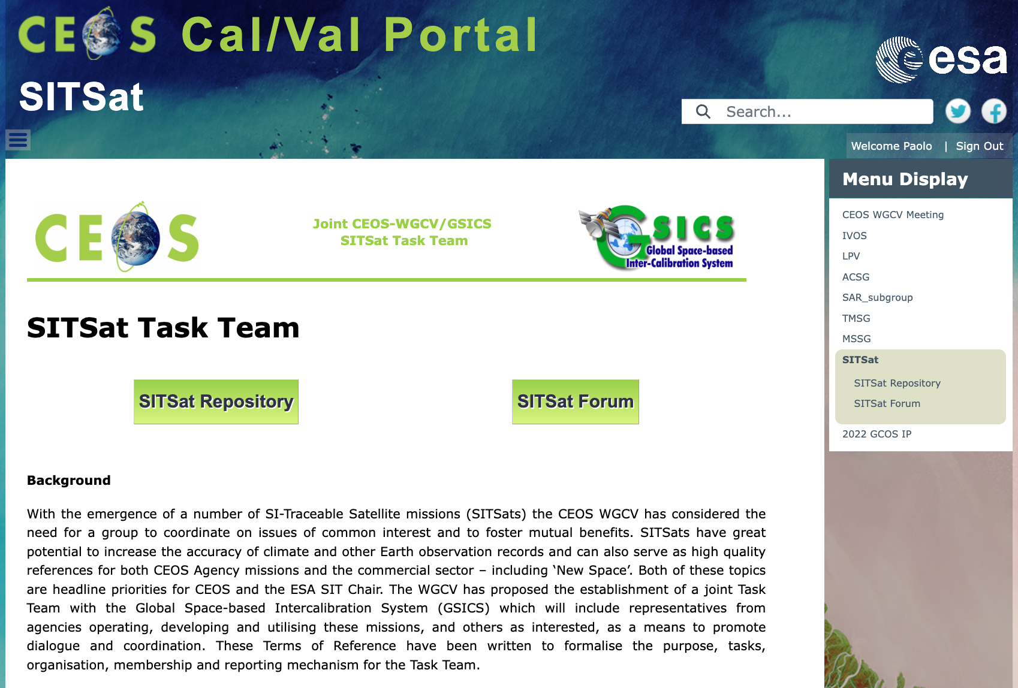
SITSat Task Team
The SITSat webpage has been proposed with
Public information: Background, Definition, Objectives; Organisation and reporting
Relevant links
SITSat Repository
SITSat Forum
Both Repository and Forum restricted to the SITSat members to share documents/materilas and discussions
https://calvalportal.ceos.org/sitsat
The SITSat for GSICS website offers an overview on the SITSat Missions, some key open questions and relevant links.
http://gsics.atmos.umd.edu/bin/view/Development/Sitsat

Slide 9
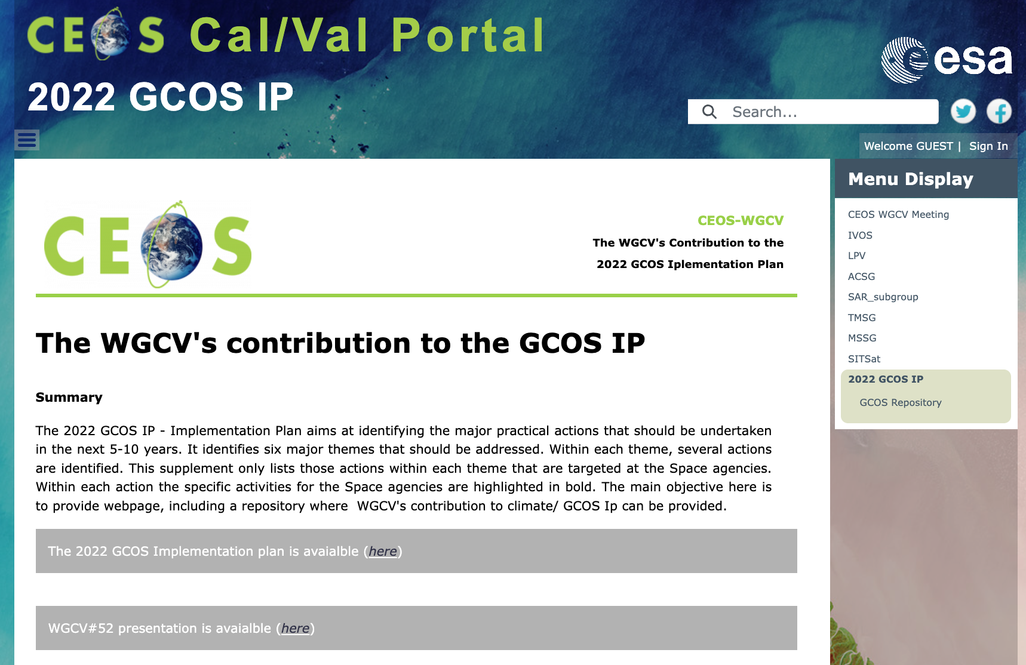
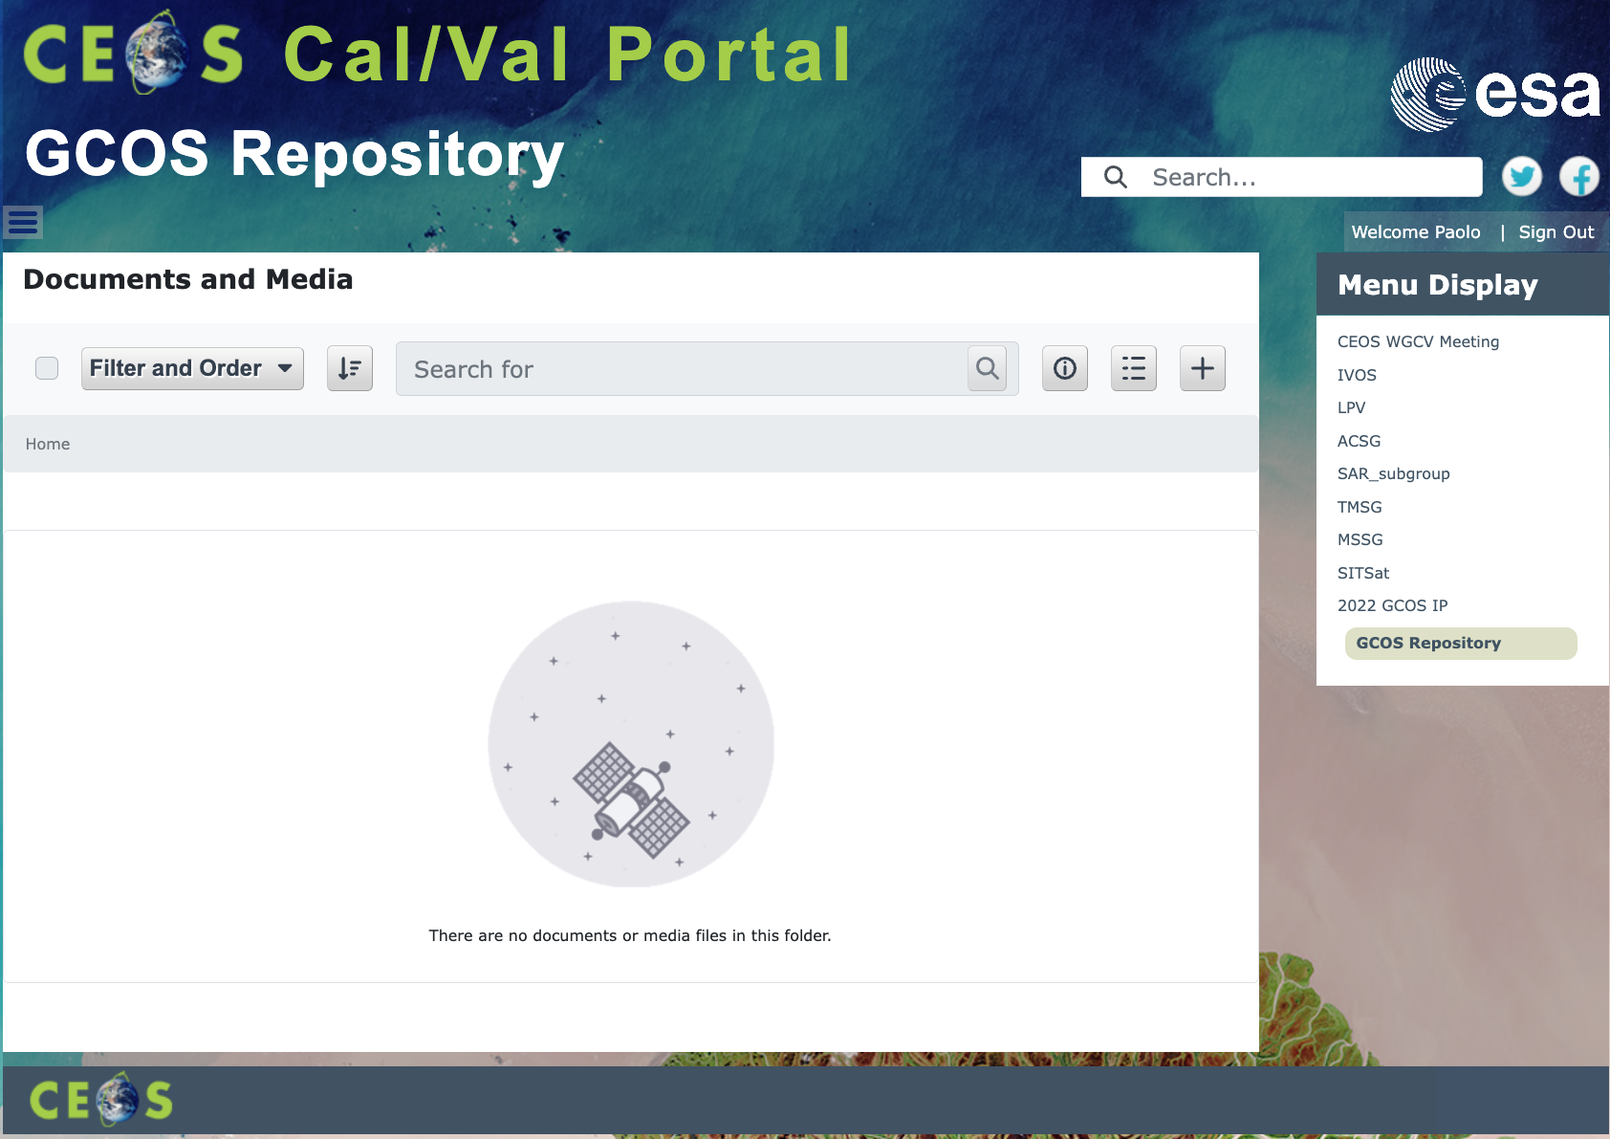
WGCV's contribution to the GCOS IP
The GCOS Implementation Plan webpage has been proposed with:
Summary;
link to the 2022 Implemenaion Plan;
link to the WGCV#52 presentation;
list of proposed actions with priorities.
A WGCV’s contribution repository (restricted to the portal’s members) is available to share documents/materilas
https://calvalportal.ceos.org/2022-gcos-ip

Slide 10
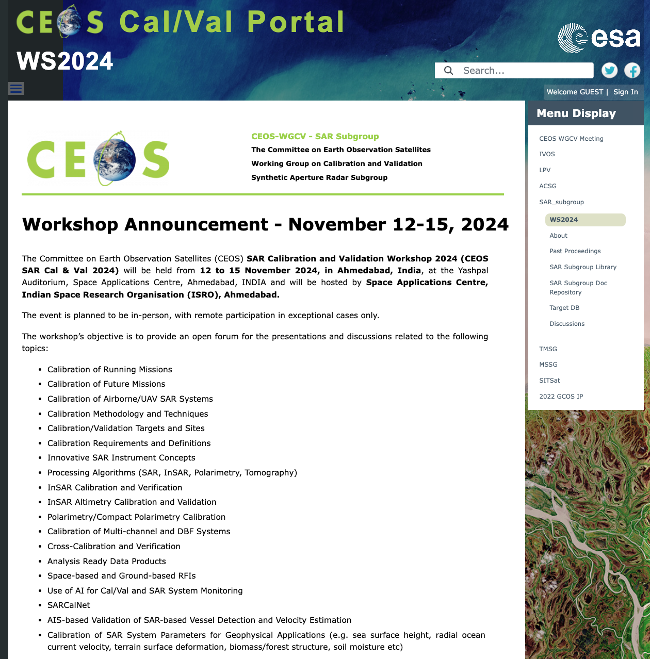
SAR Cal/Val Workshop 2024
The CEOS SAR Calibration and Validation Workshop 2024 (CEOS SAR Cal & Val 2024) will be held from 12 to 15 November 2024, in Ahmedabad, India, at the Yashpal Auditorium, Space Applications Centre, Ahmedabad, INDIA and will be hosted by Space Applications Centre, Indian Space Research Organisation (ISRO), Ahmedabad.

Slide 11
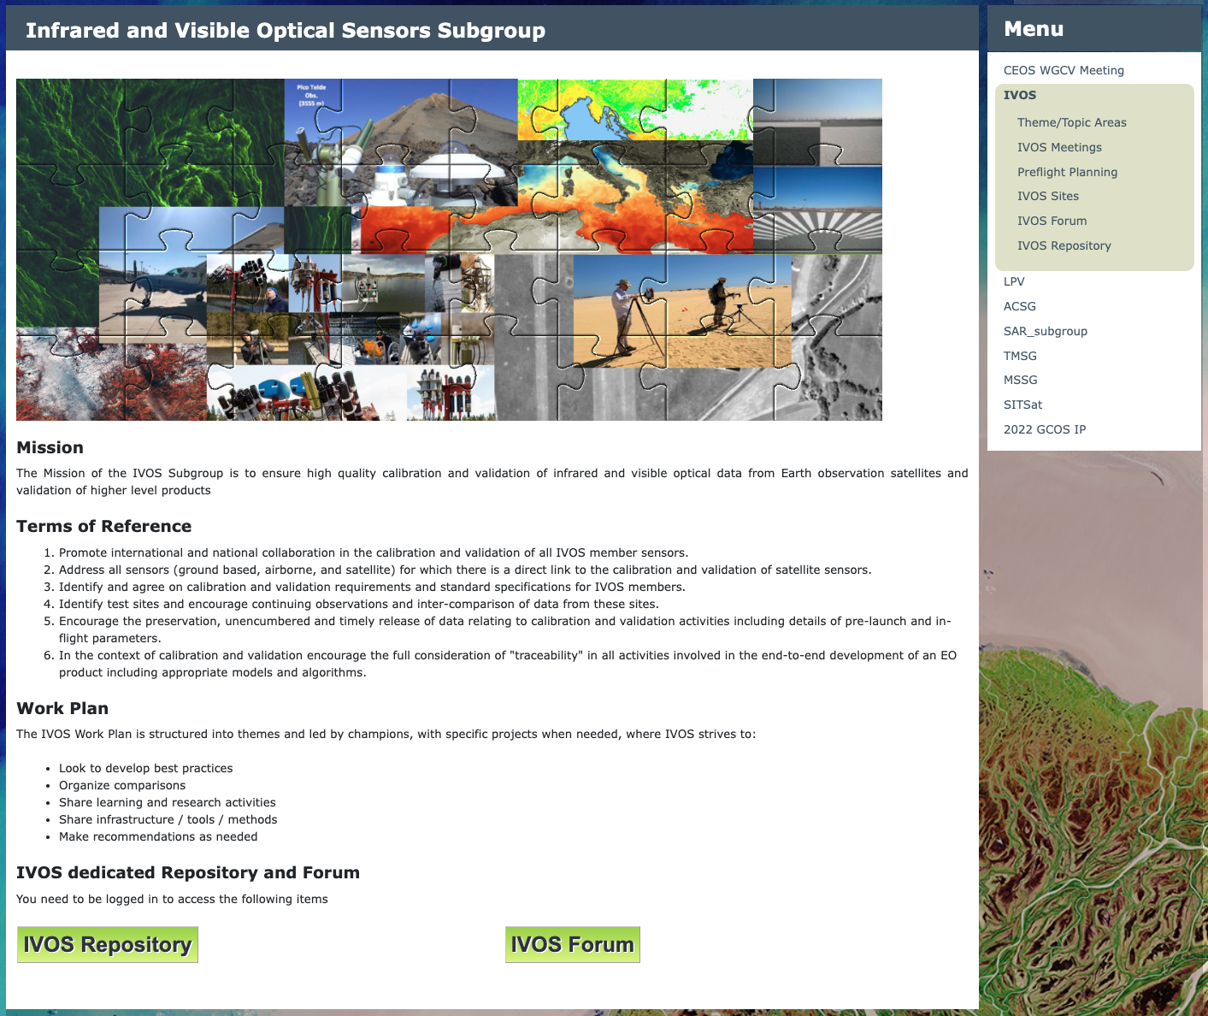
IVOS Subgroup
A number of activities are related to the IVOS subgroup, it is worth mentioning the updated Solar Irradiance Spectrum page with the CEOS endorsed TSIS-1 Hybrid Solar Reference Spectrum. The IVOS entry page has been recently equipped to access a dedicated Repository and Forum

Slide 12
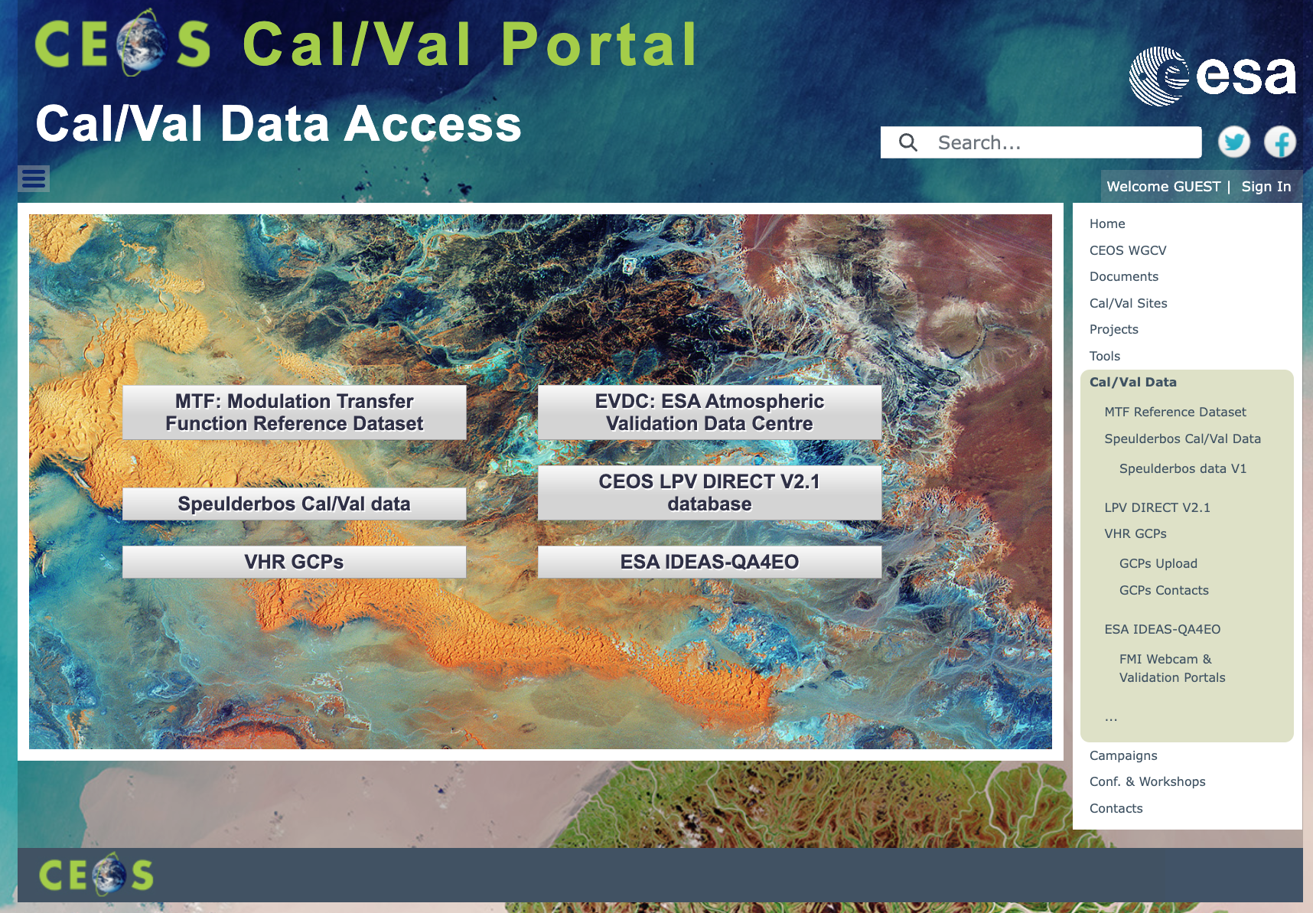
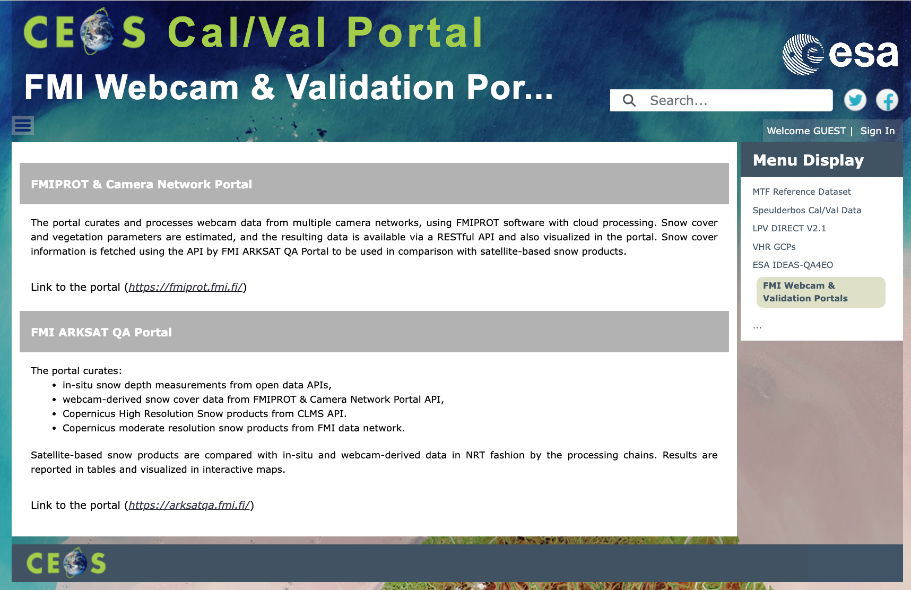
Snow and Vegetation parameters Validation (FMI Webcam & Validation portals)
In the context of snow and vegetation parameters and validation of satellite snow products, the FMI Webcam & Validation Portals includes links to the FMIPROT & Camera Network Portal and to the FMI ARSAT QA Portal

Slide 13
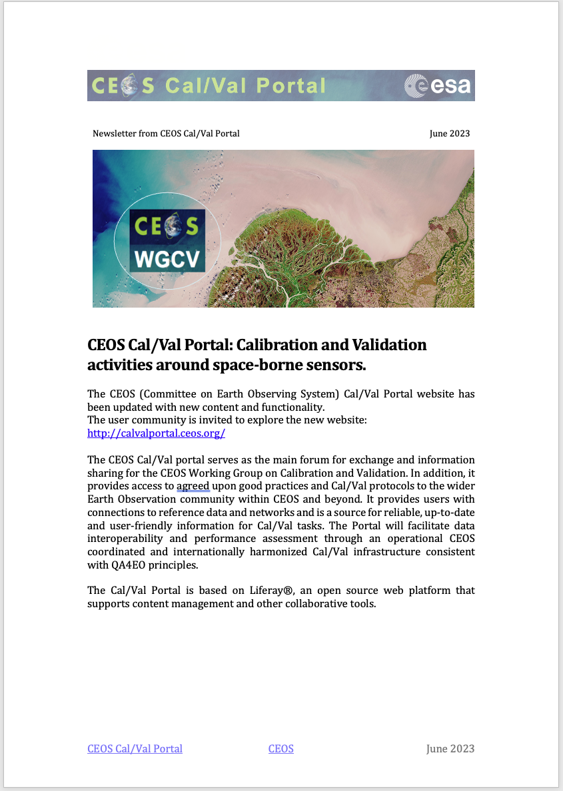
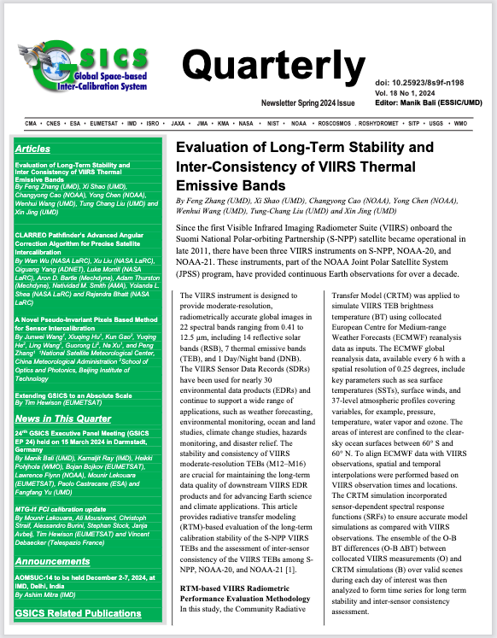

Outreach/Newsletter
Newsletter published in Oct 2024
Content Updates
Outreach, video tutorials, X post, contact and support

Slide 14
Collaboration area with WGISS (discussion)
Maturity Matrix approach (DMSMM see C.2, Interoperability MM see C.3)
WGCV Terms and Definition Wiki see E.3 (hosted in the CEOS Cal/Val Portal)
GCPs for Very High Resolution analysis webpage (from VH-RODA 2023)
and more

