Slide 1
CEOS Analytics Laboratory (CAL)
Jonathan Hodge CEOS SEO
Adolfo Ibáñez University
Agenda Item F.1
WGISS / WGCV Joint Meeting
15 & 18 October 2024
Sioux Falls, South Dakota, USA

Slide 2
CEOS Analytics Laboratory (CAL) (Formerly known as EAIL)
cal.ceos.org

Slide 3
CEOS Analytics Laboratory (CAL)
What is CAL?
What can you do with CAL?
Recent Developments
Coming soon
How can we help you?

Slide 4
Elastic Kubernetes Service
Analytics Laboratory
OGC Web Services
Data visualisation
https://cal.ceos.org
WMS, WMTS and WCS
Horizontal Pod Autoscaler (HPA) adjusts to user demand
Customisable, on-the-fly functions and calculations
Handles OGC, ESRI, other map services and geospatial files
2D, 3D and 4D visualisations
Above and below ground
Charting and time-series
OWS
Storage
Data for visualization
Public
Amazon S3
Amazon EC2 Auto scaling
Amazon EC2 Auto scaling
Dask Worker
ARCO data formats
(e.g. COG/Zarr)
Dask Worker
Metadata queries
Analytics environment
Flexible, scalable workers
Metadata
(eo3/STAC)
32MB, 8CPU default capacity
>500 pre-installed python libraries
Optional extra CPU/RAM
Optional GPU
Powerful parallel processing
Optional GPU, extra CPU or extra RAM (per worker)
Metadata and data response
Amazon S3
Amazon RDS
Argo Workflows
Powered by:
Data updates and new product generation
(ARCO data formats and eo3 metadata)
Powerful workflow engine
Hugely scalable
Automated data and product updates
Customised, on-demand data workflows
In addition to:
Automation and orchestration with:
Amazon Cognito
Amazon EFS
Amazon DynamoDB
Amazon CloudFront

Slide 5
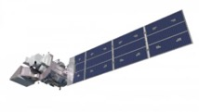
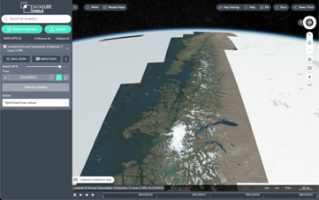
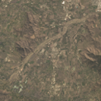
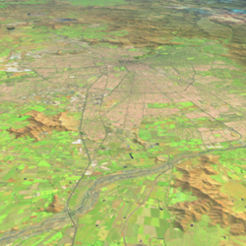
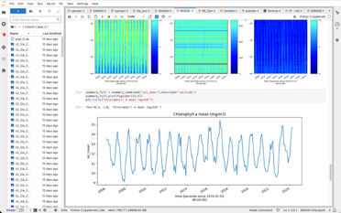
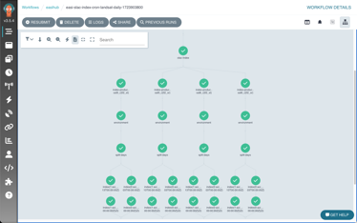
CEOS Analytics Laboratory
Analytics Laboratory
ARD
Visualisation
From pilot or project
to national or continental
ARCO
Analysis Ready:
Landsat 5/7/8/9
Sentinel 1/2/3
MODIS
VIIRS
ALOS
Elevation
Small sats
Commercial
…
Exploratory analysis
1 computer or 200
30GB RAM or 6TBs
8 CPU or 1600 CPU
Scalable workflows

Slide 6
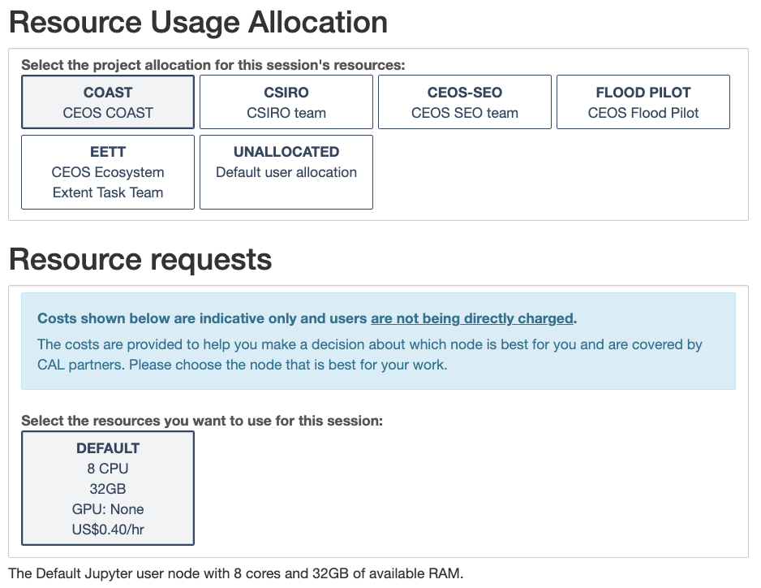
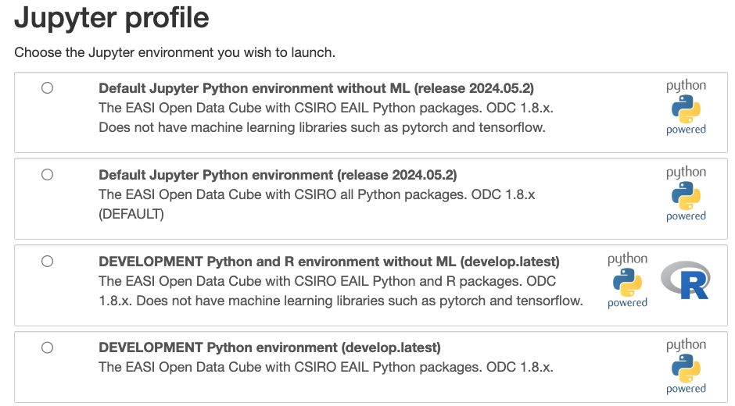
Using CAL

Slide 7
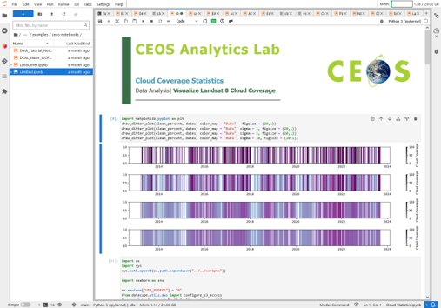
Example Notebooks
Cloud Statistics
Land Change
Water Threshold
Vegetation Phenology
Spectral Products
Vegetation Change
Water Observations from Space (WOFS)
Notebooks available at: https://github.com/AMA-Labs/cal-notebooks

Slide 8
CAL Uses and Use Cases
All WGs, VCs and others can work with CAL
Working actively with COAST and EETT
With COAST, we are developing training sessions and supporting data and processing needs
Actively in development - new data, new capabilities to suit your needs

Slide 9
CAL Uses and Use Cases
SARCalNet - Aiming to make available data for any available SAR data over all SARCalNet sites – public and commercial
Why not do the same for RadCalNet?
What about cloud native vector data?
GCP database?
Other interoperability questions?

Slide 10
Recent Developments
Analysis of commercial SAR data suitability
Palsar-2 Scansar Gamma 0
ceos.org/cal website:
ceos.org/cal/datarequest
ceos.org/cal/support
System updates

Slide 11
Coming soon
GPU capabilities with CUDA and Tensorflow or PyTorch
Additional system updates including new GPU & ML images
New datasets:
More Sentinel-1
Sentinel-3, MODIS, VIIRS
Commercial SAR

Slide 12
How can we help?
Tell us what you need…
Data?
Derived products?
Training?
Specific python packages?
Scale?
What else?

Slide 13
Final messages
CAL is extremely flexible
There are many example notebooks from similar installations around the world (e.g. Digital Earth Australia, DE Africa, etc)
It is very likely that whatever you are trying to do, someone has done before
There might be a learning curve, but this sort of system can accelerate your science and code very effectively
Don't be afraid to ask questions or for advice!

Slide 14
¡Gracias!
Points of Contact:
David Borges – NASA CEOS-SEO
Brian Terry – AMA
Jonathan Hodge – UAI
Jonathan Hodge Executive Director
Center for Earth & Space
Adolfo Ibáñez University
jonathan.hodge@uai.cl

