Slide 1
Interoperability - Quality Factor
Cody Anderson, USGS
CEOS WGCV Vice-Chair
Agenda Item E.2
WGISS / WGCV Joint Meeting
15 & 18 October 2024
Sioux Falls, South Dakota, USA

Slide 2
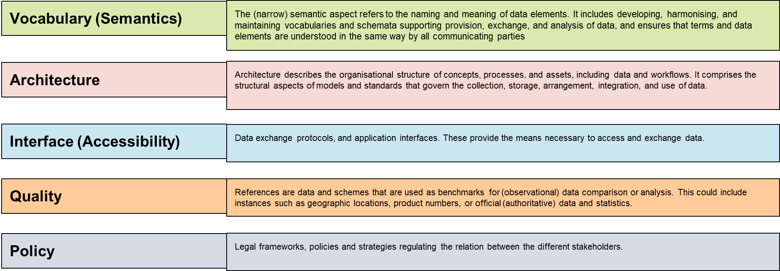
Interoperability Framework : Factors

Slide 3
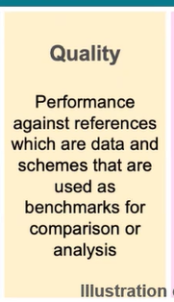
Quality – Factor
References are data and schemes that are used as benchmarks for (observational) data comparison or analysis. This could include instances such as geographic locations, product numbers, or official (authoritative) data and statistics.
Older Factor

Slide 4
Quality – Proposed Factor
Current Framework
References are data and schemes that are used as benchmarks for (observational) data comparison or analysis. This could include instances such as geographic locations, product numbers, or official (authoritative) data and statistics.
Proposed
Indicators (parameters, metrics, etc.) for informing users of the trustworthiness (accuracy, uncertainty, consistency, etc.) of the data provided (measurands, measurements, observations, etc.)

Slide 5
Interoperability Framework : Factors
Indicators (parameters, metrics, etc.) for informing users of the trustworthiness (accuracy, uncertainty, consistency, etc.) of the data provided (measurands, measurements, observations, etc.)

Slide 6
Quality – Definition within Framework
Current Framework
Quality ensures long term confidence in the accuracy and consistency of Earth Observation data and products and to provide a forum for the exchange of information about calibration and validation, including the coordination of cooperative activities.
Proposed
Quality informs users of the trustworthiness of Earth Observation data and products and to provides a forum for the exchange of information about calibration and validation, including the coordination of cooperative activities.

Slide 7
Calibration and Validation – Definition within Framework
Current Framework
Calibration helps in quantitatively defining a sensor response to known and controlled signal inputs. Validation is the process of assessing the quality of the data
Proposed: CEOS Website
Calibration is the process of quantitatively defining a system’s response to known and controlled signal inputs. Validation, on the other hand, is the process of assessing, by independent means, the quality of the data products derived from those system outputs.

Slide 8
Quality Chapter – Outline Proposal
Desired Measurand
Description of the Measurement/Observation
Sensor Description
Sensor Characteristics
Observation Characteristics
Observation and Target Characteristics
Sensor, Observation, and Target Characteristics
Uncertainty
Multi Sensor Characteristics

Slide 9
Quality Chapter – Outline Proposal
Measurand
Passive Satellite Viewed Bottom of Atmosphere Surface Reflectance
Description of the Measurement/Observation
Sensor Description
Ground Sample Distance (GSD), Relative Spectral Response (RSR), Point Spread Function (PSF), etc.

Slide 10
Quality Chapter – Outline Proposal
Sensor Characteristics
Voltage to DN (Bias/Dark Current, Linearity, Flat Fielding/Relative Gain)
Artifacts: Saturation, Noise, Stray Light, Cross-talk, etc.
Absolute/Temporal Calibration (DNs to SI: Radiance or Reflectance)
Temporal Degradation, Radiance to Reflectance (solar model), etc.
Observation Characteristics
Cloud/Cloud Shadow Masking
Atmospheric Correction/Compensation (Aerosols, O-zone, Water Vaper, Path length, Elevation, Direct Illumination, Diffuse Illumination, etc.)

Slide 11
Quality Chapter – Outline Proposal
Observation and Target Characteristics
Atmospheric Adjacency Effects
Bi-Direction Reflectance Distribution Function
View Angle, Solar Angle, Land Cover Mapping, Nadir Adjusted BRDF Reflectance
Terrain Illumination
Slope and Aspect
Sensor, Observation, and Target Characteristics
Polarization

Slide 12
Quality Chapter – Outline Proposal
Uncertainty
Uncertainty associated with each of the above and the combination of all significant contributors
Multi Sensor Characteristics
Inter-calibration
Spectral Band Adjustment

Slide 13
Discussion Topics/Questions
Most Quality, and other Factors, considerations are directed at a single datasets as an input to Interoperability
Is the audience of the Interoperability Framework - Data Providers?
Is there an intent to define thresholds to meet within the Interoperability Framework?
Where does measurand/measurement/observation description belong?
Data Content Factor?
Where does Griding/Tiling/Projections get addresses?

