Slide 1
CEOS-ARD Product Assessments
Medhavy Thankappan,
Peter Harrison
Geoscience Australia
Agenda Item D.1
WGISS / WGCV Joint Meeting
15 & 18 October 2024
Sioux Falls, South Dakota, USA

Slide 2
CEOS-ARD Review Process
ORIGINAL PROCESS

Slide 3
CEOS-ARD Review Process
MODIFIED PROCESS
ONLY FOR TARGET LEVEL EVALUATIONS
LSI-VC Secretariat: Matt Steventon, Symbios
WGCV PoC: Medhavy Thankappan, GA
WGCV Alternate PoC: Clement Albinet, ESA
Technical Support: Peter Harrison, GA

Slide 4
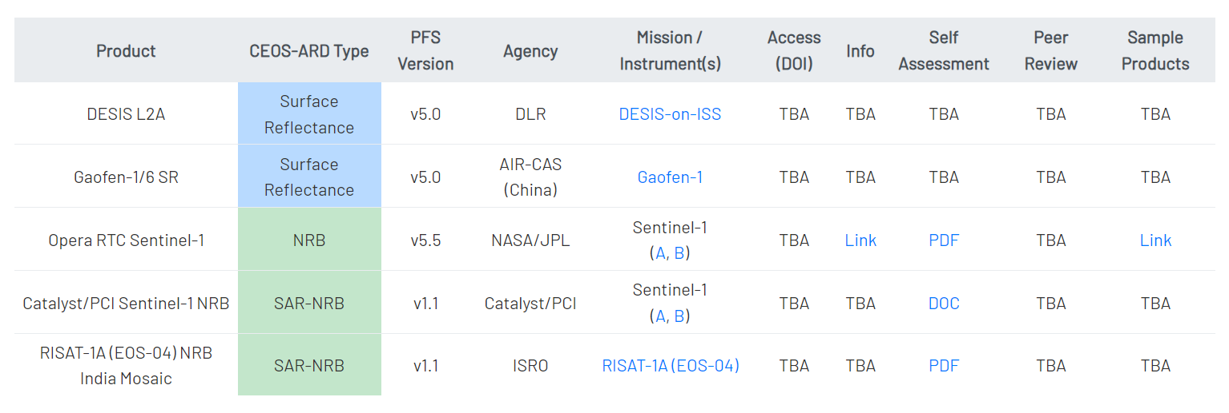
CEOS-ARD Assessments
CEOS-ARD self-assessments currently in review

Slide 5
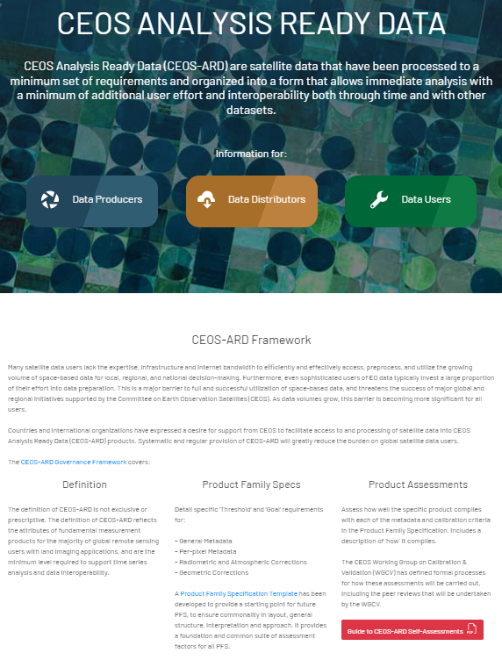
CEOS-ARD Website
Details of all self-assessments endorsed as CEOS-ARD compliant
https://ceos.org/ard/index.html#datasets
Information on self-assessments in review and soon to be submitted
Links to ARD Strategy and other useful information
https://ceos.org/ard

Slide 6
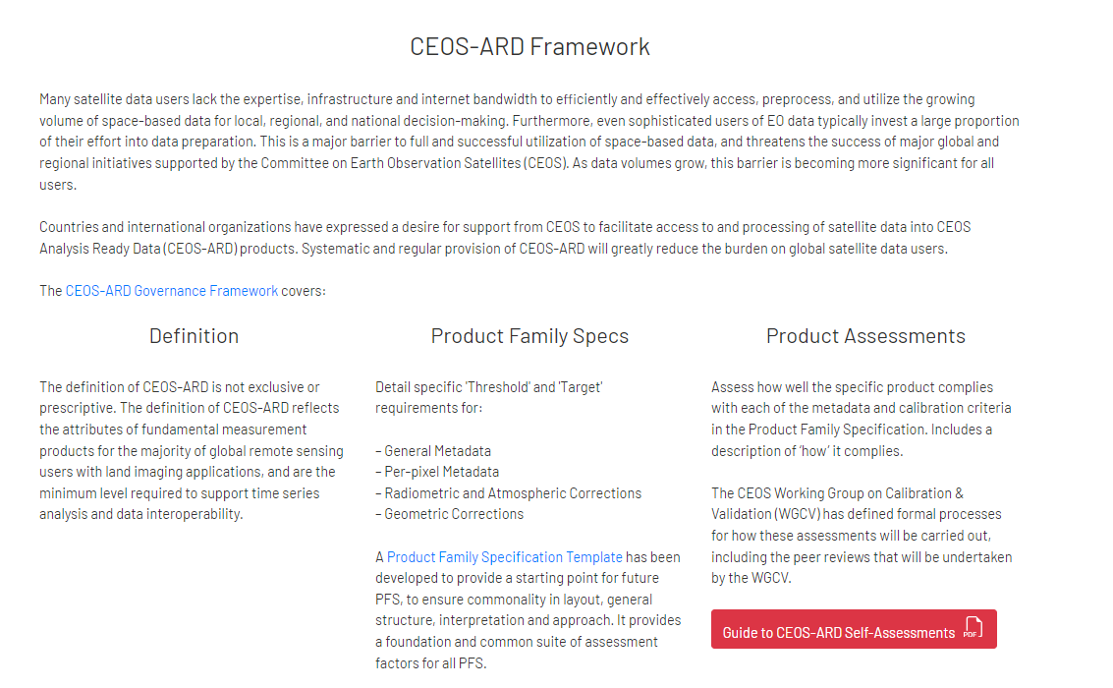
CEOS-ARD Self-Assessment Guide
Guide for CEOS-ARD Self-Assessment available
Completed self-assessment PFS to be submitted for review via email
Email for submission of self-assessments ard@ceos.org
https://ceos.org/ard/files/User%20Guide/CEOS_ARD%20User%20Guide%20v1_4.pdf

Slide 7
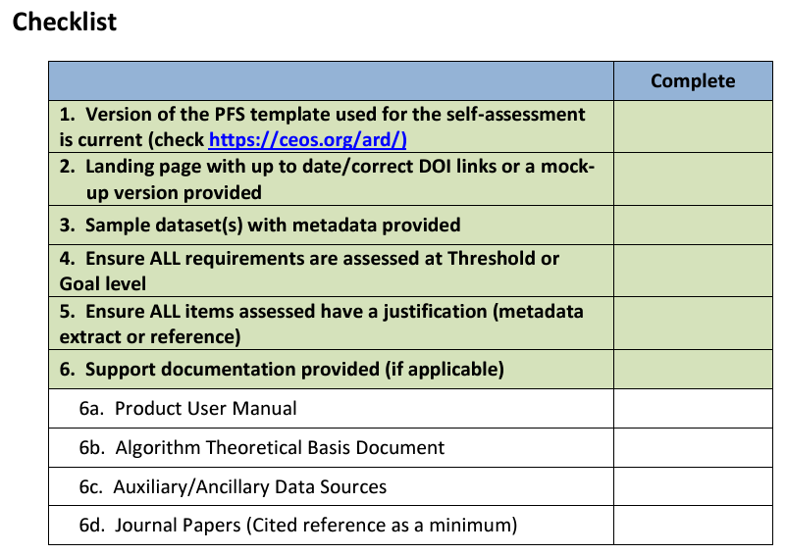
Checklist for CEOS-ARD Reviews
https://ceos.org/ard/files/User%20Guide/CEOS_ARD%20User%20Guide%20v1_4.pdf

Slide 8
Thank you
medhavy.thankappan@ga.gov.au
peter.harrison@ga.gov.au

