Slide 1
CEOS-ARD Progress
Chris Barnes, USGS/KBR
LSI-VC co-lead
Agenda Item D.1
WGISS / WGCV Joint Meeting
15 & 18 October 2024
Sioux Falls, South Dakota, USA

Slide 2
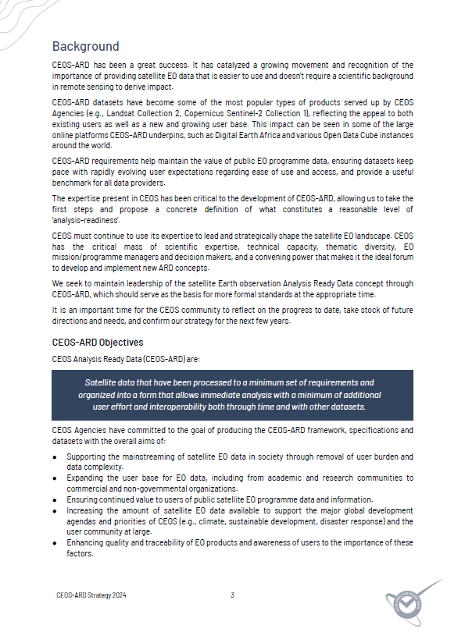
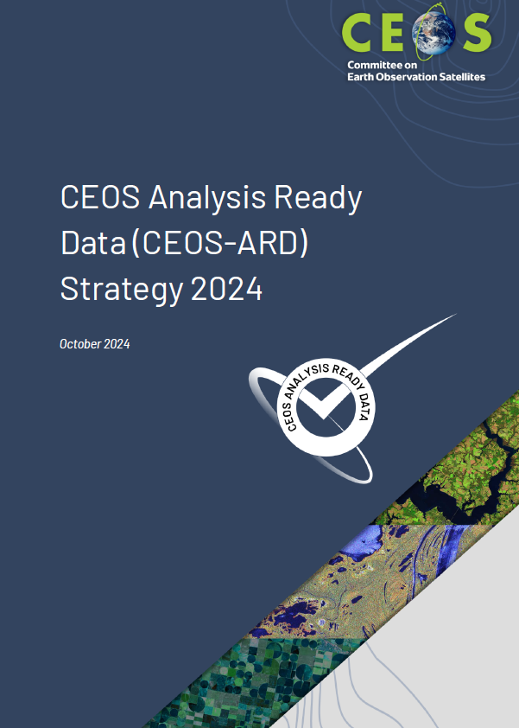
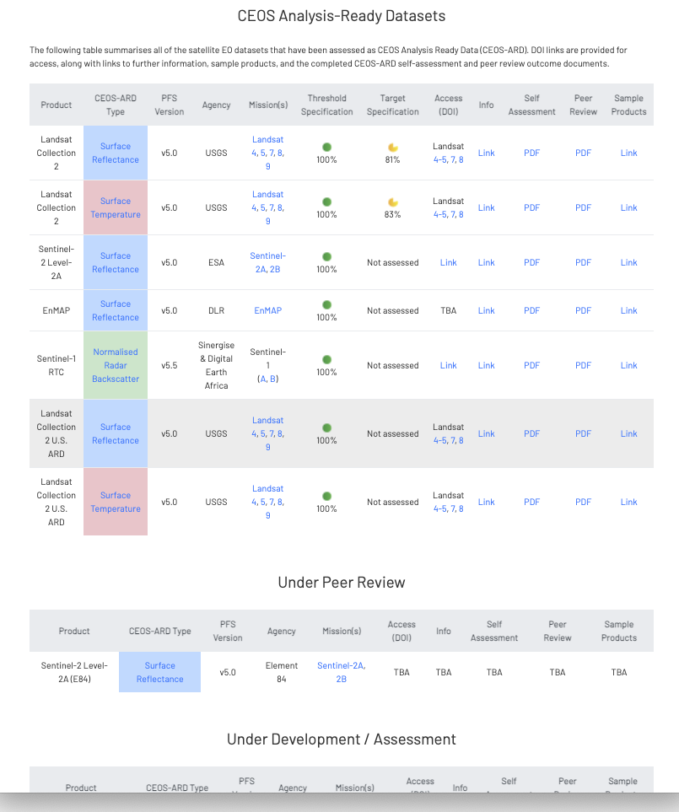
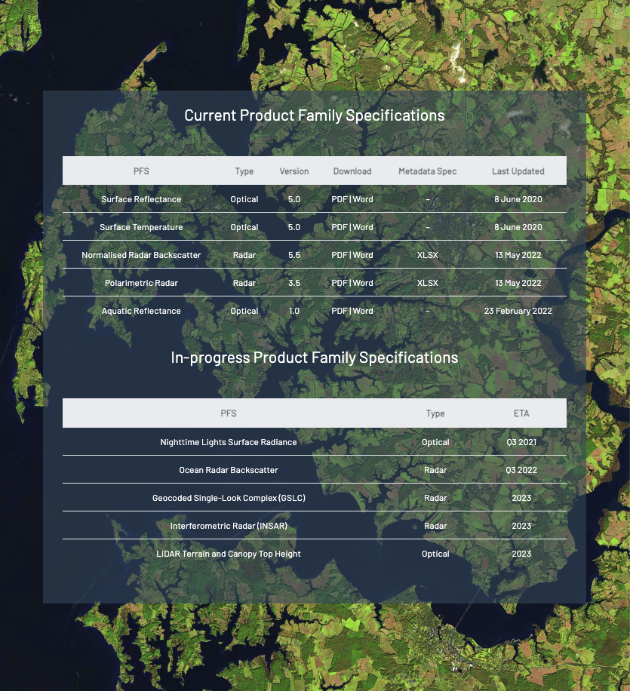
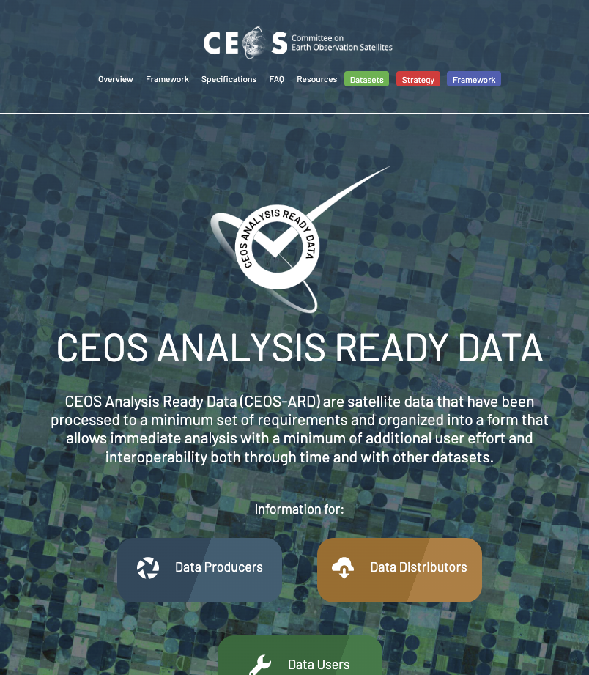
Outline
2024 CEOS-ARD Strategy
CEOS-ARD Assessments Update

Slide 3
2024 CEOS-ARD Strategy

Slide 4
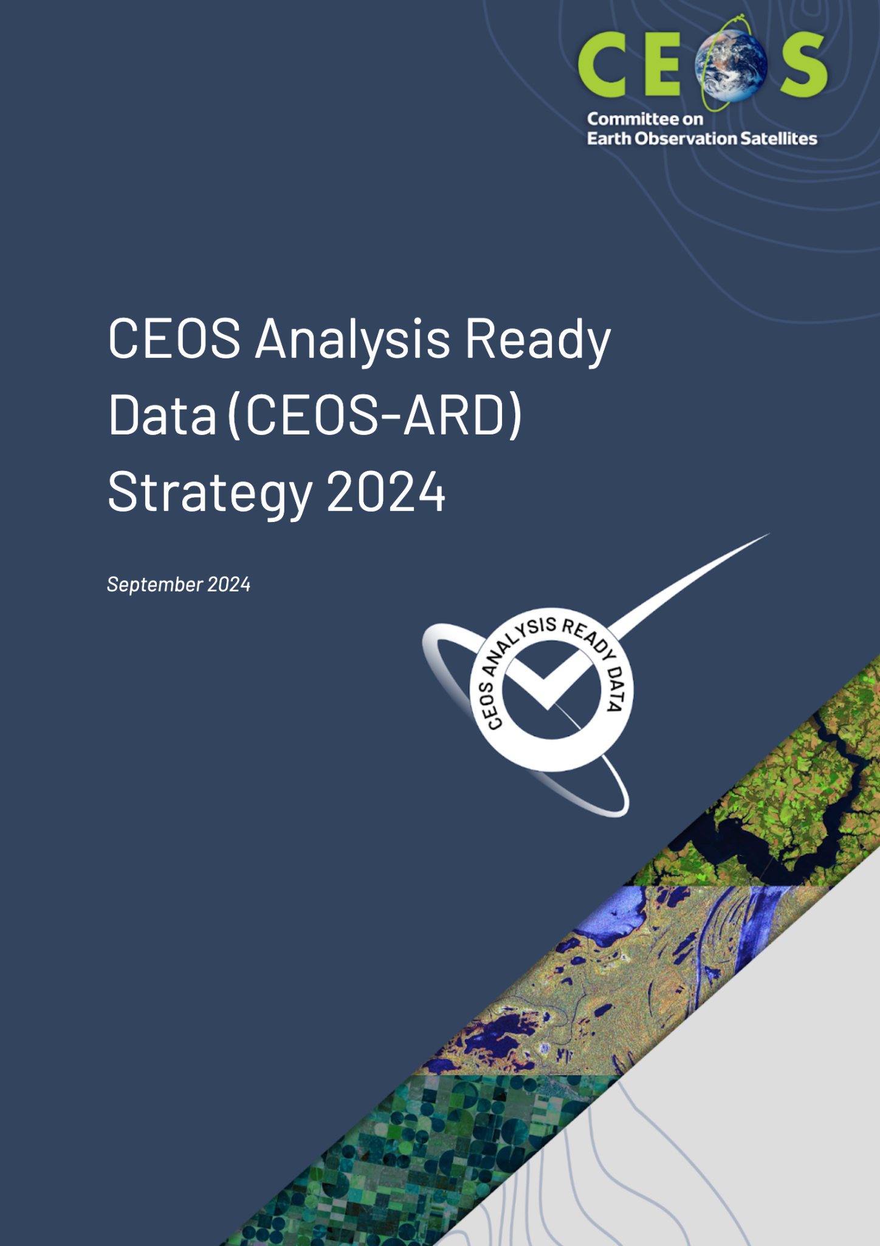
CEOS-ARD Strategy 2024
Update to past editions from 2019 and 2021
Reflects on the progress to date, takes stock of future directions and needs, and confirms our strategy for the near to long term
Lots happening within CEOS-ARD!
Packed into <20 pages
Covers the ‘what’ and ‘why’ – ‘when’ and ‘how’ to be decided and added to future CEOS Work Plans
GOAL: Broad portfolio of CEOS-ARD compliant products that are easily discovered, accessed and publicly used

Slide 5
2024 CEOS-ARD Strategy
Activities are categorised into six broad themes:
CEOS-ARD Availability, Product Diversity, and Representation
Applicable to: CEOS member agencies & who support leadership of Virtual Constellations
CEOS-ARD Framework and Specification Advancement
Applicable to: CEOS-ARD Oversight Group, LSI-VC, SEO, WGISS, WGCV
Discovery, Access, Utilisation, and Interoperability
Applicable to: CEOS member agencies, CEOS-ARD Oversight Group, LSI-VC, SEO, WGISS, VCs, CEOS MIM Database Team
Community Engagement
Applicable to: CEOS member agencies, CEOS-ARD Oversight Group, LSI-VC, SEO, EETT, LSI-GEOGLAM Subgroup, COAST-VC, CEOS SDG Coordination Group, WGDisasters, CEOS Communications Team
Research, Test Cases, and Pilot Activities
Applicable to: CEOS member agencies, LSI-VC, SEO, WGCV, CEOS-ARD Oversight Group, COAST-VC, EETT, WGDisasters
Commercial Engagement
Applicable to: LSI-VC, SEO, CEOS-ARD Oversight Group, WGISS

Slide 6
2024 CEOS-ARD Strategy
Activities are categorised into six broad themes:
CEOS-ARD Availability, Product Diversity, and Representation
Applicable to: CEOS member agencies & who support leadership of Virtual Constellations
CEOS-ARD Framework and Specification Advancement
Applicable to: CEOS-ARD Oversight Group, LSI-VC, SEO, WGISS, WGCV
Discovery, Access, Utilisation, and Interoperability
Applicable to: CEOS member agencies, CEOS-ARD Oversight Group, LSI-VC, SEO, WGISS, VCs, CEOS MIM Database Team
Community Engagement
Applicable to: CEOS member agencies, CEOS-ARD Oversight Group, LSI-VC, SEO, EETT, LSI-GEOGLAM Subgroup, COAST-VC, CEOS SDG Coordination Group, WGDisasters, CEOS Communications Team
Research, Test Cases, and Pilot Activities
Applicable to: CEOS member agencies, LSI-VC, SEO, WGCV, CEOS-ARD Oversight Group, COAST-VC, EETT, WGDisasters
Commercial Engagement
Applicable to: LSI-VC, SEO, CEOS-ARD Oversight Group, WGISS
In the interest of time, and audience, will focus on WGISS & WGCV applicable themes

Slide 7
2024 CEOS-ARD Strategy 2. CEOS-ARD Framework and Specification Advancement – CEOS member agencies, WGISS & WGCV
2.4 Replica datasets, authenticity, traceability, and inherited CEOS-ARD compliance - CEOS-ARD Framework should be updated in recognition that there are often replicas of CEOS-ARD datasets mirrored in multiple locations and that there needs to be a mechanism for these mirrored datasets to inherit CEOS-ARD compliance.
2.7 Terminology - CEOS-ARD will seek to have consistent terminology and parameter names across all of the PFSs and Framework, leveraging conventions established by WGCV and WGISS and the CEOS Interoperability Framework/Handbook.

Slide 8
2024 CEOS-ARD Strategy 3. Discovery, Access, Utilisation, and Interoperability – CEOS member agencies, WGISS
3.1 Embrace the CEOS Interoperability Framework. - CEOS-ARD is a step towards interoperability, but it is not sufficient on its own. Needs to aligned with the principles developed in the CEOS Interoperability Framework/Handbook. WGISS support is needed to ensure CEOS-ARD development is aligned with broader efforts to advance interoperability.
3.2 Alignment of CEOS-ARD and SpatioTemporal Asset Catalogs (STAC). - Natively expressing CEOS-ARD metadata in STAC could be beneficial because it provides the metadata in a form that people already use and is supported by a vibrant software ecosystem.

Slide 9
2024 CEOS-ARD Strategy 3. Discovery, Access, Utilisation, and Interoperability – CEOS member agencies, WGISS
3.3 Incorporate additional cloud native approaches and facilitate machine-to-machine access and utilization. - Work with WGISS to investigate changes to the CEOS-ARD Framework that will make CEOS-ARD datasets more suited to the cloud environments.
3.4 CEOS-ARD discoverability and branding. - Undertake efforts to increase the visibility of and access to CEOS-ARD datasets and better promote the availability of CEOS-ARD in a consistent manner, with branding, documentation, etc.
3.6 Technical Advisory Notes - Advisory Notes might recommend data provision in cloud-friendly formats (e.g., STAC, COGs, HDF5/netCDF, Zarr), certain algorithms/methods, providing guidelines for source code, etc.

Slide 10
2024 CEOS-ARD Strategy 5. Research, Test Cases, and Pilot Activities – CEOS member agencies, WGCV
5.3 Surface Reflectance Quality, Equivalency and Consistency Project - Community agreed definition of what constitutes Surface Reflectance in the context of CEOS-ARD. May then be able to explore all the parameters that need to be considered for equivalence between multi-source Surface Reflectance datasets.
- Simon Oliver (GA) will talk more about this shortly.

Slide 11
2024 CEOS-ARD Strategy 6. Commercial Engagement – WGISS
6.3 CEOS-ARD Development Sprints - Sprints intentionally attract target audiences at technical levels, which could complement traditional CEOS meetings which often do not allocate dedicated time for collaborative, technical development on specific topics e.g., PFS “building blocks” approach.
- STAC approach was successfully developed using a series of well organized in-person sprints.

Slide 12
2024 CEOS-ARD Strategy
Access the 2024 CEOS-ARD Strategy for endorsement at CEOS Plenary
Feedback & comments are welcomed!

Slide 13
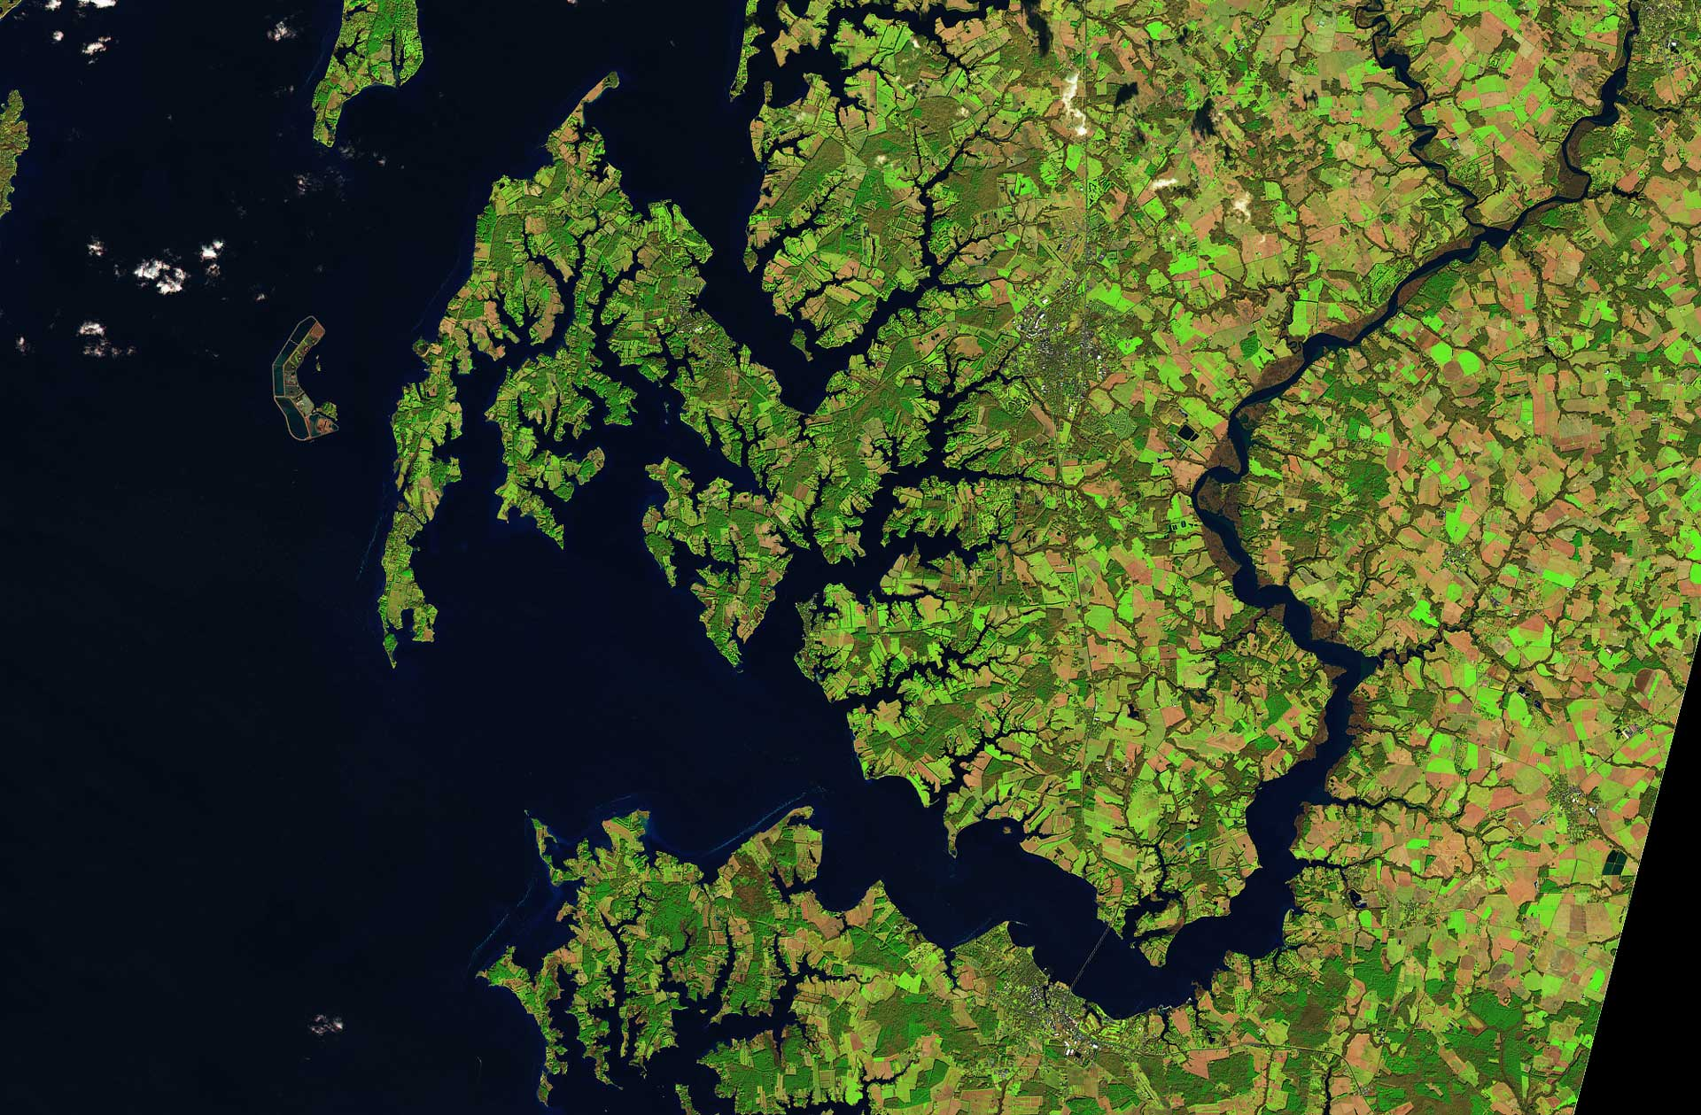
Resources
CEOS-ARD
CEOS-ARD Newsletter
CEOS-ARD Framework
Guide to CEOS-ARD Self-Assessments
THANK YOU!
Chris Barnes: barnes@contractor.usgs.gov

Slide 14
Backup Slides

Slide 15
2024 CEOS-ARD Strategy 1. CEOS-ARD Availability, Product Diversity, and Representation - CEOS member agencies
1.1 CEOS Agencies should review their offering of data products, identifying those of relevance to CEOS-ARD Product Family Specifications (PFSs) and prioritize self-assessments of these products. - Commit to reviewing the available and upcoming CEOS-ARD PFSs and consider which datasets would be candidates for assessment, and commit staff to undertake those self assessments.
1.2 Support a strong CEOS-ARD Oversight Group with broad representation of the CEOS Virtual Constellations. - Ensuring participation of all Virtual Constellations means the group has diverse thematic representation.

Slide 16
2024 CEOS-ARD Strategy 1. CEOS-ARD Availability, Product Diversity, and Representation - CEOS member agencies
1.3 Encourage the CEOS Virtual Constellations to work on CEOS-ARD. - VCs are the fora where new PFSs are developed in response to existing or foreseen user needs and trends.
- VCs should be tasked with bringing all stakeholders together to look for new opportunities. - VCs should be encouraged to consider the new, ‘non-expert’ user angle that has proven effective in the land domain, and consider the potential for expanding the user base and applications of their EO products.
1.4 CEOS-ARD at mission inception and planning stages and in archive reprocessing plans. - Include systematic CEOS-ARD production into their plans at the mission inception and design stages and, for missions that are ongoing/ended, at major archive reprocessing opportunities.

Slide 17
CEOS-ARD Origins
2016: Needed to define something - address the ambiguity of ‘ARD’
CEOS-CARD4L 🡪 CEOS-ARD
Open Data Cube – Digital Earths
Space agency experience
What do most ‘non-expert’ users want?
Sensor agnostic geophysical variables
Define key metadata parameters and data corrections for different types of geophysical products
Ensuring documentation, rather than prescribing methods
… and so to where we are today …

