Slide 1
WGISS Data Management and Stewardship Maturity Matrix (DMSMM)
Iolanda Maggio
and Paolo Castracane
Starion for ESA
Agenda Item C.2
WGISS / WGCV Joint Meeting
15 & 18 October 2024
Sioux Falls, South Dakota, USA

Slide 2
Presentation Guidance
The WGISS Data Management and Stewardship Maturity Matrix
The MMT tool
Configuration
Assessment
Updates
Way Forward

Slide 3
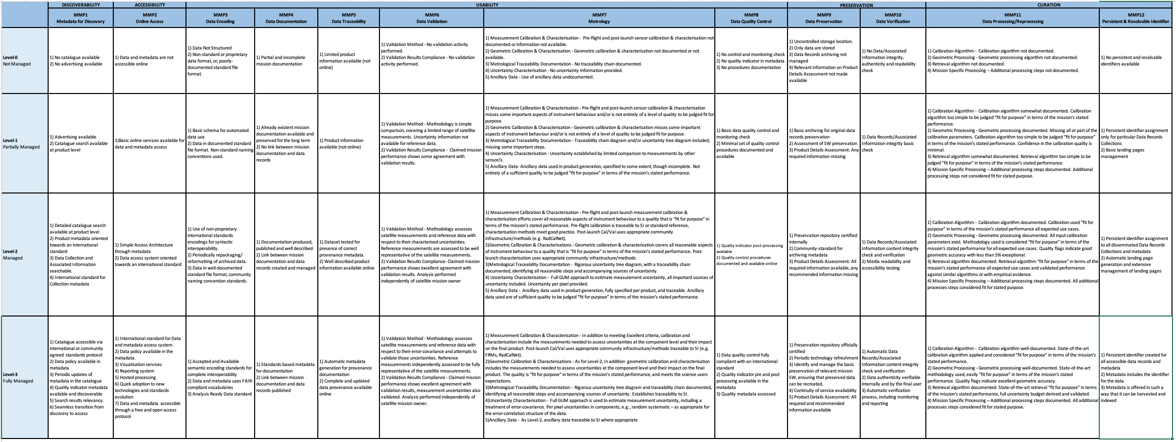
The WGISS Data Management and Stewardship Maturity Matrix

Slide 4
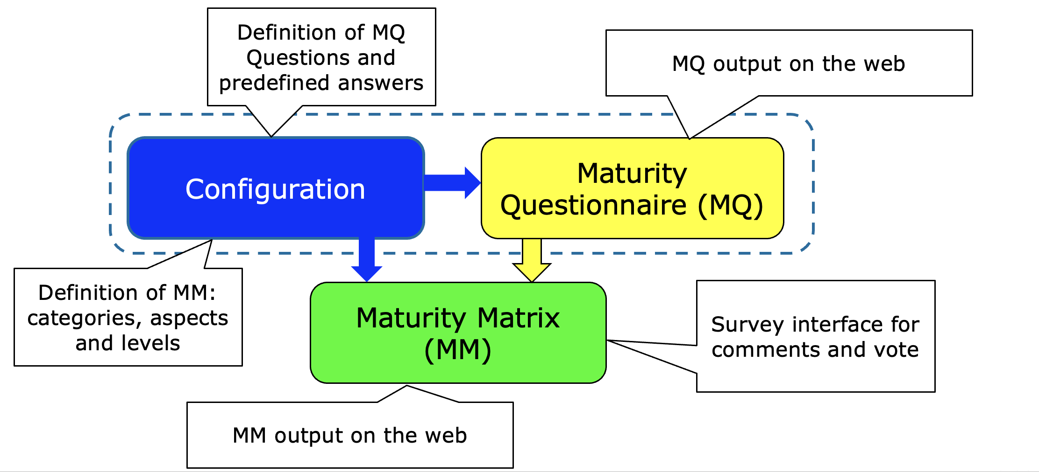
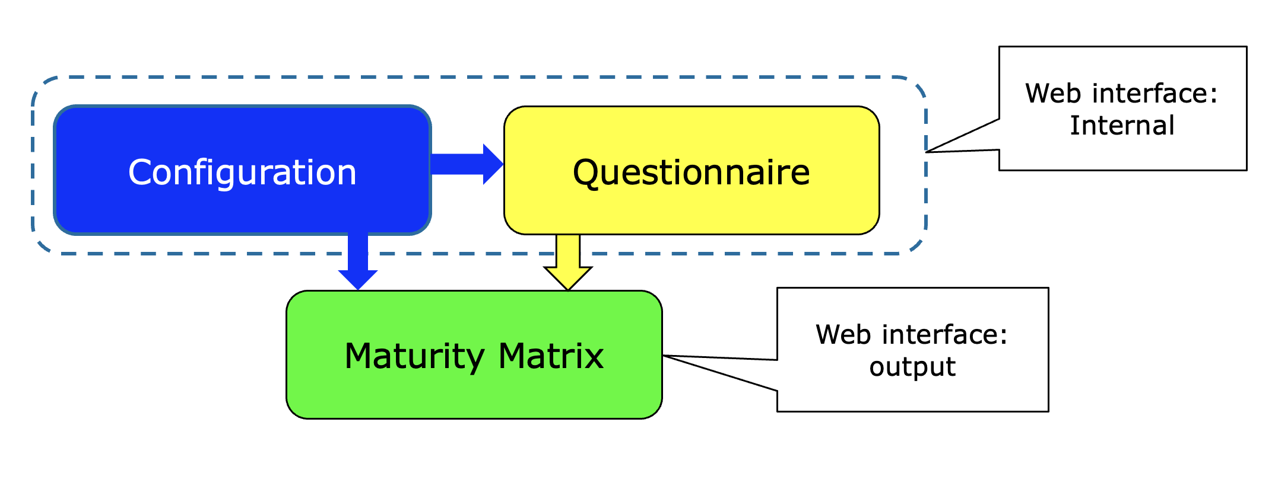
Maturity Matrix tool: Logical Overview

Slide 5
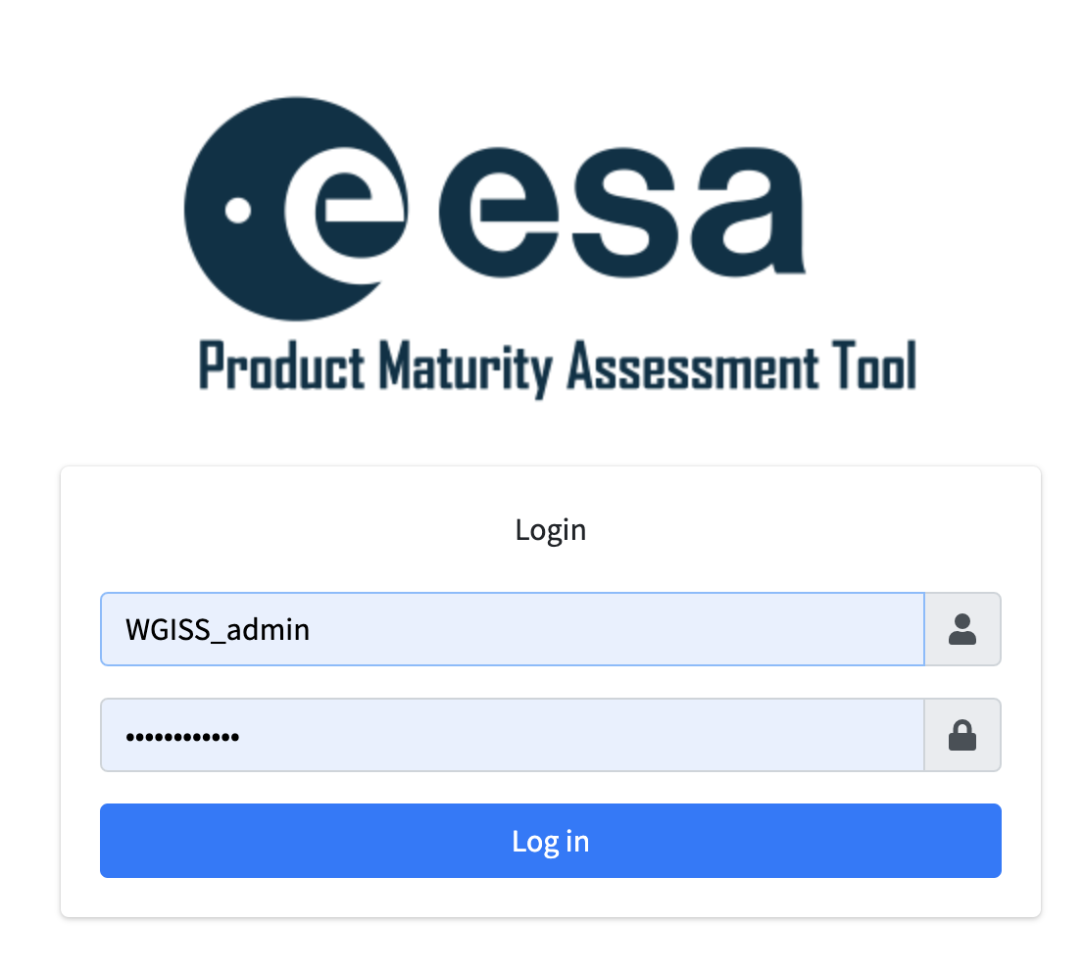
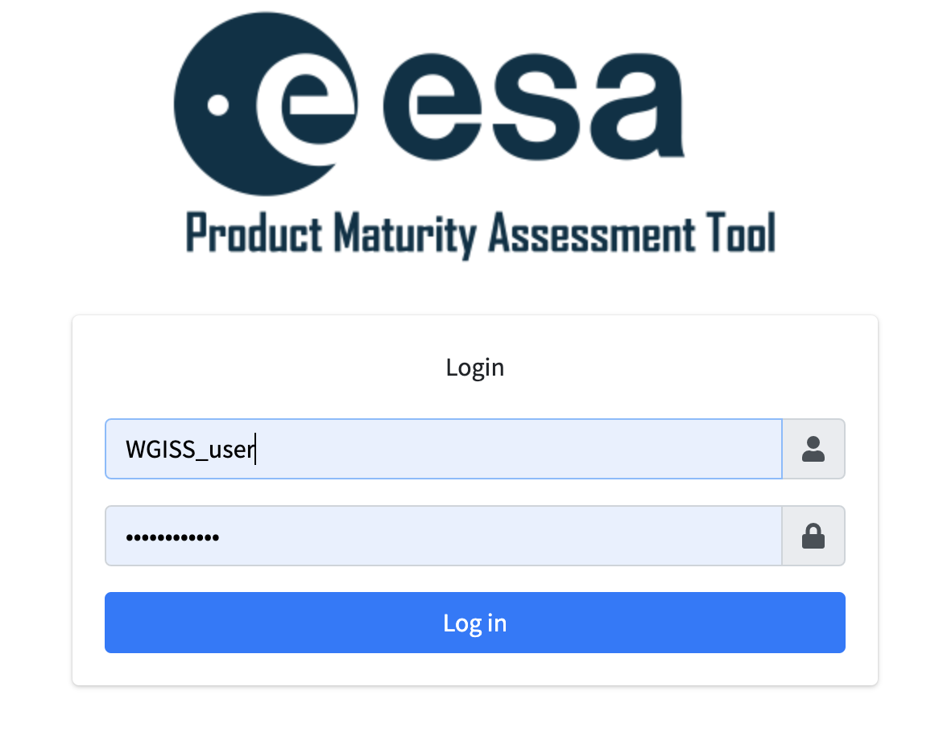
WGISS admin and user
Access to the full MM configuration, compare assessments
Assessment, review/edit comments and attach info/docs

Slide 6
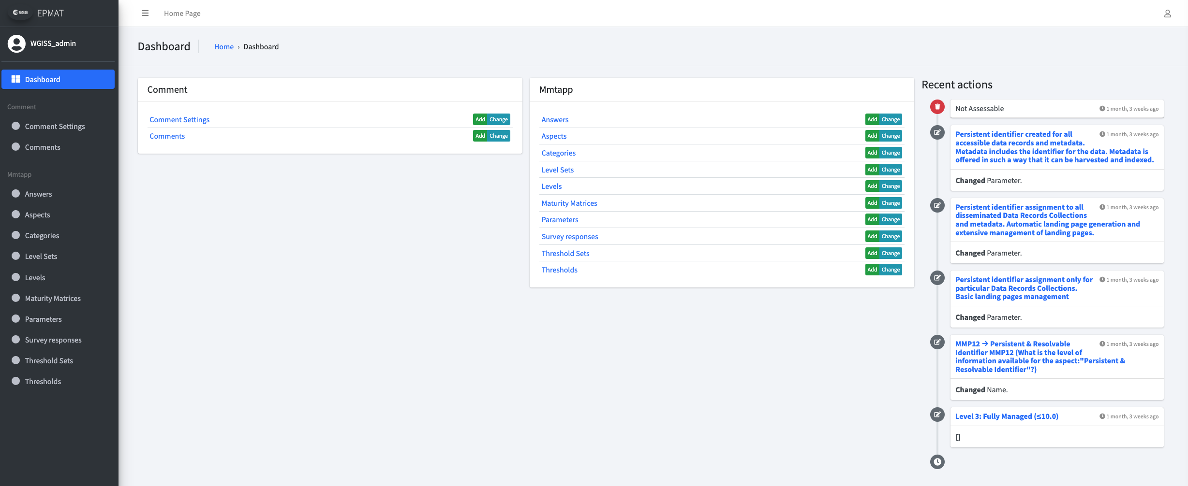
Admin: MM Configurability
to define MM (Name, Threshold set, Level set, version, description, intro and final comment etc);
to define Categories (Columns);
to define Aspects (items in Categories);
to define Parameters (items in Aspects – Question text);
to define Answers (Answer text associated to a level);
Survey Interface
Notes:
s

Slide 7
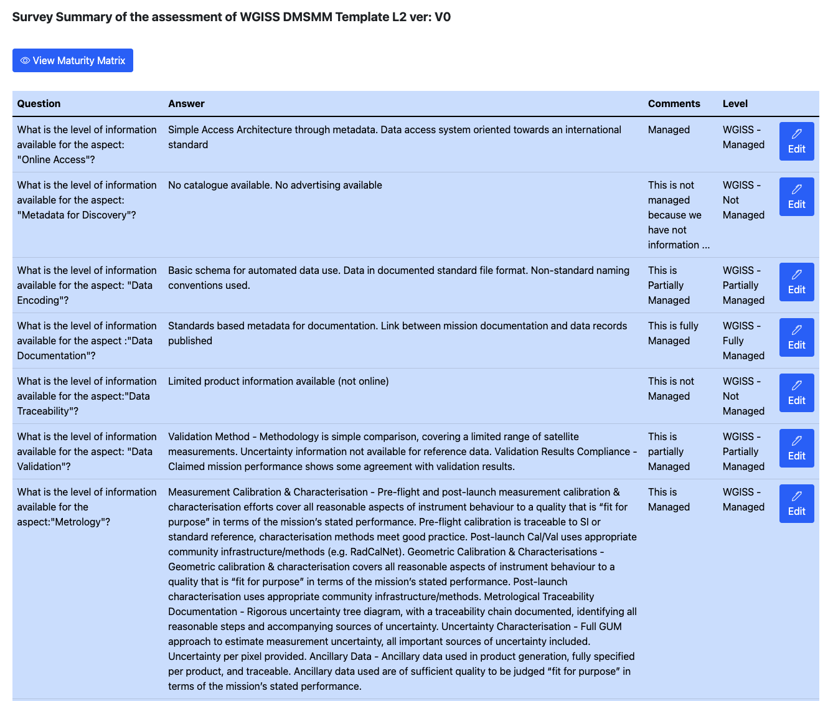
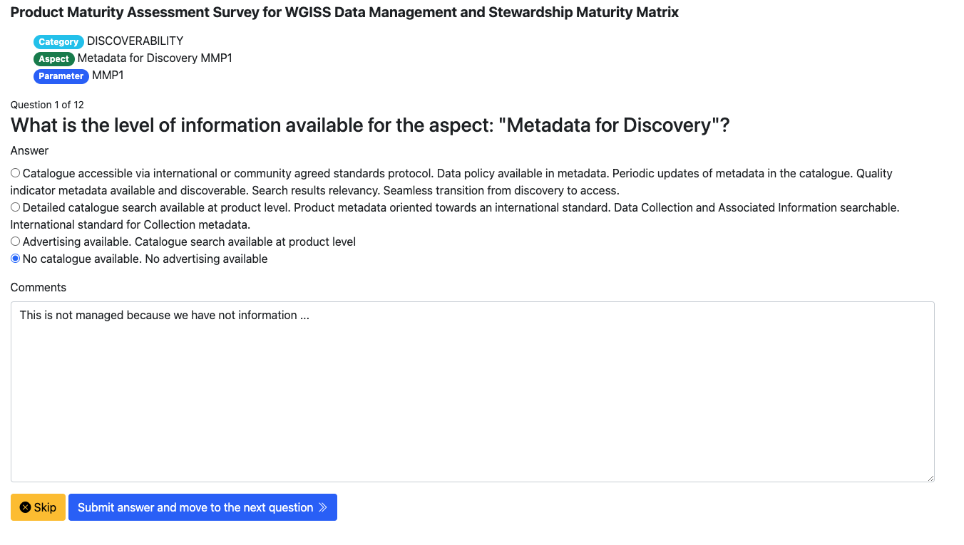
User assessment

Slide 8
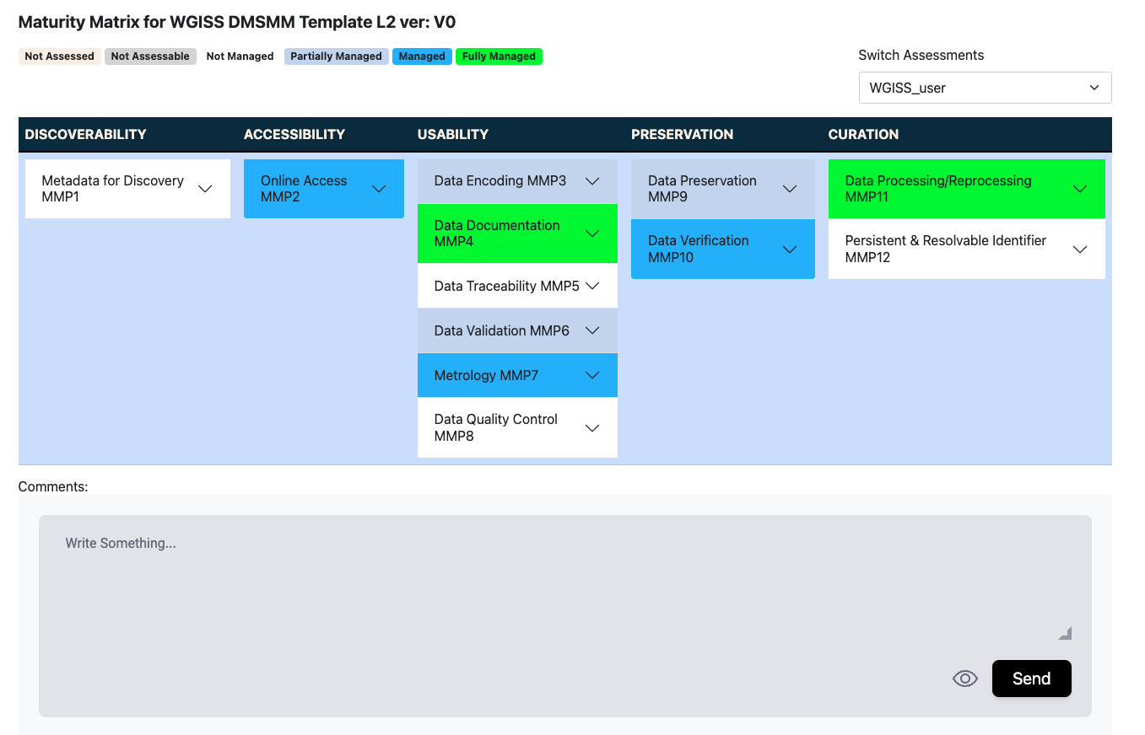
User assessment: Maturity Matrix

Slide 9
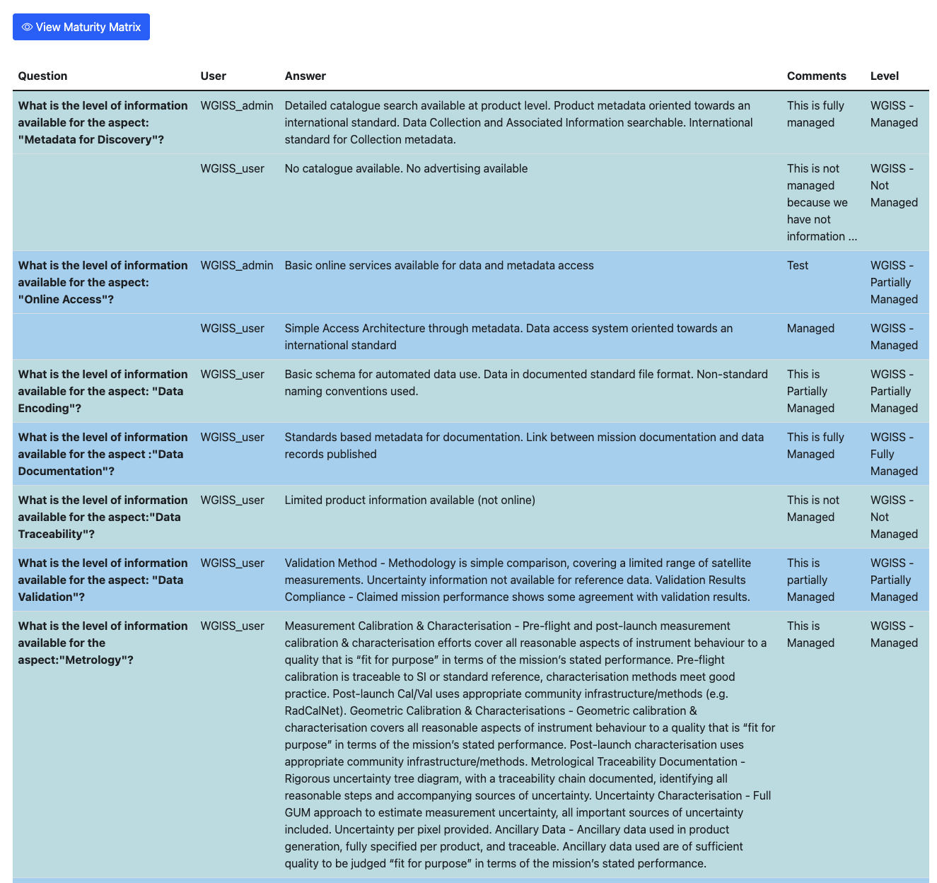
Admin: Compare Assessments

Slide 10
Maturity Matrix Tool Updates
ID Title | Description | Status
1) Intro panel for each assessment | It has been requested to have, before of the first question, an introductive text panel where the assessor can specify and describe the intended purpose of the assessment | Done
2) Additional info for Configuration of Parameter (Question) and Answer | In order to better explain the possible answers, especially for data providers, which are not familiar with uncertainty tree diagrams and other metrological concepts. It could be useful have the possibility to add, links, or documentation during configuration of both parameters (Questions) and answers. | Done
3) Supporting Documents/References | We should find ways to encourage the assessor to provide evidence of his assessment, it could be reference papers, links, reports, sample data. Otherwise we cannot verify the FRM assessment. When compiling the matrix, for each question, under the “Comments” textbox, it could be added an item called “Supporting documents/references” allowing to attach documents/materials. | Done
4) Verification (last column) for independent assessor | The last column named “Verification” of the FRM MM (but it is also valid for EDAP MM) shall be compiled by an independent assessor (i.e. different from the ones who filled the first part of the MM). In order to highlight this difference (currently Verification columns has the same color of the other columns), it has been requested to change the color of the column | In progress
5) Automatic CEOS FRM classification | The idea is to provide the resulting CEOS-FRM overall classification directly from the tool. The classification: Class A, B, C or D is based on score of matrix cells according to the criteria defined in the reference document. The result should be included in the MM | In progress
6) Assessment report | It would be useful to generate an assessment report in pdf at the end of the process, collecting the maturity matrix together with the detailed answers to all questions and eventually links to supporting material provided. | In progress

Slide 11
Maturity Matrix Tool Updates
Dedicated inputs requested from WGISS (more to come?)
In the compare functionality: to add the aspect as first column and use the assessment colour for the entire row.
User must have rights to handle different versions of the same MM template to trace the achieved progress.

Slide 12
Way Forward
Testing phase finalization
Collection of new functionalities/issues to be implemented/resolved
Start registering/ingestion the already created datasets Maturity Matrix xls reports (Heritage Space Programme)

