Slide 1
WGCV / WGISS
GISTDA Agency Report
Prayot, GISTDA
Agenda Item B.7
WGISS / WGCV Joint Meeting
15 & 18 October 2024
Sioux Falls, South Dakota, USA

Slide 2

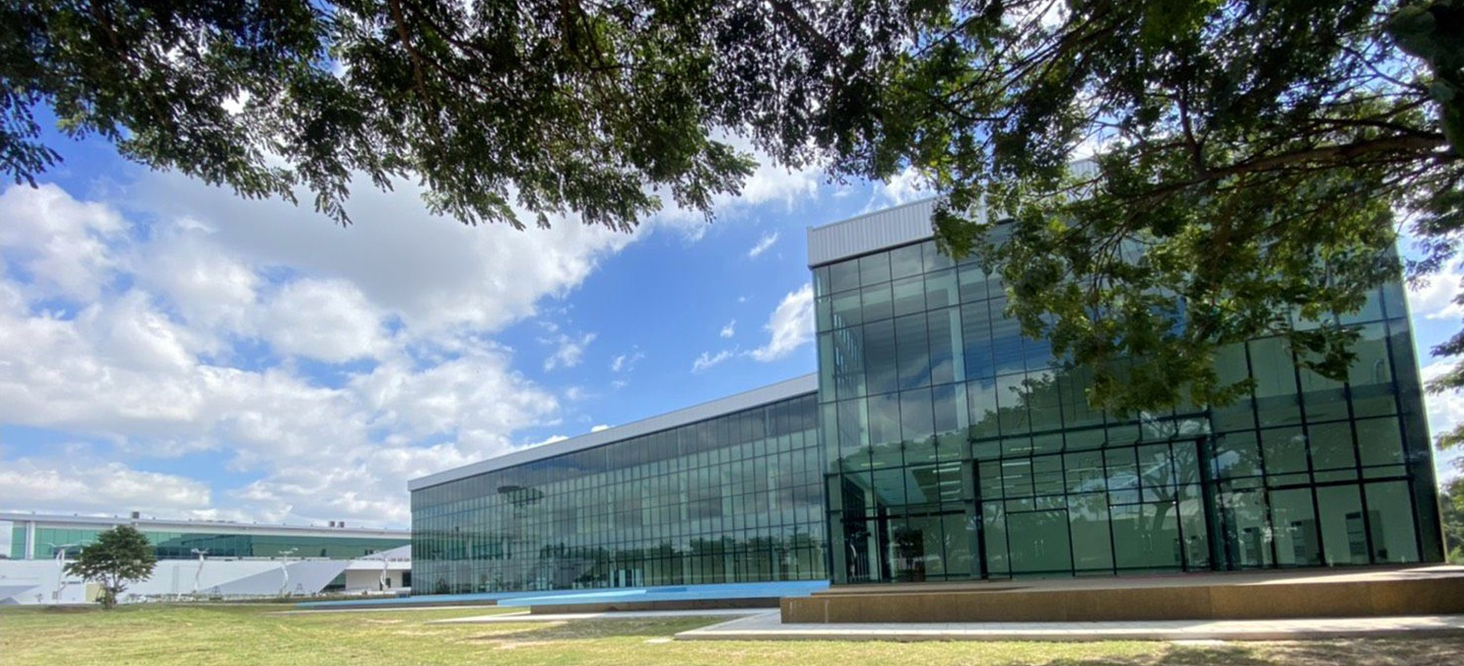
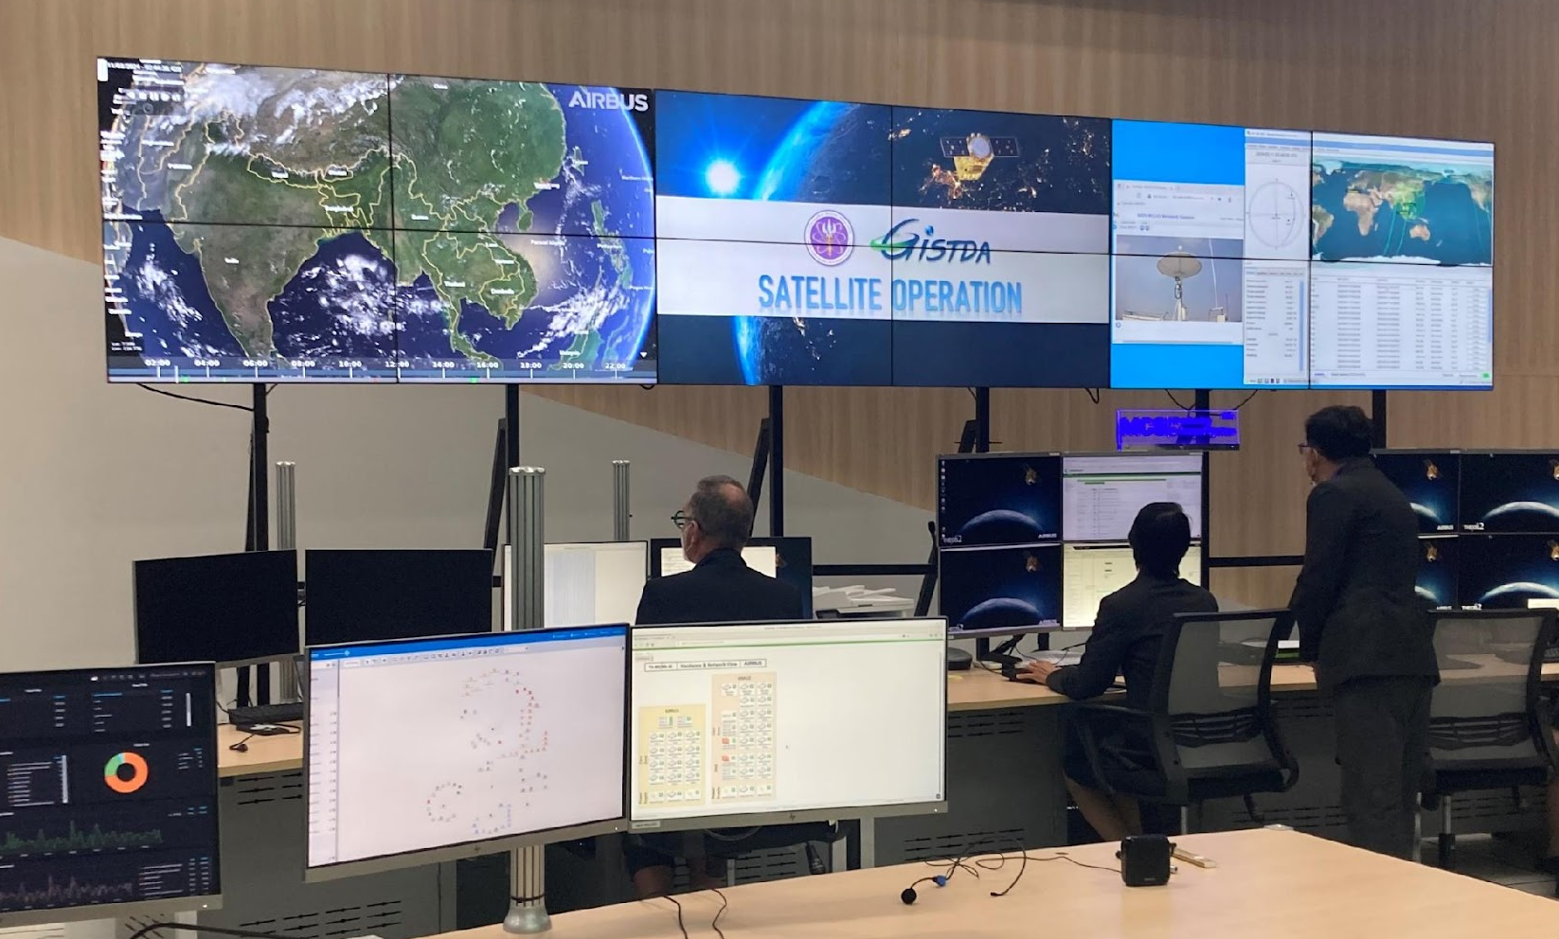
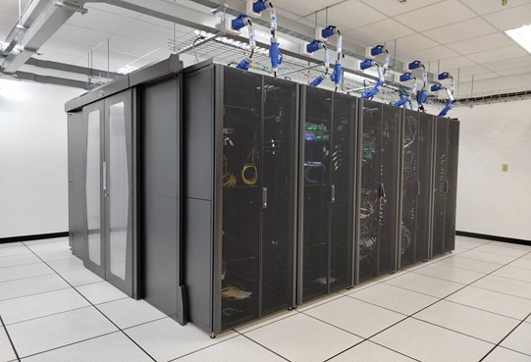
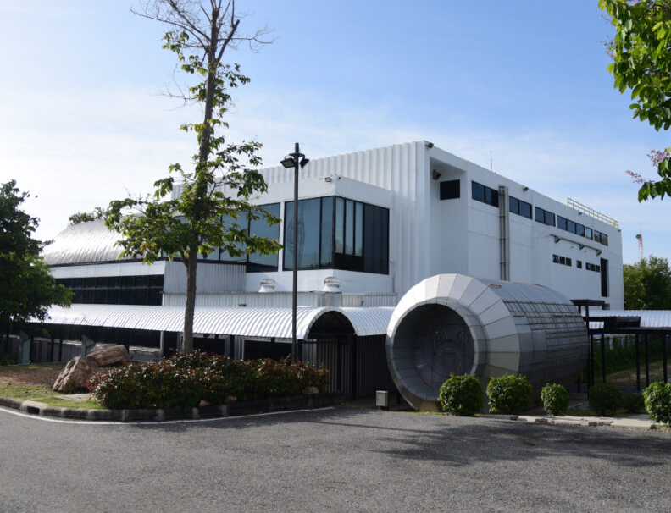
About GISTDA
Geo-Informatics and Space Technology Development Agency (Public Organization)
Established: November 3, 2000
Headquarters: Bangkok, Thailand
Ground Station: Located in Chon Buri, Thailand
Mission: Focused on developing space and geo-informatics technology
Vision: Delivering the value of space to Thai society and the global community
GISTDA Ground Station (SKP)
Thung Sukhla, Si Racha District, Chon Buri 20230
National Assembly Integration and Test (AIT) Center
THEOS Satellites Operation Center
National Space Data Center
Space Museum

Slide 3
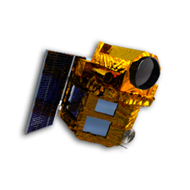
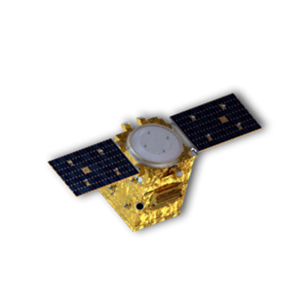

THEOS Satellite Missions
2020 | 2021 | 2022 | 2023 | 2024 | 2025 | 2026 | 2027 | 2028 | 2029 | 2030 | 2031 | 2032 | 2033 | 2034 | 2035
THEOS-1 (CCD)
MS 15 m (90 km swath)
Pan 2 m (22 km swath)
Launched on Oct 1, 2008
> 16 years In-orbit
THEOS-2 MainSat (CCD)
MS 2 m (10.3 km swath)
Pan 0.5 m (10.3 km swath)
Launched on Oct 9, 2023
1 year In-orbit
Mission Operation (10 years)
THEOS-2A SmallSat (CMOS)
RGB 1.1 m (5.9 km swath)
Mission Operation (3 years)
Planned to launch
in Q1, 2025
THEOS-3, 4, 5, 6, 7 (Roadmap for the next 15 years)
THEOS-1 is operating normally in-orbit
THEOS-2 was successfully launched on Oct 9, 2023
THEOS-2A is planned to launch in quarter 1, 2025
The THEOS-3, 4, 5, 6, 7 project is under discussion
Thailand Earth Observation System (THEOS)

Slide 4
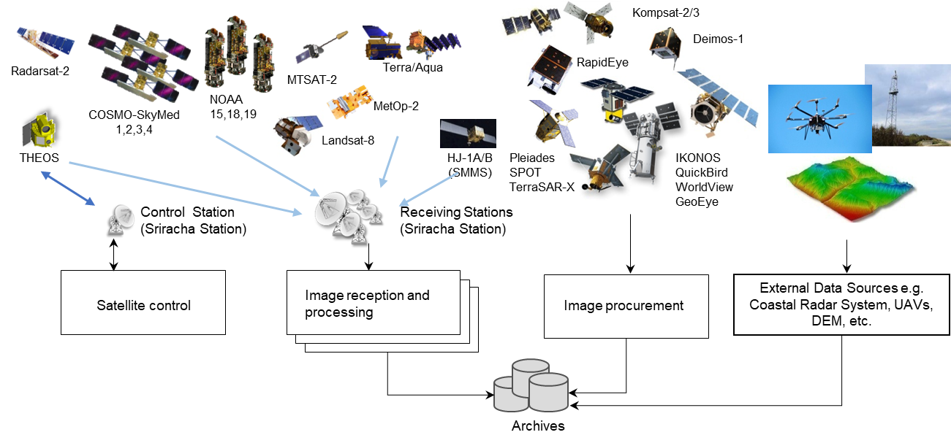
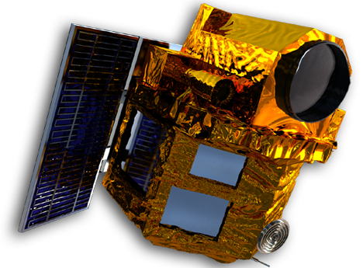
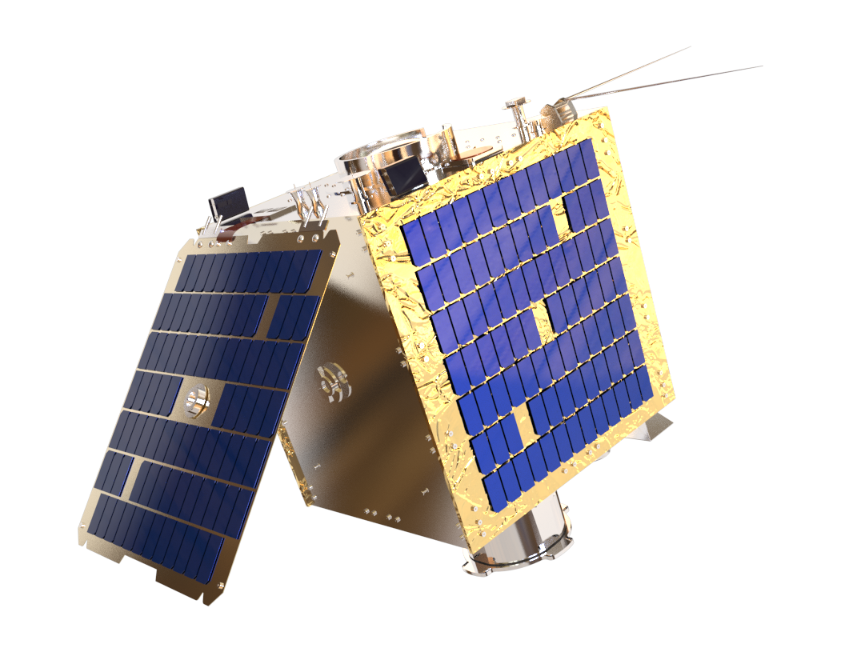
Satellite Imagery Services
National Space Data Center

Slide 5
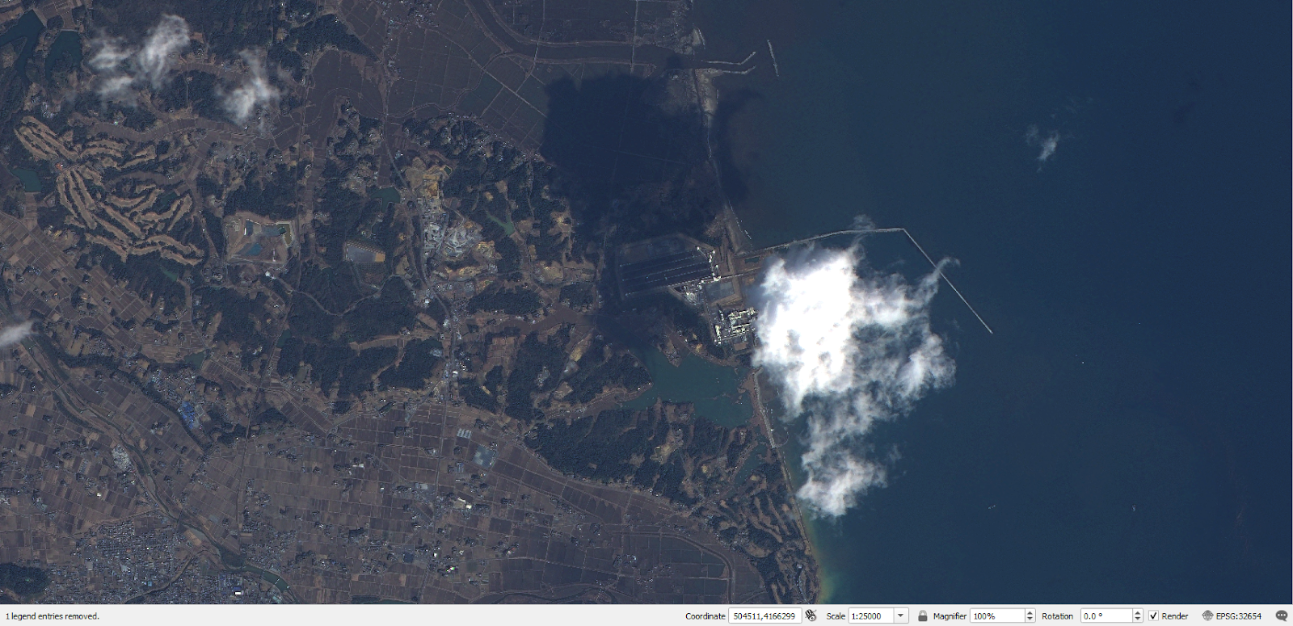
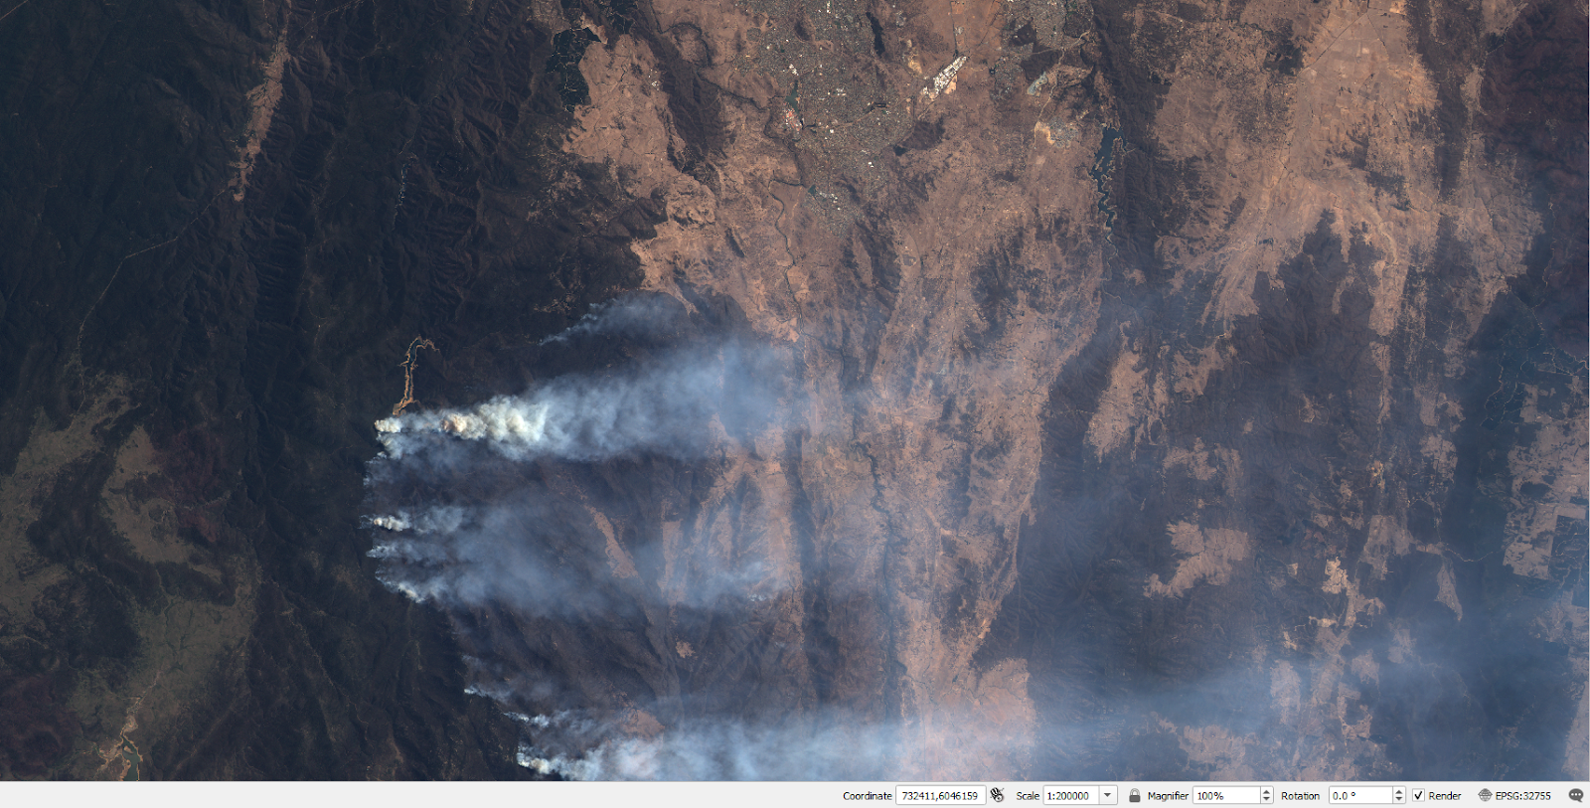
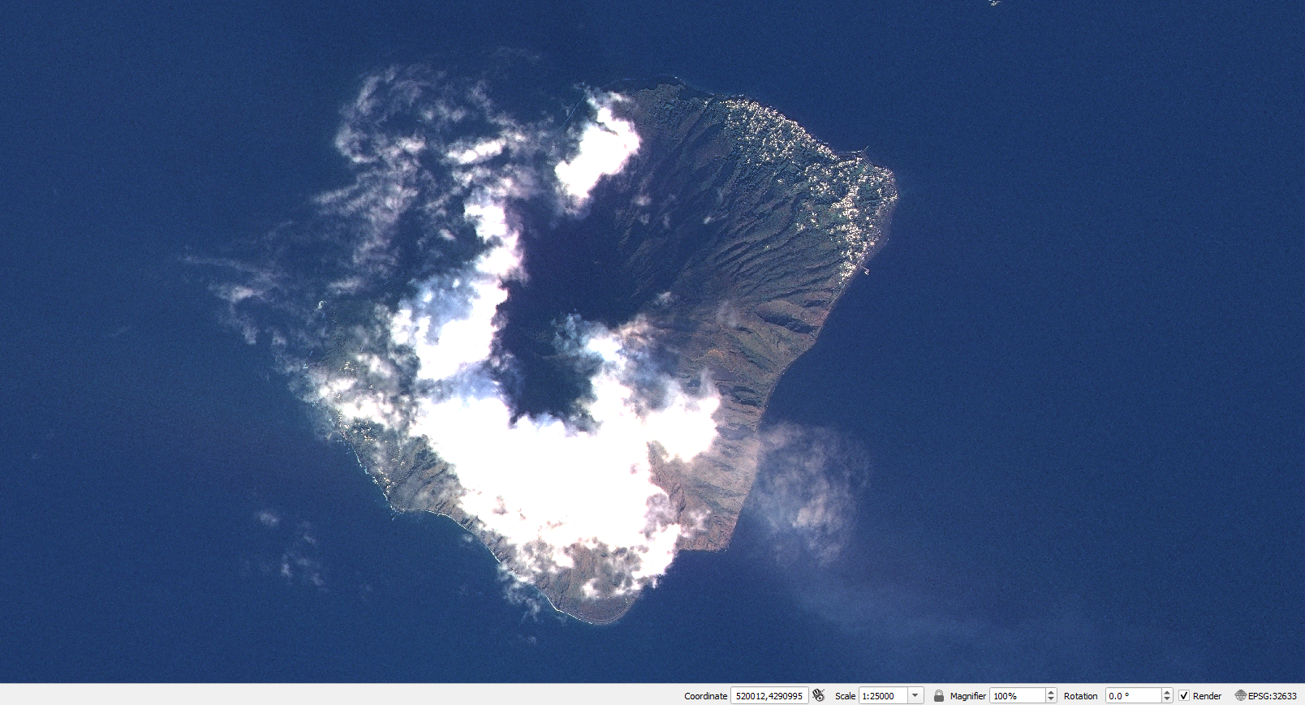
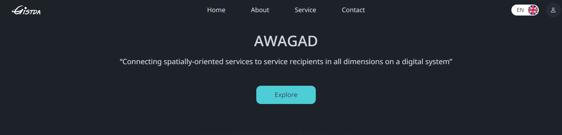
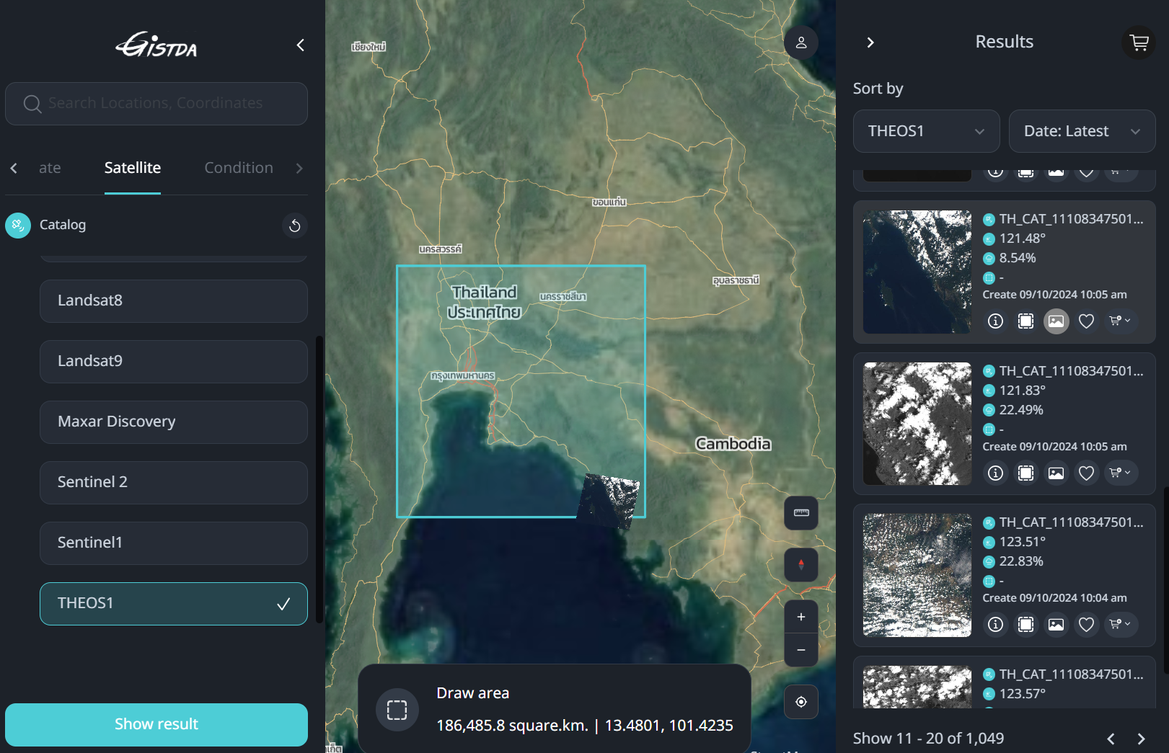
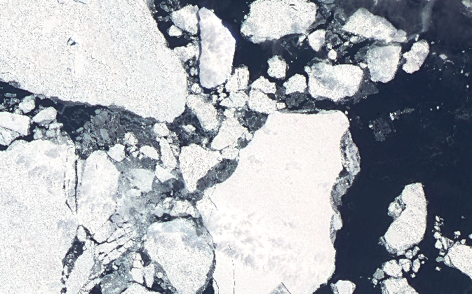
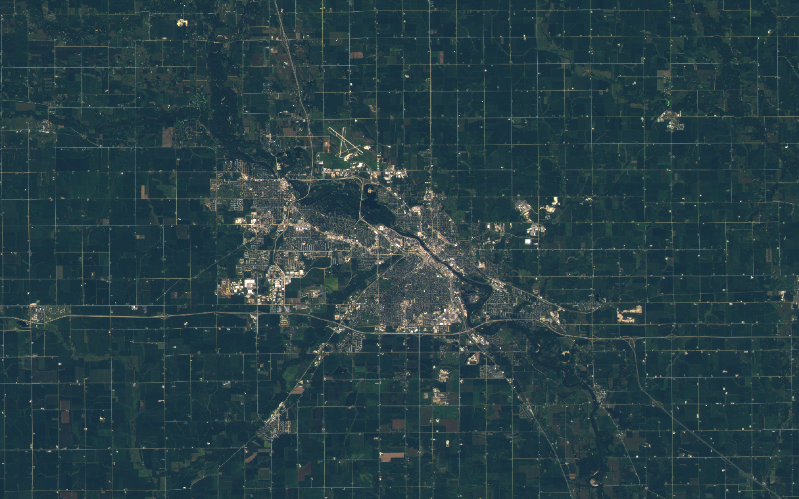
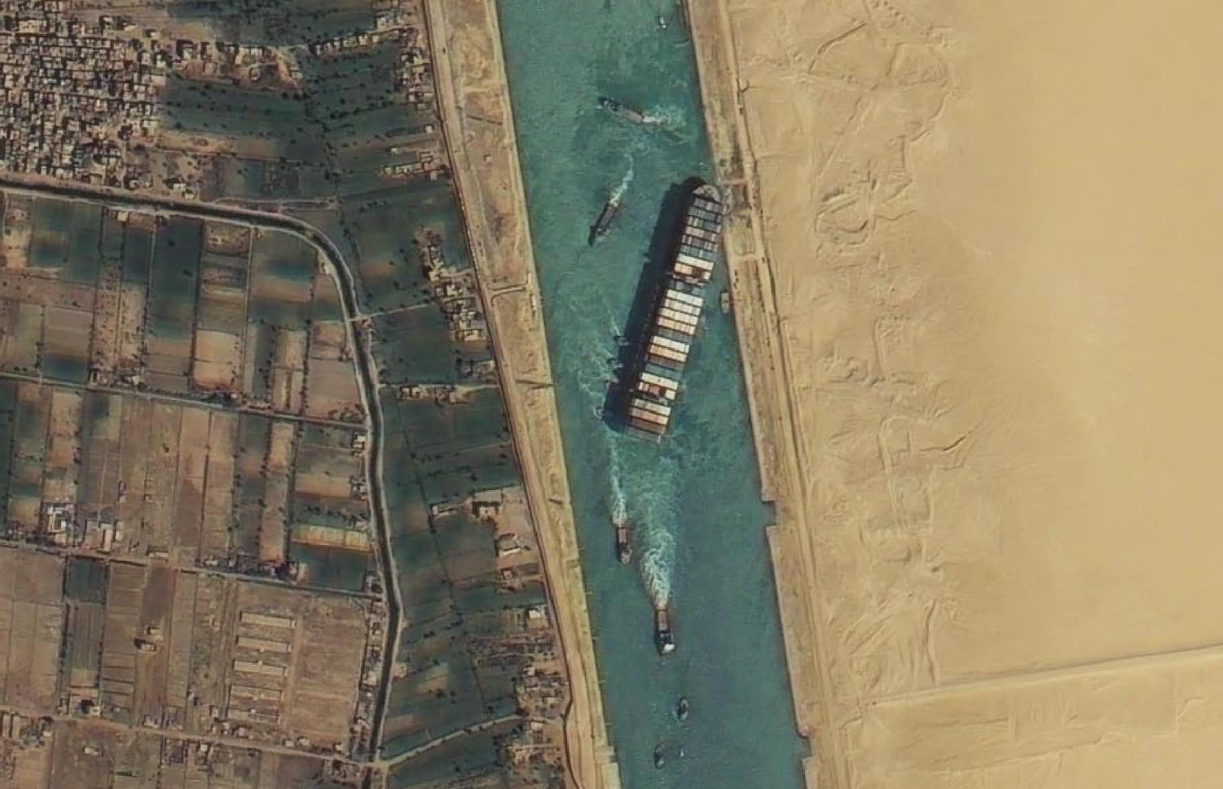
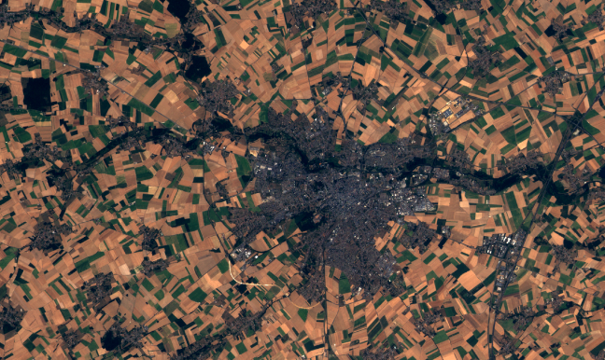
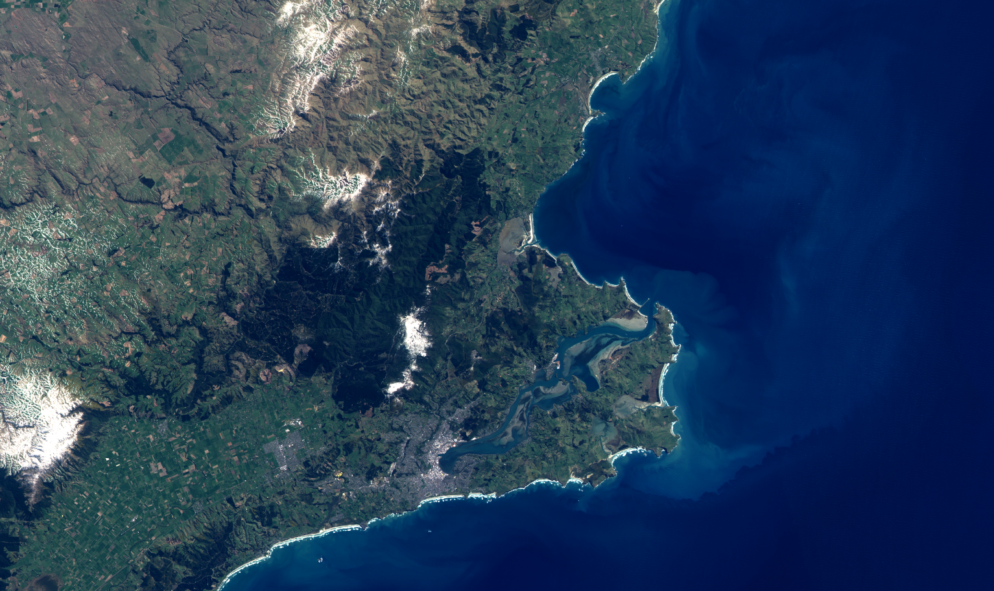
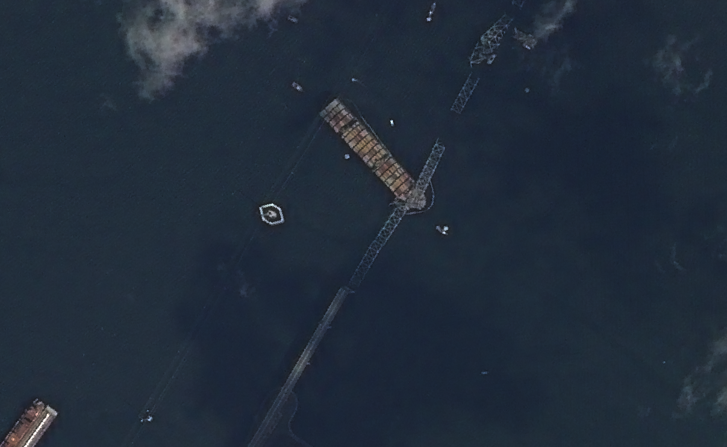
THEOS Catalogue
2011 Tohoku Earthquake and Tsunami (2011.03.12)
Fukushima, Japan
Wildfire in Namaji National Park (2020.02.02)
Canberra, Australia
Stromboli Volcano Eruption (2022.12.25)
Stromboli, Italy
Sea Ice Cracking (2022.11.23)
Antarctica
Waterloo City (2022.08.31)
IOWA, USA
Suez Canal Obstruction (29.03.2022)
Egypt
Arras (03.08.2018)
France
Dunedin (07.10.2022)
Newzealand
Francis Scott Key Bridge Collapse (28.03.2024)
USA
THEOS gallery
THEOS Catalogue
https://awagard.gistda.or.th/
For more information,
contact GISTDA’s user service: usd@gistda.or.th

Slide 6
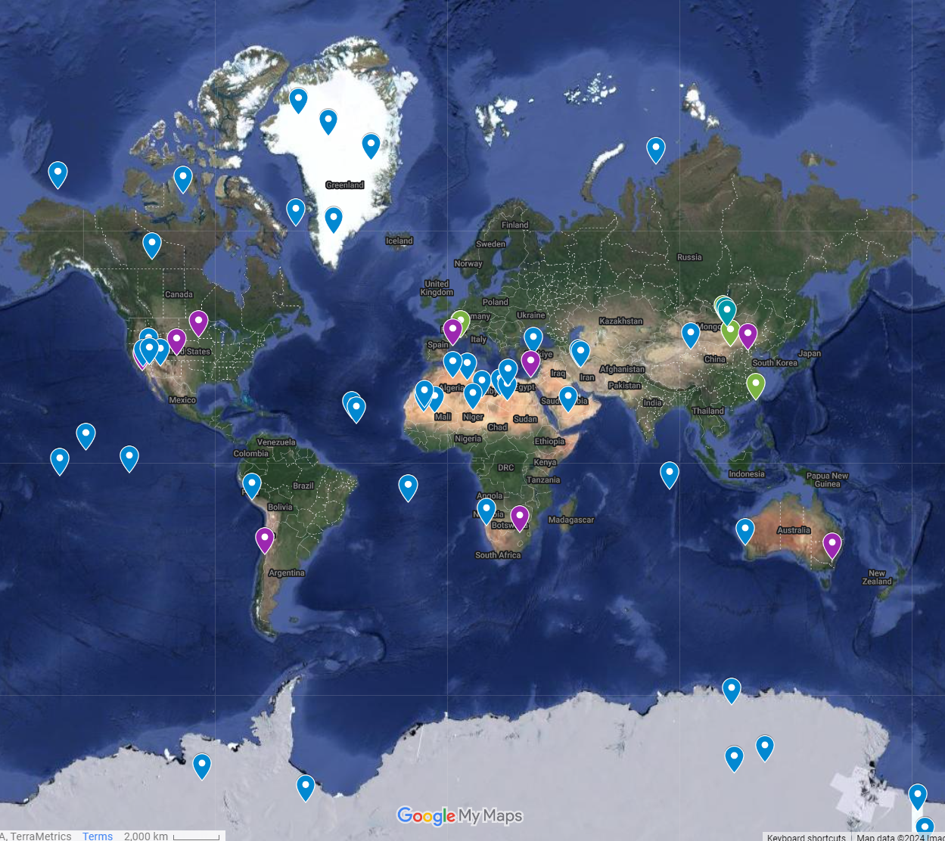
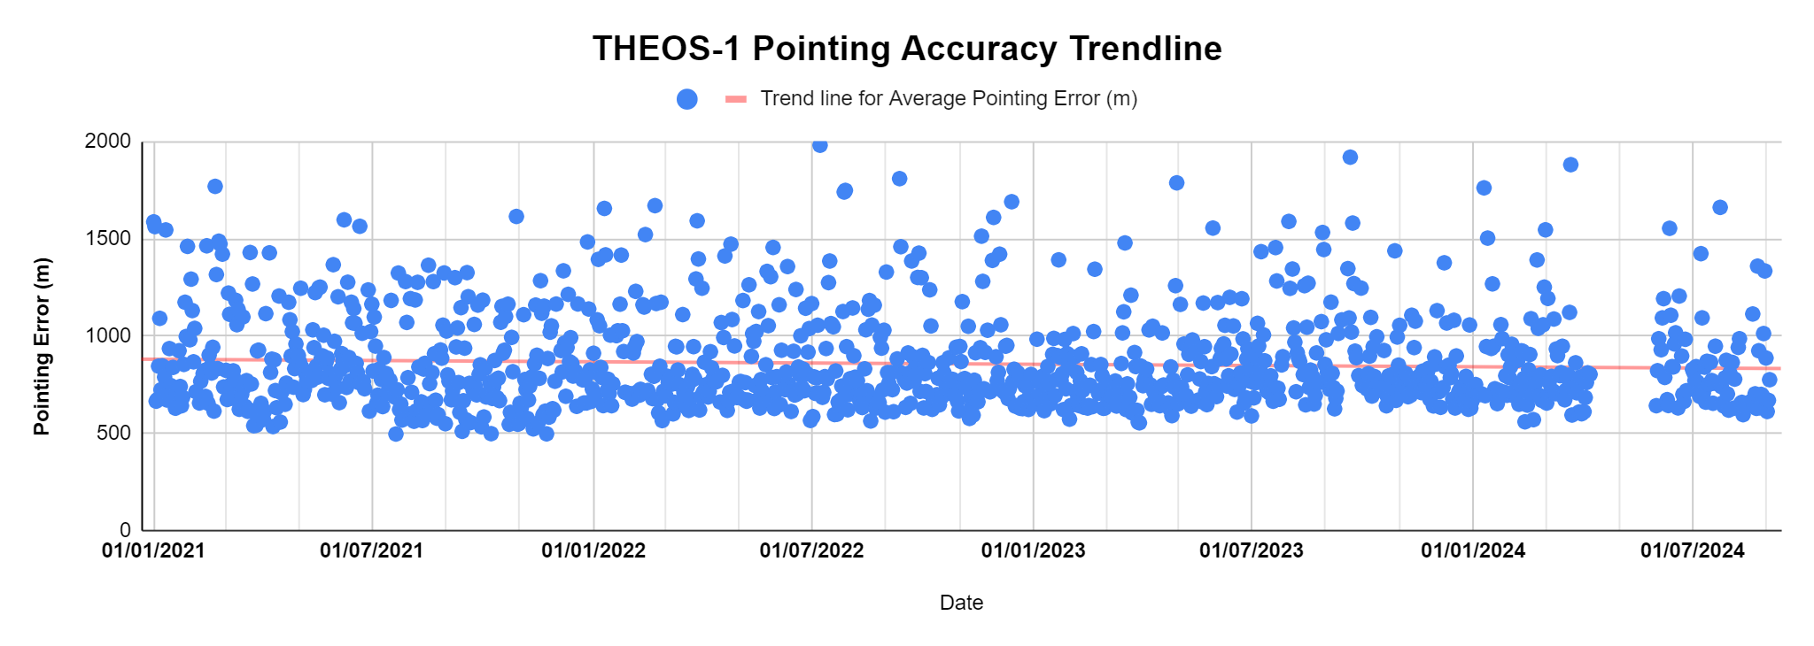
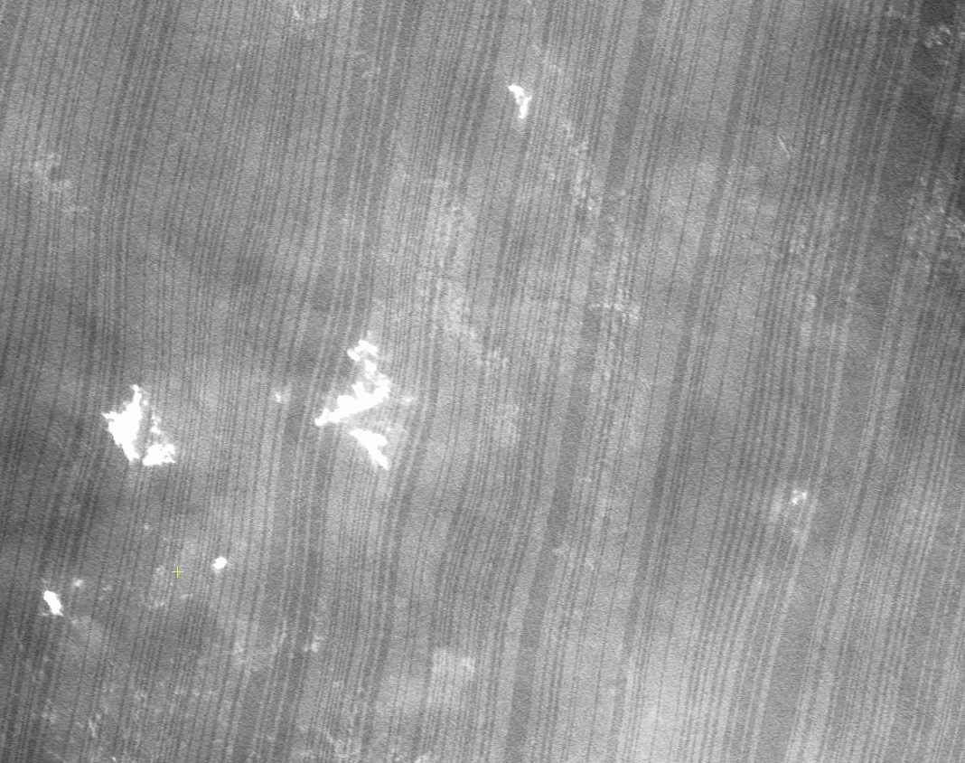
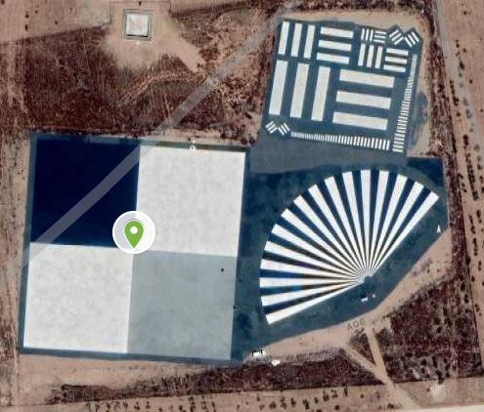
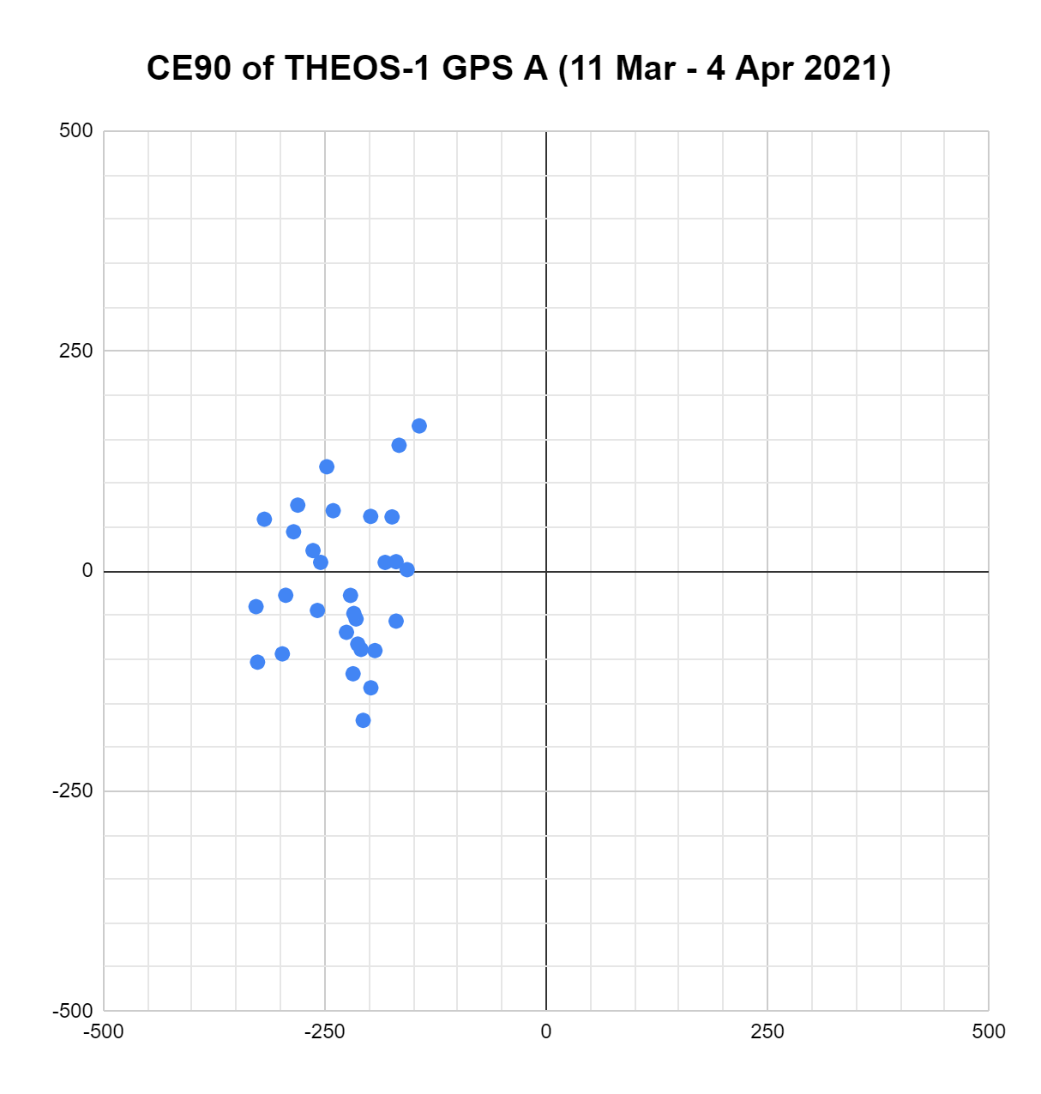
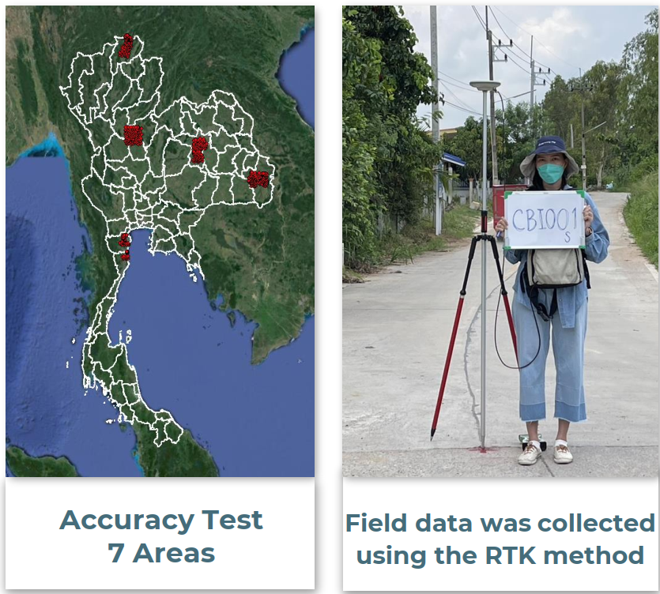
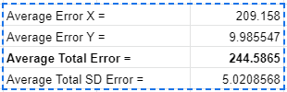
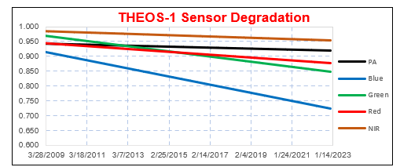



GISTDA Cal/Val Activities
Radiometric Calibration
- Dark Signal Non-Uniformity (DSNU)
- Photo Response Non-Uniformity (PRNU)
- Modulation Transfer Function (MTF)
- Absolute Radiometric Calibration
- etc.
Geometric Calibration
- Pointing Accuracy
- Location Accuracy
- etc.
THEOS Cal/Val Test Sites
Pointing Error Monitoring
DSNU & PRNU
MTF
https://sites.google.com/gistda.or.th/calval/calval-sites
Radiometry
Geometry
Geolocation Error Monitoring
Sensor Degradation Monitoring
Spatial

Slide 7
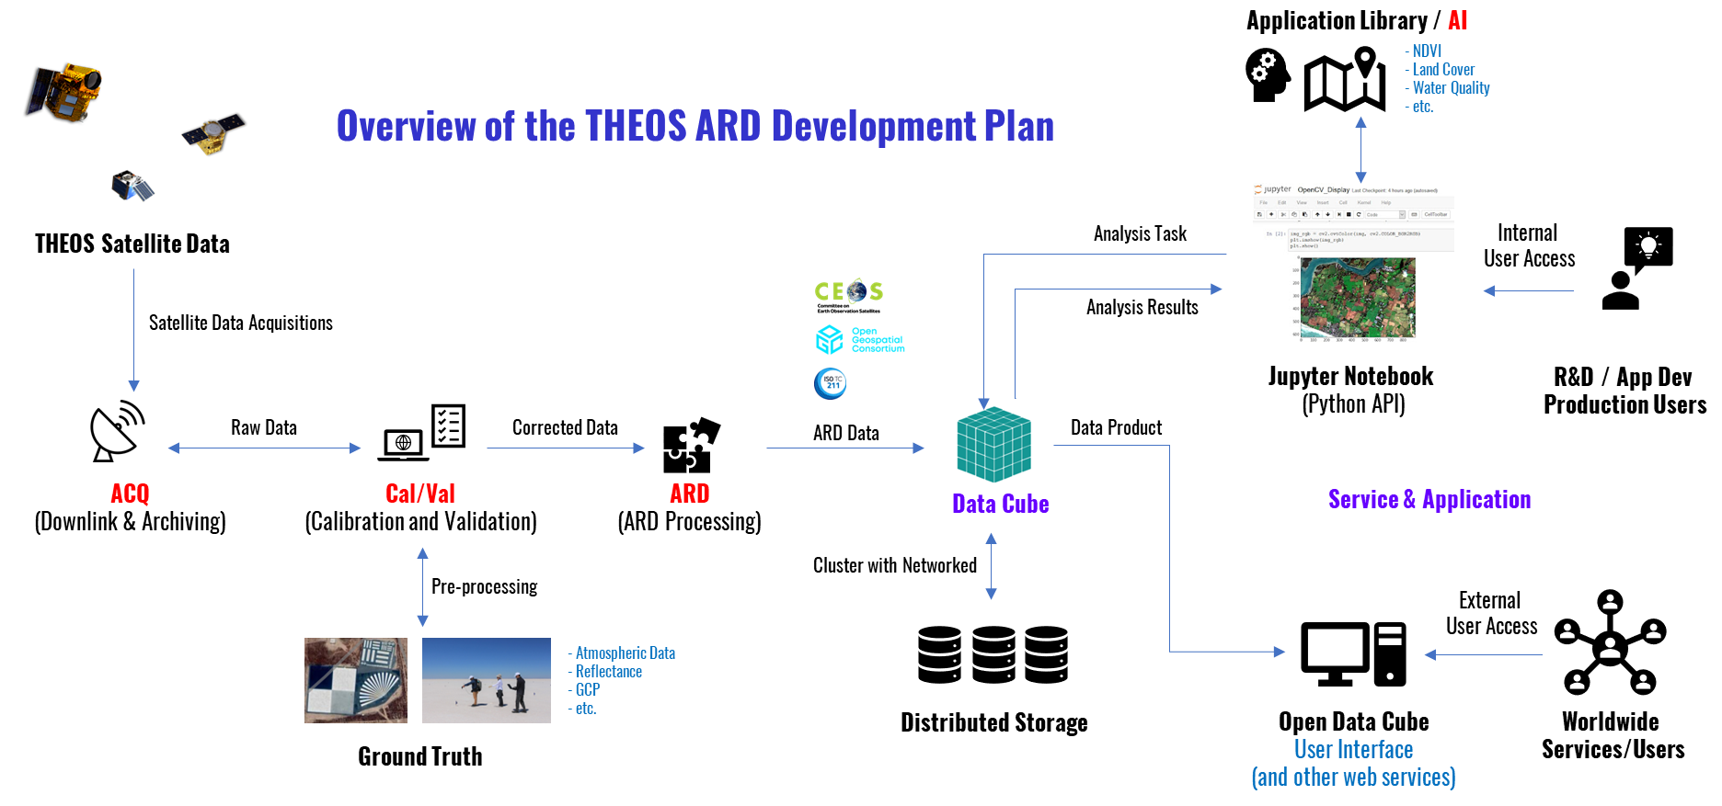
Future Goals
Improving GISTDA's Cal/Val processes in accordance with ISO/TS 19124 standards.
Developing THEOS-1 and THEOS-2 satellite products in ARD format, in line with CEOS SR-ARD standards.
Developing an Open Data Cube system for the efficient distribution of satellite imagery.
Improving GISTDA satellite services to fully comply with CEOS DMSMM guidelines.
Exploring collaboration opportunities within CEOS Cal/Val and WGISS networks.
GISTDA aims to enhance our collaboration with CEOS community to ensure our satellite data meets international standards.

Slide 8






Self Assessments
SR-ARD Self Assessments
DMSMM Self Assessments (mostly partially managed)
 | Threshold |  | Goal
1. General Metadata | THEOS1 | THEOS2 | THEOS1 | THEOS2
1.1 Traceability | Not required | Not required | No | No
1.2 Metadata Machine Readability | Yes | Yes | No | No
1.3 Data Collection Time | Yes | Yes | No | No
1.4 Geographical Area | Yes | Yes | No | No
1.5 Coordinate Reference System | Yes | Yes | No | No
1.6 Map Projection | Yes | Yes | Yes | Yes
1.7 Geometric Correction Methods | Not required | Not required | No | No
1.8 Geometric Accuracy of the Data | Not required | Not required | No | No
1.9 Instrument | Yes | Yes | No | No
1.10 Spectral Bands | No | Yes | No | No
1.11 Sensor Calibration | Not required | Not required | No | No
1.12 Radiometric Accuracy | Not required | Not required | No | No
1.13 Algorithms | No | No | No | No
1.14 Auxiliary Data | No | No | No | No
1.15 Processing Chain Provenance | Not required | Not required | No | No
1.16 Data Access | No | No | No | No
1.17 Overall Data Quality | Not applicable | Not applicable | No | No
2. Per-Pixel Metadata
2.1 Metadata Machine Readability | Yes | Yes | Yes | Yes
2.2 No Data | Yes | Yes | Yes | Yes
2.3 Incomplete Testing | No | No | No | No
2.4 Saturation | Yes | Yes | No | No
2.5 Cloud | No | Yes | No | No
2.6 Cloud Shadow | No | No | No | No
2.7 Land/Water Mask | Not required | Not required | No | No
2.8 Snow/Ice Mask | Not required | Not required | No | No
2.9 Terrain Shadow Mask | Not required | Not required | No | No
2.10 Terrain Occlusion | Not required | Not required | No | No
2.11 Solar and Viewing Geometry | Yes | Yes | No | No
2.12 Terrain Illumination Correction | Not required | Not required | No | No
2.13 Aerosol Optical Depth Parameters | Not required | Not required | No | No
3. Radiometric and Atmospheric Corrections
3.1 Measurement | No | No | No | No
3.2 Measurement Uncertainty | Not required | Not required | No | No
3.3 Measurement Normalisation | Not required | Not required | No | No
3.4 Directional Atmospheric Scattering | No | No | No | No
3.5 Water Vapour Corrections | No | No | No | No
3.6 Ozone Corrections | Not required | Not required | No | No
4. Geometric Corrections
4.1 Geometric Correction | Yes | Yes | No | No
Areas | Components | THEOS-1 | THEOS-2
Discoverability | MMP1: Metadata for Discovery
Accessibility | MMP2: Online Access
Usability | MMP3: Data encoding
 | MMP4: Data Documentation
 | MMP5: Data Traceability
 | MMP6: Data Validation
 | MMP7: Data Metrology
 | MMP8: Data Quality Control
Preservation | MMP9: Data Preservation
 | MMP10: Data Verification
Curation | MMP11: Data Processing/Reprocessing
 | MMP12: Persistent & Resolvable Identifier

Slide 9
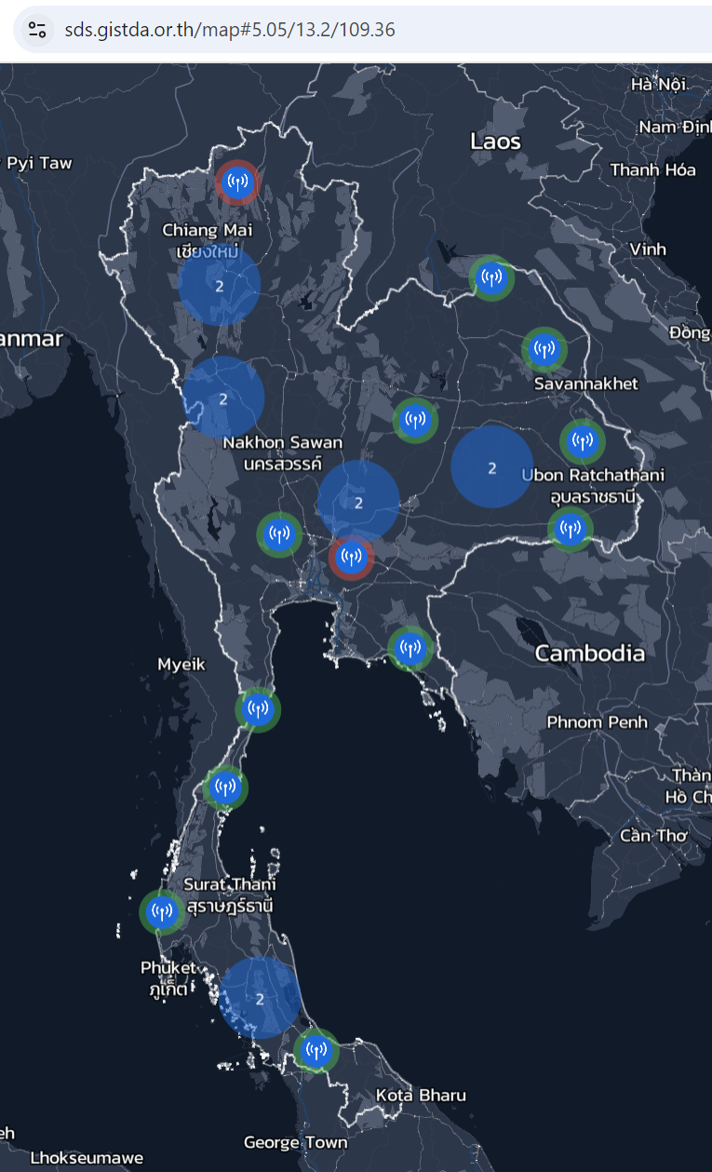
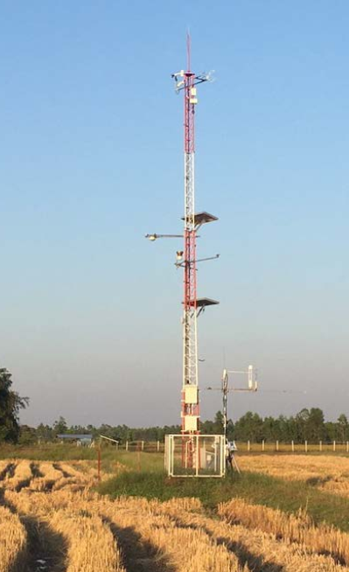
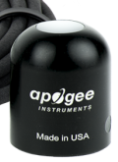
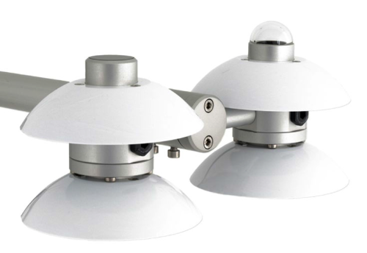
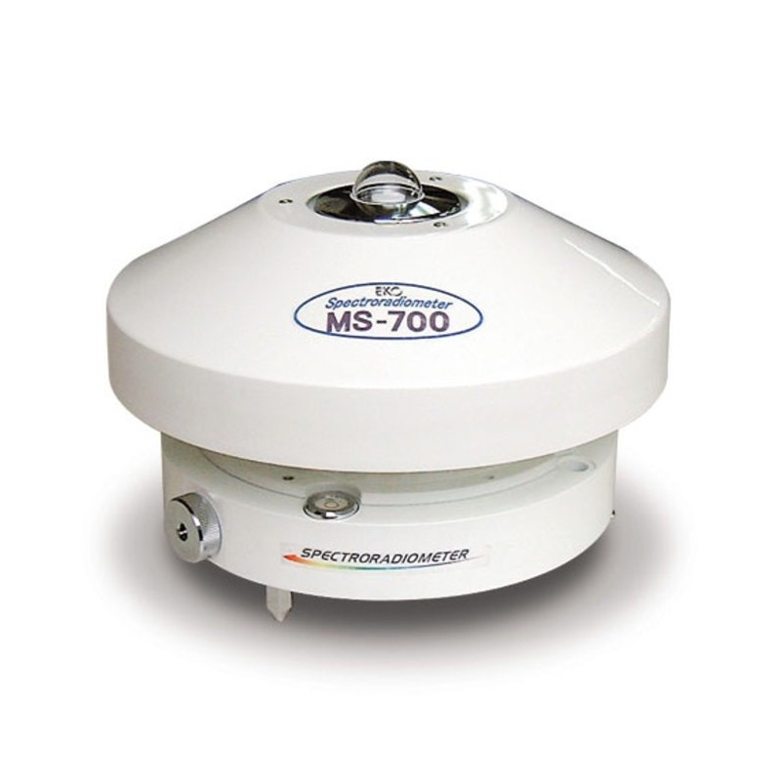
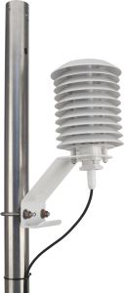
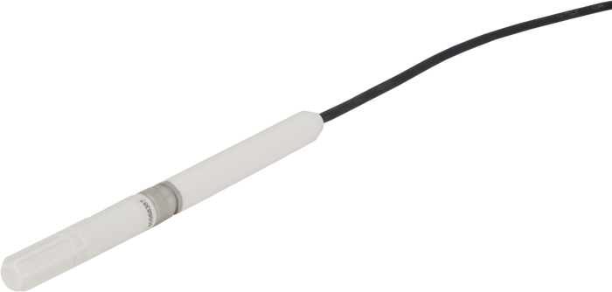
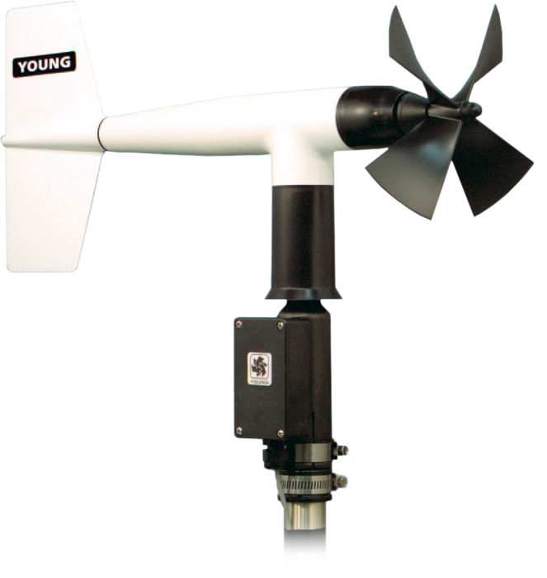
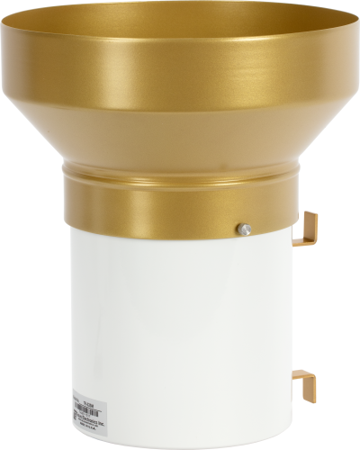
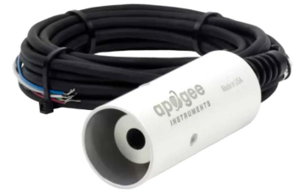
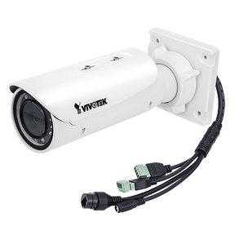
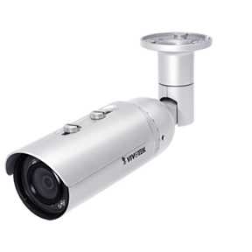
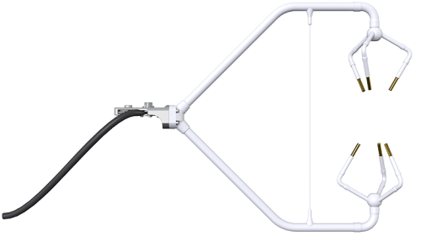
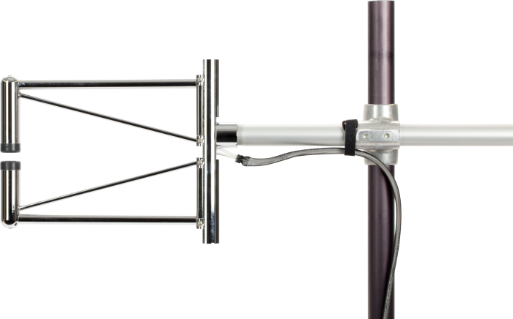
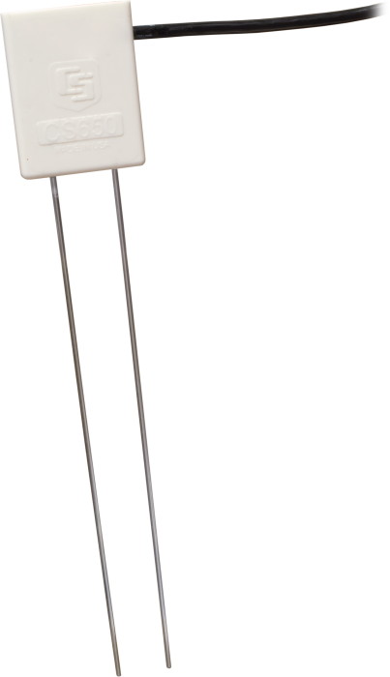
GISTDA Weather Stations
Recently, GISTDA deployed 20 weather stations across Thailand
The data is currently available at https://sds.gistda.or.th/
GISTDA is interested in supporting the expansion of CEOS’s Cal/Val networks
Instruments in GISTDA Weather Station
    Pyranometer
    Net Radiometer
    Spectroradiometer
    Temperature and Humidity Probe
    Wind Sensor
    Rain Gauge
    Standard Field of View Infrared Radiometer
    Vivotek Network Camera IB836BA-HT
    Vivotek Network Camera IB8369
    3D-Anemometer
    Krypton Hygrometer
    Soil Water Content Profile Probe

Slide 10

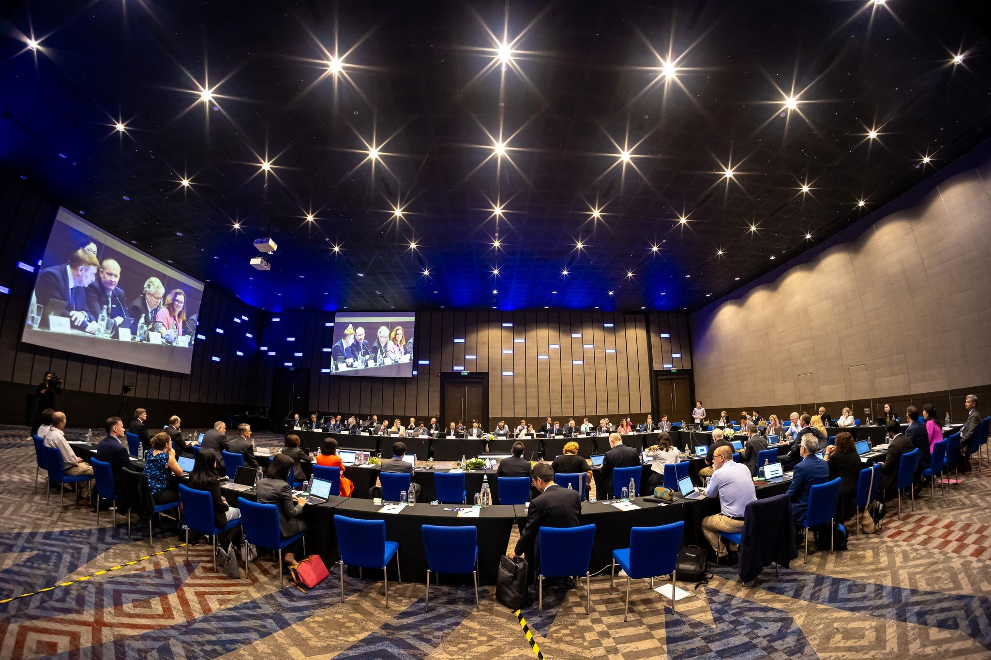
Upcoming Events
CEOS WGISS 59
24 – 28 March, 2025
Bangkok, Thailand

Slide 11

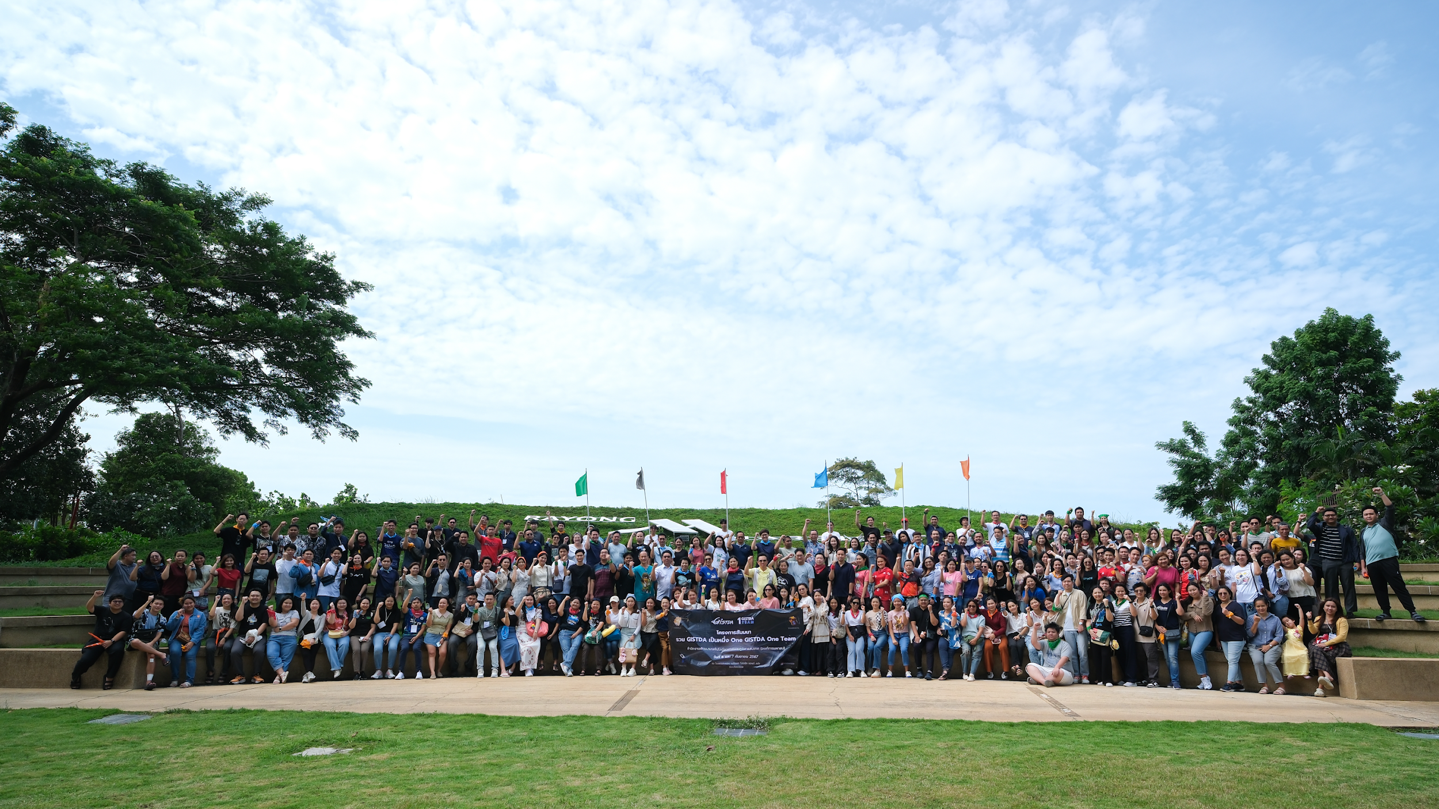
For further information,
please contact: prayot@gistda.or.th.
Thank You

