Slide 1
Earth Observation and Climate October 2024

Slide 2
Agenda
UK EO Investment Programmes
UK Missions and Projects
UKSA CEOS Chair 2025
Space 4 Climate
2

Slide 3
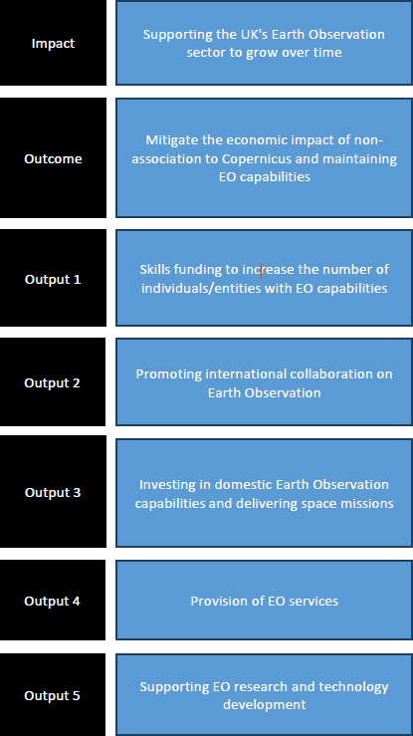
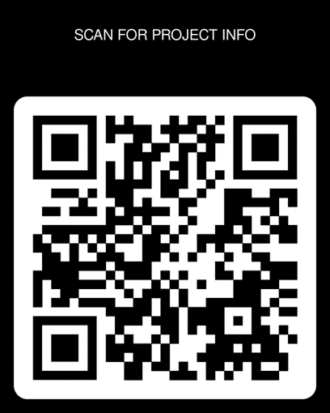
EO Investment Programme
🡨🡨 18 projects, c.£247m funded, 2022–2025, delivered by:
ESA, Innovate UK, Met Office, NERC, STFC, UKSA
Investment objectives:
Mitigate economic impact of non-association to Copernicus
Support UK EO sector to grow
Preserve and retain EO capabilities
UKSA oversight since April 2024 (took over from DSIT)
Projects close March 2025, external evaluation underway,
reports November 2025
Projects progressing against a range of indicators 🡺🡺
5

Slide 4
UKSA ‘other’ Programmes
Hold for EO activities in other uksa
programmes
Earth Observation activities are being funded through UK Space Agency national and
international programmes e.g., ETP , NSIP, IBF etc.
Enabling Technology Programme:
6 EO activities currently being funded, totalling more than £1.3M
National Space Innovation Programme:
2 EO projects being funded through NSIP Major Projects
2 EO projects being funded through NSIP Kick Starter calls Totalling more than £9.5M
For more information: nsip@ukspaceagency.gov.uk
International Bilateral Fund:
Funded in partnership with other countries, totalling more than £1.2M For more information: ibf@ukspaceagency.gov.uk

Slide 5
National EO Technology Support
The Centre for Earth Observation Instrumentation (CEOI) ran their 16th major call for proposals in Autumn 23. The successful projects will all finish by March 25.
£9m total grant awarded
around 4x larger than the average CEOI award
around 2x larger than the previous largest CEOI award
12 projects are being supported, including:
6 Flagships (up to £3m)
4 Fast Tracks (up to £250k)
2 Pathfinders (up to £75k)
CEOI track them to ensure effective delivery, champion project progress, and help us prepare for the next CSR period.
9

Slide 6
16th CEOI Call Flagship Projects
CitiScan | TAS-UK, University of Leicester | Producing city-scaled measurements of aerosols and NO2 gases.
CAITDM Cold Atom Interferometry Thermosphere Drag Measurement | STFC-RAL, University of Nottingham, Metamorphic Additive Manufacturing Ltd | A cold atom interferometer to accurately measure the drag suffered by a 16U CubeSat
SOLSTICE Solar Occultation Limb Sounding Transformative Instruments for Climate Exploration | STFC-RAL, Bright Ascension, Open Cosmos | An advanced, miniaturised scientific payload for atmospheric sounding
Unfolding Large-Aperture Telescope | SuperSharp Space Systems, In-Space Missions | A TIR large aperture telescope to produce images 4x sharper than conventional methods
NIMCAM Near Infrared Multispectral Camera for Atmospheric Methane | University of Edinburgh, UK Astronomy Technology Centre, NPL | High spatial resolution imaging for small methane plumes
HERCHI Hyperspectral Chroma-D Instrument | SSTL, Pixalytics | Hyper-spectral cameras capable of measuring atmospheric constituents
10

Slide 7
Earth Observation Data Capability Call
Two new projects to enhance Earth Observation Data Capability.
This initiative is designed to bolster the UK’s standing in space-based data technologies, supporting innovative projects that enhance industrial capabilities, unlocking access to future commercial opportunities.
The selected projects will receive funding totalling £87K to develop tools and services that improve the accessibility, use and impact of EO data across various sectors. These advancements will play a critical role in driving economic growth, enhancing public services and positioning the UK as a global leader in space-data.

Slide 8
Winners:
Earth-I
GMV
Earth-i Ltd has been granted £70,610.40 for its MuSeReCo project, which focuses on enhancing the accuracy and interoperability of EO data. This project will aim to develop a tool that can automatically and accurately co-register data from multiple satellites, regardless of their formats, resolutions or geo-referencing standards.
By using pixel-based change detection through machine learning, MuSeReCo will significantly improve EO capabilities and will open doors for much-sought-after automated surveillance of industrial sites, security and intelligence targets, ports and airfields.
GMV NSL Limited has been granted £16,400 for its forward-thinking project “Data Processing as a Service”. This project aims to position the UK as a leader in EO data processing.
Their planned services will intergrade automation, data fusion and cloud infrastructure, pushing the boundaries of midstream EO capabilities. GMV NSL would be positioned to take advantage of the UK’s participation in the Copernicus programme as a participating state, to bid for production services and help secure the participation of UK as an operational provider within the programme.

Slide 9
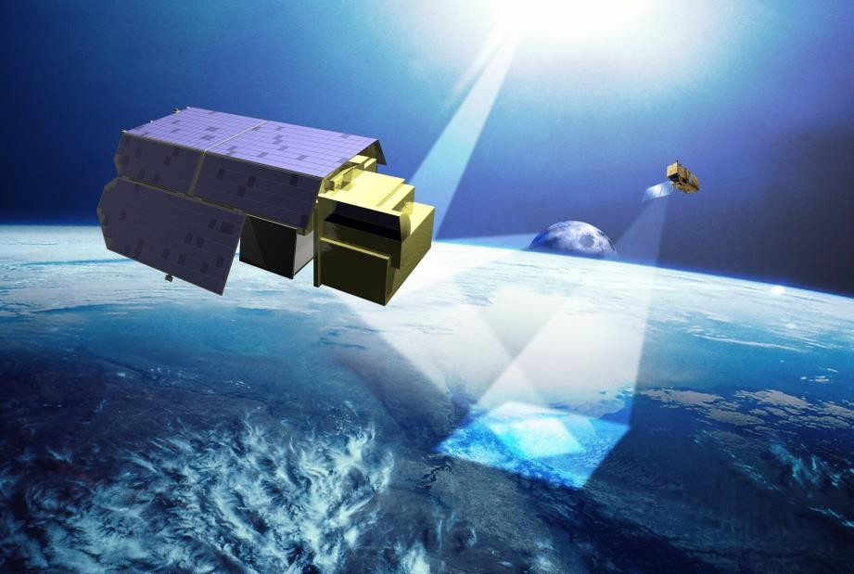
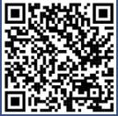
TRUTHS (UKSA contacts: Kainat Hussain/William Smith)
A UK-conceived and UK-led ESA mission. TRUTHS will be a calibration lab in space, increasing accuracy of EO data ten-fold.
It will provide a benchmark reference of the optical radiation state of the planet.
Our ambition is to host the TRUTHS ground segment in the UK, to build and develop the UK's capabilities for end-to- end delivery of a complex space mission
A UK Ground Segment will provide opportunities for scaling up skills development in the Flight Operations and Downstream sector
The tender is now live on ESASTAR, closing on 28th October 2024
Watch the S4C TRUTHS video:
Download the S4C TRUTHS mission explainer:

Slide 10
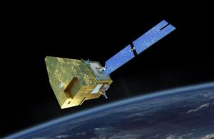
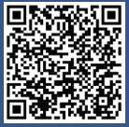
MicroCarb (UKSA contacts: William Smith/Kainat Hussain)
A joint mission between UKSA and CNES which will characterise GHG fluxes and gauge how much carbon is being absorbed by oceans and forests.
Monitoring the data will allow us to anticipate how the ecosystems will react to global warming and help us to monitor progress in meeting the Paris Agreement climate targets.
AIT is now complete and the satellite is currently in storage, awaiting a proposed launch on Vega-C in June 2025
Watch the S4C
MicroCarb video:
Download the S4C
MicroCarb mission explainer:

Slide 11
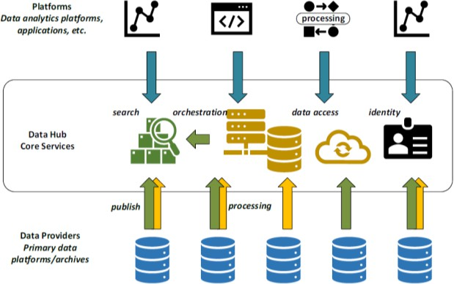
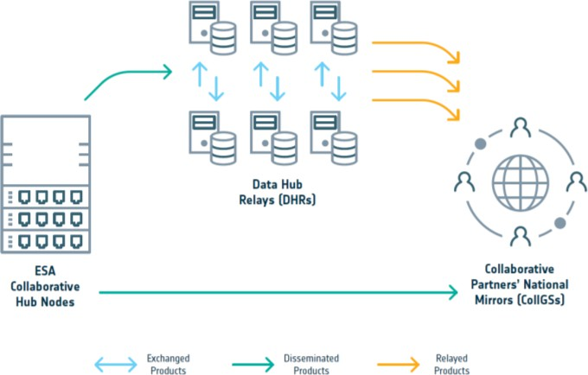
Earth Observation Data
UK Representation:
ESA Digital Twin Earth: creates the conditions for a strong uptake of novel EO capabilities in the future design and implementation of operational Digital Twins ecosystems. This enables the whole
UK EO community (industry, academia and government) to get involved, from national activities to international collaboration.
National Point of Contact for Sentinel Data
ESA Data Coordination Body & Working Groups
PBEO attendee
CEOS Working Groups
Copernicus: The UK rejoined Copernicus from 1 January 2024. UKSA is working with ESA and others to
support our sector in re-engaging with Copernicus. Participating in Copernicus provides the UK with increased access to the wealth of data and sophisticated services. It also provides opportunities for UK entities to bid for multi-million pound contracts to design and deliver
Copernicus.
ESA Collaborative Ground Segment: UKSA coordinates the ground segment activities in the UK and acts as an interface between ESA and national initiatives. The UK has two Data Hub Relays which are in the process of upgrading the interface with the new Copernicus Data Space Ecosystem.
EO Value Chain: an illustration of the UK’s EO
value chain, from data acquisition to applications.
NCEO-led EO Data Hub: The EO Data team plays a key advisory role in the £10M NCEO led DataHub, piloting a next- generation data platform to give the UK a single portal for accessing and processing satellite data to develop new applications and environmental insights.
16

Slide 14
Data Access for the UK EO Data Hub – Ambitions & Goals
The Hub Platform will use a federated approach for the integration of data sources
This is a fundamental requirement and a core goal for the overall EO DataHub programme of work: to demonstrate integration of data from multiple sources which lowers barriers for access for users
It will be possible for Hub-users to be able to search and access data across multiple source providers
From our research there is a desire that the EODH extends beyond a singular repository, to enable collaboration and integration across diverse organisations, government bodies, and existing platforms
An important feature of this UK EO Hub system is that it will interface, by intent, to public service data (state-funded through space agencies)
Encourage access and use of datasets that are of strategic value to the UK and UK users

Slide 15
Geospatial Commission
The value of satellite-derived EO data has been further evidenced by the work of the Geospatial Commission, DSIT’s expert committee tasked unlocking the value of location data.
In 2023-24, the Commission led a cross-Whitehall pilot to test various uses of EO data across the public sector.
The pilot provided further evidence of the high value of this data across a variety of use cases.
However, it also demonstrated that improvements can be made in how EO data is acquired and used, to deliver efficiencies, accelerate innovation, and drive forward a modern digital government.
The Geospatial Commission will be sharing these findings in due course, along with its recommendations.

Slide 16
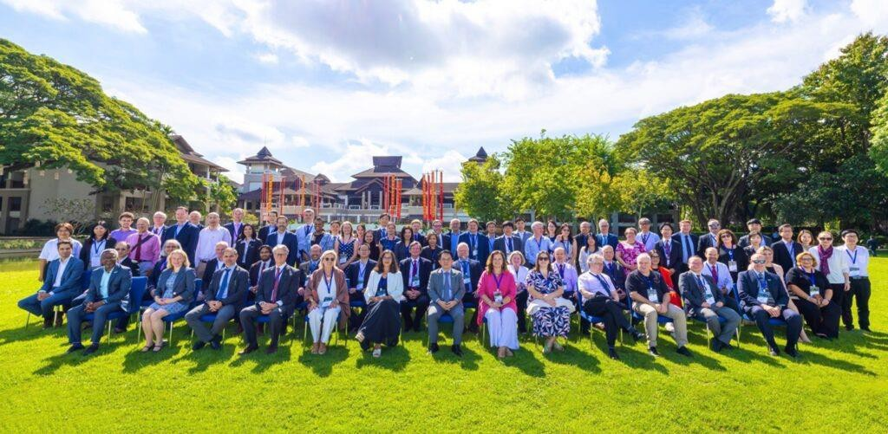
UK Space Agency to become CEOS Chair for 2025
CEOS ensures international coordination of civil space-based Earth observation programmes and promotes exchange of data to optimise societal benefit and inform decision making for a prosperous and sustainable future for humankind.
CEOS was established in 1984 and is celebrating its 40th anniversary.
The Chair oversees the operation of CEOS through monthly secretariat meetings, and can influence the work of CEOS during the year by setting one or more priorities.
The UK Space Agency’s year will culminate in the 41st annual CEOS Plenary in Bath, UK in November 2025.
Attendees of the 39th CEOS Plenary, in Chiang Rai, Thailand, 2023
20

Slide 17
UKSA’s CEOS Chair Theme:
Unlocking EO Data for Society
Vast and rapidly growing collections of global satellite Earth observation data offer immense societal value. However, bridging the gap to use such data to transform public
services and grow data-fuelled businesses is an ongoing challenge faced by many countries.
UKSA will use our year as CEOS Chair to:
Share knowledge and best practice for bridging the gap between EO data and public services
Unlock EO data for the UN Framework Convention on Climate Change global stocktakes
Champion the joint UK-NASA led work to develop best practices for the space-based measurement of methane emissions – and push for their adoption in an update to the Global Methane Pledge at COP30 in Brazil.
Inspire the next generation with ‘CEOS in Schools’
21

Slide 18
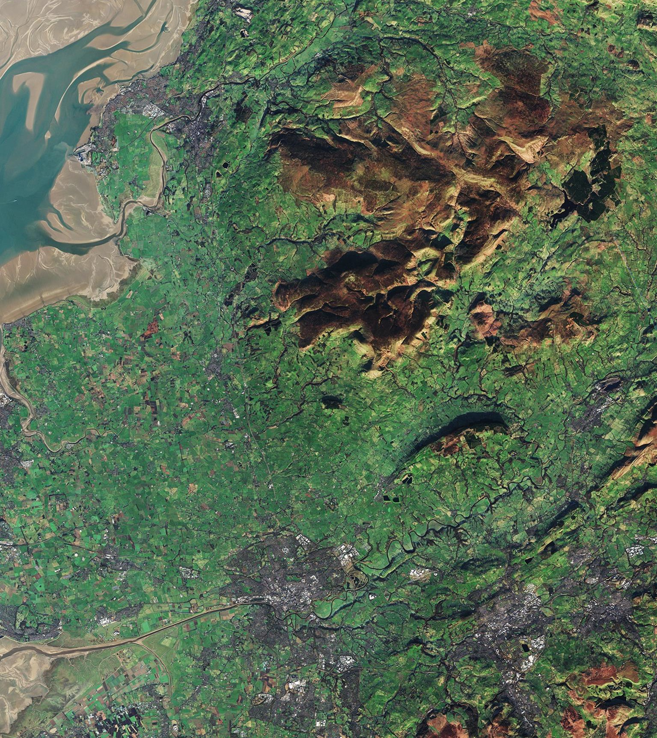
CEOS ‘In Schools’ objectives
Educate: Create a low-cost repeatable programme that can Educate and inspire young people on EO
Collaborate: Provide an opportunity for students to work collaboratively across International borders using the platform of CEOS.
Engage: Facilitate a discussion between CEOS principals and youth representatives on key CEOS topic areas.

Slide 19
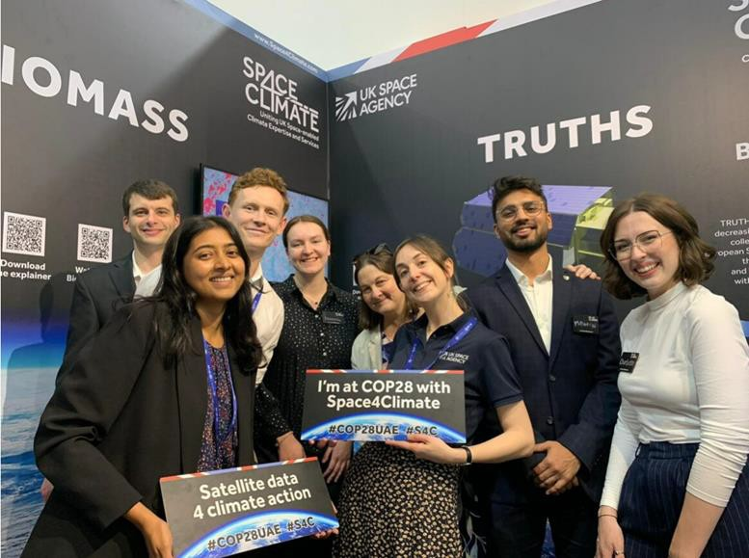
Climate
We fund Space4Climate (S4C), which will celebrate its
ten-year anniversary in May 2024
We provided grant funding for 10 Climate Services Calls.
COP is also a big part of the team's portfolio– significant achievement to attend COP28 last December in Dubai in partnership with S4C and will be in attendance at COP29.
- Methane Standards Framework for emissions reporting a key priority
Some of the UKSA and S4C team at the stand in the Green Zone at COP28 in Dubai, December 2023

Slide 20
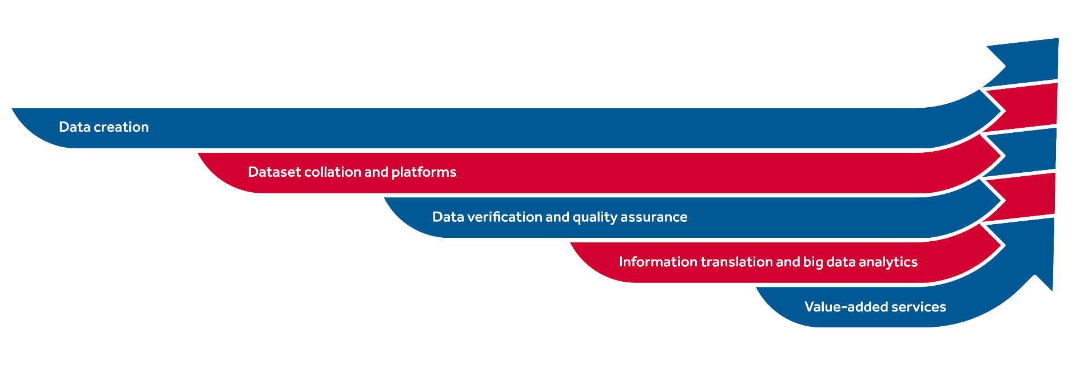
Space4Climate:
A programme uniting UK space-enabled climate expertise and services
OFFICIAL-SENSITIVE
Convene the satellite EO community
Showcase UK space climate service capabilities and successes
Facilitate the exploitation of climate data from space
Host and support climate development innovation activities
Data creation
Data collation and platforms
Data verification and quality assurance
Information translation and big data analytics
Value-added services
OFFICIAL-SENSITIVE

Slide 21
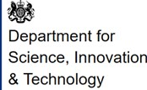
81
-------
Board Members
-------
MEMBERS
-------
Members
-------

