Slide 1
WGISS / WGCV Joint Meeting
JAXA Agency report
K. Tanada,
Y. Ikehata,
A. Kuze
Agenda B.2
WGISS-WGCV
16-17 October 2024
Sioux Falls, South Dakota, USA

Slide 2
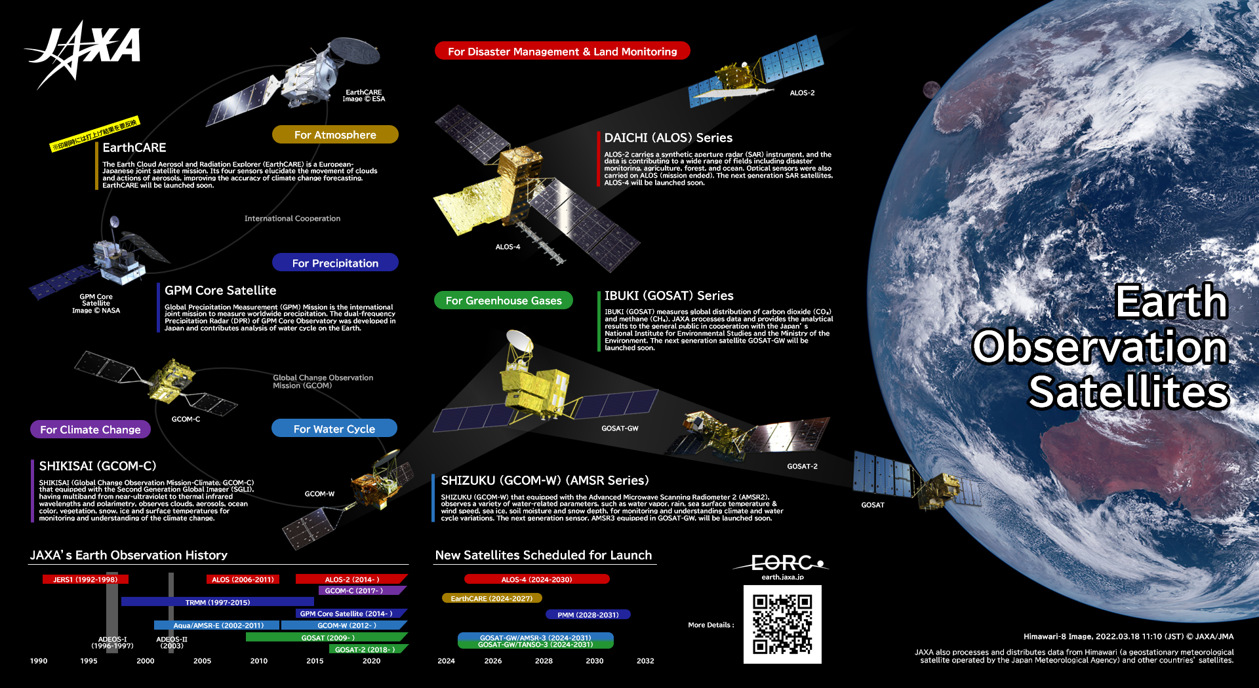

Slide 3
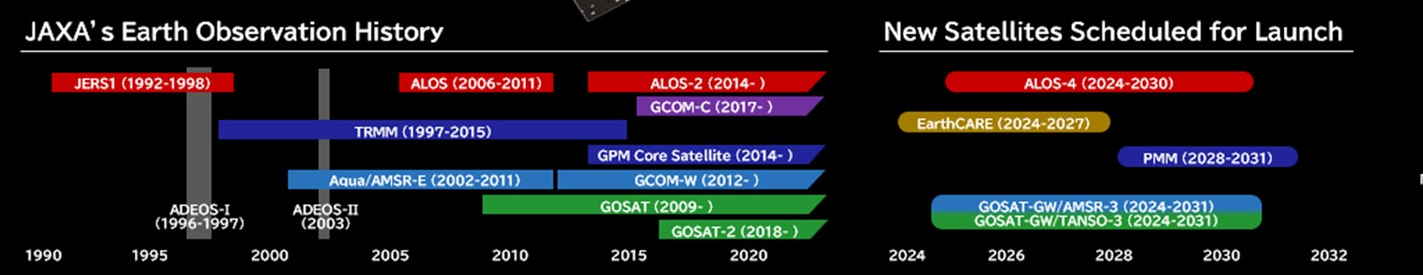
History and Launch Schedule
March 2023: ALOS-3 (Optical) was lost due to H3 Test Flight #1 (TF1) rocket failure
Feb 17, 2024: H3 TF2 rocket launch (successful)
May 29, 2024: EarthCARE (Hakuryu) launched by Space X Falcon 9, JAXA provides Cloud Profiling Radar (CPR). (Successful)
July 1, 2024: ALOS-4 (Daichi 4) (SAR) by H3 F3 (successful)
FY2024: GOSAT-GW (GHG spectrometers and microwave radiometer) launched by H-IIA

Slide 4
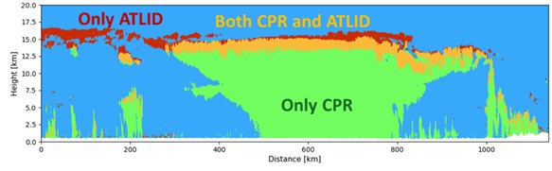
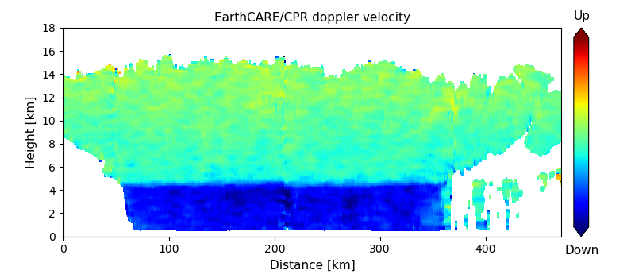
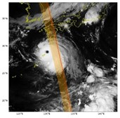
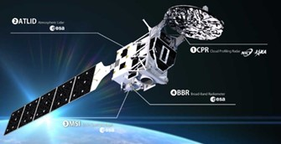
EarthCARE (2024.5 launched)
EarthCARE successfully launched on May 28th, 2024 UTC.
L1 & L2 products are planned to be released in Jan. 2025 and Mar. 2025, respectively.
CPR provided by JAXA/NICT is the world’s first W-band Doppler radar (94GHz) which can observe the vertical structure of clouds, as well as the ascending and descending movement of clouds.
The CPR is sensitive to thick cloud, while the ATLID is sensitive to thin cloud. Combining the CPR and the ATLID allows observation of a wider range of cloud types
Vertical distribution of the CPR Doppler velocity for a tropical cyclone in the northeast Pacific
(22 UTC, 22 August 2024)
4 sensors simultaneous observation
(CPR, ATLID, MSI, BBR)

Slide 5
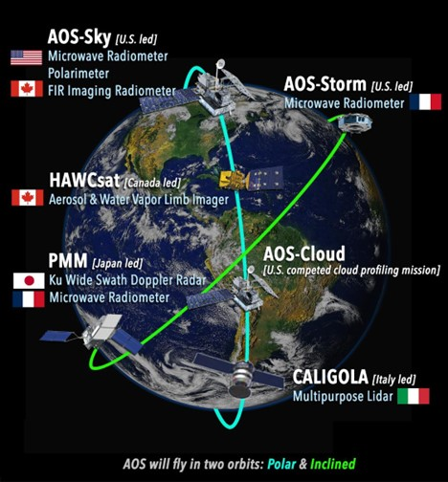
AOS Collaboration (2029~?)
Atmosphere Observing System
JAXA GPM + EarthCARE community has agreed to join the AOS project with PMM (Precipitation Measurement Mission) / KuDPR (Ku-band Doppler Precipitation Radar) in inclined orbit with following new/advanced functions improved from GPM/DPR
AOS delivers globally distributed measurements​ over a range of temporal scales
Polar-orbiting observatories will provide measurements central to understanding aerosol-cloud interactions for climate and aerosol studies
PMM/AOS-Storm will enable observations of convective storms/precipitation over varying times of day
Architecture contingent on funding

Slide 6
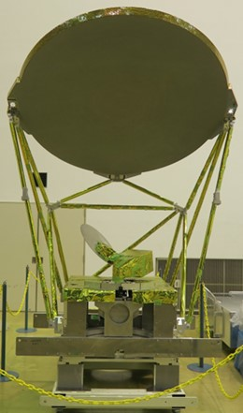
GOSAT-GW / AMSR3 (JFY 2024~)
GOSAT-GW will carry two instruments, AMSR3 & TANSO-3
AMSR3, developed by JAXA, will succeed AMSR series observations adding new high-frequency channels for solid precipitation retrievals and water vapor analysis in NWP.
TANSO-3, led by Japanese Ministry of the Environment (MOE), will improve observation capability of greenhouse gases from GOSAT-2/TANSO-2. (Choose grating spectrometer to enable spatially detailed observation)
Target launch is JFY2024 (Apr. 2024 - Mar. 2025)
AMSR3 Features
AMSR3 specifications: https://www.eorc.jaxa.jp/AMSR/satellite/gosat-gw_en.html
Additional 166 & 183 GHz channels to enable monitoring of global precipitation (rain & snow) and contribute to water vapor analysis in NWP
Additional 10.25 GHz channels with improved NEDT to enable robust SST retrievals in higher spatial resolution
  AMSR series (AMSR-E, AMSR2, AMSR3: Microwave channels of 6.9-89GHz) achieve continuous observation +22 years
AMSR3 sensor in production.
Photo: AMSR3 Main Reflector at Tsukuba Space Center

Slide 7
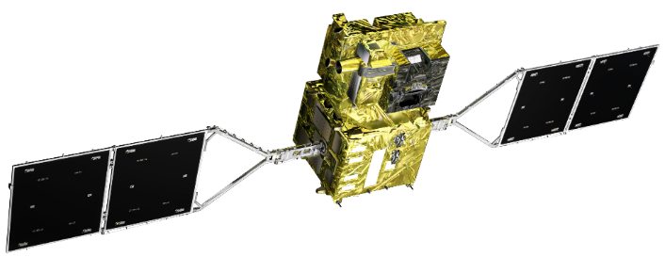
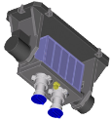
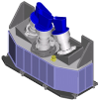
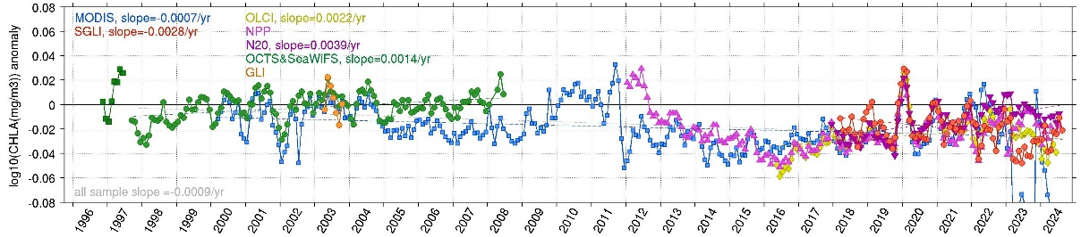
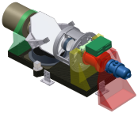
GCOM-C CAL-VAL
Global Change Observation Mission – Climate, "SHIKISAI"
GCOM-C characteristics
Launch Date | 23 Dec. 2017 (data available since 1 Jan 2018)
Orbit | Sun-synchronous (descending local time: 10:30am), Altitude: 798km, Inclination: 98.6deg
SGLI channel specification | Specification of SGLI spectral bands
swath | CH | λ | Δλ | L_{std} | L_{max} | SNR@L_{std} | IFOV
km |  | nm |  | W/m²/sr/μm K: Kelvin |  | - K: NEΔT | m
1150km (VNR: push-broom electric scan) | VN01 | 380.0 | 10.6 | 60 | 240-241 | 624-675 | 250 /1000
 | VN02 | 412.5 | 10.3 | 75 | 305-318 | 786-826 | 250 /1000
 | VN03 | 443.2 | 10.1 | 64 | 457-467 | 487-531 | 250 /1000
 | VN04 | 489.8 | 10.3 | 53 | 147-150 | 858-870 | 250 /1000
 | VN05 | 529.6 | 19.1 | 41 | 361-364 | 457-522 | 250 /1000
 | VN06 | 566.2 | 19.8 | 33 | 95-96 | 1027-1064 | 250 /1000
 | VN07 | 672.0 | 22.0 | 23 | 69-70 | 988-1088 | 250 /1000
 | VN08 | 672.1 | 21.9 | 25 | 213-217 | 537-564 | 250 /1000
 | VN09 | 763.1 | 11.4 | 40 | 351-359 | 1592-1746* | 250 /1000*
 | VN10 | 866.8 | 20.9 | 8 | 37-38 | 470-510 | 250 /1000
 | VN11 | 867.1 | 20.8 | 30 | 305-306 | 471-511 | 250 /1000
 | PL01 | 671.9 | 20.6 | 25 | 293 | 609 | 1000@nadir
 | PL02 | 866.2 | 20.3 | 30 | 396 | 646 | 1000@nadir
1400km (IRS: whisk-broom) | SW01 | 1055 | 21.1 | 57 | 289.2 | 951.8 | 1000
 | SW02 | 1385 | 20.1 | 8 | 118.9 | 347.3 | 1000
 | SW03 | 1635 | 195.0 | 3 | 50.6 | 100.5 | 250 /1000
 | SW04 | 2209 | 50.4 | 1.9 | 21.7 | 378.7 | 1000
 | TI01 | 10793 | 756 | 300K | 340K | 0.08K | 250/500/1000
 | TI02 | 11956 | 759 | 300K | 340K | 0.13K | 250/500/1000
VNR-POL
Polarization two telescopes (670nm and 865nm)
VNR-NP
11 channel three telescopes
InfraRed Scanner (SGLI-IRS)
(4 SWIR, 2 TIR channels)
Visible and Near-infrared Radiometer
(SGLI-VNR)
Second-generation Global Imager (SGLI)
Global environmental minoring by NUV-TIR optical imagers
SGLI (2018~)
OCTS
VIIRS
SeaWiFS
GLI
Terra
Aqua MODIS
OLCI
Long-term timeseries of 60N-60S monthly mean Chl-a anomaly by multiple sensors
https://suzaku.eorc.jaxa.jp/GCOM_C/data/prelaunch/index.html

Slide 8

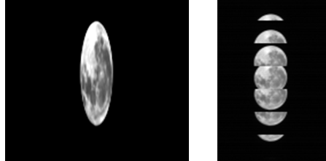
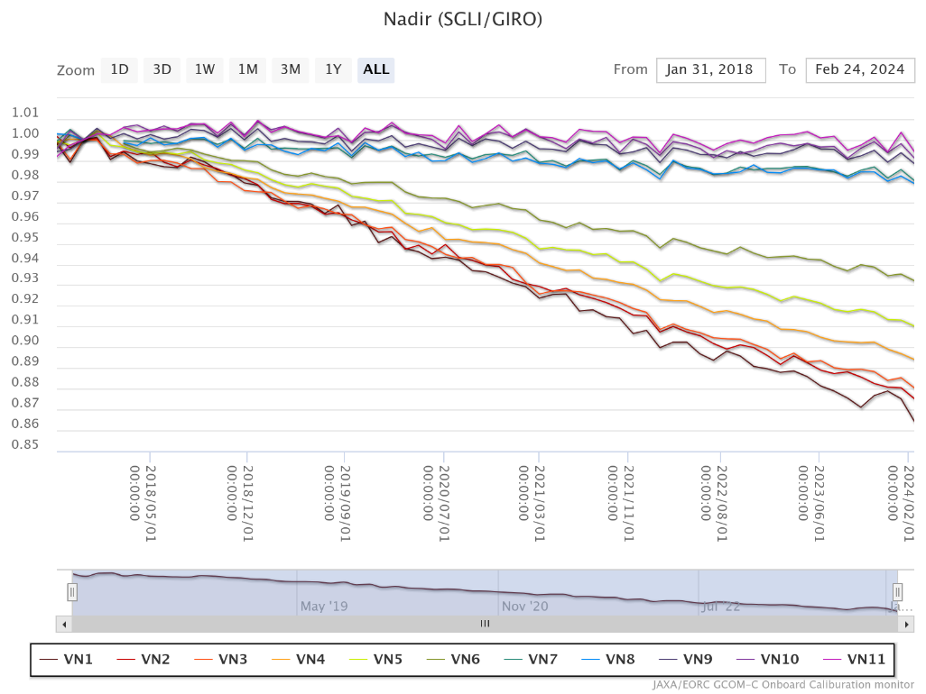
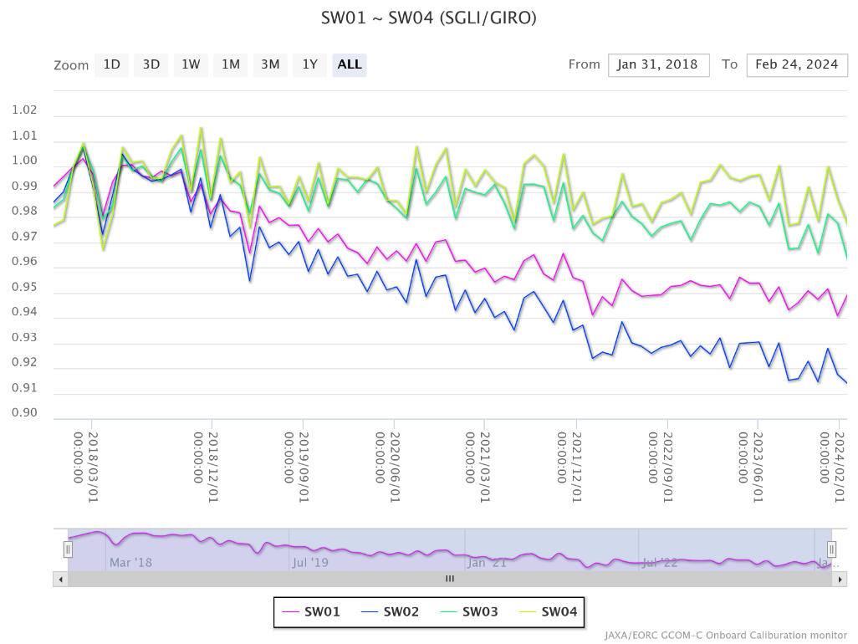
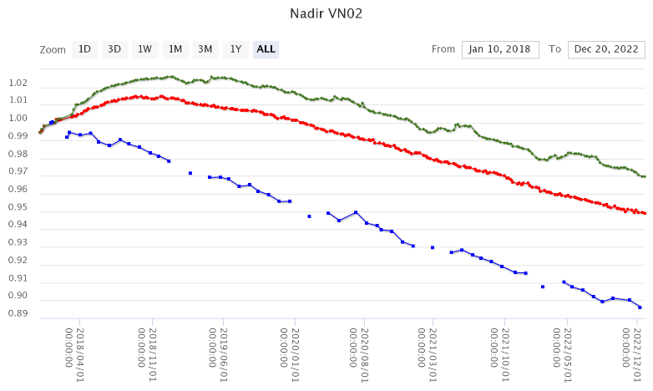
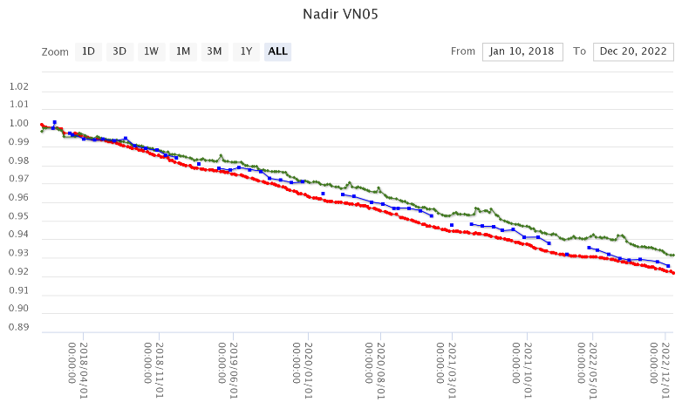
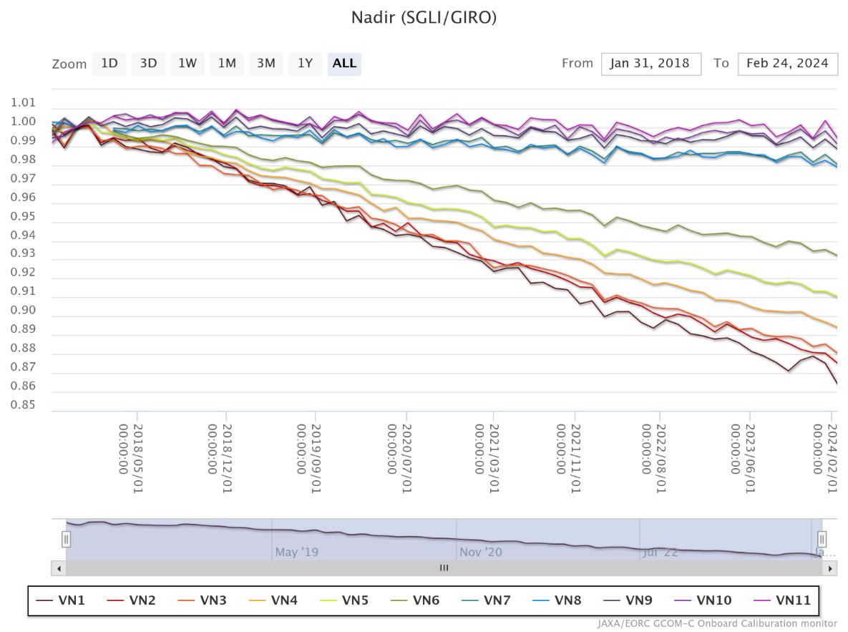
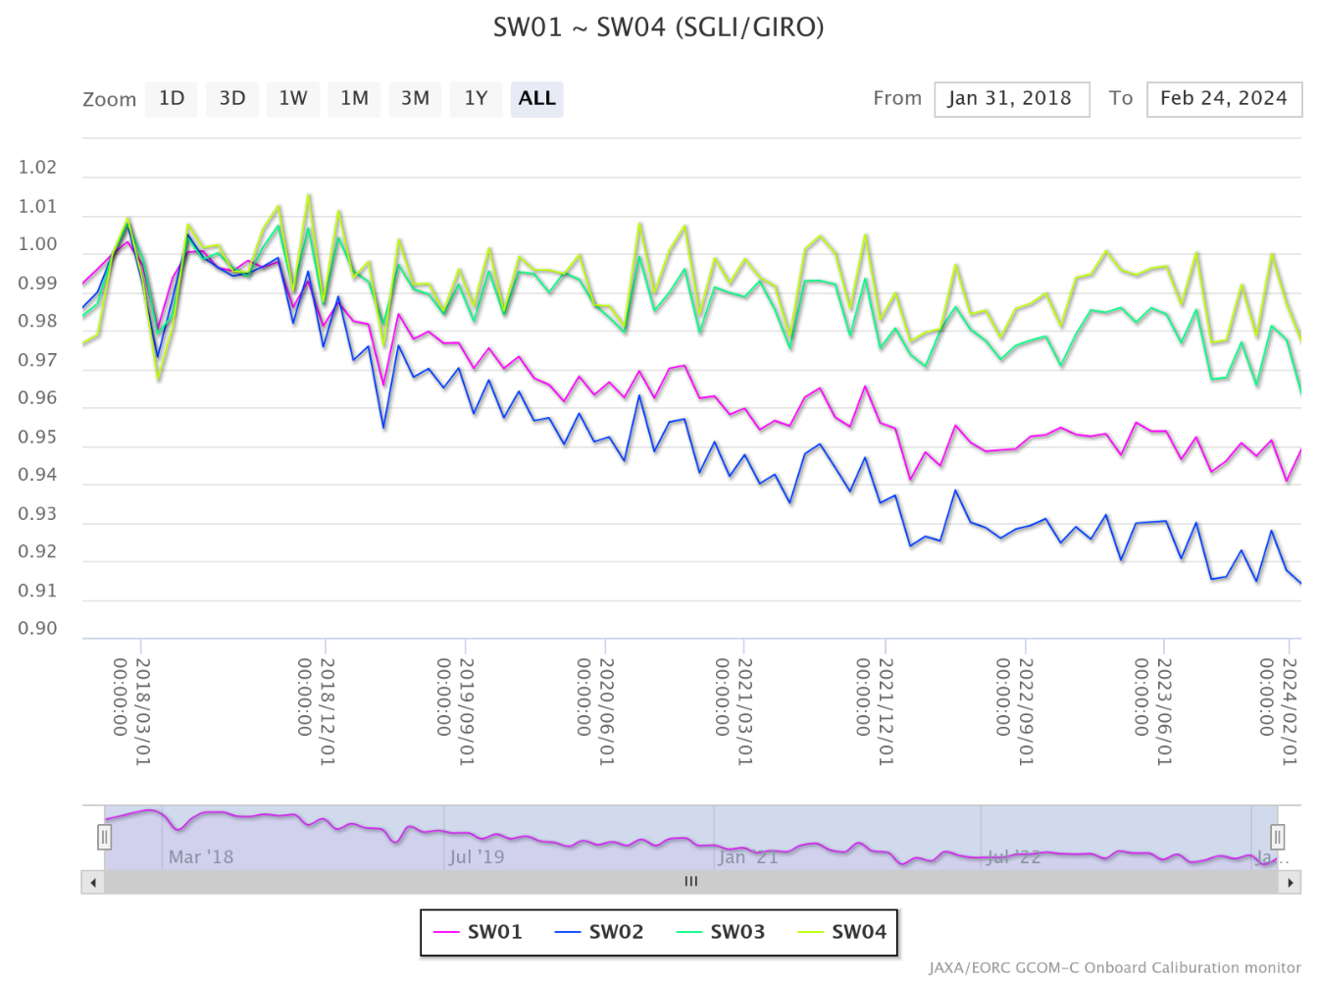
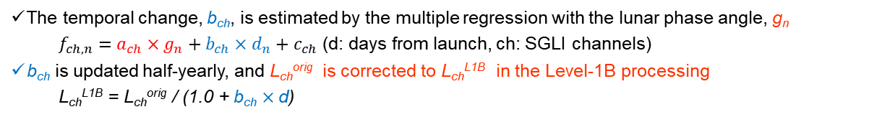
GCOM-C CAL-VAL
SGLI Lunar CAL by GIRO
GCOM-C SGLI lunar calibration is regularly updated by the monthly (phase angle ~+7°) lunar observation operations (by the pitch maneuver; 80 times from Jan. 2018 to Feb. 2024) with GIRO
All SGLI lunar observation data (GIRO input/output files) have been submitted to GLOD
The temporal change, b_{ch}, is estimated by the multiple regression with the lunar phase angle, g_{n}
    $f_{ch,n}=a_{ch}×g_{n}+b_{ch}×d_{n}+c_{ch}$ (d: days from launch, ch: SGLI channels)
b_{ch} is updated half-yearly, and L_{ch}^{orig} is corrected to L_{ch}^{L1B} in the Level-1B processing
  L_{ch}^{L1B} = L_{ch}^{orig} / (1.0 + b_{ch} $×$d)
VNR
IRS
Post-launch calibration comparison (lunar, solar, internal lamp)
Because of the diffuser reflectance change especially in shorter wavelengths, the difference among the on-board CAL results becomes large (e.g., VN02), however, it is small (less than about ±0.5%) in other wavelengths.
VNR 380nm~865nm
SWIR 1.05μm~2.21μm
1.01
1.02
VN02: 412 nm
VN05: 530 nm
SGLI/GIRO
SGLI/GIRO
1.03
Solar CAL
1.03
0.85
0.90
1.00
1.00
2024/02
Internal-lamp CAL
Solar CAL
2018/01
2024/02
2018/01
Lunar CAL
Internal-lamp CAL
Time series of SGLI/GIRO trend (Normalized by 2018/2/1)
Normalized by 31 Jan 2018
Normalized by 31 Jan 2018
Lunar CAL
0.89
0.89
Urabe et al. (2020). DOI: 10.3390/rs12010069;
Urabe et al. (2019) DOI: 10.1109/IGARSS.2019.8897892

Slide 9
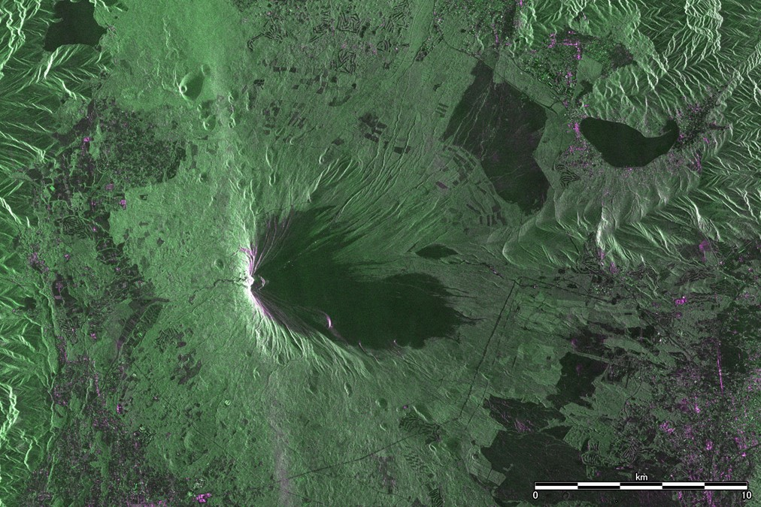
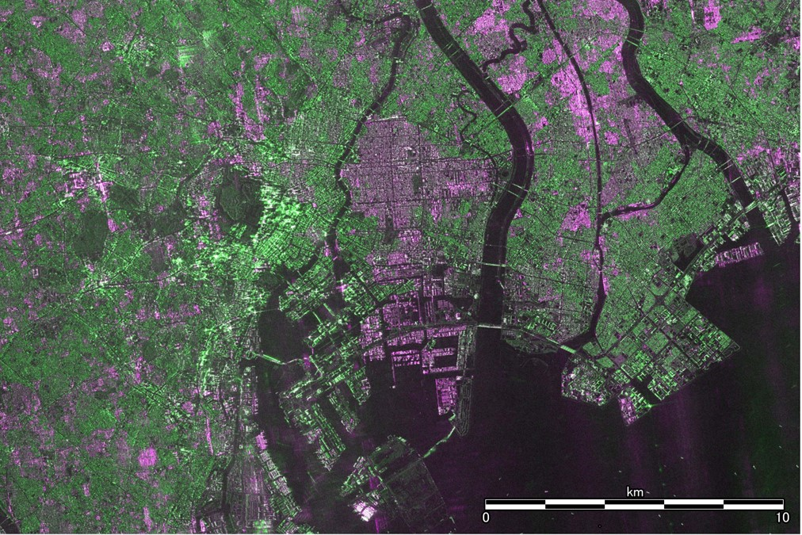
ALOS-4
(1) First images from Advanced Land Observing Satellite-4 “DAICHI-4” (ALOS-4) / Phased Array type L-band Synthetic Aperture Radar-3 (PALSAR-3)
- Extended swath width to 200 km with world's highest resolution (3 m) –(July 31, 2024)
Enlarged images of the vicinity of Mount Fuji and downtown Tokyo by PALSAR-3
(2) Demo Successful achievement of the world's fastest optical inter-satellite communication at a speed of 1.8 Gbps between the Laser Utilizing Communication System (LUCAS) and the Advanced Land Observing Satellite-4 (ALOS-4).(Oct 8, 2024)

Slide 10
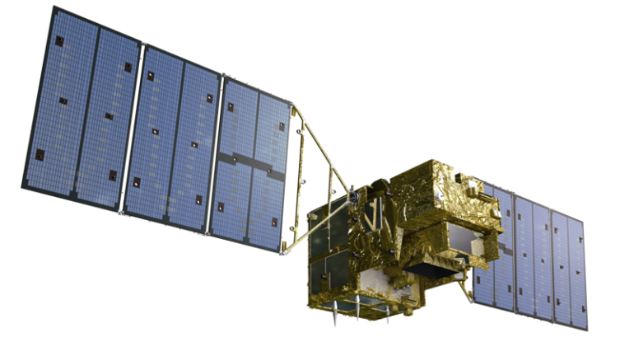
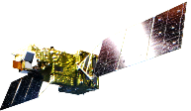

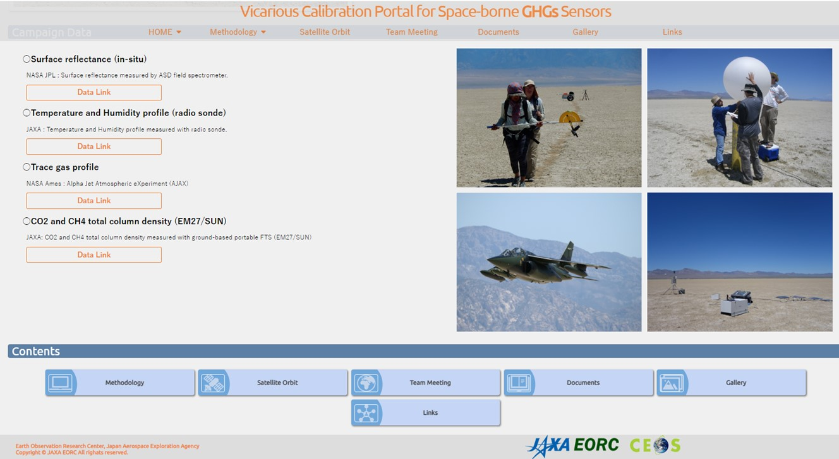
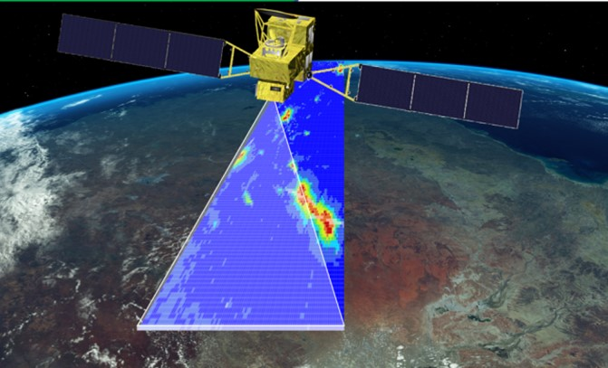
GOSAT Series CAL-VAL
GOSAT (2009-)
Satellite Condition & Calibration
Enough fuel, healthy four batteries are healthy
15-year solar irradiance calibration data set
Level 1 V300.300 (released in March 2023)
Best-estimate radiance spectra using TSIS-HSRS
JAXA Level 2 Partial Column product V3
GOSAT (15-year ) and GOSAT-2 (6-year)
GOSAT-2 (2018-)
Intense target observations
using flexible and wider angle pointing
Calibration
6-year monthly lunar calibration with phase of 7 deg.
Level 1 V221 (released in March 2024)
Updated Best-estimate radiance spectra
July 2024 16th Joint campaign in NV GHG V-Calibration Portal
GOSAT-GW (to be launched in FY2024)
Total Anthropogenic and Natural emissions mapping SpectrOmeter-3 (TANSO-3)
Adding NO₂ as an emission proxy for CO₂.
Imaging Spectrometers
+ Advanced Microwave Scanning
Radiometer 3 (AMSR-3)

