Slide 1
Committee on
Earth
Observation
Satellites
Viewing Earth
    Serving Society
Steven Ramage, CEO Update
October 2024

Slide 2

CEOS Executive Officer Report
CEOS Working Groups SIT Technical Workshop 2024/Plenary 2024 Work Plan Activities CEOS Communications (40th Anniversary of CEOS) CEOS Organizational GitHub (on behalf of SEO)
Some items in this presentation are subject to approval
of the SIT-TW meeting notes and actions,
as well as CEOS Plenary discussion and outcomes.

Slide 3

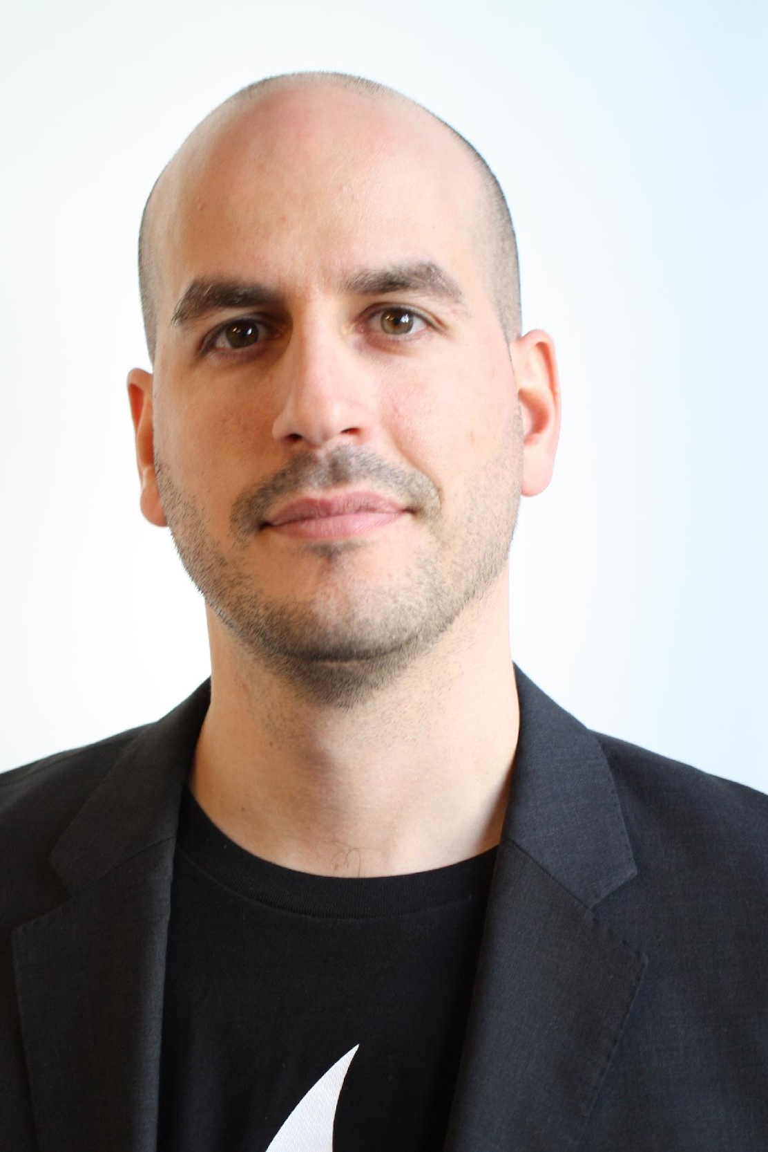
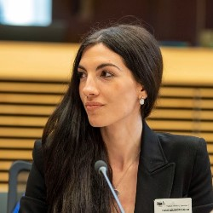
CEOS Executive Office Team
Work on the CEOS Work Plan with Working Groups, Virtual Constellations and others to ensure contributions and track deliverables
Support the CEOS Chair and Strategic Implementation Team (SIT) Chair, including representing CEOS at meetings of CEOS partners and stakeholders upon request of the CEOS Chair and CEOS SIT Chair
Routinely liaise with CEOS Working Groups, Virtual Constellations, the CEOS Systems Engineering Office (SEO)
Consult and coordinate with the GEO Executive Committee, GEO Programme Board, GEO Secretariat and GEO Work Programme activities, e.g. GEO BON, GEOGLAM, GFOI and GEO LDN
Provide input to CEOS leadership on prospects for continued/expanded internal and external cooperation
Track and report on upcoming internal and external meetings and events where CEOS representation/participation is required/invited; report on the status of CEOS representation at relevant meetings during monthly CEOS Secretariat teleconferences
Review and manage the CEOS mailing and contact lists and consult with the SEO in updating the CEOS mailing list servers
Monthly work package report delivered to EUMETSAT, CEOS Chair and CEOS SIT Chair
Additional tasks in the framework of activities listed in the tasks above
  Steven Ramage
  CEOS Executive Officer (CEO)
  Founder & CEO, Réseau Consulting
  Lefteris Mamais
  Strategic support to the CEO team
  Co-Founder & CEO, Evenflow
  Irena Drakopoulou
  Operational support to the CEO team
  Programme Manager, Evenflow

Slide 4



CEOS Membership
Now in its fourth decade,
CEOS comprises
34 Members
(Space Agencies) and
30 Associates
(UN Agencies, Phase A programmes or supporting ground facility programmes)
All of whom contribute to CEOS on a ‘best efforts’ and voluntary basis.
Recent discussions with Azerbaijan, Ethiopia, Ghana, Greece, Kenya, Malaysia, Nigeria and Rwanda regarding greater engagement with CEOS – numerous topics of interest to all agencies.
This is a concerted effort through WG Capacity Building and Data Democracy (WG CapD).

Slide 5
CEOS Chair Themes
Canadian Space Agency 2023/4 – biodiversity monitoring
from space, plus commercial space engagement
Notes:
CEOS Plenary 2025 – 14, 15, 16 YO pre university age

Slide 6
CEOS Biodiversity
SIT-TW-2024-01 | CEOS Chair Team to work with Ecosystem Extent Task Team to develop a proposal on the way forward for evolution of the Task Team and a sustained presence for biodiversity in CEOS. The proposal should be informed by, and comply with, CEOS governance documents on new initiatives and entities., and comply with them. | CEOS Plenary 2024
 | Ecosystem Extent Task Team recommends an expanded mandate to include other aspects of biodiversity, and to continue working over the next year to set a course for define CEOS contributions to Biodiversity.
Notes:
CEOS Study Team

Slide 7
CEOS Chair Themes
UK Space Agency 2024/5 – Unlocking EO for Society
1. Unlocking EO for public service
2. Unlocking EO for UNFCCC global stocktakes
3. Unlocking EO for the Global Methane Pledge
4. CEOS in Schools and the Youth Summit
Notes:
CEOS Plenary 2025 – 14, 15, 16 YO pre university age

Slide 8




CEOS Long-term Priorities
Ensure that climate observation requirements identified by the Global Climate Observing System (GCOS) – and implications of the Paris Climate Agreement – are addressed.
Ensure, in the context of the Sendai Framework for Disaster Risk Reduction 2015-2030, that CEOS Agency data are made available in support of disaster risk reduction and that CEOS continues engagement with UN agencies and authorities.
Ensure that space-based Earth observation data and products are integral to the success of the next decade of the Group on Earth Observations (GEO), and that CEOS contributions to, and engagement in, GEO governance and leadership are further enhanced.
Systematically engage in and contribute to global efforts on the critical challenges that face humanity in support of the UN 2030 Agenda for Sustainable Development.

Slide 9
Space-based Data – Open Data Open Knowledge
Challenges
- The variety of remote sensing data keeps increasing, leading to a greater demand for access and applications.
- Awareness of open data policies is an urgent need for the EO community.
- A large variety of satellite imagery formats means there is a need for standardized RS product specifications.
- Research and applications of models and methods using Big Earth data are inadequate.
- Insufficient/outdated resources on data cubes in GEO.
Actions
- Advocate for greater adoption of open standards and open data cubes in the GEO community.
- Build on existing [CEOS] Analysis Ready Data specifications
- Adopt developing technologies (Cloud and Quantum Computing, Docker, Kubernetes, Deep Learning).
- Enhance capabilities for joint calibration and validation of remote sensing data & products. See QA4EO and CEOS WG CalVal.
- Strengthen regional collaboration and capacity building around space-based data in GEO.
- Support open data policies and efforts and technologies based on CARE, FAIR and TRUST
Suggestions for the GEO Infrastructure
- GIDTT should look at the UN API Strategy from the UN Environment Programme and CODES.
- GKH should be seen as the place to find out how to cook, including the recipes and the contents.
Greater input was requested from across the GEO Work Programme, as well as CEOS.
- Communication around tools and services should be improved.
- There is a lot of effort around the platform additional efforts on the content would also be welcome.
- GEO should foster collaboration, data accessibility, and capacity development
(on the technology and the data analysis aspects).

Slide 10

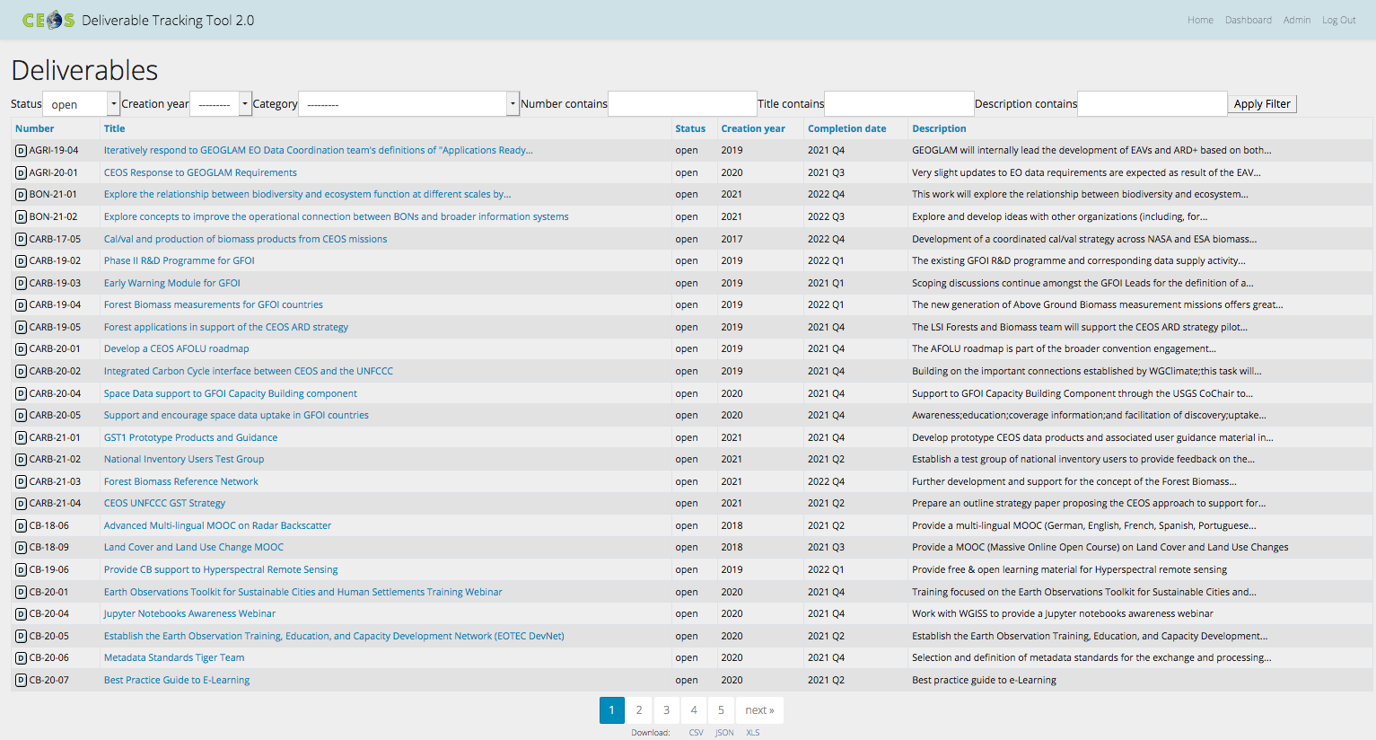
CEOS Work Plan
3-year plan re-evaluated and updated annually by all CEOS entities and presented for formal endorsement in Q1 of each calendar year.
CEOS undertakes rigorous work planning, monitoring and implementation of its activities, all of which ensure CEOS’s internal accountability and external credibility.
The Work Plan informs the spectrum of deliverables that CEOS membership agree to undertake.
CEOS deliverables are reconciled and tracked with a dedicated CEOS deliverable tracking tool.
The CEOS 2023-2025 Work Plan defines 130 deliverables.
http://deliverables.ceos.org/

Slide 11
CEOS Work Plan – WGCV
Number | Title | Completion date | Description
CV-24-01 | Third Cabauw INtercomparison of DOAS-like Instruments (CINDI-3), May-June 2024 | Q1 2025 | Semi-blind intercalibration and intercomparison field campaign of ground-based UV-Visible DOAS instruments with external referee. Complemented by mobile DOAS systems and an exhaustive range of measurements of aerosols, ozone and other UV-Visible trace gases. Primary goals: (i) to intercalibrate instruments and assess mutual consistency of their measurements, (ii) to get NDACC/ACTRIS-CREGARS certification for new instruments, (iii) to assess and improve FRM maturity of the measurements for the validation of the Air Quality and Ozone satellite constellations. Primary target species: atmospheric NO2 and O3; secondary targets: HCHO, CHOCHO and aerosols; others: HONO, BrO and H2O.
CV-24-02 | Good Practices Protocol on Land Cover | Q4 2024 | A community developed document detailing standards and methods for validating land cover classification from a variety of satellite platforms
CV-24-03 | Good Practices Protocol on Vegetation Indices | Q4 2024 | A community developed document detailing review of practices for vegetation index validation and intercomparison.
CV-22-01 | Validation protocols for atmospheric aerosol and cloud profiles | Q1 2024 | Development of validation protocols for atmospheric aerosol and cloud profiles
CV-22-02 | CEOS Terms and Definitions Wiki | Q4 2024 | Compilation of an agreed list of terms to ensure consistent use across CEOS. Covering words on: Earth observation systems, measurement and metrology, observation properties, and data stewardship.
CV-23-01 | Develop an FRM Assessment Framework | Q4 2024 | Fiducial Reference Measurement Self Assessment process will be put in place and proposed at WGCV-52.
CV-23-02 | SARCalnet: Establishment of initial SARCalnet processes and network initiation | Q1 2024 | Network of curated calibration sites for SAR cal/val. It includes standard information on targets as well as their characterisation and should facilitate the use of multiple calibration sites by experts and non-experts, while also promoting cross-comparisons between data of different missions. The SARCalnet webesite will be set-up by Q4 2023 or Q1 2024.
CV-23-03 | TIRCalNet: Establishment of initial TIRCalNet processes and network initiation | Q4 2026 | Development of a network for Top Of Atmosphere Brightness Temperature Measurements at Fiducial Reference Measurements standard. A working group will be constituted with initial sites selections and roadmap toward the establishment of the network.
CV-23-04 | Launch of a GCP Intercomparison Exercise | Q4 2024 | Develop tools for quantifying colocation between different agencies GCP references (to be discussed and endorsed at next TMSG plenary)
CV-23-05 | Retrieval and validation of high winds with combined active-passive microwave measurements | Q2 2025 | The combination of measurements by radar scatterometers and microwave radiometers capable of improving the measurement and retrieval of high winds. It is good time to explore the combined information. This task will provide a comparison of respective wind results from both type of sensors and examples of joint application methods for high wind retrievals.
CV-23-06 | Retrieval and validation of sea surface atmospheric pressure with microwave remote sensing | Q2 2025 | Retrieval of sea surface atmospheric pressure with microwave measurements have the advantage for all weather capabilities, which is essential for the application of forecast and analysis of typhoon/hurricane. This task will develop the retrievals and assessment for this sea surface atmospheric pressure with microwave remote sensing.
CV-20-03 | DEMIX | Q1 2024 | Intecomparison of publicly-available DEM
CV-17-01 | L1 top-of-atmosphere interoperability | Q4 2025 | Develop an initial recommendation of a community reference in collaboration with GSICS.
CV-14-03 | Workshop on state of the art for pre-flight calibration techniques | Q4 2025 | Hold an open-invitation workshop to discuss and promote best practices on pre-flight and onboard calibration of sensors;initially focusing on optical.
CV-20-01 | Surface Reflectance measurements Intercomparison exercise for vegetation (SRIX 4Veg) | Q4 2024 | Intercomparison exercise for surface reflectance fiducial measurements for vegetation to test user-based differences in surface reflectance fiducial reference measurements (FRM) used for validation of current SR satellite products;and to ensure consensus on global SR validation protocols.
Notes:
Outstanding deliverables 22-01, 23-02 and 20-03 – all from Q1 2024. Another 6 for end Q4 2024

Slide 12
CEOS Work Plan – WGISS
DATA-23-01 | AI/ML White Paper | Q4 2024 | Use cases of AI/ML technologies for the Earth Observations will be collected, categolized and summarized as a white paper.
DATA-22-01 | Jupyter Notebook Best Practice | Q4 2024 | Knowledge sharing with Jupyter Notebook will be investigated and the best practice will be issued.
DATA-24-01 | White Paper on EO Data collections management and governance | Q1 2025 | This white paper would address topics including management of data collections in the Cloud, Preservation of "MASTER" collections, reproducibility of previous collections versions (algorithm availability), cross-collection validation, and general Interoperability and Governance approaches.
DATA-24-02 | White paper on Software preservation | Q3 2025 | This white paper would address and recommend techniques to ensure preservation and reusability of software tools related to EO missions (e.g. processors, exploitation and visualization tools).
DATA-24-03 | CEOS Interoperability Handbook 2.0 | Q1 2025 | This Interoperabilty Handbook would be revised version of the handbook originally published by WGISS in 2008 and provided guidance toward the implementation of the recently endorsed CEOS Interoperability Framework (2023).
DATA-22-05 | Feasibility Study for Common Guidlines for the STAC Implementations | Q3 2024 | Evaluate the possibility of defining a guideline/best practice for the STAC at CEOS level, By that act for an alignment in implementing STAC (in all forms API, static search or metadata modelling)
Notes:
DATA-22-05 has expired and DATA-22-01 and DATA-23-01 are due at the end of Q4 2025

Slide 13
WGISS CEO Team Action
SIT-TW-2024-03 | CEOS Executive Officer will support the WGISS Interoperability team in securing the appropriate engagement from across CEOS, as well as identify potential approaches and opportunities for CEOS to consider for engagement with the means and opportunities for commercial sector engagement. WGISS is to report on progress regularly at CEOS Secretariat meetings. | SIT-40
 | The Interoperability Handbook in development should have engagement from across CEOS and beyond, as it is an issue that affects all aspects of EO. The CEOS Secretariat is the appropriate forum to discuss if well placed to ensure the proposed engagement is advised before suggesting it to the broader CEOS community work has the correct engagement.

Slide 14
CEOS Work Plan – New Space
Title | Completion Date | Description | Responsible User(s) - including email address | Responsible CEOS Entity(ies) | Contributing Agency(ies)
Include New Space sessions at CEOS meetings where appropriate | Q4 2026 | CEOS Members and Associates should strive to continue to share information on relevant events and activities related to New Space, including commercial data evaluation results when possible, as detailed in recommendation 2 from the 2023 CEOS New Space White Paper. CEOS Agencies should also investigate ways to work together on cooperation agreements with New Space actors possibly including common lines to take on end-user licence agreements and IPR issues. The CEOS and SIT Chairs should thus consider, where appropriate, options to include discussions on New Space and the commercial sector in the SIT, SIT TW and CEOS Plenary agendas for 2024, 2025 and 2026. | Eric Laliberte (eric.laliberte@asc-csa.gc.ca); Frederic Fournier (frederic.fournier@asc-csa.gc.ca); Osamu Ochiai (ochiai.osamu@jaxa.jp); Matthew Steventon (matthew@symbioscomms.com) | CEOS Chair; SIT Chair | CSA, JAXA
Increase engagement with the commercial sector on CEOS-ARD | Q4 2024 | Recommended deliverable from the 2023 CEOS New Space White Paper: To ensure users can benefit from increased complementarity and interoperability of CEOS Agency and New Space datasets, the CEOS-ARD initiative should identify and implement mechanisms to deepen engagement with the New Space sector, consistent with CEOS Governing Documents. Examples include establishing a mechanism to consult the New Space sector during the development and review of CEOS-ARD Product Family Specifications (PFS), encouraging commercial sector participation in the ISO-AGC ARD Standards Working Group, and encouraging and assisting New Space entities to undertake self-assessments of their datasets against CEOS-ARD PFSs. | Ferran Gascon (ferran.gascon@esa.int); matthew Steventon (matthew@symbioscomms.com) | CEOS ARD Oversight Group | All ARD OG members, All Virtual Constellations, WGCV CEOS-ARD POCs
Unify CEOS engagement with the commercial sector at at key meetings with respect to ARD and Cal/Val | Q4 2026 | Recommended deliverable from the 2023 CEOS New Space White Paper: CEOS Members and Associates should continue unified engagement with New Space actors on key topics such as ARD, Cal/Val and data quality via CEOS representation at key meetings including VH-RODA, JACIE, IGARSS, Living Planet Symposium, and ARD2x. | Ferran Gascon (ferran.gascon@esa.int); Philippe Goryl (philippe.goryl@esa.int); Matthew Steventon (matthew@symbioscomms.com); Riza Singh (riza@symbioscomms.com) | CEOS ARD Oversight Group; WGCV | All ARD OG members
Revise the CEOS-ARD Industry Engagement Strategy | Q4 2024 | Recommended deliverable from the 2023 CEOS New Space White Paper: A revision of CEOS-ARD Industry Engagement Strategy should include consideration of aspects of specific relevance to the New Space sector, and the CEOS-ARD Oversight Group should consider the merits of organising a dedicated New Space workshop. | Andreia Siqueira (Andreia.Siqueira@ga.gov.au); Matthew Steventon (matthew@symbioscomms.com) | CEOS ARD Oversight Group; LSI-VC | All ARD OG and LSI-VC members
Ensure that legacy and new public and commercial datasets can be used more interoperably | Q4 2024 | Recommended deliverable from the 2023 CEOS New Space White Paper: The CEOS Interoperability Roadmap will ensure that legacy and new public and commercial datasets can be used more interoperably to generate advanced decision-support products and new research applications. As such, adequate resources should be made available to complete its development and maturation | Tom Sohre (tsohre@usgs.gov); Libby Rose (libby@symbioscomms.com) | WGISS | All WGISS members
Integrate New Space data into the CEOS Analytics Lab | Q4 2024 | Recommended deliverable from the 2023 CEOS New Space White Paper: The CEOS Systems Engineering Office should demonstrate the integration of New Space data into the CEOS Analytics Lab and evaluate its interoperability with common CEOS datasets. | David Borges (david.borges@nasa.gov) | SEO | NASA
Notes:
LSI VC in Japan, VH-RODA Very High-resolution Radar & Optical Data Assessment (VH-RODA) 2024 early Dec in ESA, ARD

Slide 15
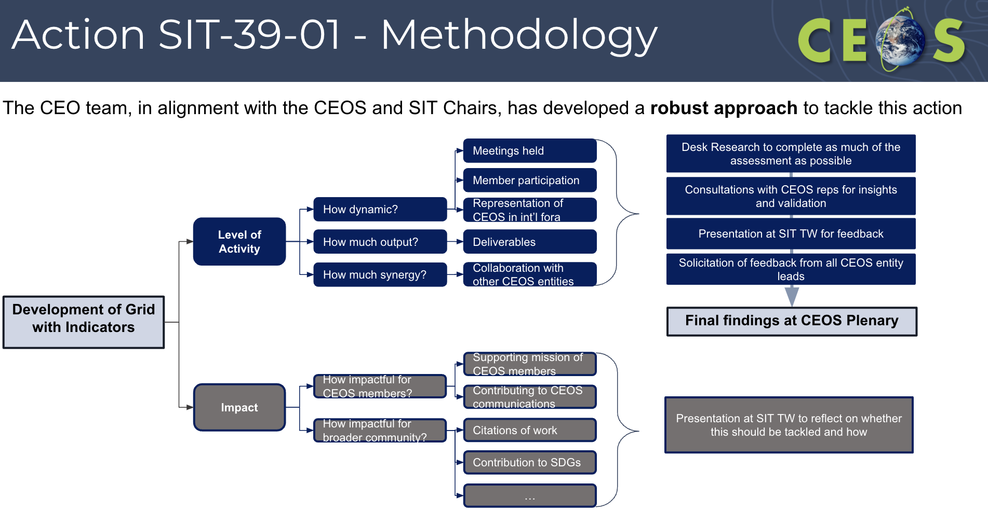
CEO Work Plan Action

Slide 16
COAST CEO Team Action
SIT-TW-2024-08 | CEOS Executive Officer and COAST-VC to formulate a letter to IOC/UNESCO to detail opportunities for remote sensing, in particular for activities that will advance goals of the surrounding the UN Decade of Ocean Science for Sustainable Development (UN Ocean Decade). The letter should encourage IOC and the UN Ocean Decade to highlight remote sensing capabilities in future communications. The CEOS Secretariat will assist with development and final review of the letter support formulation and review of any resulting correspondence. | CEOS Plenary 2024
 | COAST-VC has identified a marked imbalance in the highlighting of in situ and satellite Earth observations lack of remote sensing identified in IOC and UN Ocean Decade communications. Said imbalance underrepresents the significance of satellite Earth Observations and the added value of their complementarity with in situ observations.

Slide 17
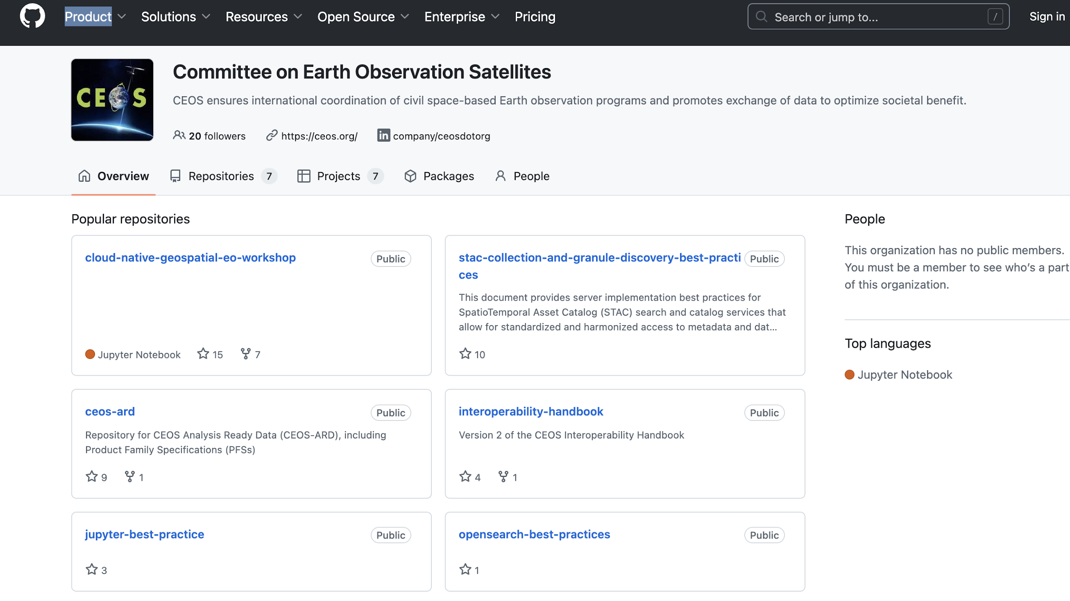
SEO Support - https://github.com/ceos-org

Slide 18
SEO Support
CEOS Analytics Lab
https://ceos.org/cal/
A Shared Platform
Current utilization includes the Ecosystem Extent Task Team, COAST Virtual Constellation, and WGDisasters Flood Pilot.
The CEOS Analytics Lab is freely and openly available for use by all CEOS Members and Associate Members.
CEOS Github
https://github.com/ceos-seo/odc-colab
Open Data Cube and Google Earth Engine
https://github.com/ceos-org/ceos-ard
CEOS ARD and PFS

Slide 19
Plenary decision items
CEOS Plenary decision items
Item 1.3: Endorsement of the minor revision to the CEOS Strategic Guidance Document.
Item 2.4: Proposal regarding evolution of the EETT and way forward to a sustained presence for biodiversity in CEOS.
Item 3.2: Endorsement of Medhavy Thankappan from Geoscience Australia (GA) as the next Working Group Calibration and Validation (WGCV) Vice Chair (2025-2026) and subsequently WGCV Chair (2027-2028).
Item 3.5: Endorsement of the updated WGISS Terms of Reference.
Item 3.6: Endorsement of Vincent-Henri Peuch from European Centre for Medium-Range Weather Forecasts (ECMWF) for position of next WG Climate Vice Chair (2025-2026) and subsequently WG Climate Chair (2027-2028).
Item 3.6: Endorsement of the merged gap analysis and coordinated action plan for the prior two ECV Inventory analyses (v4.0, v4.1).
Item 4.4: Endorsement of Issue 2 of the CEOS-CGMS Greenhouse Gas Roadmap
Item 7.2: Endorsement of the CEOS-ARD Strategy 2024

Slide 20
Plenary decision items
CEOS Plenary decision items
Item 8.1: Endorsement of the joint SST-VC and COAST-VC Statement - Recommending Masking Requirements in Coastal Areas for Upcoming SST Missions
Item 10.4: Decide on CEOS representation in the future UNOC3/Ocean Space Alliance
Item 11.1: Endorse the 2024 CEOS Plenary Montréal Statement
Item 11.2: Endorse the nomination for the 2026 CEOS Chair

Slide 21
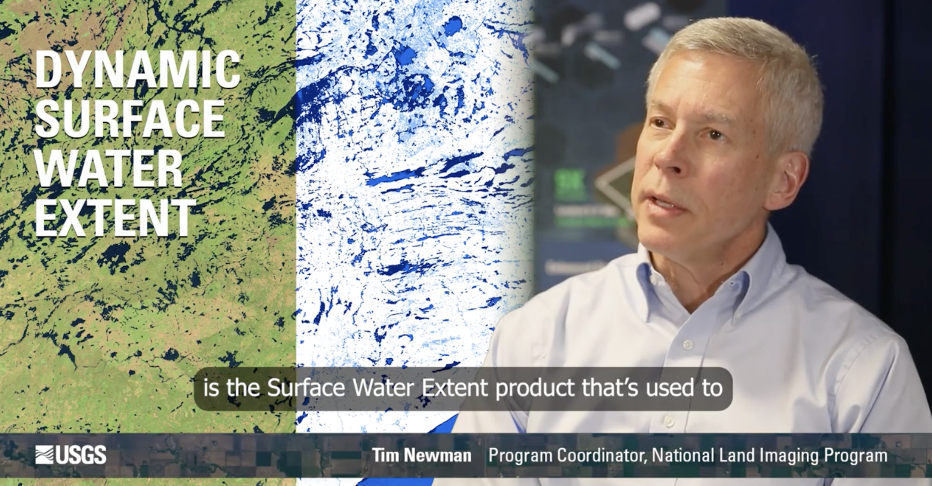
CEOS 40th Anniversary Videos
Notes:
Comms Plan from Nov 2023, section 5.1 talks about the 40th anniversary

Slide 22
executive_officer@lists.ceos.org
@steven_ramage
Thanks for listening.

