Slide 1

Data management for data science
October 2024
Pete Doucette, Director, EROS
U.S. Department of the Interior
U.S. Geological Survey

Slide 2
Earth observation (EO) community shared mission
Study the Earth’s surface to support the safeguarding of life, limb, property and natural resources.

Slide 3
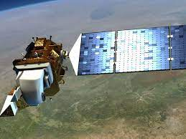

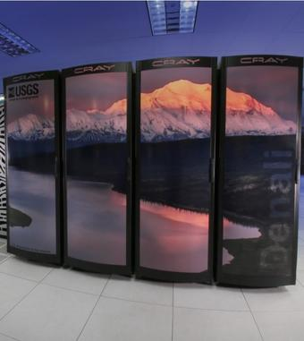
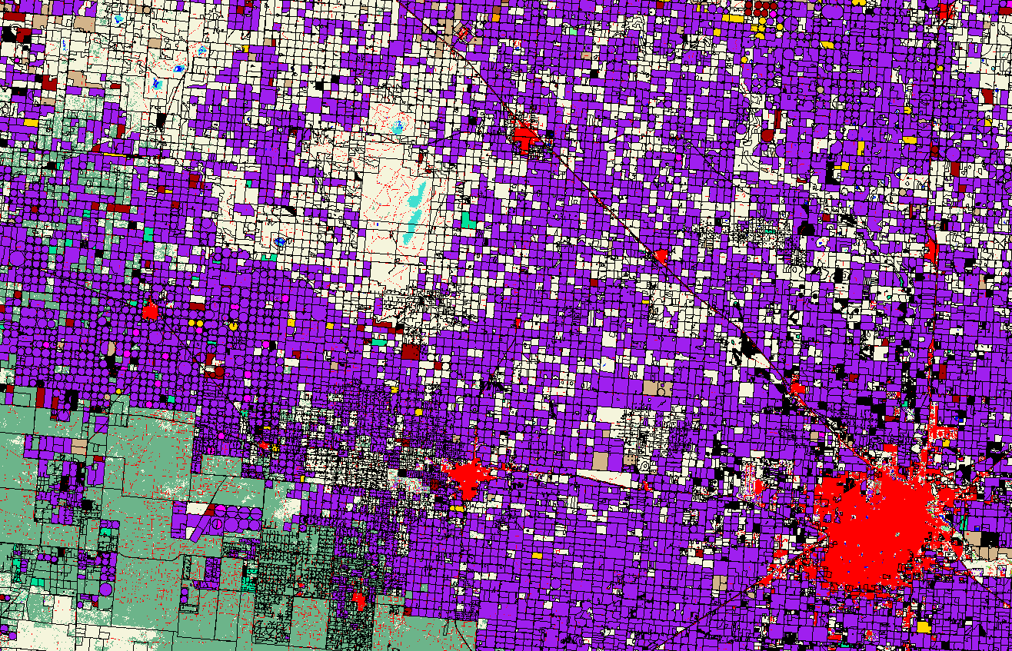

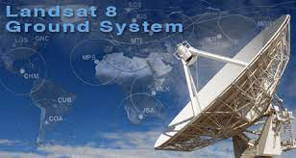

EROS organization
Satellite
Operations
Data Management
Science
Applications
New
Missions
Interagency
International
Commercial
~55 PB
on-prem
~20 PB in Cloud
Budget for FY24: $130M; ~$3B in space and ground assets
Staffing: ~700 personnel (80% contractor workforce)
Notes:
Cloud high level incident from pecora, and long-term direction to reduce downloads to encourage doing collaborative work in more a common environment.
DOI RFP for cloud.
What should you care is perspective– among your individualized activity, we ask the LST to provide guidance collectively across all of these areas.
Cal/val sits under SGO.
Sat ops is job 1🡪 recent safehold event details. GPS interference, etc.

Slide 4







Common data management activities
Acquisition / Storage
Processing/
Quality Control
Distribution
Security / Governance
Multimodal integration
AI

Slide 5
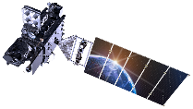
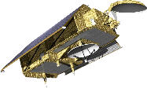
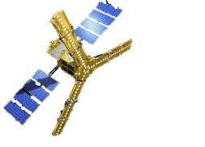
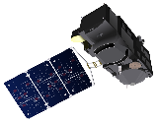
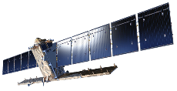
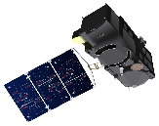

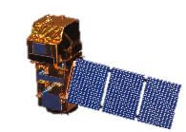
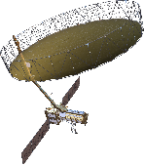
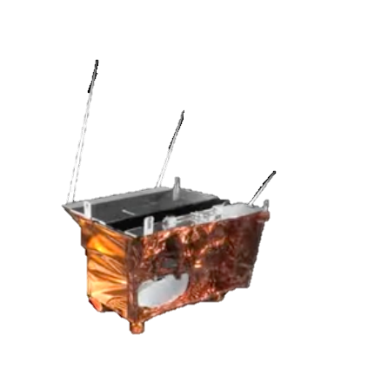
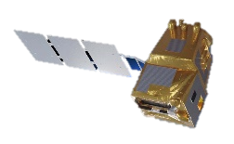
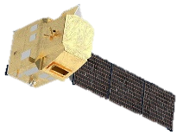
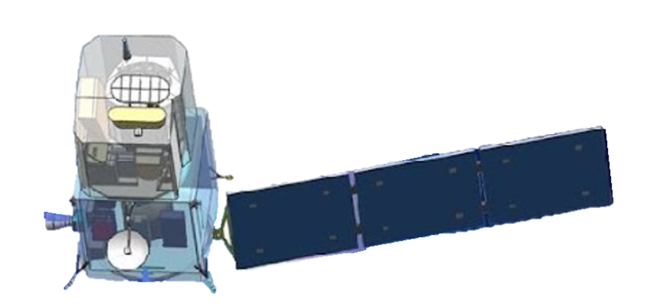
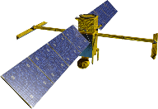
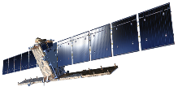
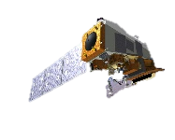

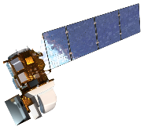
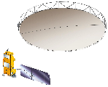
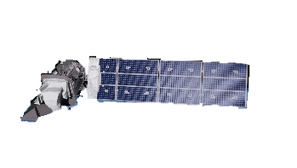

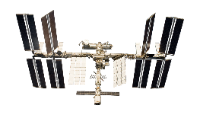
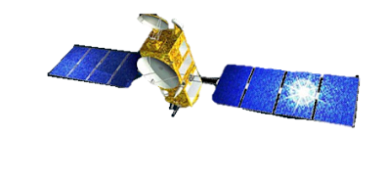



New/planned Land Imaging Satellite Missions
GOES-U ABI
~36,000 km
Sentinel-6B
FLEX
(1,366km)
Sentinel-3D
Sentinel-3C
Sentinel-1D
Sentinel-2D
GOES-T ABI
JPSS-2 VIIRS
NISAR
Sentinel-2C
PACE
LSTM
SWOT
CHIME
Surface Biology and Geology (SBG)
Sentinel-1C
800km
Landsat 9
700km
WorldView Legion
Biomass
Resourcesat 3/3A
Landsat Next
ISS
800km
ECOSTRESS
Surface Deformation and Change (SDC)
600km
700km
Indian Space Research Organization (ISRO)
European Space Agency
500km
600km
Commercial (EnhancedView)
500km
US Government
400km
Joint US / International
400km

Slide 6
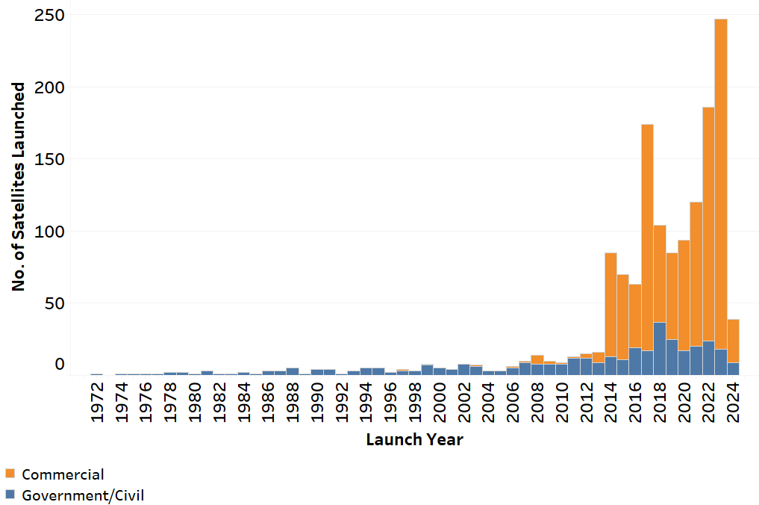
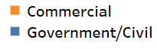
Earth observing satellite trends
Commercial business model generally favors smaller and cheaper systems that trades off rigor for more agility and resilience.
By EROS CalVal Center of Excellence (ECCOE) JULY 30, 2024

Slide 7
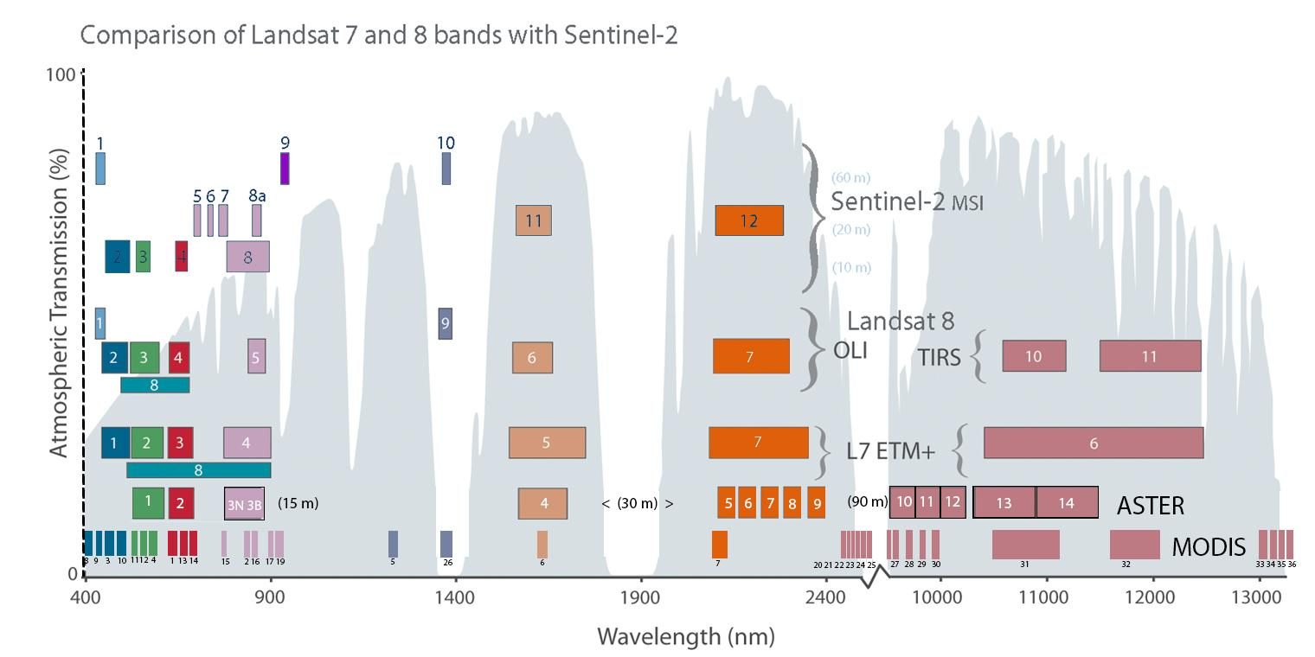
Inter-modal comparison example
Global
refresh
B
G
R
R
NIR
Commercial satellites < 5m
1 day
E
Pan
60m
20m
5 days
10m
30m
/9
30m
100m
8 days
15m
1a 1
9
10
Landsat Next (proposed)
4a
8a
60m
12a
15
16
60m
6 days
5
6
7
8b
20m
12b
12c
13, 14, 14a, 14b
[ MWIR and TIR ]
9
11
2
3
4
8
10m
VIS
NIR
SWIR
Thermal
Notes:
Mixing different grades of oil

Slide 8
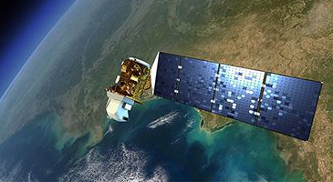
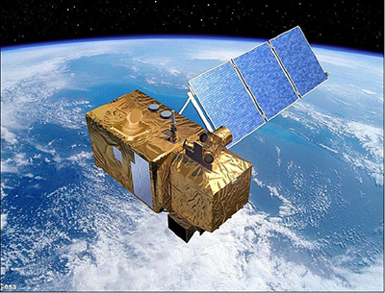
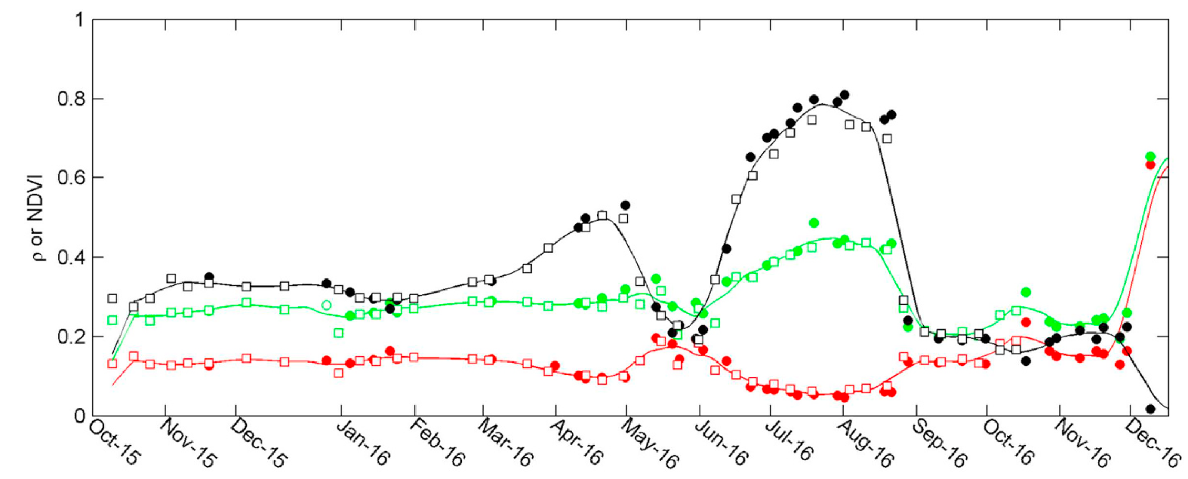
Multimodal example: [Explicit] Harmonized Landsat-Sentinel (HLS)
Spatial down sampling of Sentinel from 10m to 30m
Spectral band matching and bandpass adjustment
BRDF corrections
Effective integrated bands for time-series:
(Blue, green, red, NIR, SWIR1, SWIR2 @ 30M)
Landsat 8/9
(USGS)
Sentinel 2a-b
(ESA)
Red Band
Green Band
NDVI
Landsat 8
Sentinel 2
Claverie, M., Ju, J., Masek, J., Dungan, J., Vermote, E., et al. “The Harmonized Landsat and Sentinel-2 surface reflectance data set.” Remote Sens. Environ. 2018.

Slide 9
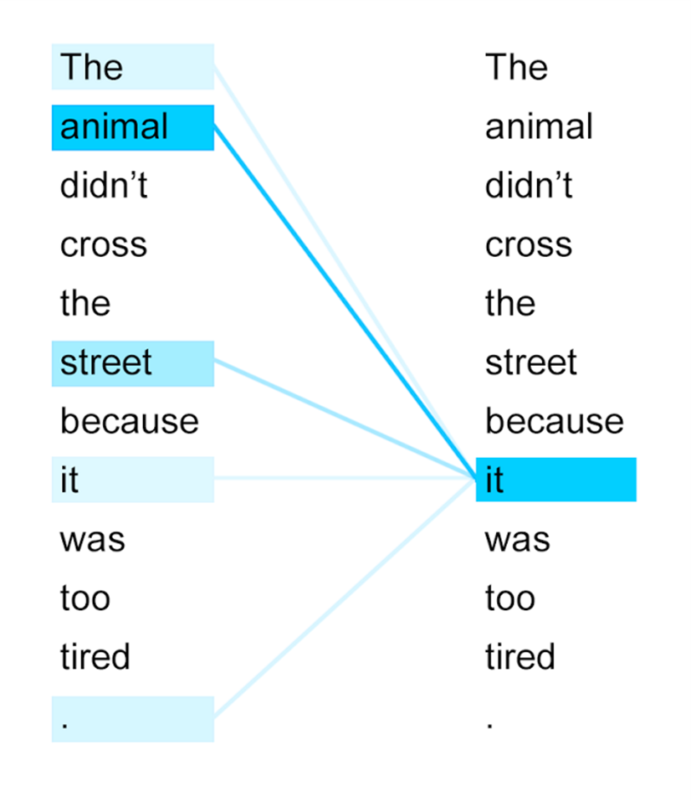
Rise of the Transformer
and “self-attention”
Vaswani, A., et al. (2017). Attention Is All You Need. Advances in Neural Information Processing Systems, 30, 5998-6008.
understands meaning implicitly through context, by assigning weights between every word pair.
self-supervised learning by masking– no labels needed.
Transforms multimodal text inputs into a high-dimensional (100s-D) numerical feature space from which to draw inference.
Graphic cropped and rotated 90deg from: Devopedia. 2019. "Attention Mechanism in Neural Networks." Version 3, November 16. https://devopedia.org/attention-mechanism-in-neural-networks. (cropped and rotated) Licensed under CC BY-SA

Slide 10
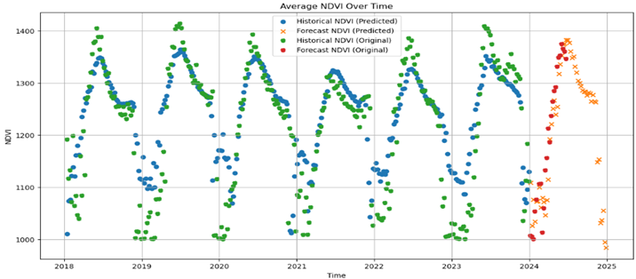
A Generalist Foundation Model for EO Data Imputation and Forecasting (multimodal inputs: HLS indices, LST, Elevation)
[Dr. Neal Pastick, EROS]
Do not distribute; preliminary results

Slide 11
A.I. Transformers represent a new way to think about
multimodal geodata integration [implicitly]
Climate
data
Minimal input data [explicit]
manipulation and “prep”
EO data
set A
Multimodal
Transformer
Socio-economic data
EO data
set B
Other
geodata
EO data
set C
Inference

Slide 12
Earth observation community shared mission: Public health
“Land-use change has caused the emergence of more than 30 percent of new diseases since 1960.”*
Examples of land-use change that encroach upon wildlife habitat:
  Deforestation
  Agricultural expansion
  Urban development
  Mining and extraction activities
  Infrastructure development
*Food and Agriculture Organization of the United Nations. 2022. The State of the World’s Forests 2022. Forest pathways for green recovery and building inclusive, resilient and sustainable economies. Rome, FAO. https://doi.org/10.4060/cb9360e

Slide 13
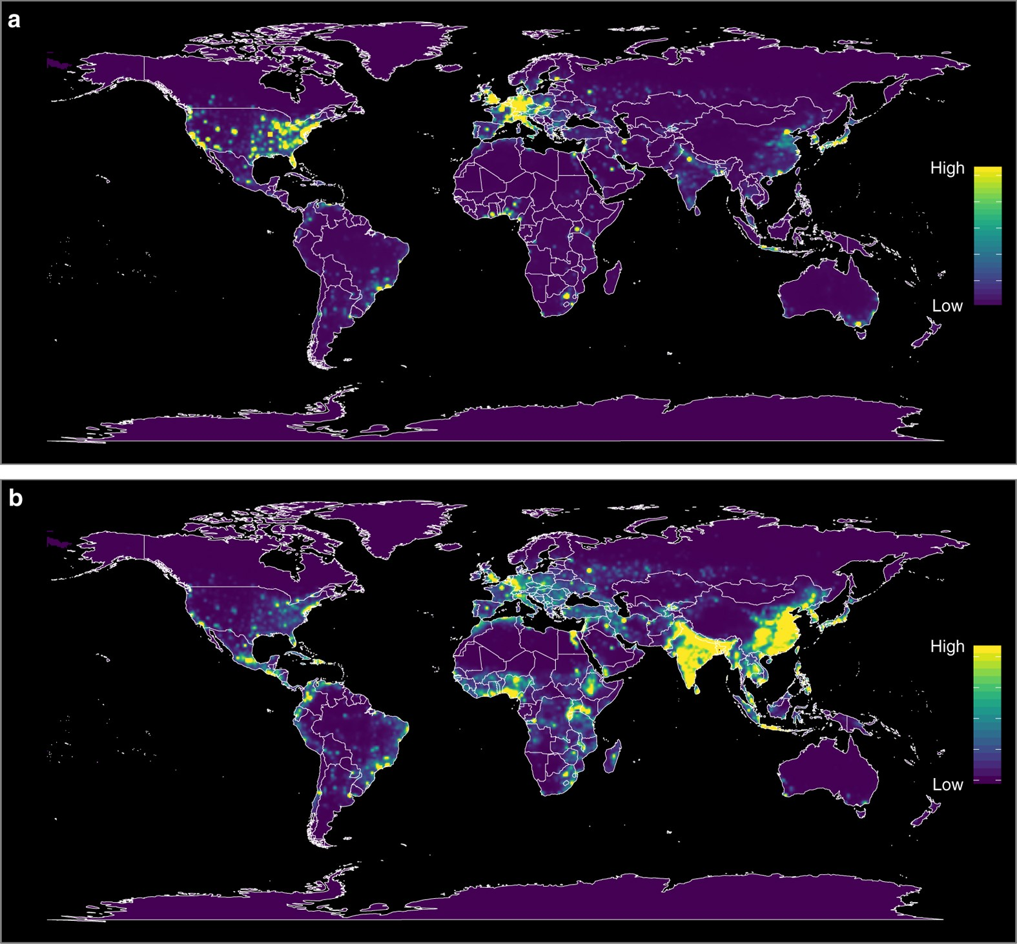
Risk assessment example for zoonotic disease spread
“Heat maps of predicted relative risk distribution of zoonotic EID events. a shows the predicted distribution of new events being observed (weighted model output with current reporting effort); b shows the estimated risk of event locations after factoring out reporting bias (weighted model output reweighted by population).” *
*Allen, T., Murray, K.A., Zambrana-Torrelio, C. et al. Global hotspots and correlates of emerging zoonotic diseases. Nature Communications 8, 1124 (2017). https://doi.org/10.1038/s41467-017-00923-8

Slide 14

The future of [implicit] integration of multimodal EO data is using AI Transformers

Slide 15
