Slide 1
Review of CGMS Best Practices
Matt Paget, CSIRO
Damiano Guerrucci, ESA
Agenda Item 9.1
WGISS-58
16-17 October 2024
Sioux Falls, South Dakota, USA

Slide 2
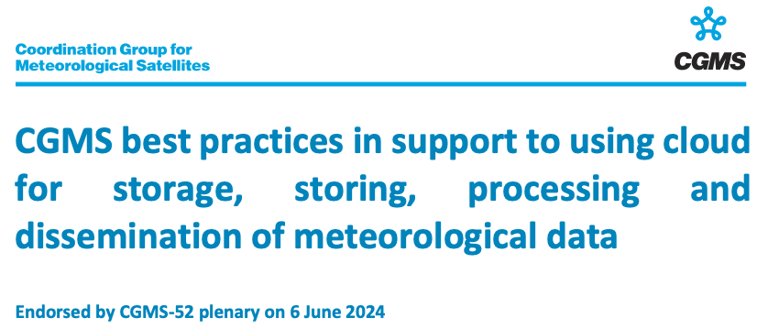
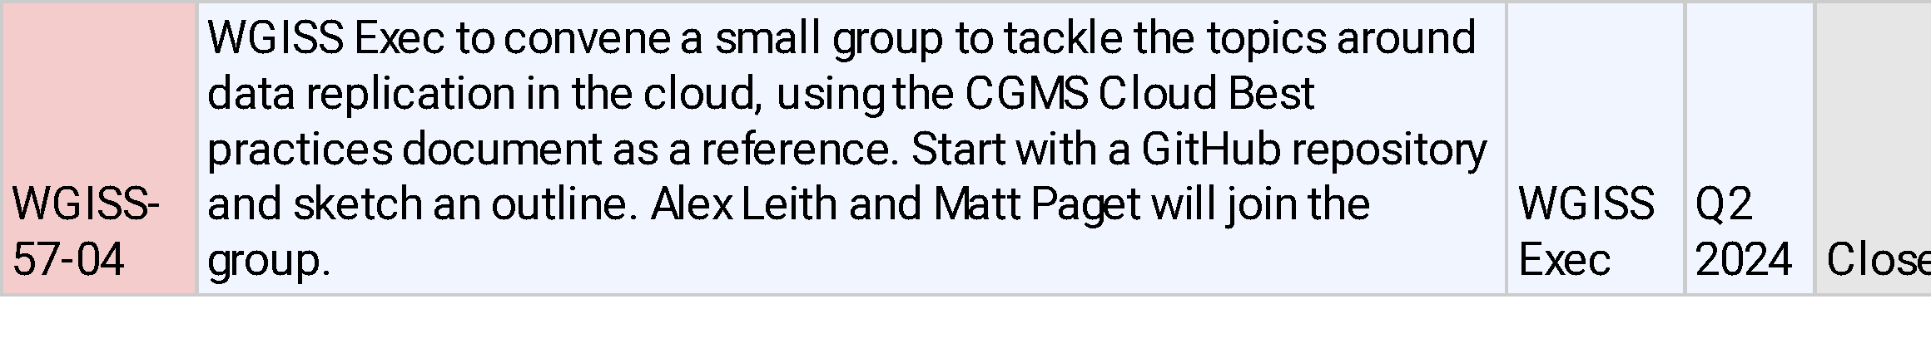
Review from WGISS-56 and -57
Invited presentation by Coordination Group for Meteorological Satellites (CGMS) on Cloud Best Practices and Approach to International Collaboration [WGISS-56]
Action Item WGISS-57-04: Review the CGMS cloud best practices document in the context of the Interoperability Handbook v2
  CGMS-agency-best-practices-in-support-to-using-cloud-for-storage-storing-processing-and-dissemination-of-meteorological-data-6.pdf

Slide 3
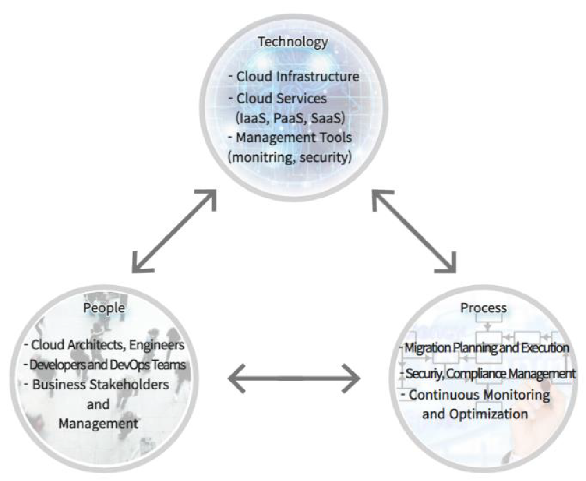
Contents
Provides with:
  Definition of concepts related to cloud (e.g. private/public/hybrid model, infrastructure as code, …)
  Governance, financial aspect and list associated challenges
  Migration strategies (e.g. rehosting, refactoring, retiring,…) -> next slide
  Acquired experience in moving specific functions to cloud (e.g. processing, data access, storage)

Slide 4
Migration Strategies table
Helpful reference for all practitioners as we progressively include cloud-computing in more of our new and legacy workflows
See the original table for further description, pros and cons
Strategy | Brief explanation | Potential effort
Rehosting (Lift-and-Shift) | Rehost applications on a VM | Low
Replatforming (Lift-and-Reshape) | Rehost with some cloud-based upgrades | Medium
Refactoring (Rewriting, Re-architect) | Rebuild the applications for cloud | Medium
Reimagine | Redesign the workflows | High
Repurchase (Replace) | Adopt an enterprise solution | High
Retain | Decide to leave the application as is | Low
Retire | Decide to retire the application | Low
Summarised and adapted from ”Migration strategies” table in “CGMS best practices in support to using cloud for storage, storing, processing and dissemination of meteorological data”

Slide 5
Summary
Well written and relevant, fluent, good reading
Covers the breadth of topics an Organisation should consider when transitioning to the cloud (mostly not specific to meteorological data)
Usefulness of the document will be dependent on where an Organisation is on its cloud journey
  An Org already operating in the cloud will recognise and understand many of the concepts and recommendations described in the BP
  Whereas, an Org at the start of their cloud journey would find this a helpful guiding document to share/summarise with their IT and manager people
The document remains neutral with respect to final solutions mostly applied

