Slide 1
Jupyter Notebooks Best Practices
Esther Conway, STFC
(proxy)Yousuke Ikehata, JAXA
Agenda Item 8.2
WGISS-58
16-17 October 2024
Sioux Falls, South Dakota, USA

Slide 2
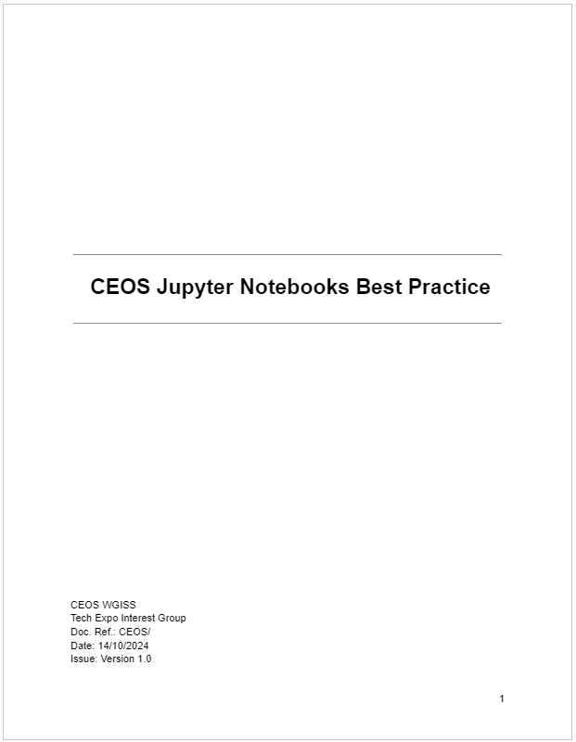
Current Status
We finished writing best practice.
I will port google doc -> github soon.
https://docs.google.com/document/d/1b9HMAz1SewUjP7OTc6Hgez62Vn3BLj0Q-mPyhpZvQ18/edit?tab=t.0

Slide 3
Actions
WGISS-57-21
WGISS-57-22
TEIG to contact EUMETSAT for some example notebooks to demonstrate the Jupyter Notebook best practices. Look at WGISS-56 presentations and FedEO catalogue.
Closed
TEIG to work with SEO to ensure CEOS Analytics Lab notebooks are compliant with the Jupyter Notebooks best practices.

Slide 4
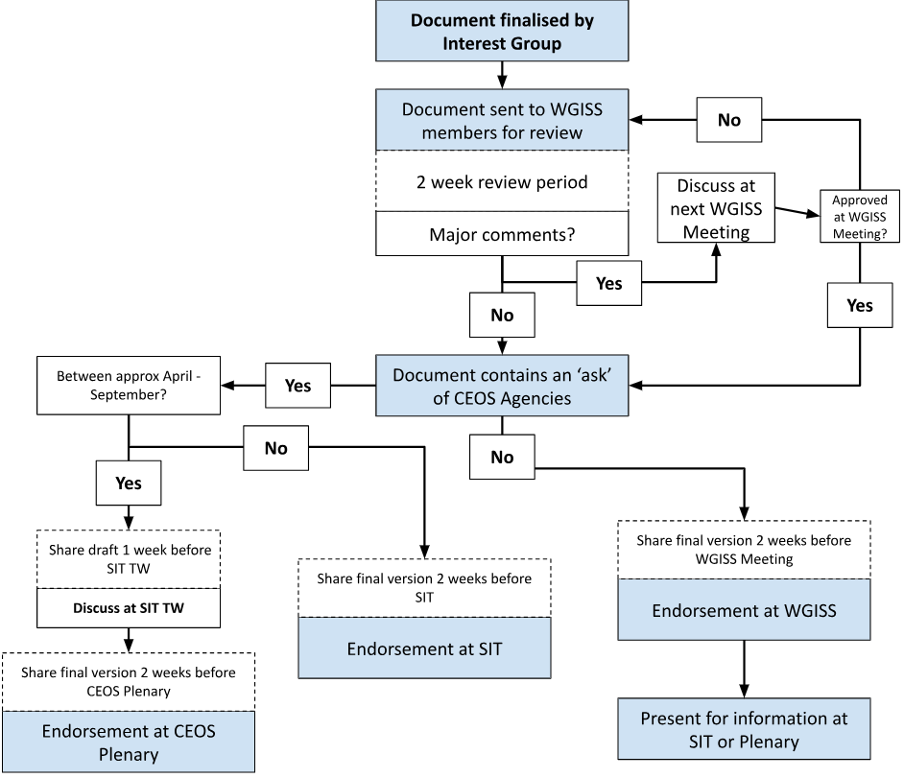
Next Step
We will circulate this best practice WGISS member at first.

