Slide 1
AI/ML White Paper
Yousuke Ikehata, JAXA
Agenda Item 8.1
WGISS-58
16-17 October 2024
Sioux Falls, South Dakota, USA

Slide 2
Context
Current status
Update sections for Initiatives and data
Actions
WGISS-56-02, 06, 07
WGISS-57-24
Discussion
“AI/ML ready data”
Schedule for approval

Slide 3
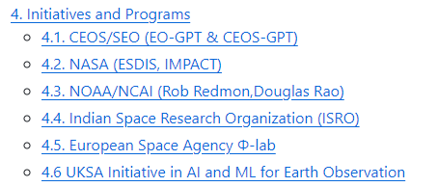
Current status
Updates from last WGISS
4. Initiatives and Programs
CEOS/SEO (EO-GPT & CEOS-GPT)
European Space Agency Φ-lab
UKSA
7. Data and platform
BigEarthNet
https://github.com/ceos-org/aiml-white-paper/tree/main

Slide 4
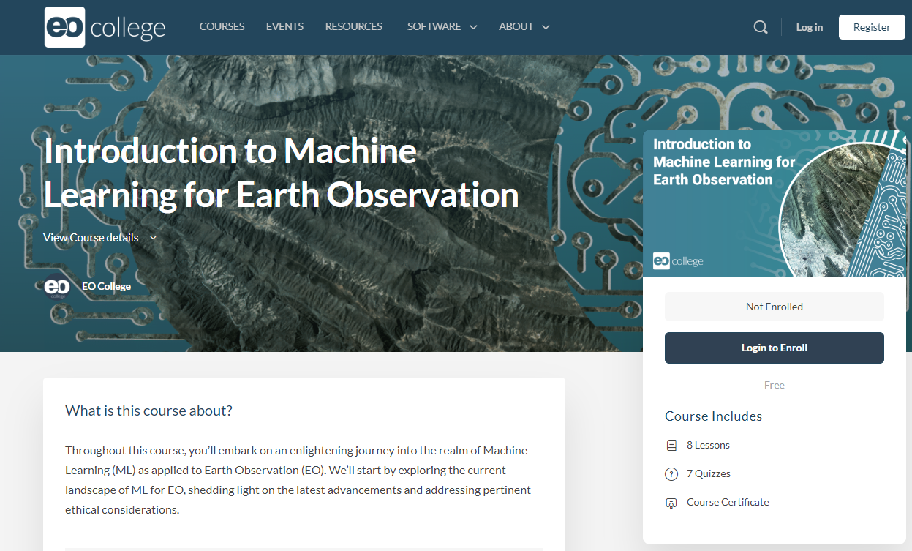
Actions(1/3)
WGISS-56-02
We call for training topic to TEIG, but we couldn’t find.
WGCapD announces training course which focuses machine learning.
https://eo-college.org/courses/introduction-to-machine-learning-for-earth-observation/
I propose to close this action, because TEIG can’t provide opportunity for WGCapD’s activity.
I want WGCapD to contribute our white paper by ml training course.
Technology Exploration to explore the use of the AI/ML White Paper as a training topic in cooperation with WGCapD.

Slide 5
Actions(2/3)
WGISS-56-06
WGISS-56-07
We can refer ESIP’s checksheet about AI/ML ready data.
https://www.esipfed.org/checklist-ai-ready-data/
We gather the information about “AI/ML ready data” by survey.
Compatibility for AI/ML ready data check sheet. (google.com)
I wonder how much this can be applied to the AI/ML data sets introduced in our white paper
I hope to figure out "What AI/ML ready data should be" and write it to white paper.
Tyler Christensen to facilitate discussion with working groups in ESIP for cooperation between NOAA, NASA, USGS on the topic of AI/ML-ready data.
Technology Exploration to consider including an inventory of well-known and easy to use training datasets (AI/ML-ready) in the white paper.
Discussion

Slide 6
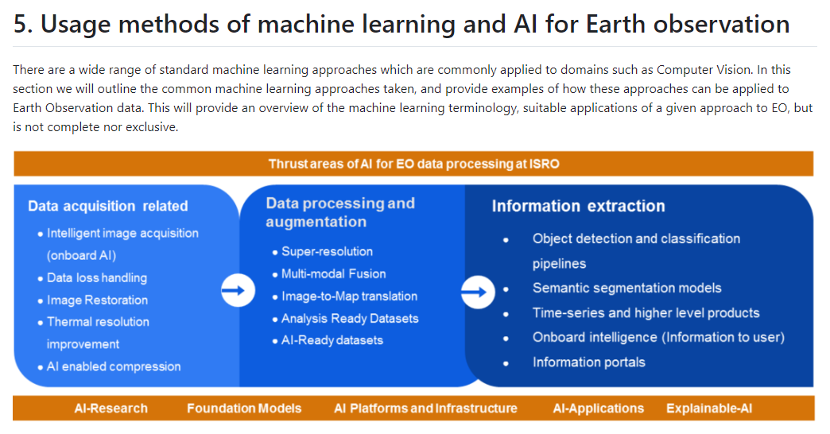
Actions(3/3)
WGISS-57-24
We would like to propose that figure about AI/ML should be available on white paper (section 5).
https://github.com/ceos-org/aiml-white-paper/blob/main/usage-methods-of-ml-and-ai-for-eo.md
Because WGISS home page doesn't have contents about AI/ML so I could not understand where to post in.
TEIG to develop slide 5 from the ISRO presentation into a figure available on the WGISS website.

Slide 7
Discussion 1
"What AI/ML ready data should be“
Metadata, format, documentation, lineage and so on.
I want to figure out current coverage to our white paper.
example
Definition | Mandantory | Recommend
Have null values/gaps been filled? | *
Have outliers been identified? |  | *

Slide 8
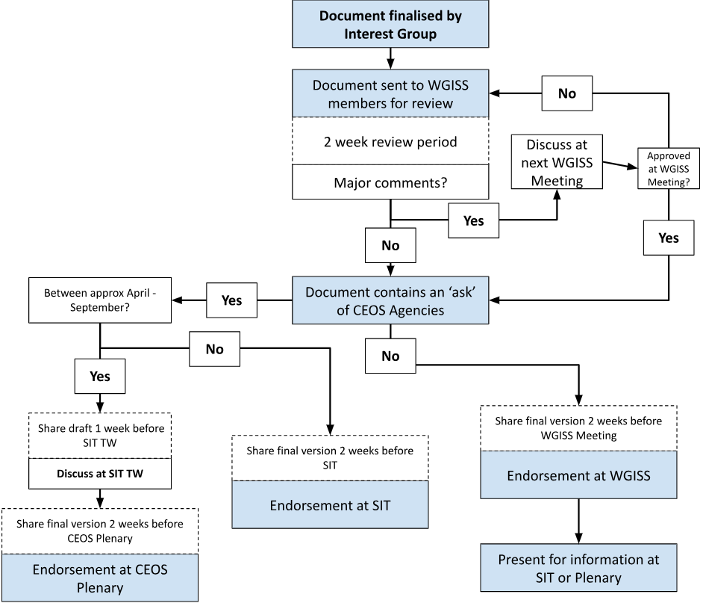
Discussion 2
Our white paper need to enact till 2024.
We should postpone the deadline? or we can start to finalize?
I think we can be enriched if it’s postponed. But we need to break “DATA-23-01(CEOS deliverables)”.

