Slide 1
Federated Authentication and Authorization
F. Marchesi (Solenix for ESA)
D.Guerrucci (ESA)
Agenda Item 7.1
WGISS-58
16-17 October 2024
Sioux Falls, South Dakota, USA

Slide 2
Definition
Authentication: Authentication is the process of confirming the correctness of the claimed user identity.
Authorization: Authorization is the process of granting or not access to a protected resource to a user, based on information available about such a user.
Federation: Federation is a group of institutions that agreed about policies for exchanging information about their users/data/metadata/process in order to grant access and utilization of protected resources and services.

Slide 3
Federated Authentication & Authorization meaning
Different Level of Federation
1. Catalogue: central portal that allows users to discover and access to data
2. Authentication: in terms of User Identity verification
3. Authorization: in terms of Data & Services Access Rights assignment
4. Application running
4. Archival: Offline, Online and near line archives

Slide 4
No federation
Discovery
(data/services/tools)
CatalogA
CatalogB
Authentication
AuthnA
AuthnB
Authorisation
AuthzA
AuthzB
Data StorageA
online
Data Storage B
online
Archival
ArchivalA
ArchivalB

Slide 5
With federation
Discovery
(data/services/tools)
CatalogA
Federation
CatalogB
Authentication
AuthnA
Federation
AuthnB
AuthzA
Federation
AuthzB
Authorisation
Data Storage A
online
Data Storage B
online
ArchivalA
Federation
ArchivalB
Archival

Slide 6
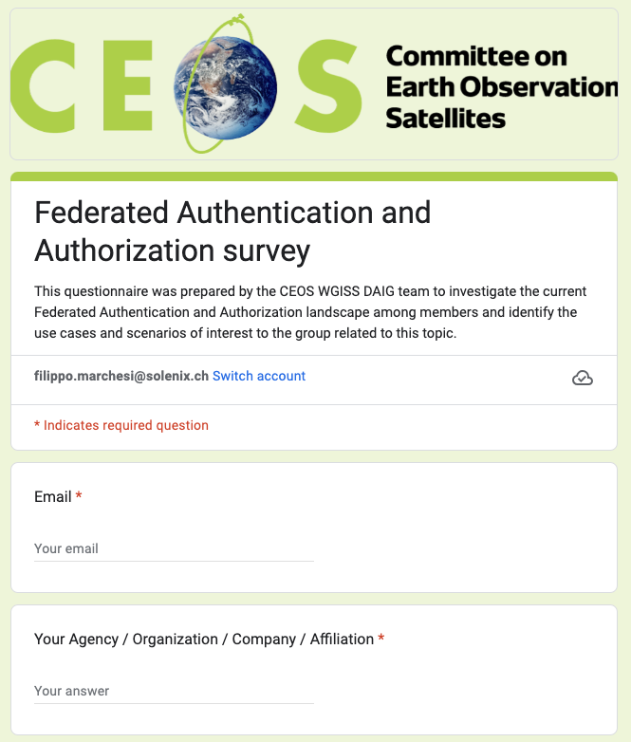
Federated Authentication & Authorization Survey
Goals behind the questionnaire:
Investigate the current Federated Authentication and Authorization landscape among members
Identify the use cases and scenarios of interest to the group related to this topic.
Define steps forward depending on interests emerged

Slide 7
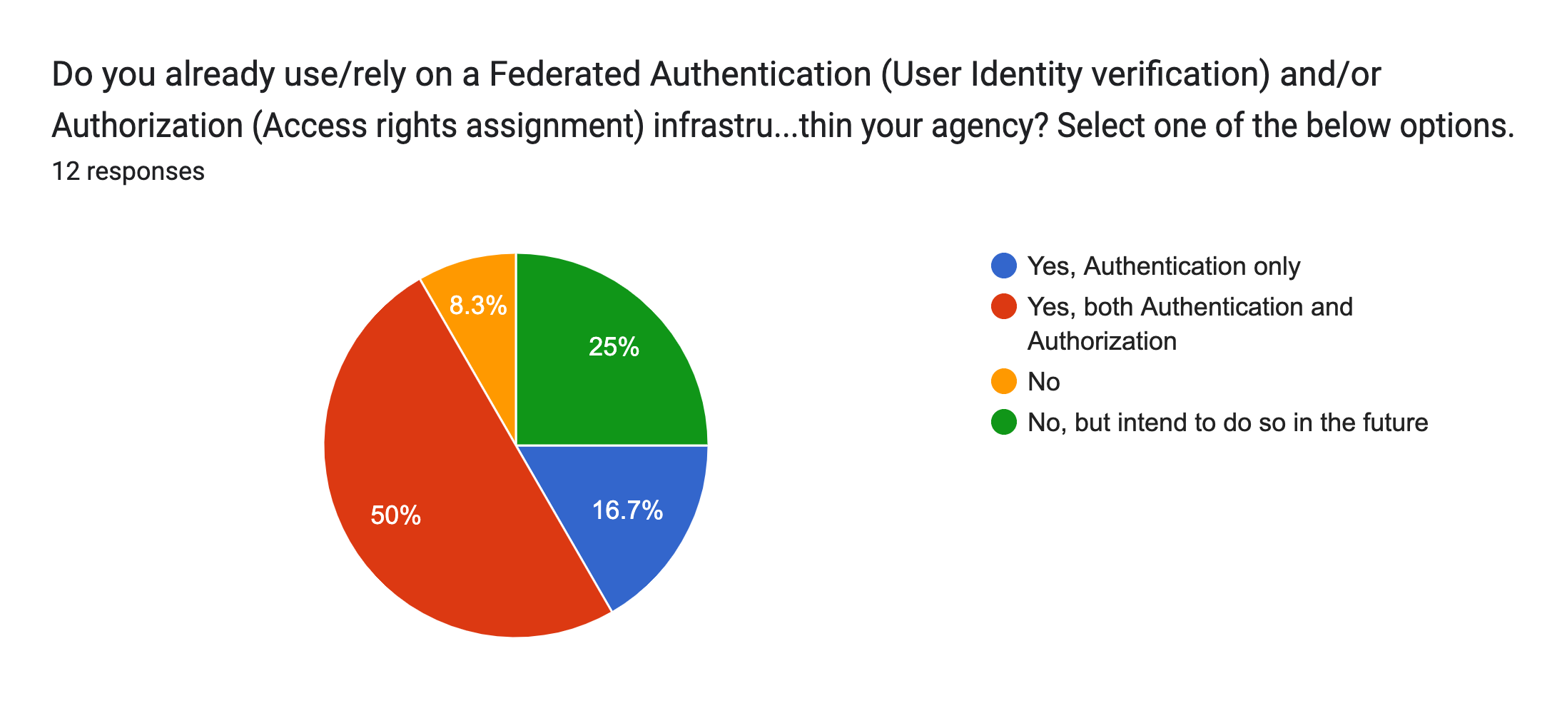
Federated Authentication & Authorization - Answers
12 answers received
CNES
CSIRO
DLR
ESA
EUMETSAT
European Commission
ICHEC
JAXA
Natural Resources Canada
NASA
Spacebel
USGS
Background & Technology
Survey still open
https://forms.gle/qh5uCthzYxV1K7wd7

Slide 8
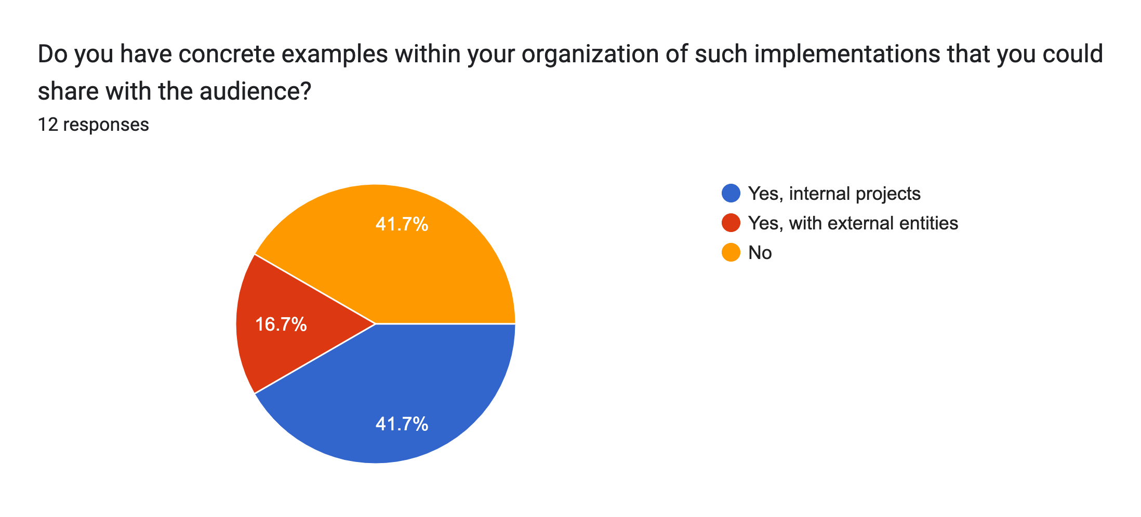
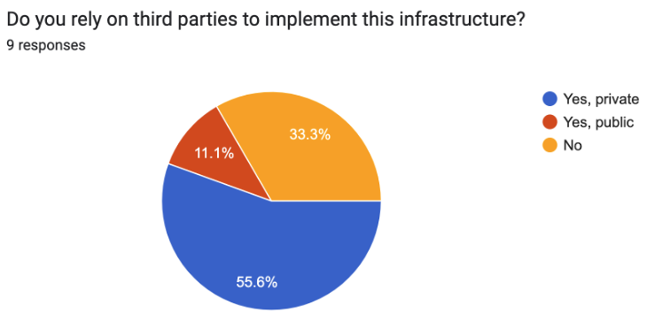
Federated Authentication & Authorization - Projects
Ongoing Projects
Spacebel / EOIAM ALTIUS EO PDGS ESTEC
Spacebel / SSI-EBSI-DID (OGC TB20 IPT)
ICHEC / Development of EO Exploitation Platform
CSIRO / Australian Access Federation (https://aaf.edu.au)
EUMETSAT / EO Portal – Federation of identity with internal services. Platform initiatives (WekEO, DestinE)

Slide 9
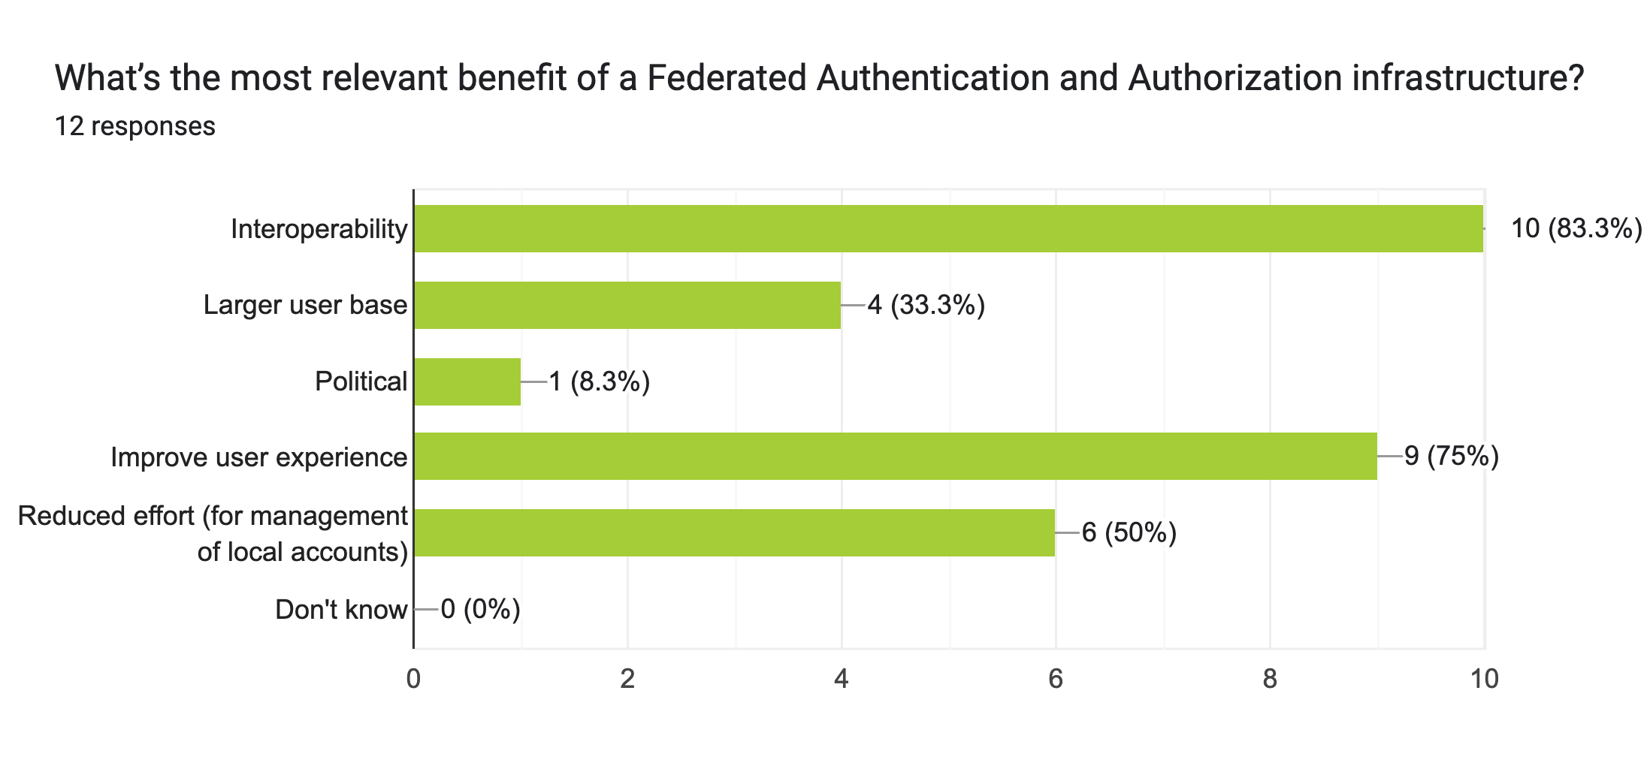
Federated Authentication & Authorization – Benefits

Slide 10
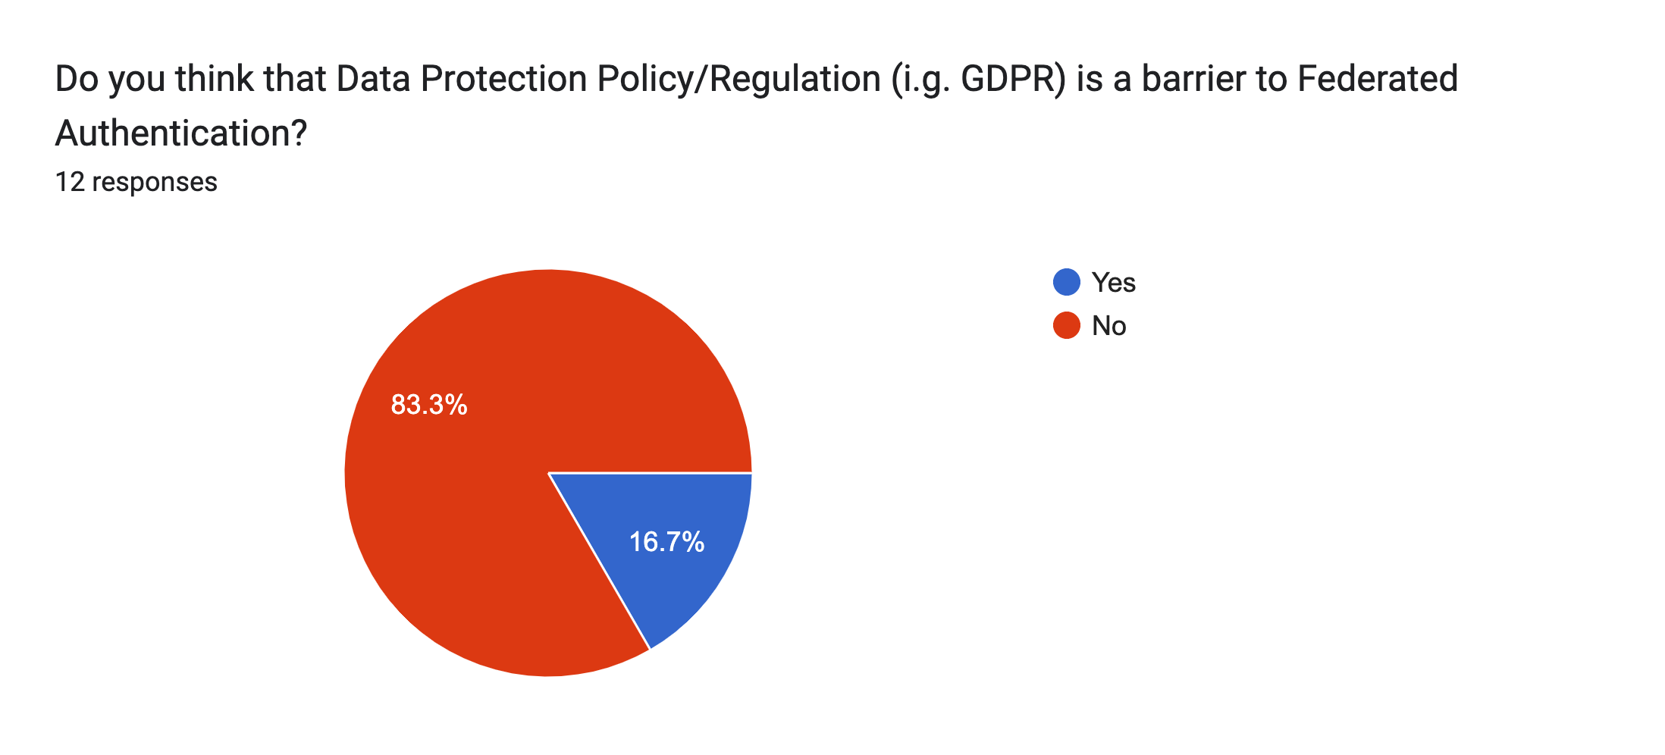
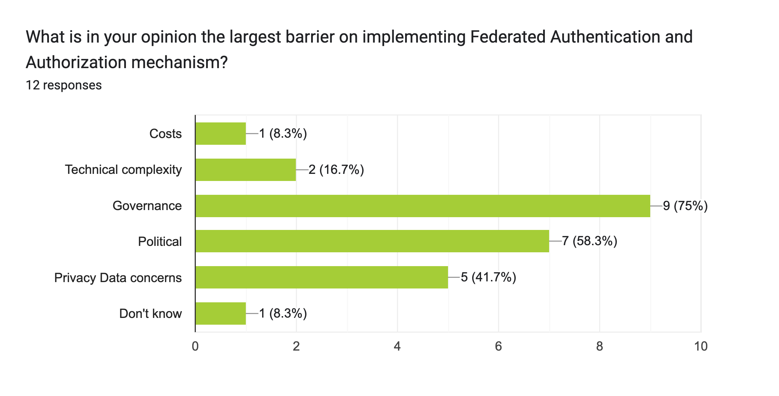
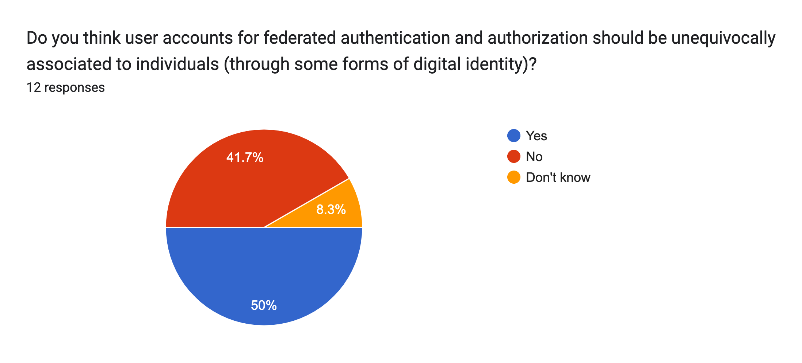
Federated Authentication & Authorization – … & Barrier

Slide 11
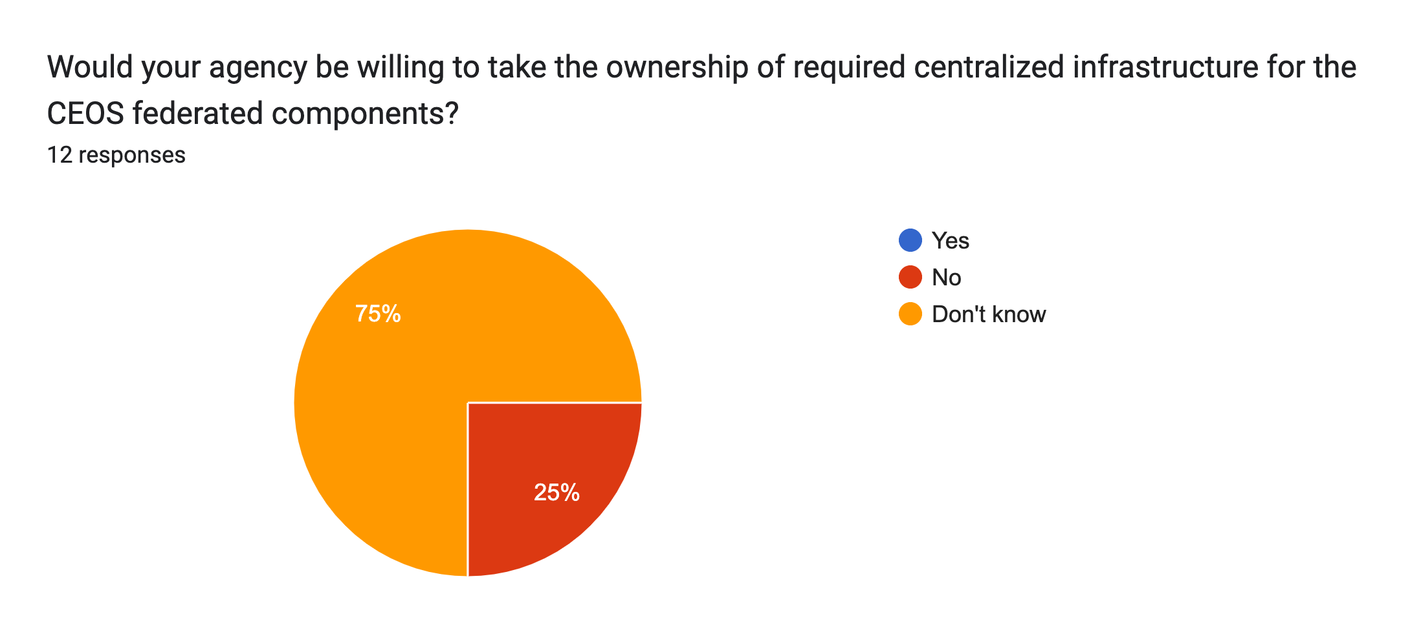
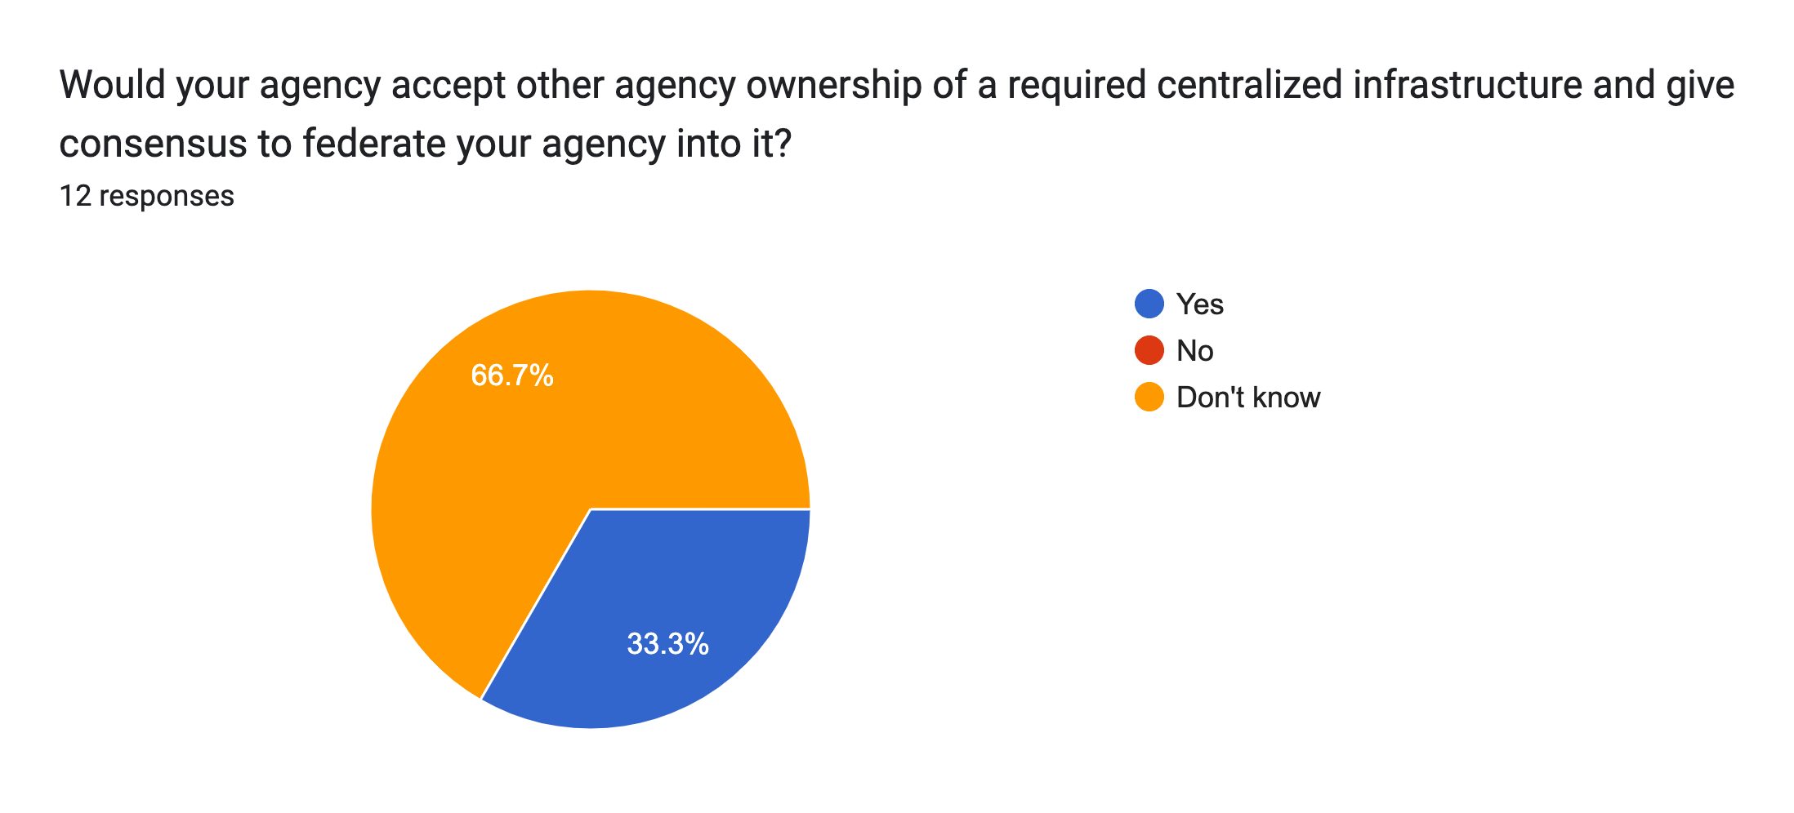
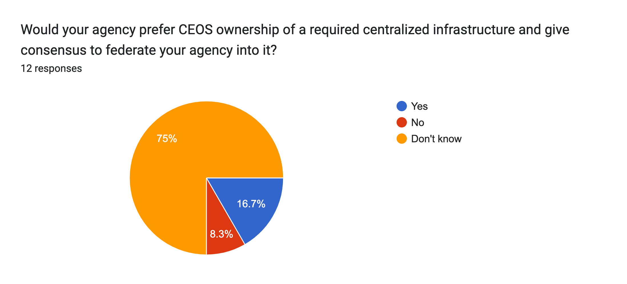
CEOS involvement & Centralized authority
WGISS-57-15 | DAIG to discuss with SEO the possibility of a central CEOS Authentication mechanism.

Slide 12
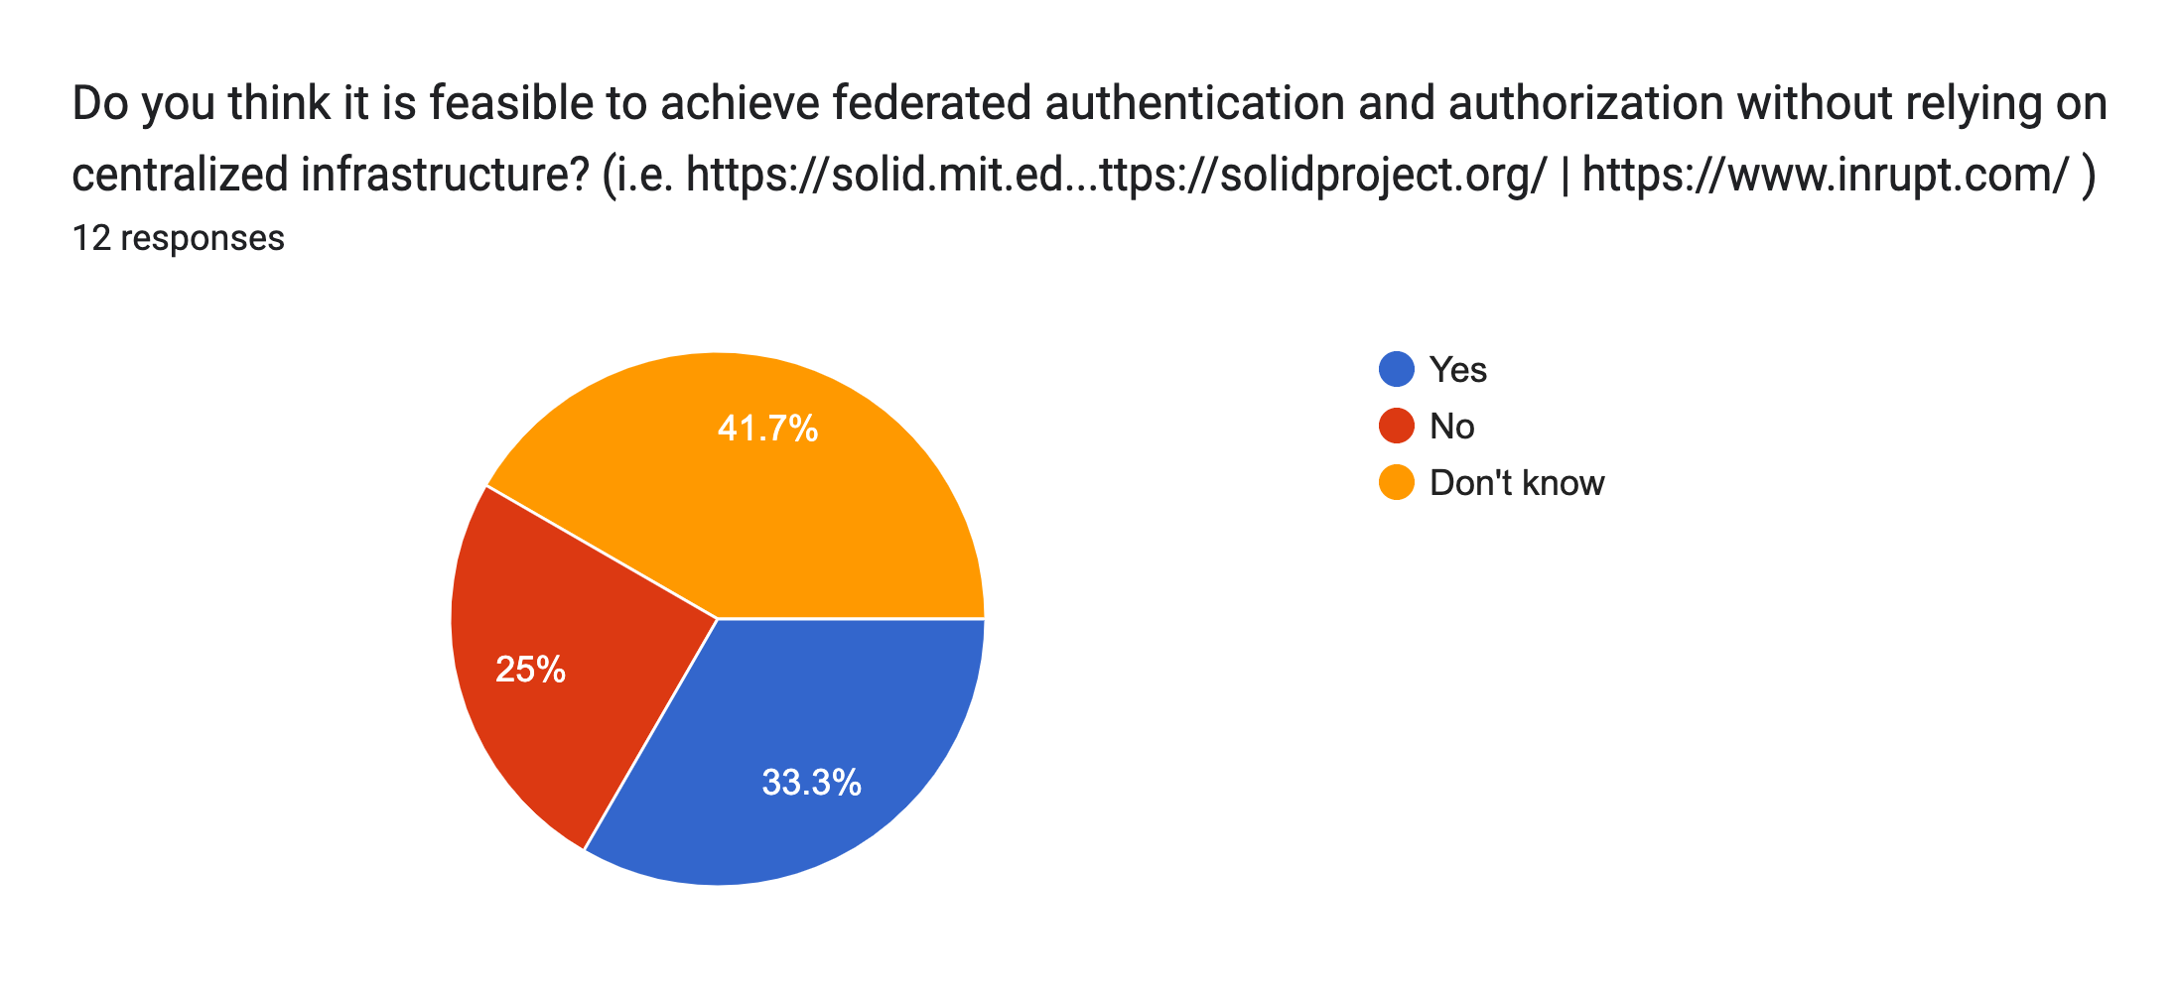
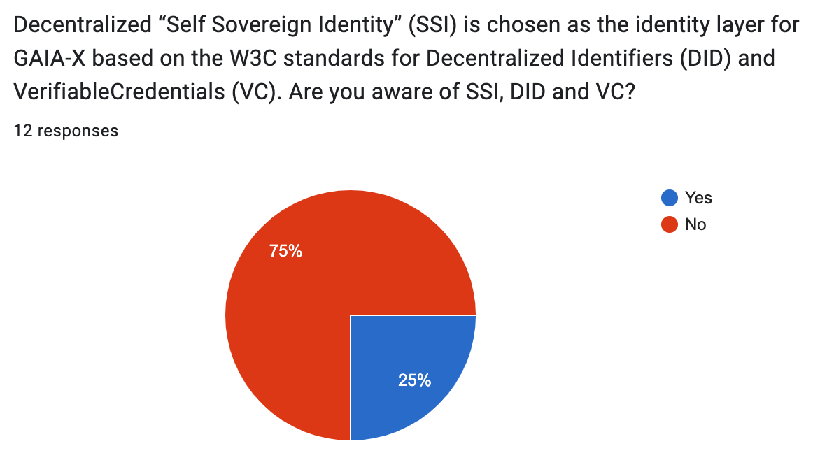
CEOS involvement & Centralized authority
https://solidproject.org/
https://www.inrupt.com/
Discussion point:
Centralized Authority w/wo CEOS involvement
vs
No relying on centralized infrastructure

Slide 13
CEOS involvement – Existing References
Are you aware of documents/guidelines/standards across organizations that are treating Federation Authentication and Authorization topics?
Government of Canada guidelines: https://www.canada.ca/en/government/system/digital-government/online-security-privacy/security-identity-management.html
OGC - https://www.keycloak.org/
REFEDS - https://refeds.org
AARC Policies - https://aarc-community.org/policy/
AARC Guidelines - https://aarc-community.org/guidelines/
NIST Guidelines - https://www.nist.gov/publications/digital-identity-guidelines-federation-and-assertions
Kantara Initiative - https://kantarainitiative.org/
ESA EOEPCA and EuroHPC, Edugain systems
W3C DID, W3C Verifiable Credentials, OID4VC - https://ec.europa.eu/digital-building-blocks/sites/display/EBSI/Explained+Series
Australian Access Federation - https://aaf.edu.au/support/resources/

Slide 14
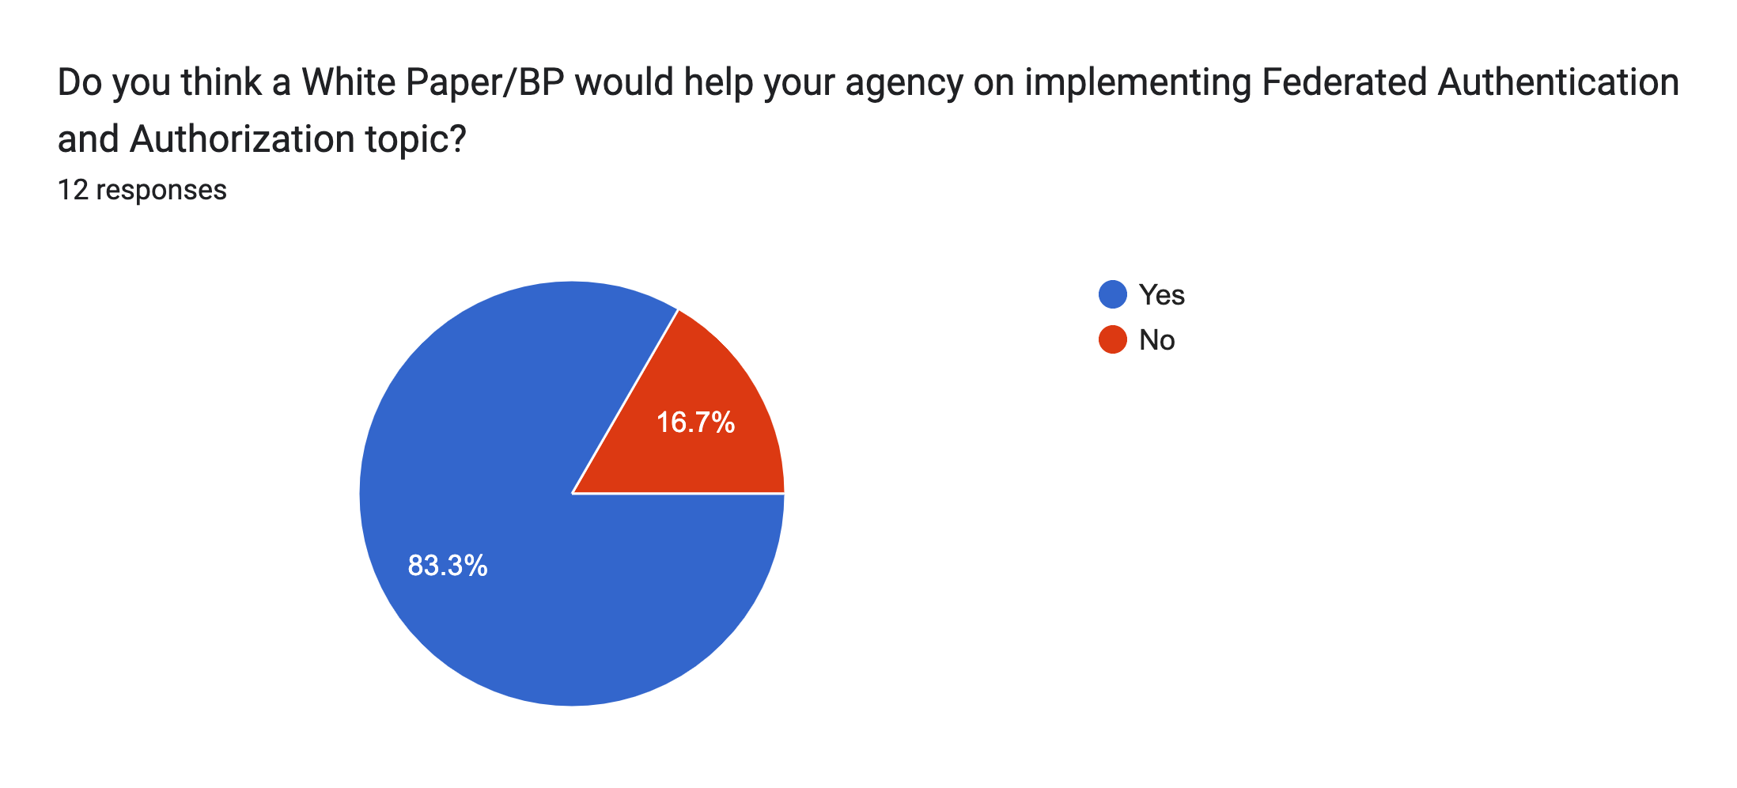
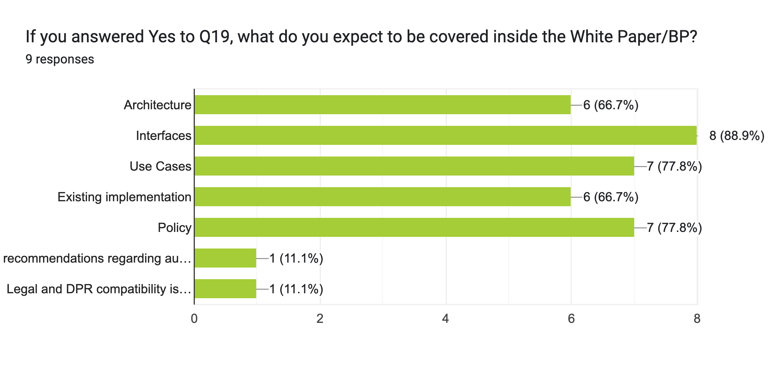
CEOS involvement – White Paper / BP

Slide 15
Next steps & way forward
Keep collecting feedback from the survey
CEOS Authentication mechanism and ownership? (WGISS-57-15)
Start drafting a White Paper and/or Best Practices, from given guidelines
Identify ongoing projects to be shared for next WGISS-59

Slide 16
Decentralized infrastructure - Solid
Solid is an open standard for structuring data, digital identities, and applications on the Web, supporting its creation as Sir Tim Berners-Lee originally envisioned it
Solid is a specification that lets people store their data securely in decentralized data stores called Pods. Pods are like secure personal web servers for your data.
Any kind of data can be stored in a Solid Pod
What makes Solid special is the ability to store data in a way that promotes interoperability. Specifically, Solid supports storing Linked Data. Structuring data as Linked Data means that different applications can work with the same data.

