Slide 1
Service Metadata & Discovery Best Practice – STAC Integration
Yves Coene (Spacebel for ESA), Mattia Stipa (ESA)
CEOS WGISS #58, Sioux Falls (SD, US)
Session 5: STAC Topics, 17/10/2024

Slide 2
Outline
Introduction
Document updates
STAC Examples

Slide 3
Introduction – Best Practices
“CEOS Best Practices for Service Metadata and Discovery”
Version 1.0: approved and published in November ’22.
Extends Best Practices for collection and granule discovery (CEOS OpenSearch Best Practices) to “services” (incl. tools, applications, service endpoints) with intention to “share”.
Defines core set of metadata properties without imposing single metadata format.
First step towards sharing tools and applications metadata via CEOS IDN.
Version 1.1: updated to include STAC and STAC API (September ‘24 / Draft April ‘24).

Slide 4
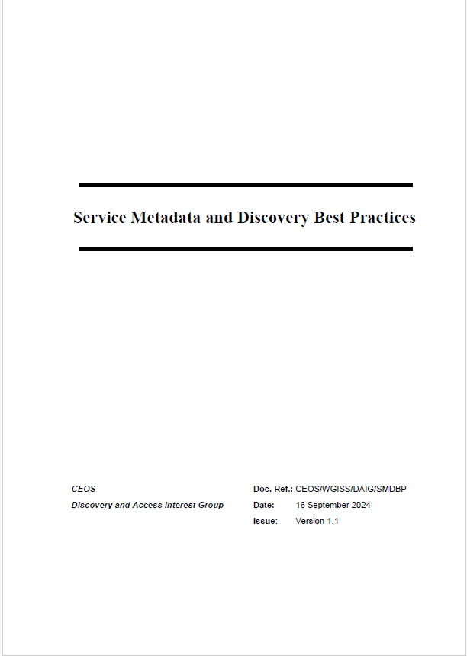
Introduction - TOC
§2 - Objectives and needs
Use cases for service discovery
Detailed scenarios
§3 - Best Practices and recommendations
Service metadata model (minimal)
Metadata encodings
Controlled vocabularies
Service discovery interface
§4 - Description of current implementations

Slide 5
Introduction - Discovery Scenarios
Best practices document describes several discovery scenarios for tools and services:
Scenario 2: Downloadable tools
Source code, binaries, Jupyter Notebooks, Docker images, …
Download from repository (GitHub, Zenodo, ..) or registry (e.g. DockerHub, …)
Scenario 3: Web GUI tools
Software as a Service (SaaS)
E.g. Jupyter Notebook on Google Colaboratory, Binder
Scenario 5: Coupled Services
Associate tools and services (e.g. Notebook) to EO collections

Slide 6
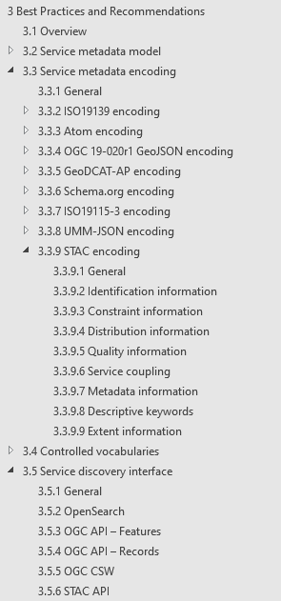
Best Practices and Recommendations
§3.2 Service metadata model (encoding agnostic)
8 categories
2 levels: [Requirement] or [Recommendation]
based on survey of applicable models
§3.3 Service metadata encoding
Applies Best Practices to 7 8 encodings
Including encoding examples
STAC added.
§3.5 Service discovery interface
STAC API added.

Slide 7
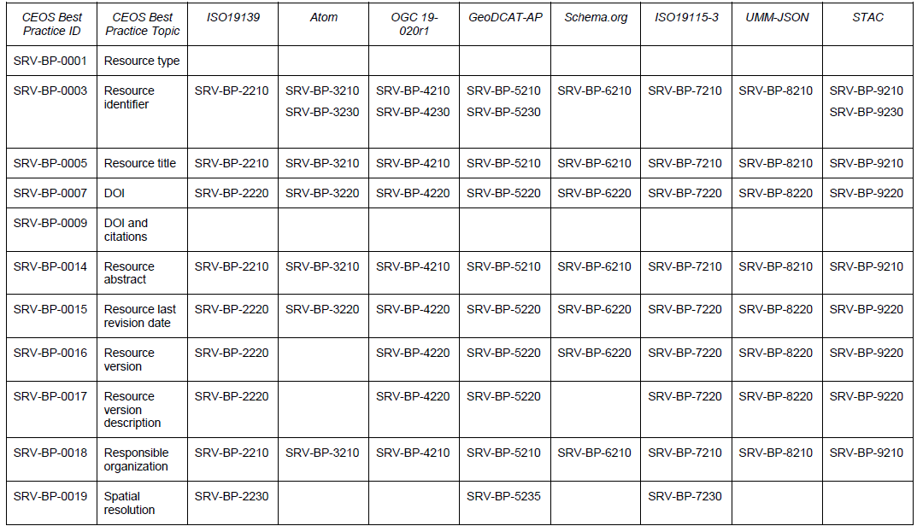
Best Practices and Recommendations
Proposed Best Practices can be applied to different encodings:

Slide 8
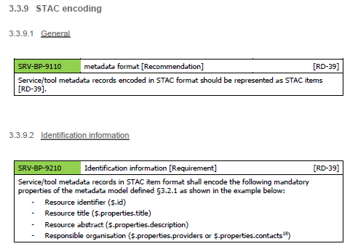
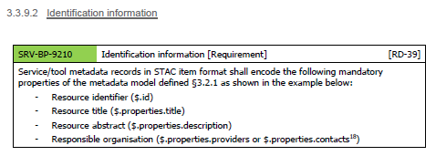
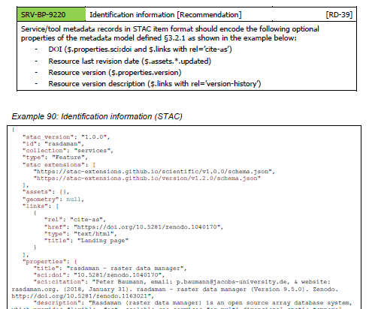
Example Content
Presentation organized as the other metadata encodings
Including STAC encoding examples.

Slide 9
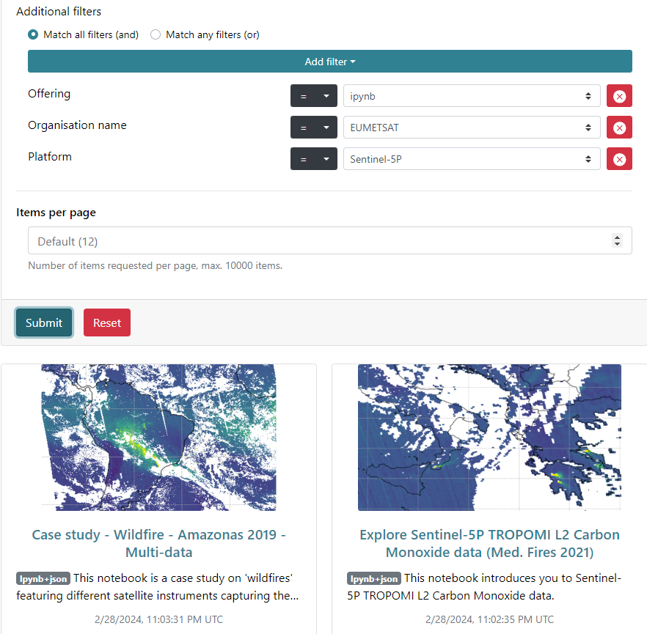
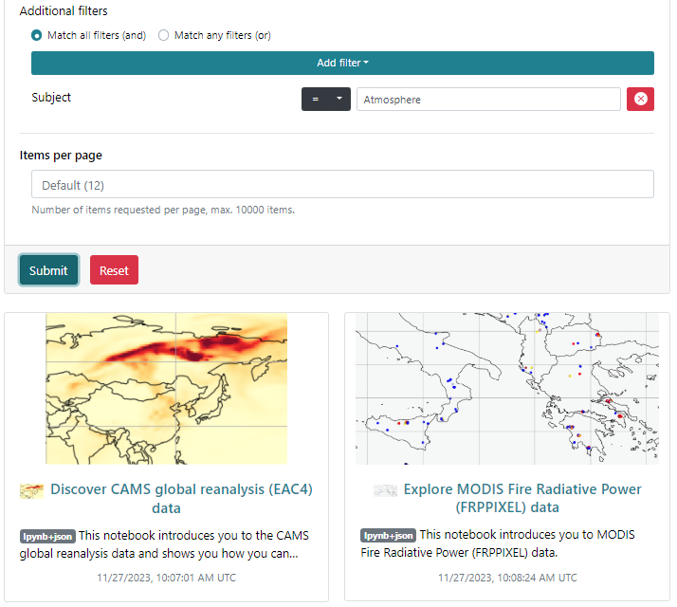
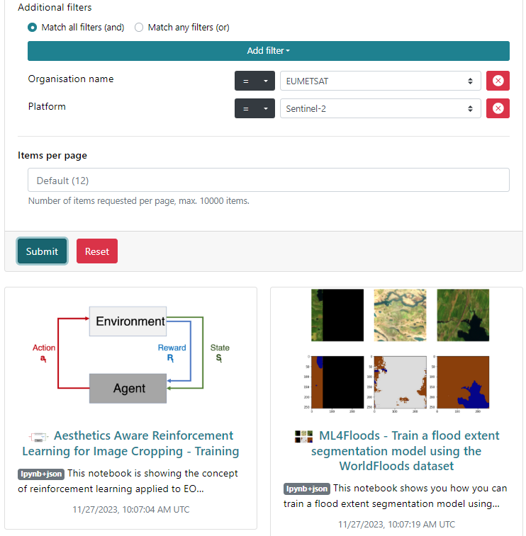
Service and Tool Discovery – STAC API (Search)
STAC API Search requests (filter, CQL2) to find tools and notebooks about a subject or platform or …
Free text search
Controlled keyword (concept) search

Slide 10
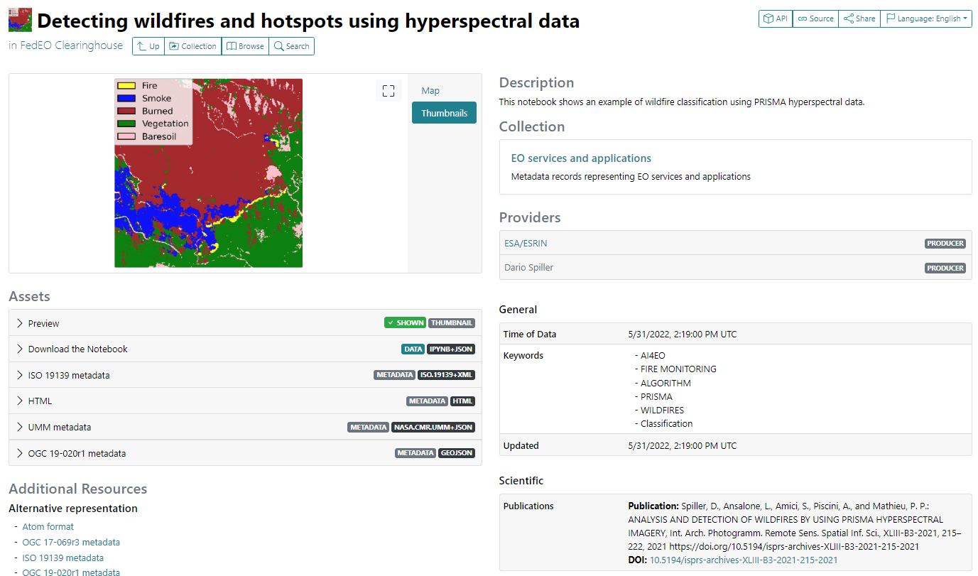
Service/Tool Metadata Example - Notebook
AI4EO Notebook.
Download Notebook
Scientific STAC Extension (for associated DOI, e.g. publications)
Notes:
https://radiantearth.github.io/stac-browser/#/external/emc.spacebel.be/collections/services/items/ai4eo-detecting-wildfires?httpAccept=application%2Fgeo%2Bjson%3Bprofile%3Dhttps%3A%2F%2Fstacspec.org&.language=en

Slide 11
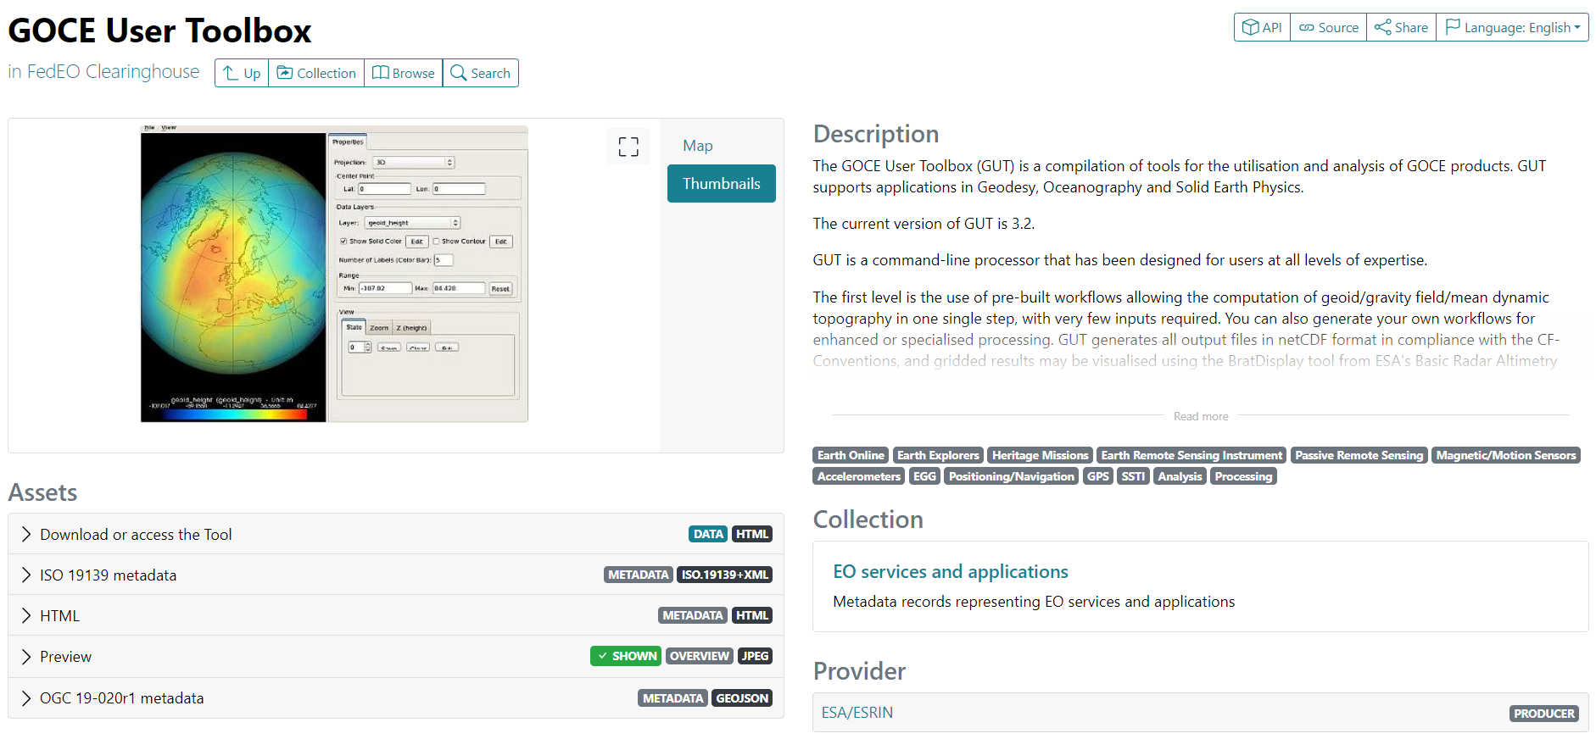
Service/Tool Metadata Example - Tool
AI4EO Notebook metadata (STAC).
Notes:
https://radiantearth.github.io/stac-browser/#/external/emc.spacebel.be/collections/services/items/ai4eo-detecting-wildfires?httpAccept=application%2Fgeo%2Bjson%3Bprofile%3Dhttps%3A%2F%2Fstacspec.org&.language=en

Slide 12
In Summary
No changes to the objective of the document, the use cases and the document organisation.
STAC added as additional metadata encoding.
STAC API added as additional discovery interface.
V1.1 now available.

Slide 13
AOB

